Slide 1


REINDEER
GAMES

Slide 2

Look at the pattern …
?
What symbol comes next?
A
B
C
D

Slide 3
?
?
?
?
The reindeer are decorating the stable by
hanging decorations as above.
What pattern of decorations should replace:
?
?
?
?
1
2
3

Slide 4

= 3
Groups of reindeer work together to light up their noses to signal numbers to other groups.
For example…
= 5
= 10
Can you work out what number this group
reindeer are signalling?
= ?

Slide 5
Vixen the reindeer has taken a photo of some holly and zoomed in.
The photo is stored as a set of numbers.
Can you work out what numbers are missing?
Zoomed in photo
Stored as…
3 | 2 | 0 | 3 | 1 | 1 | 1 | 1
1 | 3 | 3 | 1 | 1 | 3 | 1 | 3
1 | 3 | 1 | 1 | 1 | 1 | 3 | 1
3 | 1 | 2 | 2 | 1 | 3 | 3 | 3
1 | 3 | 3 | 1 | 2 | 2 | 3 | 1
1 | 1 | 3 | 3 | 0 | 2 | 1 | 1
1 | 3 | 3 | 3 | 1 | 1 | 1 | 1
?
Enter your answer with no spaces eg 12301230

Slide 6
The reindeer use code to send messages. Part of the code has been found….
A=65, B=66, C=67,
D=68, E=69, F=70 ….
Can you work out the rest of the code and figure out this message?
83 76 69 73 71 72 82 73 68 69

Slide 7

Can you code the claw to swap the green robot with the red roller skate using the commands on the left. Only ONE object can be on one platform at any time.
For example the code RDCU would move the claw Right, Down, Close, Up
Enter your answer in capital letters with no spaces
D
U
C
O
R
L

Slide 8

N for North
S for South
E for East
W for West
Code one route that each reindeer can follow that will end with all three reindeer on a different object.
Reindeer cannot land on or pass through rocks
Enter your answer in capital letters with no spaces eg EENS would be East East North South

Slide 9
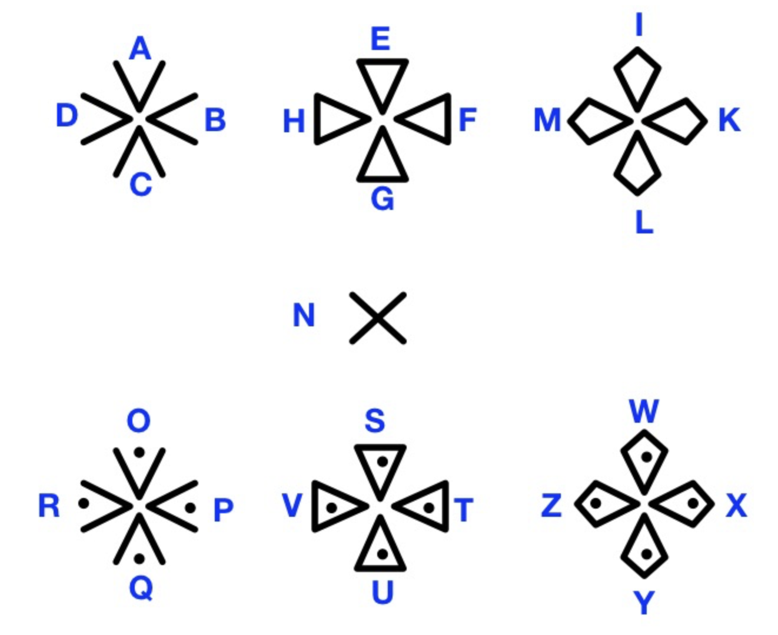







The reindeer have made patterns in the snow and use these patterns to leave messages for each other.
The patterns are shown on the right.
What message has been left here?
SNOW PATTERNS

Slide 10
Comet the reindeer lives at point A. They want to visit all of their friends who live at all the other points on the map.
C
B
A
L
D
K
Plot a route for Comet so that they only visit each friend once and ends up back at A.
G
I
H
J
F
E
Enter your answer with no spaces eg ABCDE

Slide 11
Blitzen, Dancer and Cupid are having a race!
During the race, the following happens….
Cupid will overtake one reindeer when running uphill.
Blitzen will overtake one reindeer when running downhill.
Dancer will overtake one reindeer when running across ice.
Who will be first, second and third?
Dancer
Cupid
Blitzen
Ice
Ice

