Slide 2
1

Slide 4
2

Slide 5
Why did the snowman look at all the carrots?

Slide 6
Because he was picking his nose!

Slide 7
3

Slide 8
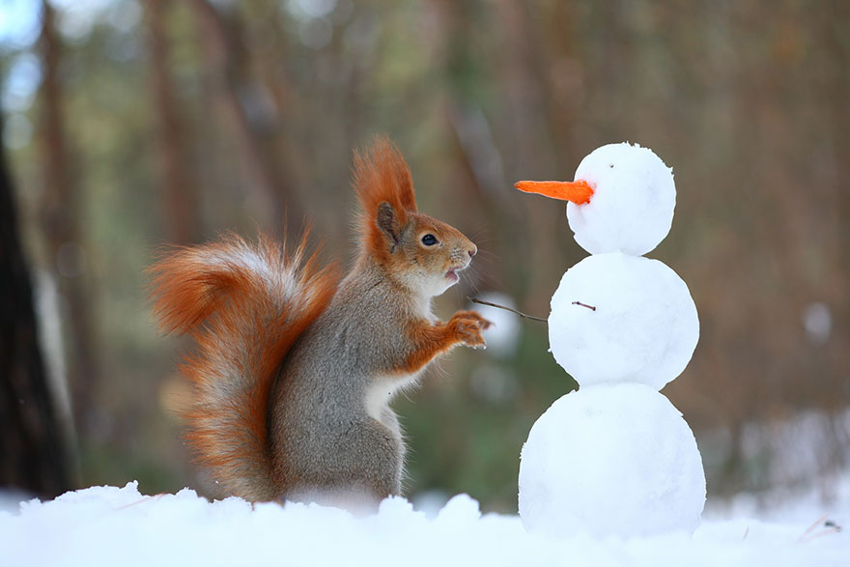
Do you want to build a snowman?
This Photo by Unknown Author is licensed under CC BY

