Slide 1
Can you guess the video game characters while we wait for the session to start? Keep them to yourself just now!
Answers at 2pm!
Say Hello in the Chat and let us know where you are!
1
2
3
4
5
6
7
8

Slide 2
1
2
3
4
5
6
7
8

Slide 3
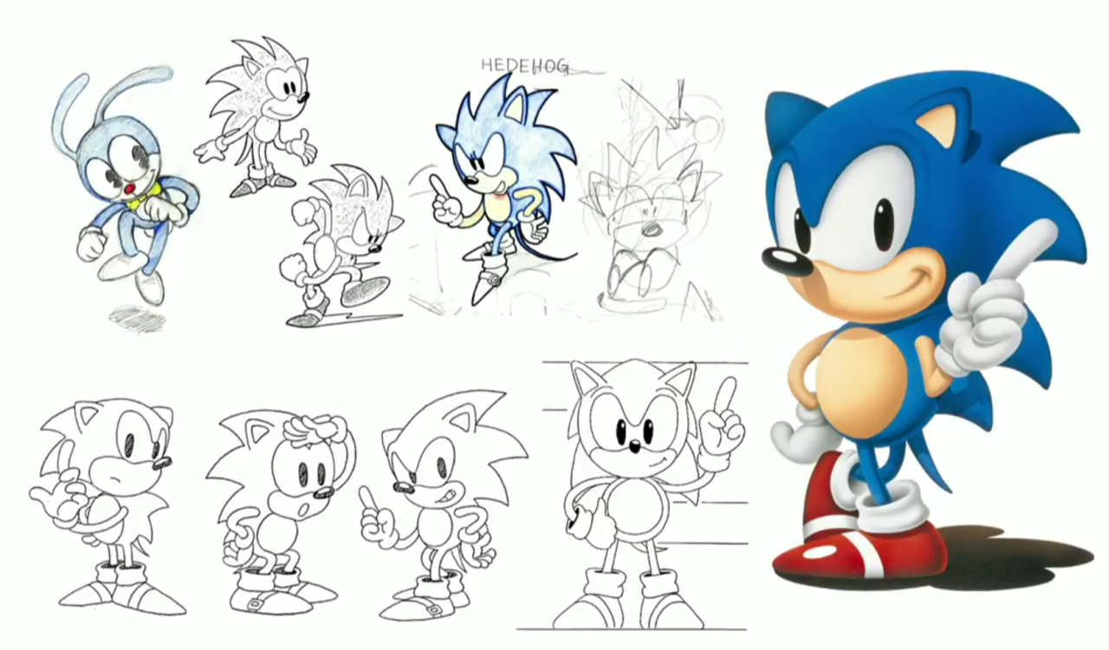

Slide 4
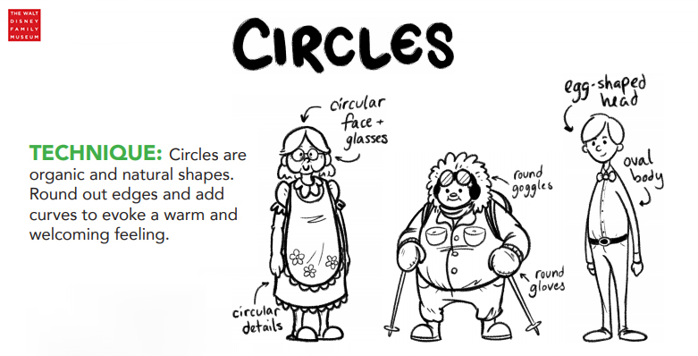

Slide 5
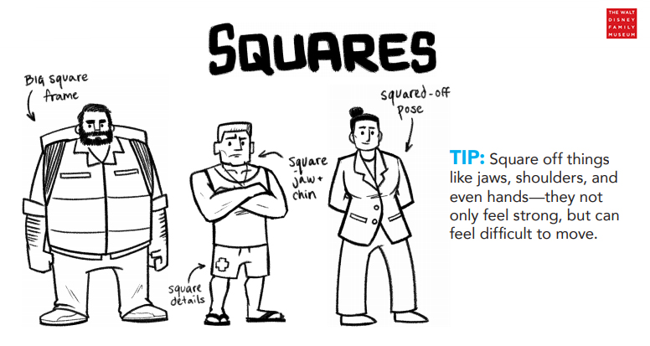

Slide 7
