Slide 1
Games Design
Dr Amanda Ford
West College Scotland

Slide 2
Games – what's your favourite?
Mines is Super Mario World
Released in 1990
Created over 3 years by a team of 16 people at Nintendo

Slide 3
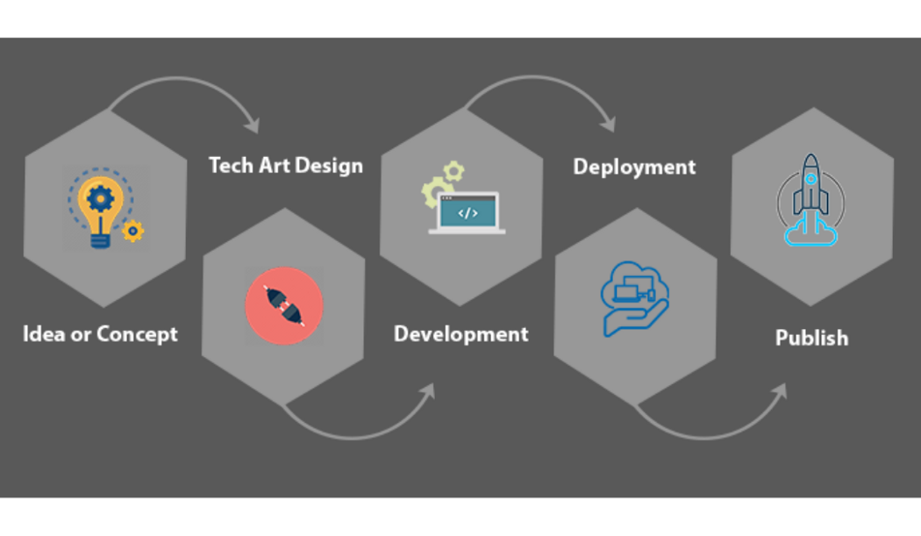

Slide 4
How do I make a game?
Well its easy enough to get started you need an idea
Everyone can do that
You don’t have to be Team Terrible or 4J studios

Slide 5
Lets think
What is a game?
Well its something you play
It has rules
It has an end point (win/lose)

Slide 6
How do I start?
Idea generation
Can be based from a theme (e.g. events happening, popular trends).
Can be out of nowhere quite literally.
Can be something that’s inspired you.

Slide 7
Let's think up a game idea
Who is the game for? (target audience)

Slide 8
Let's think up a game idea
Location/environment

Slide 9
Let's think up a game idea
Goal of the game

Slide 10
Let's think up a game idea
Narrative

Slide 11
Let's think up a game idea
Character

Slide 12
Let's think up a game idea
Enemy or NPC (non playable character)

Slide 13
Let's think up a game idea
How do we play the game?

Slide 14
Let's think up a game idea
Can we think of a name for our game?

Slide 15
Useful links
https://ygd.bafta.org/ygd-teacher-resources
https://twinery.org/
https://scratch.mit.edu/
https://letsmakeagame.net/game-idea-generator/ (for older students)
https://orteil.dashnet.org/gamegen
https://writingexercises.co.uk/create-a-setting.php
https://inventwithpython.com/blog/2012/07/30/need-a-game-idea-a-list-of-game-mechanics-and-a-random-mechanic-mixer/
https://firith.studio/game-idea-generator
https://tools.mouse.org/apps/game-mechanic-generator/

