Slide 1
Earthquakes
Danielle Coutts, Megan Baines, Alisha Gentles, Kerry Graham, Katelynn Cochrane and Georgia Crowe

Slide 2
What do you already know about earthquakes?
Take a few minutes to discuss with your partner what you already know about earthquakes.
http://www.online-stopwatch.com/eggtimer-countdown

Slide 3
Experience and Outcome.
I can describe the physical processes of a natural disaster and discuss its impact on people and the landscape.
SOC 2-07b
Learning Intention:
To understand and explain what an earthquake is, the impact it can have on people and the environment and the what can be done to help support people after an earthquake.
Success Criteria:
Describe how an earthquake happens.
Describe the affect on the environment.
Describe the affect on people.
Know who and how people can help.

Slide 4
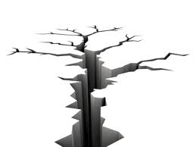
What are earthquakes?
Earthquakes are natural disasters.
Earthquakes are the rolling, shaking and sudden shock of the Earths surface.
Earthquakes typically cause a vast amount of destruction due to the movements within the earths crust or volcanic action.
They usually last for less than a minute.
They are Earths natural means of releasing stress.

Slide 5
What causes an earthquake?
The Earths surface has roughly about 20 plates that continually move. They move that slowly that we can not feel them.
Pressure builds up at plate boundaries and this causes a sudden release in energy in the Earths crust.

Slide 6
Lets watch these short clips.
Second Level Teaching Clip: https://www.youtube.com/watch?v=e7ho6z32yyo
First Level Teaching Clip: https://www.youtube.com/watch?v=dJpIU1rSOFY

Slide 7
What impact do you think an earthquake could have you and your environment?
With your shoulder partner take a few minutes to think of the impact an earthquake could have on you and your environment?
http://www.online-stopwatch.com/eggtimer-countdown/

Slide 8
Impacts on the environment
Earthquakes can cause major disruption to transport and communication links.
Water connections may be damaged which can cause lack of water or lead to water contamination.
Buildings and homes can be destroyed.
Natural and human landmarks may be lost.
Natural food sources may be destroyed.

Slide 9
Impacts on people
People may have to be rehoused.
Lack or loss of income due to work places being destroyed.
Diseases can spread.
Loss of life.
Long term injuries and health problems.
Families can be torn apart.

Slide 10
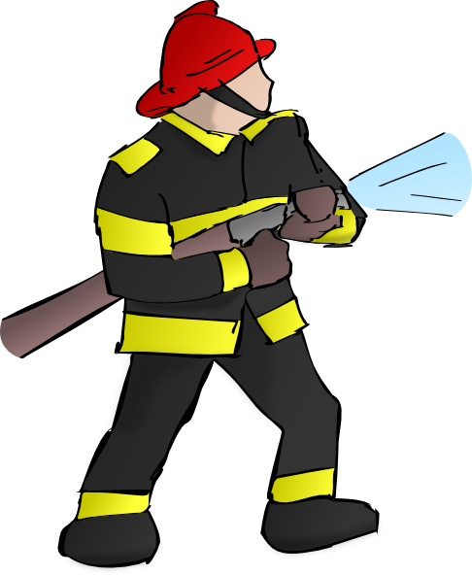
Who can help?

Slide 11
Disasters Emergency Committee
Work in collaboration with 13 other UK charities.
Respond to disasters in the worlds poorest countries.
Send an appeal only when they know they can help.
Use cost effective and efficient methods to deliver aid.
Part of the Emergency Appeals Alliance.

Slide 12
How can you be prepared?
Have a disaster plan set up in your home.
Have a first aid kit in your home.
Bolt tall furniture to the wall.
Practice drop, cover and hold on – drop under something secure, hold on and cover your mouth and eyes by pressing your face against your arm.
https://www.youtube.com/watch?v=YXxPTAhMGLI

Slide 13
Any questions?

Slide 14
References
Disasters Emergency Committee, (2017). How we work. Available: https://www.dec.org.uk/how-we-work [Accessed: 25th October 2017]
FEMA, (2014). When The Earth Shakes. Available: https://www.youtube.com/watch?v=YXxPTAhMGLI [Accessed: 27th October 2017]
Furgang, K. and National Geographic Kids. (2013). Everything volcanoes and earthquakes. USA: National Geographic Society.
Martain, C. (2015). My little book of volcanoes and earthquakes. London: QED Publishing.
National Geographic, (2015). Earthquakes 101 | National Geographic. Available: https://www.youtube.com/watch?v=e7ho6z32yyo [Accessed: 26th October 2017]
Peekaboo Kidz, (2015). What Is An Earthquake? | The Dr. Binocs Show | Educational Videos For Kids. Available: https://www.youtube.com/watch?v=dJpIU1rSOFY [Accessed: 26th October 2017]
Scoffham, S. and Owens, P. (2017). Teaching Primary Geography. London: Bloomsbury Publishing.
USGS, Science for a changing world, (2017). Earthquakes Hazard Programme. Available: https://earthquake.usgs.gov/earthquakes/ [Accessed: 26th October 2017]

