Slide 1

Chatting Together
Key messages about early interactions that build language and communication for parents, carers and the early years workforce
Notes:
Title font Fredoka
These slides show the Getting Ready to Chat together for bump to baby and toddler to young child stage.
A summary of the main Chatting Together messages for each stage is also included here. You will find individual posters and postcards with more details of each message on the Parent Club website and NELC team glowblogs site.

Slide 2
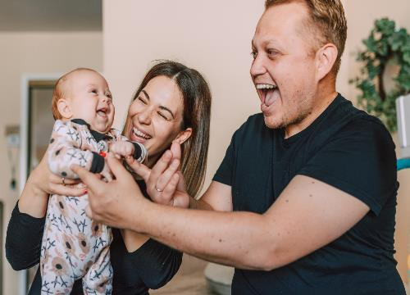
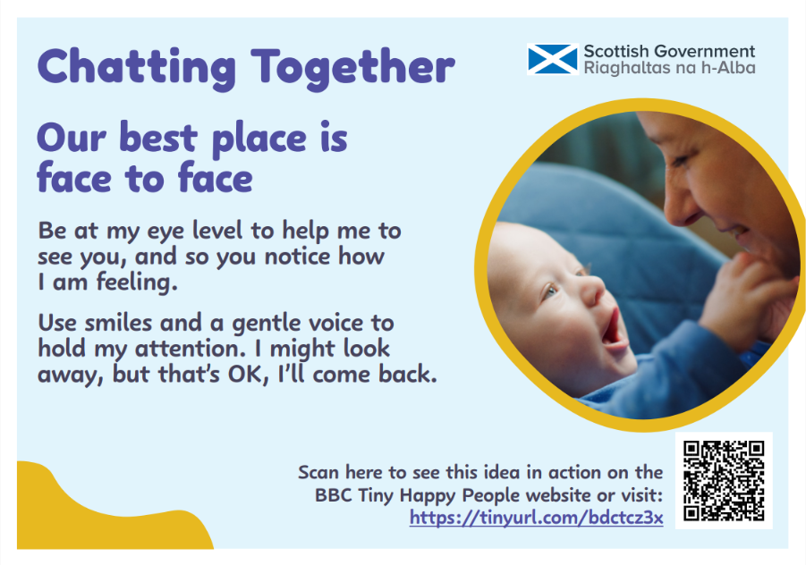
Getting Ready to Chat Together
bump to baby
Let’s chat and play everyday.
Help me to tune in by putting your phone away and turning off the TV.
If I nap with a dummy, put it away when I am alert.
Be sure to use your home language or languages.
Notes:
Text: Kermit

Slide 3
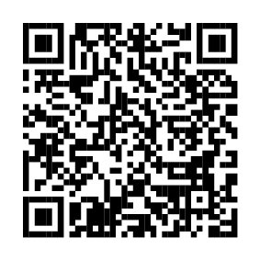
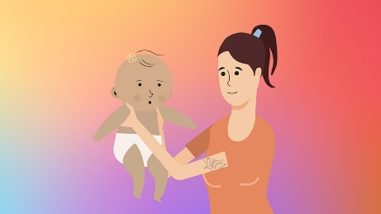
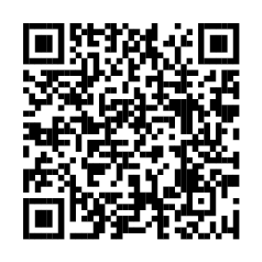
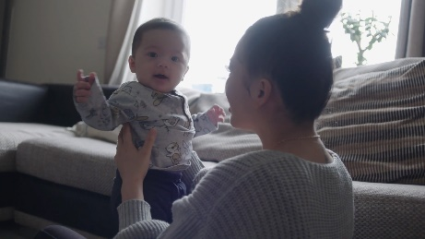
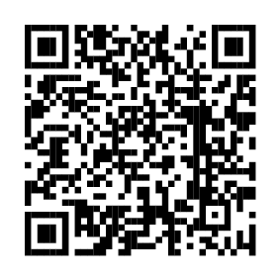
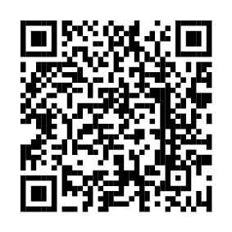
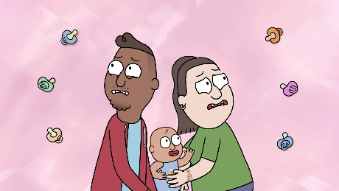
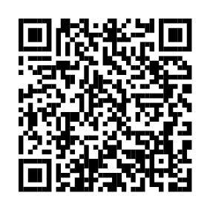
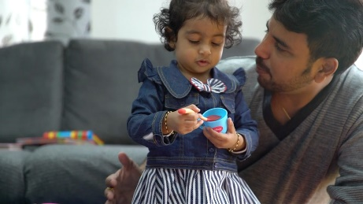
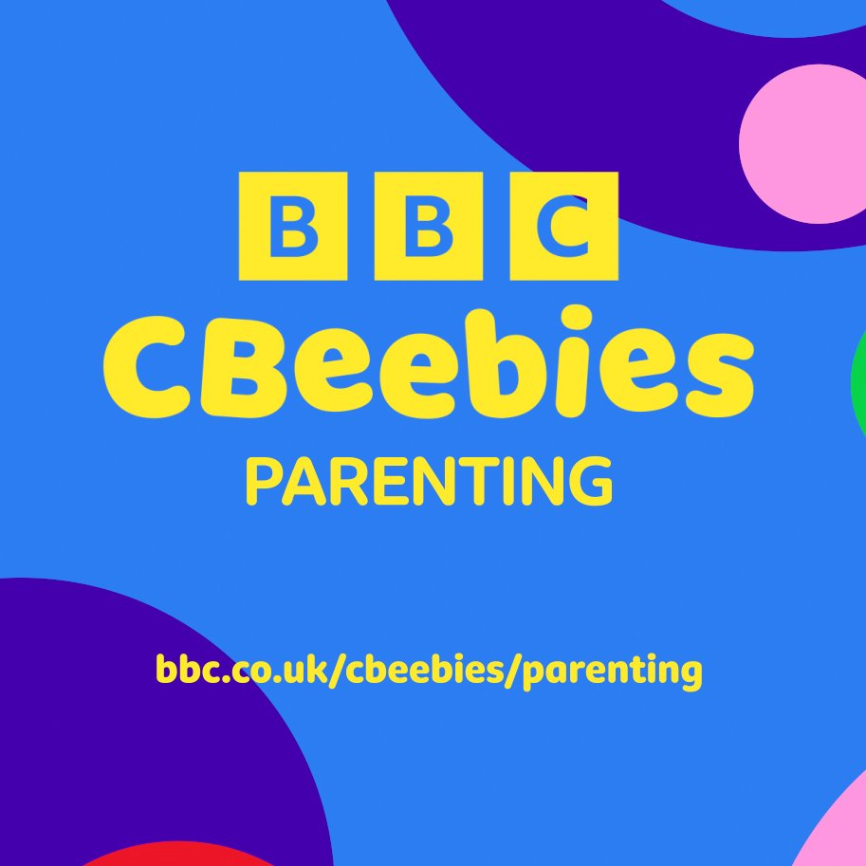
Getting Ready to Chat Together
Let’s chat and play every day.
If I nap with a dummy, put it away when I am alert.
Help me to tune in by putting your phone away and turning off the TV.
Be sure to use your home language or languages.
bump to baby

Slide 4


Chatting Together:
bump to baby
copy my sounds, funny faces and gestures
listen, watch and respond to me
our best place is face to face
use a sing song voice

Slide 5
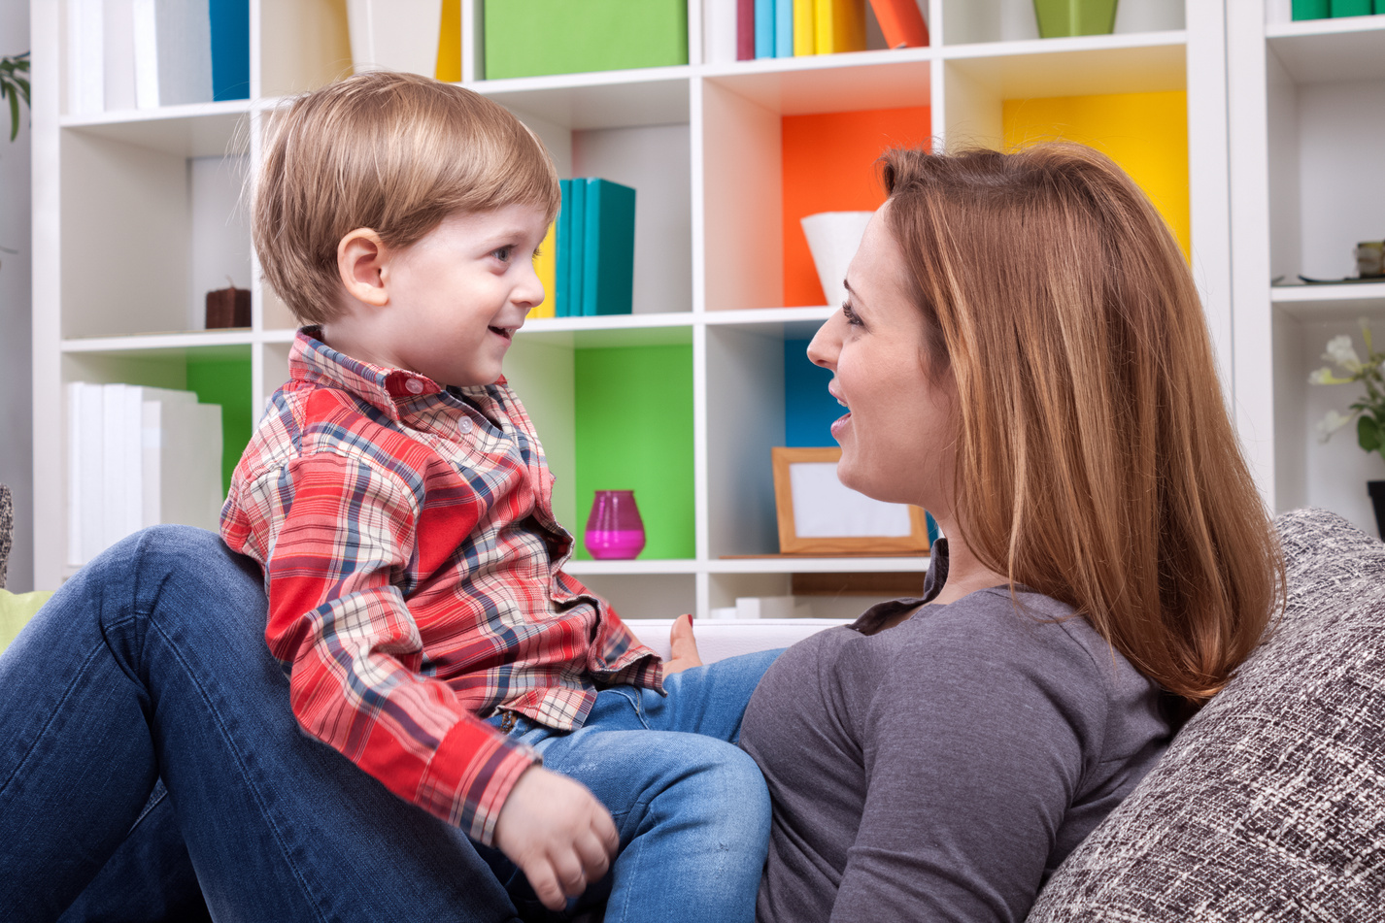
Getting Ready to Chat Together
Let’s chat and play everyday.
Help me to tune in by putting your phone away and turning off the TV.
Be sure to use your home language or languages.
toddler
and young child

Slide 6
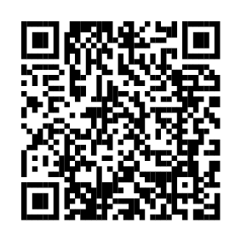
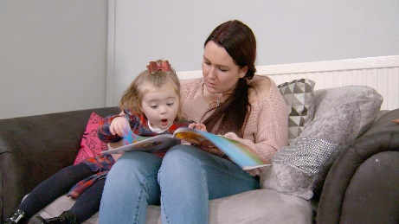
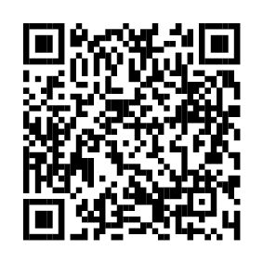
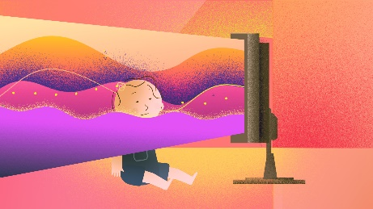
Getting Ready to Chat Together
Let’s chat and play every day.
Help me to tune in by putting your phone away and turning off the TV.
Be sure to use your home language or languages.
toddler and young child

Slide 7
Chatting Together with
toddlers and young children:
copy my sounds or words and add a bit more
talk to me about whatever we’re doing
watch and wait before joining in
get down to my level

