Slide 1
Chatting Together
Bump to Baby (Gaelic)

Slide 2
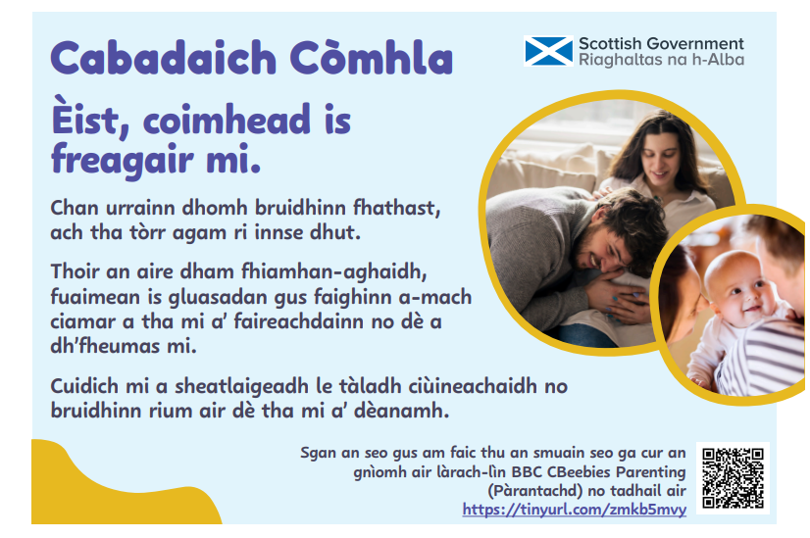
Notes:
Listen, watch and respond to me.
I can’t talk yet, but I have lots to tell you. Pay attention to my facial expressions, sounds and wiggles to find out how I am feeling or what I need. Help me settle with a calming lullaby or chat to me about what I am doing.

Slide 3
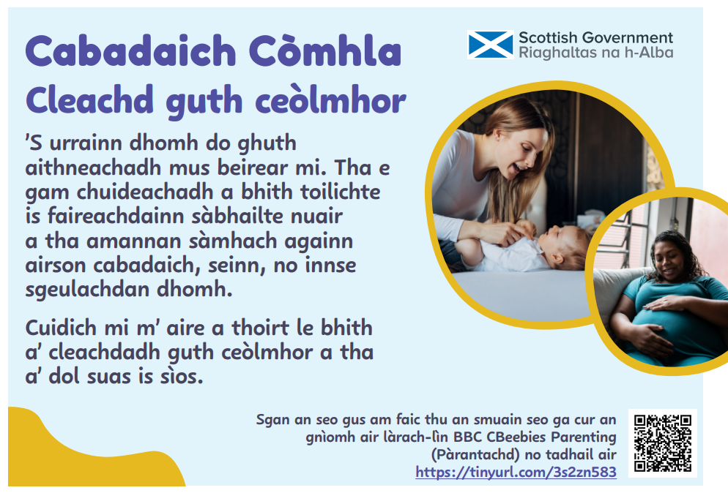
Notes:
Use a sing song voice.
I can recognise your voice before I’m born. Finding quiet times to chat, sing or tell me stories helps me feel happy and safe. Help me to tune in by using a sing song voice that goes up and down.

Slide 4
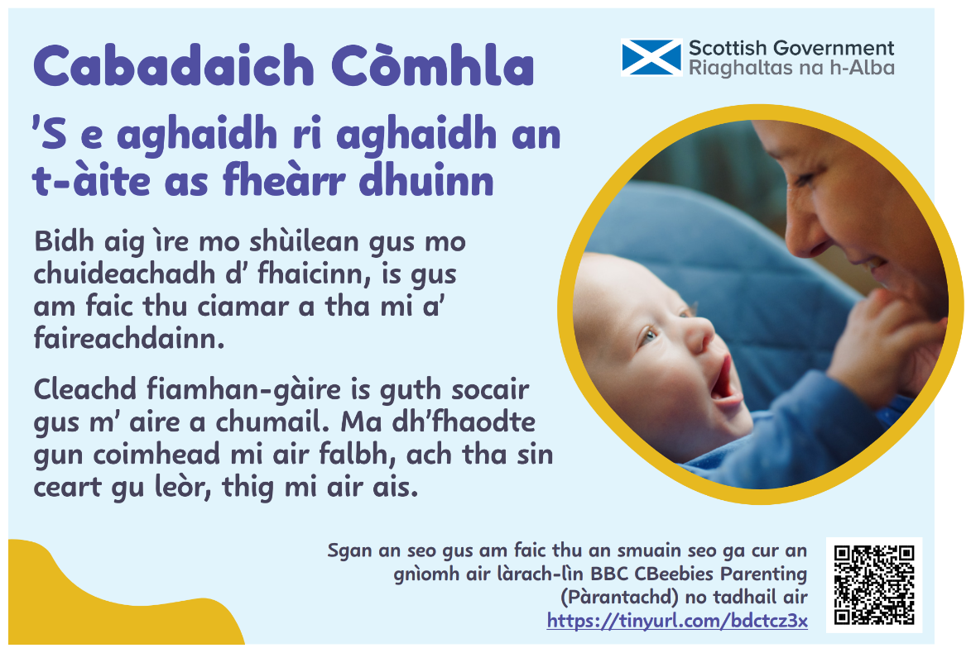
Notes:
Our best place is face to face.
Be at my eye level to help me to see you, and so you notice how I am feeling. Use smiles and a gentle voice to hold my attention. I might look away, but that’s OK, I’ll come back.

Slide 5
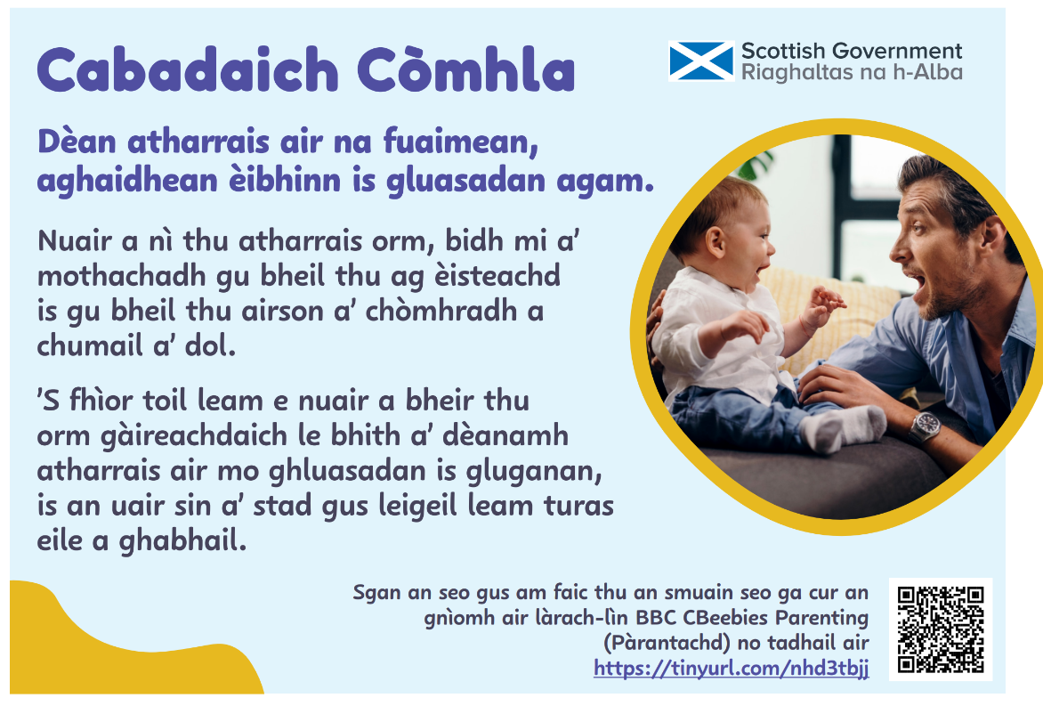
Notes:
Copy my sounds, funny faces and gestures.
When you copy me, I notice you are listening and that you want to keep the conversation going. I love it when you make me laugh by copying my gestures and gurgles, then pausing for me to take another turn.

Slide 6
Chatting Together
Toddler to Young Child (Gaelic)

Slide 7
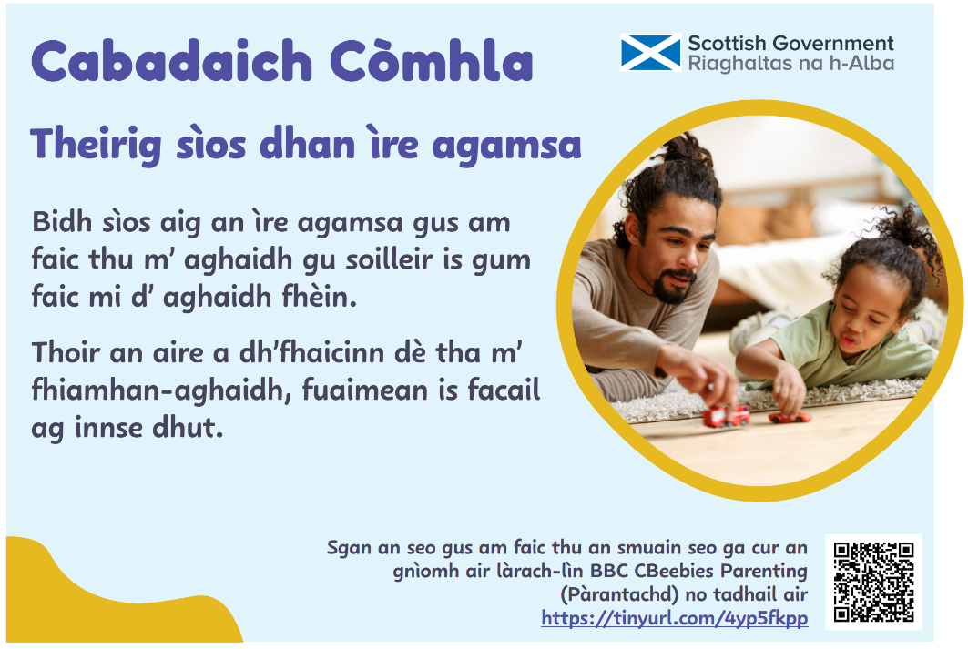
Notes:
Get down to my level.
Be down at my level so you can clearly see my face and I can see yours. Pay attention to notice what my facial expressions, sounds and words are telling you.

Slide 8
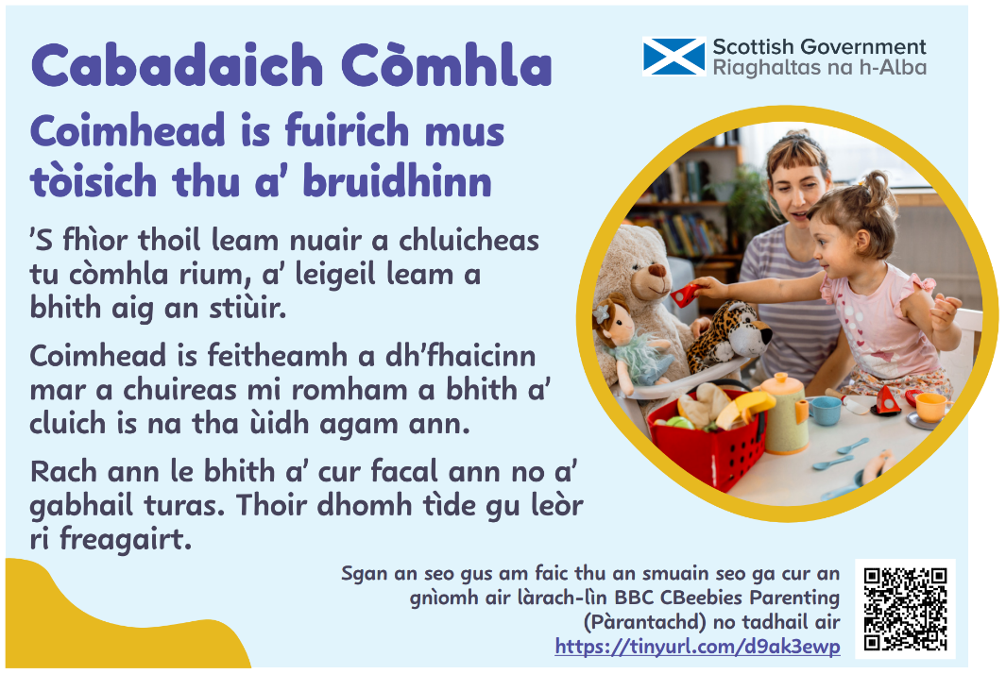
Notes:
Watch and wait before joining in.
I love it when you play alongside me, letting me take the lead. Watch and wait to see how I choose to play and what I am interested in. Join in by making a comment or taking a turn. Give me plenty of time to respond.

Slide 9
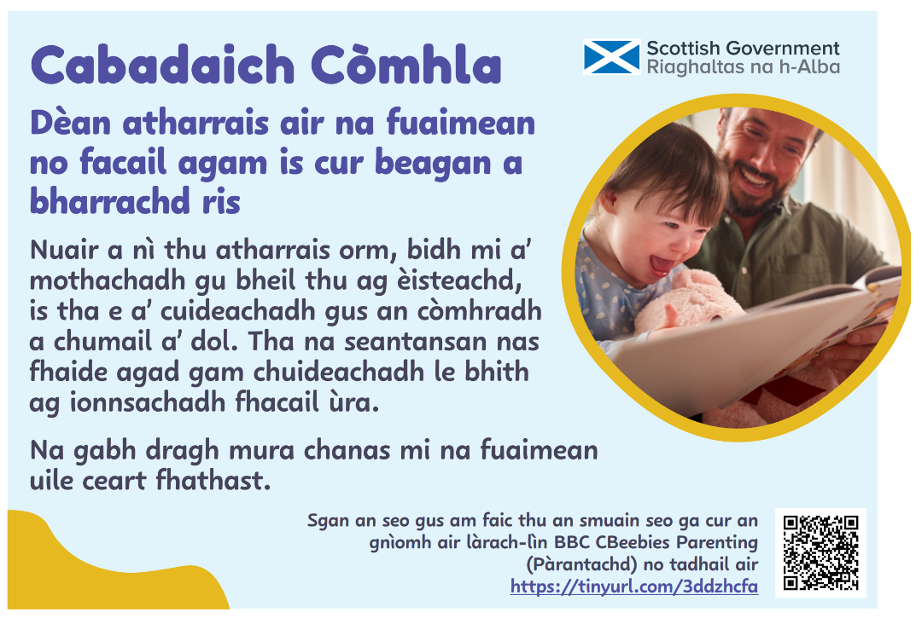
Notes:
Copy my sounds or words and add a bit more.
When you repeat what I say, I know you are listening, and it helps to keep the conversation going. Your longer sentences help me to learn new words. Don’t worry if I can’t say all the sounds correctly just yet.

Slide 10
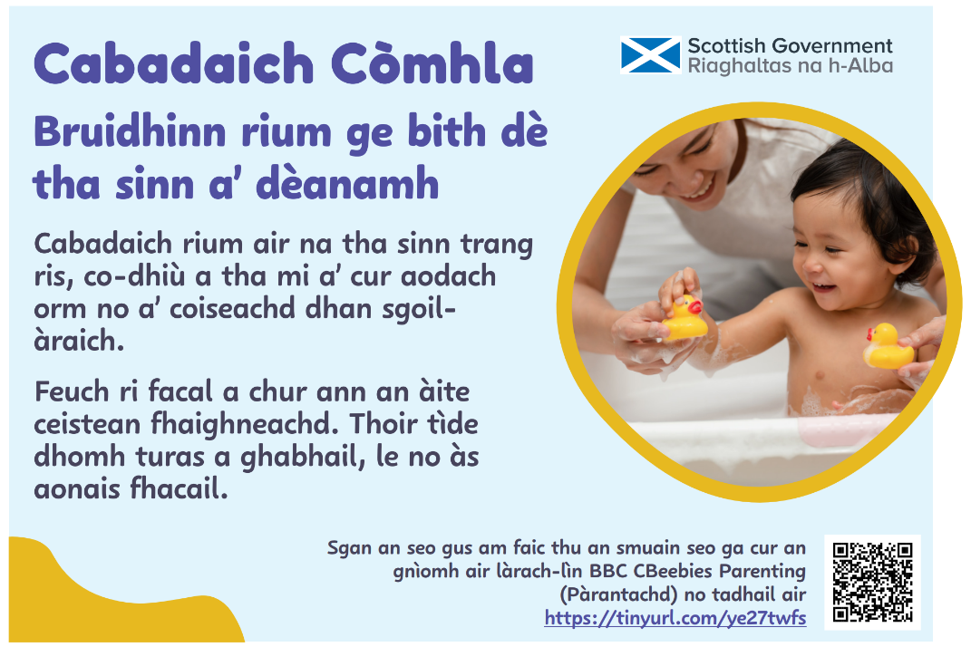
Notes:
Talk to me whatever we are doing.
Chat with me about whatever we are busy doing, whether I’m getting dressed or walking to nursery. Try to comment instead of asking questions. Give me time to take a turn, with or without words.

