Slide 1






How Good is our school
CORPUS CHRISTI PRIMARY

Slide 2

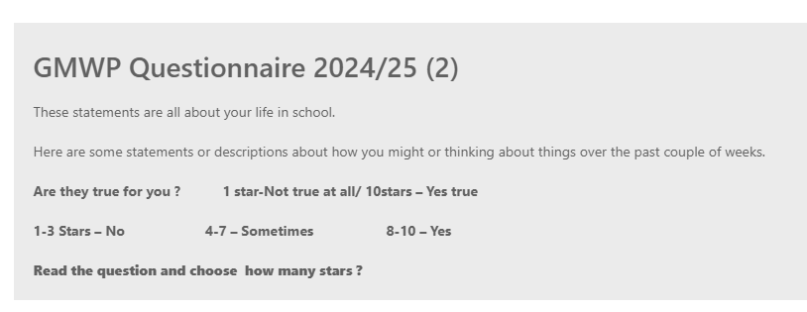
Glasgows Motivation & Wellbeing profile
The GMWP (Glasgow Motivation and Wellbeing Profile) is a 20 item questionnaire that explores motivation and sense of wellbeing in the learning context. It elicits children and young people’s views of themselves and their emotions; it gives them an opportunity to reflect on their feelings and current experiences and encourages them to consider how they can increase their own determination, motivation and sense of wellbeing.
CORPUS CHRISTI PRIMARY

Slide 3
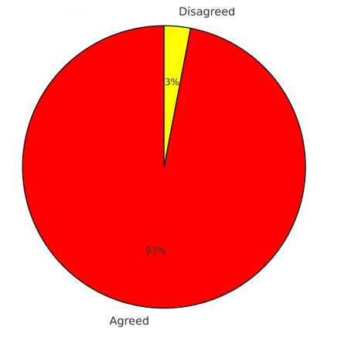

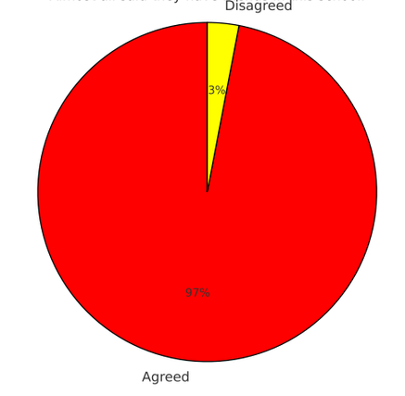
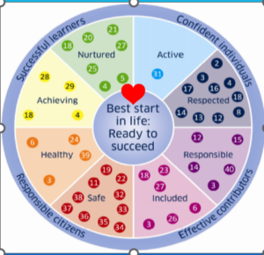

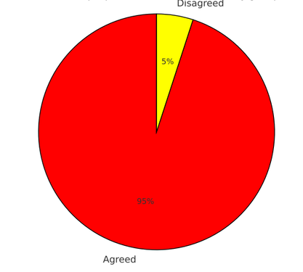
Do you like this school?
Almost all said they like this school.
Do you have friends in this school?
Almost all said they have friends in this school.
Do people in school help you if you get upset?
Almost all said people in school help them if they get upset.
CORPUS CHRISTI PRIMARY

Slide 4
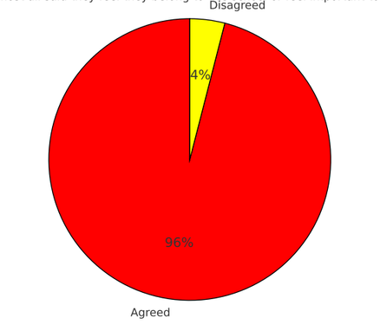

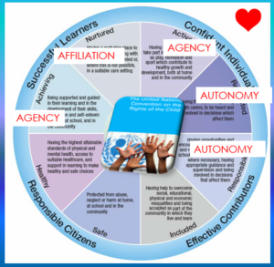
Do you feel you belong to this school or feel important to this school?
Almost all said they feel they belong to this school or feel important to it.
Do you work hard in this school?
Almost all said they work hard in this school.
Do you feel proud of the work you do in school or feel your work is good?
Almost all said they feel proud of the work they do in school or that their work is good.
CORPUS CHRISTI PRIMARY

Slide 5
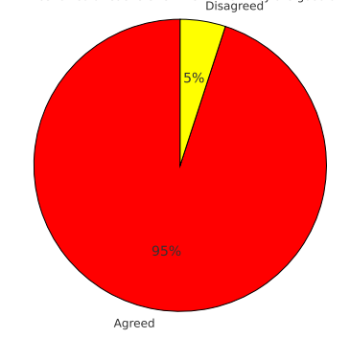
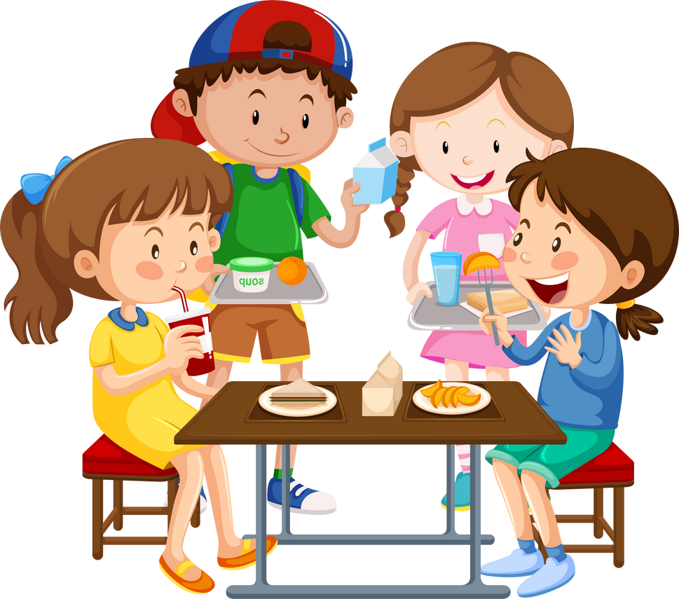
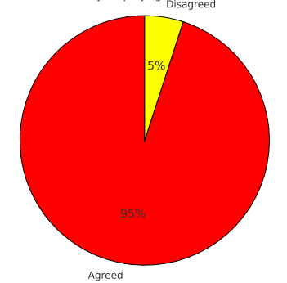
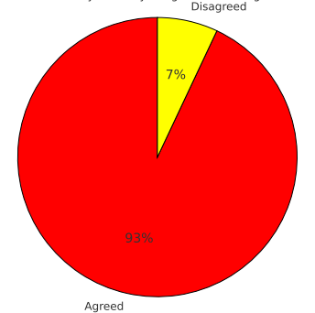
Do teachers tell you what you are good at?
Almost all said teachers tell them what they are good at.
Do you keep trying even if the work is hard?
Almost all said they keep trying even if the work is hard.
Do you feel you are good at working with others?
Most said they feel they are good at working with others.
CORPUS CHRISTI PRIMARY

Slide 6
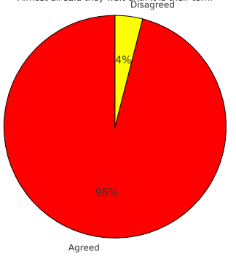

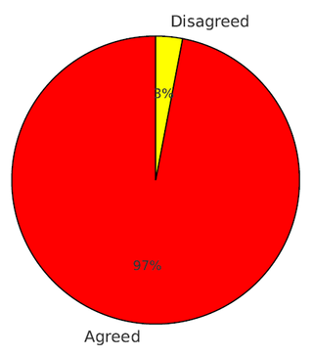
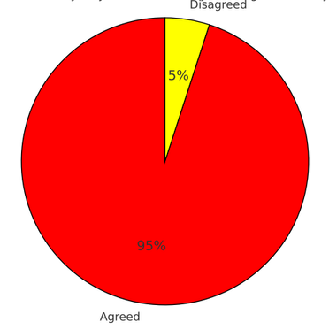

Do you wait until it is your turn?
Almost all said they wait until it is their turn.
Do you follow the school rules?
Almost all said they follow the school rules.
Do you stay calm even if you do not get what you want?
Almost all said they stay calm even if they do not get what they want.
CORPUS CHRISTI PRIMARY

Slide 7
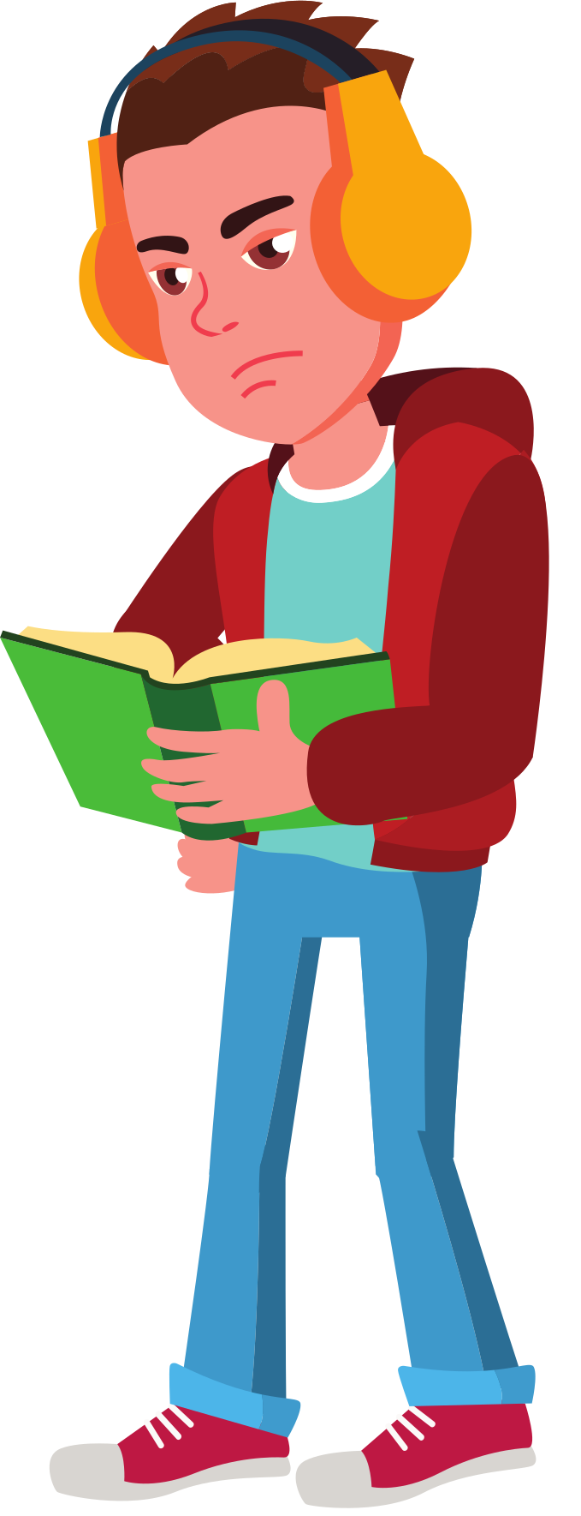

Do you like being chosen to do things in school?
Almost all said they like being chosen to do things in school.
Do you feel you can stand up for yourself in school?
  Almost all said they feel they can stand up for themselves in school.
Do people listen to you in school?
Almost all said people listen to them in school.
CORPUS CHRISTI PRIMARY

Slide 8
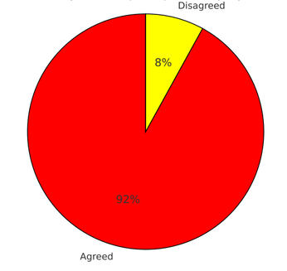
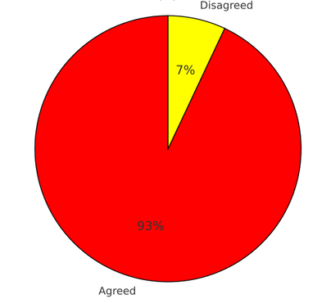
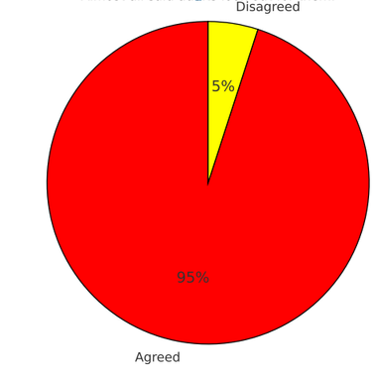
Do you complain if you feel picked on by anyone in school?
Most said they would complain if they felt picked on by anyone in school.
Do other pupils look out for you in school or make sure you are feeling okay?
Most said other pupils look out for them in school or make sure they are feeling okay.
Do adults look out for you in school or make sure you are feeling okay?
Almost all said adults look out for them in school or make sure they are feeling okay.
CORPUS CHRISTI PRIMARY

Slide 9
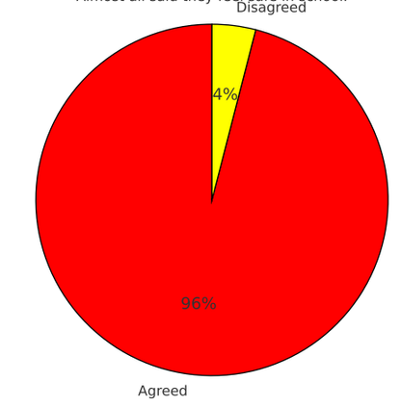

Do you feel safe in school?
Almost all said they feel safe in school.
Do you feel good about yourself in school?
Almost all said they feel good about themselves in school.
CORPUS CHRISTI PRIMARY

Slide 10
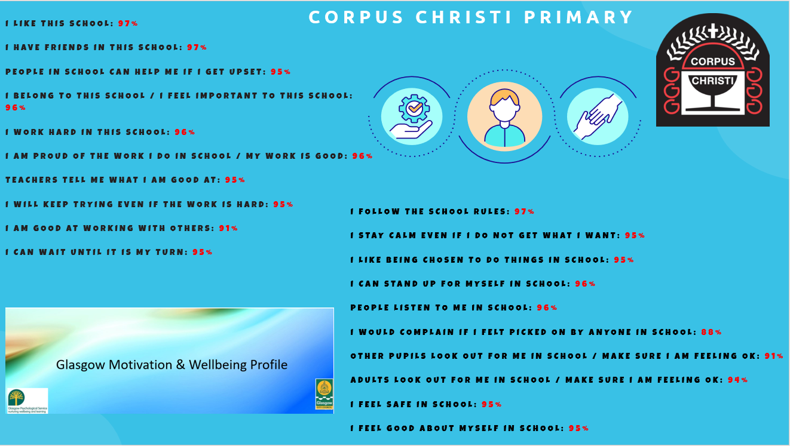

Slide 11
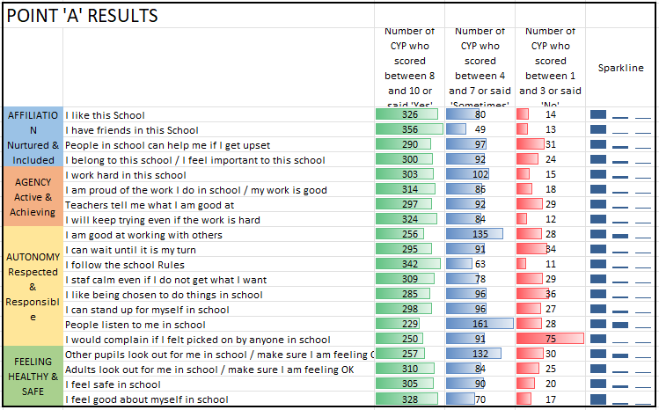
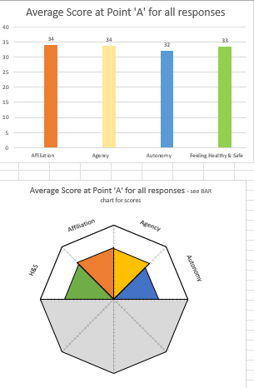
CORPUS CHRISTI PRIMARY
GMWP RESULTS

Slide 12



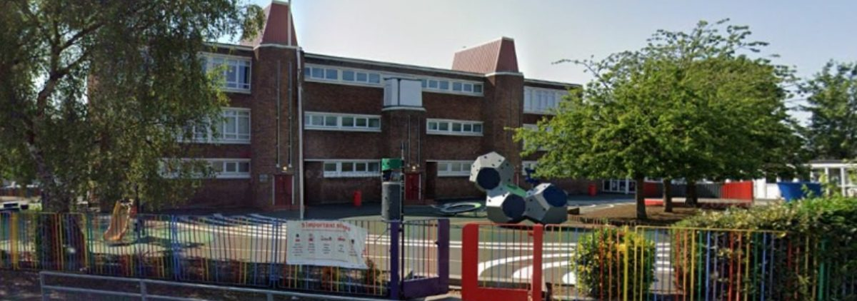
CORPUS CHRISTI PRIMARY
School Contact Information
0141 954 5380
headteacher@corpuschristi-pri.glasgow.sch.uk
https://blogs.glowscotland.org.uk/glowblogs/corpuschristi/
179 Pikeman Road
Knightswood
GLASGOW G13 3BH

