Slide 1
COURSE INFORMATION
CORPUS CHRISTI PRIMARY 15th -19th April 2023
Notes:
Choose one of the title slides – there are 3 to choose from. Then complete the school/youth group details within the relevant sections. If you need different images to the ones included here, please contact Marketing. Slides can be added to the template as and when needed.

Slide 2
WELCOME
to
Outward bound
“
We are all better than we know. If only we can be brought to realise this, we may never again be prepared to settle for anything less.
“
Kurt Hahn
Notes:
Please do not edit this slide.

Slide 3
Your programme
Notes:
Please do not edit this slide. If you need a different image to the ones included here, please contact Marketing. Slides can be added to the template as and when needed.

Slide 4
YOUR PROGRAMME
LEARNING OUTCOMES
Increased awareness of own skills and abilities
Improved confidence and self-belief in own abilities
Improved ability to listen and communicate effectively with others
Increased awareness and concern for the natural environment
Increased resilience and determination
In addition, instructors will develop strands of learning as appropriate.
Notes:
First Challenge
Choose one of the Learning Outcomes slides. These are the learning outcomes for the First Challenge programme. You can edit these to suit your prospect if you wish.

Slide 5
YOUR PROGRAMME
THE FINER DETAIL
DATES | 15th-19th April 2023
CENTRE | Howtown
START TIME | 1pm | FINISH TIME | 1pm
FIRST MEAL | Dinner | LAST MEAL | Lunch
AGE RANGE | P7
NO. OF GROUPS | 5
NO. OF STAFF | 5 staff
Notes:
Fill in the details above.

Slide 6
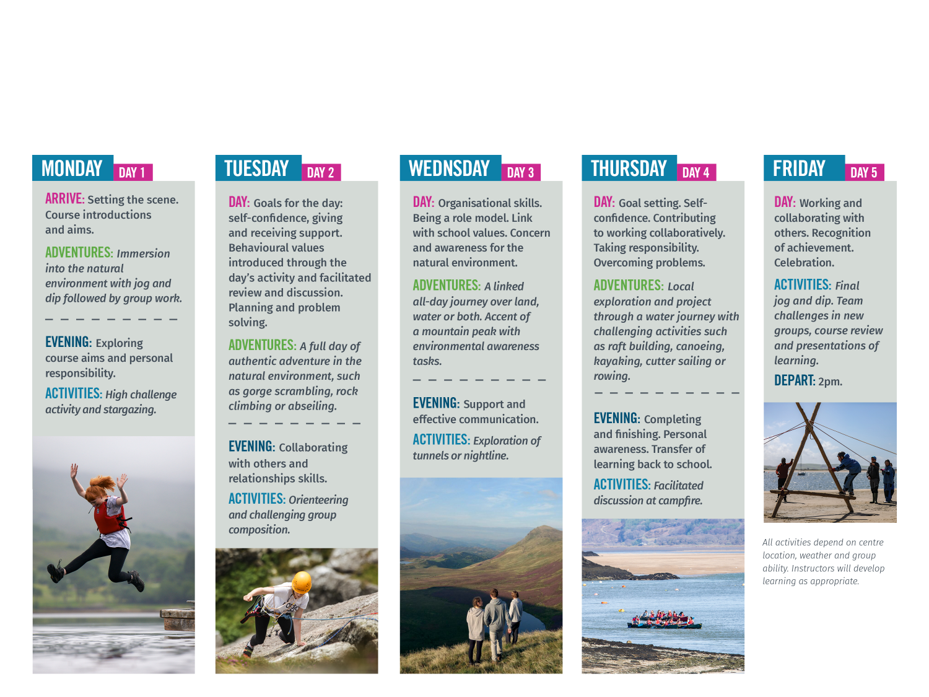
SAMPLE programme
Notes:
Sample Programme 5 Days (without expedition)
Choose one (or more) of the Sample Programme slides. This is the sample programme for 5 days without expedition. Please do not edit this slide.

Slide 7
SAMPLE ACTIVITIES
Jog and dip
Shelter building
Rowing
Mountain expeditions
Gorge scrambling
Raft building
Canoeing
Rock climbing
Orienteering
Kayaking
Cutter sailing
Abseiling
Understanding nature
Woodland exploration
Notes:
Include this slide if you want to show the sample activities. You can choose to update the sample activities to suit your prospect.

Slide 8
YOUR CHOSEN CENTRE
HOWTOWN, THE LAKE DISTRICT
Outward Bound Howtown is in the heart of the UK’s largest national park, with direct access to the lak. It’s a short distance from famous peaks, like Helvellyn. This outdoor education centre is located in a secluded and sheltered bay on the shores of Ullswater. The newest of our Outward Bound Trust residential centres, it is ideally situated for adventures on the lake and surrounding mountains and is used exclusively by our education clients.
Notes:
Ullswater, the Lake District
Choose one (or more) of the Centre slides. Please do not edit this slide.

Slide 9
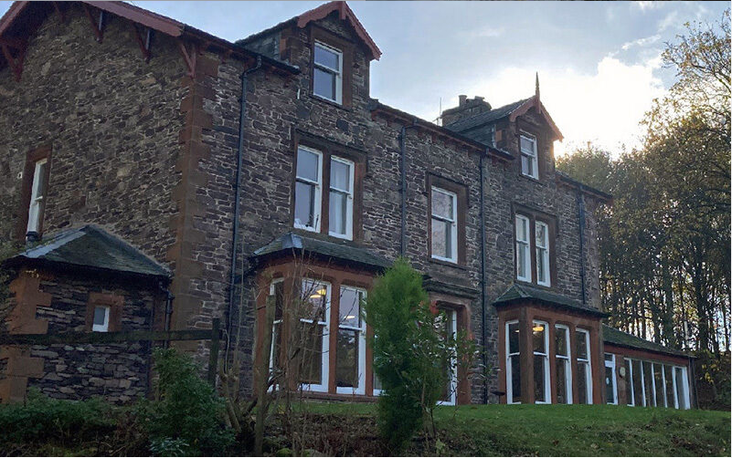
HOWTOWN, THE LAKE DISTRICT
Participants: Accommodates 72 participants in bunk rooms of 4-6. All rooms have a toilet and a shower.

Slide 10
YOUR PROGRAMME
PRICES
WHAT’S INCLUDED
£320
Full day and evening plan, jam-packed full of activities
24-hour pastoral care
A dedicated instructor per group
Accommodation and bedding
Breakfast, lunch and dinner
All equipment and kit
Fully comprehensive insurance for all
CPD opportunities for visiting staff
Access to resources in our Education Resources Area
As much flapjack as you can get your hands on!
Please pay using Parent Pay.
Payment schedule:
Deposit – June 2023 £30
6th October 2023 - £70
24th November 2023 - £60
31st January - £50
29th February - £60
29th March - £50
The full amount can be paid at any time and payments can be made before the suggested dates.
Notes:
Fill in the details above.

Slide 11
ABOUT US
We’re an educational charity that inspire young people to defy their limitations.
Limitations on young people, whether real or perceived, come in all shapes and sizes. We use the power of learning and adventures in the wild to defeat them all.
We partner with schools, colleges and youth groups to teach young people the most important lesson they could ever learn: to believe in themselves.
It’s the superpower that transforms their behaviour throughout school, work and beyond.
.
Notes:
Please do not edit this slide.

Slide 12
Why use
OUTWARD BOUND?
We equip young people with a stronger sense of self-belief, able to cope better with stressful situations and interact more positively with others.
Our inspiring instructors will take your students on a personal journey out in the wild.
Using experiential and transformational learning, this process has a huge impact on your students’ development and skills.
.
Notes:
Please do not edit this slide.

Slide 13
Not your
BOG-STANDARD RESIDENTIAL
No two courses are the same. Your course is made to order depending on the learning needs of the group.
One super-skilled, dedicated instructor for each group for the entire course.
Hugely impactful experiences like no other, including carefully planned overnight expeditions.
Backed by an independently-reviewed evaluation programme – we genuinely make a real difference to young people.
All-inclusive. All food, accommodation, tuition, 24-hour pastoral care and fully comprehensive insurance included.
Notes:
Please do not edit this slide.

Slide 14
Our
PILLARS OF
Change
1. Self-Belief & Resilience
2. Improving Chances
3. Hunger for Challenge
4. Great Relationships
We inspire young people to believe they are capable of more, and to get up when they are knocked back.
We develop skills in young people, which help lead to better life chances, particularly those from less privileged backgrounds
We inspire young people to seek out challenge, not be afraid of it, and be risk aware, not risk averse.
We promote the importance of strong, authentic relationships to develop internal self worth and a sense of belonging in the world.
Notes:
Please do not edit this slide.

Slide 15
How we do it
An Outward Bound course is all about learning and the impact this has on the individual.
This is achieved through skilful people working in an inspiring and challenging environment and applying an effective process.
1 OUR PEOPLE
HARD SKILLS
2 OUR PLACES
IMPACT Participant Outcomes
1
Experienced educators who facilitate learning
Challenge and impel people to perform
Highly qualified and experienced outdoor instructors
SOFT SKILLS
AUTHENTIC ADVENTURE
2
Real adventures in the natural environment
Inspiring locations provide limitless opportunities
Scale of experience and journeys in unique and challenging
3 OUR PROCESS
3
Personal journey
Experienced and transferable
Continuous reviewing and reflection
Notes:
Please do not edit this slide.

Slide 16
OUR IMPACT
resilience
From a teacher’s perspective changes in pupils’ resilience improved four to six weeks after their Outward Bound course.
confidence
Many young people feel they do not have the confidence to navigate the demands of everyday life.
95%
87%
The ability to keep going when they encounter difficulties and setbacks.
The speed at which they recover from setback.
60%
69%
60% of participants reported an increase in their confidence immediately after their course.
This increased to 69% six months post-course.
View our Social Impact Report.
Notes:
Please do not edit this slide.

Slide 17
OUR IMPACT
teamwork
The quality of our interactions with those being us form the basis for wellbeing.
Emotional control
91%
77%
Emotional control is often seen as a key indicator of mental health.
60%
91% of participants recorded an overall increase in their confidence to interact with others post-Outward Bound.
77% continued to score higher six months later.
60% of participants on our five-day courses recorded an increase in their emotional control score.
This indicates they are better able to cope with stress and adapt positively to changing circumstances.
View our Social Impact Report.
Notes:
Please do not edit this slide.

Slide 18
OUR IMPACT
Environmental awareness
When our courses focus on increasing respect for the environment and learning about man’s environmental impact…
Goal setting
Those who demonstrate higher levels of self-discipline have been shown to have greater success in their education.
90%
79%
69%
65%
90% of participants felt more motivated to act with environmental responsibility.
79% felt more motivated to discover nature close to where they live.
69% of students on our five-day education course recorded an increase in their confidence to achieve goals.
65% recorded an increase in setting targets and 57% to make decisions.
View our Social Impact Report.
Notes:
Please do not edit this slide.

Slide 19
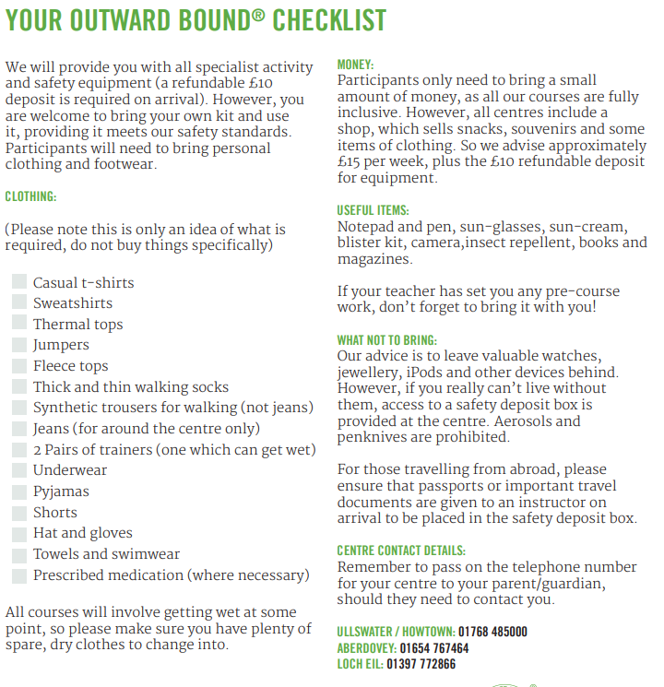

Slide 20
Every year we see changes in our students almost immediately and this experience stays with them for the rest of their school life.
Staff member, Shenley Academy
More case studies and stories.
Notes:
You can choose up to two Quote slides. Try and limit to choosing a maximum of two slides so not to make the proposal too long. If you need different quotes or images to the ones included here, please contact Marketing. Slides can be added to the template as and when needed.

Slide 21
Thank you for giving a life-changing opportunity to our pupils. You have provided life-long memories whilst helping to develop them into accomplished young people.
Tim O’Brien, Teacher
More case studies and stories.
Notes:
You can choose up to two Quote slides. Try and limit to choosing a maximum of two slides so not to make the proposal too long. If you need different quotes or images to the ones included here, please contact Marketing. Slides can be added to the template as and when needed.

Slide 22
Next steps
Visit outwardbound.org.uk
Complete online Parent Consent Form
Use the Parent Pay payment schedule to complete payment:
Deposit – June 2023 £30
6th October 2023 - £70
24th November 2023 - £60
31st January - £50
29th February - £60
29th March - £50
Notes:
Choose one of the end slides – there are 3 to choose from. Then complete your details within the relevant sections. If you need different images to the ones included here, please contact Marketing. Slides can be added to the template as and when needed.

