Slide 1
Autism Awareness Week

Slide 2
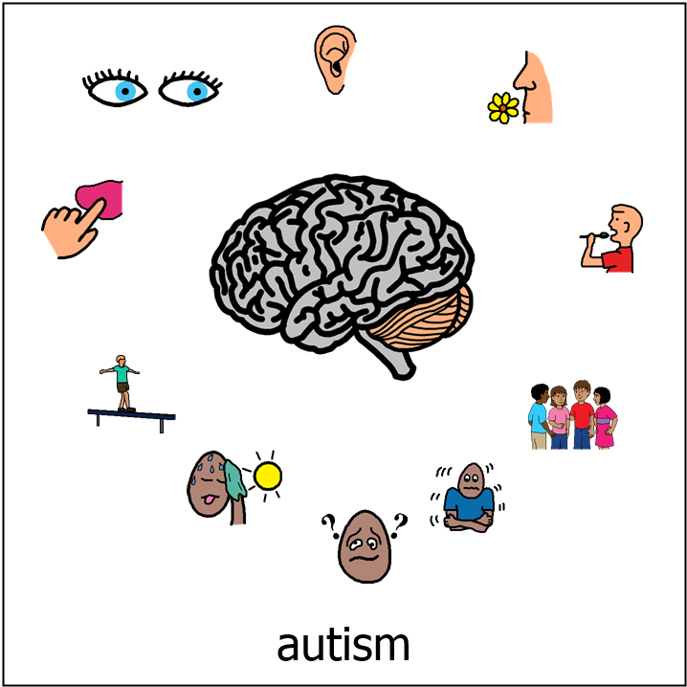
What is Autism?
We all have differences.
The way we look, the things we like, where we live, our beliefs.
Some differences like hair colour we can see.
Some differences like our favourite colour can be more difficult to see.
Some differences happen in our brain.
Autism is a bit like that.

Slide 3
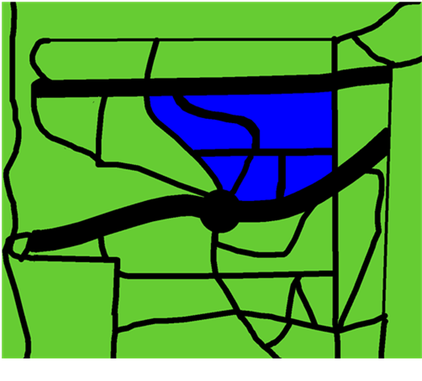
Autistic Brain
The brain is like a map with different roads going to different places.
One road might be taking a message from the tummy to the brain to let us know that we are hungry.
An autistic brain looks the same but our roads are slightly different.
Sometimes there are lots of messages travelling at once.
This can mean that sometimes our roads are too busy and messages don’t always go to the right place.
The roads in our brain are called pathways.

Slide 4
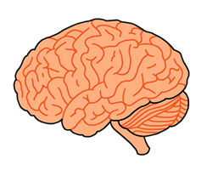
Pathways
When we learn something new, a new pathway (or road) is created within our brain.
The more we use our new skill or knowledge the more familiar our brain is with this new pathway.
Sometimes we create lots of new pathways.
Sometimes we use our old and familiar pathways.

Slide 5
Change
Creating a new pathway can be hard for some things.
It’s like using a new road.
There may be buildings you haven’t seen before.
It may be unfamiliar and strange to you.
This can sometimes make you feel uncomfortable or even scared.
Our brain can work like this too.
Sometimes using the new pathway can be scary.

Slide 6
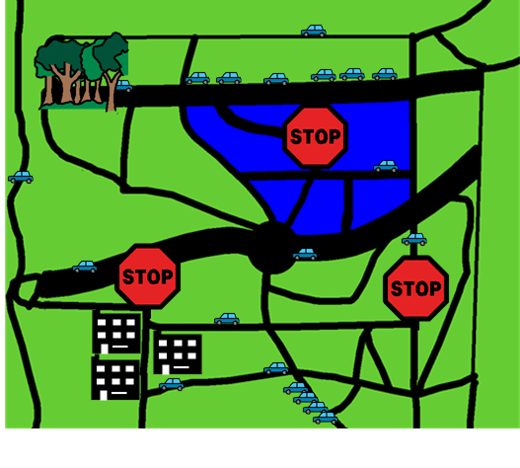
Transition
In an Autistic brain, it’s sometimes like the cars travelling along will ignore the new pathway.
The car will travel to the familiar pathway and keep using that one.
Sometimes there might be road works on a road and we have to go a different way.
Sometimes we can be distracted by the scenery.
Sometimes we can decide to take a different road.
This can be really hard to do and sometimes we need more time to get ready for a change.

Slide 7
Overload
Sometimes there are too many messages travelling through the brain.
That’s like when there are too many cars on the road. This causes traffic jams.
When we have traffic jams in our brain, this is called overload.
Sometimes we need to stop. Sometimes we get upset.
When this happens we might need help to calm down.

Slide 8
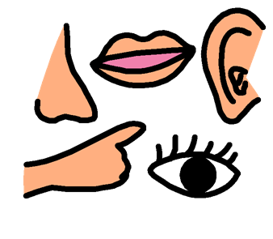
Sensory
Some of the messages travelling through our brain are linked to our senses.
Sometimes these messages go too fast. This means we might hear noises louder than others or feel things more than others.
Sometimes these messages might go too slow and we can’t understand what someone has said or we can’t follow instructions.

Slide 9
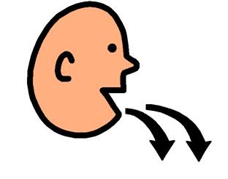
Echolalia (pronounced echo-lay-lee-ah)
Sometimes our pathways take us to familiar places such as replaying out favourite film scene or our favourite song or our favourite book.
This mean we may start to repeat words or songs.
Sometimes we might repeat words or phrases again and again.

Slide 10
Stimming
Sometimes our cars start to slow down and we need to move to help keep our cars moving.
To do this we move. Sometimes it’s just our hands that we flap. Sometimes we run back and forward. Sometimes we fidget.
This helps the messages in our brains travel to the right place.

Slide 11
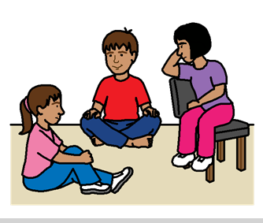
Talking to others
We can’t always understand how someone else feels because our pathways are too busy.
It is like other people are driving different roads and travelling in different directions. Sometimes it feels as though people are travelling on roads we have never been on before.
Sometimes if the pathway hasn’t been created, we don’t know what to do. For example if we want to talk to someone new, we don’t know what they like or how they talk so we don’t know what to do.

Slide 12
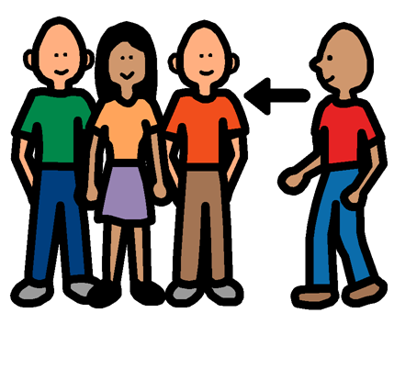
What we need from you…
Now that you understand a bit more about our different brains, you can help by
Letting me know about changes. For example if Science Week is coming up, let me know the week before and give me an idea of what it will mean for me.
Be patient with me. Try not to overload me with too many questions.
When I am overloaded, try to offer me something that helps to calm me down. E.g. place a rubix cube beside me.
Offer me brain breaks to allow the pathways to develop.
Don’t make fun of me.
Help me with my interactions by showing me what to do instead of telling me.

Slide 13
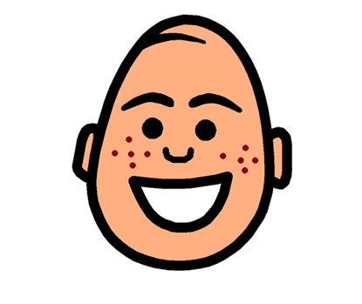
Thank you!

