Slide 1

These optional activities are produced nationally, and adaptable locally, to support the leadership of curriculum change in schools and settings.
Head teachers and leaders will have the opportunity to explore these during professional learning sessions in September 2026 and throughout the 2026/27 and 2027/28 sessions.
Facilitators may choose to use the presentation in its entirety or choose selected slides to use and /or adapt to suit local needs.
Facilitator notes offer suggestions of key points to emphasise or opportunities to link to recent local work where relevant.
These co-designed activities will be adapted and updated over the enactment phase.
Notes:
Activity 1: Exploring the change
These optional activities are produced nationally, and adaptable locally, to support the leadership of curriculum change in schools and settings.
Head teachers and leaders will have the opportunity to explore these during professional learning sessions in September 2026 and throughout the 2026/27 and 2027/28 sessions.
Facilitators may choose to use the presentation in its entirety or choose selected slides to use and /or adapt to suit local needs.
Facilitator notes offer suggestions of key points to emphasise or opportunities to link to recent local work where relevant.
Further activities will be co-designed over the enactment phase.

Slide 2
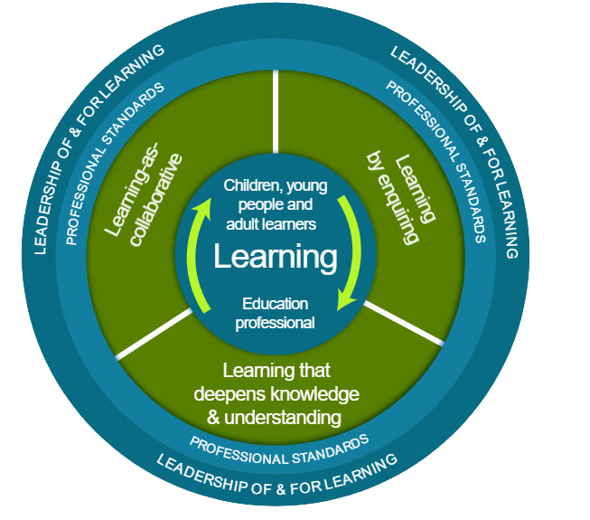
Ways of working together
  Learn from, with and on behalf of each other
  We create a safe space to share ideas
  We agree everyone is equal and valued
  We remain ‘in the room’
Notes:
Activity 1: Exploring the change
National Model for Professional Learning
If you are using the material with groups of staff, these ways of working can support
Take a moment to establish group protocols.
Ask participants to comment on anything they would like to add or amend.
Is there anything that participants feel is missing or anything they would like to remove?
The protocols on the slide are suggestions to be amended for your context.
- Why establish group protocols
Effective professional learning goes beyond simply delivering information. It fosters a learning community where educators can learn with, from, and on behalf of one another. To achieve this, the facilitator of this learning should establish clear protocols and a positive learning environment at the outset. The general notes below will support the facilitator to help everyone feel comfortable participating and contribute to a rich learning experience.
1. Contract a Safe Space:
Co-create a Safe Space agreement with your group. This agreement outlines expectations for respectful communication and active listening. A safe space allows trust to flourish, fostering a collaborative environment where everyone feels comfortable sharing ideas and taking risks.
2. Shift from Top-Down to Collaborative Learning:
Move beyond the traditional model where one person imparts knowledge. Embrace a collaborative approach where all participants actively engage. This means learning with, from, and on behalf of one another. By leveraging the diverse perspectives within the group, gaining a richer understanding and creating a more impactful learning experience for everyone.
3. Holding the Ladder: Shared Expertise and Recognition
Holding the ladder signifies a two-fold approach:
Sharing Expertise: Those with experience can share their knowledge and insights.
Recognise Everyone's Contribution: Actively listen and be open to learning from the unique perspectives and experiences of colleagues. Build on each other's ideas to foster a collaborative environment where everyone feels valued, and their contributions are respected.
4. Hold Space for Silence and Respectful Discussion:
Hold space for silence after someone speaks or asks a question. It can be tempting to jump in to fill silence but allowing time for quiet can avoid interrupting thought and produce more thoughtful responses. Everyone deserves to be heard and understood.
Adapt the time allocation based on the size of the group and the complexity of the topic.
5. Schedule Regular Breaks:
Schedule regular breaks throughout the session. This allows participants to process information, refocus, and return with renewed energy, leading to a more productive learning experience.
6. Centre Learning in Real Life:
Connect the learning to real-life experiences by encouraging participants to share relevant personal anecdotes or applications. This strengthens understanding and makes the learning more relatable and impactful for all.

Slide 3

Curriculum Improvement Cycle
Activity 1: Exploring the change
Notes:
Activity 1: Exploring the change
This session focuses on building a shared understanding and reassurance around the Curriculum Improvement Cycle. It draws on the content of Section 1 of the draft guidance, Building Scotland's Curriculum.
Emphasise this is an early conversation to explore the change. We will build a shared understanding over time.
Signpost timing (30–45 mins depending on discussion).

Slide 4

Session aim
To build a shared understanding of key changes happening to Scotland’s Curriculum
Notes:
Activity 1: Exploring the change
These are the aims of this session.
This is a 10-year programme of work. We will have further opportunities to explore the change and to ensure we all feel supported and ready.
And again, to reassure you, this is part of a longer journey, not a one-off session. The pace of change will be manageable.

Slide 5
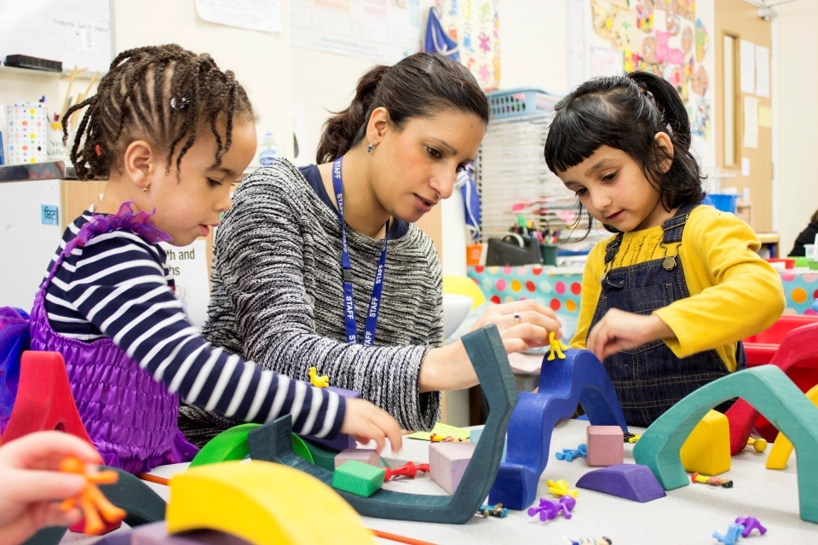
Scotland’s Curriculum is evolving
Notes:
Activity 1: Exploring the change
Scotland's curriculum is evolving over the 10 years of the curriculum improvement cycle.
In this session we will explore the strong foundations of our curriculum that remain in place, and begin to consider the key changes to the technical framework that we use.
The following text is from the draft national guidance: Building Scotland’s Curriculum:
What should schools and settings do now?
2026/27
Leaders and educators are encouraged to explore, reflect on and consider how this guidance might be meaningfully enacted from August 2028 onwards.
Educators should not begin using the draft KDU samples in curriculum making.
The suggested activity for the first part of 2026/27 is on using the provocations and activities to build a shared understanding of the CIC and of curriculum purpose (Sections 1& 2).
This period will also include the time to provide feedback on the draft KDU samples.
Once the final materials are available from January 2027, schools and settings will want to consider and explore the ‘What’: what does the updated curriculum mean for all four contexts for learning? (Section 3)
2027/28
From session 2027/28, the focus will move into the ‘How’ (Section 4).

Slide 6
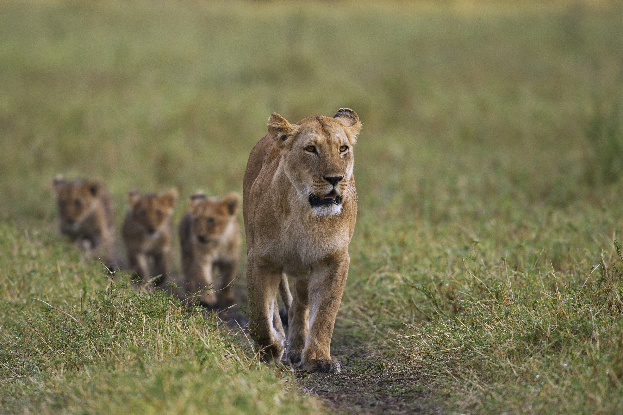
Leading Change
Cognitive Readiness
Understanding the need for change
Emotional Readiness
Feeling safe and supported in the process
Behavioural Readiness
Being prepared to act or implement change
Armenakis et al. (1993); Fullan (2007)
Notes:
Activity 1: Exploring the change
It might be helpful to consider theories of change.
Fullan invites us to consider cognitive, emotional and behavioural readiness.
Think about these in relation to yourself and, if appropriate, the people you lead.
Cognitive / Head – do we have a shared understanding of the need for change?
Emotional / Heart – where are my / our sources of support and answers?
Behavioural / Hands – what practical tools or resources that will help us?

Slide 7

Getting started
How are you feeling about Scotland's curriculum changing?
Notes:
Activity 1: Exploring the change
Let's take a moment to pause and consider how we are feeling about Scotland's curriculum changing. This could be a think, pair, share.
Facilitator - Invite a few participants from the room to share one word that sums up how they are feeling about the change coming. Acknowledge that we may be in different places and that’s ok, and part of the process of change.
Circling back, this session is to help us understand the need for change and as Fullan says for us all to feel safe and supported in the process.

Slide 8

As we explore this together keep in mind…
What feels familiar?
What feels new or significant?
What needs clarification?
Notes:
Activity 1: Exploring the change
As we go through this session, we invite you to use these framing questions.
What feels familiar to you?
What feels new or significant?
What needs further clarification?
Your thoughts are really important to inform further developments both for the next iteration of the guidance and the wider curriculum improvement cycle.
Facilitator – participant can gather their thoughts to provide feedback later as part of the consultation.

Slide 9
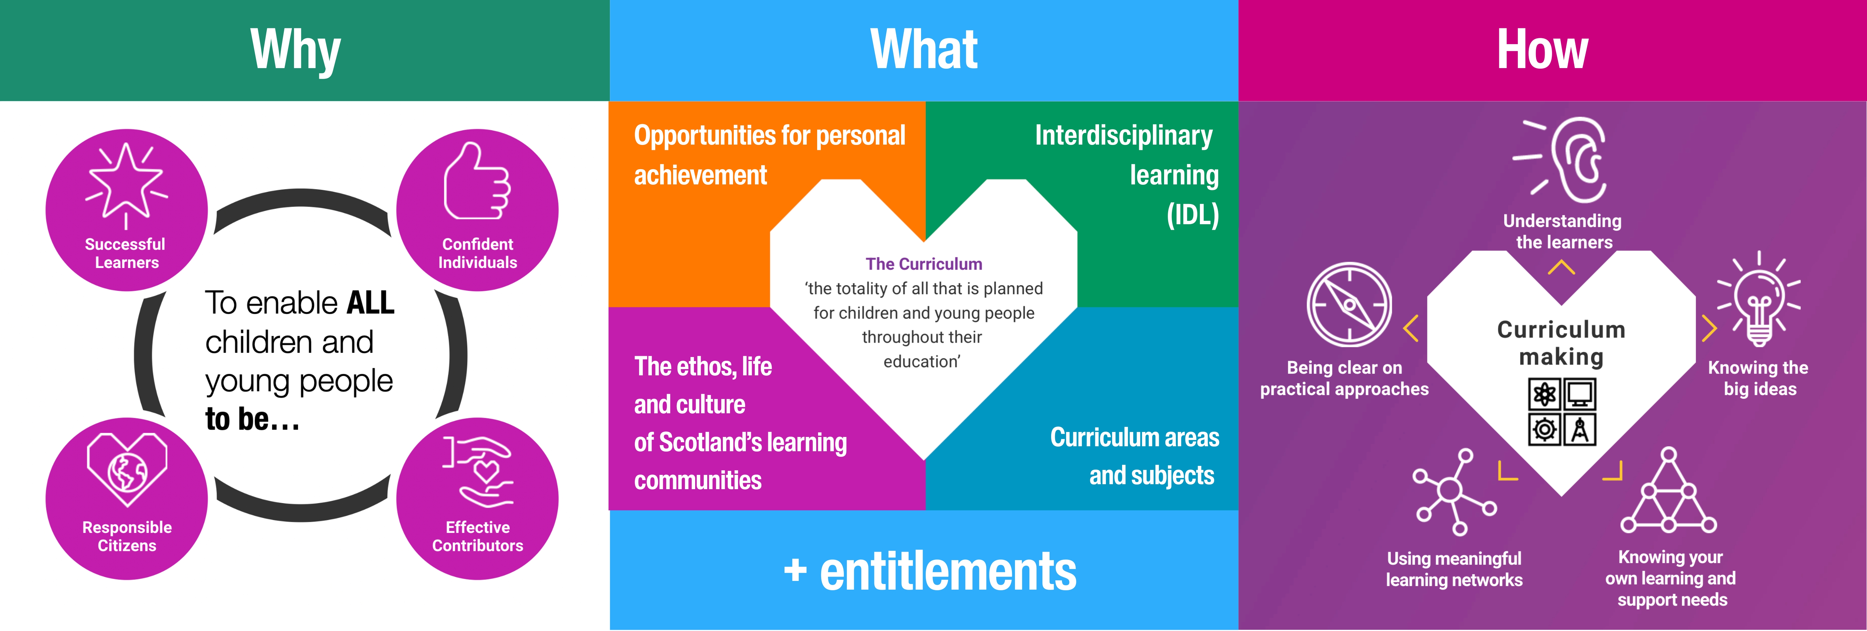
Not everything is changing
We are building on strong foundations
Notes:
Activity 1: Exploring the change
The core components of Scotland’s Curriculum remain.
The consensus around the four capacities as the purposes of Scotland’s Curriculum is strong.
Scotland’s approach to curriculum encourages us to think of curriculum design as a process of Why, What, then How.
We are still 2 years away from when formal adoption starts in August 2028 and will work through the steps of Why, What and How over that time.
Scotland's curriculum framework as shown is remaining. In particular this means:
The purpose of Scotland's curriculum remains the 4 capacities
Educators will still plan over the four contexts for learning
The entitlement to a broad general education from early years until the end of S3 remains
The entitlement to a senior phase (S4 – S6), which includes qualifications, for young people aged 15 -18 remains
The principles of curriculum design continue to be helpful for educators and leadership teams
All 8 Curriculum Areas remain
The ASN Milestones remain
The Curriculum levels from early to fourth in BGE and up to SCQF Level 7 in the senior phase remain, however there will be a stronger alignment between CfE 4th Level and SCQF Level 4.

Slide 10

What is changing?
Notes:
Activity 1: Exploring the change
Given that development work is underway as part of a ten year cycle, it is useful for us to outline the changes at this stage.

Slide 11
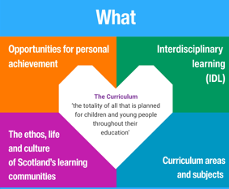
What is changing?
All four contexts will be strengthened.
Opportunities for Personal Achievement; Ethos, Life and Culture ; and Interdisciplinary Learning have clearer articulations and purposes.
Practical tools, exemplification and professional learning will strengthen these by building on innovative practice from across Scotland.
Notes:
Activity 1: Exploring the change
Given that development work is underway as part of a ten year cycle, it is useful for us to outline the changes at this stage.

Slide 12


The main change is a deliberate move away to a concept-based curriculum.
This will be a
Know-Do-Understand Model, informed from overarching 3-18 Big Ideas.
Notes:
Activity 1: Exploring the change
1
This is the main focus of the change.
Scotland is moving deliberately away from Experience, Outcomes and Benchmarks, to a concept-based curriculum.
This will allow Scotland to balance clear national expectations about knowledge with the flexibility to contextualise learning to suit local needs. This will be a know do understand model informed by overarching 3-18 big ideas.

Slide 13

Concept-based curricula were widely adopted within international education because they provide a framework that can operate across diverse cultural and contextual settings.
Notes:
Activity 1: Exploring the change
Concept-based curricula have been present in international schools and contexts for decades. They offer the balance of being able to guarantee entitlements around knowledge as well as allowing the curriculum to be contextualised to suit learner needs and local contexts.

Slide 14
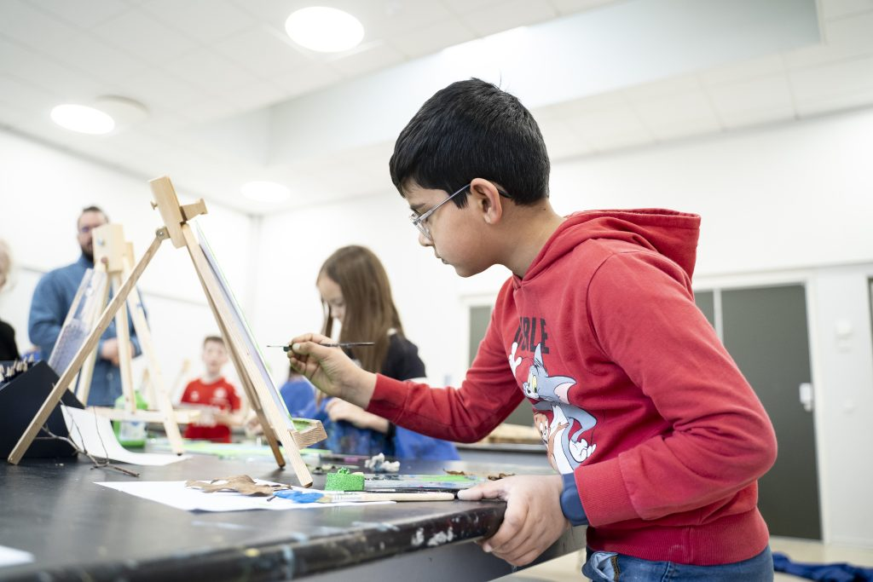
By organising learning around transferable concepts rather than fixed content, they create coherence when context varies.
Notes:
Activity 1: Exploring the change
A concept-based curriculum will help us address the position of knowledge in Scotland’s Curriculum while avoiding the risk of over-prescription.

Slide 15

Notes:
Activity 1: Exploring the change
A concept-based approach suits Scotland’s approach of prioritising excellence and equity.

Slide 16
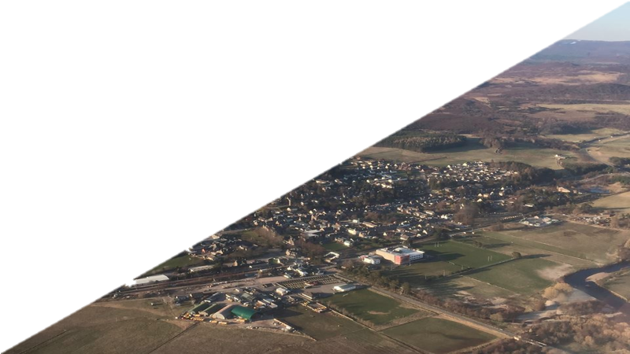

Notes:
Activity 1: Exploring the change
Leaders may wish to add or make reference to specific local contexts or recent work on place-based approaches.

Slide 17

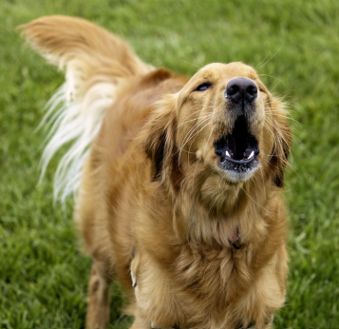
Same word different meaning...
bark
Notes:
Activity 1: Exploring the change
OECD (2021) highlighted that we often use the same words to mean different things when we have conversations about education in Scotland.

Slide 18
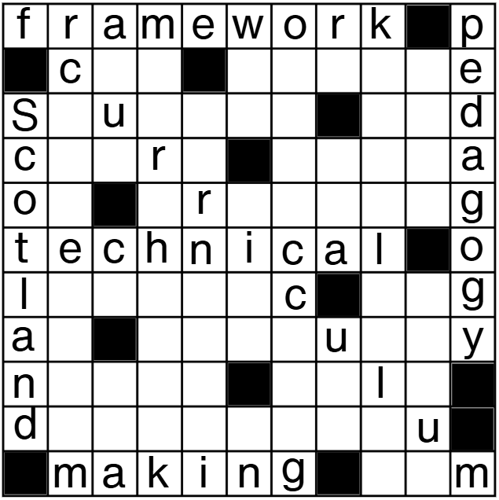
What do these mean to you?
Reflect individually then share your thoughts with a partner/in a group.
Curriculum
Curriculum making
Technical framework
Pedagogy
Notes:
Activity 1: Exploring the change
Suggestion: quick 60 / 90 seconds partner discussion on what comes to mind from the terms on the screen
What do these words mean to you? Have a go, work in twos or threes and share with each other quick and instinctive responses.
Don't worry if you are not fully aware of these at this stage as the purpose of this exercise is to surface that we may hold different interpretations of language.

Slide 19
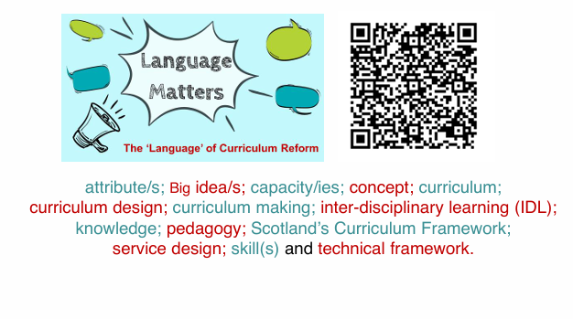
Notes:
Activity 1: Exploring the change
To support the with the Curriculum and Assessment Board to produce a first glossary of terms related to the emerging work of the CIC.
Suggestion: ask participants to read over the definitions on p3 of the draft Building Scotland’s Curriculum and discuss what is new to them.
Individually read page 3 of the draft guidance
In pairs discuss what is new to you.
The definitions are produced on the following slides too.

Slide 20
Language Matters
Curriculum in Scotland is defined as the totality of all that is planned and enacted for children and young people from early learning and childcare, through school and beyond.
That totality is shaped by the purpose (the ’why’) set out in the four capacities and a set of entitlements and can be planned for and experienced by learners across four contexts ( the ‘what’): opportunities for personal achievement; the ethos and life of the school/setting as a community (and with its community); curriculum areas and subjects and interdisciplinary learning.
Notes:
Activity 1: Exploring the change

Slide 21
Language Matters
Curriculum making: the development of practices, processes and policies – happens across different parts of the education system.
Place-based curriculum making which happens, for example, in early learning and community learning settings and schools, involves work such as curriculum design and the development of pedagogical practices.
Notes:
Activity 1: Exploring the change

Slide 22
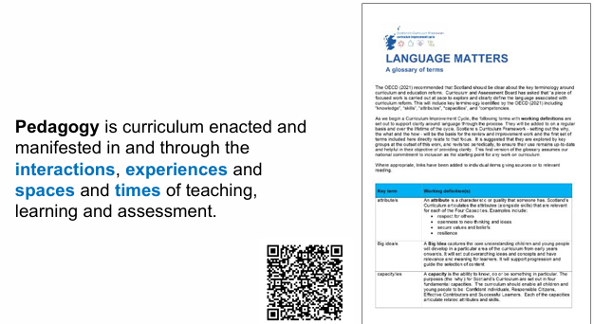
Notes:
Activity 1: Exploring the change
Suggested reflection / discussion :
What are the interactions, experiences, spaces and times in our current curriculum offer that serve our learners well and that we want to hold on to?
Are there interactions, experiences, spaces and times that we might want to strengthen as we evolve our curriculum over the next few years?

Slide 23
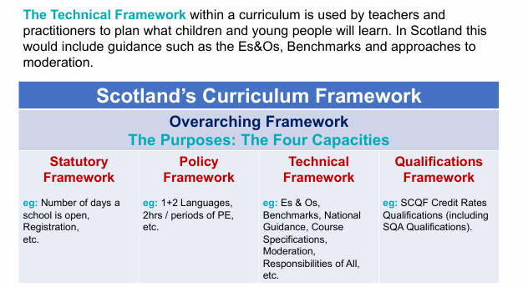
Notes:
Activity 1: Exploring the change
The current focus of the co-design work is on providing an updated technical framework.

Slide 24
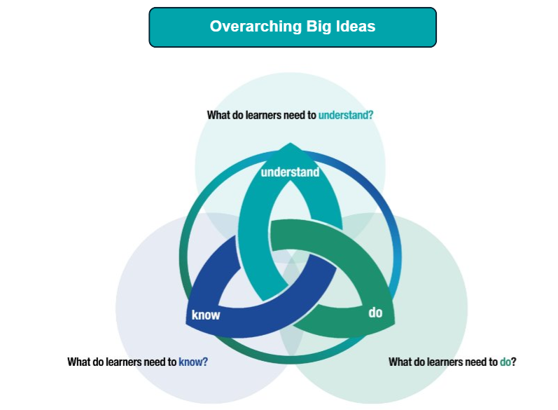
Scotland’s Big Ideas Model:
Know Do Understand (KDU)
Experiences and outcomes and
Benchmarks will be withdrawn
Notes:
Activity 1: Exploring the change
In this concept-based curriculum the experiences and outcomes and benchmarks are being replaced with the know do understand model.
The updated model will be explored in depth during Head Teacher / leader days in September and during in-service time in the autumn.
Samples are available now to give teachers and practitioners a sense of what the updated model will look like. (These are early samples and should not be used for planning).
The full draft framework will be available from September 2026 onwards so every educator in Scotland has the opportunity to provide feedback.

Slide 25
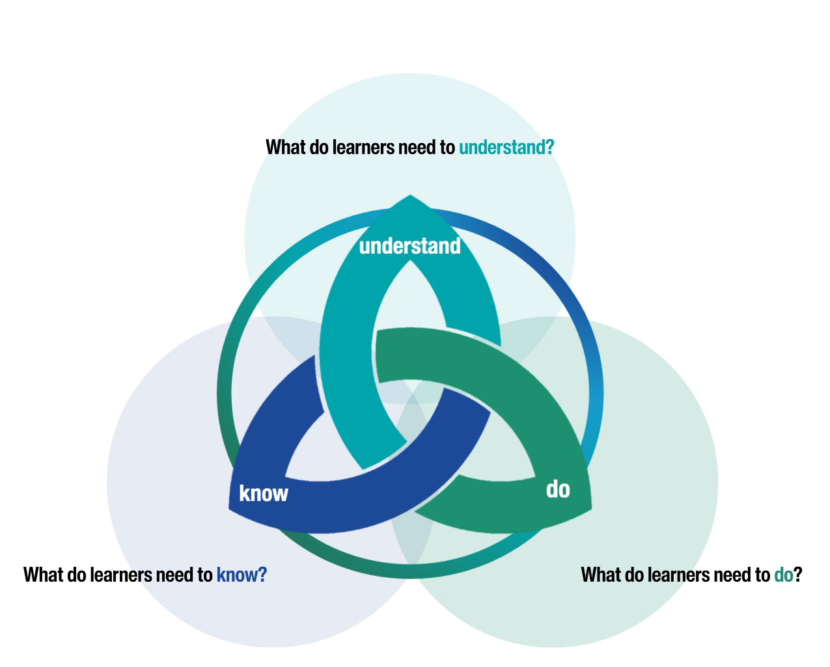
Overarching Big Ideas
Relationships between concepts…
Facts, definitions, examples…
Skills, Processes, Procedures, Strategies…
Notes:
Activity 1: Exploring the change
The Curriculum Improvement Cycle co-design groups first worked to identify Big Ideas - the overarching understanding for each of the curriculum areas.
They then worked to identify the key concepts in their curriculum areas that underpin those Big Ideas.
Understandings are concepts tied together with verbs. The verb states the nature of the relationship.
From these concepts, they set out what children, young people and adult learners would need to know and be able to do in order to develop a deep understanding.
What do learners need to understand?
What do learners need to know?
What do learners need to do?
The learning is organised in strands, allowing teachers and practitioners to see the progression clearly from Early to Fourth Level.
The image shows Scotland’s Know-Do-Understand model.

Slide 26
Some samples are available now
Choose a sample from a curriculum area and level that interests you.
Note: these samples are intended only to give practitioners a sense of what the updated curriculum model will be. They should not be used in planning.
The full KDU model will be shared in September and we we will have time to engage and give feedback.
Notes:
Activity 1: Exploring the change
See suggested think, pair, share prompts on the next slide.

Slide 27
Think, Pair & Share #1
5 mins individual reflection
8 -10 mins paired reflection
8 -10 mins group feedback
What might this look like in a classroom or setting you know?
What might a learner actually experience?
How might this need to adapt for a diverse range of learners?
Where might this need refinement?

Slide 28
The co-design process is still ongoing
De-cluttering and improving the position of ‘responsibilities of all’ and cross-curricular themes
Developing pedagogy and assessment approaches
Developing a holistic approach to Early level
Continuing to consider the wide range of ASN represented in schools and settings
Further exploration of the Know-Do-Understand model to plan learning for children with complex needs.
Work with Qualifications Scotland to develop the curriculum for the senior phase, ensuring a coherent 3-18 curriculum.
Notes:
Activity 1: Exploring the change
We are still in the co-creation phase.
All educators are encouraged to explore the draft materials over the autumn and to give feedback, to ensure that the updated curriculum is as strong as it can be.

Slide 29
Now we have explored together…
What feels familiar?
What feels new or significant?
What questions should we explore next?
Notes:
Activity 1: Exploring the change
As we draw towards the end of this session, it is worth taking a moment to revisit the initial questions and notice how you are feeling.
This feedback will support the further development of the practice guidance and support materials.

