Slide 1

These optional activities are produced nationally, and adaptable locally, to support the leadership of curriculum change in schools and settings.
Head teachers and leaders will have the opportunity to explore these during professional learning sessions in September 2026 and throughout the 2026/27 and 2027/28 sessions.
Facilitators may choose to use the presentation in its entirety or choose selected slides to use and /or adapt to suit local needs.
Facilitator notes offer suggestions of key points to emphasise or opportunities to link to recent local work where relevant.
Further activities will be co-designed over the enactment phase.
Notes:
Activity 2: Why? Purposes of curriculum
These optional activities are produced nationally, and adaptable locally, to support the leadership of curriculum change in schools and settings.
Head teachers and leaders will have the opportunity to explore these during professional learning sessions in September 2026 and throughout the 2026/27 and 2027/28 sessions.
Facilitators may choose to use the presentation in its entirety or choose selected slides to use and /or adapt to suit local needs.
Facilitator notes offer suggestions of key points to emphasise or opportunities to link to recent local work where relevant.
Further activities will be co-designed over the enactment phase.

Slide 2
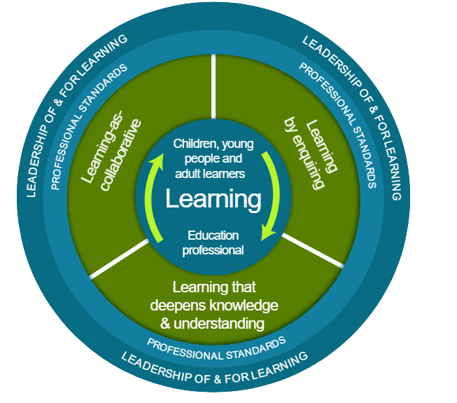
Ways of working together
  Learn from, with and on behalf of each other
  We create a safe space to share ideas
  We agree everyone is equal and valued
  We remain ‘in the room’
Notes:
Activity 2: Why? Purposes of curriculum
If you are using the material with groups of staff, these ways of working can support
Take a moment to establish group protocols.
Ask participants to comment on anything they would like to add or amend.
Is there anything that participants feel is missing or anything they would like to remove?
The protocols on the slide are suggestions to be amended for your context.
- Why establish group protocols
Effective professional learning goes beyond simply delivering information. It fosters a learning community where educators can learn with, from, and on behalf of one another. To achieve this, the facilitator of this learning should establish clear protocols and a positive learning environment at the outset. The general notes below will support the facilitator to help everyone feel comfortable participating and contribute to a rich learning experience.
1. Contract a Safe Space:
Co-create a Safe Space agreement with your group. This agreement outlines expectations for respectful communication and active listening. A safe space allows trust to flourish, fostering a collaborative environment where everyone feels comfortable sharing ideas and taking risks.
2. Shift from Top-Down to Collaborative Learning:
Move beyond the traditional model where one person imparts knowledge. Embrace a collaborative approach where all participants actively engage. This means learning with, from, and on behalf of one another. By leveraging the diverse perspectives within the group, gaining a richer understanding and creating a more impactful learning experience for everyone.
3. Holding the Ladder: Shared Expertise and Recognition
Holding the ladder signifies a two-fold approach:
Sharing Expertise: Those with experience can share their knowledge and insights.
Recognise Everyone's Contribution: Actively listen and be open to learning from the unique perspectives and experiences of colleagues. Build on each other's ideas to foster a collaborative environment where everyone feels valued, and their contributions are respected.
4. Hold Space for Silence and Respectful Discussion:
Hold space for silence after someone speaks or asks a question. It can be tempting to jump in to fill silence but allowing time for quiet can avoid interrupting thought and produce more thoughtful responses. Everyone deserves to be heard and understood.
Adapt the time allocation based on the size of the group and the complexity of the topic.
5. Schedule Regular Breaks:
Schedule regular breaks throughout the session. This allows participants to process information, refocus, and return with renewed energy, leading to a more productive learning experience.
6. Centre Learning in Real Life:
Connect the learning to real-life experiences by encouraging participants to share relevant personal anecdotes or applications. This strengthens understanding and makes the learning more relatable and impactful for all.

Slide 3

Curriculum Improvement Cycle
Activity 2: Why? Purposes of curriculum
Notes:
Activity 2: Why? Purposes of curriculum
This session focuses on Section 2 of the National Practice Guidance: Building Scotland's Curriculum which is currently in draft form.

Slide 4
Session aims
To support teams of teachers and practitioners to consider and build a shared understanding of the purposes of their curriculum offer
Notes:
Activity 2: Why? Purposes of curriculum
This connects with the draft practice guidance Building Scotland’s Curriculum Part 2: Why? Our Curriculum purposes.
2.1 The Four Capacities
2.2 Curriculum entitlements

Slide 5
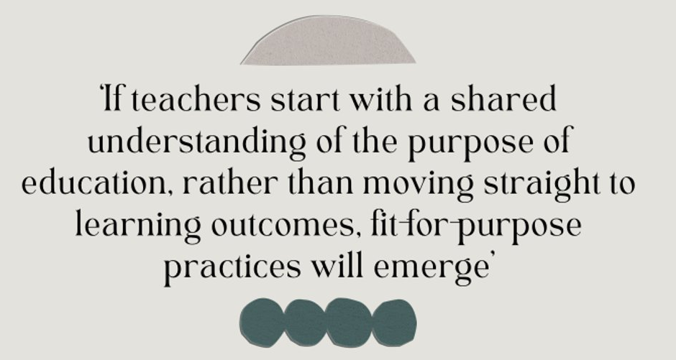
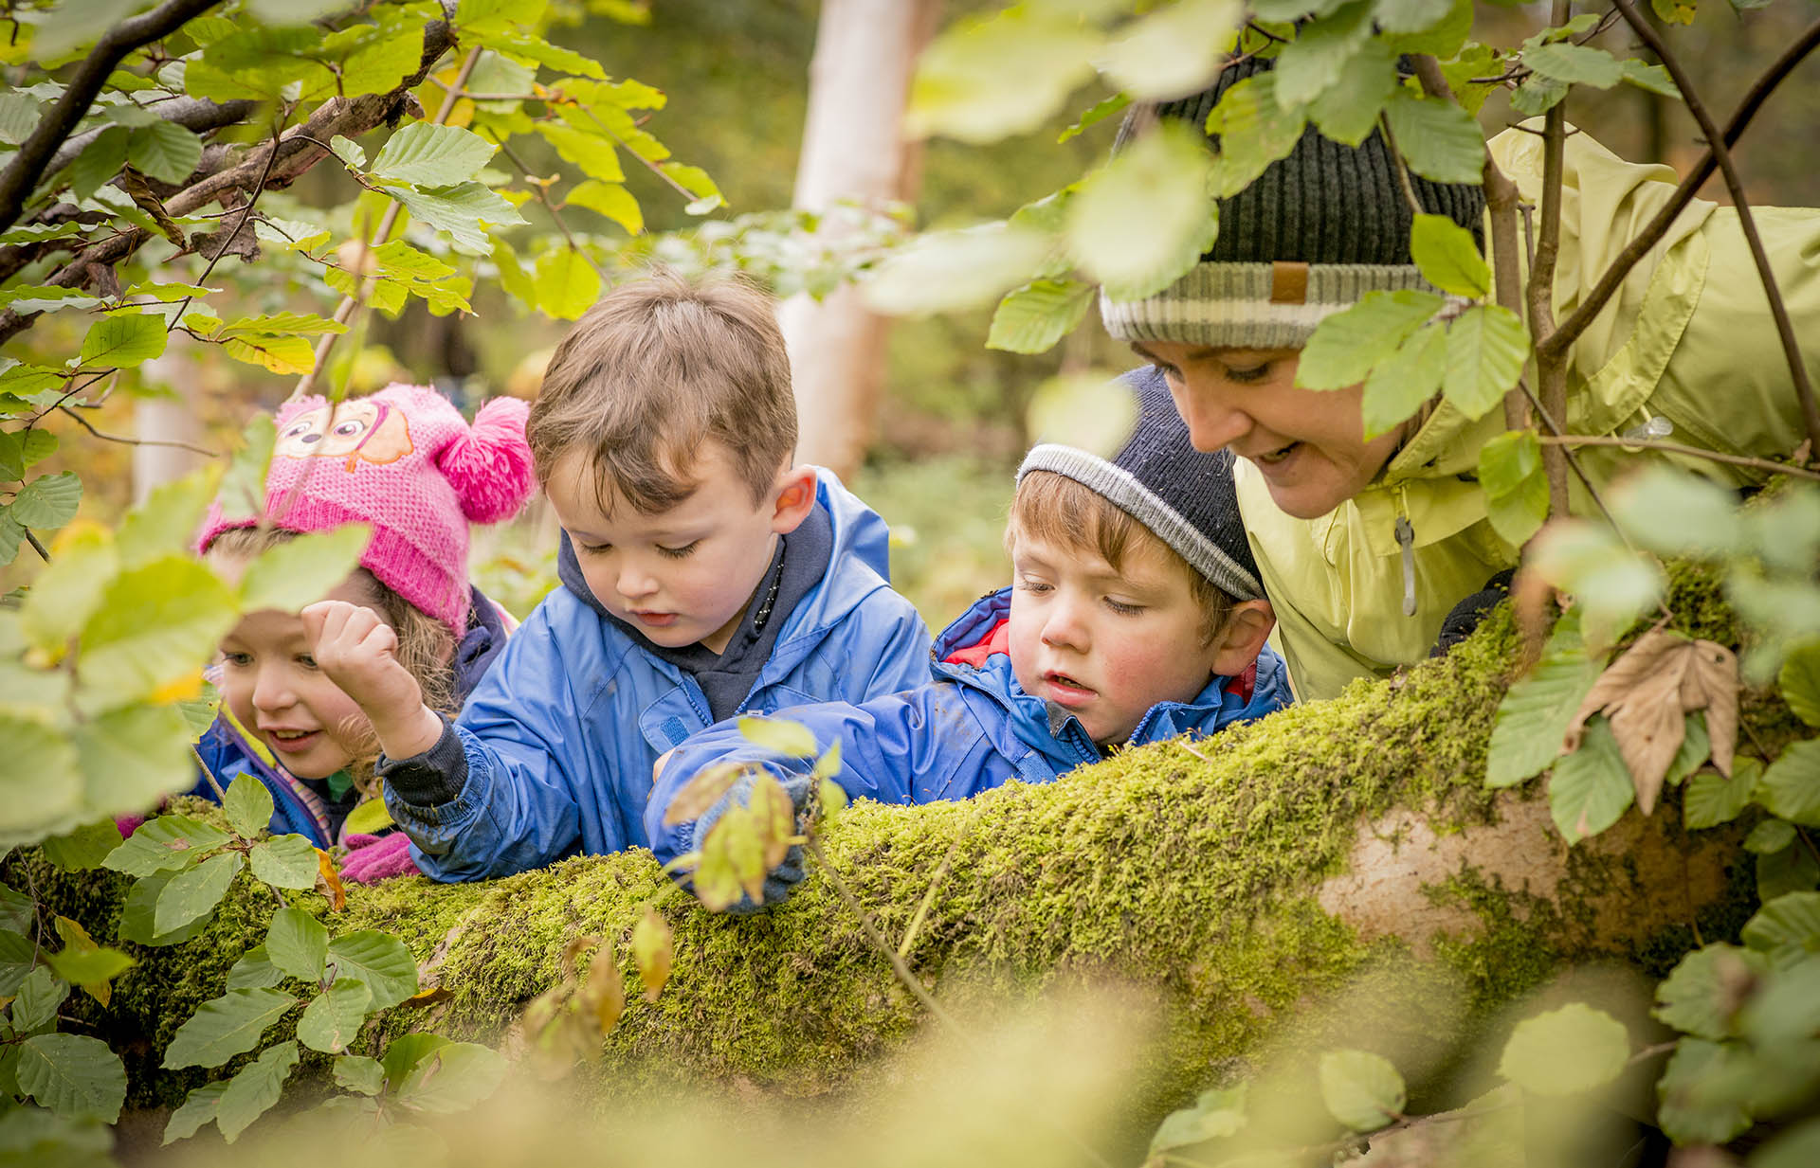
Why?
Scotland 2030: Future Schooling, Education and Learning (Scotland Futures Forum, 2020)
Notes:
Activity 2: Why? Purposes of curriculum
Suggested possible speaking points:
The CIC will require us to make many decisions over the coming years about the interactions, spaces and experiences we offer our learners, and about how we organise the time of learning
We need to spend time revisiting our purpose so we have a strong, shared understanding of why we educate, upon which to base all of our coming decisions and change
We will consider what is unique about our context here
Recent examples of how we have been purpose-led in our work in this school / setting / cluster

Slide 6
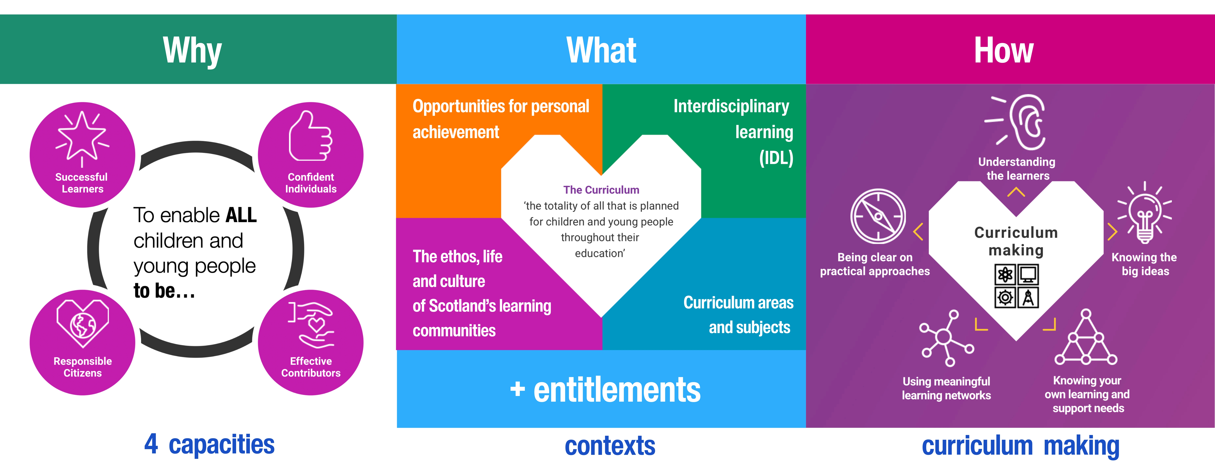
Scotland’s Curriculum Framework is remaining
www.scotlandscurriculum.scot
Notes:
Activity 2: Why? Purposes of curriculum
Suggested possible speaking points:
Scotland’s Curriculum Framework is staying – all parts of this will be strengthened by the CIC over the 10 years of our programme
Curriculum is a process in which educators explore questions of Why, then What and then How
We must resist the temptation to go straight into frameworks about the what, or fall into the “activity trap” of updating lots of folders before we have fully explored the change.
We must first explore and develop a shared understanding of our rationale for the change we will lead.
.

Slide 7
Why educate?
Notes:
Activity 2: Why? Purposes of curriculum
Invite participants to consider this questions. This could be a short think, pair, share, e.g. 2 minutes to discuss with your partner.

Slide 8
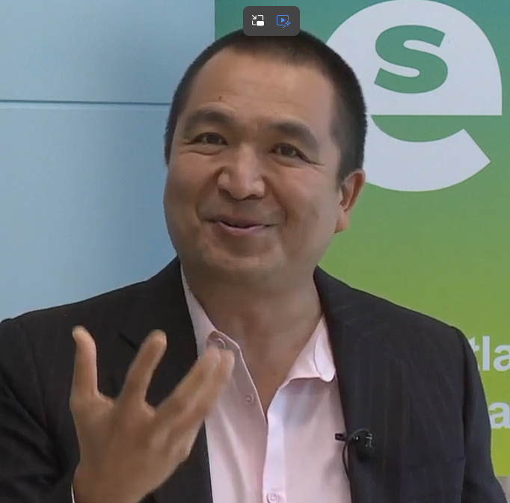
Video provocation option 1
Watch this 5 minute Why Educate? clip from Santiago Rincon Gallardo (10m:03s - 15m:36s)
As a group, discuss and agree on the 2-3 most important takeaways from the recording.
Notes:
Activity 2: Why? Purposes of curriculum
We are now going to zoom out and gain an international perspective of Scotland's purpose for education.
Dr. Santiago Rincón-Gallardo’s keynote at Scottish Learning Festival in 2023 and we are now going to listen to a clip from it.
Facilitator - This activity is most closely associated with section 2.1 of the draft guidance. This professional learning activity uses a 5 minute YouTube clip as a stimulus for discussion. The link should start the video at 10m 03s, but you will need to manually stop it at 15m 36s.
Facilitator – invite some groups to share their takeaways.

Slide 9
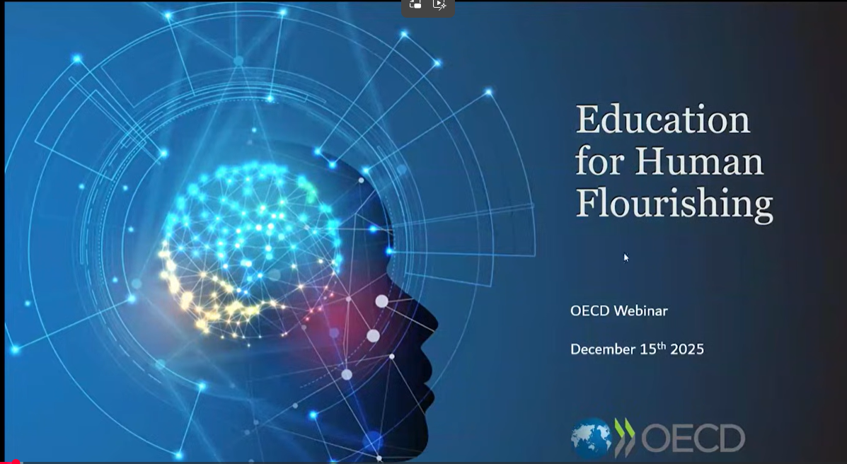
Video provocation option 2
Education for Human Flourishing – A professional learning activity based around an approx. 5 minute clip from an OECD webinar launching this report.
  Watch this 5 minute clip from the OECD webinar on education for human flourishing (2m:59s - 8m:15s)
Notes:
Activity 2: Why? Purposes of curriculum

Slide 10
Optional group discussion
Small group / pair discussion:
    What resonates?
    What’s challenging?
    Is there anything you disagree with?
    In what ways does this approach relate to the eleven themes of the cross-curricular exploration?
  Identify Key Points: As a group, discuss and agree on the 2-3 most important takeaways from your conversation.
  Sharing and Connecting: Representatives from the small groups share their key points with the whole staff.
  Facilitate a larger discussion: Look for common themes across the groups' findings. How do these connections reinforce the importance of the curriculum entitlements?
Notes:
SLIDE 15

Slide 11
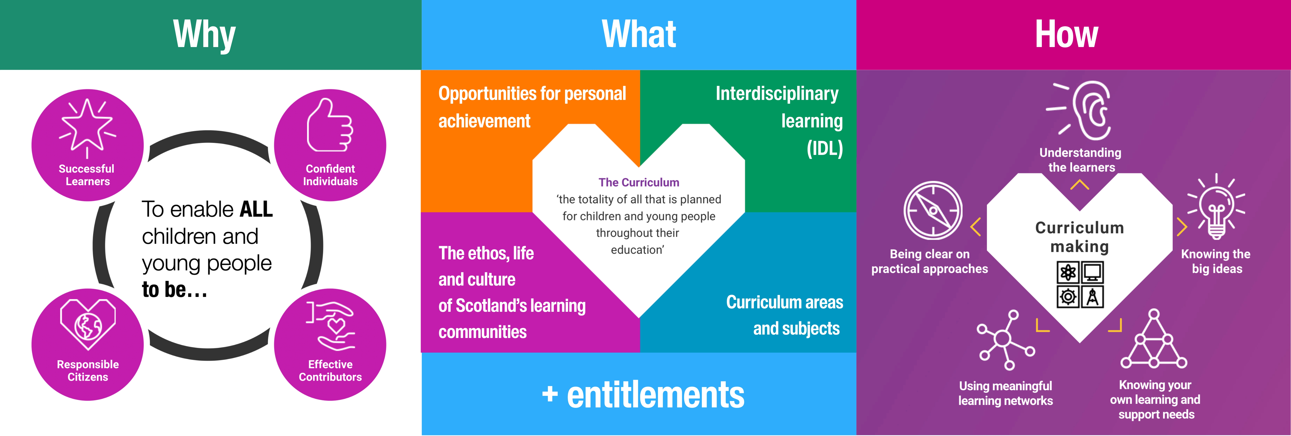
Our Why: The Four Capacities
In Scotland, the purposes of the curriculum are outlined in the four capacities. They are important for children and young people now as much as for any future world.
Notes:
Activity 2: Why? Purposes of curriculum
Possible / suggested speaking points:
The four capacities continue to outline the driving purpose of Scotland's curriculum both now and for the future.
Note the emphasis on “to enable all children and young people to be…” (not to become). This reinforces that ‘being me’ as an individual, a citizen, contributor and learner is important now, and not only about preparation for the future.
Updated statements have been developed to support teams to think about how their curriculum making created opportunities for children and young people to be, and to grow and develop, across the 4 capacities (like everything in the draft guidance, these statements are DRAFT, and feedback is welcomed)
The statements appear on the following four slides, or you might want to invite participants to read over section 2.1 of the draft guidance, before considering the provocations on slide 15

Slide 12
Our Why: The Four Capacities
Being Me: as a Confident Individual
Curriculum making in Scotland’s schools and education settings helps children and young people to understand themselves, to develop a sense of purpose, and foster belonging and the ability to navigate life with resilience and meaning.
Curriculum making supports children and young people to be reflective, emotionally aware and capable of using their personal values and beliefs to make choices that support their wellbeing and fulfilment over time, such as developing self-awareness and making informed decisions about careers and pathways and with money and finances.
Notes:
Activity 2: Why? Purposes of curriculum

Slide 13
Our Why: The Four Capacities
Being Me: as an Effective Contributor
Curriculum making in Scotland’s schools and education settings develops children and young people’s knowledge, skills and creativity to make a positive difference in their communities and in shared endeavour.
It helps them develop collaboration and an entrepreneurial mindset, modelling how varying and adapting behaviours can solve new problems or complex challenges in ethical ways. Curriculum making fosters the initiative to improve our world.
Notes:
Activity 2: Why? Purposes of curriculum

Slide 14
Our Why: The Four Capacities
Being Me: as a Responsible Citizen
Curriculum making in Scotland’s schools and education settings helps develop children and young people’s understanding of social justice, rights and equalities. It develops ethical awareness and responsibility towards others, society and the planet.
It helps them to understand how the world around them works locally, nationally and globally, through democratic values. The curriculum includes diverse perspectives, values fairness and supports thoughtful participation in civic life. It helps them to understand their status as rights holders and global citizens, and nurtures commitment to Learning for Sustainability.
Notes:
Activity 2: Why? Purposes of curriculum

Slide 15
Our Why: The Four Capacities
Being Me: as a Successful Learner
Curriculum making in Scotland’s schools and education settings helps develop children and young people’s curiosity, adaptability and motivation for lifelong learning, including continually evolving their digital skills.
It demonstrates how they can engage with complexity, deepen their understanding built on knowledge and skills acquired across curriculum areas and continue developing this in response to new opportunities. It supports children and young people to be well-informed and able to act in the world.
Notes:
Activity 2: Why? Purposes of curriculum

Slide 16
Section 2: Why? Our Purpose
The Four Capacities
In pairs or groups, discuss the following provocations then feedback a summary of your discussion.
Provocations:
To what extent do we have a shared understanding of the purposes of our curriculum?
Where are the opportunities across our curriculum to help children and young people develop as each of the four capacities?
Notes:
Activity 2: Why? Purposes of curriculum

Slide 17

Optional individual / group
reading activity
Read Section 2.1 of the draft guidance Building Scotland’s Curriculum
Discuss in groups
What feels familiar?
What feels new or significant?
What needs clarification?
Notes:
Activity 2: Why? Purposes of curriculum
We invite you to read Section 2.1 of the draft guidance individually and to consider the following three questions
What feels familiar?
What feels new or significant?
What needs clarification?
Facilitator - Ask groups to share a summary of their discussion with the wider room. Draw out thinking from the group around the key messages of equity, the changing world and the strengthened four capacities. Summaries of these are found on the next few slides.

Slide 18

Think about a child or young person in our setting who is not experiencing success all the time
Notes:
Activity 2: Why? Purposes of curriculum
This is an invitation to consider a particular child or young person that you know or work with.
Take a moment to think about how the current curriculum is working for them.
What is working for them?
What could be better?
Facilitator – pause to enable this reflection.
Facilitator – you may wish to invite some participants to share.
The reason for including this reflection is to support our thinking of the need to change to a future oriented curriculum that meets the needs of all of Scotland's learners.
As we go through today's session, we invite you to hold them in your thoughts as we explore the purpose of Scotland's curriculum.

Slide 19

Our Why: Equity and social justice
Scotland’s curriculum is commitment to equity and social justice. It has health and wellbeing at its core and a well-designed curriculum ensures that all children and young people, regardless of background or circumstance, will develop their understanding of the world and have access to the shared and coherent knowledge and skills that empowers them to question, analyse, innovate and solve complex challenges throughout their lives.
Notes:
Activity 2: Why? Purposes of curriculum
Scotland's curriculum is a commitment to equity and social justice.
This is our why, our purpose.
The starting point is always why.
When we’re designing learning, we have to ask: whose needs are we centring? Whose experiences are reflected—and whose are missing?
Because if we don’t ask that question explicitly, we tend to design for the ‘imagined average learner’—and we know that learner doesn’t actually exist.
Equity starts by making the full diversity of our learners visible in our thinking.

Slide 20

Our Why: The changing world
Environmental, economic and social trends are placing increasingly complex demands on our young people. They are expected to participate confidently in a world facing sustainability challenges, rapid technological change and growing concerns about social cohesion.
Notes:
Activity 2: Why? Purposes of curriculum
We are currently seeing the effects of climate change, food insecurity and the rapid rise of AI in our daily lives in addition to many other challenges. We know these pressures impact our children and young people's health and wellbeing.
A future oriented curriculum must take account of the increasingly complex demands on our children and young people. This is our why, our purpose.

Slide 21
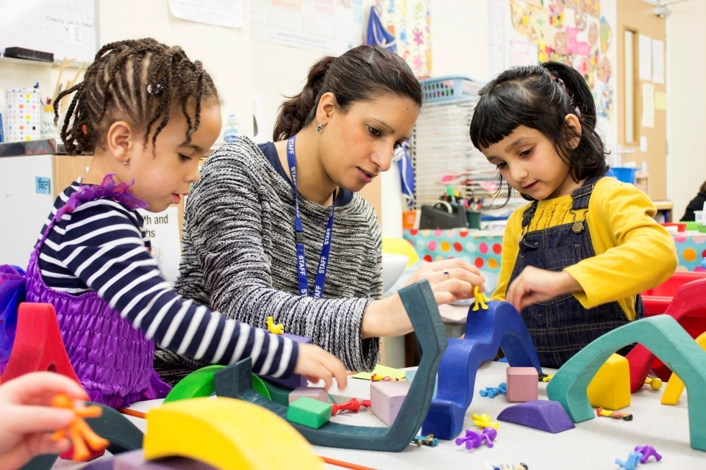

All children and young people are entitled
to a continuous and coherent educational experience from 3 -18
Notes:
Activity 2: Why? Purposes of curriculum
Now that we have explored our overall purpose, we are going to spend a little time reminding ourselves what children and young people are entitled to in their curriculum – their entitlements.

Slide 22
Curriculum Entitlements
For many, this will be a typical journey from Early Learning and Childcare, to primary and then secondary school. Some children and young people will progress through their learning at different stages, for example with ASN milestones, or remaining within one level in one or more curriculum areas for longer periods of time.
3-18 Entitlements
Including skills, responsibilities of all and learning for sustainability
Notes:
Activity 2
Slide 14
Facilitator – read out the text on the screen
When it comes to entitlements, for many, this will be a typical journey from Early Learning and Childcare, to primary and then secondary school. Some children and young people will progress through their learning at different stages, for example with ASN milestones, or remaining within one level in one or more curriculum areas for longer periods of time.
We know that the atypical development of some learners with complex additional support needs means that they will not always progress through their learning in a linear or straightforward way. Throughout the 3-18 learner journey, there is a strong emphasis on opportunities for individuals to achieve and to develop an understanding of their own skills, strengths, interests, and the possibilities that lie before them.
This reinforces for us that the curriculum is about stage not necessarily age.

Slide 23

EARLY LEARNING & CHILDCARE
3-18 Entitlements
Including skills, responsibilities of all and learning for sustainability
Notes:
Activity 2: Why? Purposes of curriculum
Through nurturing, play-based and developmentally appropriate practices, children build the foundations for curiosity, communication, wellbeing and lifelong learning.

Slide 24
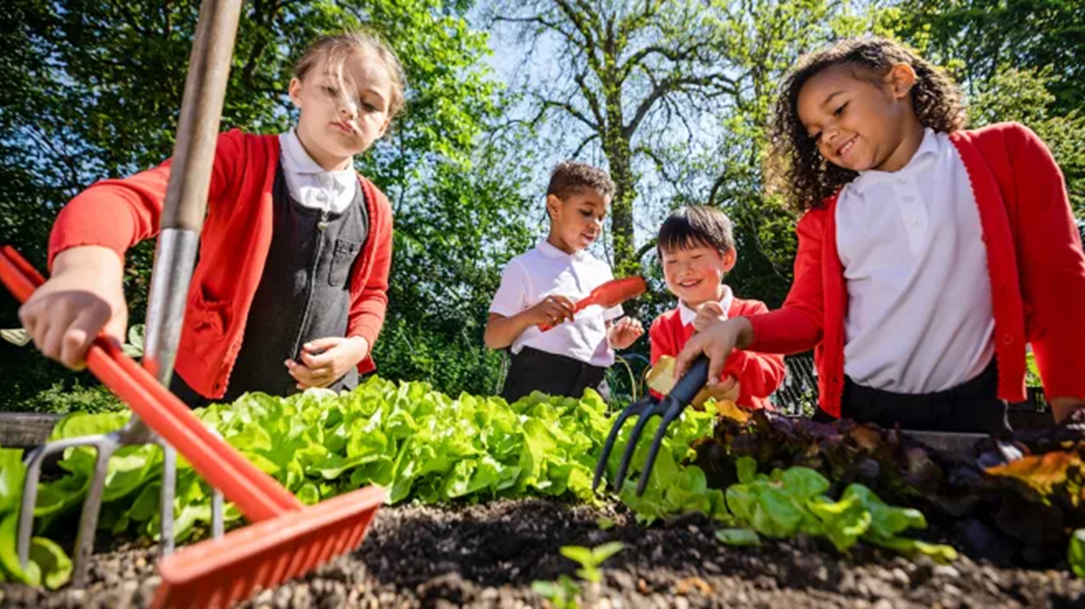
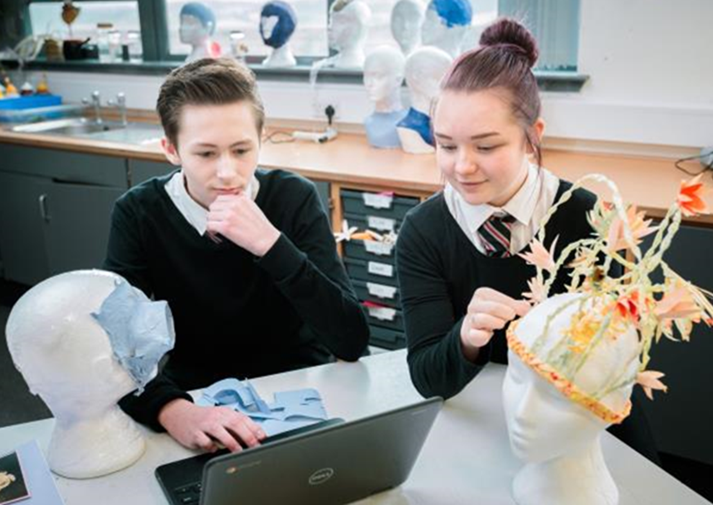
EARLY LEARNING &
CHILDCARE
P1-P7
S1-S3
3-18 Entitlements
Including skills, responsibilities of all and learning for sustainability
Notes:
Activity 2: Why? Purposes of curriculum
As the broad general education (BGE) continues, children are offered experiences of learning across the four contexts of learning to support their development as individuals, contributors, citizens and learners. This breadth allows children and young people to develop knowledge, skills and understanding to guide their interest, enabling them to make informed choices when they begin the senior phase.

Slide 25
EARLY LEARNING &
CHILDCARE
P1-P7
S1-S3
SENIOR PHASE
3-18 Entitlements
Including skills, responsibilities of all and learning for sustainability
Notes:
Activity 2: Why? Purposes of curriculum
The senior phase should continue to offer learning across the different contexts and contribute to the development of the four capacities. It includes personalised pathways and the opportunity to achieve a portfolio of qualifications across the three-year span, including interdisciplinary project-based learning. These programmes of learning may include SCQF-rated qualifications, Qualifications Scotland national courses, a range of technical and vocational qualifications, industry and sector-led qualifications and achievement awards.

Slide 26
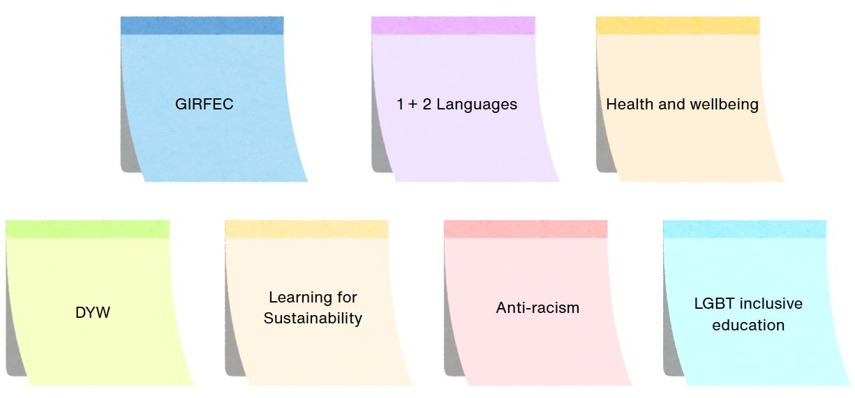
Section 2.2: Policy requirements
Notes:
Activity 2: Why? Purposes of curriculum
Curriculum making must consider these policy commitments. CIC groups are taking account of these if you want to read more please read here Legislation | Education Policy and Legislation | Policies and information | About Education Scotland | Education Scotland

Slide 27
Section 2: Why? Our Purpose
2.2 The curriculum entitlements
In pairs or groups, discuss the following provocations then feedback a summary of your discussion.
Provocations:
Why are some non-negotiables necessary for curriculum making?
To what extent does the curriculum experienced by children and young people in our school/setting reflect what is intended in the curriculum entitlements? How do we know?
Notes:
Activity 2: Why? Purposes of curriculum
Ask participants to discuss the provocations in small groups and then feedback a summary of their discussion.

Slide 28
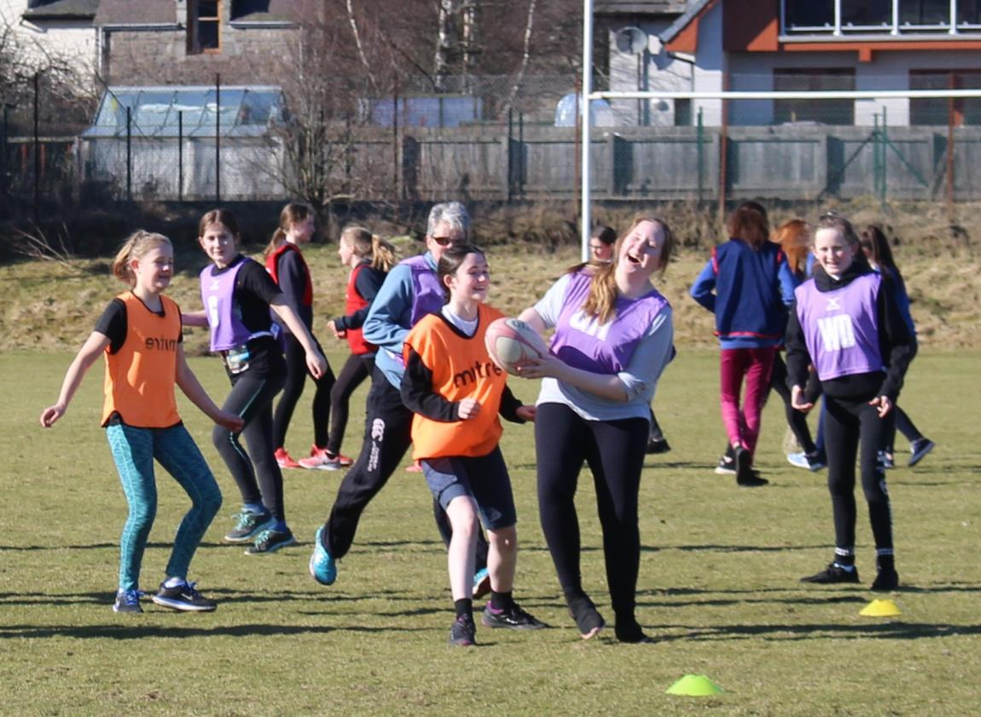

If equity is about removing barriers to opportunity, curriculum is where those opportunities are designed
- or denied.
Notes:
Activity 2: Why? Purposes of curriculum
In Scotland we have the opportunity to design what is right for our children and young people.
Facilitator – pause for a moment then say the words on the screen:
If equity is about removing barriers to opportunity, curriculum is where those opportunities are designed - or denied.

Slide 29
Curriculum is where these opportunities can be designed or denied – it is up to all of us.
Think back to the child or young person you identified.
Which aspects of our current curriculum offer strengthen opportunities?
Which aspects of our curriculum offer might we consider strengthening ?
Notes:
Activity 2: Why? Purposes of curriculum
Take a moment to think about that and jot down a few reflections.
Facilitators may use this slide as a prompt for a short discussion on its own, or for an introduction to a SWOT analysis, using the next slide.

Slide 30
What’s strong?
What’s wrong?
What do we want to innovate, enhance or improve?
What are the barriers & challenges?
Notes:
Activity 2: Why? Purposes of curriculum
Use this slide, alongside A3 or flipchart grids to support a discussion in groups on:
What is strong about our current curriculum offer? (The aspects of our offer that really develop the four capacities or extend opportunities for our learners)
What are the aspects of our curriculum offer that no longer seem as relevant, or as helpful in our aims
What might we want to innovate, enhance or improve?
What will get in our way?
This could be part of a full staff session used as a “follow-up” task by senior or middle leadership teams, stage partners., or in departments / faculties.

Slide 31
What does all this mean for us?
What have we already been working on that will help with our readiness for change?
What else might be important to start considering?
Who can help our thinking?
What is our next step as a team?
What do we need, as individuals and a team, to take that step?
Notes:
Optional Activity
Slide 1
Either as part of a session using the earlier slides, and / or following any of the activities above, hold a space for leadership team and / or teacher and practitioner colleagues to explore what this means for our setting.
Point back to emotional readiness, cognitive readiness and behavioural readiness
OPTIONAL activities which may support or scaffold current work around curriculum design at school / setting level and / or inform thinking about preparation for next year.
This is where we shift from understanding to application
Encourage practical thinking:
What are we already doing well?
What might need to shift?
What are our next steps?
Keep expectations realistic, this is early thinking

