Slide 1




Leading Change
Note for Facilitators
Cognitive Readiness
Understanding the need for change
Emotional Readiness
Feeling safe and supported in the process
Behavioural Readiness
Being prepared to act or implement change
Armenakis et al. (1993); Fullan (2007)
Notes:
Facilitator Notes – Pre-reading
This is not part of the presentation, rather something to consider as a facilitator.
We have two years to prepare (for formal adoption from August 2028 onwards)
Fullan: 3 aspects of leading change, it is important to consider our own, and others:
Cognitive Readiness
Understanding the need for change
Emotional Readiness
Feeling safe and supported in the process
Behavioural Readiness
Being prepared to act or implement change

Slide 2
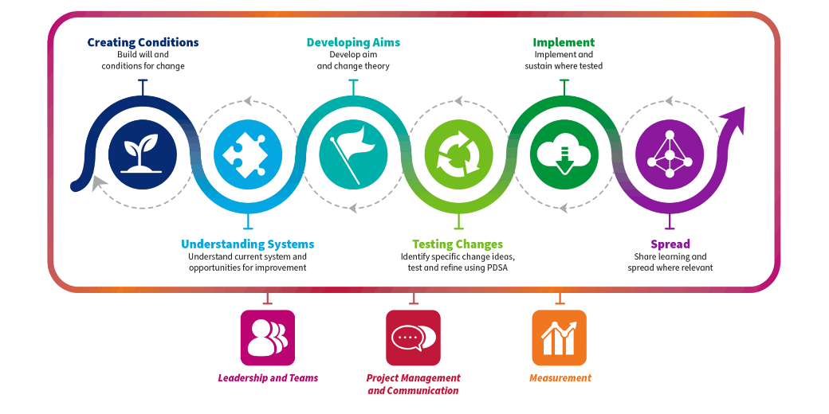
Leading Change
Note for Facilitators
The Quality Improvement Journey
Notes:
Facilitator Notes – Pre-reading
As the facilitator, it is important that you are Creating the Conditions for Change.
Taking the time to create the conditions for change helps provide a springboard for action and build a strong foundation for establishing sustained improvement.
The diagram on the screen outlines the Quality Improvement Journey.
More information about the Quality Improvement Journey can be found here:
Quality Improvement journey | Turas | Learn
Creating conditions | Turas | Learn

Slide 3



A CLD Perspective:
Understanding the Curriculum Improvement Cycle – Session 1
Notes:
A CLD Perspective: Understanding the Curriculum Improvement Cycle
Introduction
CLD is different to formal education, with its own distinct set of values, ethics and competencies. CLD is a voluntary, learner-centred approach, where programmes are developed through dialogue and shaped by the goals of individuals and communities. We recognise that CLD motivates people to be lifelong learners, contributors, citizens and individuals. We will look at how this has been reflected in Curriculum guidance.
The Scottish Government has instructed Education Scotland to lead on a systematic review of Scotland’s Curriculum. This is called the Curriculum Improvement Cycle (CIC).
There has been some very valuable involvement by CLD stakeholders in the Curriculum Improvement Cycle (CIC) work so far and we are keen to support wider involvement from CLD practitioners and learners in CIC projects as they develop.

Slide 4
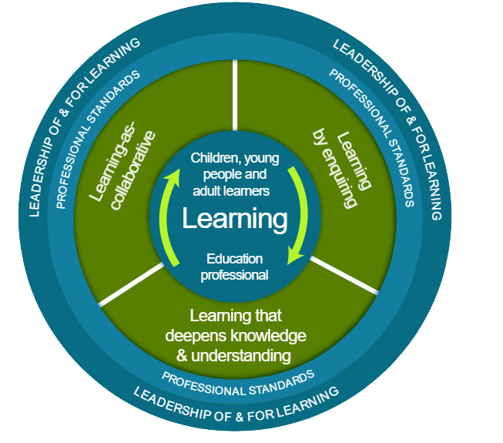

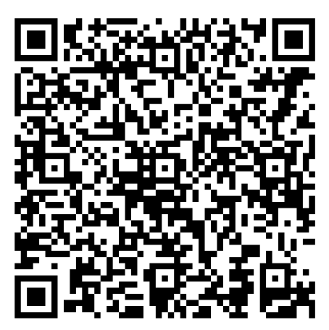
National Model of Professional Learning
Notes:
National Model of Professional Learning
Facilitator Notes: Introduce the National Model of Professional Learning
As educators, we engage in professional learning to stimulate our thinking, deepen our understanding, and enhance our practice. The Curriculum Improvement Cycle (CIC) will impact every learner in Scotland. By actively engaging in professional learning at this early stage we can ensure that we develop a fuller understanding of the CIC process and outcomes and that we advocate for our learners at every stage. By taking an enquiring stance as we engage with CIC, by considering the opportunities to develop our curriculum and pedagogical practices we will directly and positively impact learners.
The National Model of Professional Learning supports this by outlining the key principles and features of effective professional learning, helping us build capacity and foster collaborative approaches across our settings. The model encourages us to be critically informed and responsive to current educational contexts, ensuring our practice remains relevant and impactful.
Explore the model further here:
The national model of professional learning | National approach to professional learning | Professional Learning | Education Scotland

Slide 5
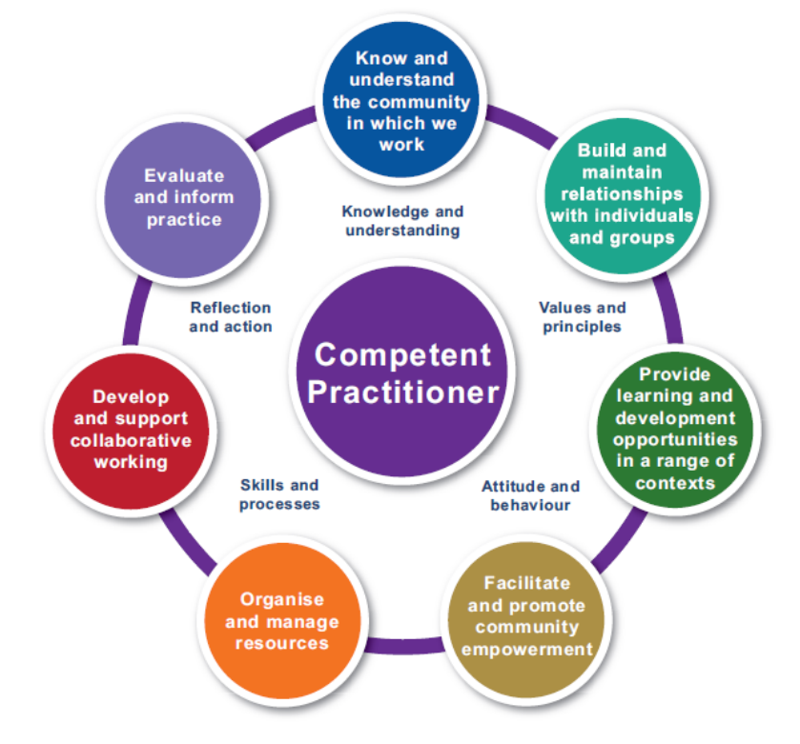


CLD Competencies and Ethics
It is important to know and understand the community in which we work – and consider how the Curriculum Improvement Cycle influences and impacts upon communities.
Participating in this training can be recorded towards Professional Learning time, which can contribute to the 35 hours per year (pro rata) required for membership of the CLD Standards Council, another professional body, or your own learning and development plan.
When recording your professional learning you may wish to reflect on your development from this session in relation to the relevant CLD Competences and CLD Ethics.
For more information CLD Standards Council,
please visit https://cldstandardscouncil.org.uk/
Notes:
Connecting to CLD Competencies and Ethics
Facilitator Notes: Highlight the CLD competent practitioner framework.
As competent CLD leaders and practitioners, It is important to know and understand the community in which we work – and consider how the Curriculum Improvement Cycle influences and impacts upon individuals and communities that we work with.
For more information CLD Standards Council, please visit https://cldstandardscouncil.org.uk/

Slide 6

Ways of working together
  We all work together
  We learn from, with and on behalf of each other
  We create a safe space to share ideas and build learning
  We agree that everyone is an equal and valued participant
  We remain ‘in the room’
Notes:
Ways of working together
Facilitator Notes & Key Messages
Take a moment to establish group protocols.
Ask participants to comment on anything they would like to add or amend.
Is there anything that participants feel is missing or anything they would like to remove?
The protocols on the slide are suggestions to be amended for your context.
- Why establish group protocols
Effective professional learning goes beyond simply delivering information. It fosters a learning community where educators can learn with, from, and on behalf of one another. To achieve this, the facilitator of this learning should establish clear protocols and a positive learning environment at the outset. The general notes below will support the facilitator to help everyone feel comfortable participating and contribute to a rich learning experience.
1. Contract a Safe Space:
Co-create a Safe Space agreement with your group. This agreement outlines expectations for respectful communication and active listening. A safe space allows trust to flourish, fostering a collaborative environment where everyone feels comfortable sharing ideas and taking risks.
2. Shift from Top-Down to Collaborative Learning:
Move beyond the traditional model where one person imparts knowledge. Embrace a collaborative approach where all participants actively engage. This means learning with, from, and on behalf of one another. By leveraging the diverse perspectives within the group, gaining a richer understanding and creating a more impactful learning experience for everyone.
3. Holding the Ladder: Shared Expertise and Recognition
Holding the ladder signifies a two-fold approach:
Sharing Expertise: Those with experience can share their knowledge and insights.
Recognise Everyone's Contribution: Actively listen and be open to learning from the unique perspectives and experiences of colleagues. Build on each other's ideas to foster a collaborative environment where everyone feels valued, and their contributions are respected.
4. Hold Space for Silence and Respectful Discussion:
Hold space for silence after someone speaks or asks a question. It can be tempting to jump in to fill silence but allowing time for quiet can avoid interrupting thought and produce more thoughtful responses. Everyone deserves to be heard and understood.
Adapt the time allocation based on the size of the group and the complexity of the topic.
5. Schedule Regular Breaks:
Schedule regular breaks throughout the session. This allows participants to process information, refocus, and return with renewed energy, leading to a more productive learning experience.
6. Centre Learning in Real Life:
Connect the learning to real-life experiences by encouraging participants to share relevant personal anecdotes or applications. This strengthens understanding and makes the learning more relatable and impactful for all.

Slide 7

Session Aims
This session aims to provide opportunities for CLD stakeholders to:
Explore the contributions and impacts of Community Learning & Development (CLD) to Scotland’s Curriculum
Develop an understanding of the Curriculum Improvement Cycle (CIC)
Consider how CLD stakeholders can be involved in the CIC
Notes:
Session Aims
This session is designed to give a brief overview of the Curriculum Improvement Cycle (CIC) and aims to provide opportunities for CLD stakeholders to:
Explore the contributions and impacts of Community Learning & Development (CLD) to Scotland’s Curriculum
Develop an understanding of the Curriculum Improvement Cycle (CIC)
Consider how CLD stakeholders can get involved in shaping the CIC

Slide 8

Connector
In groups or pairs discuss:
1. Recent feedback from CLD stakeholders said that the CLD sector is “essential to making Scotland’s Curriculum more inclusive and relevant” – what do you think?
2. Consider what Scotland’s Curriculum means in your context.
Notes:
Connector Activity
This is an example of a simple connector activity. It is recommended that facilitators use a connector activity that allows participants to take part in an informal discussion.
This is to ensure that participants are relaxed, focused and ready for an interactive workshop.
Depending on the group, as a group or in pairs discuss:
Recent feedback from CLD stakeholders said that the CLD sector is “essential to making Scotland’s Curriculum more inclusive and relevant” - what do you think?
Consider what Scotland’s Curriculum means in your context.

Slide 9
Discussion Activity: Curriculum
Discuss in pairs or groups what curriculum means to you in a CLD context.
You may wish to discuss this quote from Learning: For All. For Life. The Independent Review of CLD (2024) which stated that:
“There is no ‘CLD curriculum’ as such, and every learner’s journey starts from where the learner finds themselves, rather than having set expectations about the level of prior learning or experience required to engage in new learning. The course of the journey is largely determined by the learner, as is the pace.”
Page 12 - Learning for All for Life
Notes:
Discussion Activity: Curriculum
There are many definitions and interpretations of the word curriculum. Discuss as a group, or in pairs what it means in a CLD context.
You may wish to spend time discussing this quote from Learning: For All. For Life. The Independent Review of CLD (2024) and encourage debate.
“There is no ‘CLD curriculum’ as such, and every learner’s journey starts from where the learner finds themselves, rather than having set expectations about the level of prior learning or experience required to engage in new learning. The course of the journey is largely determined by the learner, as is the pace.”
Page 12 - Learning for All for Life

Slide 10
Discussion Activity: Curriculum
The Curriculum Improvement Cycle uses this working definition of curriculum.
How does this connect to your discussions about curriculum in a CLD context?
“Curriculum in Scotland is defined as the totality of all that is planned and enacted for children and young people from early learning and childcare, through school and beyond. That totality is shaped by the purpose (the ’why’) set out in the four capacities and a set of entitlements and can be planned for and experienced by learners across four contexts ( the ‘what’): opportunities for personal achievement; the ethos and life of the school/setting as a community (and with its community); curriculum areas and subjects and interdisciplinary learning.”
Terminology – Curriculum Improvement Cycle
Notes:
Discussion Activity: Curriculum
Follow on with discussions from the previous activity on the meaning of ‘curriculum’.
Discuss in pairs or in a group how this working definition from the Curriculum Improvement Cycle connects with a CLD context and contrasts with the quote on the previous slide.
Terminology – Curriculum Improvement Cycle

Slide 11

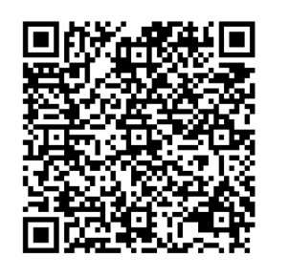
Language Matters
The OECD Report (2021) recommended that Scotland should be clear about the key terminology around curriculum and education reform.
Language Matters is a glossary of terms to define the language associated with curriculum reform. It is intended that this glossary will develop as time goes on. It can be accessed here: Language Matters
Notes:
Language Matters
The OECD (2021) recommended that Scotland should be clear about the key terminology around curriculum and education reform.
You may wish to spend some time reading and discussing the Language Matters paper.
Language Matters is a glossary of terms to define the language associated with curriculum reform. It is intended that this glossary will develop as time goes on.
The paper includes definitions for terms including:
attribute/s; Big idea/s; capacity/ies; concept; curriculum; curriculum design; curriculum making; inter-disciplinary learning (IDL); knowledge; pedagogy; Scotland’s Curriculum Framework; service design; skill(s) and technical framework.
Language-Matters_Final_May_2025.pdf

Slide 12


Scotland's Curriculum: Some Background
Notes:
Curriculum for Excellence
Scotland's Curriculum for Excellence is the national curriculum in Scotland for learners ages 3–18. This is the focus of the Curriculum Improvement Cycle.
The aims of CfE were first set out in 2004 and began to be rolled out in schools in 2010-11.
The purpose of CfE is to help children and young people gain the knowledge, skills and attributes needed for life in the 21st century.
Curriculum for Excellence aimed to place learners at the heart of education. At its centre are four fundamental capacities. These capacities reflect and recognise the lifelong nature of education and learning. The four capacities are aimed at helping children and young people to become:
Successful learners
Confident individuals
Responsible citizens
Effective contributors
A refreshed narrative on Scotland's curriculum, which set CfE within an updated context, was published in September 2019 and hosted on a dedicated microsite. It re-states the purpose (‘why?’) in the four capacities and the relevance of the four contexts to enable the ‘what’. The key elements for curriculum making were identified in a new section to support the ‘how’. Since then, we have referred to 'Scotland's Curriculum' or 'Scotland's Curriculum for Excellence'

Slide 13
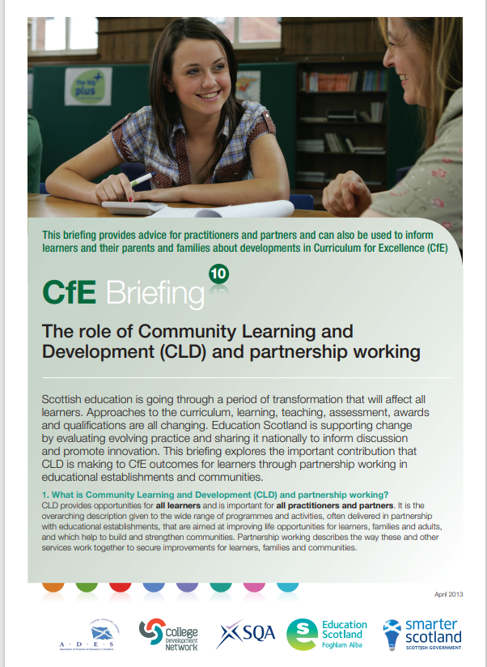
Scotland's Curriculum and CLD
'Community Learning and Development and the youth work sector have a significant role to play in Curriculum for Excellence (CfE). They are important delivery partners, offering young people valuable opportunities for learning and personal development, both in and out of school.'
Curriculum for Excellence Briefing 10: The role of Community Learning and Development and partnership working, 2013
Notes:
Scotland’s Curriculum and CLD
A key message from the beginning of Curriculum for Excellence has been that partnerships are key to making the it work. School can't fully realise the curriculum on their own. CLD has long been identified as a key partner - in national curriculum guidance, if not always in practice.
You may wish to send time discussing this quote: 'Community Learning and Development and the youth work sector have a significant role to play in Curriculum for Excellence (CfE). They are important delivery partners, offering young people valuable opportunities for learning and personal development, both in and out of school.’
Furthermore, these two quotes highlight the importance of partnerships from Our ambitions for improving the life chances of young people in Scotland: National Youth Work Strategy 2014-2019
'Curriculum for Excellence has supported and enhanced these opportunities for further partnership working'
'Strengthening partnerships between school staff and youth work practitioners remains a priority for Curriculum for Excellence programme, particularly within the planning and delivery of the senior phase.'

Slide 14
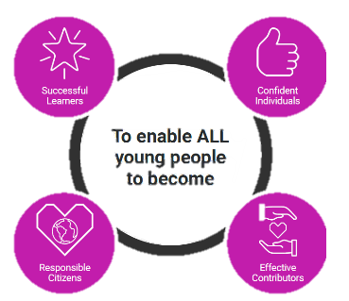
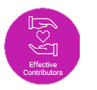
Scotland’s Curriculum Framework
why
At the centre of Scotland's Curriculum are four fundamental capacities which reflect and recognise:
The lifelong nature of education and learning.
The need for all children and young people to know themselves as individuals and to develop their relationships with others, in families and in communities
The knowledge, skills and attributes that children and young people need to acquire to thrive in our interconnected, digital and rapidly changing world
The role of children and young people as democratic citizens and active shapers of that world
To enable ALL
young people
to be…
www.scotlandscurriculum.scot
Notes:
Scotland’s Curriculum Framework
This slide focuses on the ‘why’ of the curriculum – this is not changing as part of CIC.
The Four Capacities (see image on slide) have been consistently commended in research and consultation on Scotland’s Curriculum in recent years and will continue to define our core purpose, or ‘Why’.
At the centre of Scotland's Curriculum are four fundamental capacities which reflect and recognise:
The lifelong nature of education and learning.
The need for all children and young people to know themselves as individuals and to develop their relationships with others, in families and in communities
The knowledge, skills and attributes that children and young people need to acquire to thrive in our interconnected, digital and rapidly changing world
The role of children and young people as democratic citizens and active shapers of that world

Slide 15

Scotland’s Curriculum Framework
what
+ entitlements
Curriculum is defined as the totality of all that is planned for children and young people from early learning and childcare, through school and beyond.
That totality can be planned for and experienced by learners across four contexts.
Opportunities for personal achievement
Interdisciplinary learning
Ethos and life of the school as a community
Curriculum areas and subjects
www.scotlandscurriculum.scot
Notes:
Scotland’s Curriculum Framework
This slide focuses on the ‘what’ of the curriculum – the totality of all that is planned for children and young people throughout their education.
The Four Contexts for Learning – the ‘What’ – which teachers and practitioners use to plan learning, will also remain in place and be strengthened.
The totality can be planned and experienced across the four contexts;
Opportunities for personal achievement
Interdisciplinary learning
Ethos and life of the school as a community
Curriculum areas and subjects

Slide 16
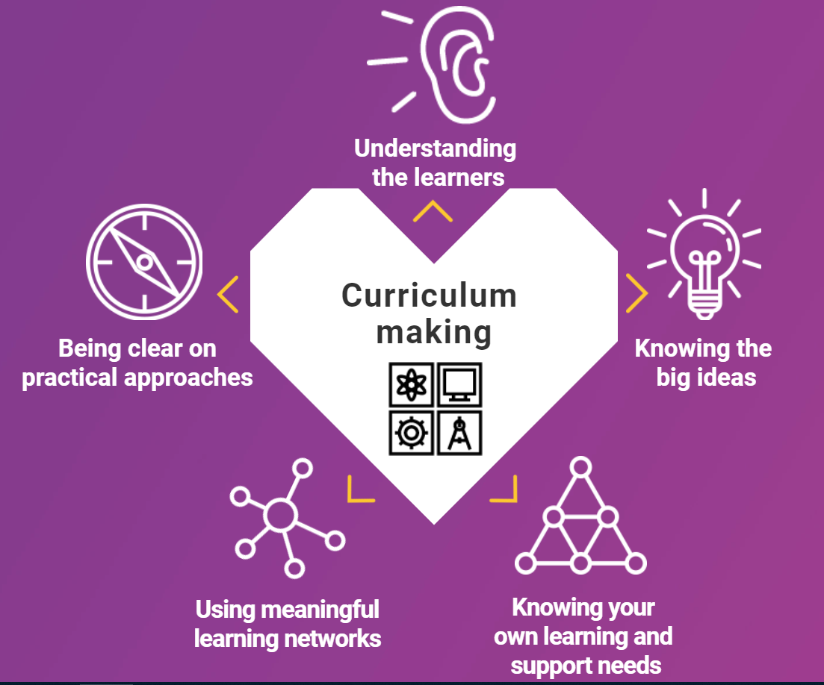
Scotland’s Curriculum Framework
how
Curriculum making includes:
Understanding the learners
Knowing the big ideas
Using meaningful learning networks
Knowing your own learning and support needs
Being clear on practical approaches
www.scotlandscurriculum.scot
Notes:
Scotland’s Curriculum Framework
This slide focuses on the ‘how’ of the curriculum.
Scotland’s Curriculum Making model – the ‘How’ – will also continue and will provide the foundation for the professional learning and capacity building planned, for 2026/27 and 2027/28, to support the enactment of the refreshed curriculum.
Understanding the learners
• Knowing children and young people and where they are on their individual learner journeys
• Listening to learners and being informed by their motivations and aspirations
• Empowering learners to have agency in their learning with opportunities for personalisation
• Using observations, assessments and feedback to design and develop the learning
Knowing the big ideas
• Maximising opportunities that develop the four capacities for learners, making clear links to future skills, for example meta-skills
• Understanding and sharing the pleasure and benefits that come from learning
• Being clear on the knowledge and skills that underpin individual curriculum areas
• Being informed by shared vision, values and aims, locally and nationally
• Understanding drivers for improvement and how they align at national and local levels
• Being responsible for the development of literacy, numeracy and health and wellbeing across the whole curriculum for all learners. This includes digital literacy skills
Being clear on practical approaches
• Having clear strategies for delivering excellence and equity for learners
• Agreeing the pedagogies that are best for purpose and the development needs of learners
• Reviewing and refining the curriculum against the seven design principles.
• Ensuring learners have clear progression pathways
• Making clear links between learning and the world of work
• Embedding Creativity and Learning for Sustainability in curriculum design
• Using knowledge of the local community and robust data to inform the curriculum offer
• Articulating and sharing curriculum rationale and narrative
Using meaningful learning networks
• Planning, enquiring and reflecting with other practitioners to optimise impact
• Collaborating with parents, carers, families and the community
• Developing and maximising the opportunities derived from partnerships across clusters, local authorities and Regional Improvement Collaboratives
• Building partnerships with colleges, employers, universities, the third sector and others to co-design the curriculum
• Using the outdoors and our built and cultural heritage to support learning
• Sharing, celebrating and reflecting on successes
Knowing your own learning and support needs
• Committing to career-long professional learning based around high quality, rigorous professional standards
• Committing to meaningful professional review and development
• Belonging to communities of practice and enquiry
• Developing collaborative practice locally, nationally and globally

Slide 17
Discussion Activity:
Reflecting on the Curriculum Framework from a CLD perspective
Read the extracts below and discuss your reflections on: The impact of the 4 Capacities and the 4 Contexts for Learning in Scotland's Curriculum on your CLD practice
Extracts from: The Four Capacities- Education Scotland and No Tosh, 2022
'The simplicity of the 4 capacities is helpful for some to bridge dialogue & understanding about the curriculum with parents & partners.’
'We discovered that the majority (of 600 learners) hadn’t heard of the four capacities. 60% hadn’t heard of them at all, & over 20% more weren’t sure. ‘
'Even amongst educators, there is a common consensus that not enough time & attention has been paid to unpacking & interrogating the four capacities .’
'One way to create a different kind of curricular purpose might be the involvement of curriculum-makers beyond the walls of education settings - many of those working in the youth & third sectors point out that their business-as-usual has always been the work of developing those four capacities (& many more besides).’
Notes:
Discussion Activity: Reflecting on the Curriculum Framework from a CLD Perspective
Read the extracts below and discuss your reflections on: The impact of the 4 Capacities and the 4 Contexts for Learning in Scotland's Curriculum on CLD practice.
Extracts from: The Four Capacities- Education Scotland and No Tosh, 2022
'The simplicity of the 4 capacities is helpful for some to bridge dialogue & understanding about the curriculum with parents & partners.’
'We discovered that the majority (of 600 learners) hadn’t heard of the four capacities. 60% hadn’t heard of them at all, & over 20% more weren’t sure. ‘
'Even amongst educators, there is a common consensus that not enough time & attention has been paid to unpacking & interrogating the four capacities .’
'One way to create a different kind of curricular purpose might be the involvement of curriculum-makers beyond the walls of education settings - many of those working in the youth & third sectors point out that their business-as-usual has always been the work of developing those four capacities (& many more besides).’
https://education.gov.scot/media/fyhfck3p/education-scotland-notosh-exploring-the-four-capacities-october-2022.pdf
In addition, you may wish to share these additional quotes to support further discussion.
‘Curriculum-making is not solely the job of educators in mainstream school settings - too often, we forget that the remit and reach of Curriculum for Excellence encompass the expertise and experience of educators in Early Years, ASN, third sector and youth work settings. And they are incredibly successful and innovative at developing models of curriculum-making.'
'From a children’s rights perspective, there is a concern that children cannot take ownership of the four capacities because of the language.’

Slide 18
What is the Curriculum Improvement Cycle?
The CIC is designed to systematically review and evolve the curriculum in response to learners’ needs and societal demands.
The CIC is part of a coordinated effort involving the Education Profession, Scottish Government, Education Scotland, and the forthcoming Qualifications Scotland body, aiming to make learning more engaging and inclusive for all learners.
Notes:
What is the Curriculum Improvement Cycle?
We are currently in the second year of a ten-year programme to strengthen the curriculum.
Led by Education Scotland, the CIC includes pilot reviews, evolving the technical framework, and fostering collaboration.
The CIC is designed to systematically review and evolve the curriculum in response to learners’ needs and societal demands.
The refreshed curriculum will be formally adopted in schools and settings from August 2028. It is being co-created by teachers, practitioners, partners, and children and young people. We anticipate draft curriculum guidance will be shared in the summer of 2026. It will provide greater clarity, strengthen the connections between knowledge, skills and understanding, and improve coherence from the ages of 3 to 18.

Slide 19
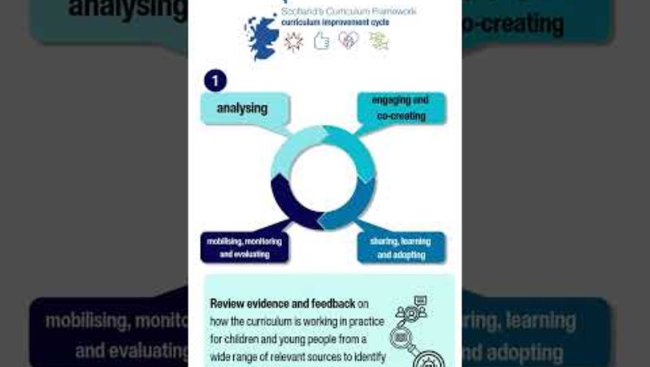
Introduction to the CIC - Video
Notes:
Short Video: Introduction to the CIC
Watch this short video (2min:16secs) CIC introduction video from Ollie Bray
Also accessible on youtube here: https://youtu.be/yMZ_tshgKwg

Slide 20

Why is Scotland embarking on the CIC?
Curriculum Review Gap
  The 2021 OECD Review identified the lack of a systematic curriculum review process in Scotland leading to inconsistencies.
Reactive Curriculum Changes
  Curriculum changes were often reactive, driven by political or attainment pressures causing overload in CfE.
Purpose of CIC
  The Curriculum Improvement Cycle aims to proactively address curriculum issues ensuring relevance and responsiveness to learners.
Notes:
Why are we embarking on the CIC
This origins and necessity of the Curriculum Improvement Cycle.
It draws on findings from the 2021 OECD Review, which highlighted the absence of a systematic curriculum review process in Scotland. The reactive nature of curriculum changes, often driven by political or attainment pressures, led to inconsistencies and overload within the Curriculum for Excellence (CfE). The CIC was introduced to address these issues proactively, ensuring the curriculum remains relevant and responsive to learner needs. Facilitators guide participants through these insights and prompt reflection on their own experiences with CfE.
Education Scotland published Paper 1: Background and A Case For Change : Findings from the Pilot Curriculum Reviews 2023/24 . This was published in November 2024. This paper explains why we are doing this work and talks about the pilot curriculum reviews. These pilot reviews were really informative and this paper shares everything that we learned. It also talks about evolving the technical framework and aims to inspire thinking.

Slide 21

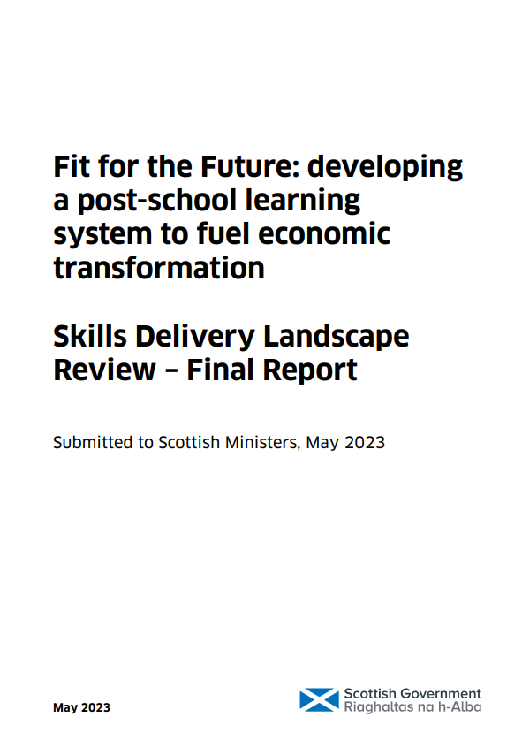
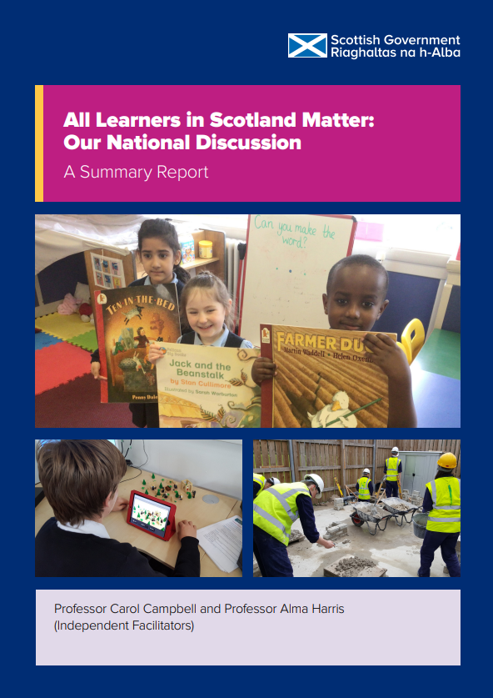

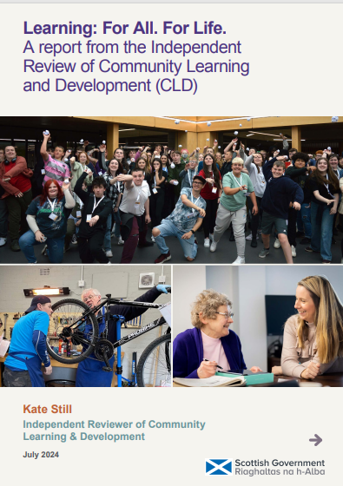
Education Reform Journey
OECD
Review
2021
Muir
Review
[Structures]
2022
Skills
Delivery
Review
2023
National
Discussion
Report
2023
Review of
Assessment &
Qualifications
2023
Independent Review of
CLD
2024
Notes:
Highlighting some other recent reports which include references to curriculum.
Scotland’s Curriculum for Excellence into the Future (OECD, 2021)
The OECD’s independent review of Scotland’s Curriculum for Excellence (CfE) endorsed Curriculum for Excellence as the right Curriculum for Scotland. It recommended strengthening the position of knowledge, building capacity in curriculum design, and improving 3-18 coherence. It identified the need for a systematic approach to reviewing and updating the curriculum.
Putting Learners at the Centre: Towards a Future Vision for Scottish Education (Scottish Government, 2022)
Professor Ken Muir’s report’s proposals included: a national discussion on the future of Scottish education; structural reforms including a new qualifications body, Qualifications Scotland.
Fit for the Future: developing a post-school learning system to fuel economic transformation. Skills Delivery Landscape Review – Final Report (Scottish Government, 2023)
Led by James Withers. Recommendations included: strengthening and joining approaches to skills in the post-school space, including in regional skills planning, funding, qualifications and pathways and a digital training record. (Note that Scotland’s Learner Profile is now live and available to all schools and settings via My World of Work.
All Learners Matter: Our National Discussion (Scottish Government, 2023)
The National Discussion gathered views from children and young people, educators, parents, and communities across Scotland. It shared a vision and call to action, emphasising its main message that “All Learners Matter.” It recommended reviewing the curriculum to ensure that it remains fit for purpose, reflects contemporary learner needs, and can be enacted in ways which ensure all learners in Scotland experience high quality, curricular linked learning experiences.
The Independent Review of Qualifications and Assessment (Scottish Government, 2023)
Led Professor Louise Hayward, this review recommended changes to assessment and certification in the senior phase. Central to the proposal was the creation of a Scottish Diploma of Achievement (SDA), which would recognise achievements across three areas: Programmes of Learning, Project Learning, and a Personal Pathway.
Learning: For All. For Life. Independent Review of CLD (2024)
Led by Kate Still, the Independent Review of CLD outlines 20 recommendations to strengthen CLD across Scotland
Key highlights from the report include:
Leadership and structures: Calls for clearer national leadership with the establishment of a CLD Strategic Leadership Group.
Workforce development: Emphasises professional recognition, training, and career pathways for CLD practitioners.
Funding and sustainability: Advocates for long-term, stable funding to support community-based learning.
Equity and inclusion: Prioritizes access for marginalized groups and lifelong learning opportunities.
Data and impact: Recommends improved data collection to demonstrate CLD’s value and outcomes.
Collaboration and innovation: Encourages partnerships across sectors and innovative approaches to learning.

Slide 22

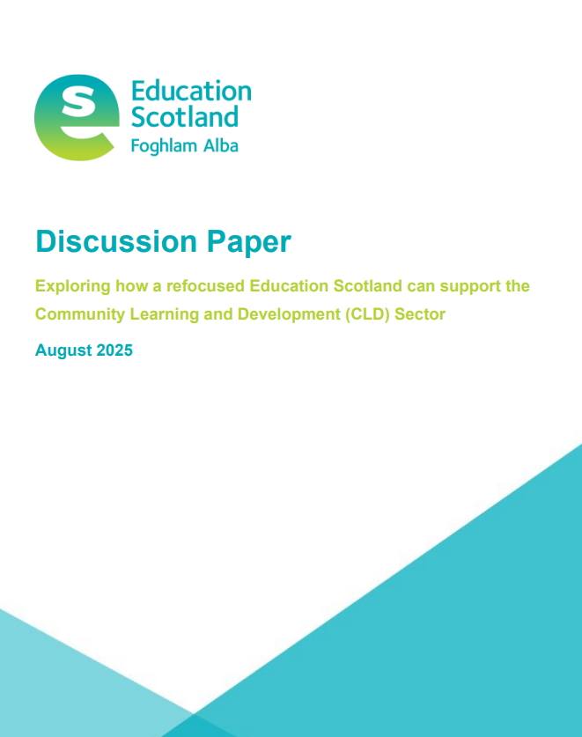
Understanding the rationale for CIC
Read
CLD Discussion Paper 1
Watch
CIC explainer video
Listen
Background and Case for Change Podcast
Do
Familiarise yourself with the CIC blog and sign up for the newsletter
Notes:
Understanding the rationale for the CIC
This slide contains Read, Watch, Listen & Do tasks. These can be used as part of the session - or as pre or post session tasks.
Read and discuss the paper, How can Education Scotland better support Community Learning Development (CLD) stakeholders to contribute to Scotland’s Curriculum Improvement Cycle (CIC)? (pages 12-17) National Development Work – Education Scotland – Community Learning & Development Portal
The video in Watch is the same introduction video as on Slide 19 so you may have already watched this as a group.
Either in advance of the session, during the session or following the session, participants can further familiarise themselves with Discussion paper 1: Background and A Case For Change.

Slide 23
All Learners Matter
'Children and young people will be involved in each stage of the CIC.'
Working Together to Make Change Happen, March 2025 (CIC discussion paper 3)
Reflective Questions for CLD Practitioners
How do I ensure that every learner feels seen, heard, and valued, especially those whose voices are often marginalised?
How can I adapt my practice to better reflect the diversity, interests, and ambitions of learners in a rapidly changing world?
How might I support learners and communities to shape the development of the CIC and inform decisions? What difference could this make?
Notes:
All Learners Matter
'Children and young people will be involved in each stage of the CIC.’ from Curriculum Improvement Cycle (CIC) Working Together to Make Change Happen, March 2025 (CIC discussion paper 3)
020425-CIC-Working-Together-to-Make-Change-Happen-V1.0.pdf
Consider and discuss these three reflective questions. This could be done with groups considering each question or just 1. Feedback to the larger group. Questions can be changed as required.
Reflective Questions for CLD Practitioners
How do I ensure that every learner feels seen, heard, and valued, especially those whose voices are often marginalised?
How can I adapt my practice to better reflect the diversity, interests, and ambitions of learners in a rapidly changing world?
How might I support learners and communities to shape the development of the CIC and inform decisions? What difference could this make?

Slide 24
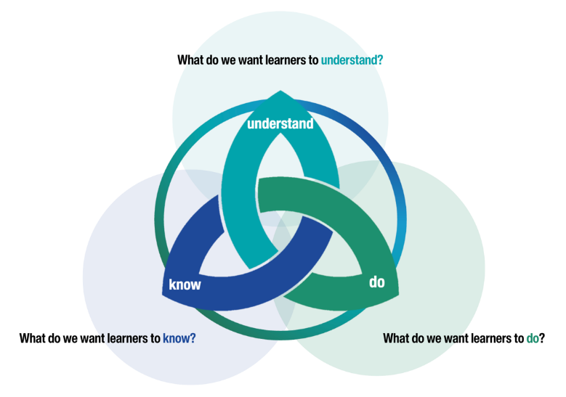
What is changing?
Focus of change: the technical framework
Experiences & Outcomes and Benchmarks will be phased out
The new framework will be underpinned by a
Know–Do–Understand approach
It will clarify the knowledge and skills to support the development of key conceptual understanding at each level.
Notes:
So what is changing?
The focus of change is on the guidance and technical framework: the documentation that teachers and practitioners use to plan learning for and with children and young people.
Experiences & Outcomes and Benchmarks will be phased out and they will be replaced by a new technical framework.
The new framework will be underpinned by A Know–Do–Understand approach.
The new guidance will set out big ideas and associated concepts that all children and young people need to help them be individuals, contributors, citizens and learners.
At each level, it will clarify the knowledge and skills that will support children and young people in the development of key conceptual understanding.

Slide 25
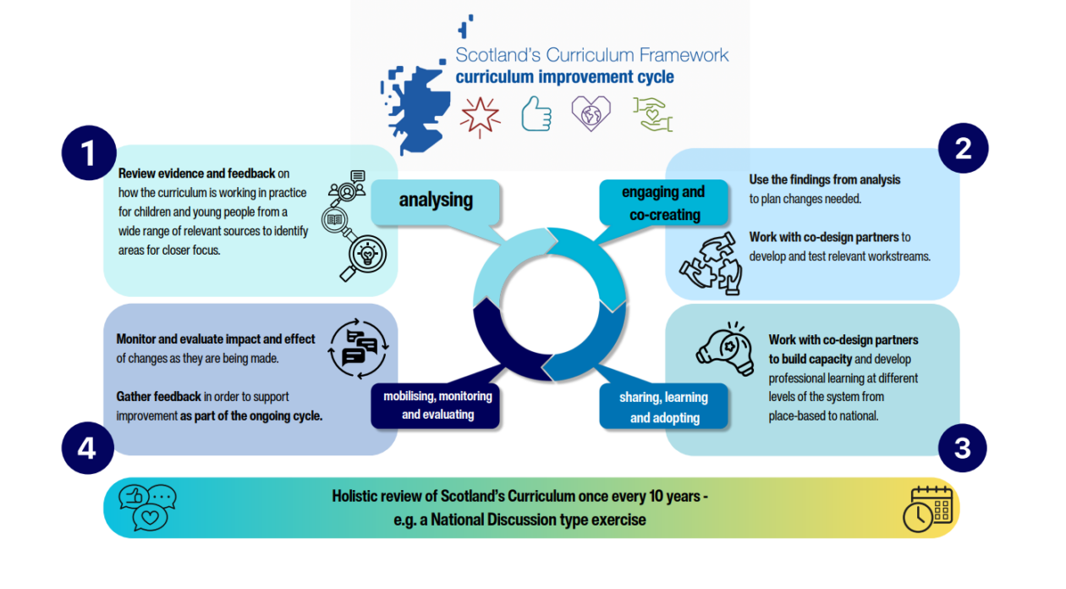
The Curriculum Improvement Cycle 4 Phases
Notes:
The Curriculum Improvement Cycle – 4 Phases
The CIC is a 10-year cycle. This approach was developed by Scottish Government, based on learning from international research and discovery work, and shared with Curriculum and Assessment Board in June 2023. The CIC consists of four interlinked phases: About the Curriculum Improvement Cycle – Curriculum Improvement Cycle
Analysis – analysis of evidence and feedback from practice on how the curriculum is working at all levels and in all sectors (Early Learning and Childcare, schools and education settings, colleges, regional, national), studies on future trends including international evidence and research on specific issues. This will help identify areas for closer focus.
Engagement and co-creation – planning, engagement, collaboration and processing of feedback to test draft workstreams. Importantly in the Scottish model in this stage the implementation strategy is also co-designed.
Share, Learn and Adopt – local capacity building and professional development; development of support material; monitoring of experiences of educators and learners.
Mobilise, monitor and evaluate – mobilising the system around the approach and implementation. Once the new approach is mainstream, the cycle begins again in terms of monitoring and evaluation through inspectorate reports, research and feedback. This last stage (evaluation) is interlinked with stage 1 (analysis) thereby closing the review cycle.
This cyclical model is designed to take approximately 10 years per full cycle, with the aim of creating a sustainable, evidence-informed approach to curriculum development. Each 10-year cycle would start and end with a national exercise similar to the National Discussion.
We are currently in the co-creation phase (phase 2).

Slide 26
Planned timeline
Awareness Raising and Sense Making
August 2025 – June 2026 | August – December 2026 | January 2027 – June 2028
Curriculum Development Phase | Curriculum Alignment Phase | Sharing and Adopting Phase
Notes:
Planned Timeline (approx.)
This activity is taking place now because we are in Phase 2 of the CIC, engaging and co-creating.
In January 2027 we will move into the first part of Phase 3, Sharing, Learning and Adopting.
Timeline Highlights:
Summer 2025: National rollout of the digital learner profile.
Autumn 2025: Design phase begins for new qualifications at SCQF levels 4 and 5.
2028–2032: Phased implementation of revised curriculum and qualifications

Slide 27
What's happened so far?
The CIC formally began in April 2024.
Groups of practitioners from across sectors coming together to look at key Curriculum Areas
Some engagement with learners - but much more to be done
CLD involvement in aspects of the CIC work – with scope for more
11 cross-curricular areas have been reviewed
Work is underway to review Contexts for Learning:
  Opportunities for Personal Achievement
  The Ethos and Life of the School
  Inter-disciplinary Learning (IDL)
Feedback being sought from ‘Reference Groups’ with specialist knowledge
Notes:
What’s happened so far?
The CIC model is based on a participatory approach. It includes a commitment to involve CLD practitioners alongside children and young people, teachers, lecturers, early years practitioners, parents and families, employers and other key stakeholders. There has been some very valuable involvement by CLD stakeholders in the CIC work so far and we are keen to support wider involvement from CLD practitioners and learners in CIC projects as they are developed.
There is more work to be done to engage learners and families in the CIC discussions. 'The curriculum review should include consideration of compliance with children’s rights, as well as whether children are being taught about their rights and the rights of others.' “This is our lives, it matters a lot.” Putting children's rights at the heart of education The Children's Commissioner
Feedback is also being sought on a regular basis from ‘Reference Groups’ with specialist knowledge. The format of Reference Groups will be flexible and draw on existing networks. A CLD Reference Group is being established with CLD Managers Scotland and other CLD partnerships,
Education Scotland has been engaging with CLD stakeholders to explore its refocused role as a curriculum improvement agency. The first paper on this has been published here: National Development Work – Education Scotland – Community Learning & Development Portal

Slide 28
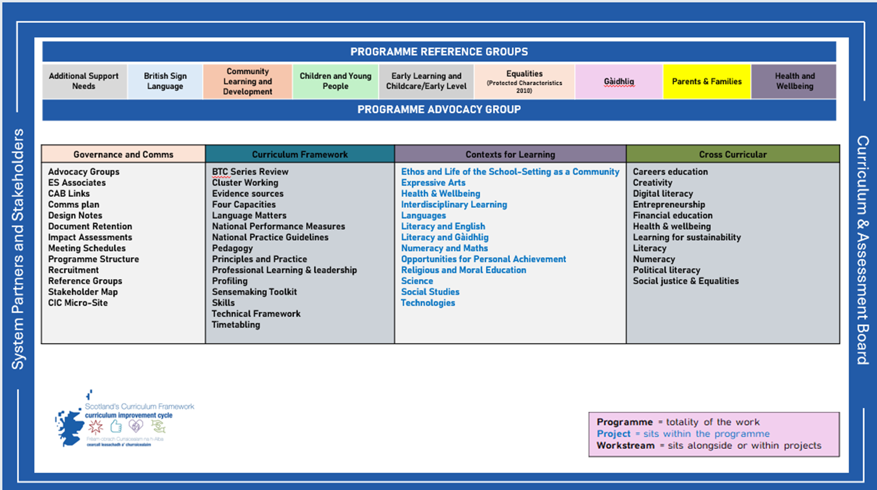
High Level Curriculum Improvement Cycle Programme Structure – March 2025
Notes:
High Level Curriculum Improvement Cycle Programme Structure – March 2025
The High Level Curriculum Improvement Cycle Programme Structure gives a visual overview of the four main areas of work that currently sit within the programme.
These areas are: Governance and Communications; the Curriculum Framework; Contexts for Learning and Cross Curricular.
The overall programme is supported by system partners and stakeholder work, the CAB, reference and advocacy groups.
Commentary on a selection of work from each of these four can be found in paragraphs 2.1 to 2.4, page 13 onwards, in Paper Three here: 020425-CIC-Working-Together-to-Make-Change-Happen-V1.0.pdf

Slide 29
Discussion activity
Having looked at the CIC programme structure, what areas of Scotland’s Curriculum do you see CLD having the biggest contributions to make?
What could CLD involvement in the Curriculum Improvement Cycle look like?
Notes:
Discussion Activity
Having looked at the CIC programme structure, what areas of Scotland’s Curriculum do you see CLD having the biggest contributions to make?
What could CLD involvement in the Curriculum Improvement Cycle look like?

Slide 30
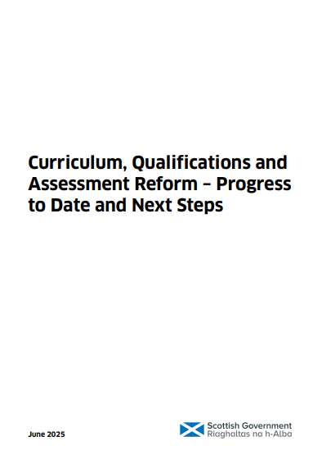
Progress to date and timeline
The CIC is a long-term programme of work.
The document provides an initial timeline to give clarity to partners and practitioners across the education and skills system, as well as to parents, carers, children and young people, about what will happen and when, and to support early thinking about when and how teaching, learning, and assessment will start to feel different.
More information on timelines available here: Curriculum, Qualifications and Assessment Reform – Progress To Date and Next Steps
Notes:
Progress to date and timeline
The CIC is a long-term programme of work.
The document provides an initial timeline to give clarity to partners and practitioners across the education and skills system, as well as to parents, carers, children and young people, about what will happen and when, and to support early thinking about when and how teaching, learning, and assessment will start to feel different.
More information on timelines available here: Curriculum, Qualifications and Assessment Reform – Progress To Date and Next Steps
Supporting documents - Curriculum, Qualifications and Assessment Reform: progress to date and next steps - gov.scot

Slide 31

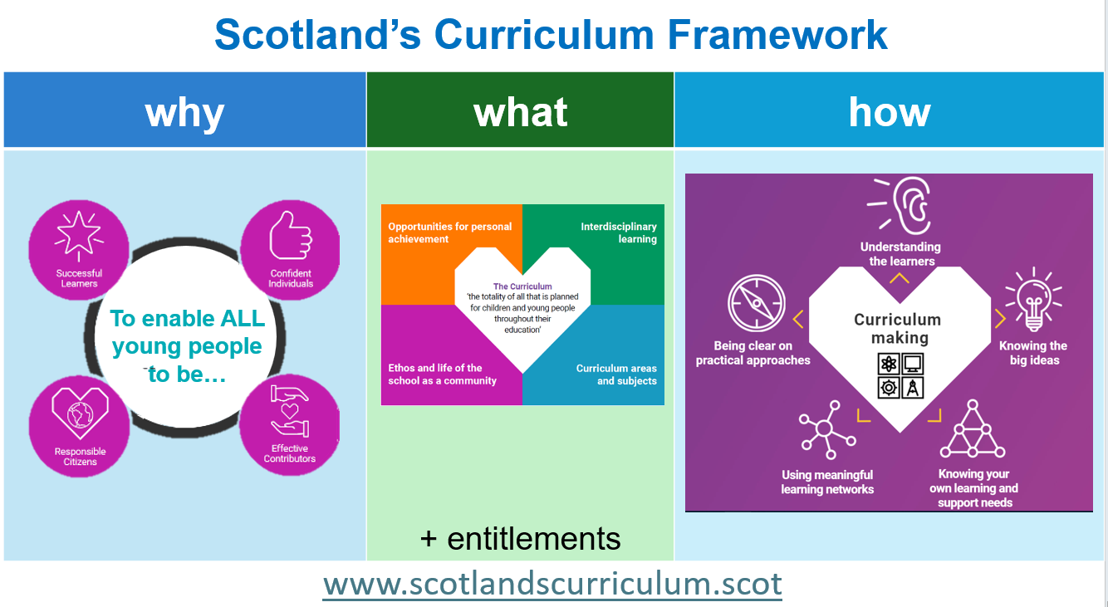
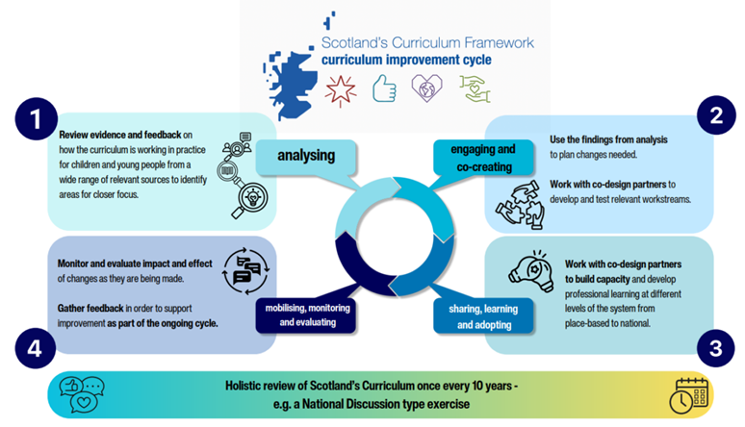
Reflections: A CLD perspective
Consider how Scotland’s Curriculum connects with your current work?
What more would you like to find out or what doesn’t make sense yet?
What could be one next step, or connection that you might make to support CLD contributions to the Curriculum Improvement Cycle? What support do you need to do this?
What would you like to feedback to Education Scotland?
Notes:
Reflections: A CLD Perspective
Reflect individually or in small groups,
Consider how Scotland’s Curriculum connects with your current work?
What more would you like to find out or what doesn’t make sense yet?
What could be one next step, or connection that you might make to support CLD contributions to the Curriculum Improvement Cycle? What support do you need to do this?
What would you like to feedback to Education Scotland?
What additional information would you like from Education Scotland – please let us know.
To stay updated on opportunities as they arise, please register with the CIC bulletin here: Subscribe to Curriculum Improvement Cycle Mailing List

Slide 32
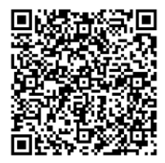

It would be really helpful if you could complete the feedback form with your thoughts on this initial sense making professional learning.
There is space on the form to identify if you would be willing to support with the creation of further materials or be a critical friend in advance of any publications.

