Slide 1




Leading Change
Cognitive Readiness
Understanding the need for change
Emotional Readiness
Feeling safe and supported in the process
Behavioural Readiness
Being prepared to act or implement change
Armenakis et al. (1993); Fullan (2007)
Notes:
SLIDE 1
This is not part of the presentation, rather something to consider as a facilitator.
From Fullan: 3 aspects of leading change.
Think about these for ourselves, and for our teams
We have two years to prepare (for formal adoption from August 2028 onwards)

Slide 2
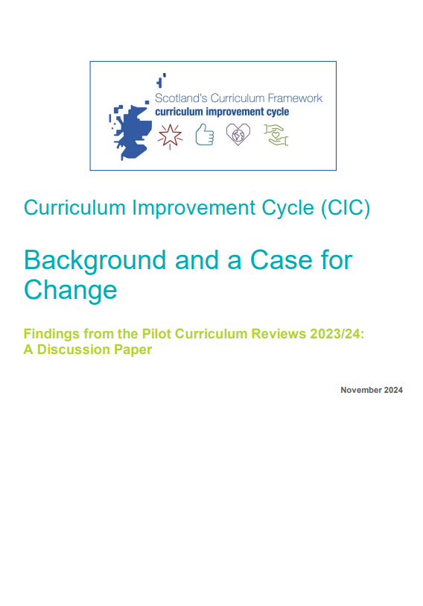
Optional individual tasks
Any of these might work as optional individual tasks in advance of or following the sessions. The short CIC explainer video can also be used during the session.
Read
Discussion paper 1: Background and A Case For Change
Watch
CIC explainer video
Listen
Background and Case for Change Podcast
Do
Familiarise yourself with the CIC blog and sign up for the newsletter
Notes:
SLIDE 2
This is not part of the presentation but identifies possible individual tasks that might be helpful in advance or as a follow-up to the session.
The short CIC explainer video identified here is included as an embedded video on slide 11 and may also be used during the session.

Slide 3



Understanding the Curriculum Improvement Cycle
Session 1
Notes:
SLIDE 3
FACILITATOR
Introduce yourself (if applicable) and welcome everyone to the session.
Explain that this session focuses on developing a shared understanding of ‘Why’ we are embarking on a Curriculum Improvement Cycle and key, high level messages, including the timeline for change.
This session will last approximately 30-45 minutes depending on time allowed for discussions etc.

Slide 4
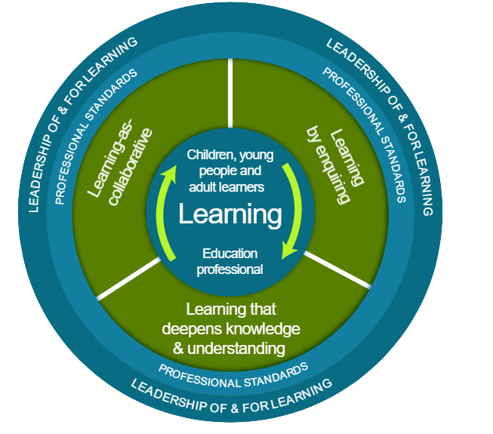
National Model of Professional Learning
CIC will impact every learner in Scotland
Active engagement
Advocate for our learners
Learning together and over time
Enquiring stance
Connecting to our practice
Notes:
SLIDE 4
Key messages:
This is session is aligned with the National Model of Professional Learning
As education professionals, we engage in professional learning to stimulate our thinking, deepen our understanding, and enhance our practice. Actively engaging in professional learning at this early stage we can ensure that we develop a fuller understanding of the CIC process and outcomes and that we advocate for our learners at every stage. By taking an enquiring stance as we engage with CIC, by considering the opportunities to develop our curriculum and pedagogical practices we will directly and positively impact the learners.
The NMPL supports this by outlining the key principles and features of effective professional learning, helping us build capacity and foster collaborative approaches across our settings.
The model encourages us to be critically informed and responsive to current educational contexts, ensuring our practice remains relevant and impactful.
Explore the NMPL further here:
The national model of professional learning | National approach to professional learning | Professional Learning | Education Scotland
Alignment with the National Model of Professional Learning. This Professional Learning Resource (PLR) aligns with several core aspects of the NMPL:
See the full list of Professional Standards:
GTCS https://www.gtcs.org.uk/knowledge-base/articles/a-guide-to-the-professional-standards
CLD Practitioners https://cldstandardscouncil.org.uk/resources/competent-practitioner-framework/
ELC Practitioners Social Service | Children and Young People | SCQF 7 | National Occupational Standards (NOS) Navigator (sssc.uk.com)
Social Service | Children and Young People | SCQF 9 | National Occupational Standards (NOS) Navigator.

Slide 5

Ways of working together
  Learn from, with and on behalf of each other
  We create a safe space to share ideas
  We agree everyone is equal and valued
  We remain ‘in the room’
Notes:
SLIDE 5
Key Messages
Take a moment to establish group protocols.
Ask participants to comment on anything they would like to add or amend.
Is there anything that participants feel is missing or anything they would like to remove?
The protocols on the slide are suggestions to be amended for your context.
- Why establish group protocols
Effective professional learning goes beyond simply delivering information. It fosters a learning community where educators can learn with, from, and on behalf of one another. To achieve this, the facilitator of this learning should establish clear protocols and a positive learning environment at the outset. The general notes below will support the facilitator to help everyone feel comfortable participating and contribute to a rich learning experience.
1. Contract a Safe Space:
Co-create a Safe Space agreement with your group. This agreement outlines expectations for respectful communication and active listening. A safe space allows trust to flourish, fostering a collaborative environment where everyone feels comfortable sharing ideas and taking risks.
2. Shift from Top-Down to Collaborative Learning:
Move beyond the traditional model where one person imparts knowledge. Embrace a collaborative approach where all participants actively engage. This means learning with, from, and on behalf of one another. By leveraging the diverse perspectives within the group, gaining a richer understanding and creating a more impactful learning experience for everyone.
3. Holding the Ladder: Shared Expertise and Recognition
Holding the ladder signifies a two-fold approach:
Sharing Expertise: Those with experience can share their knowledge and insights.
Recognise Everyone's Contribution: Actively listen and be open to learning from the unique perspectives and experiences of colleagues. Build on each other's ideas to foster a collaborative environment where everyone feels valued, and their contributions are respected.
4. Hold Space for Silence and Respectful Discussion:
Hold space for silence after someone speaks or asks a question. It can be tempting to jump in to fill silence but allowing time for quiet can avoid interrupting thought and produce more thoughtful responses. Everyone deserves to be heard and understood.
Adapt the time allocation based on the size of the group and the complexity of the topic.
5. Schedule Regular Breaks:
Schedule regular breaks throughout the session. This allows participants to process information, refocus, and return with renewed energy, leading to a more productive learning experience.
6. Centre Learning in Real Life:
Connect the learning to real-life experiences by encouraging participants to share relevant personal anecdotes or applications. This strengthens understanding and makes the learning more relatable and impactful for all.

Slide 6


Connector
In groups or pairs:
  What does curriculum improvement mean to you?
  Identify two features of the Curriculum Improvement Cycle (CIC) which are clear to you.
  Identify two elements which are unclear.
Notes:
SLIDE 6
Key Messages
This is an example of a simple connecter activity. It is recommended that facilitators use a connector activity that allows participants to take part in an informal discussion.
This is to ensure that participants are relaxed, focused and ready for an interactive workshop.
If you use this connector it will generate questions which you may wish to come back to at the end of the session, or in future sessions.

Slide 7

Session aims
To build a shared understanding of:
why Scotland is embarking on the CIC
the timeline for change
where we are now
what’s coming next
Notes:
SLIDE 7
Key Messages
Outline the aims of this session
This session is about an introduction to a complex and long-term (10 years) programme of work. We will have further opportunities to explore the change in detail and to ensure we feel supported and ready.

Slide 8

Why is Scotland embarking on the CIC?
Endorsed Scotland’s Curriculum (CfE)
Establish a systematic process to update the curriculum
Ensure the curriculum remains relevant
Clarify the role of knowledge (and how this interacts with skills and understanding)
Improve coherence 3 – 18
Build capacity for curriculum design in schools and settings
Scotland’s Curriculum for Excellence: Into the Future (OECD, 2021)
Notes:
SLIDE 8
Why Scotland is embarking on the CIC
This work originates in recommendations from the 2021 OECD review. This review endorsed Scotland’s Curriculum (CfE) as an approach, and made several recommendations.
It highlighted the reactive nature of curriculum changes, leading to inconsistencies. As well as updating the curriculum now, the CIC is establishing on ongoing 10-year cycle to ensure that Scotland’s Curriculum remains up-to-date.
Facilitators guide participants through these insights and prompt reflection on their own experiences with CfE.
This activity could be combined with some pre-reading, follow-up reading or jigsaw reading of Paper 1.
Paper 1 seeks to:​
Set out the background for undertaking pilot curriculum reviews in session 2023/24​
Outline how the pilot curriculum reviews were carried out and how the approaches used will inform the Curriculum Improvement Cycle (CIC)​
Share the key findings and learning identified through the pilot reviews​
Make a case for evolution of the current technical framework​
Stimulate thinking by exploring how the position of knowledge can be strengthened within CfE​

Slide 9

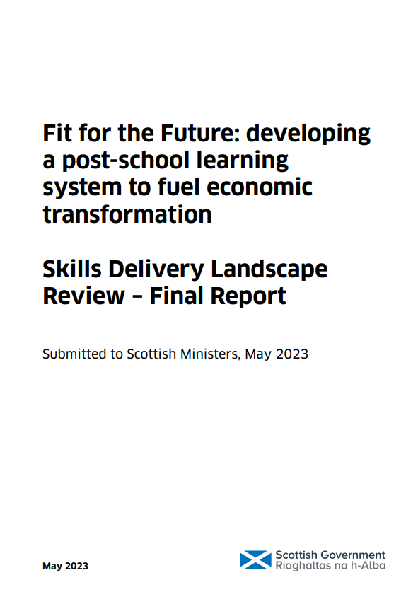


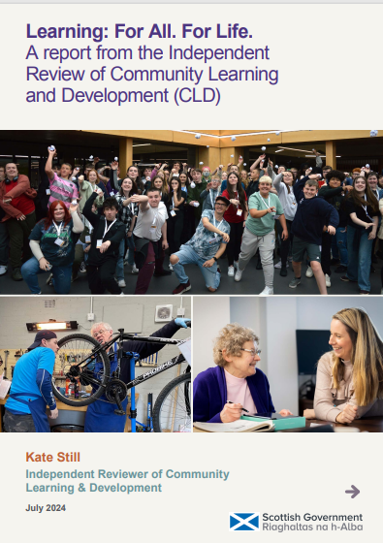
Why is Scotland embarking on the CIC?
OECD
Review
2021
Muir
Review
2022
Skills
Delivery
Review
2023
National
Discussion
Report
2023
Review of
Assessment &
Qualifications
2023
Review of
CLD
2024
Notes:
SLIDE 9
Highlighting some other recent reports which include references to curriculum.
The CIC will not take forward every recommendation in every report, but there are links.
Scotland’s Curriculum for Excellence Into the Future (OECD, 2021)
The OECD’s independent review of Scotland’s Curriculum for Excellence (CfE) endorsed Curriculum for Excellence as the right Curriculum for Scotland. It recommended strengthening the position of knowledge, building capacity in curriculum design, and improving 3-18 coherence. It identified the need for a systematic approach to reviewing and updating the curriculum.
Putting Learners at the Centre: Towards a Future Vision for Scottish Education (Scottish Government, 2022)
Professor Ken Muir’s report proposed: a national discussion on the future of Scottish education; structural reforms including a new qualifications body, Qualifications Scotland.
Fit for the Future: developing a post-school learning system to fuel economic transformation. Skills Delivery Landscape Review – Final Report (Scottish Government, 2023)
Led by James Withers. Recommendations included: strengthening and joining approaches to skills in the post-school space, including in regional skills planning, funding, qualifications and pathways and a digital training record.
All Learners Matter: Our National Discussion (Scottish Government, 2023)
The National Discussion gathered views from children and young people, educators, parents, and communities across Scotland. It shared a vision and call to action, emphasising its main message that “All Learners Matter”. It recommended reviewing the curriculum to ensure that it remains fit for purpose, reflects contemporary learner needs, and can be enacted in ways which ensure all learners in Scotland experience high quality, curricular linked learning experiences.
The Independent Review of Assessment and Qualifications and Assessment (Scottish Government, 2023)
Led Professor Louise Hayward, the Independent Review recommended a more inclusive and holistic approach to assessment and certification in the senior phase. Central to the proposal was the creation of a Scottish Diploma of Achievement (SDA), which would recognise achievements across three areas: Programmes of Learning, Project Learning, and a Personal Pathway.
Learning: For All. For Life. A report from the Independent Review of Community Learning and Development (CLD) (Scottish Government, 2024)
Led by Kate Still, the Independent Review of CLD outlines 20 recommendations to strengthen CLD across Scotland. It highlights the central role of CLD in lifelong learning for all in Scotland.
innovation.

Slide 10
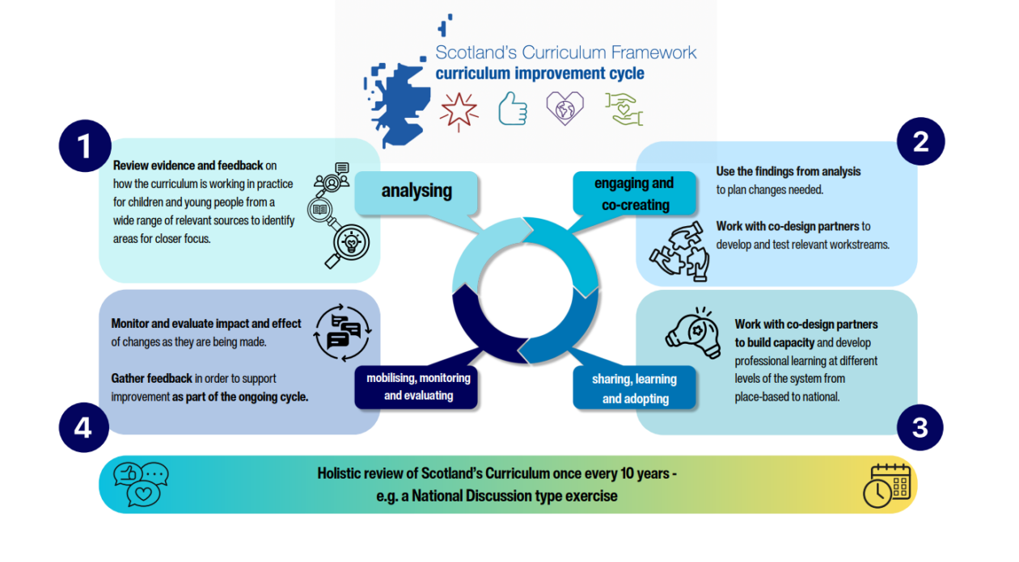
Notes:
SLIDE 10
The CIC is a 10-year cycle. This approach was developed by Scottish Government, based on learning from international research and discovery work, and shared with Curriculum and Assessment Board in June 2023.
The CIC consists of four interlinked phases: [About the...ment Cycle]
1. Analysis – analysis of evidence and feedback from practice on how the curriculum is working at all levels and in all sectors (Early Learning and Childcare, schools and education settings, colleges, regional, national), studies on future trends including international evidence and research on specific issues. This will help identify areas for closer focus.
2. Engagement and co-creation – planning, engagement, collaboration and processing of feedback to test draft workstreams. Importantly in the Scottish model in this stage the implementation strategy is also co-designed.
3. Share, Learn and Adopt – local capacity building and professional development; development of support material; monitoring of experiences of educators and learners.
4. Mobilise, monitor and evaluate – mobilising the system around the approach and implementation. Once the new approach is mainstream, the cycle begins again in terms of monitoring and evaluation through inspectorate reports, research and feedback. This last stage (evaluation) is interlinked with stage 1 (analysis) thereby closing the review cycle.
This cyclical model is designed to take approximately 10 years per full cycle, with the aim of creating a sustainable, evidence-informed approach to curriculum development. Each 10-year cycle would start and end with a national exercise similar to the National Discussion.
We are currently in the co-creation phase (phase 2).

Slide 11
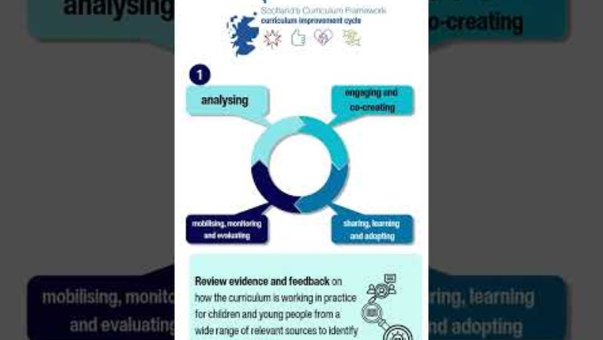
CIC explainer video
Notes:
SLIDE 11
This slide has the CIC Explainer Video (2 mins 15 seconds) embedded and should play automatically in Powerpoint presenter mode.
It can also be accessed here: https://youtu.be/yMZ_tshgKwg and can be used as a short, independent pre-session task.

Slide 12
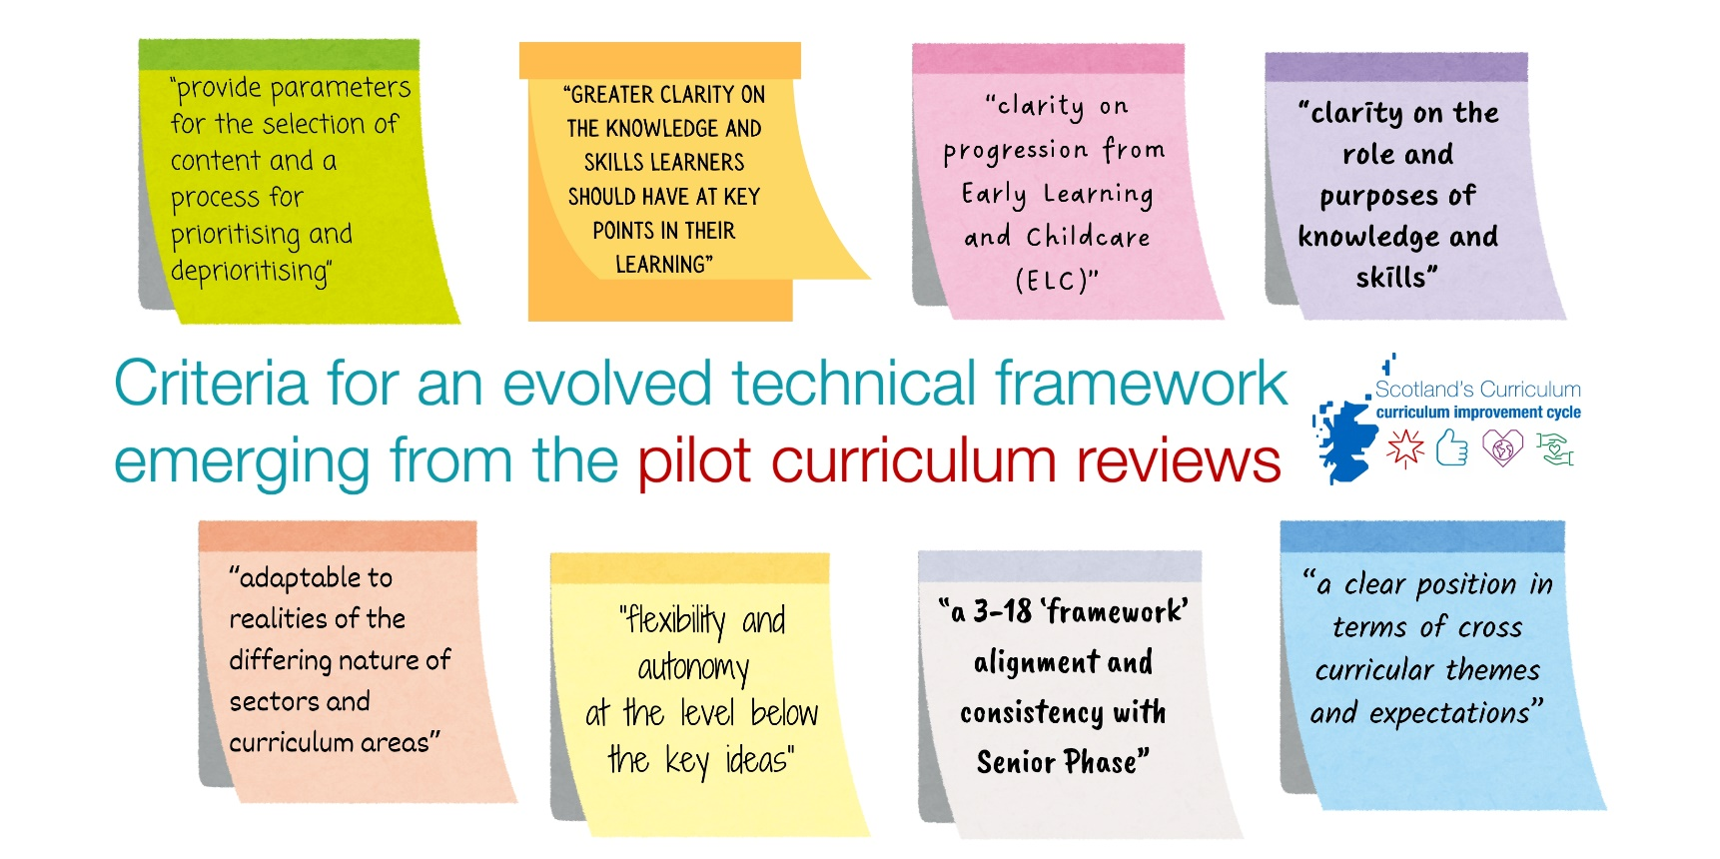
We are building on findings from pilot reviews…
Notes:
SLIDE 12
As part of the discover phase in developing the CIC, pilot reviews were held with groups of 3-18 practitioners in 6 Curriculum Areas. There were recurring themes and messages across these groups, including: declutter the curriculum, increase clarity around knowledge and simplify guidance.
The co-design groups are working to address these issues.

Slide 13

We are not
starting from
a blank piece
of paper…
Notes:
SLIDE 13
Key message:
This is an evolution of Scotland’s existing Curriculum not a complete restart. The next few slides clarify that the underlying structure of Scotland’s Curriculum will remain and explain what the focus of the change will be.

Slide 14
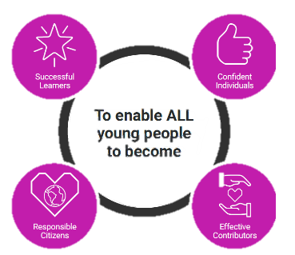

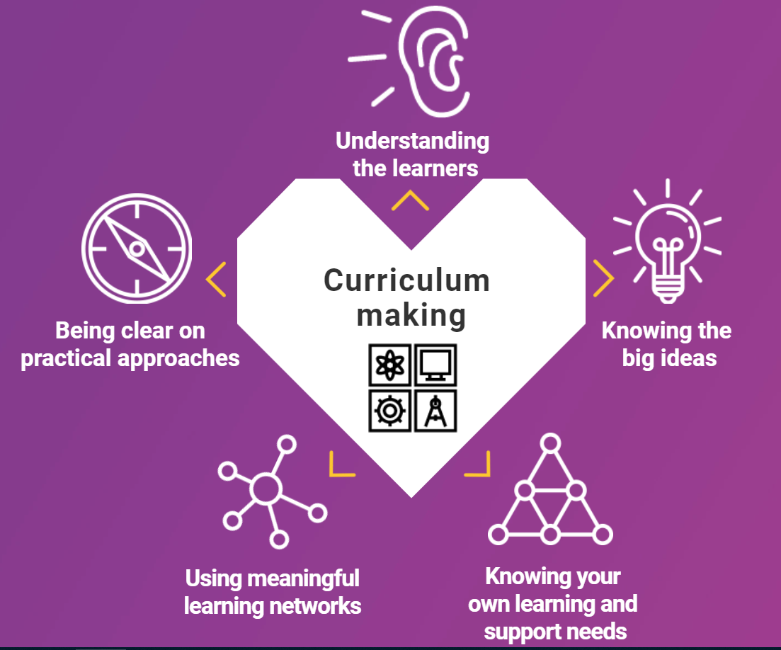
What is not changing? Scotland’s Curriculum Framework
why | what | how
 | + entitlements
To enable ALL young people to be
To enable ALL
young people
to be…
www.scotlandscurriculum.scot
Notes:
SLIDE 14
It is important to note that the core parts of Scotland’s Curriculum Framework are NOT changing.
The Four Capacities remain as the central purpose for Scotland’s Curriculum.
The Four Contexts for Learning will remain and will be strengthened.
The 5 parts of Curriculum Making will also remain and will underscore the professional learning that will be planned for 2026/27 and 2027/28.

Slide 15
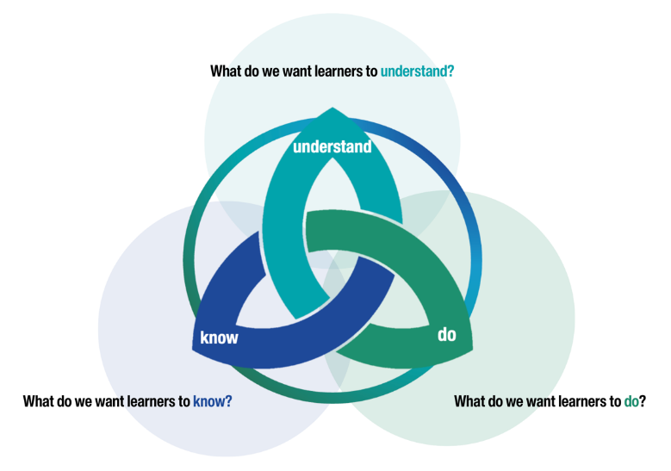
What is changing?
Focus of change: the technical framework
Experiences & Outcomes and Benchmarks will be phased out
The new framework will be underpinned by a Know – Do – Understand approach
It will clarify the knowledge and skills that will support the development of key conceptual understanding at each level.
Notes:
SLIDE 15
The focus of change is on the guidance and technical framework: the documentation that teachers and practitioners use to plan learning for and with children and young people.
Experiences & Outcomes and Benchmarks will be phased out and they will be replaced by a new technical framework.
The new framework will be underpinned by A Know–Do–Understand approach.
The new guidance will set out big ideas and associated concepts that all children and young people need to help them be individuals, contributors, citizens and learners.
At each level, it will clarify the knowledge and skills that will support children and young people in the development of key conceptual understanding.

Slide 16
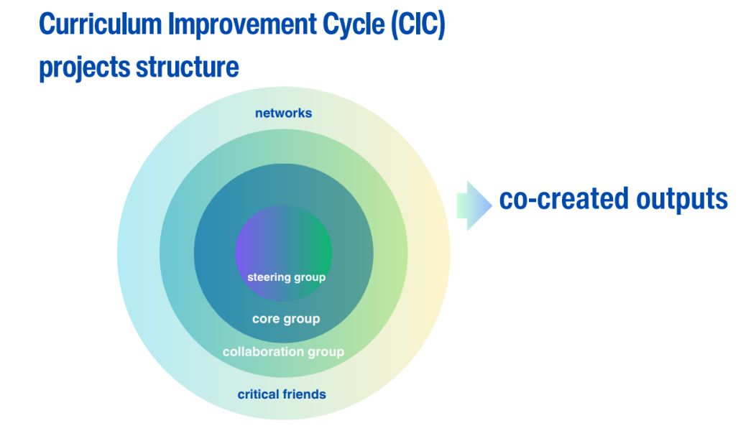
Who is working on this?
Over 1500 practitioners from across all 32 local authorities are involved in co-creating the new technical framework.
The groups are organised into 13 projects covering all 4 Contexts for Learning, including the Curriculum Areas.
The open recruitment process included steps to strengthen representation by including perspectives and voices with expertise in Early Learning and Childcare, Primary schools, Secondary schools, Additional Support Needs, equalities and Gaelic.
Notes:
SLIDE 16
There is a commitment to ensure this change is led by the profession and in a way that is transparent. Co-design groups will share emerging thinking (see next slide) so everyone has the chance to be involved.
The groups were recruited through open recruitment and there will be further opportunities to become involved as the CIC progresses.
Equity, inclusion, and learner engagement are at the heart of this work.
The specific roles of each of the groups is unpacked in more detail in the 3 papers.

Slide 17

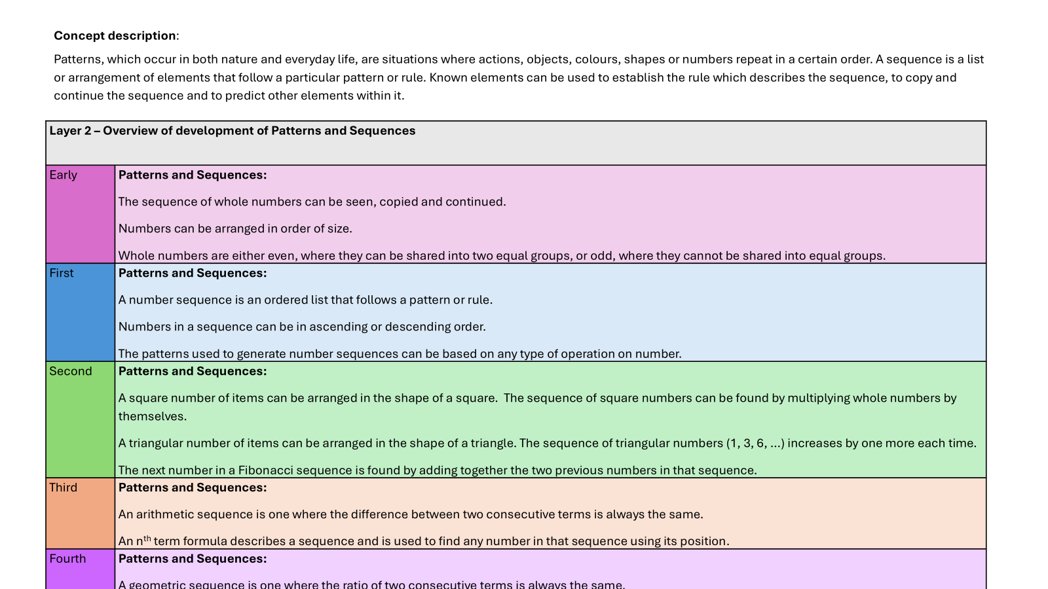
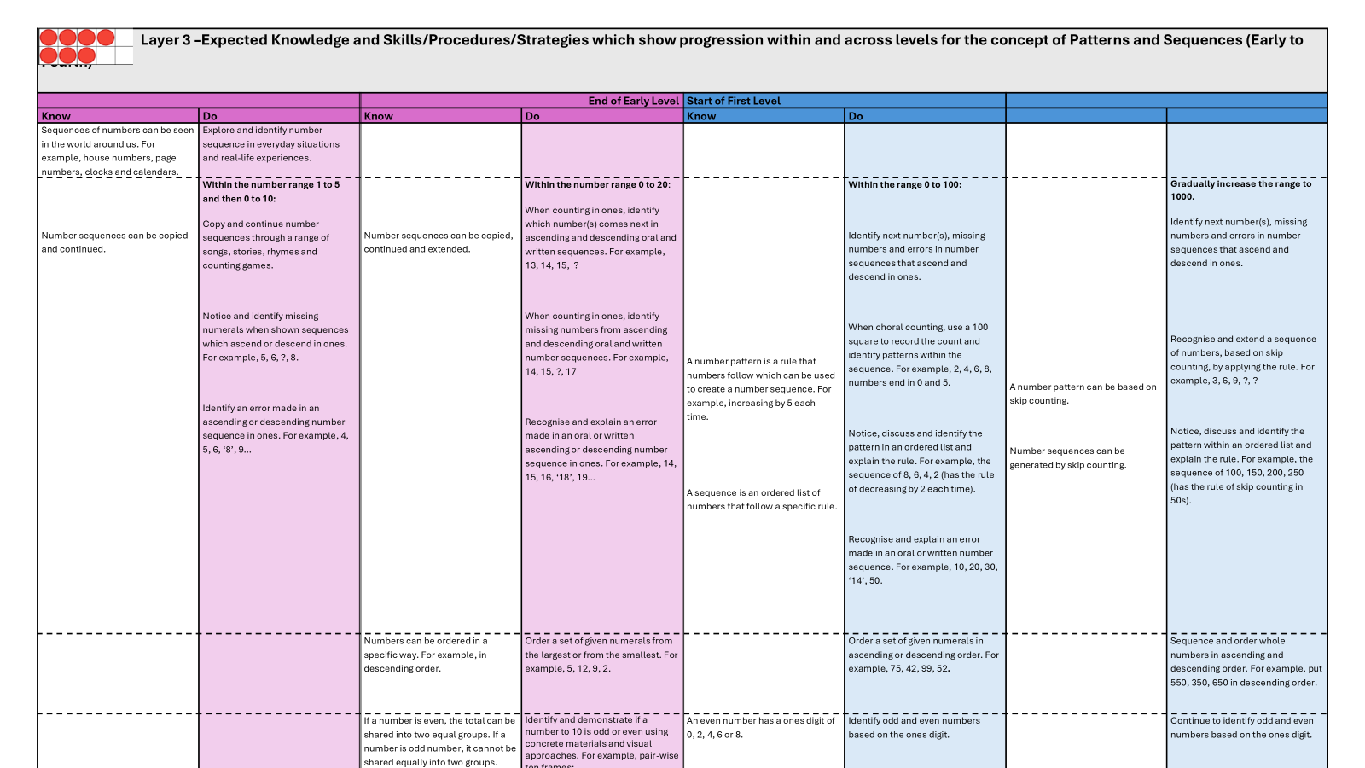
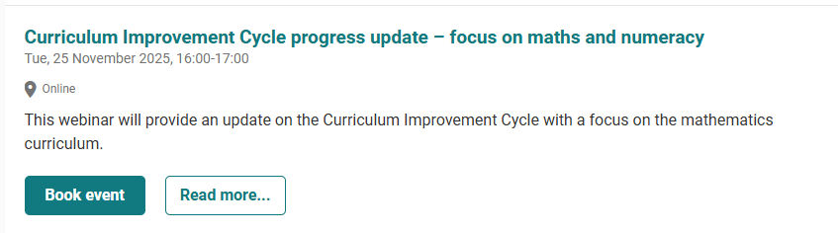
When can we see it?
CIC groups will share examples of emerging thinking during this session.
This is emerging thinking only – it is NOT what the final curriculum guidance will look like
It is shared so all teachers and practitioners have an opportunity to provide feedback during this co-creation phase
For a first example, see the recent Maths & Numeracy Webinar (November 2025) as associated materials
Notes:
SLIDE 17
Clear message: the groups will share EMERGING THINKING for feedback during the rest of this session – this is not how the final framework will look. The final framework will also be packaged appropriately for practitioners working in different sectors.
For a first example of emerging thinking, see the recent Maths & Numeracy webinar and associated materials:
https://blogs.glowscotland.org.uk/glowblogs/cices/2025/11/25/cic-maths-webinar-25-november-2025/
Encourage colleagues to use the feedback button on the CIC website to provide feedback on the emerging thinking documents.

Slide 18
Timeline
June 2026: Draft national guidance and draft technical framework available
August 2028: Formal adoption of changes to Early, First, Second and Third level
(e.g. current P2 ➔ P5; current S1 ➔ S4)
August 2029: Phased formal adoption of changes to Fourth level and beyond
Awareness Raising and Sense Making
August 2025 – June 2026 | August – December 2026 | January 2027 – June 2028
Curriculum Development Phase | Curriculum Alignment Phase | Sharing and Adopting Phase
Notes:
SLIDE 18
We are currently in the co-creation phase (phase 2) which will run until June.
In summer 2026, the draft curriculum guidance and technical framework will be available for comment and feedback for a 6 month period. We then move into Phase 3 – the Sharing, Learning and Adopting phase.
We have all of 2026/27 and 2027/28 to prepare for formal adoption of the refreshed curriculum.

Slide 19

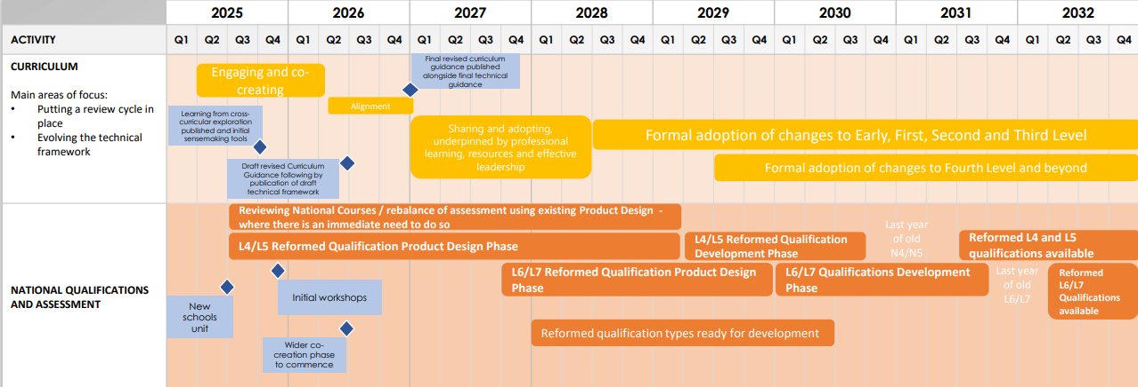
Joint timeline: curriculum and qualifications
Further information and a more detailed timeline are available in this document.
Note that CURRICULUM, QUALIFICATIONS and ASSESSMENT are joined together in this process of reform.
Updated qualifications are introduced from 2032.
Notes:
SLIDE 19
Supporting documents - Curriculum, Qualifications and Assessment Reform: progress to date and next steps - gov.scot
This timeline comes from the Scottish Government’s publication “Curriculum, Qualifications and Assessment Reform: Progress to date and next steps” (June 2025) (link in presenter notes).
Using either this, or the timeline on slide 12, it might be worth taking time to reflect on what this will mean for us.
For example, participants could use this timeline, or slide 12, to discuss each milestone and what it might mean for our team, our children and young people and families.
What does this mean – take some time to consider what this could mean for us.
SLIDES 12, 13, 14, 15 & 16 LINK TOGETHER

Slide 20
Key messages
Over 1500 teachers & practitioners are co-creating the evolved guidance and technical framework
These groups will begin to share emerging thinking during session 2025/26
See Maths & Numeracy Webinar (November 2025) for a first example of this
Draft guidance and technical framework available summer 2026
Professional learning and collaboration time over 2026/27, 2027/28 and 2028/29 to support enactment of the new guidance
Notes:
SLIDE 20
Reinforce these key messages which are in the Explainer document (November 2025): FINAL Curriculum Improvement Cycle Explainer for Teachers and Practitioners - designed v.1

Slide 21

Practical next steps?
Have we signed up to the CIC bulletin ? (4 per year)
Have we read and discussed the “Explainer for teachers and practitioners?”
Who in our school, setting, or cluster is involved in a CIC project group, and how can their perspectives help us?
Is there an opportunity for our team to discuss the CIC?
What do we need to start thinking about now for next year?
Notes:
SLIDE 21
This slide can be used either as a final summary or, along with the next slide and some of the optional activities, the basis of a longer discussion e.g. in a leadership team.

Slide 22
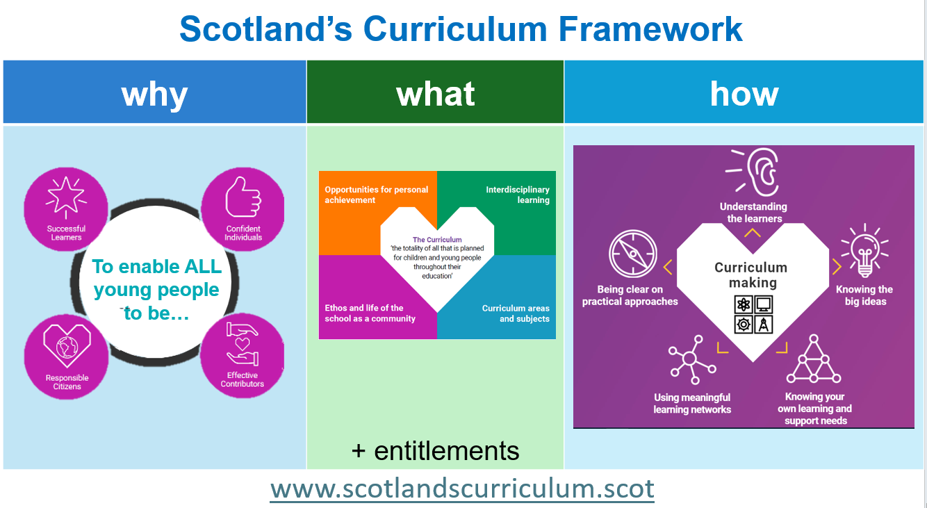
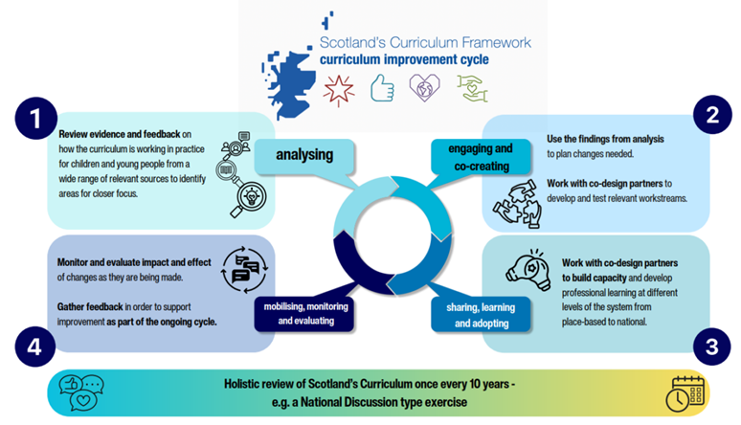

What does all this mean for us?
1. What have we already been working on that will help with our readiness for change?
2. What else might be important to start considering?
3. Who in our cluster is involved and can help our thinking?
4. What is our next step as a team
5. What do we need, as individuals and a team, to take that step?
Notes:
SLIDE 22
Time to reflect
This slide can be used either to support discussion as part of the session or, along with any of optional activities, as a basis for further dialogue e.g. in a leadership team.

Slide 23
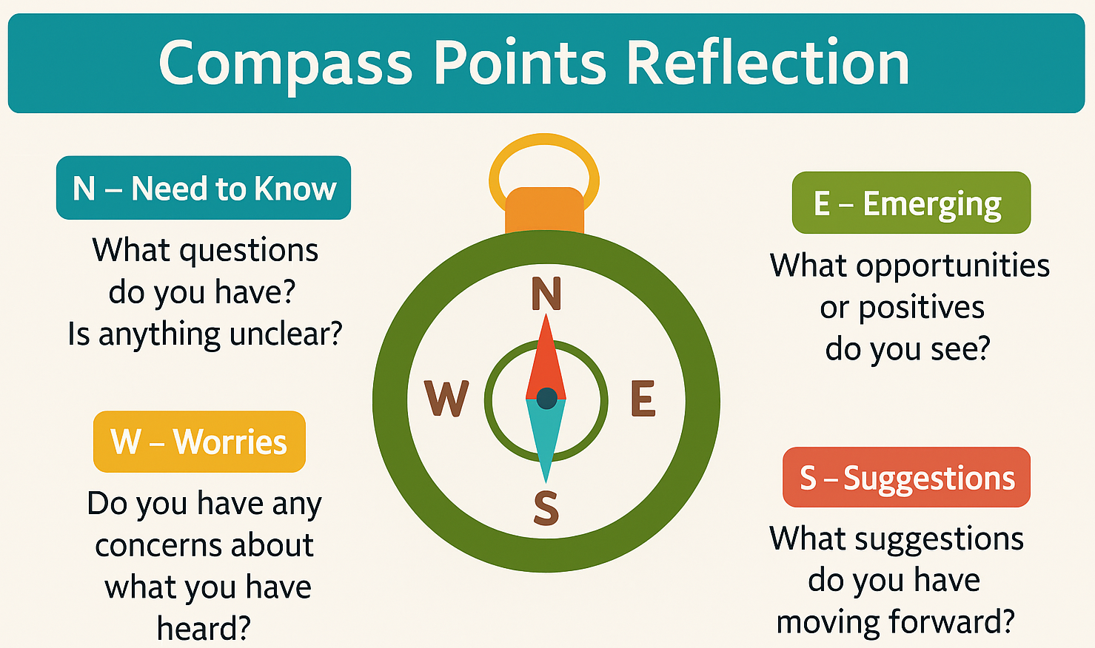
What does all this mean for us?
Notes:
SLIDE 23
Time to reflect
The compass tool can support and scaffold discussions about change.
This slide can be used either to support discussion as part of the session or, along with any of optional activities, as a basis for further dialogue e.g. in a leadership team.
Reflection
N – Need to Know What questions do you have? What is unclear?
W – Worries Do you have any concerns about what you have heard?
E – Emerging What opportunities or positives do you see?
S – Suggestions What suggestions do you have moving forward?
Introduction
Explain that the compass points represent different angles for thinking about an idea, plan, or piece of information.
Set the Context
CIC to date
Individual Reflection (5–10 mins)
Ask participants to respond to each prompt individually. This ensures everyone has time to think.
Small Group Discussion (10–15 mins)
In groups, share responses and look for common themes or contrasting viewpoints.
Whole Group Debrief
Collect key points.
Highlight:
Questions that need clarification
Concerns to address
Opportunities to leverage
Suggestions for next steps
Possible Action Planning
Consider using responses to inform next steps.
Considering what are you already doing, what else do you need.

Slide 24

Evaluation
Notes:
SLIDE 24
You may choose to add your own evaluation here

Slide 25
Optional group / team sense-making activities
Note that there is no expectation on schools and settings to engage in CIC-related work this year, other than early awareness-raising.
These suggestions are simply provided to support individuals or teams who have identified they wish to think further about early-sensemaking and / or preparation.
Options for ‘Sense-making’ and preparing the ground
Read & discuss the “CIC Explainer for teachers & practitioners” (November 2025) | This is a 4-page, accessible document aiming to cover the essential ‘need-to-know’ information for practitioners. | FINAL Curriculum Improvement Cycle Explainer for Teachers and Practitioners - designed v.1
2. Individual podcast / webinar choice | Choose from the range of podcasts, webinars and LinkedIn articles which showcase a variety of participants sharing their experiences of co-design and perspectives on the developing work. This could be an individual activity or followed-up with a team discussion. | Latest News – Curriculum Improvement Cycle
3. Jigsaw reading of Paper 1, 2 and / or Paper 3 | Divide one or more of the papers into sections to read. Compare reflections and reactions in a team discussion. | Curriculum Improvement Cycle – Education Scotland
4. Explore the ‘Why, What and How’ of the curriculum offer in our setting | Use these materials drawn from Scotland’s sessions with global educators to support reflection of our school / setting curriculum offer. How are the 4 capacities developed for all of our children and young people? | Theme 1: Why, what, who and how of education | Global voices, Scottish classrooms: exploring themes in education | Leading professional learning | Professional Learning | Education Scotland
5. Consider how we might use Youth Voice Toolkit to deepen our understanding of our learners’ experiences and views on our curriculum offer | Explore the new Youth Voice Toolkit and how it can support us to work alongside our children and young people in understanding their views and experiences of the curriculum offer in our setting. | Youth Voice Toolkit | Resources | Education Scotland
6. Engage with the emerging thinking | View the recording of the Maths webinar, review the examples of emerging thinking and provide feedback via the MS Form. | CIC Maths Webinar 25 November 2025 – Curriculum Improvement Cycle
7. Team discussion: what does this all mean for us | Either as part of a session using the earlier slides, and / or following any of the activities above, hold a space for leadership team and / or teacher and practitioner colleagues to explore what this means for our setting | Slides 22 and 23 could be used to support a discussion.
Notes:
SLIDE 25
The following slides include OPTIONAL activities which may support or scaffold current work around curriculum design at school / setting level and / or inform thinking about preparation for next year.
Note that there is no expectation on schools and settings to engage in CIC-related work this year, other than early awareness-raising. These suggestions are simply provided, based on feedback, as to activities that might help early sense-making and thinking about next year.

Slide 26
Read and discuss the ‘Explainer’
This document was shared alongside the first examples of emerging thinking in November 2025.
It is a useful starting point to explore the key messages and timeline for the CIC.
FINAL Curriculum Improvement Cycle Explainer for Teachers and Practitioners - designed v.1
Notes:
SLIDE 26
OPTIONAL activities which may support or scaffold current work around curriculum design at school / setting level and / or inform thinking about preparation for next year.
Note that there is no expectation on schools and settings to engage in CIC-related work this year, other than early awareness-raising. These suggestions are simply provided, based on feedback, as to activities that might help early sense-making and thinking about next year.

Slide 27

Individual podcast / webinar choice
Choose from the range of podcasts, webinars and LinkedIn articles which showcase a variety of participants sharing their experiences of co-design and perspectives on the developing work.
Colleagues could share reflections as a team after listening.
Possible discussion questions:
.
What is one observation or reflection you have after listening?
Why does this observation or reflection stand out to you?
What did you hear that excited you, or resonated positively?
What did you hear that challenged you?
How does this connect with your experiences and practice?
Latest News – Curriculum Improvement Cycle
Notes:
SLIDE 27
OPTIONAL activities which may support or scaffold current work around curriculum design at school / setting level and / or inform thinking about preparation for next year.
Note that there is no expectation on schools and settings to engage in CIC-related work this year, other than early awareness-raising. These suggestions are simply provided, based on feedback, as to activities that might help early sense-making and thinking about next year.

Slide 28


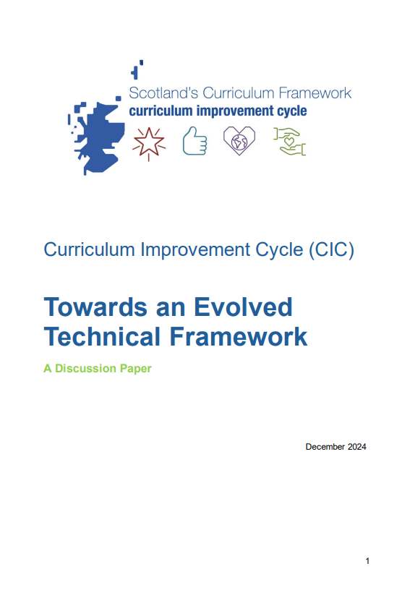
Jigsaw reading of Paper 1, 2 and / or Paper 3
Divide one or more of the papers into sections to read. Compare reflections and reactions in a team discussion.
Read an assigned section and discuss
Main ideas and purpose of this section
How this connects to your experiences and practice
Curriculum Improvement Cycle – Education Scotland
Notes:
SLIDE 28
OPTIONAL activities which may support or scaffold current work around curriculum design at school / setting level and / or inform thinking about preparation for next year.
Note that there is no expectation on schools and settings to engage in CIC-related work this year, other than early awareness-raising. These suggestions are simply provided, based on feedback, as to activities that might help early sense-making and thinking about next year.

Slide 29
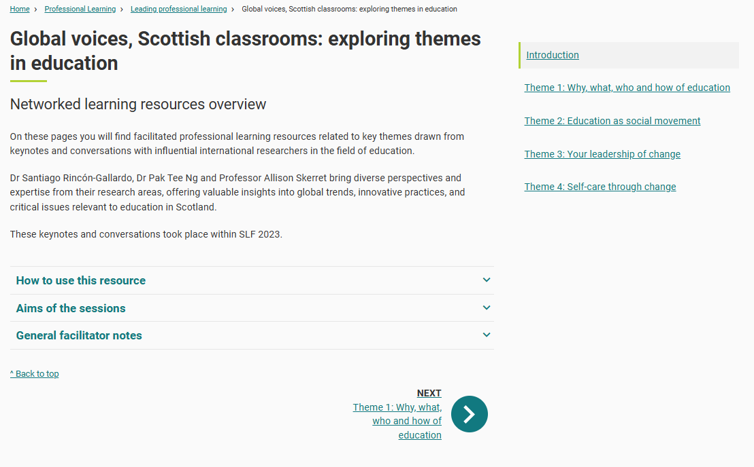
Explore the ‘Why, What and How’ of the curriculum offer in our setting
Use these materials drawn from Scotland’s sessions with global educators to support reflection of our school / setting curriculum offer. How are the 4 capacities developed for all our children and young people?
Some reflective questions:
Which observation or reflection from the Global Voices resource challenges your current thinking the most?
What practical change could you make in your planning or pedagogy as a result of this reflection?
https://education.gov.scot/professional-learning/leading-professional-learning/global-voices-scottish-classrooms-exploring-themes-in-education/theme-1-why-what-who-and-how-of-education/
Notes:
SLIDE 29
OPTIONAL activities which may support or scaffold current work around curriculum design at school / setting level and / or inform thinking about preparation for next year.
Note that there is no expectation on schools and settings to engage in CIC-related work this year, other than early awareness-raising. These suggestions are simply provided, based on feedback, as to activities that might help early sense-making and thinking about next year.

Slide 30


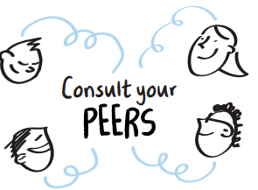
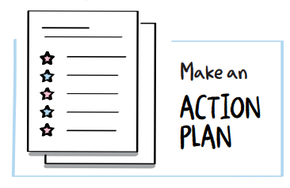
Youth Voice Toolkit
Consider how we might use Youth Voice Toolkit to deepen our understanding of our learners’ experiences and views on our curriculum offer.
The Youth Voice Toolkit aims to support a genuine approach to youth voice and consultation activities across schools and communities. The toolkit contains implementation guidance, the Empowering Youth Voice Resource Pack and support materials for practitioners and leaders. It has been developed by Education Scotland CLD officers and informed by local and regional models across the country. The toolkit can be used within individual school and community settings and can also be used to develop a broader approach to youth voice across organisations and local authorities.
Explore the new Youth Voice Toolkit and how it can support us to work alongside our children and young people in understanding their views and experiences of the curriculum offer in our setting.
Youth Voice Toolkit | Resources | Education Scotland
Notes:
SLIDE 30
OPTIONAL activities which may support or scaffold current work around curriculum design at school / setting level and / or inform thinking about preparation for next year.
Note that there is no expectation on schools and settings to engage in CIC-related work this year, other than early awareness-raising. These suggestions are simply provided, based on feedback, as to activities that might help early sense-making and thinking about next year.

Slide 31
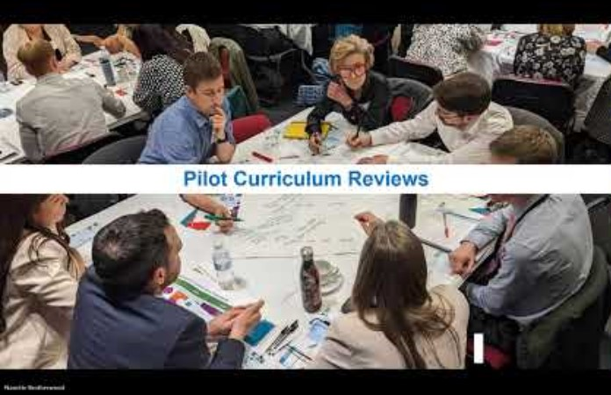
Engage with the emerging thinking
View the recording of the Maths webinar, review the examples of emerging thinking and provide feedback via the MS Form.
CIC Maths Webinar 25 November 2025 – Curriculum Improvement Cycle
Notes:
SLIDE 31
OPTIONAL activities which may support or scaffold current work around curriculum design at school / setting level and / or inform thinking about preparation for next year.
Note that there is no expectation on schools and settings to engage in CIC-related work this year, other than early awareness-raising. These suggestions are simply provided, based on feedback, as to activities that might help early sense-making and thinking about next year.

Slide 32
What does all this mean for us?
Either as part of a session using the earlier slides, and / or following any of the activities above, hold a space for leadership team and / or teacher and practitioner colleagues to explore what this means for our setting.
What have we already been working on that will help with our readiness for change?
What else might be important to start considering?
Who in our cluster is involved and can help our thinking?
What is our next step as a team
What do we need, as individuals and a team, to take that step?
Notes:
SLIDE 32
OPTIONAL activities which may support or scaffold current work around curriculum design at school / setting level and / or inform thinking about preparation for next year.
Note that there is no expectation on schools and settings to engage in CIC-related work this year, other than early awareness-raising. These suggestions are simply provided, based on feedback, as to activities that might help early sense-making and thinking about next year.

Slide 33
Optional individual sense-making activities
Any of these might work as optional individual tasks in advance of or following the sessions. The short CIC explainer video can also be used during the session.
Read
Discussion paper 1: Background and A Case For Change
Watch
CIC explainer video
Listen
Background and Case for Change Podcast
Do
Familiarise yourself with the CIC blog and sign up for the newsletter
Notes:
SLIDE 33
Read, Watch, Listen & Do tasks. This is a selection of resources with further information on the background to the CIC.
Select resources and approach to suit your team.
Either in advance of the session, during the session or following the session, participants can further familiarise themselves with Paper 1
The CIC explainer video is a short clip that can be included in a session.
Read, Watch, Listen & Do tasks. Either in advance of the session, during the session or following the session, participants can further familiarise themselves with Paper 1
Reading paper 1 as a leadership / setting / jigsaw reading team, might be a helpful task to provoke reflection and professional dialogue on the reasons for evolving Scotland’s Curriculum

