Slide 1
Technologies
Core Group Meeting, July 2025
Curriculum Improvement Cycle

Slide 2
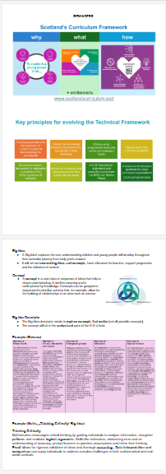
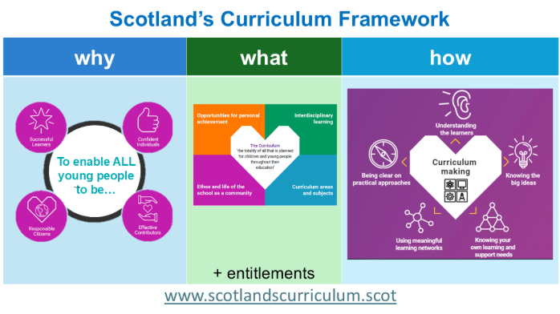
Reminders

Slide 3
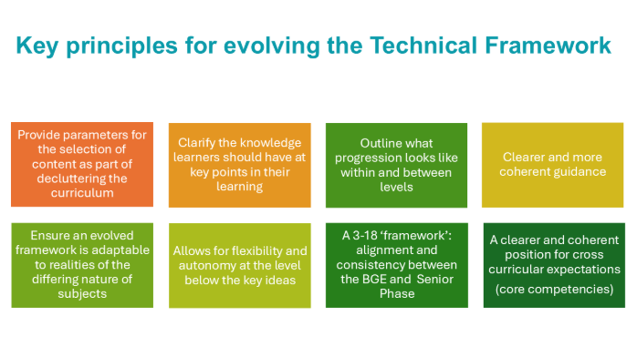
Reminders

Slide 4
4 Day Agenda
Day 1: Agree the Purpose/Rationale for the Technologies
Day 2: Identify the Big Ideas in the Technologies
Day 3: Explore and Define the Big Ideas in the Technologies
Day 4: Agree the Big Ideas in the Technologies; Explore next steps
Note: There is an element of flexibility built into Day 4 based on previous core group meetings

Slide 5
DAY 1
PURPOSE: Agree the Purpose/Rationale for the Technologies

Slide 6
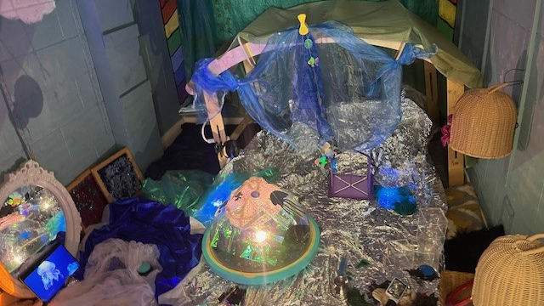
Early level technologies….
What can it look, sound, and feel like?

Slide 7
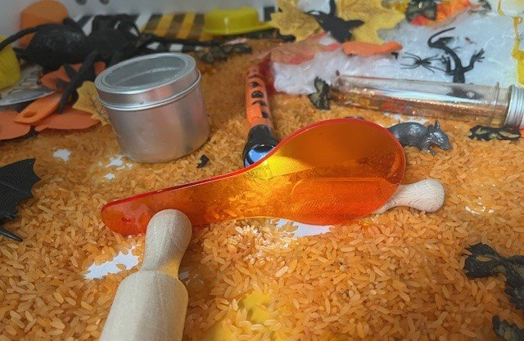
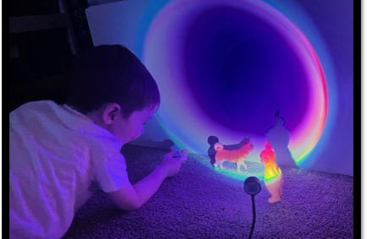

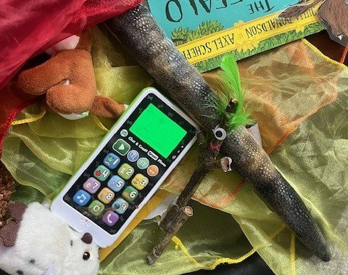
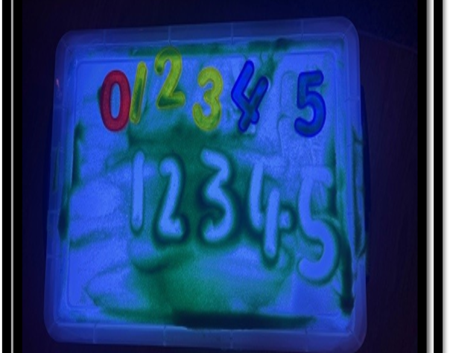
Notes:
“Digital technologies provide opportunities for us to design unique learning spaces for the children​” Realising the Ambition: Being Me.
RtA reminds to 'listen with our eyes and ears' to ask ourselves what is the child learning, what is significant here? Like Loris Mallaguzzi's One hundred Languages of the Child, RtA tells us children's actions and emotions as well as words, tell us about their learning. Digital technology opens up many different options for communicating and expressing feeling and meaning. Page 64.​
The learning environment, in terms of interactions, experiences and spaces both outside and in, must be carefully considered to support children’s learning. We need to be able to view the environment through the eyes of the children we are working with and ask ourselves: What does this environment for play look and feel like to a baby, a toddler, a young child?

Slide 8

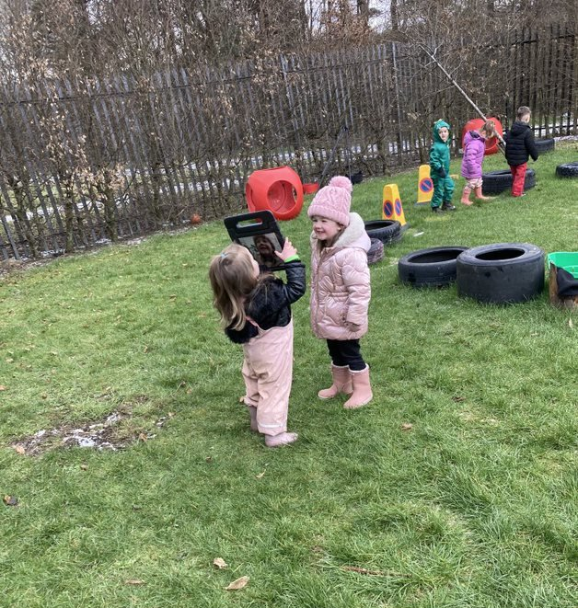
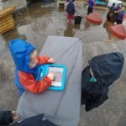
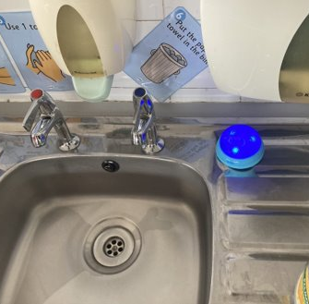
Notes:
Notice the technology outdoors?
Photo credit West Lothian Council ELC settings.

Slide 9
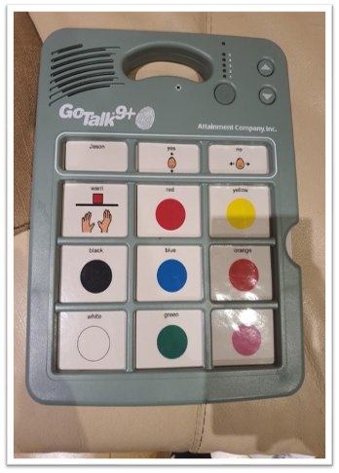
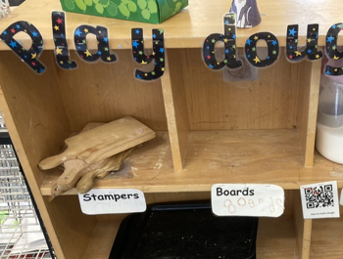
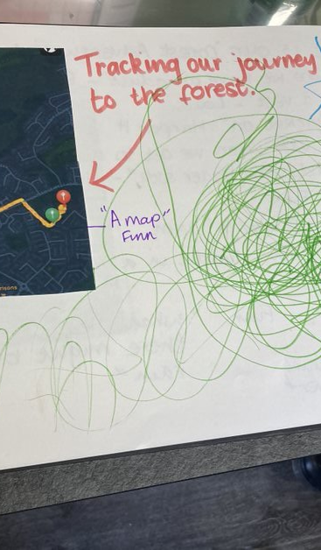
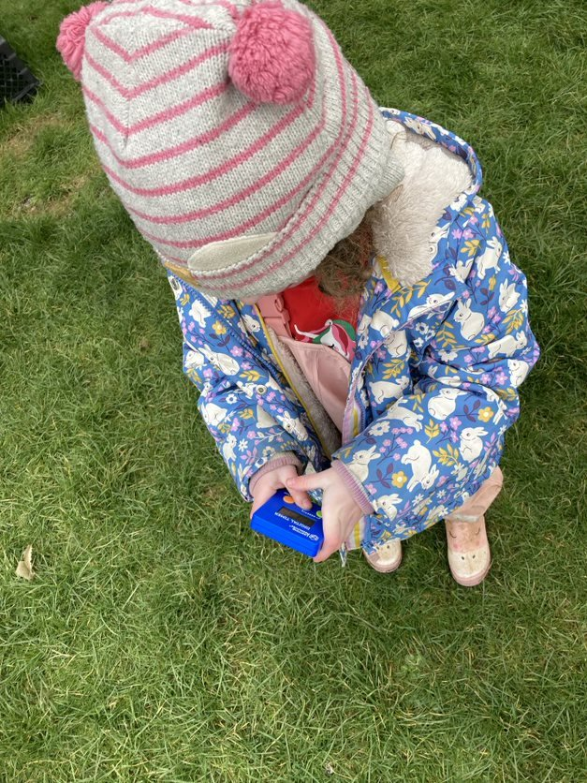
Notes:
Notice the accessibility technology, medical assistive technology and experiences being revisited thanks to the technology. It provides that synergy.
Photo credit West Lothian Council ELC settings.

Slide 10


Notes:
What did we do before?

Slide 11
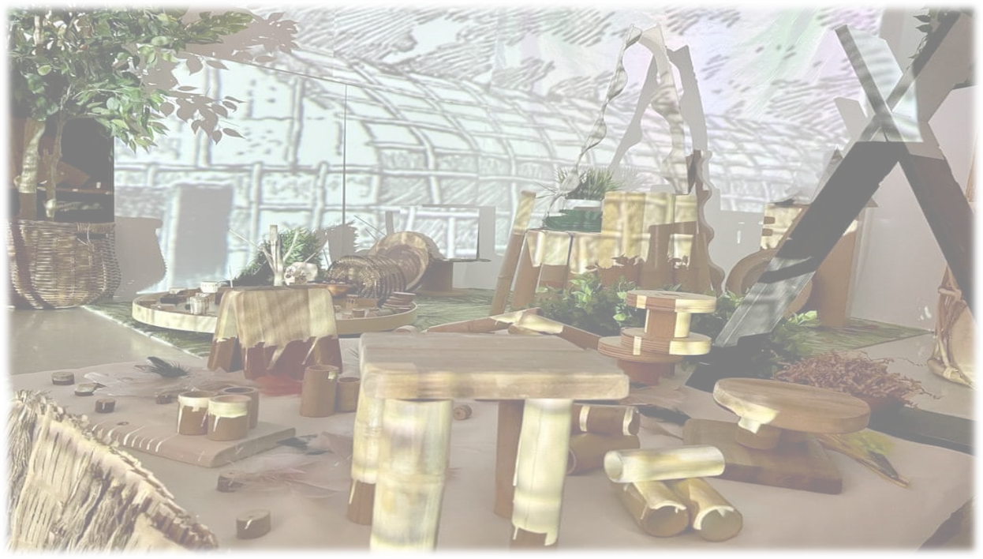
Digital technologies create geographies of place and representation close to children's visions of possible and dream worlds, with awareness that the imaginary worlds they bring to life always border on the world they inhabit……..
Tedeschi, M. et al. (2021)
Notes:
Technologies as a language.
Emphasizing the synergy between children's imaginative capacities and digital technologies. It redefines digital tools not just as instruments but as environments that foster relational, cognitive, and expressive devlopment.
"The Hundred Languages of Digital in the Reggio Emilia Approach" by Maddalena Tedeschi, Elena Maccaferri, and Annalisa Rabotti, published in the Journal of e-Learning and Knowledge Society (Vol. 17, No. 3, 2021)
Image credit Kinderoo Children’s Academy USA Home - Kinderoo Children’s Academy

Slide 12
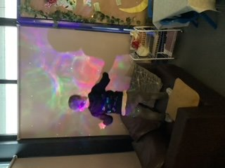
Human infants are naturally attracted to multisensory stimuli, and their brains appear to be tuned to process such information. This is reflected in their facilitation in processing multisensory information over unisensory information, which is a pattern that persists into adulthood.
Nava, E. et al. (2024)
Notes:
Nava, E. et al. (2024) 'The emergence of the multisensory brain: From the womb to the first steps', iScience, 27(1), p. 108758. Available at: https://www.tandfonline.com/doi/full/10.1080/03004430.2019.1695127 .

Slide 13
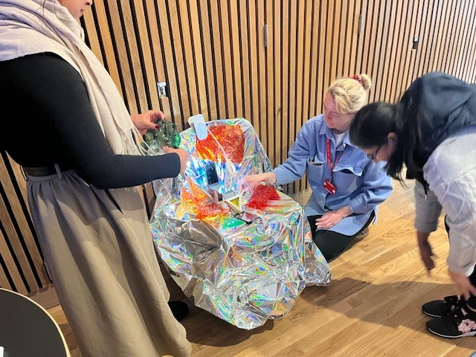
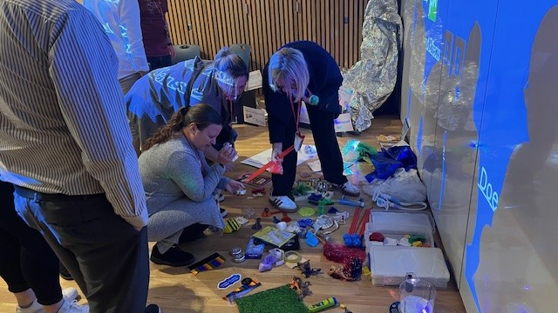

Slide 14
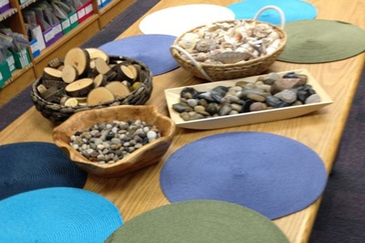
materials, shapes and smells
other physical phenomena, such as electricity, magnetism and gravity
media such as gases and fluids; sounds, music, motion; chemical interactions, cooking and fire
and other humans, and animals, plants, words, concepts and ideas
Notes:
What about loose parts? Have you ever considered technologies as a loose part?
Light and sound?
Loose parts play theory was devised by architect Simon Nicholson in the 1970s, developing the idea that moveable materials that can be constructed and taken apart create limitless possibilities for creativity.
In his theory of Loose Parts Play, he cites playing with forces as an integral part of enriched play environments. Nicholson described loose parts as ‘variables’ and provided examples such as.... CLICK
Nicholson, S. (1971). How NOT to Cheat Children: The Theory of Loose Parts. Landscape Architecture, 62(1), 30–34. http://www.jstor.org/stable/44663886
Loose-Parts-Play-Toolkit-2019-web.pdf (inspiringscotland.org.uk)

Slide 15
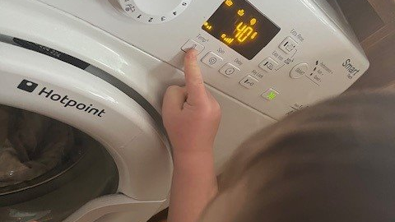
Notes:
Importance of real-life experience! First experiences, cause & effect.

Slide 16
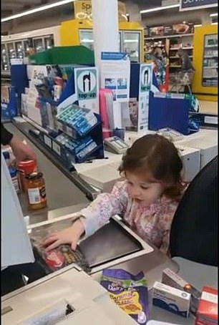
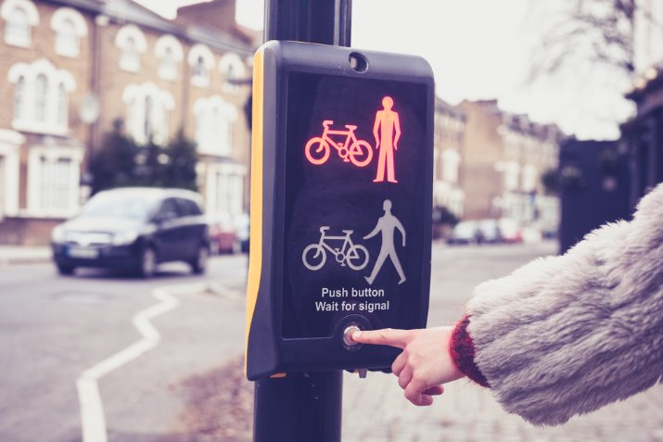
Notes:
Photo credit - Daily Mail Image of child scanning groceries https://sl.bing.net/eZaPUxdEoj6

Slide 17
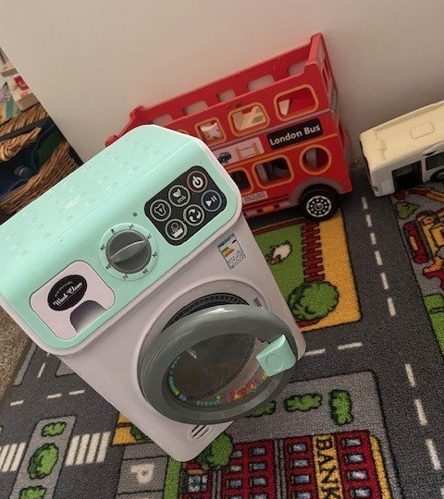
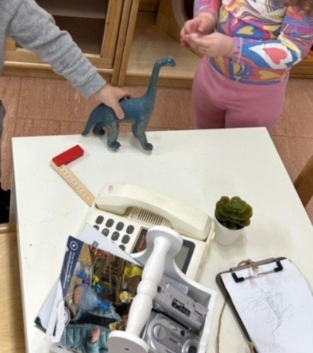
Notes:
We know children make sense of what they see and hear by repeating actions in their imaginative play.
It might be through a toy or a symbolic resource such as a cardboard box TV.

Slide 18
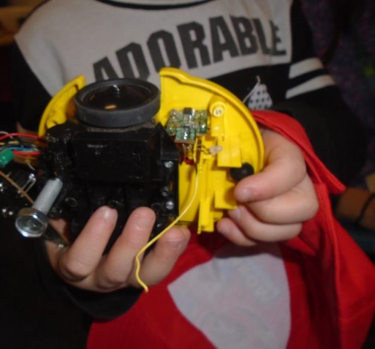
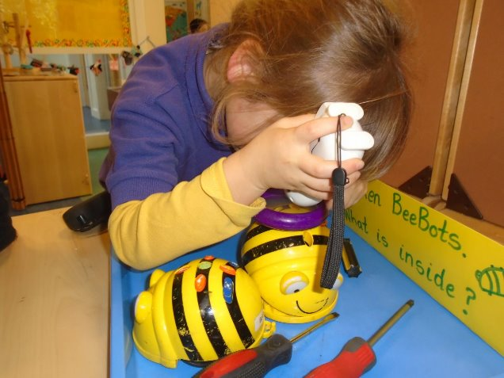
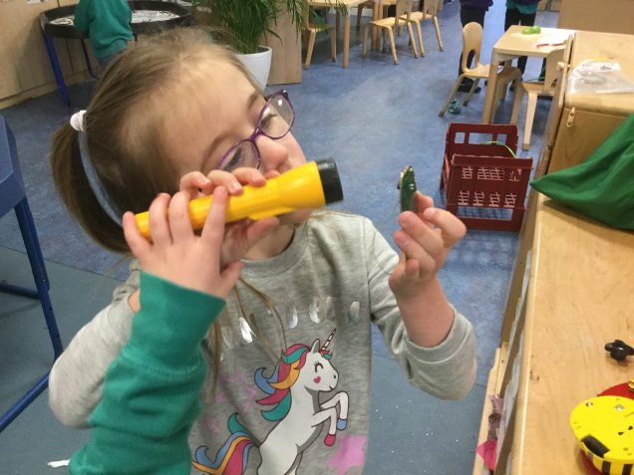
Notes:
Photo credit Broken BeeBot Investigators. – Bathgate Early Years Centre (glowscotland.org.uk)
Please see SSERC guidance on doing this safely

Slide 19
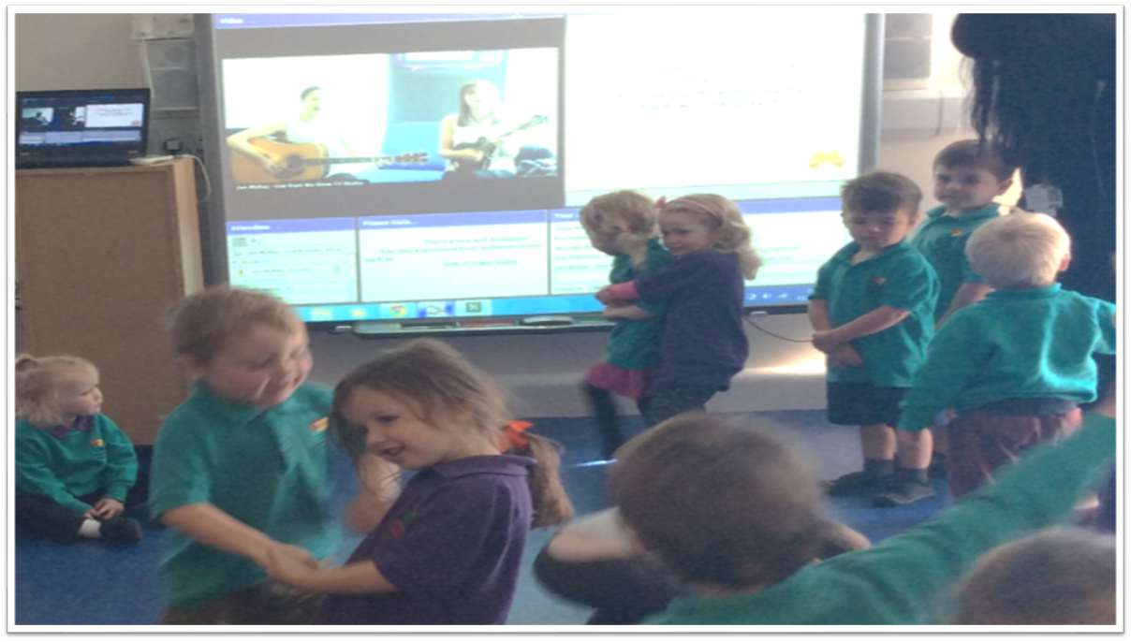
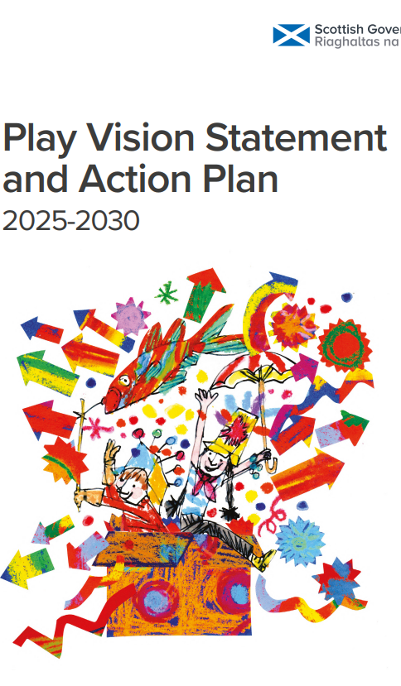
Teamwork
Social skills
Problem solving
CRIS
Notes:
Page 20 Online play – opportunities to practice teamwork, improve social skills, problem solving.
It also highlights the importance of CRIS.
More info:
The vision for Scotland is that play is welcomed, celebrated and nurtured. The Strategy aims to ensure that every child is able to play across all stages and aspects of their life to support their social development, resilience, language and communication development, health, physical and mental wellbeing. Our Action Plan outlines some of the crucial steps we will undertake until 2030 that empower and support more play opportunities for all children in Scotland.
Play Vision Statement and Action Plan 2025-2030
Photo credit: Scotland Sings on Glow TV – Bathgate Early Years Centre (glowscotland.org.uk)

Slide 20

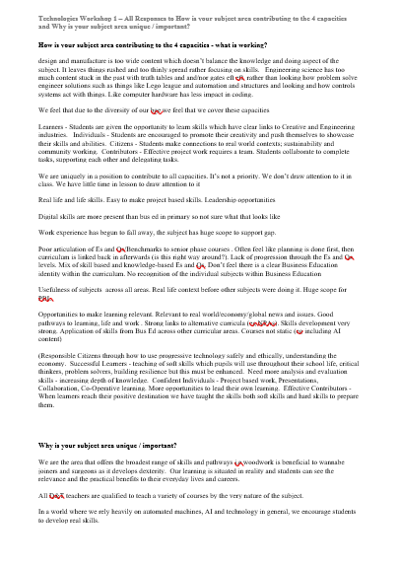
GROUP ACTIVITY
In groups, discuss and consider the feedback from the collaboration days.
- How is your subject area contributing to the 4 capacities,
- Why is your subject area unique / important?
Craft a response to the question “What is the purpose of the Technologies”
https://tinyurl.com/techcore1

Slide 21
GALLERY WALK
Put group definition on large paper and stick to wall
Groups circulate and read all responses

Slide 22
DAY 2
PURPOSE: Identify the Big Ideas in the Technologies

Slide 23
Is it right?
Do we need to make any changes?

Slide 24
Technologies ‘Big Ideas’
International Perspectives

Slide 25
EXAMPLE: International Big Ideas (Bus Ed) - Simplified
New Zealand – Business Studies
Big Ideas:
  How economic decisions affect well-being.
  How businesses respond to opportunities and constraints.
  Business ethics and responsibilities.
Ontario, Canada – Business Studies
Big Ideas:
  Interdependence of local & global businesses.
  Financial literacy and informed decision-making.
  Entrepreneurial activity as economic driver.
England – Enterprise & Business (within Citizenship and Careers)
Big Ideas:
  Economic and business understanding.
  The roles of work, entrepreneurship and enterprise.
  Ethical consumerism and globalisation.

Slide 26
EXAMPLE: International Big Ideas (CS) - Simplified
England – Computing Programmes of Study
Big Ideas:
  Algorithms, logic and programming.
  Digital literacy and safe, responsible use.
USA – AP Computer Science Principles
Big Ideas:
  Creative Development, Data & Information.
  Algorithms & Programming.
  Impact of Computing.
New Zealand – Digital Technologies
Big Ideas:
  Computational thinking (abstraction, decomposition).
  Designing and developing digital outcomes.

Slide 27
EXAMPLE: International Big Ideas (CDEG) - Simplified
England – Design & Technology
Big Ideas:
  Iterative design process: investigate, design, make, evaluate.
  Sustainability and user-centred design.
  Applying knowledge of materials and systems.
Queensland, Australia – Design & Technologies
Big Ideas:
  Preferred futures and sustainability.
  Using technologies to solve real-world problems.
Alberta, Canada – CTF & CTS
Big Ideas:
  Design thinking, iteration, and prototyping.
  Exploring impacts of technology on society and environment.

Slide 28
GROUP ACTIVITY
In groups, look at the collection of big ideas from across the globe.
Try to gather some of these ideas by themes into bundles.

Slide 29
ACTIVITY: How might you gather and group these by themes?
  How economic decisions affect well-being.
  How businesses respond to opportunities and constraints.
  Business ethics and responsibilities.
  Interdependence of local & global businesses.
  Financial literacy and informed decision-making.
  Entrepreneurial activity as economic driver.
  Economic and business understanding.
  The roles of work, entrepreneurship and enterprise.
  Ethical consumerism and globalisation.
  Algorithms, logic and programming.
  Digital literacy and safe, responsible use.
  Creative Development, Data & Information.
  Algorithms & Programming.
  Impact of Computing.
  Computational thinking (abstraction, decomposition).
  Designing and developing digital outcomes.
  Iterative design process: investigate, design, make, evaluate.
  Sustainability and user-centred design.
  Applying knowledge of materials and systems.
  Preferred futures and sustainability.
  Using technologies to solve real-world problems.
  Design thinking, iteration, and prototyping.
  Exploring impacts of technology on society and environment.

Slide 30
EXAMPLE: How might you gather and group these by themes?
  How economic decisions affect well-being.
  How businesses respond to opportunities and constraints.
  Business ethics and responsibilities.
  Interdependence of local & global businesses.
  Financial literacy and informed decision-making.
  Entrepreneurial activity as economic driver.
  Economic and business understanding.
  The roles of work, entrepreneurship and enterprise.
  Ethical consumerism and globalisation.
  Algorithms, logic and programming.
  Digital literacy and safe, responsible use.
  Creative Development, Data & Information.
  Algorithms & Programming.
  Impact of Computing.
  Computational thinking (abstraction, decomposition).
  Designing and developing digital outcomes.
  Iterative design process: investigate, design, make, evaluate.
  Sustainability and user-centred design.
  Applying knowledge of materials and systems.
  Preferred futures and sustainability.
  Using technologies to solve real-world problems.
  Design thinking, iteration, and prototyping.
  Exploring impacts of technology on society and environment.

Slide 31
EXAMPLE: How might you gather and group these by themes?
  How economic decisions affect well-being.
  How businesses respond to opportunities and constraints.
  Business ethics and responsibilities.
  Interdependence of local & global businesses.
  Financial literacy and informed decision-making.
  Entrepreneurial activity as economic driver.
  Economic and business understanding.
  The roles of work, entrepreneurship and enterprise.
  Ethical consumerism and globalisation.
  Algorithms, logic and programming.
  Digital literacy and safe, responsible use.
  Creative Development, Data & Information.
  Algorithms & Programming.
  Impact of Computing.
  Computational thinking (abstraction, decomposition).
  Designing and developing digital outcomes.
  Iterative design process: investigate, design, make, evaluate.
  Sustainability and user-centred design.
  Applying knowledge of materials and systems.
  Preferred futures and sustainability.
  Using technologies to solve real-world problems.
  Design thinking, iteration, and prototyping.
  Exploring impacts of technology on society and environment.
Systems Thinking & Interconnectedness
globalisation, market systems. Interdependence, impact of computing systems, how choices affect entire production system, preferred futures

Slide 32
ACTIVITY: How might you gather and group these by themes?
  How economic decisions affect well-being.
  How businesses respond to opportunities and constraints.
  Business ethics and responsibilities.
  Interdependence of local & global businesses.
  Financial literacy and informed decision-making.
  Entrepreneurial activity as economic driver.
  Economic and business understanding.
  The roles of work, entrepreneurship and enterprise.
  Ethical consumerism and globalisation.
  Algorithms, logic and programming.
  Digital literacy and safe, responsible use.
  Creative Development, Data & Information.
  Algorithms & Programming.
  Impact of Computing.
  Computational thinking (abstraction, decomposition).
  Designing and developing digital outcomes.
  Iterative design process: investigate, design, make, evaluate.
  Sustainability and user-centred design.
  Applying knowledge of materials and systems.
  Preferred futures and sustainability.
  Using technologies to solve real-world problems.
  Design thinking, iteration, and prototyping.
  Exploring impacts of technology on society and environment.

Slide 33
Each group to share international Big Ideas thematic groupings.

Slide 34
What might big ideas across these look like?
Big Idea | Business Education | Computing Science | Design & Technology
Problem-solving & Innovation | decisions that create well-being, entrepreneurship | creative development in code, designing digital outcomes | design processes, solving real-world problems, design thinking
Systems Thinking & Interconnectedness | globalisation, market systems. interdependence | impact of computing systems | how choices affect entire production system, preferred futures
Ethics, Responsibility & Impact | ethical business decisions, responsible consumer choices | social impact | impacts on society & environment
Iteration & Resilience | Business plans evolve with research, adapt to changing markets | Debugging & revising code, iterative software development | investigate, design, make, evaluate cycle; prototyping
Communication & Collaboration | Marketing pitches, presentations | Documenting programs, sharing code, Team projects | User interviews, collaborative design workshops
Adaptation & Future Focus | changing markets | digital citizenship & future tech, preparing for future jobs | preferred futures & sustainability, lifelong design skills

Slide 35
What might big ideas across these look like?
Shared Big Idea | How it cuts across the areas
Problem-solving & innovation | Design new products, algorithms, business models
Systems thinking | Understand how tech, business, and society interlink
Ethics & impact | Environmental, social, economic, digital responsibilities
Iteration & resilience | Prototype, test, revise in all fields
Communication & collaboration | Presenting ideas, teamwork, stakeholder engagement
Adaptation & future focus | Preparing for new tech, evolving jobs, global changes

Slide 36
Technologies ‘Big Ideas’
Examine the evidence from Collaboration Day

Slide 37
Example Technologies Big Ideas
Contextual Digital Fluency and Technical Mastery
Communication and Collaborative Practice In Action
Growth Through Making and Iteration
Sustainable and Ethical Innovation
Design-led problem solving is central to developing technological and business solutions

Slide 38
ACTIVITY
Identify the common themes emerging from Technologies Collaboration Day
https://tinyurl.com/techcore1

Slide 39
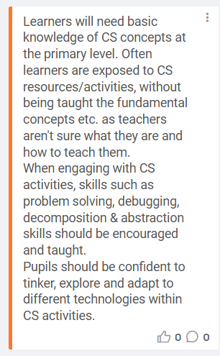
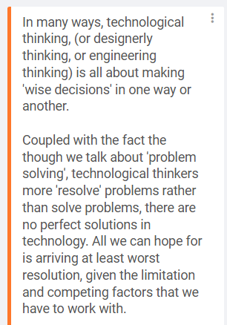
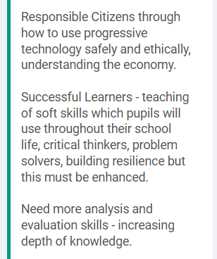
ACTIVITY: Identify Common Themes Emerging from Technologies Collaboration Day
Sample feedback
from across the Technologies subject areas

Slide 40
Common Themes Emerging from Technologies
Example
Problem
Solving

Slide 41
EXAMPLE: Common Themes Emerging from Technologies
Identify the common themes - 1 per post it
Problem
Solving
Technical Knowledge
Emerging Technology
Digital Skills
Data Literacy
Critical Thinking
Real World Relevance
Design Thinking

Slide 42
Bundle Your Themes
Problem
Solving
Technical Knowledge
Emerging Technology
Digital Skills
Data Literacy
Critical Thinking
Real World Relevance
Design Thinking

Slide 43
Bundle Your Themes
Problem
Solving
Technical Knowledge
Emerging Technology
Design Thinking
Data Literacy
Real World Relevance
Critical Thinking
Digital Skills

Slide 44
Decide upon a title for each bundle
????
????
????
Problem
Solving
Technical Knowledge
Emerging Technology
Design Thinking
Data Literacy
Real World Relevance
Critical Thinking
Digital Skills

Slide 45
Are there any that are ‘core competencies? If so remove
????
????
????
Problem
Solving
Technical Knowledge
Emerging Technology
Design Thinking
Data Literacy
Real World Relevance
Critical Thinking
Digital Skills

Slide 46
Are there any that are ‘core competencies? If so remove
????
????
????
CORE
Problem
Solving
Technical Knowledge
Emerging Technology
Digital Skills
Design Thinking
Data Literacy
Real World Relevance
Critical Thinking

Slide 47
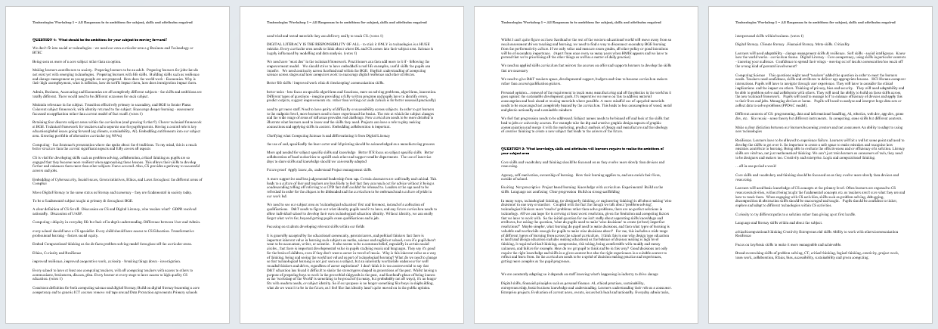
https://tinyurl.com/techcore1
RESOURCES
Responses to What should be the ambitions for your subject be moving forward? and What knowledge, skills and attributes will learners require to realise the ambitions of your subject area

Slide 48
Group Sharing Gallery Walk
Each group to share bundling activity

Slide 49
What are our overarching themes?
We need to collectively decide on 4/ 5 over arching themes for technologies that will form the Big Ideas

Slide 50
DAY 3
PURPOSE: Explore and Define the Big Ideas in the Technologies

Slide 51
Activity
In sector and subject groups consider the draft Purpose statement.
Does it work for your sector/subject?
What needs to change?

Slide 52
Descriptor Checklist
Big Ideas should capture the core understanding children and young people will develop throughout their curricular journey from early years onward.
A concept is a main idea or sequence of ideas that help to shape understanding. It clarifies meaning and is underpinned by knowledge. Concepts can be grouped or sequenced to develop schema that, for example, allow for the building of relationships in an area such as science.

Slide 53
Activity
In groups, before we draft a definition for each big idea, consider each big idea and discuss and note down the underlying concepts eg

Slide 54
EXAMPLE: Exploring Concepts Further
Design-led problem solving is central to developing technological and business solutions
Critical Thinking
Design Thinking / Iterative Development
Resilience / Risk Taking
Product development
Development methodologies
Information Analysis and Interpretation
Decision Making
Analysis
Interpretation
Inferencing
Questioning
Evaluation and Judgement
Evaluation
Reasoning

Slide 55
Activity
In groups, develop and refine each of the overarching themes
eg Problem Solving might evolve into…
  Design-Led Problem Solving
  Design-Led Problem Solving is at the heart of technological development
  Design-led problem solving is central to developing technological and business solutions

Slide 56
Share
So, what are our 4/5 developed themes. These are our Big Ideas

Slide 57
Activity
In groups, draft a definition for each big idea
Remember, The definition needs to capture concepts that matter, not all possible concepts. (The concept will sit in the understand point of the K-D-U knot.)

Slide 58
Example Definition
Design-led problem solving is central to developing technological and business solutions
Learners tackle appropriately complex, open-ended challenges and apply logical analysis and structured design approaches. Learners develop ideas in response to real-world needs, applying research, ideation, prototyping, and evaluation processes. They engage with authentic contexts, drawing connections between technical challenges and social or environmental issues. The focus is developing strategies that are both functional and innovative, positioning learners as confident creators of purpose-driven solutions.

Slide 59
GALLERY WALK
Put group definitions on large paper and stick to wall
Groups circulate and read all responses

Slide 60
DAY 4
PURPOSE: Agree the Big Ideas in the Technologies

Slide 61
Discussions
Have we identified and been explicit about the concepts in each big idea?
How does this sit within subject areas and sectors?

Slide 62
Core Comptencies
Where in the Technologies might core competencies find a home?

Slide 63
THANK YOU!
What might the next collaboration day look like?
What can we ask the critical friends to do?

