Slide 1
Technologies Collaboration Group
Meeting 1
29th May 2024

Slide 2


Slide 3


Outline of the day
09:45 | Arrival and Registration
10:10 | Welcome
10:40 | Activity A: Group Knowledge Capture – Subject Specific Groups
11:30 | Break
11:45 | Activity B: Group Discussions – Subject Specific Groups – 3 Key Questions
13:00 | Lunch
13:45 | Activity C: Group Discussion– Mixed Groups
15.00 | Next steps
15:30 | Close

Slide 4


Working Together
Learning from, with and on behalf of one another.
What will I do that will help our learning?
As part of a professional learning environment, we welcome a diverse range of thought and opinion.
Please be as present in the learning space as you can, we encourage active participation.

Slide 5

Stakeholders/Partners
Academics
ELC
Primary
ASN
Secondary
The mix of the experience is the important thing

Slide 6
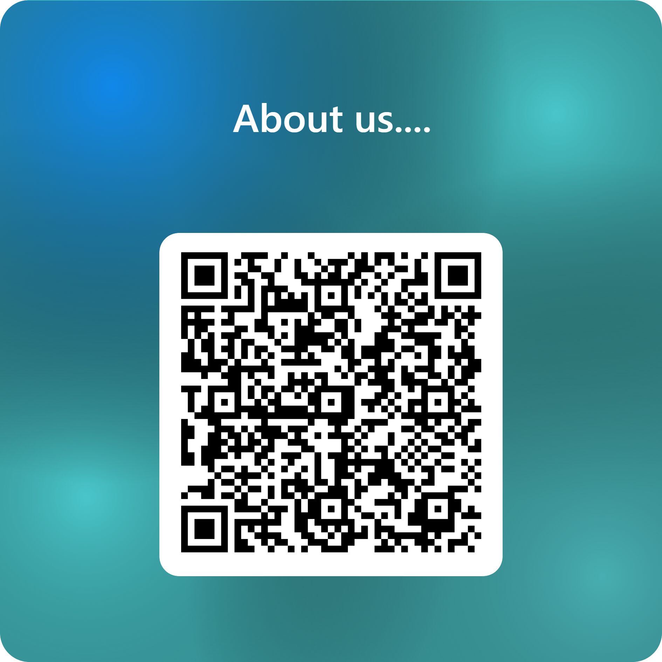
Ice Breaker
Who do we have here?

Slide 7

Ice Breaker
At your table in pairs or in threes:
Share an example of when pupils were most engaged in your class.

Slide 8
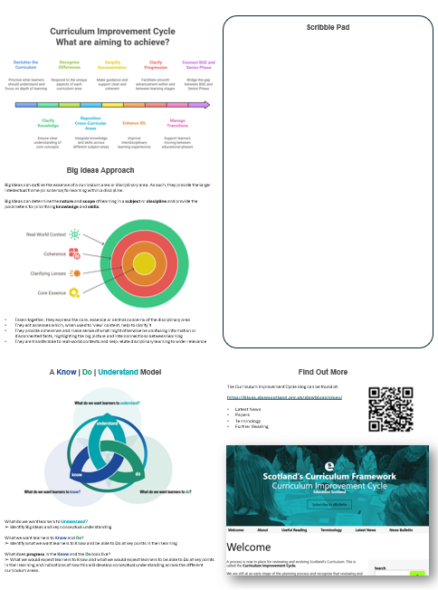
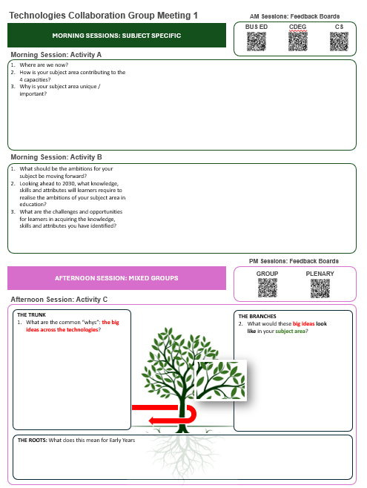
Recording Your Feedback Today
Scribble Pads
Include QR codes for online responses and links to CIC info.

Slide 9
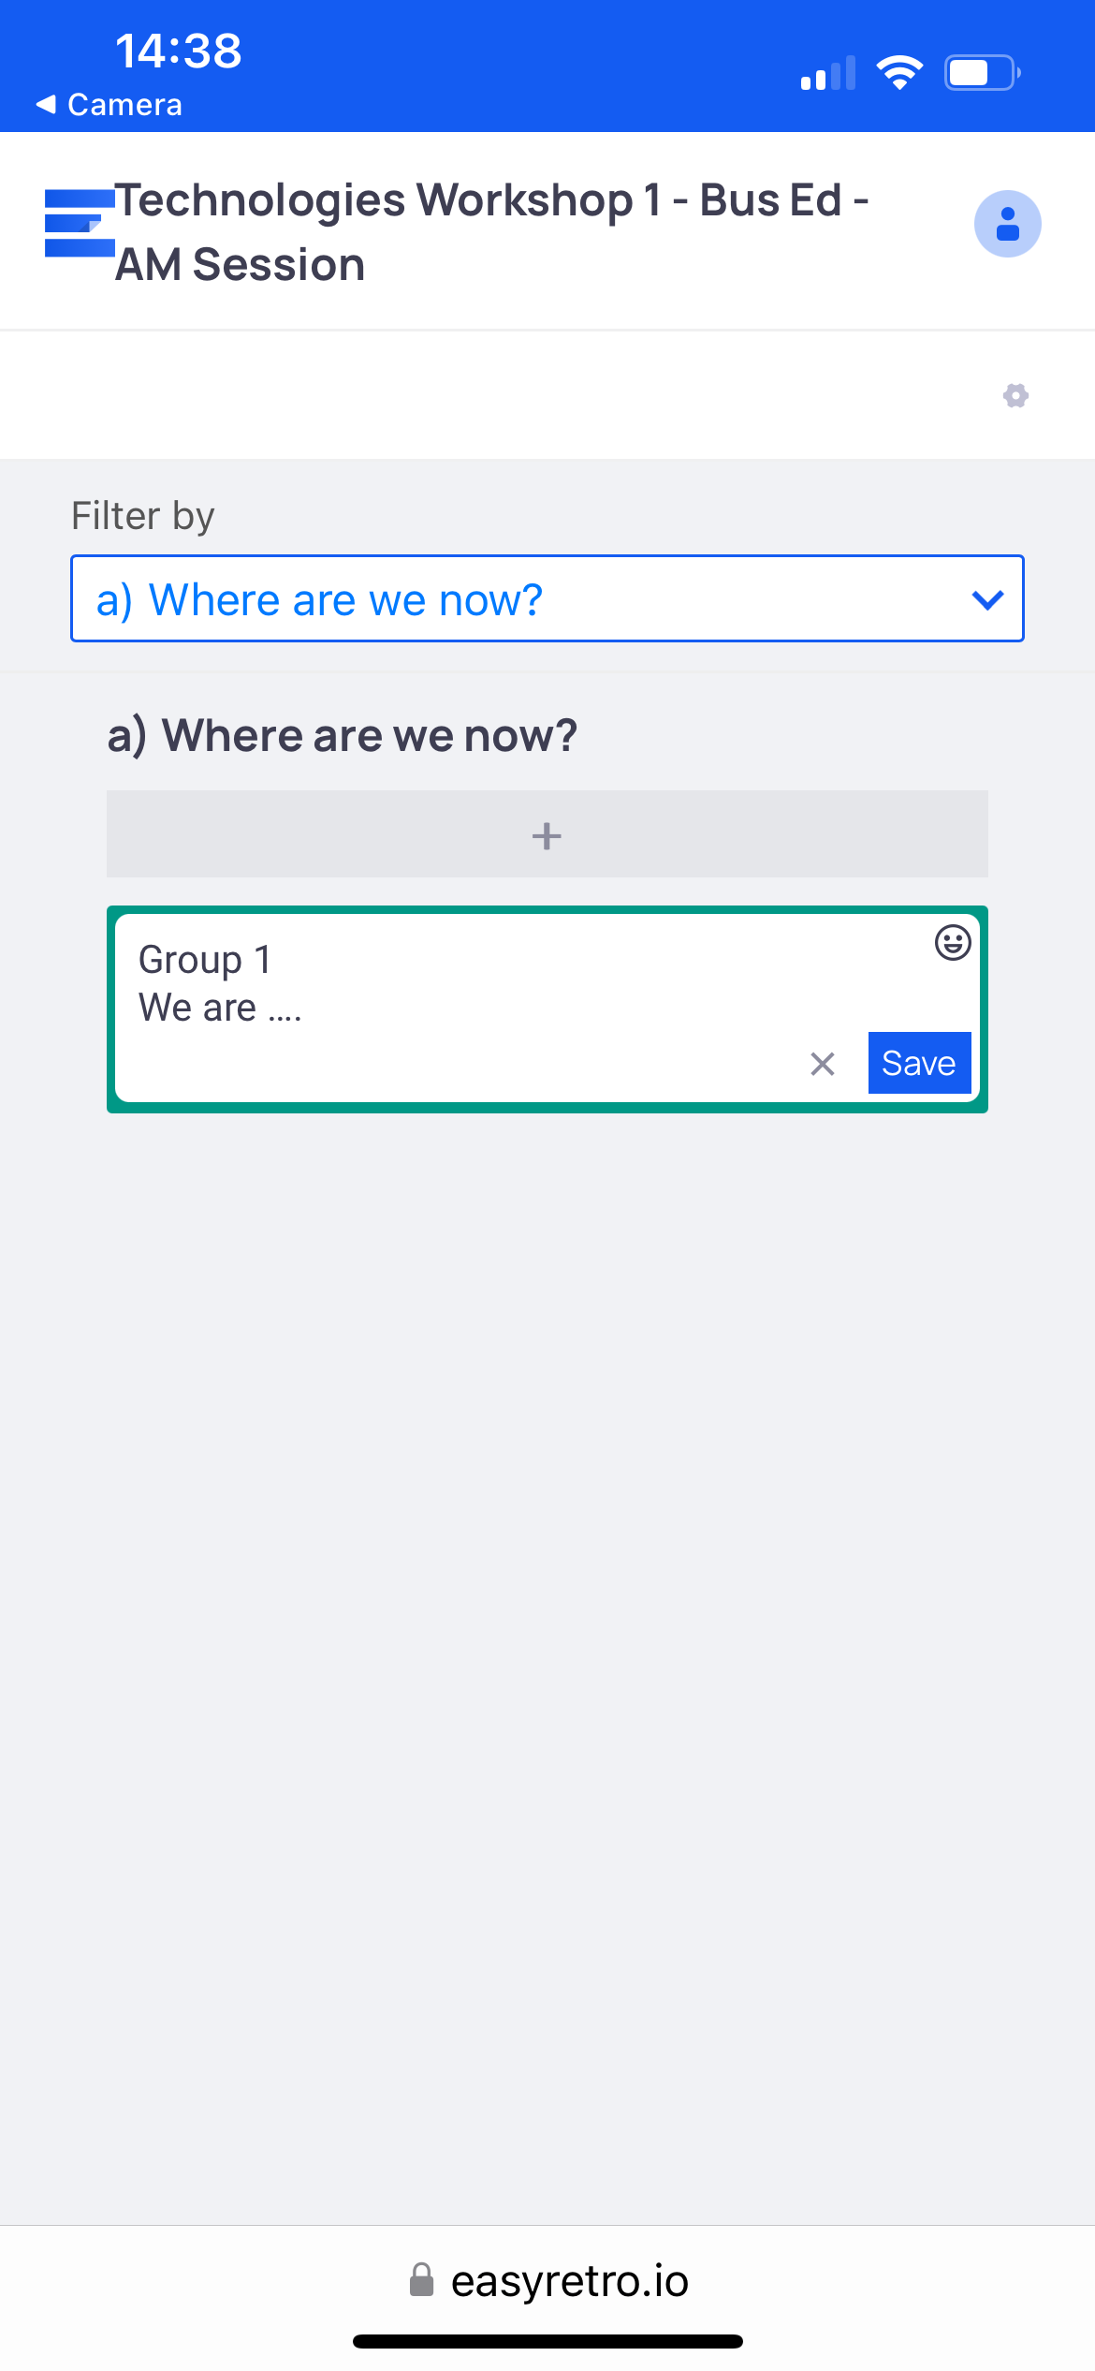
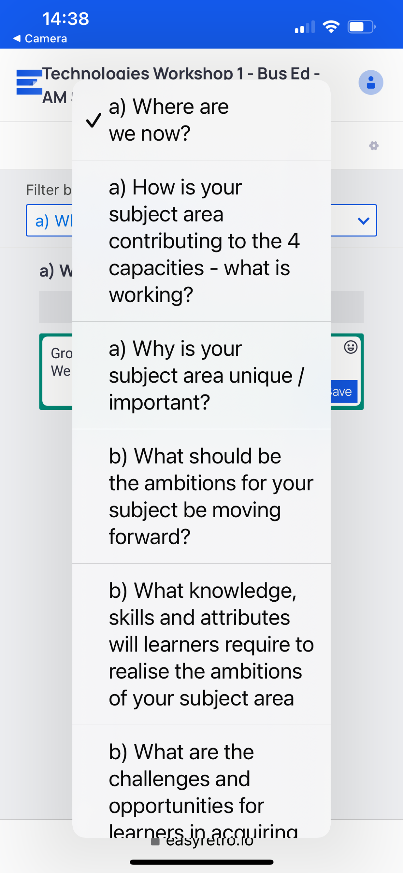
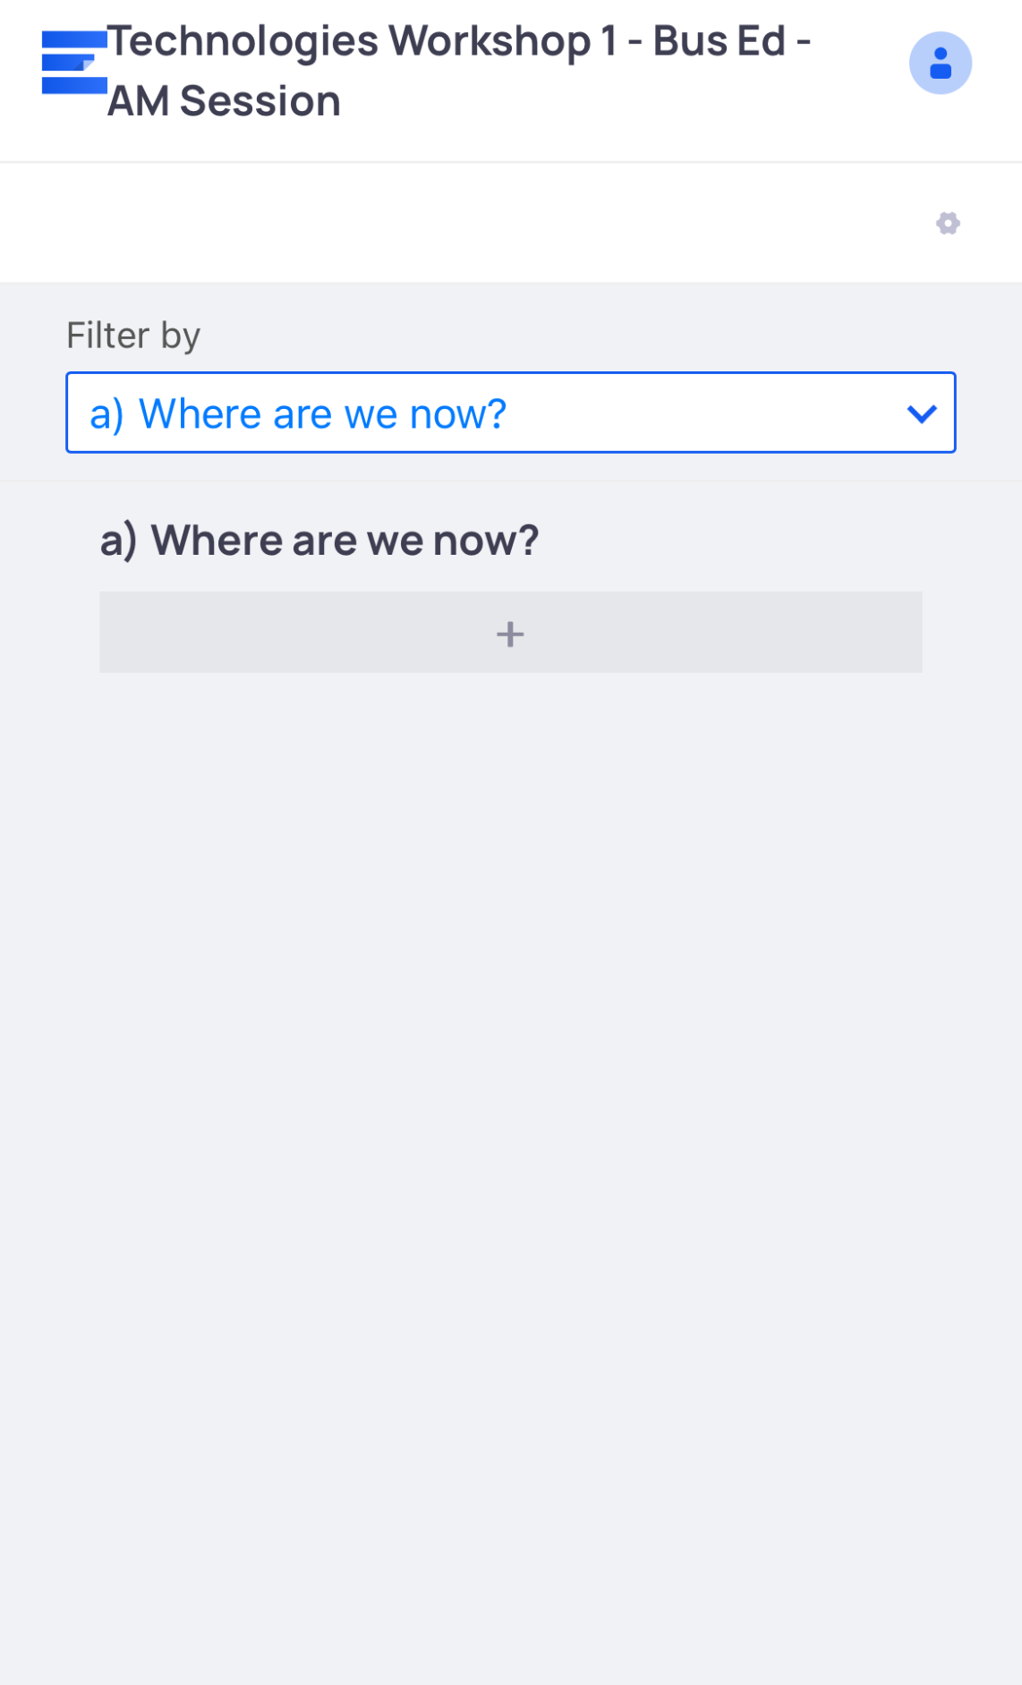
Recording Your Feedback Today
Online Reponses

Slide 10
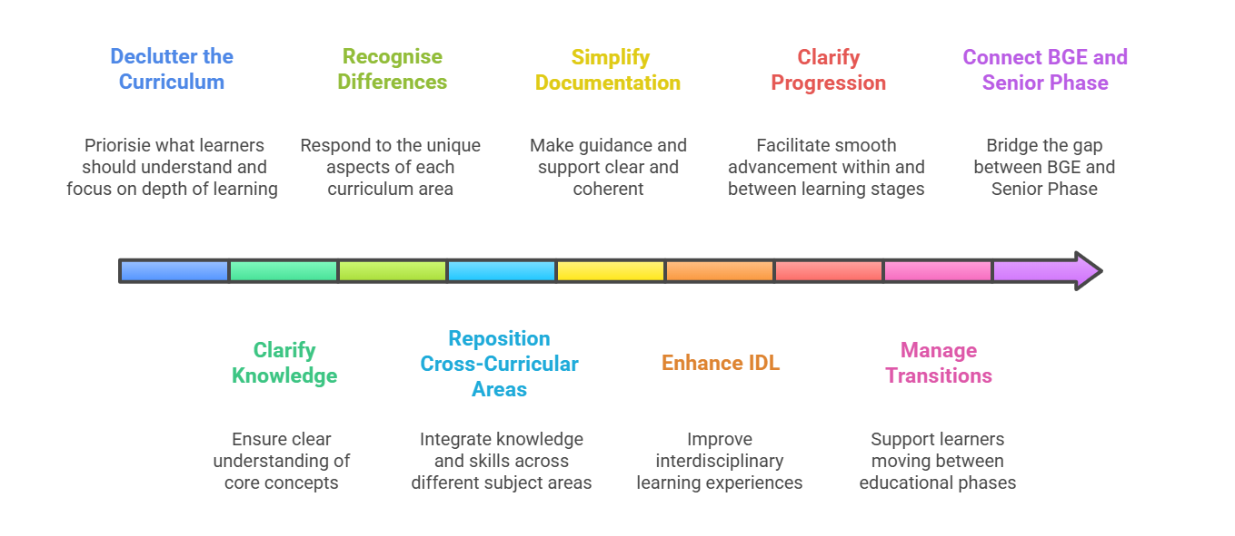
The Curriculum Improvement Cycle

Slide 11
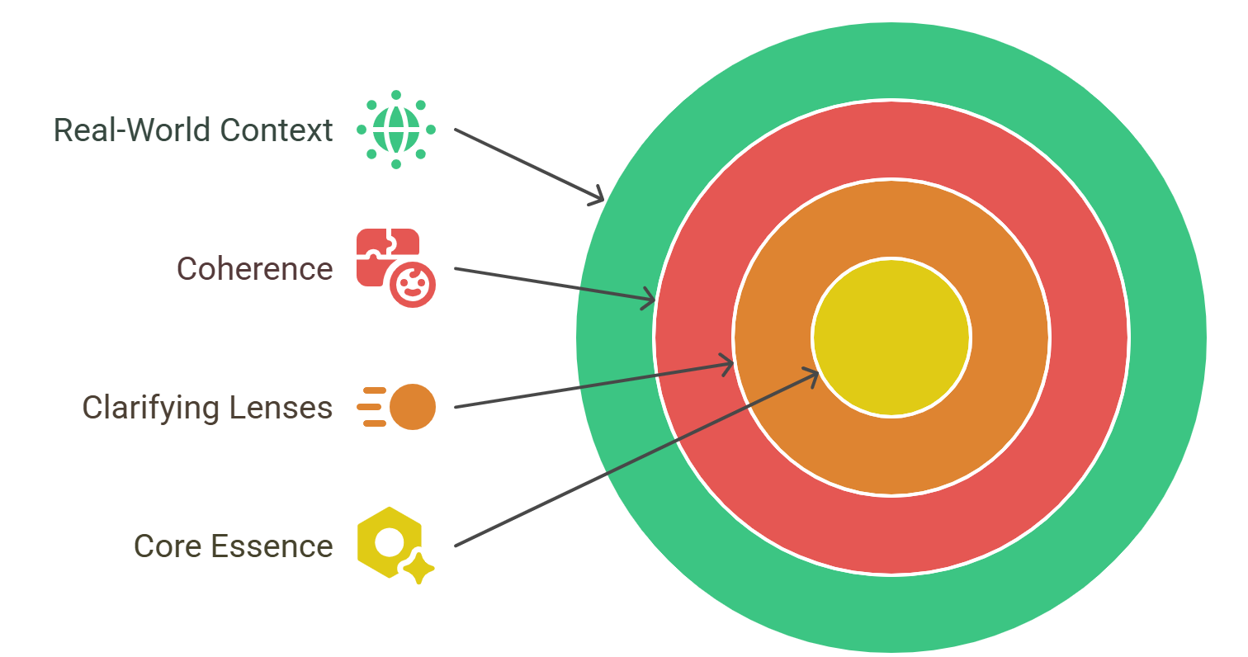
The Curriculum Improvement Cycle
Big Ideas can outline the essence of a curriculum area or disciplinary area. As such, they provide the larger intellectual frame (or schema) for learning within a discipline.
Big Ideas can determine the nature and scope of learning in a subject or discipline and provide the parameters for prioritising knowledge and skills.

Slide 12
The Curriculum Improvement Cycle
Taken together, they express the core, essence or central concerns of the disciplinary area
They act as lenses which, when used to ‘view’ content, help to clarify it
They provide coherence and make sense of what might otherwise be confusing information or disconnected facts, highlighting the big picture and interconnections between learning
They are transferable to real-world contexts and help relate disciplinary learning to wider relevance

Slide 13
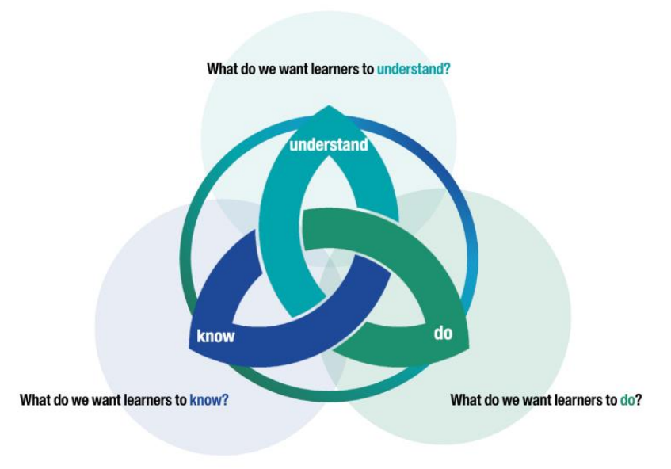
The Curriculum Improvement Cycle

Slide 14
The Curriculum Improvement Cycle
What do we want learners to Understand?
➢ Identify Big Ideas and key conceptual understanding
What we want learners to Know and Do?
➢ Identify what we want learners to Know and be able to Do at key points in their learning
What does progress in the Know and the Do look like?
➢ What we would expect learners to Know and what we would expect learners to be able to Do at key points in their learning and indications of how this will develop conceptual understanding across the different curriculum areas.

Slide 15
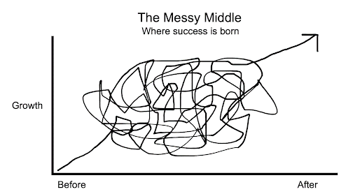
You are about to enter the process
A plan of action
Clarity
Development
After
Disagreement
Ideas
NOW

Slide 16
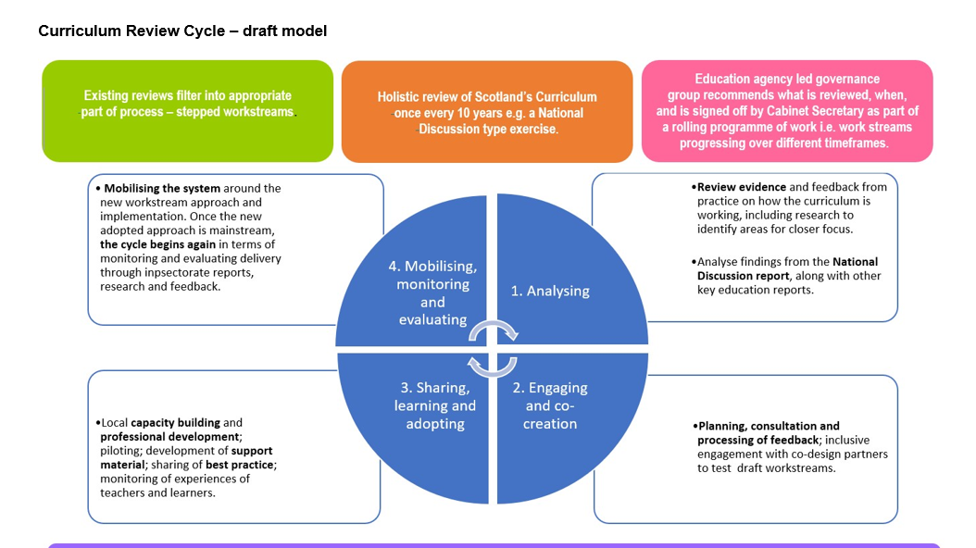
The Curriculum Improvement Cycle

Slide 17



Scotland’s Curriculum Framework
why | what | how
 | + entitlements
…
…
www.scotlandscurriculum.scot

Slide 18
Activity A
Group Knowledge Capture
Subject Specific Groups 1. Where are we now? 2. How is your subject area contributing to the 4 capacities? 3. Why is your subject area unique / important?

Slide 19
Comfort Break

Slide 20
Activity B
Subject Specific Groups – 3 Key Questions
What should be the ambitions for your subject be moving forward?
Looking ahead to 2030, what knowledge, skills and attributes will learners require to realise the ambitions of your subject area in education?
What are the challenges and opportunities for learners in acquiring the knowledge, skills and attributes you have identified?

Slide 21


Slide 22

Activity C
Group Discussion– Mixed Groups
THE BRANCHES
What would these big ideas look like in your subject area?
THE TRUNK
What are the common “whys”:
the big ideas across the
technologies?

Slide 23
Activity C
Group Discussion– Mixed Groups Identify common themes emerging from morning discussions
What are the common“whys”: the big ideas across the technologies?
What would these big ideas look like in your subject area?

Slide 24



Emerging themes / ideas

Slide 25

Exit Pass and Close
So, The Technologies…
What Next?
How will we get there?
Exit Pass – Your Experience Today
What worked for you?
What could we have done differently?
What do we need to think about for next time
Notes:
Lise - Welcome to our new colleagues joining us for the first time on this network and welcome back to those who have joined before. Hope you've had a relaxing break at some stage over the summer

Slide 26
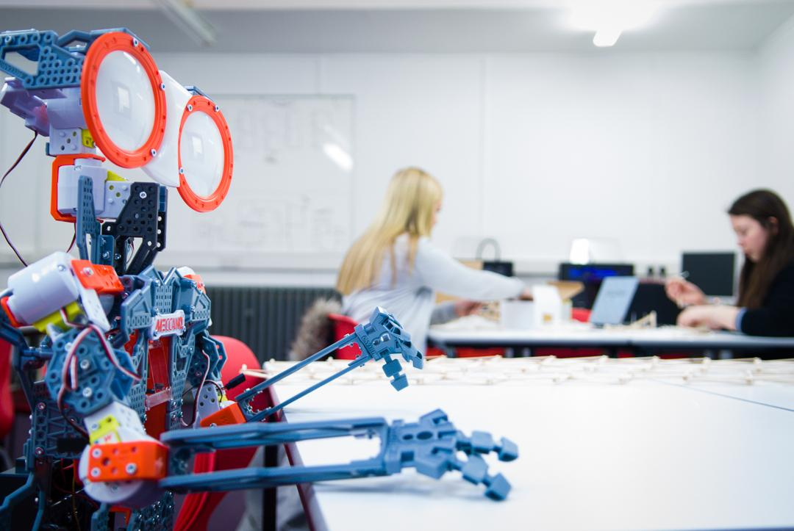
Safe journey home

