Slide 1


Curriculum for Climate Literacy
Prof Sylvia Knight
Head of Education
Royal Meteorological Society
sylvia.knight@rmets.org
sylvia-knight-rmets

Slide 2
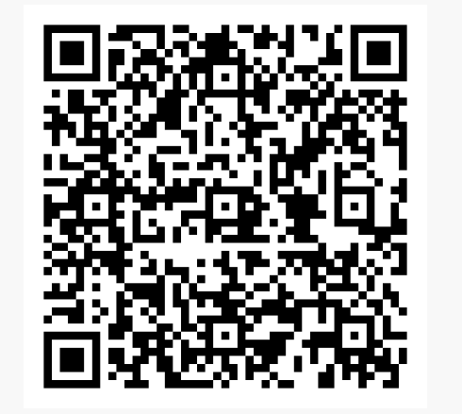
Climate Literacy Survey – 2022-2024
2021 onwards
2023/ 24 – 111 responses in Scotland (5 questions, unpublished)
(Report published by the DfE (English data, 55 questions) December 2024 https://www.metlink.org/blog/dfe-climate-literacy-survey-2024/)

Slide 3
Climate Literacy in S4/ S5 students – 2023/ 2024
How old were you when you were last taught about climate change in a lesson at school?

Slide 4
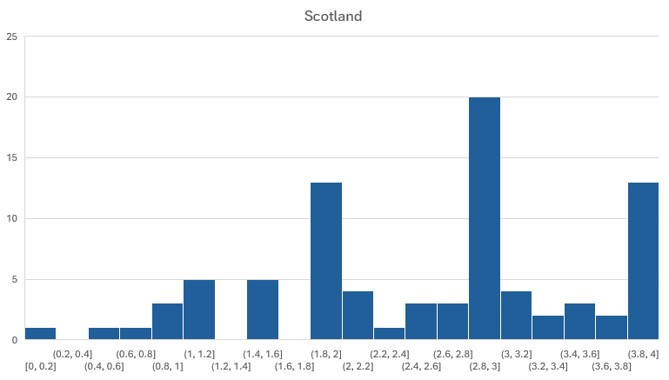
Climate Literacy in S4/ S5 students – 2023/ 2024
How much do you think the climate of the Earth has warmed since 1850, if at all?

Slide 5
Climate Literacy in S4/ S5 students – 2023/ 2024
In your lifetime, to what extent do you think climate change will affect you personally, if at all?
CAREERS

Slide 6
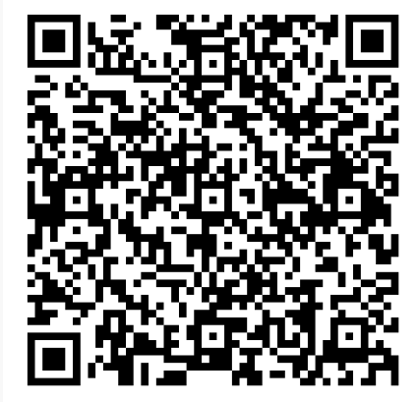
Climate Literacy Survey – 2024/ 2025
  S4, 55 questions
  Currently have over 1,600 responses, 48% England, 41% Scotland (S4), 8% Wales
  Deadline (end of June for Scotland)

Slide 7
Curriculum for Climate Literacy
Association for Language Learning
Association for Physical Education
Association for Science Education
Association for the Teaching of Psychology
British Computing Society
Design and Technology Association
Engineering UK
Geographical Association
Global Action Plan
Institute of Physics
Joint Mathematical Council
Mathematical Association
Music Mark
National Drama
PSHE Association
Regenerative Economics
Royal Geographical Society
Royal Economic Society
Royal Meteorological Society
Royal Society of Chemistry
Royal Statistical Society
SOS-UK
The Classical Association
The English Association
TIDE community
University College, London, Centre for Climate Change and Sustainability Education
University of Reading

Slide 8
Curriculum for Climate Literacy
All students should leave school with the necessary climate literacy required to be citizens of a world where the climate is changing, irrespective of their subject choices. All need to know/ some need to know.
Climate change is a multi-disciplinary problem that requires a multi-disciplinary approach to both solutions and learning. Systems thinking is key, and the climate system (as well as the Earth’s natural, social and political systems) span school subject disciplines. Responsibility of all.
Learning in science and geography provides the foundations for all other subjects.
We have aimed to create a well sequenced, progressive curriculum where disciplinary or ‘substantive’ knowledge and understanding is developed progressively and is not repetitive or tokenistic.
We have supplied very detailed information – so that this can be implemented in any curriculum, whatever its framework. The detail is necessary to ensure equitable provision of high-quality climate education which is not dependent on teacher expertise or awareness.
We acknowledge the risk of curriculum overload and have endeavoured to suggest an appropriate amount of content in each subject. However, in some subjects, there does need to be a significant proportion of the curriculum dedicated to climate literacy.
The curriculum should have the flexibility to keep up to date with climate science, climate solutions (adaptation and mitigation) and the current state of the world, not least because this keeps it relevant to the skills for green jobs and careers options open to school leavers.
The curriculum should be flexible enough for teachers to be able to adapt it to local contexts.

Slide 9
Curriculum for Climate Literacy
Critical thinking should be embedded throughout the curriculum. It has relevance beyond climate literacy but is particularly relevant here.
Teacher support is critical to delivery of this curriculum. We recognise that significant teacher training and CPD will be required to allow confident delivery of high-quality climate education, as well as classroom resource provision.
This is a Curriculum for Climate Literacy, not specifically for biodiversity or wider sustainability or environmental issues, whilst recognising that these topics are not entirely separable from climate literacy, because that is where our (RMetS) expertise lies.
This is a curriculum of hope, focussed as much as possible on solutions and green careers whilst still developing sound understanding of climate change and its far-reaching implications.
Subjects with a strong connection to a related career in climate change have these links explicitly developed within them
We have highlighted sequencing links to other subjects but assumed progression within the same subject (e.g. across the sciences).
Climate literacy supports global and local citizenship.
Climate literacy supports stewardship of the Earth and its resources.
This curriculum is focussed on knowledge and understanding. Skills & values constitute an equally vital part of a complete and coherent curriculum.

Slide 10
Curriculum for Climate Literacy - Computing
Computer Science/ IT
In computer science, the numerical, data and statistical skills introduced in mathematics are brought together with subject knowledge from the sciences, geography and elsewhere to explore the potential for computing to help us understand the climate system as well as the environmental impact of computing, AI, data centres and digital communications.
Through the cross-curricular concepts of computational thinking that underpin the discipline, it is possible to decompose and abstract problems to produce computational solutions through algorithmic thinking, generalisation and evaluation.
The use of computers and other devices to access data and information, to interrogate, analyse and display data and to communicate are key skills which can be developed in computer science lessons and made use of in climate learning across all subjects.

Slide 11
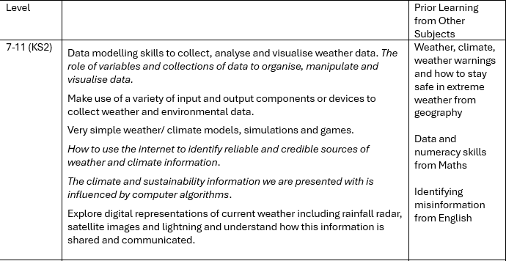
Curriculum for Climate Literacy - Computing

Slide 12
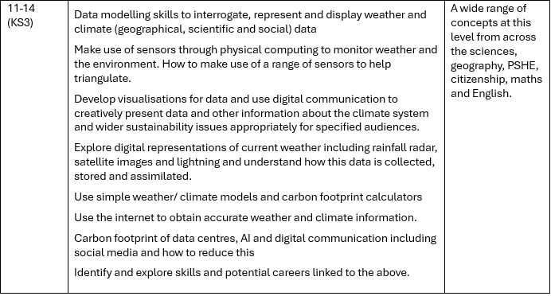
Curriculum for Climate Literacy - Computing

Slide 13
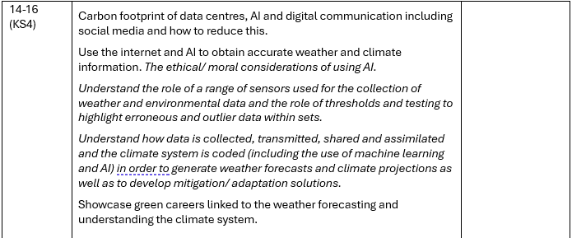
Curriculum for Climate Literacy - Computing

Slide 14
Curriculum for Climate Literacy – Design & Tech
Design & Technology / Engineering
These and related subjects empower young people to design a better world, whilst at school and in their future careers.
The curriculum should go beyond looking at the energy/ carbon/ environmental resource footprint of products and processes to looking for technical solutions to the climate crisis.
Through clear and well-sequenced links particularly with the sciences, the causes, impact and – crucially – the emerging solutions to environmental problems, particularly climate change, can be integrated throughout the curriculum, clearly demonstrating career opportunities.
Key skills which can be developed in this area relate to careers, communication, and creative thinking. Data, statistics and numeracy skills introduced in mathematics can be developed.

Slide 15
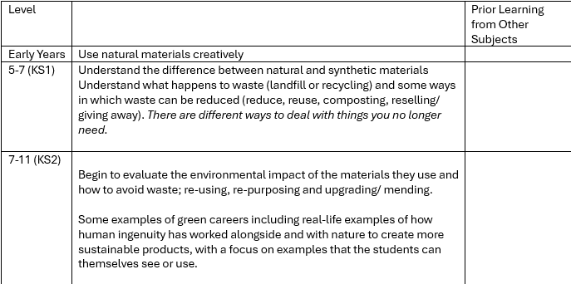
Curriculum for Climate Literacy – Design & Tech

Slide 16
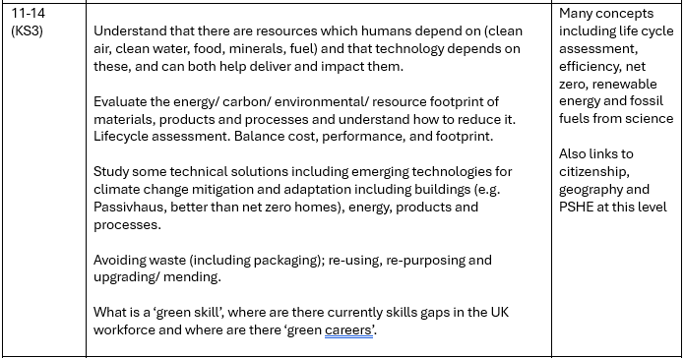
Curriculum for Climate Literacy – Design & Tech

Slide 17
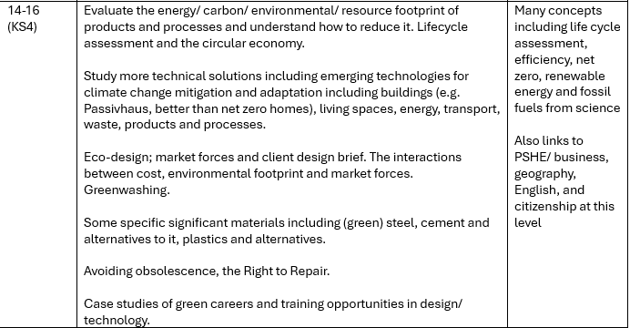
Curriculum for Climate Literacy – Design & Tech

Slide 18
Curriculum for Climate Literacy – Economics/ Business
Economics and Business Studies
The subjects of Economics/ Business Studies are subjects where there are many opportunities for understanding and knowledge to be synthesised and made relevant to individuals and their communities.
The cost of mitigation, adaptation or not acting to mitigate or adapt to climate change for an individual or household. Economic drivers of action.
An understanding of insurance and risk relating to extreme weather events at a personal/ household/ business level.
Spending options for sustainability and ethical reasons.
Understanding that the economy is embedded in social and ecological systems, both dependent on those systems and impacting them.
Understand the dynamic interaction between households, markets, government and the commons, and the perspectives of different economic agents in those four provisioning systems.
The ethics and sustainability implications of business activity.
Alternative economic systems. How we organise our economies and societies impacts the levels of human cooperation, reciprocity and care.
Understanding that the economy includes interconnected provisioning institutions including households (unpaid care and domestic work), markets, commons (self-organised management of shared resources) and state, each of which has their own and overlapping roles that are critical for a healthy, resilient society.

Slide 19
Curriculum for Climate Literacy – Economics/ Business
7-11 | Understand that we are part of nature, not separate from it; everything humans do and make depends on the Earth and climate systems and impacts their function. Understanding that our actions (as individuals and communities) have an impact on the environment, and that products & actions have a financial and environmental cost. Consumer choice; recognising and beginning to manage influences on choices. Business responsibility. Stakeholder perspectives. Case studies of green careers. | Ecosystem services from geography English – persuasive writing Creative expression in drama, music, art, dance

Slide 20
Curriculum for Climate Literacy – Economics/ Business
11-14 | The responsibility of businesses to meet human needs within planetary boundaries and how they can adapt their purpose, networks, ownership, governance and finance to have a positive impact on human and wider environmental wellbeing. Explore the carbon footprints of goods, services, organisations and individuals relevant to their own lives and communities. Including analysis of which actions have a significant impact as well as the social limitations of the concept of personal carbon footprints. Cost/ benefit analysis related to personal and business climate actions such as installing solar panels. The financial cost of extreme weather events and of insuring against those costs Energy efficiency presents an enormous potential to mitigate climate change while contributing to sustainable development and resource efficiency. Greenwashing and misinformation. What is a ‘green career’, where are there currently skills gaps in the UK workforce and where are there ‘green careers’

Slide 21
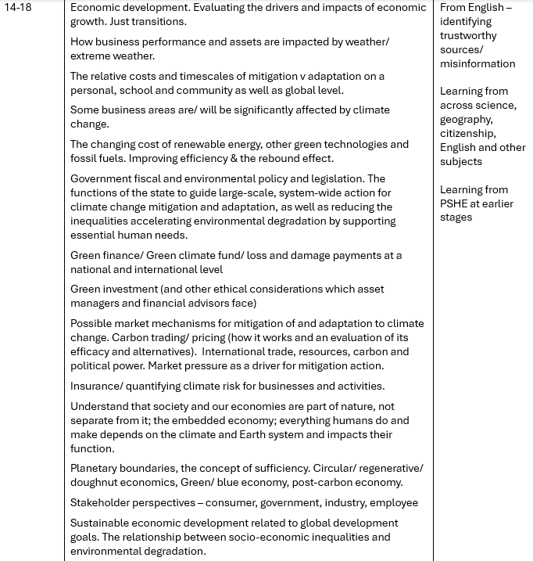
Curriculum for Climate Literacy – Economics/ Business

Slide 22
Sylvia Knight
sylvia.knight@rmets.org
sylvia-knight-rmets

