Slide 1
Bunsgoil Ghàidhlig Ghleann Dail School Improvement Plan 24-25

Slide 2
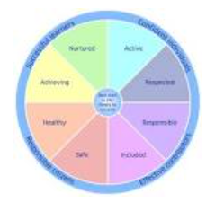
Bunsgoil Ghàidhlig Ghleann Dail
Staff
Continue to ensure the needs of all learners are met
Develop our communication strategies
Further develop our planning and resourcing of numeracy with a focus on problem solving
Further develop Health and Wellbeing using Emotion Works to support pupil understanding of emotions
Pupils
Continue to build on our Right’s Respecting Targets to ensure all children are heard in line with UNCRC
Continue to provide opportunities to lead their own learning
Children will be supported with Health and Wellbeing to ensure their needs are met
Teaching and Learning
Develop our tracking of attainment using fact, story and action to ensure we are making more accurate judgements on pupil attainment
Develop our approaches to teaching problem solving in numeracy
Develop our approaches to Health and Wellbeing using Emotion Works resource
Parents
Provide opportunities for our parents to be actively engaged in the life of the school
Actively seek parental views to ensure we are including them in the consultation process

