Slide 1
Learning from Home
Primary 1 - 3

Slide 2
How are you?
It is so nice to read that everyone is either good, amazing or great!

Slide 3
Are you enjoying your learning activities?
It was so lovely to see you are all enjoying your learning.
3 children = Quite enjoying
1 child = enjoying
3 children = really enjoying
This is so great to see, thank you for being so positive.

Slide 4
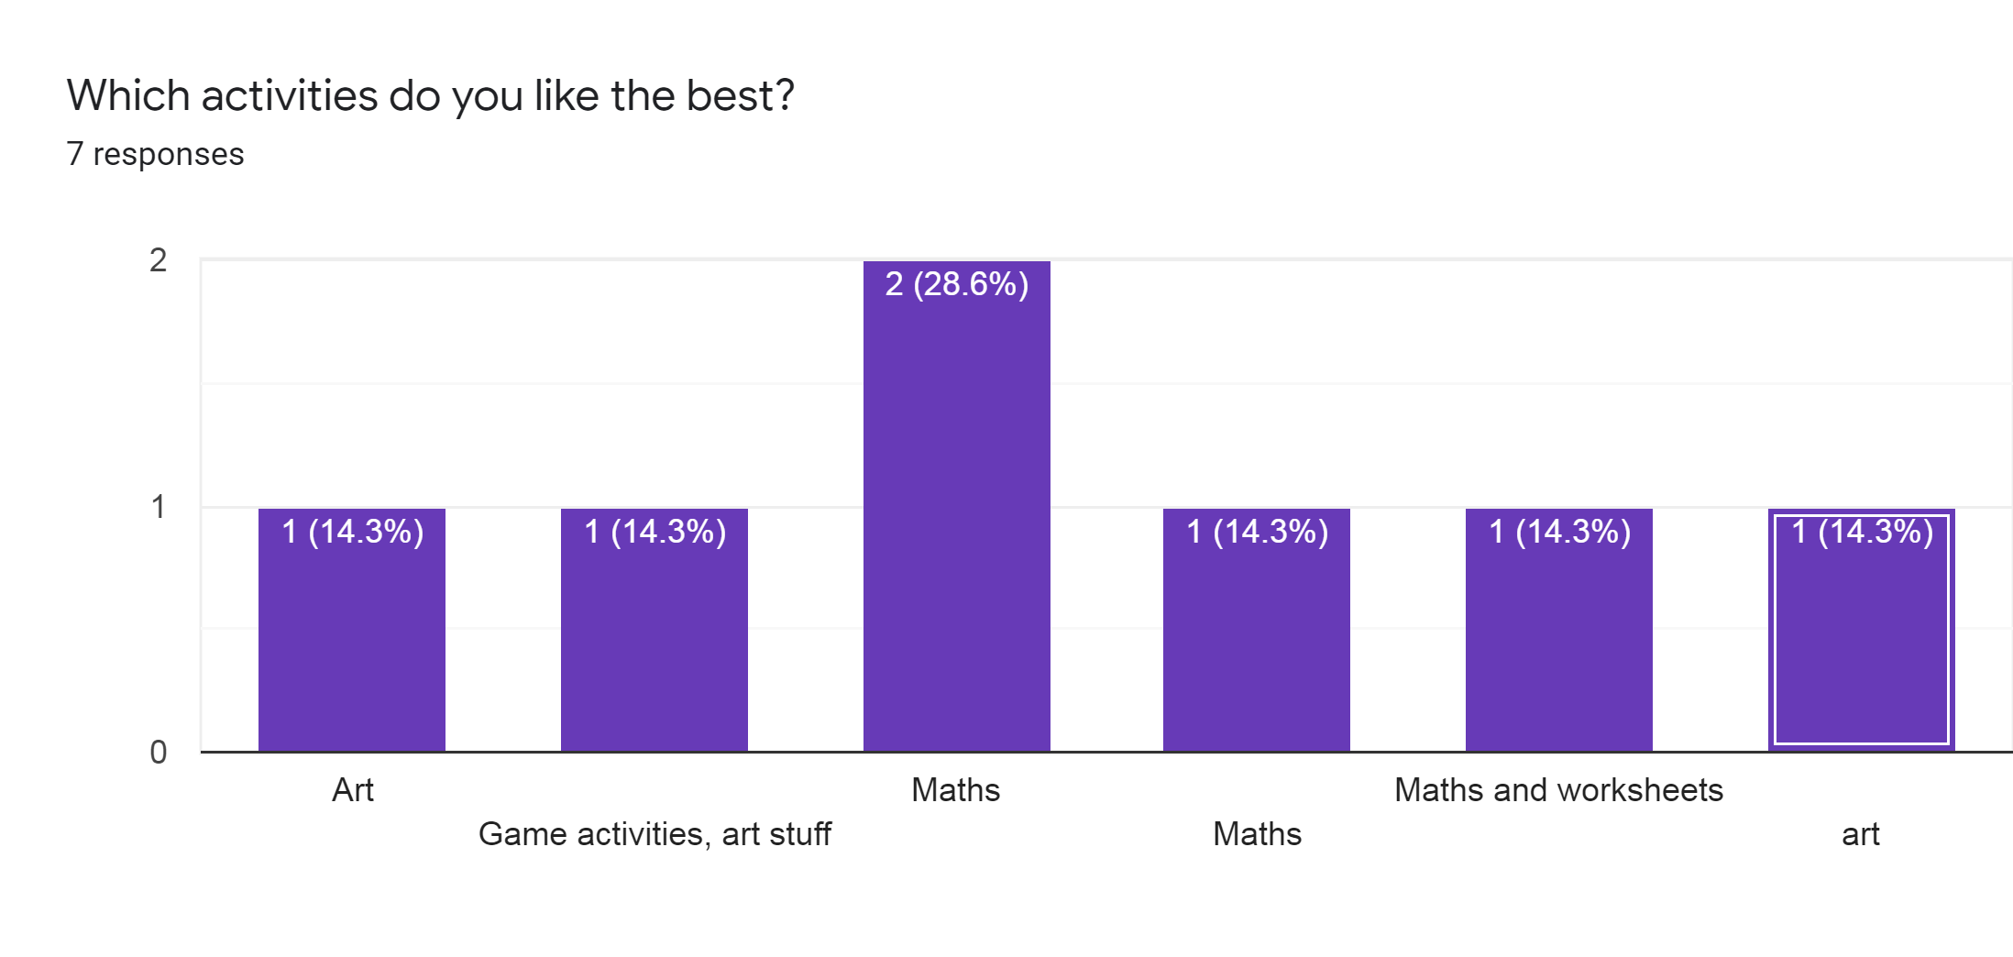
Favourite activities
4 - Maths
3 - Art

Slide 5
What is going well?
I think I am doing reading and maths
Maths and using seesaw on the chromebook
Some of it
Learning new things
That everyone is staying home
Maths and I am proud of myself for keeping up with my schedule work.
Everything!

Slide 6
What can we do better?
I would like to have meet ups like * does in the big class
It’s hard to do writing on the chrome book screen
I don’t know
Less things were I have to video myself because I don’t like it.

Slide 7
Next Steps
Arrange Google Meets once a week.
Allow for writing activities to be completed on screen or written down.

