Slide 1
Bower Primary School
Remote Learning Consultation

Slide 2
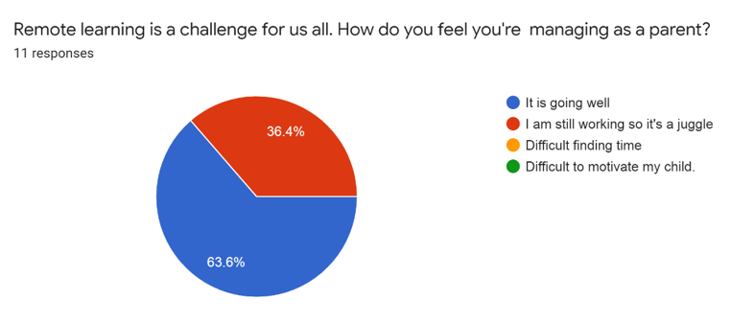

Slide 3
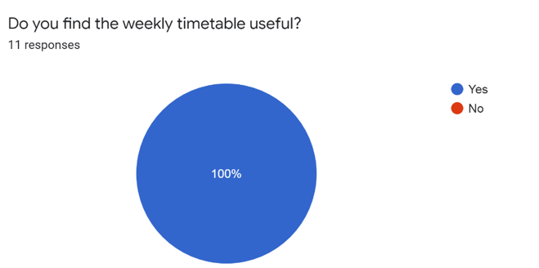

Slide 4
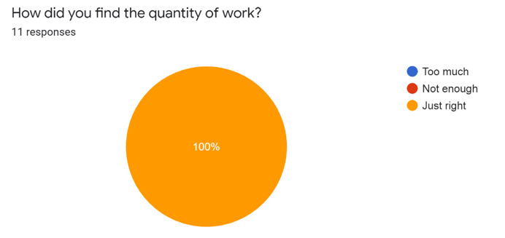

Slide 5
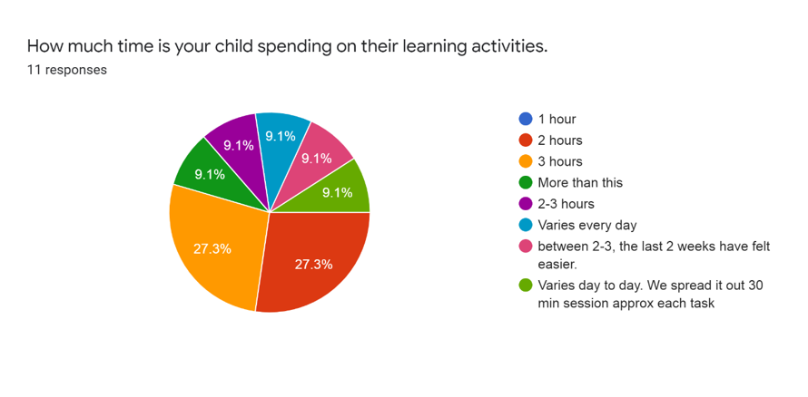

Slide 6
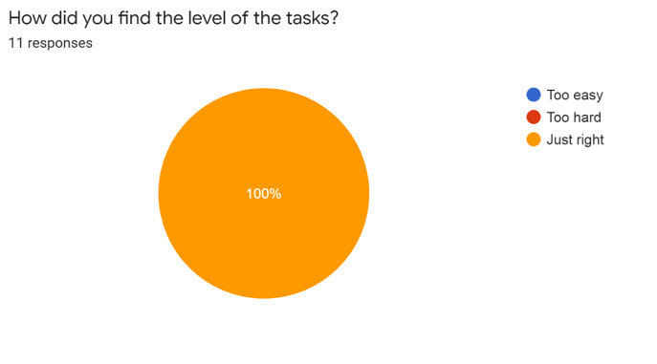

Slide 7
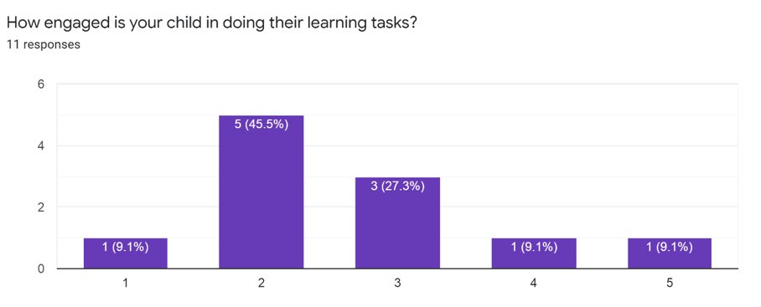
1 = Very motivated
5 = Did not want to engage at all.

Slide 8
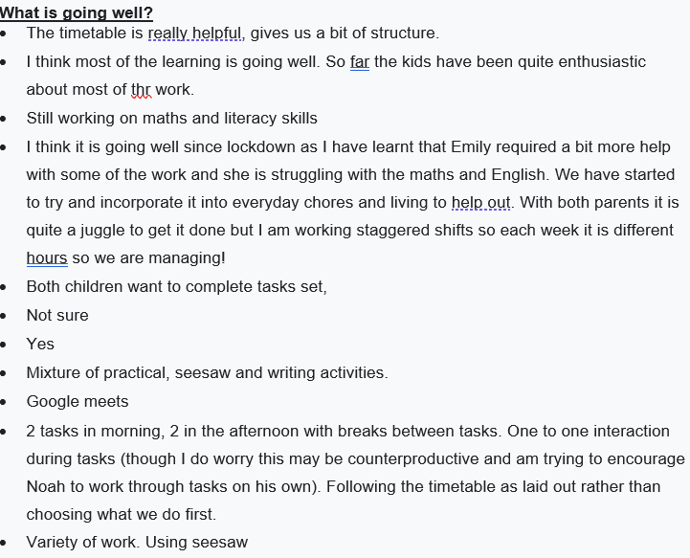

Slide 10
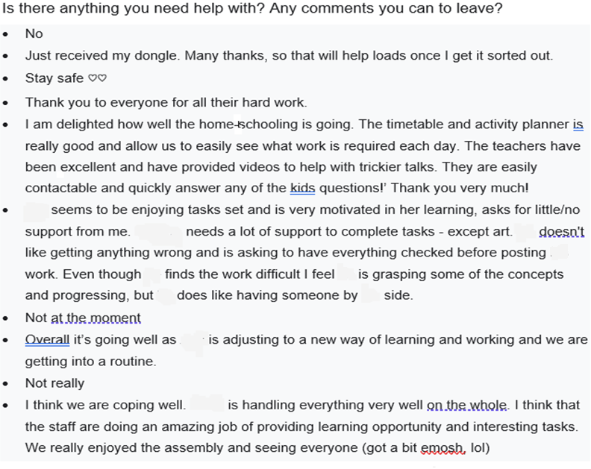

Slide 11
How are we using your feedback?
Continuing our virtual assemblies.
Continue to use planning formats and timetables that meet our families needs.
Record learner achievements via Seesaw.
Invite children to join in weekly Google Meet sessions.

