Slide 1
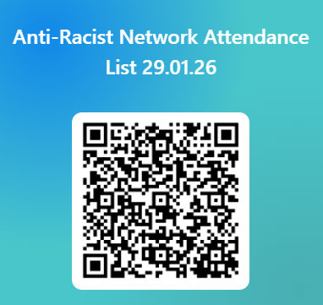
SDEP Anti-Racist Network
Session 3
26.03.26
Notes:
9.15-9.30am
William
(William to create duplicate for current date)

Slide 2

Session Outline
1. Welcome and Overview of Anti-Racist Network
2. Todays theme: “Where to now“ PCP session
3. Feedback from last network discussion: “How are you supporting communities of colour within education?”
Notes:
9.15-9.30am
William

Slide 3
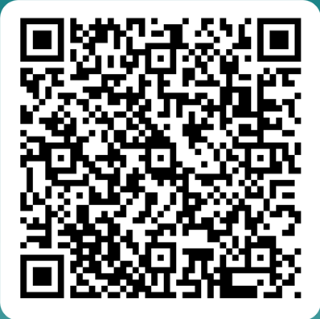
Anti-Racist Network
* Open to anyone who is an EP, TEP or EPIT in Scotland
* Aim to create a safe space for discussion and action around anti-racism within the profession
* Meet approx. 4 times in the academic year, dates set at the beginning of the academic session
* Each session focuses on both input and reflective activity
* Serves as a function for consultation for wide strategic strands
* Anyone interested in joining: Scan QR Code
Notes:
9.15-9.30am
william

Slide 4

Content Warning & Emotional Safety
Subject and content can be emotive
Aiming to achieve a balance to allows us to sit with discomfort that serves as a springboard for change and action
Please take time to step out if this is required
We do not seek to create a hierarchy of lived experiences and this group explicitly recognises that other marginalised groups also experience discrimination
These sessions do often contain difficult challenge questions
We encourage debate and discussion but the questioning of the lived experience of BPOC is not up for discussion
Language and terminology
We ask that you pay attention to any thoughts, feeling and reactions that occur during discussions
Notes:
9.15-9.30am
william

Slide 5
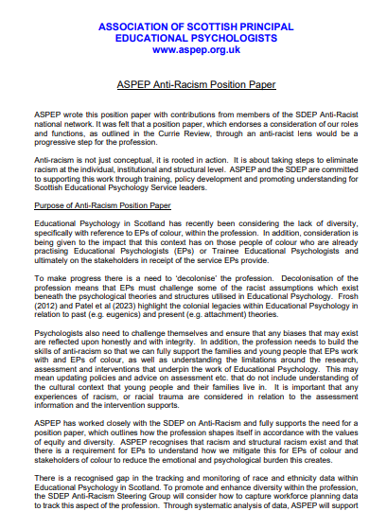


ASPEP position PAPER
Available on the SDEP Anti-Racism website here: ASPEP Anti-Racism Position Paper
Notes:
9.15-9.30am
William
Highlight reminder we have position paper

Slide 6
SDEP Anti-Racist Network
SDEP ARN Steering Group
Anti-Racist Network
National Training Pilot
Work Strands
Notes:
9.15-9.30am
william

Slide 7
SDEP Anti-Racist Work Strands
Steering Group members: Maura Kearney (REPS), William Corral (GEPS), Rebecca Gibson-Knowles (REPS), Samia Bashir (GEPS)
Work strand details:
Book Group
Managing Racism
Self-Evaluation
Frameworks and Functions
National Training Pilot
University Links
(on hold)
Notes:
9.15-9.30am
william

Slide 8
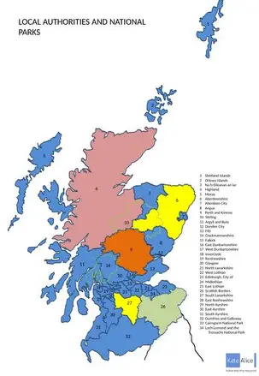


Update: national training model
Seeking notifications of interest for a possible Cohort 2 for 26-27
Notes:
9.15-9.30am
William
Contact Maura if service interested
Delete if not applicable

Slide 9
Feedback from January SDEP Anti-Racist network…
Summary of Group Discussion…
Notes:
Rgk
9.30-9.45

Slide 10
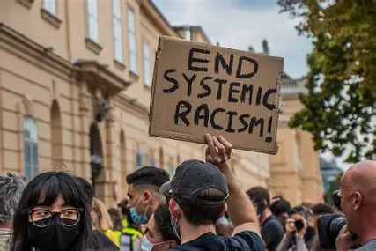
Last session we asked you to consider …
How have you supported communities of colour within education?
Notes:
Rgk 9.30-9.45
At a time we have seen an emergence of the far right pushing a very visible anti-immigrant message. For POC, the surge in highly visible nationalist imagery in the streets as well as in the media,— has been reinforcing the message of Scottish identity being defined narrowly defined by race and origin and for communities of colour they are therefore not welcome. It may be argued that this racist message may seem louder than the silence of those who wouldn’t align themselves with these views. We therefore asked what action is looking like right now for us EPs in this current climate.

Slide 11
Supporting communities of colour within education
  How have you directly supported POC through this time?
  How have you supported schools through this time?
  How have you supported CYP of colour through this time?
  How have you supported communities of colour through this time?
Notes:
Rgk 9.30-9.45
We asked…

Slide 12
How have you directly supported POC through this time?
-Checking in with colleagues of colour
-Asking families of colour about the impact on them
-Offering support
-Challenging (our own) ‘polite racism’ such as power dynamics within meetings, assumptions that may disadvantage POC, assumptions about peoples experiences
Notes:
Rgk 9.30-9.45

Slide 13
How have you supported schools through this time?
-Working group supporting a school who had become aware of racist challenges in the community; exploring views of staff, pupils & parents & lots of reflections impacting practice throughout this
-Anti-racism training in schools
-Supporting response to protests –e.g solution circles
-Upskilling other EPs to support in schools
-Supporting schools to develop their Anti-Racist practice through tools such as NVR/ PATH
-Adapting development work e.g. Nurture with antiracist focus
-Opening up discussions around anti-immigration movement, racism with schools.
-Some reflections around not having done enough to initiate conversations if schools haven’t asked us
Notes:
Rgk 9.30-9.45

Slide 14
How have you supported CYP of colour through this time?
-Including CYP of colour as part of PATH process
-Challenging and discussing racial discrimination / bias within casework
-Some further reflections around not having done enough
-Some reflections around spending time to learn about racism, challenge racism within consultations – but less work around directly supporting children and communities of colour colour (e.g did not support during race riots or when flags went up)
-Some reflections that we may not always be the person working directly with communities/ CYP – but we can coach schools to become more culturally aware.
-Reflection that we need to be more proactive in talking to schools about how they are doing this.
Notes:
Rgk 9.30-9.45

Slide 15
How have you supported communities of colour through this time?
-Charity donations e.g for refugees
-Visibility of support –e.g badges/ protests/ social media profile picture change
-Reflections around need to reach out to communities of colour without relying on them to reach out
-Need for profession to think about what community based psychology looks like for us
Notes:
Rgk 9.30-9.45

Slide 16
Teacher responses to racially motivated bullying in Scotland
:
Notes:
9.45-10.05
Network were asked to read for homework task
Lindsay?

Slide 17
Today’s theme:
“Where to now?"
Anti-Racist network PCP
Notes:
10.05-12
(break inbetween)

Slide 18

BREAK
Notes:
10.50-11

Slide 19

Final Network date for 2025-2026
Thurs 28th May 2026
Notes:
12.00
Remaining network dates and QRs for workstrand tools

