Slide 1
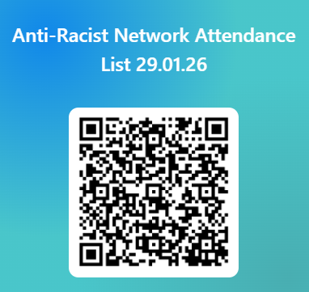
SDEP Anti-Racist Network
Session 4
28.05.26
Notes:
9.15-9.30am
William
(William to create duplicate for current date)

Slide 2

Session Outline
1. Welcome and Overview of Anti-Racist Network
2. Feedback from last network session: PCP
3. Todays theme: “Immigration in a changing world: Implications of current events for Educational Psychology Practice
Notes:
9.15-9.30am
William

Slide 3
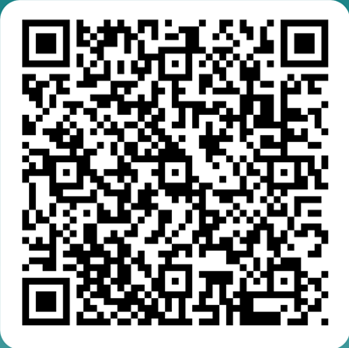
Anti-Racist Network
* Open to anyone who is an EP, TEP or EPIT in Scotland
* Aim to create a safe space for discussion and action around anti-racism within the profession
* Meet approx. 4 times in the academic year, dates set at the beginning of the academic session
* Each session focuses on both input and reflective activity
* Serves as a function for consultation for wide strategic strands
* Anyone interested in joining: Scan QR Code
Notes:
9.15-9.30am
william

Slide 4

Content Warning & Emotional Safety
Subject and content can be emotive
Aiming to achieve a balance to allows us to sit with discomfort that serves as a springboard for change and action
Please take time to step out if this is required
We do not seek to create a hierarchy of lived experiences and this group explicitly recognises that other marginalised groups also experience discrimination
These sessions do often contain difficult challenge questions
We encourage debate and discussion but the questioning of the lived experience of BPOC is not up for discussion
Language and terminology
We ask that you pay attention to any thoughts, feeling and reactions that occur during discussions
Notes:
9.15-9.30am
william

Slide 5
SDEP Anti-Racist Network (Restructure in progress!)
SDEP Steering Group
Anti-Racist Network
Work Strands
Steering Group members: Maura Kearney (REPS), William Corral (GEPS), Rebecca Gibson-Knowles (REPS), Samia Bashir (GEPS)
Notes:
9.15-9.30am
william

Slide 6
An update on SDEP Anti-Racist Workstrands
Completed Workstrands | Ongoing
ASPEP Position Paper | Managing Racism for POC EPs
AR Self-Evaluation for Services | Educational psychology response to anti-immigration protests
Managing Racism Toolkit | Research
National Training Pilot | Reading Group
 | Leadership and Supervision: POC EPs

Slide 7
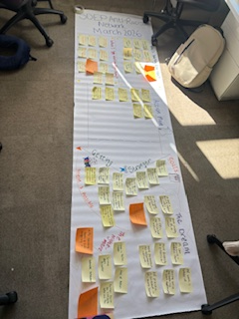
Feedback from last session.
SDEP Anti-Racist network PCP:

Slide 8
The Dream…
All EPS’s represented in the network
All EPs to have engaged in AR training
AR practice to be evidenced across Scotland
Increased diversity in the profession
We have a positive impact on CYP/ communities of colour
More safety for EPs of colour
EPs can recognise and address racism
More partnership representation in network
Intersectionality, diversity and equality having stronger links to AR practice

Slide 9

Goals (by March 2027)
Continuation of workstrand groups
Better understanding of engagement & implementation of national training
More services involved in leading change and action at network
Wider representation on steering group (EPS’/ Uni?)
Increased commitment from those in leadership positions (e.g ASPEP/ service ELT)
Improvements to self evaluation of network (i.e impact of attendance)
Improved safety for EPs of colour
Improved understanding of racial trauma
An understanding of the impact of AR work on CYP/ colleagues/ teachers/ communities of colour
Measurable wider participation in network (e.g from x to y)
Measurable increase in uptake from services undertaking training (e.g from 11 to X)
Notes:
Something about being able to demonstrate measurable impact of this work

Slide 10

Some initial actions identified by the network…
Evaluate engagement and implementation of the national training model
Explore barriers to attendance at network
Review service use and impact of workstrand materials such as SE framework
Use network activity feedback and end of year evaluation to plan next steps
Invite more partners where EP is supporting Anti-Racist practice (e.g QIO’s/ schools)
Workstrand groups continue to develop
Consider research possibilities from network
Visit steering group representation

Slide 11
…Watch this space!

Slide 12
Exploring the links between immigration and trauma
Renfrewshire Educational Psychology Service
Notes:
9.15 SM

Slide 13
Outline of Training
International, national and local context
Staff wellbeing and community supports
The Relationship between the migrant experience and stress and trauma
Supporting migrant children and young people who have experienced trauma
Notes:
C
Training incorporates the Education Scotland national training materials – with further information and adaptation for the Renfrewshire context.
Meant to give you the skills to lead the implementation and evaluation of a whole school nurturing relationships approach. You will hear a lot about the importance of implementation throughout this training.
Break about 1030

Slide 14
Some things to keep in mind…
Some of this content may be emotionally charged for some people. Please feel free to step out of the room if you need to do so
Please be respectful when listening to others views particularly those with lived experience
While some of this content can be viewed as political in nature, this session is not intended to serve as a platform to discuss different political viewpoints but to consider how particular views on immigration may impact on children and young people and their families
We ask that you are aware of the language and terminology used and seek to avoid language that may be regarded as prejudiced in any way
While there is a focus in this training on how the migrant experience may lead to stress and trauma, it is important to recognise the many positive aspects of the migrant experience
Notes:
Read this at outset to help those attending be aware of the sometimes sensitive nature of the content
The political nature of the content at times is unavoidable as the political climate in which migrants come to the UK and in particular those who are seeking asylum, has a very real impact on the experience of the children and young people in our establishments

Slide 15
Terminology
A migrant is someone who has left their home either temporarily or permanently. Reasons may include political unrest, poverty, war, education, to join family members or for work
An immigrant has the intention of living here permanently
There is distinction in UK law between refugees and asylum seekers
An asylum seeker is an individual who is seeking international protection but whose claim has not yet been finally decided. Not every asylum seeker will be recognised as a refugee but every refugee will first be an asylum seeker
Notes:
Read this at outset to help those attending be aware of the sometimes sensitive nature of the content
The political nature of the content at times is unavoidable as the political climate in which migrants come to the UK and in particular those who are seeking asylum, has a very real impact on the experience of the children and young people in our establishments

Slide 16
Quiz
Which of these things was introduced to the UK by people who migrated to the UK?
Tesco
Bagels
Fish and chips
Chicken Tikka Masala Curry
Fray and Bentos Pies
Marks and Spencer
Rimmel cosmetics
Migration has taken place for centuries for reasons such as safety, food, freedom, shelter and escape
Migrants have made many positive contributions to British society
Notes:
Answer is all of them.
Tesco was founded in 1919 by Jack Cohen the son of a Polish immigrant
Bagels brought to UK by Eastern European Jewish immigrants mainly from Poland in 19th century
Chicken Tikka masala was created by chef Ali Ahmed Aslam at his Shish Mahal restaurant when a customer complained the chicken tikka was too dry so he added creamy spiced tomato sauce – a fusion of South Asian flavours and British tastes
A Jewish immigrant called Joseph Malin opened the first ever fish and chip shop in London in 1860 – the battered fish was based on an old Portuguese- Jewish recipe
Fray and Bentos pies were founded in London by a German chemist – Justus Von Liebig in 1865
Rimmel cosmetics was founded by French immigrant Eugene Rimmel in 1834
Marks and Spencer – started by a Polish-Jewish immigrant Michael Marks along with cashier Tom Spencer
Migration has taken place for centuries for reasons such as safety, food, freedom, shelter and escape
In the late 20th century until the present, we have seen one of the largest increases in migration
Many refugees and migrants contribute positively to society

Slide 17

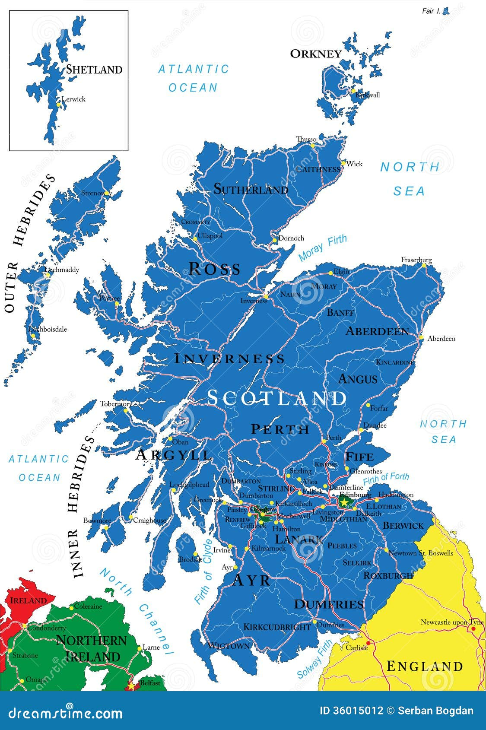

Section 1 - International, National & Local Context

Slide 18
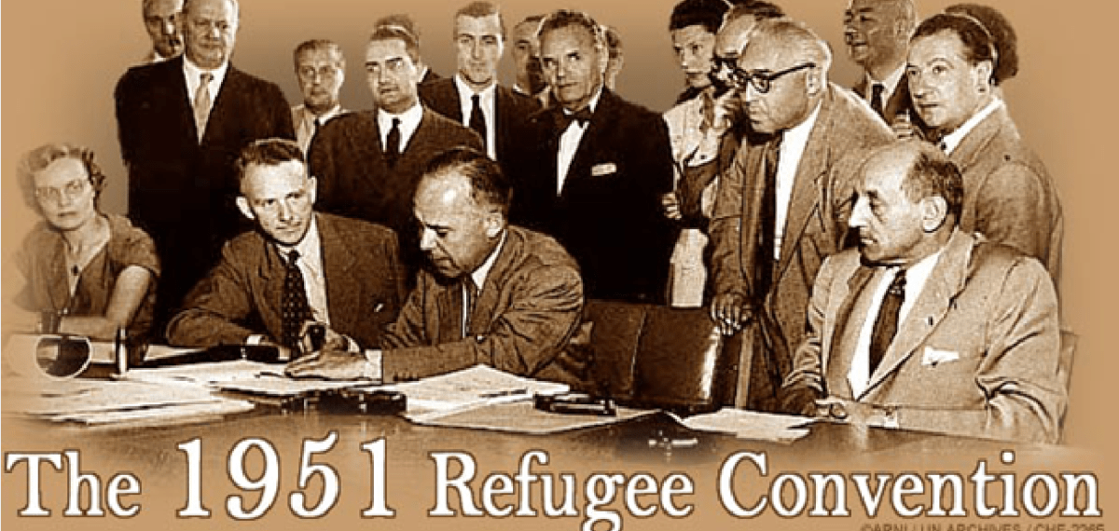
International Law
The 1951 UN Refugee Convention is the cornerstone international treaty defining who is a refugee and establishing their rights and the obligations of states to protect them.
Article 1 of the convention defines a refugee as someone who ‘owing to well-founded fear of being persecuted for reasons of race, religion, nationality, membership of a particular social group or political opinion, is outside the country of (their) nationality and is unable or, owing to such fear, is unwilling to avail (themselves) of the protection of that country, or who, not having a nationality and being outside the country of (their) former habitual residence, is unable or, owing to such fear, is unwilling to return to it’
Article 31 states that refugees seeking sanctuary should not face penalties for entering, or being present in a country without authorisation providing that they:
Are coming from a country or territory where their life or freedom was threatened;
Present themselves to the domestic authorities without delay;
Can show good cause for their presence
Notes:
In the aftermath of both world wars – millions of people fled their homelands in search of refuge. In response the international community set out guidelines, laws and conventions aimed at protecting basic human rights culminating in the 1951 UN Refugee convention and later the 1967 protocol
The UK is a signatory of this convention. Everyone who satisfies this definition is a refugee

Slide 19
UK Context
The UK is a signatory to the UN Refugee Convention
There are a number of ‘safe routes’ (legal pathways) in the UK
  Resettlement programmes, e.g. Afghanistan Citizens Resettlement Scheme
  Bespoke schemes, e.g. ‘Homes for Ukraine’
  Refugee Family Reunion
‘There are no existing means to safely apply for refugee status in the UK without reaching the country first’
- Rescue.Org
Notes:
Resettlement programmes, e.g. Afghanistan Citizens Resettlement Scheme – usually narrow eligibility requirement/limited places, and have to wait a while in country of displacement
Bespoke schemes, e.g. ‘Homes for Ukraine’ – where someone in UK is willing to provide a home for a Ukrainian family
Refugee Family Reunion - allows refugees who have already fled and been given refugee status to bring immediate family members
Some refugee charities argue that very few of the refugee resettlement commitments are being honoured
Many organisations highlight the limited presence of ‘safe and legal routes’ to the UK which leads to asylum seekers having ‘no choice but to use irregular routes to the UK’

Slide 20


UK Law and the media
Often negative discourse towards refugees in the media
Changes to UK legislation – ‘Hostile Environment’
Nationality and Border Act 2022
Illegal Migration Act 2023
Immigration policies currently under review by UK govt.
How is the current discourse and legal position on immigration likely to impact on children and young people and their families in Scotland?
Notes:
The ‘Hostile Environment’ is a set of UK govt policies initiated in 2012 by Theresa May , designed to intentionally make life difficult for undocumented migrants – encourage employers, landlords, banks, healthcare professionals to verify immigration status. Administrative and legislative measures designed to make staying in the UK as difficult as possible for people without leave to remain

Slide 21
Facts and figures..
123.2 million displaced persons internationally in 2024
36.8 million are refugees
8.4 million asylum seekers
5.9 requiring international protection
Around 75% of refugees worldwide are hosted by neighbouring low or middle income countries
Most common countries of origin for people seeking international protection are:
Afghanistan
Syria
Ukraine
Sudan
Venezuala
The UK comes around 5th in Europe for receiving the most asylum claims
In 2024 – there were approx. 110,051 claims
Top European countries for those seeking asylum:
Germany
France
Spain
Italy
Around 10% of people seeking asylum in the UK are dispersed to Scotland
Notes:
Patterns of immigration are changing both internationally and nationally with the figure for displaced persons worldwide reaching 123.2 million in 2024 (World Health Organisation) with 36.8 million being refugees, 8.4 million asylum seekers and 5.9 million needing international protection.
Many displaced people stay within their country of origin; others go to the next safest country and some others may travel further afield
Top ten countries of origin for people seeking protection in the Uk for year ending Sept 25 are Pakistan; Eritrea; Iran; Afghanistan; Bangladesh; Sudan; India; Somalia; Syria and Vietnam.
Seeking international protection is a broader term that can cover asylum seekers but also includes other forms of humanitarian protection. In the UK if an applicant doesn’t meet the convention criteria for refugee status, they can be considered for humanitarian protection
The neighbouring low or middle income countries who host refugees include Turkey who hosts the most refugees and asylum seekers followed by Iran, then Germany and then Pakistan
The UK comes around 5th in Europe – depending on whether Poland is included – Poland included as hosts many displaced Ukrainians.
UK receives around 9-11% os asylum claims made in Europe, when population is taken into account – they would fall about 15-17th place in ranking of most asylum claims

Slide 22
UK Context
Of those coming to the UK each year, the majority come for Study, work or Family Visas.
In the year ending Sept 25, the UK offered protection to 171,000 people through safe and legal (humanitarian) routes such as the Ukrainian permission extension scheme
In Year ending Sept 25, there were 110,000 asylum claims (around half came through ‘irregular’ routes)
In Year ending Sept 25, 134,000 asylum decisions were made - around 45% of these were granted
‘Many of the systems and processes in the UK do not work well for asylum seekers and refugees’
- MH Foundation
Notes:
In the year ending Sept 25, the UK offered protection to 171,000 people through safe and legal (humanitarian) routes, either to come to or remain in the country, in the year ending September 2025; this is 95% more than the previous year, largely due to the introduction of the Ukraine Permission Extension scheme
Of the asylum claims around half came through illegal routes
Around 33% of asylum applications are refused – appeals are then allowed
As you will be aware the system of granting asylum is complex and the MH foundation has spoken out about how it can adversely impact on the MH of asylum seekers and refugees. There is no specific strategy in England to support the integration of asylum seekers although there is in Scotland and Wales

Slide 23
Scottish context
People seeking asylum in Scotland are mainly dispersed to Scotland by the Home office from SE England.
Glasgow City is the individual local authority accommodating the highest number of asylum seekers in the UK. They can also be dispersed to other parts of Scotland.
Each asylum seeker get £49.18 a week as part of an ASPEN Card
In the 2022 census, Scotland’s popn grew by 2.7% since 2011 but would have decreased without migration
In Scotland, a New Scots Refugee Integration Strategy has existed for a number of years and was updated in 2025
Notes:
UK Govt figures – top 5 LAs accommodating the highest number of asylum seekers include:
Glasgow City (3,844 people)
Birmingham (2,755 people)
Hillingdon (2,481 people)
Liverpool (2,361 people)
Manchester (1,997 people)
Around 89% of people stay in England, about 10% sent to Scotland.
More people in Scotland are dying that being born so we need migration for population growth so apart from any other benefits there are economic and service benefits given the greater demand on health and social care services. The Asian, African, Caribbean and Black mixed ethnic groups doubled from 2% to 4% of population
An ASPEN Card (Asylum support enablement) card is a Visa prepaid debit card issued by the UK Home office and managed by Migrant Help – it provides financial support to eligible asylum seekers to cover necessities like food, clothing and toiletries. The exact amount depends on your accommodation type – some have food tied in, etc. The amount if for each member of the household. If you have a child of 1-3 you get an extra £5.25 a week or £9.50 for a baby under 1.

Slide 24

New Scots Refugee Integration Strategy
‘The New Scots vision is for a welcoming Scotland where refugees and people seeking asylum are able to rebuild their lives from the day they arrive’
New Scots are people in Scotland who have been forcibly displaced, or are making a claim or are granted ‘status’ or other humanitarian protection and their dependents, those seeking asylum as well as those whose application has been refused…
Recognises the value of the refugee community and seeks to integrate them positively into society rather than just assimilate them
New Scots Refugee Integration Strategy: 2024 - gov.scot
Notes:
This strategy is informed by recent research and has been compiled by SG, Cosla and the Scottish Refugee Council who are working together to support better outcomes for forced migrants. Informed by those with lived experience
MH foundation recognises this strategy as an example of good practice

Slide 25
Activity
Discuss:
Given the information we have shared so far, imagine if you were a migrant coming to the UK and specifically Scotland to settle, what do you feel the challenges would be
Consider both migrants more generally and those who are seeking asylum in the UK
Notes:
Spend around 15/20 mins discussing.

Slide 26
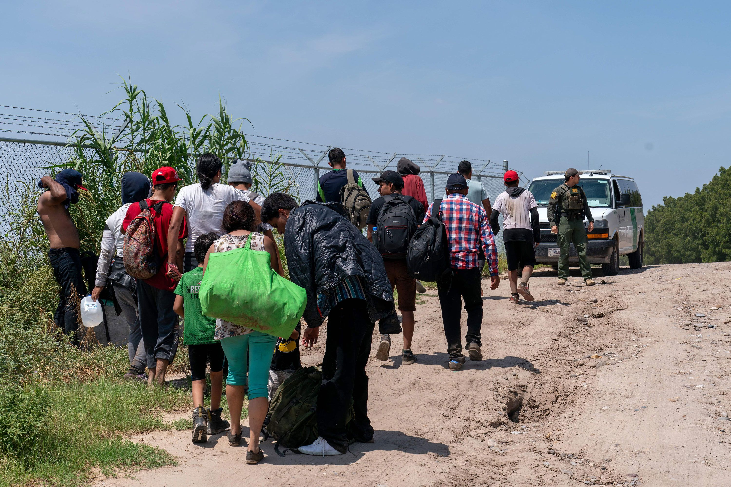
Section 2 - The Relationship between the migrant experience and stress and trauma
Notes:
We will now look at the relationships between culture, migration, acculturative stress and trauma which can be complex. The migrant experience is unique and it can differ greatly between cultures, between families and between the different experiences of the migration itself – we will explore this in more detail in this section.
While it is acknowledged that migration can be particularly challenging for refugee and asylum seekers – given the systems around this and other aspects of the migration journey, it should be acknowledged that there are also other potential challenges for other migrant groups including ongoing stress associated with integrating within a new culture.

Slide 27
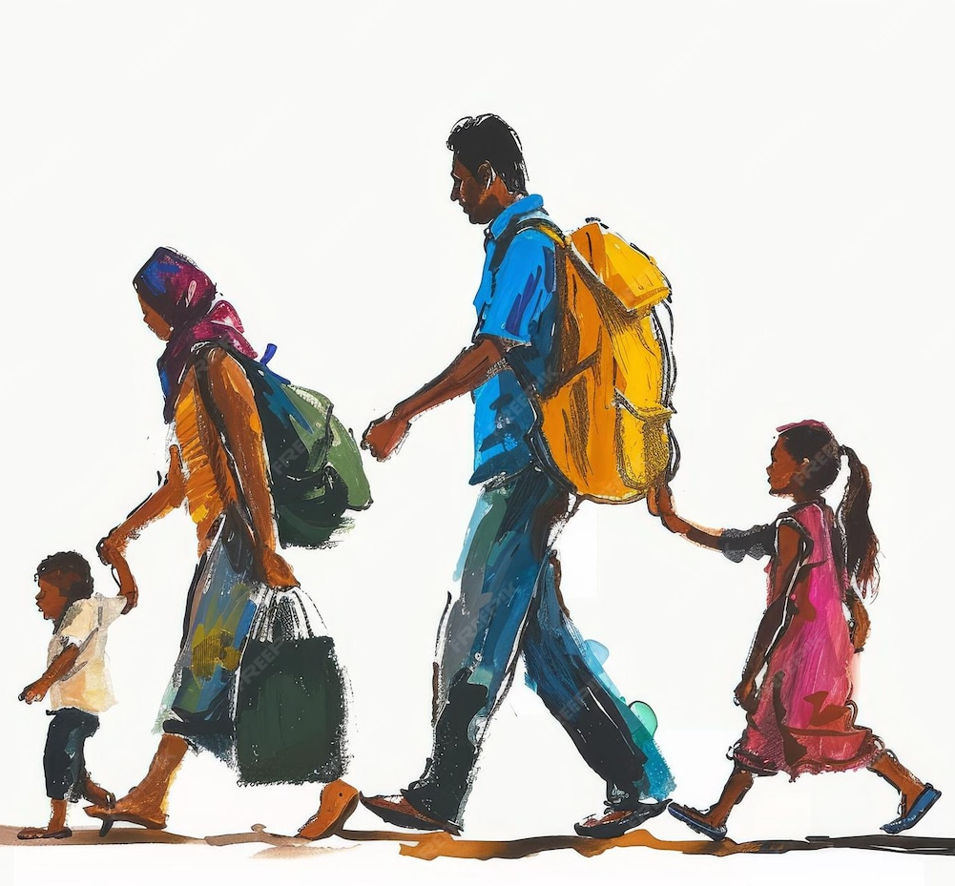
‘The condition of being a migrant is often burdensome, especially in the case of forced migration of asylum seekers and refugees and the combined effects of these experiences can result in problematic consequences for the mental health of parents and children..’
Notes:
Remind that Educ Scotland trauma slides would be here
Wiese and Bruthorst, 2004,2007
While many migrants will face some kind of stress and loss – given the change from one country to another and the adaptation to a new and often very different culture – it can be particularly challenging for asylum seekers and refugees due to the forced nature of the migration experience.
The reasons for migration vary and in general when someone moves to live in another country they can face economic, linguistic, administrative and legal difficulties

Slide 28
Activity
Discuss:
If you were a migrant from another country, what kind of trauma do you feel you might experience?
How might this specifically impact on children and young people?
‘It is not migration alone but rather traumatic or derailing events before, during or after dislocation that leads to psychological distress’
Notes:
The potential for trauma can happen at many stages of the migrant journey – before we explore this in more detail think about the nature of the trauma that might be experienced by migrants and which type of trauma it might lead to.

Slide 29
The Stages of Migration
Pre-migration
(in country of origin)
During Migration
(Travel and Transit)
Post migration
(initial settling in country of residence)
Post Migration
(Integration and settlement)
Notes:
At least half of migrants have experienced trauma prior to migration, some estimates predict that around 80% of refugees/asylum seekers haves experienced some degree of violence (Dr Vanja Pejic, PhD)
Pre-migration trauma is predictive of psychological distress at least 5 years after exposure
We will explore the different aspects of trauma that might be experienced at each stage of this journey

Slide 30
Trauma
  Violence, abuse, war
  Natural disasters
  Poverty
Loss
  Loss of home, culture, way of life
  Death of family members and loved ones
Cultural Adjustment and resettlement stress
  Basic needs being met
  Legal status
  Navigating new culture and identity
Notes:
At least half of migrants have experienced trauma prior to migration, some estimates predict that around 80% of refugees/asylum seekers haves experienced some degree of violence (Dr Vanja Pejic, PhD)
Pre-migration trauma is predictive of psychological distress at least 5 years after exposure
Persecution due to race, religion, sexual orientation, gender

Slide 31

Understanding of Immigration Trauma
Family loss
Research demonstrates that there are complex psychosocial stressors that are endemic to the immigrant experience
It is not migration alone but rather traumatic or derailing events before, during or after dislocation that can lead to psychological distress
Cumulative trauma experiences can lead to more severe mental health responses
This can be compounded by ethnocentric assumptions about mental health and supports
Loss of culture
Legal status
Poverty
Detention
Persecution
Notes:
In some literature – immigration trauma is perceived as a particular type of trauma that is likely to

Slide 32
Pre-Migration (in country of origin)
Pre -migration
war
Violence including sexual violence
Lack of livelihood
Natural disasters
persecution
Notes:
At least half of migrants have experienced trauma prior to migration, some estimates predict that around 80% of refugees/asylum seekers haves experienced some degree of violence (Dr Vanja Pejic, PhD)
Pre-migration trauma is predictive of psychological distress at least 5 years after exposure
Persecution due to race, religion, sexual orientation, gender

Slide 33
During Migration (travel/in transit)
During migration
Detention
Life threatening conditions
Separation and loss
Lack of access to services
Modes of exodus
Notes:
Life threatening conditions – little sanitation, medical support etc but also linked to mode of exodus such as boats, etc.

Slide 34
Post Migration (initial settling in country of residence)
Post -migration
Poor living conditions
Detention
Family/support networks
Limbo status/legal position
Access to services
Inhospitable environments
Notes:
When get to country of destination or host country

Slide 35
Post-Migration (integration and settling)
Integration and settlement
Unemployment
Change of status
Threats to cultural/religious identity
Living conditions
Racism/exclusion
Mistrust of services
Notes:
Families will often now share experiences of traumatic migration experiences due to fear or shame
Professionals may be seen as representatives of a more dominant culture and this may lead to mistrust and suppression of difficulties
Experiences of trauma can differ for different ethnic groups – can be helpful to know a little about the culture the migrants/refugees have come from
Mental health of parents, particularly mother has often been linked to the impact of stressors on

Slide 36
Activity
Discuss:
How might experiences at each stage of the migrant journey impact on levels of stress and trauma, consider:
  Pre-migration
  Migration transit
  Initial settling in country of residence
  Integration and Settlement
  How might you react if you had experienced this?
Notes:
We developed Renfrewshire’s Nurturing Relationships Approach because we know about the importance of relationships for children both with their early care givers and with adults when they enter our education system.
Our first Aim is to promote and understanding of attachment theory …
In a nurturing establishment staff know about the impact of early relationships and have an understanding that children will be coming with different social skills and ability to understand and regulate their emotions because of the early nurturing experiences that they have had, and of the need to differentiate and teach these skills as well as academic ones.
Nurturing relationships remain crucial when a child comes to school and throughout their time in school – attachment/relationships remain important right throughout secondary school as well.
It is a whole school approach and so our training is for the whole school community –we involve teachers, Support staff, office staff/janitors. RNRA is not about having a nurture room or area in the school but how we develop nurturing relationships and practices in everything that everyone does across the whole school so that it forms part of the bricks and mortar; the ethos of the school.
Through a nurturing approach – research shows the importance of relationships to wellbeing and resilience – but also if schools wanted support with specific programmes, such as Bounceback.
It isn’t just that the nurturing approach itself is evidenced based, but also that how we asked schools to implement this nurturing approach was based on evidence of how to best ensure that new initiatives are implemented well and in a way that becomes embedded within the organisation and is sustainable.

Slide 37
What is culture?
Culture:
Impacts on how we regulate and express emotions
Influences how we learn from relationships
Helps make sense of the world
Sets a collective identity
Influences children’s interaction with parents and other attachment figures
Culture is a system of shared beliefs, values and customs, behaviours and artefacts that members of a society use to cope with one another and with their world, and that are transmitted from generation to generation
- Bates and Flor, 1990
Migration can cause ruptures in cultural identity
Notes:
To see how the post migration phase of settling into a new country might impact – it is important to understand about culture and its impact.
Culture is transmitted through everyday interactions – explicitly and implicitly, often through parental interactions – children develop their cultural identity through these interactions, when migrant families move to another country can lead to a loss of cultural identity or can lead to a split between parents and children as children seek to embrace new culture which can go against their traditional culture
Migrant parents will have more opportunities for contact with host society through children but can be different values and practices about raising children and host society will often expect them to conform to values of their society. Western society often has predominantly individualistic cultural values. Western society will often feel that aspects of their culture are ‘superior’ – parenting styles, education, mental health support.
Berting, 2009 demonstrated through research that after a while migrants don’t maintain their original culture in its totality

Slide 38
What is acculturation?
Acculturation can have different phases:
Marginalisation (not able to keep original culture but not developed identity of host);
Separation (holding onto original culture, rejecting host)
Integration (maintains original culture but also interacts with host)
Assimilation (complete adoption of host culture and let go of original culture)
These are not linear and will be experienced by everyone in different ways
Acculturation is the process of cultural, psychological and social change that occurs when people come into contact with a new culture
It usually involves an interactive process of change, involving both the host society and the migrant culture, whereby both are changed in some way.
Ease or difficulty relates to factors such as age; intrapersonal factors (personality/attitude); and interpersonal factors (social and cultural context)
Notes:
In reality, migrants may go through this process in different ways, depending on a number of factors such as age, attitude to move, their original cultural influences and how strongly they adhere to these, the disparity between their own culture and that of host country – within family can experience this differently – children and young people often more likely to assimilate
Integration – blending both, assimilating – adopting new, dropping old; separating – holding onto the old; marginalising – loses both.
Can cause stress – acculturative stress. Level of acculturation often linked to length of time in new country; language proficiency and age at immigration.
Can be a mourning process.

Slide 39
Acculturative Stress
‘Resettlement doesn’t mark the end of the psychological journey. Adapting to a new country is another challenging step and can add to distress. Refugees (in particular) will be experiencing loss and grief, even survivors guilt, and the normality of the new environment can be a painful reminder of what has been lost.’
Acculturative stress is a term coined to describe the migrant experience.
It is defined as the psychological strain resulting from adapting to a new culture
It encompasses emotional, social and economic pressures.
Acculturative stress is linked to mental health issues such as depression, anxiety and social isolation.
Notes:
Acculturative stress can be experienced by all migrants as there is a process of acclimatising to new environments for all migrants – often there is a sense of bereavement or loss, a mourning process – for family left behind, for a way of life, for a culture that you are no longer part of,
It can impact on our whole sense of who we are/ our sense of identity

Slide 40
Acculturative
Stress
Can lessen or increase acculturative stress
Contentment with decision to move
English proficiency
Racial discrimination
Levels of religiosity
Ability to see family
Age at moving
Community support network
Parental mental health
Can lessen or increase acculturative stress
Notes:
Acculturative stress is a term coined to describe the migrant experience. Defined as the psychological strain resulting from adapting to a new culture, encompasses emotional, social and economic pressures. Acculturative stress is linked to mental health issues such as depression, anxiety and social isolation.
A study of migrants carried out in 2024 (Venera Bekteshi) – mainly based in USA but some implications for migrants populations in UK and Europe. found that some aspects of the migrant experience can increase acculurative stress and some can lessen it
Need to understand and address contextual factors in understanding and addressing acculturative stress and psychological distress. Need culturally sensitive interventions
Often parents behaviour and interactions significantly relate to childrens affective states – parents are the physical and emotional holding environment for the child

Slide 41
Prevalence of mental health issues in migrant population
Around 32 to 47% of migrants have experienced some form of PTSD
Around 32% of adult asylum seekers or refugees have experienced depression
1/3 of adolescents and 34% of parents have experienced trauma during migration
More than a quarter of refugee children suffer from a psychological disorder (this is 3 times higher than in English children)
26% of children and adolescents travelling with families had experienced physical and psychologically traumatic experiences, this rose to 68% in unaccompanied minors
Notes:
1. Mental health foundation (31.4%) Bustamante, et al (2018) – 47%
2. Perriera and Omeas (2013)
3. Fazel and Stein (2003) – UK study
4. Wiese and Burhorts, 2004
Prevalence for PTSD in general population is around 3.9% and for depressive disorders it is around 12%

Slide 42
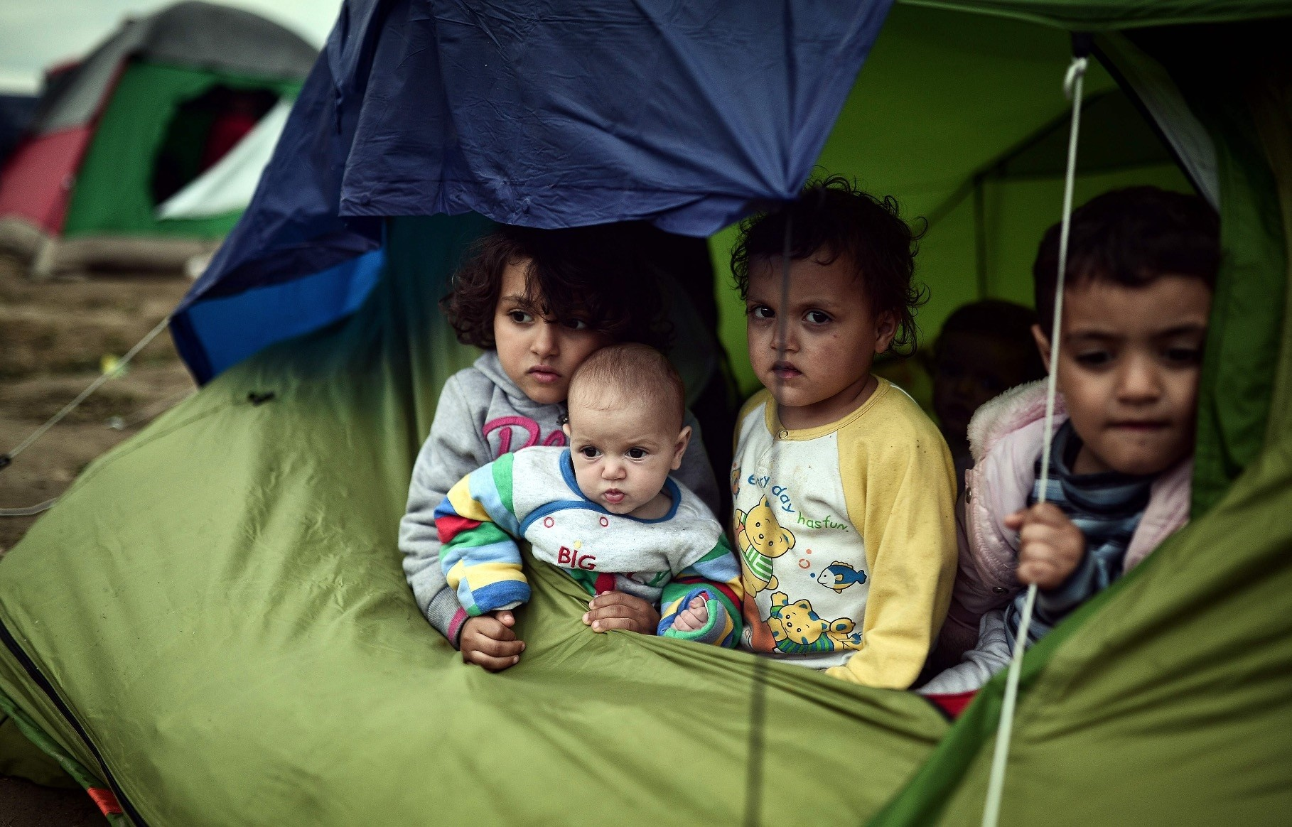
Impact on children
Migration, either voluntary or forced, independent of motivation, can be understood as a potentially stressful and even eventually traumatic event, especially for children and adolescents’
Acculturation is often much faster for children and young people
Parents and caregivers attitudes to host culture can act as a barrier or protective factor
Parental mental health can be a protective factor
Attachment bonds can be fractured by the immigration process
For children and adolescents, a period of intense change can make them more vulnerable developmentally
Notes:
Children are often vulnerable developmentally during this period where a lot of change is taking place
Culture can act or a stressor or mediator for children – if they are able to adapt to their new culture can help them but may cause fractures in relationships with parents who struggle to adapt.
Also if have strong links with old culture and community supports can act as both a support or sometimes a barrier depending on whether it leads to confusion or stigmatisation
Can feel like a split between two worlds – may end of hiding their true feelings for fear of upsetting others or through lack of trust towards those in new culture
Moro 2005 – can result in a form of ego splitting, child can feel like a foreigner in their own family
They are also vulnerable to secondary trauma due to the trauma experienced by parents or may have experienced significant distressing events themselves
Can be more likely to have attachment disorders as lose trust in caregivers to keep them safe, exploratory behaviour is reduced

Slide 43
When might adversity become trauma? (stressor continuum)
Stress responses or reactions to a traumatic/adverse event can be either positive, tolerable or toxic
Positive
mild stress in the context of good attachment
increased resilience and confidence
Tolerable
serious, temporary stress buffeted by supportive relationships
Adaption and recovery with some possibility for physical/emotional damage
Toxic
Prolonged activation of stress response systems in the absence of protective relationships
Lifelong impact on health and wellbeing
development of coping skills
Notes:
There has been much discussion around the definitions, similarities and differences between adverse events and traumatic events. As currently defined, ACEs reference types of experiences which increase the likelihood that a child will either experience toxic or traumatic stress. Stress becomes toxic when it is prolonged and intense and is not buffered by supportive relationships. Types of experiences which increase the likelihood that a child will experience toxic levels of stress include parental substance misuse, parental discord/separation, parental mental illness, witnessing violence between parents, parental incarceration and emotional or physical neglect. Stress is experienced as traumatic when experiences are so severe that they pose a threat to life or to the physical integrity of the child. Types of experiences which increase the likelihood that a child will experience traumatic stress include sexual, physical and emotional abuse, particularly in contexts where there are no supportive adults. Combining an understanding the potential impact of toxic and traumatic experiences on the individual with an understanding of what helps support resilience and recovery is important.

Slide 44


Unmet attachment needs
Baby has a need
Baby expresses need
e.g. cries
Care response not successful at meeting needs.
No comfort or inconsistent comfort
Baby feels anxious, restless and fearful
Trust does not develop
Transitions may trigger painful memories of loss or rejection, feelings of high anxiety or grief.
Difficulties often arise from children’s emotional needs.
Transitions and inconsistency can pose a threat – stress response!
Valuable recovery opportunity for children.
Notes:
So why do children with unmet attachment needs find transitions particularly tricky?
At times such as the end of a school year, a child with unmet attachment needs may be more likely to reject the adults they have had good relationships with the previous year. Rejecting these adults is less painfully emotional than the child feeling like the adult is rejecting them.
Experiences of loss – children will likely see some changes (e.g. moving up a year) as loss and rejection, even though we know this isn’t and it’s just change. They are potentially used to people walking away in their lives.
For children with unmet attachment needs, difficulties with transitions often arise from their emotional needs (different to neurodevelopmental needs when this is usually coming from a ‘cognitive’ need).
Likely to feel threatened by transitions and inconsistency. Stability is most important for these children but transitions are times of change, especially bigger transitions.
Stress response – link with anxiety and emotion regulation. Children with unmet attachment needs are often usually operating at a state of heightened arousal. They also find emotion regulation more difficult and often require adult support with this – important when thinking about how we feel when we are anxious (e.g. about a change) and how we support this.
If poorly managed, these changes may lead to a serious setback or trauma. When managed well, a positive experience of change provides a valuable opportunity for learning and recovery from trauma.

Slide 45
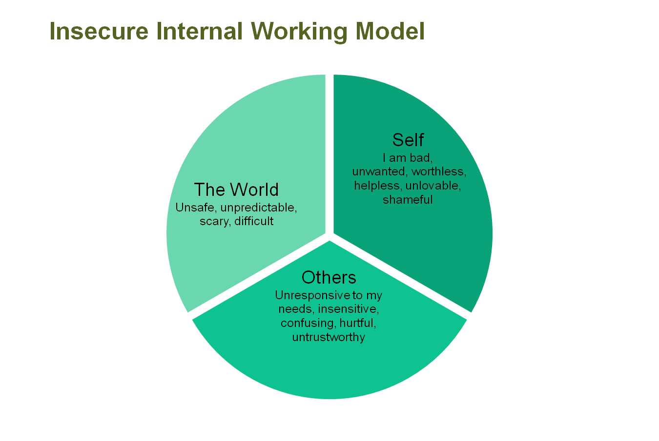
Notes:
If children experience some of these traumas – is likely to impact on their internal working model. May impact on ongoing attachment bond.
Where a child’s experience of an adult is that they don’t always come when you need them or maybe they come and are angry or critical/abusive Then the pathways that develop and the working model of adults is one maybe of fear, anger and mistrust and this is what child expect other adults will be like.
The “internal working model” of a child considered to be insecurely attached would include the following types of beliefs:
I am bad, worthless, unwanted and unlovable
caregivers are hurtful and untrustworthy
the world is dangerous.
But the good news is that the brain is changing all the time making new brain connections and building new internal working models of what adults are like so by providing the good nurturing experiences in school we can help to build models of adults being consistent, trustworthy, helpful, protective, comfort and help calm me when I am upset, fun, - all the things that help a child to develop more secure attachments and a secure base from which they have the confidence to explore and learn.
These models can be changed through a nurturing approach, but this takes time and for the children with most complex needs can be very demanding for staff.

Slide 46
Activity
Discuss:
How are children and young people likely to be impacted upon by these experiences?
What behaviours might you see in the playroom/classroom?
Notes:
We developed Renfrewshire’s Nurturing Relationships Approach because we know about the importance of relationships for children both with their early care givers and with adults when they enter our education system.
Our first Aim is to promote and understanding of attachment theory …
In a nurturing establishment staff know about the impact of early relationships and have an understanding that children will be coming with different social skills and ability to understand and regulate their emotions because of the early nurturing experiences that they have had, and of the need to differentiate and teach these skills as well as academic ones.
Nurturing relationships remain crucial when a child comes to school and throughout their time in school – attachment/relationships remain important right throughout secondary school as well.
It is a whole school approach and so our training is for the whole school community –we involve teachers, Support staff, office staff/janitors. RNRA is not about having a nurture room or area in the school but how we develop nurturing relationships and practices in everything that everyone does across the whole school so that it forms part of the bricks and mortar; the ethos of the school.
Through a nurturing approach – research shows the importance of relationships to wellbeing and resilience – but also if schools wanted support with specific programmes, such as Bounceback.
It isn’t just that the nurturing approach itself is evidenced based, but also that how we asked schools to implement this nurturing approach was based on evidence of how to best ensure that new initiatives are implemented well and in a way that becomes embedded within the organisation and is sustainable.

Slide 47
Signs of trauma in refugee children
Fight, flight or freeze responses
Regression in behaviours
Overwhelming and strong emotions
Psychosomatic symptoms
Mistrust in others
Executive function and readiness to learn
Irritability/anger
Notes:
Can have nightmares, concentration issues, irritability, hypervigilance, headaches, stomachaches, enuresis,
Crying, depression, withdrawal
Attachmentn disorder – lack of trust in caregivers, exploratory behaviours are reduced
Not eating, sleeping

Slide 48
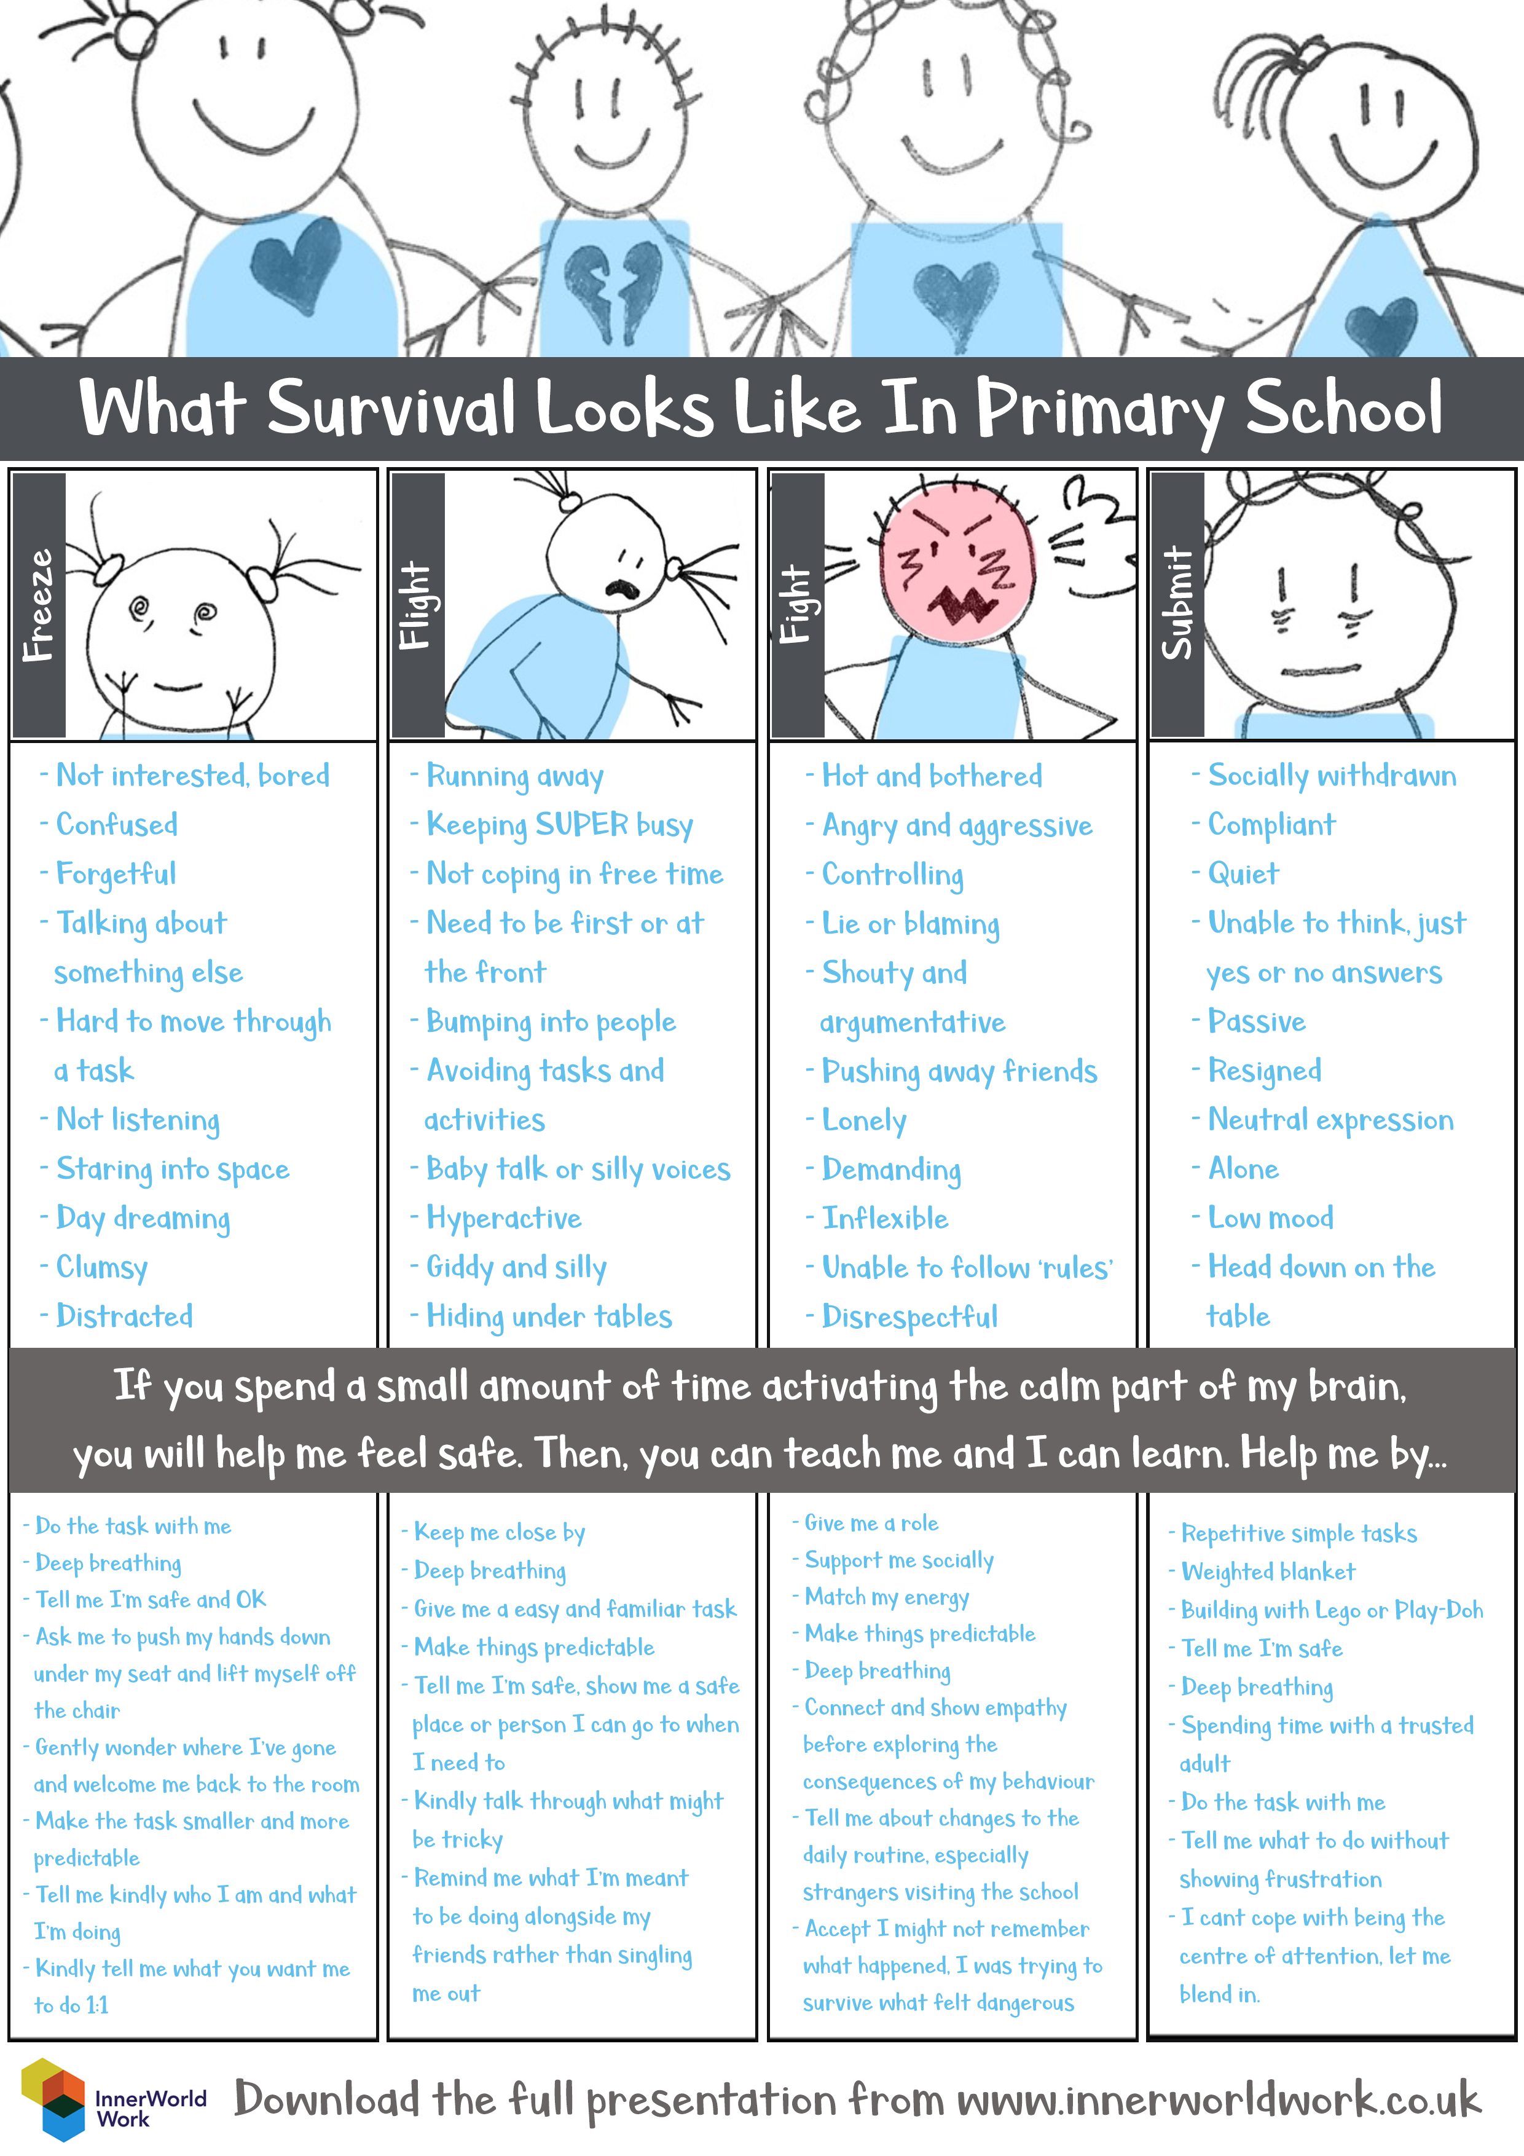
Secondary resource: http://www.innerworldwork.co.uk/wp-content/uploads/2017/04/Survival-In-Secondary-School.pdf
Notes:
Optional slide if needed
Inner world have produced these resources detailing what survival responses could look like in school and of ways to support.
There is a secondary one too.
This inner world resource is one that we would share – these resources are in your journal
www.innerworldwork.co.uk

Slide 49
Potential protective/resilience factors
Family support
Community support
Culture/religion
Education
Relationships/trust
Beliefs about move
‘Parents hold the physical and emotional holding environment for the child. Parental behaviour and interactions often significantly relate to the child’s affective state’
- Perez Foster (2001)
Education
Relationships/trust
Access to resources/supports
Religion/Culture
Family support
Response of country of residence
Notes:
We saw with acculturative stress that there are aspects that can lessen or increase this. Some of this is outlined here.
Family support – when the migrant has family in the country of residence who can support them also when there are strong attachment links between parents and children and when the parents/care takers mental health is not significantly impacted – this can be protective
Community support - when they move to a country where there are strong community links or can make those links with community groups when they get there
Culture/religion can play a significant role – research shows that when culture they move into is very different from their own cultures this can cause stress but when more familiar – can be easier to adapt. However, having a strong sense of culture and a strong faith/belief systems can help to protect some families and young people.
Having a belief in education and being able to access this can be protective factor – education that is supportive and aware of cultural differences and celebrates these is also important. We will move on to looking at how schools can do this.
Developign relationships of trust with those in education and in communities can also be a significant factor. Professionals and others ensuring that they reach out and take into account cultural sensitivities
Having a strong sense of commitment to the move and feeling you have done right thing can also positively impact
Supporting the parents and family is as important as supporting the child as they hold such a key role

Slide 50
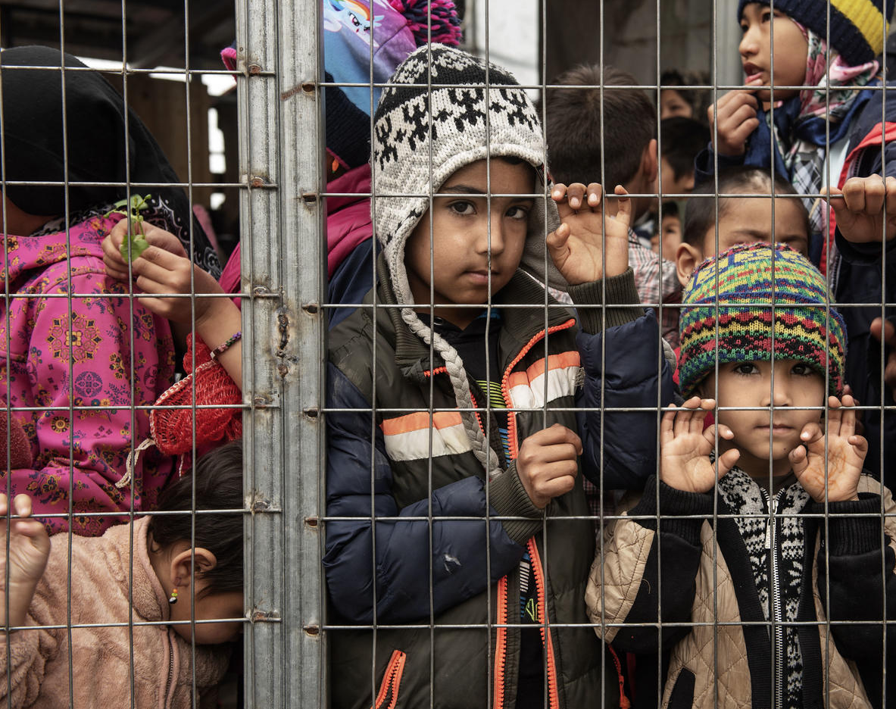
Section 3: Supporting migrant children and young people who have experienced stress and trauma

Slide 51

Developing a Culturally Responsive School
Why?
Schools can respond to the different populations and cultures of their local area
Schools are ideological sites for ‘being’ and ‘becoming’
Schools can teach about human values and identify and expose practices that encourage forms of oppression
How?
Awareness raising on diversity and racism
Identifying community supports
Help families to make sense of how system works
Psychological support for children and yp
Representation of cultures, e.g. food in canteen
Empathy with lived experience
Schools can become sites of fostership and empowerment for all children including those from migrant backgrounds
- Badwan, Khawla and Popan, 2021
Notes:
Authors state that fostership means to embrace, nurture, protect and wrap arms around those who most need our love and protection
Different cultures should be represented in curriculum, resources, visuals around school
Identities and needs of culturally diverse groups should be valued and celebrated
Social justice should be a key value

Slide 52
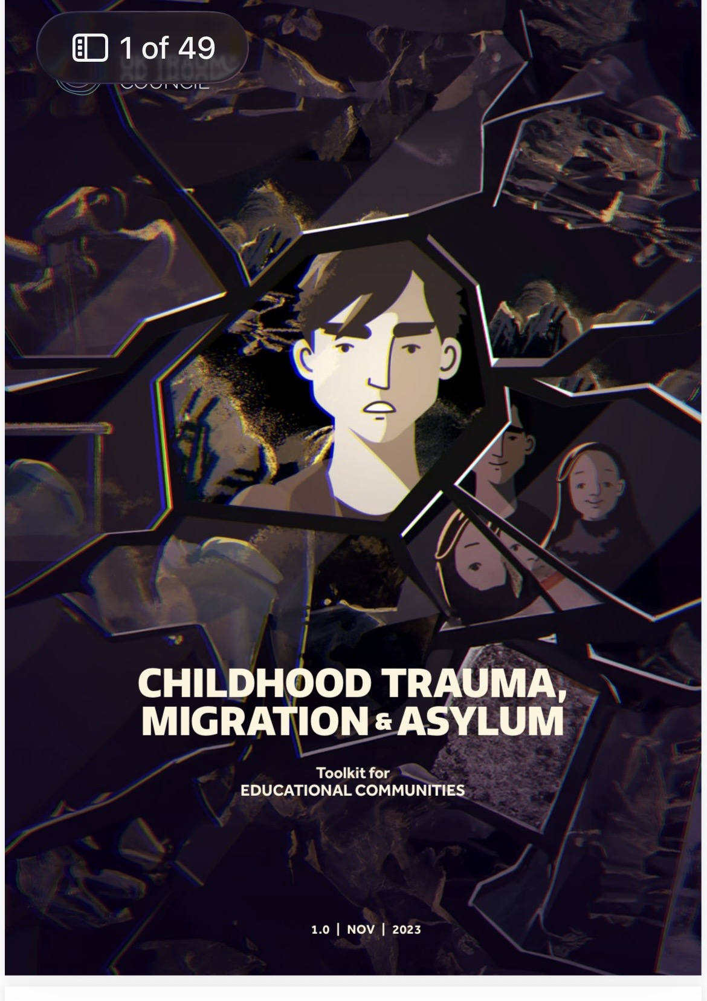
Video clip
Childhood Trauma, War and Conflict (with English subtitles) | UK Trauma Council

Slide 53
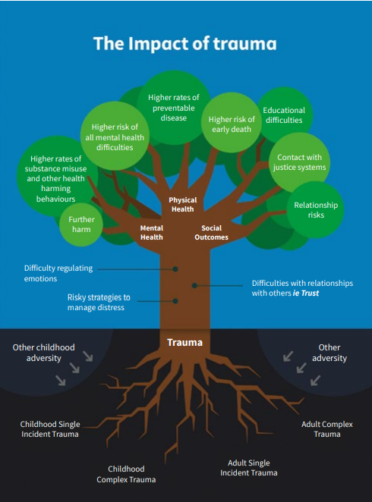
Scotland’s vision…
‘a trauma informed and responsive nation that is capable of recognising where people are affected by trauma and adversity, and that responds in ways that prevent further harm, support recovery, address inequalities and improve life chances.’
NES Trauma Informed - National Trauma Training Programme Online Resources Summary (transformingpsychologicaltrauma.scot)
Notes:
Diagram taken form Transforming Psychological Trauma Framework to highlight why trauma matters and that it is everyone’s business.
The roots highlight types of traumatic event and adversity
The leaves show the impact that these events can have on physical and mental health and social outcomes (links to ACEs research)
The trunk shows examples of how we may see the impact of trauma in terms of an individuals behaviour.
There is now widespread agreement that experiences of adversity and trauma are prevalent within our society and have the potential to significantly affect the quality of a person’s life over the course of their lifetime, particularly where these experiences occur in childhood and are not buffered by supportive adults.
Research shows that childhood adversity and trauma can have a significant impact on a child’s ability to learn, to relate to and trust thers and to cope with stress.
Safe and supportive relationships are known to be key in fostering resilience and in enabling recovery following adversity and trauma. For this reason, it is important that we recognise the potential for each contact we have with people affected by trauma to afford safety, enhance resilience and promote recovery.
Children who experience adversity and trauma are, in adulthood, more likely to become parents at a young age, experience poor mental health, use substances, have contact with the criminal justice system, experience poor physical health and die prematurely
What this means is that exposure to adversity and trauma in early life can significantly affect a child’s life chances, and, because children grow into adults who shape the next generation, potentially the life chances of their children.

Slide 54
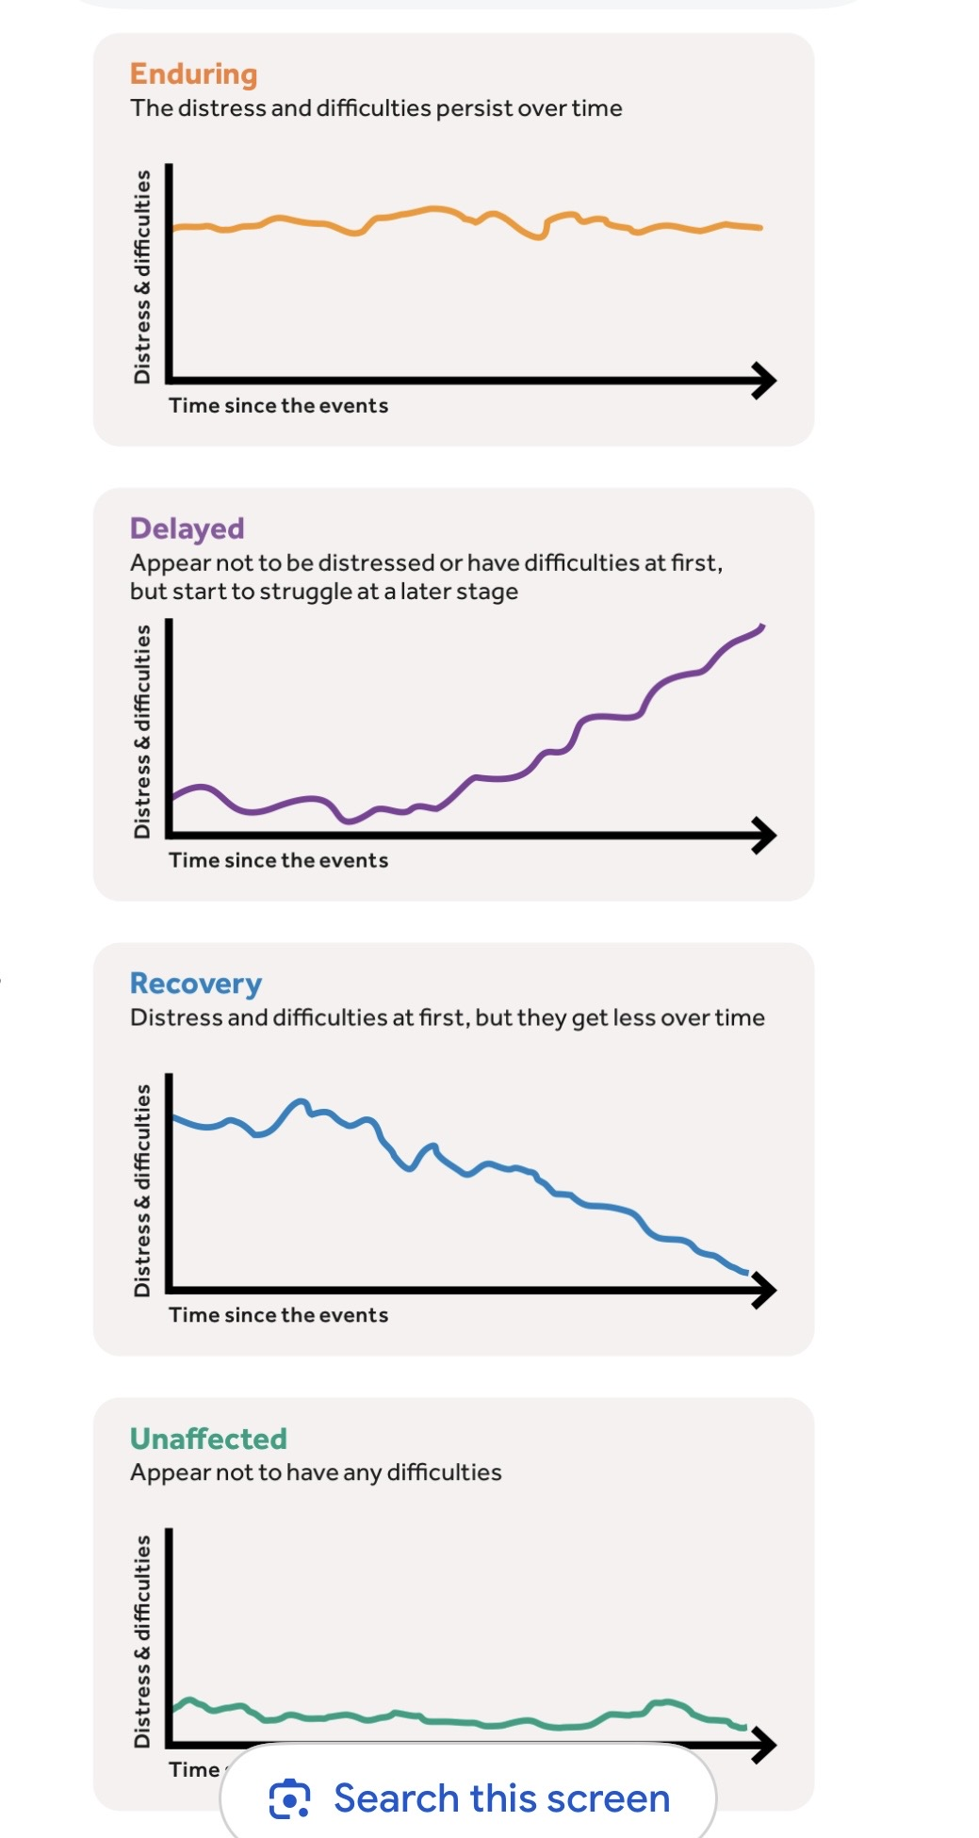
Recognising and Responding to
Trauma in migrant children
Trauma is likely to impact on children and their families in different ways
We need to:
Remain curious and open minded
Be culturally sensitive
Engage community groups
Use Safeguarding protocols (be aware of potential misunderstandings)
Use sensitive questioning
Notes:
Many children and young people and their families will recover and have a positive future but may require support along the way
It is important that we don’t always impose our western notions of mental health and support in a sensitive and culturally appropriate way
Sometimes children or families wont share their difficulties or trauma through lack of trust and so we may need to be vigilant to signs
Examples may be reluctance to engage with services, showing difficulties through play, being on high alert, loss of focus in learning, anxiety, suicidal thoughts
Possible questions (use ASSIST training or primary one): When things are really tough, how do you manage?
Have you ever hurt or harmed yourself?
Do you think about dying or want to die?
Have you ever thought about

Slide 55
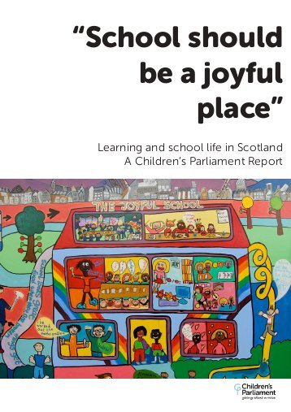
It’s all about rights ……
‘A child’s right to an education that is concerned with realising their fullest potential means getting alongside the child, valuing their lived experience, giving them love and care and using our best professional knowledge and skills to make a positive difference.
It’s all about relationships.’
Notes:
Link to work of Childrens Parliament and UNCRC – it’s all about rights!
http://www.childrensparliament.org.uk/wp-content/uploads/School-should-be-a-joyful-place-2016.pdf
https://downloads.unicef.org.uk/wp-content/uploads/2010/05/UNCRC_summary-1.pdf?_ga=2.64049839.1413422596.1533280020-1637565666.1533280020

Slide 56

Evidence informed principles to support
SAFE
CALM
CONNECTED
IN CONTROL
HOPEFUL
Notes:
Taken from UK Trauma Council – Childhood Trauma, Migration and asylum

Slide 57

SAFE
Trusting relationships where they are seen, known and valued, e.g. know chosen name and how to pronounce it
Language – provide supports, e.g. fan with key words
Familiarity and routine, e.g. timetable and visuals
Curriculum – help reflect their culture through the curriculum, avoid triggers, e.g. suggest a signal if anything is triggering
Physical environment – provide space but be aware small rooms may be triggering
Plan Ahead – staff meeting and training, consider how to support
Notes:
This is about ‘felt safety’ not just physical safety, it includes:
Relationships – know their chosen name and how to pronounce it, make them feel special, kept in mind, find out about likes/dislikes, status, follow up about recent events, notice when they return after absence, build a relationship wit h family
Take account of any anti-bullying and anti-racism policies to address anything discriminatory (example given by Regine, Pachedu)
Language – teach English, translate key bits of lesson, have a fan with key words on it, have an interpreter. Don’t ask child to interpret for parents, give opportunities to use 1st language
Familiarity and routine – Provide necessary equipment, uniform, visuals, explain expectations about how things are done, e.g. going to gym, lunch hall, provide a peer/buddy
Curriculum – PSE – use this to discuss challenges/opportunities of being a migrant – help explore feelings

Slide 58
CALM
Safe Space – have access to a safe space with calm activities, e.g. pop up tent
Culturally sensitive space
Calm communication, e.g. avoid loud noises, shouting, watch body language
Settling Activities – comfort box, exit pass
Visuals of who can help – posters of staff or peers who can help
Calm Techniques – learn what helps them to feel calm, e.g. prayer, music, interests
Trusting relationships where they are seen, known and valued, e.g. know chosen name and how to pronounce it
Language – provide supports, e.g. fan with key words
Familiarity and routine, e.g. timetable and visuals
Curriculum – help reflect their culture through the curriculum, avoid triggers, e.g. suggest a signal if anything is triggering
Physical environment – provide space but be aware small rooms may be triggering
Notes:
Safe space – calm activities to help regulate, pop up tent, blanket, items from home
Culturally sensitive space – place to pray
Calm communication - try to avoid shouting, watch body language, avoid threatening body language, being too close, respond calmly to work, avoid over excitement
Calm techniques – will depend on individual, find what helps them, could be touch or journal or drumming or any other interests
Settling activities - have a comfort box, familiar items, etc
May do Seasons for Growth if helpful

Slide 59
CONNECTION
Celebrate faith/culture - get to know faith/culture and reflect this around the school
Connect with staff - show that staff in school care about them
Careful Curiosity - Gently explore about country of origin/family
Connection with Peers – find activities with peers that are not always language based, e.g. sports dance, etc
Teach peers some of words or phrases
Connect with other migrants/refugees
Notes:
Meaningful connection can be difficult – think back to acculturation, may want to keep a connection to country of origin
Celebrate, share information on faith and culture, let them see this mirrored around the school – books, pictures, play objects that reflect their country of origin and faith – Mirrors and windows – displays that reflect their culture and background, home corner, books, foods
Connect with staff – find out interests, likes, etc and discuss these.
Some conversation starters in the guide
Put into contact with other migrants or refugees in school or local area – community groups, etc

Slide 60
CONTROL
Agency – provide opportunities to make their own decisions
Offer Choices – language to use, lessons, when to have support
Allow them to share when ready – don’t ask too many questions, go at their pace
Draw on strengths – don’t always focus on what they cant do, use strengths to guide learning
Representation in student council
Plan Ahead – staff meeting and training, consider how to support
Notes:
Traumatic events can make cyp feel out of control, need to help give sense of control – think back to principles of trauma informed practice
Don’t do to, do with/alongside
If offering help – make sure they are happy with this – family and yp – go at their pace.
Help them have a voice in matters relating to school – school council etc

Slide 61
HOPE
Don’t minimize but help to maintain optimism
Be aware of role of culture and religion – use hopeful messages from these
Talk about hopes and dreams – possible Person Centred Planning
Use positive affirmations
Notes:
Important to support but also look to future and hopes and dreams and what they want to achieve

Slide 62
Welcoming and Settling Children
Hold whole school assemblies that focus on cultures of children
Identify key adults and peers to support
Explore stereotypes/prejudices – challenge attitudes
Promote parental engagement
Engage with community groups
Check local authority and national resources
Be aware that refugees and migrant groups are a heterogenous group and one size doesn’t fit all
Emphasise wellbeing before learning but be aware of value of education for many cultures
Do a mapping exercise of resources and supports
Helpful organisations
Pachedu – Renfrewshire based
IN-Ren – Renfrewshire based
Refuweegee – Glasgow and surrounding areas
Scottish Refugee Council - national
Notes:
Taken from BPS guidance to supporting migrants

Slide 63
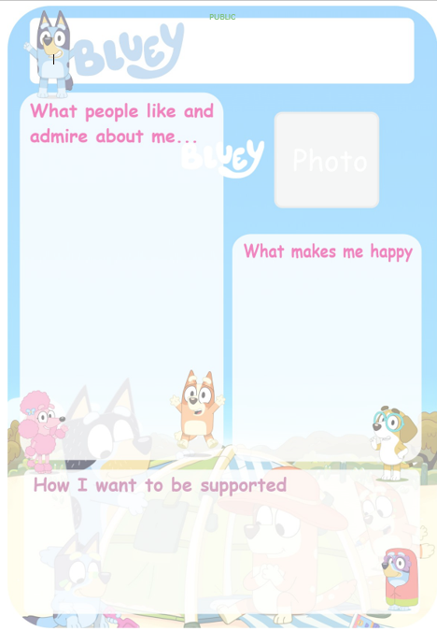

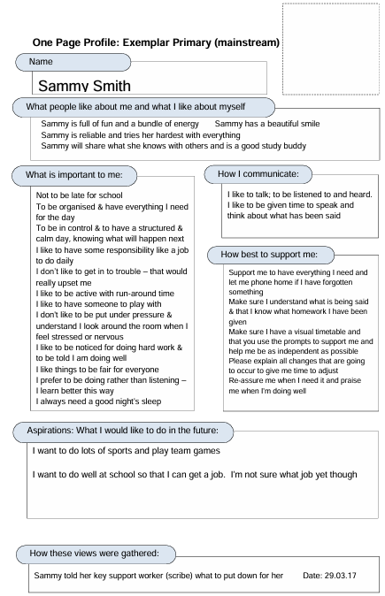

Key principles: Providing connection (‘feeling known’)
“Your picture is beautiful. Can I put it on the wall so I can look at it while I am working?”
“I noticed earlier that you helped to tidy up. I was thinking how well you have done.”
One page profile Resources
“Hold that thought, I’ll come back to you.”
Transition Cards (beaconhouse.org.uk)
One page profile - Lancashire County Council
Notes:
Children seeing themselves in your playroom/classroom – in your wall displays, in what you teach, in the resources you use
They are visual supports, they can serve to reinforce your words that the CYP is important to you and you will meet again soon – again, the power of a visual message is that it stays when spoken words disappear and it can be kept in a pocket providing reassurance, the CYP can go back to it whenever they want.
In the same way that keeping the child in mind can be used to support them during the day, it can be used to support them with breaks. Post-its in their jotter, postcards/transition cards are another tool to provide brief comments like Hope your enjoying your holiday, Looking forward to working with you again in August, See you soon, Thinking of you during the holidays. STAFF maybe hesitant to use these objects because either other pupils might object or fear of creating dependency however they are EXTREMELY important aspect of work. Link with NVR and relational gestures.
Engagement
Invite them to let you know about last night and the journey to school
Use active listening, give eye contact and summarise
Sharing feelings at circle time
Refers to active listening and making connections e.g. you can say – How did you get on with your new bike? You're feeling a bit grumpy this morning because you’re a bit tired, hope you’ll be ok once you get going
Transitional Objects are a way to bridge home and the education setting. Objects from home have important value. They need to be kept in a special box with a lid. Keeping objects safe will communicate care, it sends a message you can trust me, you are safe with me.
Reflective time - protected time to talk about and prepare for change (ending). It can be helpful to use drawing, writing and role play.
Research suggests that smiles and healthy appropriate touch are the key factors that help the development of the child's brain – in particular social and emotional parts of the brain (Gerharde 2004).

Slide 64
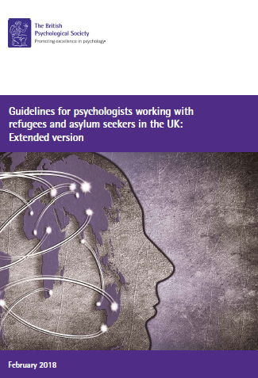
Role of Educational Psychologist
Be aware of the legal and wider context around migration and potential impact of this
Be respectful of different cultures and practices – take time to learn these
Cultural competency toolkit
Support schools with awareness and strategies
Work with community groups to support
Be aware of potential challenges with trust of professionals
Be aware of and seek support for language barriers
Utilise trauma informed and therapeutic approaches to support (not always language based)

Slide 65
Exploring your own cultural competency
A key part of supporting migrants in your school community is to ensure that you are aware of your own cultural competency
Cultural competence is the ability to understand, respect and effectively interact with people across different cultures, backgrounds and beliefs. It involves recognising one’s own biases, valuing diversity and adapting behaviours to communicate and work effectively in cross-cultural situations.
Key aspects include:
Self-awareness
Knowledge
Skill
Attitude
Notes:
Self-awareness – understanding your own cultural background, values and biases
Knowledge- gaining understanding of others practices, worldviews and social contexts such as the role of religion, family and language
Skill – applying this knowledge to communicate effectively and provide appropriate, respectful care or services
Attitude – maintaining and open non-judgemental stance , cultural humility

Slide 66
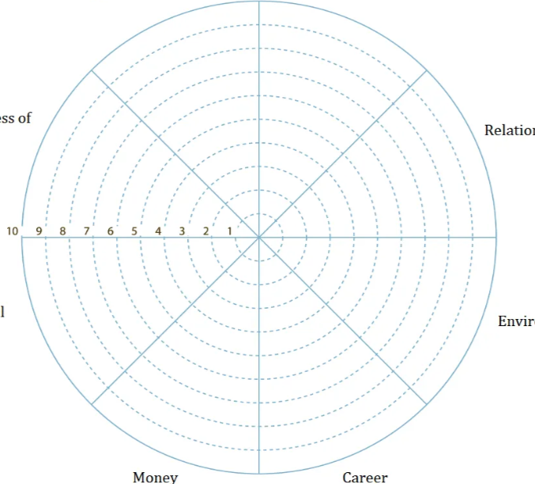
Challenging Discrimination:
How actively do you challenge discrimination and demonstrate allyship to support inclusivity and equity for marginalised groups?
Awareness: How often do you examine your own cultural identity and biases to enhance your understanding and respect for cultural diversity in your developing practice?
Research & Reflection:
How effectively do the educational resources and research you engage with incorporate diverse cultural perspectives, and how do you reflect on your own biases and privileges when engaging with or conducting research in teaching?
Knowledge: How actively do you expand your cultural knowledge while respecting individual identities and avoiding assumptions?
Teaching Practice:
How inclusive and culturally responsive is the teaching you provide, particularly in addressing biases and honouring the diverse backgrounds and practices of your students?
Collaboration/ Communication Skills:
How effectively do you adapt your communication and teaching approach to ensure respect, understanding and inclusion of diverse cultural perspectives?
Support & Intervention Strategies:
How thoroughly do I consider the cultural appropriateness and sensitivity of the support strategies and interventions I use to meet the diverse needs and backgrounds of my students and their families?
Assessment and Differentiation Skills:
How consistently do you ensure that any assessment of children is culturally fair, avoids assumptions and considers the broader cultural context of the child and their environment?

Slide 67
Awareness | Knowledge | Collaboration & Communication Skills | Assessment Skills
In what ways do you value diversity and view human differences as positive? How does your own ethnic, cultural or racial identity shape your interactions with others? What assumptions or stereotypes do you hold about people from different cultures? How do you address these to reduce harm? How does your own cultural perspective influence what you consider ‘appropriate’, ‘normal’ or ‘superior’? How do you reflect on these biases? How often do you seek opportunities to learn about cultural differences? How often do you connect with diverse communities and within your interactions reflect on the impact of power, privilege and oppression? How do you acknowledge the ways you may benefit from racial, cultural or social privilege? | How do you approach mistakes as opportunities for growth and learning around your cultural competency? How do you expand your understanding about cultural groups while respecting unique identities and avoiding assumptions or stereotypes? How do you seek knowledge without placing undue responsibility on marginalised communities to fill gaps in your understanding? How do you use your awareness of historical and current injustices to inform your practice? How does your own cultural background and perspective shape your understanding of others. How do you challenge yourself to move beyond this? | How could communication be adapted to respect individuals or groups whose cultural perspectives differ from your own? What can you do to seek, understand and validate the perspectives of the child, family and other professionals where cultural differences may exist? How can you address any racial biases or cultural attitudes (yours or others’) that may affect understanding the child's experiences? How do you ensure your approach values and integrates the child and family’s cultural assets, avoiding a white-centric bias? How do you ensure multilingual children and families can fully participate and share their views during consultations? How do you access appropriate support, like translators or EAL services? | Are the assessment tools that you are using fair for all children or are they shaped by white cultural norms and experiences? Are you taking the time you need to pause, step back and explore other possible hypotheses, explanations or perspectives? Have you thought about the child’s cultural background and that of their family? How have you involved the child’s parents or caregivers in the assessment process, and have you encouraged and supported their participation? Have you considered the culture within their school or learning environment? How might the child’s culture, race, gender, family background, or support needs intersect, and how could this impact their experiences and support? If English is not the child’s first language, have you thought about their experiences of learning English? Have you considered how their school experience might differ from monolingual English speakers?

Slide 68
Support & Intervention Strategies | Teaching Practice | Research & Reflection | Challenging Discrimination
How do you ensure that students, parents, and colleagues clearly understand your role as a teacher and the rationale behind the teaching strategies or interventions you recommend? How do you consider the family’s cultural values and parenting practices to ensure the teaching strategies or interventions are appropriate and supportive? Are the strategies you are suggesting or using culturally fair, or are they based only on white cultural experiences, research and norms? Are you actively participating in initiatives, whether big or small, that promote understanding and connection between different cultural groups within the school or community? If your intervention involves working with a family, have you taken time to understand the family’s cultural context and their specific needs? Have you considered the impact of racial or generational trauma on the student and their family, and how can you support this through your teaching or interventions? | Have you reflected on your own biases or cultural norms, and how they might influence the content and materials you choose to include in your teaching? Are you assuming all students and families share a similar cultural background? How can you avoid this in your teaching practice? Does the research or evidence you’re sharing with your students or colleagues come from a wide range of cultural perspectives, or does it primarily focus on white populations? If the research lacks diverse cultural perspectives, have you highlighted this and advised caution in applying it broadly in your classroom or educational setting? Have you encouraged students, parents, or colleagues to reflect on their own biases and cultural norms when applying the knowledge they gain from your teaching in their own practice? How does your teaching support culturally sensitive learning for all children? How do you ensure play experiences and materials are culturally inclusive? | When conducting research or gathering information for your teaching, does the research include perspectives from a wide range of cultural backgrounds? Have you critically examined the research process and findings, ensuring that they are inclusive and respectful of cultural differences? If analysing data, have you reflected on your own biases and how they may influence your interpretation? How does your privilege and identity as a researcher affect your interactions with participants? Are you ensuring that the voices of diverse participants are truly heard and valued? How do you actively challenge assumptions and ensure you consider how your research methods and findings are understood and experienced across different cultures? How do you actively reflect on and address any biases embedded in your academic and professional training? | How do you respond when you witness racist or discriminatory behaviour in the classroom or school environment? When you notice potentially harmful views or actions, do you challenge them? How are you developing the skills needed to challenge discrimination in a constructive and educational manner? How do you reflect on instances where you have failed to act against discrimination? What might have influenced your inaction, and how can you work to overcome it in the future? How do you reflect on and challenge biases or assumptions held by colleagues, parents, or others that may influence their perceptions of students or the information they provide about them? How do you reflect on and address any ways you may have contributed to bias in your own teaching practice, and what steps can you take to challenge and resolve it?

Slide 69
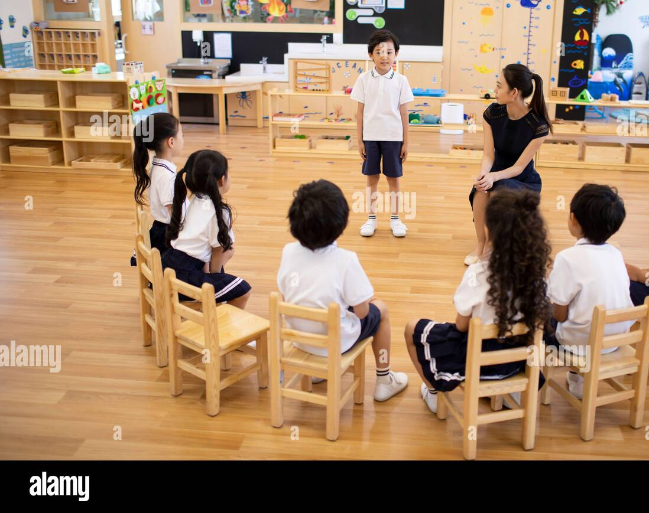
Section 4: Staff Wellbeing and community support
a

Slide 70
Looking after staff wellbeing
‘You cannot wipe the tears off anothers face without getting your hands wet’
- Zulu Proverb
Create an environment that supports staff wellbeing and helps recovery
Explore what wellbeing looks like and how it can be influenced by vicarious trauma
Ensure staff have a support network and strategies to deal with challenges
Consider the strengths that can be built from working with migrant and diverse communities
Notes:
Make sure that staff know they can seek support if it becomes challenging when working with children who have experienced trauma
Hold a session where staff potentially look at what wellbeing looks like for them and how they maintain this and think about signs when that wellbeing is compromised – stress reactions, create spaces to take breaks to seek support, have sessions on wellbeign activities.
Know your own limits

Slide 71
Signs of vicarious trauma
Emotional numbing
Social withdrawal
Work related nightmares
Feelings of despair and hopelessness
Loss of sense of spirituality
More negative view of the world
Reduced sense of respect for your clients
No time or energy for yourself
Finding you talk about work all the time (can’t escape)
Feeling you can’t discuss work with family/friends
Sense of disconnection from loved ones
cynicism/pessimism
Increased illness/fatigue
Increased absenteeism
Reduced productivity
Reduced motivation
Lowered self esteem
Less time reflecting on your experiences

Slide 72
Links to key documents
Childhood Trauma, War, Migration and Asylum - UK Trauma Council
Guidelines for psychologists working with refugees and asylum seekers in the UK | BPSGuidelines for psychologists working with refugees and asylum seekers in the UK | BPS
afya_leitfaden_englisch.pdf

Slide 73

Notes:
Coming from attachment theory there are 6 core nurturing principles that are good for all children, but particularly for understanding and supporting children who have insecure attachment patterns often due to poor early nurturing experiences.
In RNRA we support schools to explore and understand one nurture principle in depth and then identify and implement sustainable improvements across the whole school as a result of this developed understanding, before moving on to another nurture principle.
Learning is understood developmentally: Thinking about where has a child got in their development from birth, rather than how far are they from where they ‘should’ be. You may have a 11 year old standing in front of you but with the ability to manage his emotions of a toddler – because no one may have taught them before – he needs an adult’s help to start to learn. Changing the narrative from ‘what is wrong with you?’ to ‘what has happened to you?’….
Environment offers a safe base: There is a welcoming and safe environment for all, with predictable routines and consistent adults who show emotional warmth. Boundaries are set and delivered clearly, fairly and with sensitivity – psychologically safe also– there is an understanding that children need support to contain and manage their emotions and that is ok.
Nurture is essential for wellbeing: This is the case for everyone, but again particularly for children who may have a negative image of themselves. Understanding how we can promote resilience, positive self esteem and self efficacy through nurturing approaches – for children and for the adults who support them. Recognising that staff wellbeing plays an important part in children’s wellbeing.
Language is a vital means of communication: Attuned interactions in very early childhood (eye contact, responding to noises and early attempts at speech, looking where they point) help to develop the skills underlying language. So it is no surprise to learn that often pupils who have poor early nurturing experiences have delayed language skills. Yet language is so important for so many things: make our needs known; interact with others; express our likes and dislikes; make friends; label/control/explore emotions or feelings. Also important to think about what our verbal & non verbal language conveys – how adults talk to and about children really matters.
All behaviour is communication: Attachment theory recognises that children may already be at high levels of stress – what seems trivial to you might have the physical effect of fighting a sabre tooth tiger to the pupil – that fight/flight or freeze survival mechanism may be primed – why pupils hide under desks, run away, climb trees, hit out - it might be about a broken pencil lead to you but a matter of survival for the child. We see the behaviour – what is behind this – what is the child’s behaviour telling us? ITS ABOUT GETTING CURIOUS, NOT FURIOUS
Transitions are important in children’s lives: Transitions are difficult because of the anxiety they cause – big transitions like moving schools but also daily transitions like moving from one task to another, from one class to another not to mention changes in the people around them. Children who most need consistency are often the ones who have to move most – taken into care, foster placements break down, school placements beak down – so any good relationships that they have made are lost and they need to start again where everything is new – they have least skills to deal with it.
We are going to look in more depth at these principles and what implementing it would look like practically in the sessions that follow

Slide 74

The impact of recent global events on the lived experience of immigrants

Slide 75


Unite the Kingdon Rally Video

Slide 76
Reflective Activity
If you an immigrant living in this country (or have an immigrant background) what might be some of your thoughts and feelings be when watching this footage?

Slide 77

Mentimeter.com Code: 23919074
What are the benefits of immigration?

Slide 78
Mentimeter.com Code: 23919074
What are the benefits of immigration that don’t involve economic gain?

Slide 79
Some thoughts and feelings….
Walking down the street…
Atmosphere and everyday climate : Increase in incidents, second class citizens, language being used, safety
Uncertainty around future: financial, geographical , loss of opportunity, loss of identify, loss of relationships
Policy and Law eventually trickling into educational policy and practice
Institutional Racism
Poor outcomes: How long do you wait? What is the tipping point?
Psychological Load
Impact on CYP: The impact of narratives and the shaping of many generations to come
Worries around the impact of ‘reverse immigration’
The cost of inertia…

Slide 80
Reflective Activity (Individual 3 mins)
After listening to today's input:
What has stayed with you?
What has challenged you?
Where (if at all) did you feel discomfort?

Slide 81
Group Discussion: 20 mins
Where does the current anti-immigration rhetoric show up in our work, even subtly?
What feels possible to change (within the scope of our work) and what feels constrained?
How do we disrupt the chain? (This can be personal or professional)
How would a family/person who had an immigrant background know that you were an ally? (Can be personal or professional)

Slide 82
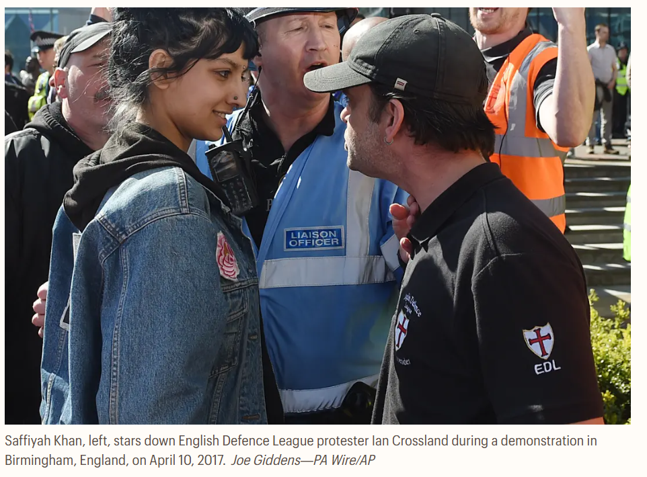
Some final thoughts..

Slide 83
Dates for the Next Session
24th September 2026
19th January 2027
24th March 2027
27th May 2027

Slide 84
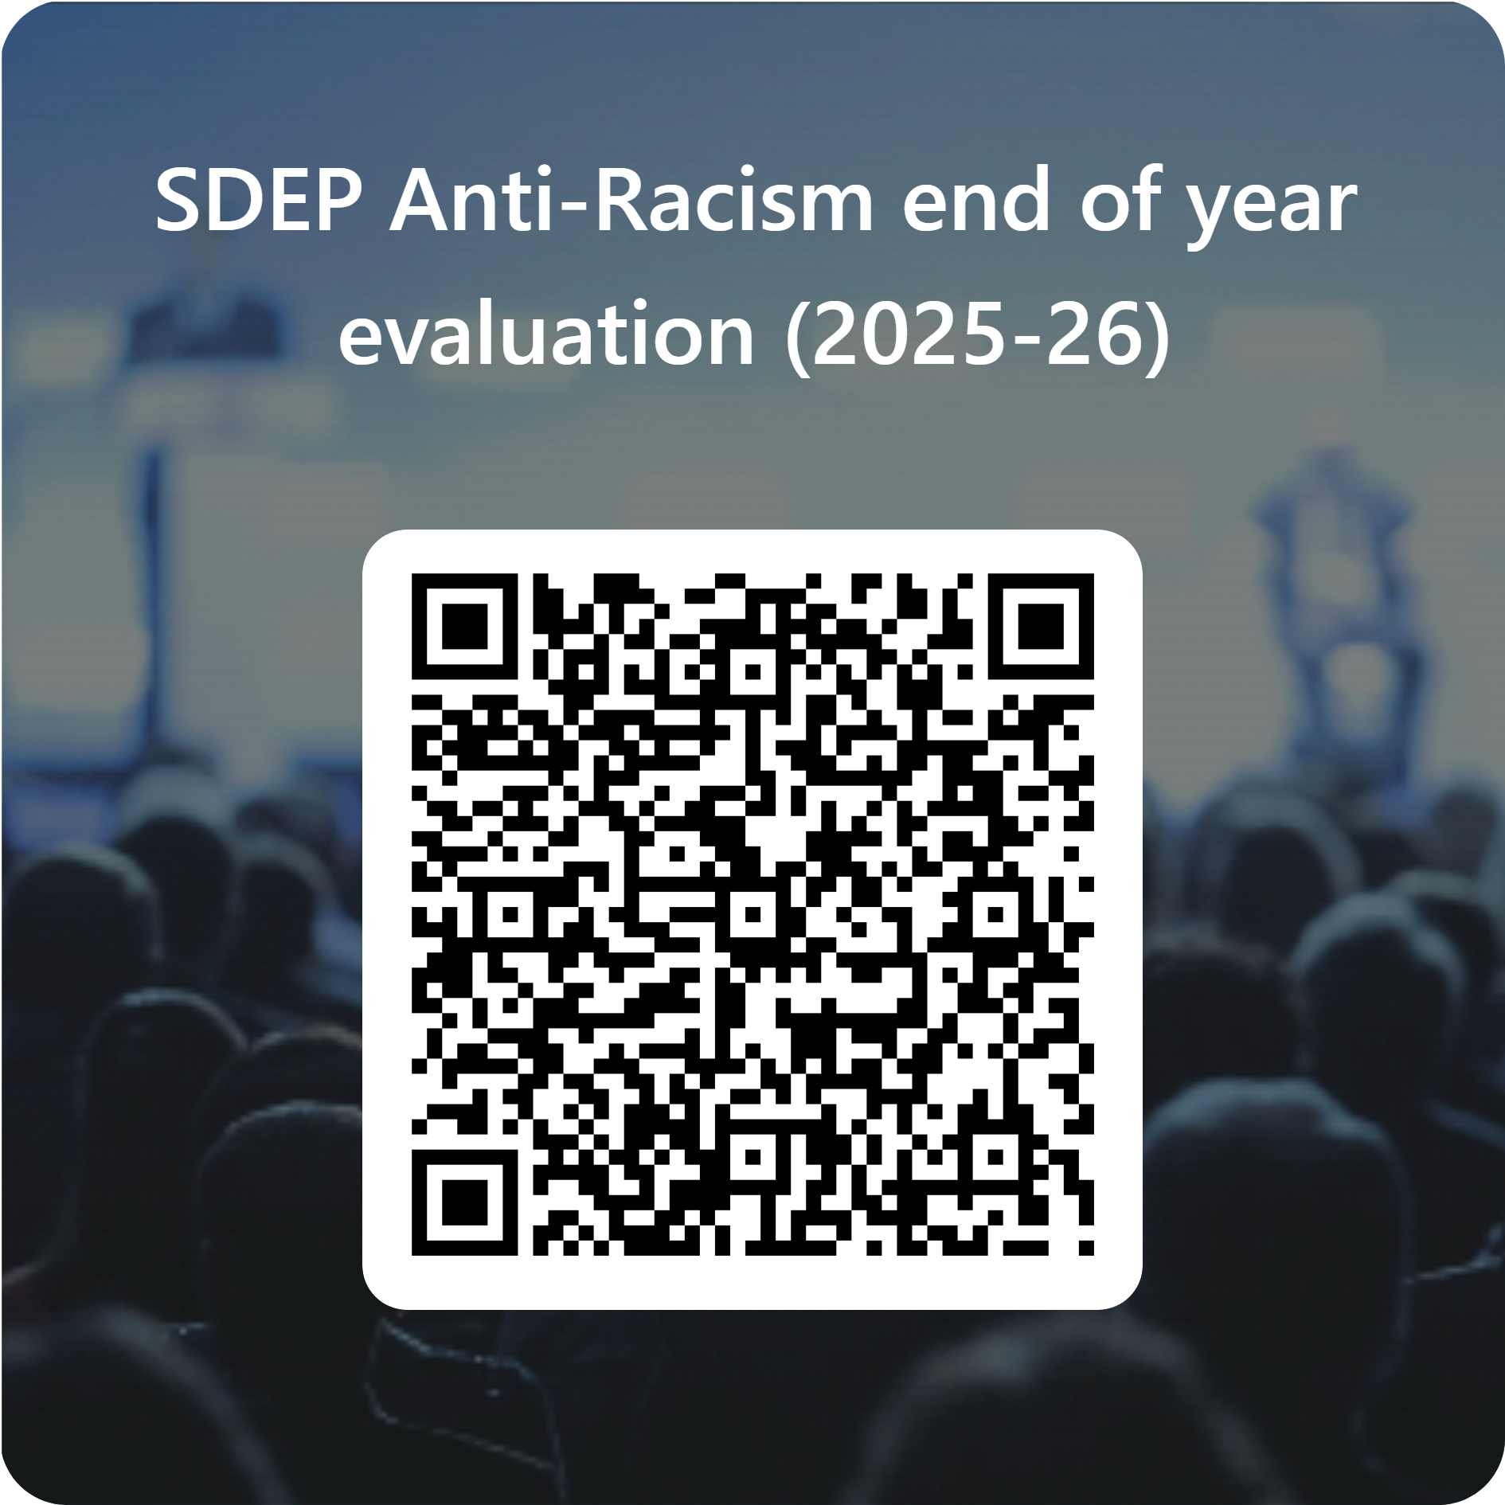
End of Session Evaluation

