Slide 1
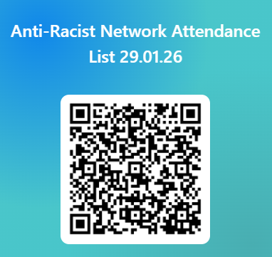
SDEP Anti-Racist Network Session 1 29.01.26
Notes:
9.15-9.30am
Maura
(William to create duplicate for current date)

Slide 2

Session Outline
1. Welcome and Overview of Anti-Racist Network
2. Todays theme: "Building an Anti-Racist Community"
3. Feedback from last network discussion
4. Reflective activity: How are you supporting communities of colour within education?
Notes:
9.15-9.30am
Maura

Slide 3
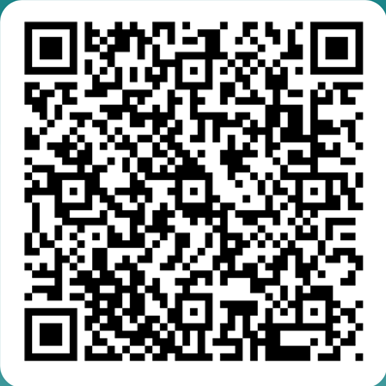
Anti-Racist Network
* Open to anyone who is an EP, TEP or EPIT in Scotland
* Aim to create a safe space for discussion and action around anti-racism within the profession
* Meet approx. 4 times in the academic year, dates set at the beginning of the academic session
* Each session focuses on both input and reflective activity
* Serves as a function for consultation for wide strategic strands
* Anyone interested in joining: Scan QR Code
Notes:
9.15-9.30am
Maura

Slide 4

Content Warning & Emotional Safety
Subject and content can be emotive
Aiming to achieve a balance to allows us to sit with discomfort that serves as a springboard for change and action
Please take time to step out if this is required
We do not seek to create a hierarchy of lived experiences and this group explicitly recognises that other marginalised groups also experience discrimination
These sessions do often contain difficult challenge questions
We encourage debate and discussion but the questioning of the lived experience of BPOC is not up for discussion
Language and terminology
We ask that you pay attention to any thoughts, feeling and reactions that occur during discussions
Notes:
9.15-9.30am
Maura

Slide 5
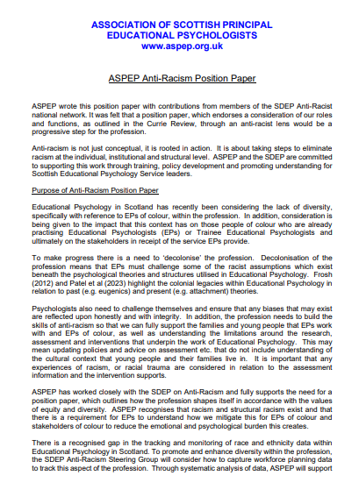


ASPEP position PAPER
Available on the SDEP Anti-Racism website here: ASPEP Anti-Racism Position Paper
Notes:
9.15-9.30am
Maura
Highlight reminder we have position paper

Slide 6
SDEP Anti-Racist Network
SDEP ARN Steering Group
Anti-Racist Network
National Training Pilot
Work Strands
Notes:
9.15-9.30am
Maura

Slide 7
SDEP Anti-Racist Work Strands
Steering Group members: Maura Kearney (REPS), William Corral (GEPS), Rebecca Gibson-Knowles (REPS), Samia Bashir (GEPS)
Work strand details:
Book Group
Managing Racism
Self-Evaluation
Frameworks and Functions
National Training Pilot
University Links
(on hold)
Notes:
9.15-9.30am
Maura

Slide 8
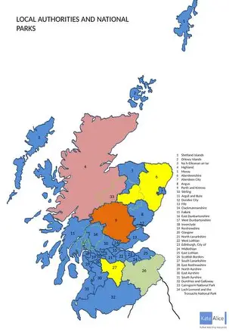


Update: national training model
Seeking notifications of interest for a possible Cohort 2 for 26-27
Notes:
9.15-9.30am
Maura
Opportunity to promote this Maura? Delete slide if not applicable

Slide 9
Today’s theme: "Supporting Communities of Colour in partnership with Education"
Shaheen Baber, Hate Crime Policy Officer
Charles Neil, Head Teacher of Dalmarnock Primary School (site of recent anti-immigration protests)
Shaheen Rashid, PT Pastoral Care, Bellahouston
Questions we have asked our speakers:
An overview of the work that you do and how it supports communities.
Whether you feel that you are reaching communities of colour and what this looks like
If you have found a way to evaluate or gather they voices of those you work with
Where/if you see the gaps or strengths between education and who they serve
Notes:
Maura
9.30 -10.30: Table top discussion
Insert any slides/ intro of presenters here

Slide 10
Mr Shaheen Baber
Hate Crime Policy Officer
Glasgow City Council
shaheen.baber@glasgow.gov.uk

Slide 11
Trigger Warning / Content Advisory
This session addresses hate crime and prejudice impacting people across the seven protected characteristics under Scottish law, as well as people from many other backgrounds and lived experiences.
While some of the material may be challenging, it is shared in the spirit of learning, understanding, prevention, and building safer, more inclusive communities.
Your wellbeing is important - support is available as appropriate and as required.
Notes:
“Before we start, I just want to note that today’s session looks at hate crime and prejudice across the seven protected characteristics in Scottish law, as well as wider backgrounds and lived experiences. Some of this may feel challenging. It’s shared in the spirit of learning, prevention and building safer, more inclusive communities. Your wellbeing matters, so please step out at any point if you need to.”

Slide 12
Hate Crime & Public Order (Scotland) Act 2021
Effective from 1 April 2024
Seven protected characteristics.
Age, Disability, Race, Religion, Sexual Orientation, Transgender Identity and Variations of Sex Characteristics.

Slide 13
What is a hate crime?
Any crime motivated wholly or partly by malice or ill will (hostility or prejudice) based on one or more actual or perceived characteristics.
The actions of any alleged perpetrators must amount to a crime defined by law in Scotland - Scottish Crime Recording Standards.
There must be evidence that the crime was motivated by malice and ill-will…Assessment of the offenders, behaviour before, during or after the incident will provide evidence…Context is important!
The person experiencing hate does not always need to be in one of these groups. Police look at why the act or offence was committed and the perceptions of those involved.

Slide 14
Hate Crime or Equality Diversity and Inclusion (EDI)
Hate Crime – Law enforcement / CJ focus, reactive, protecting victims and reporting methods.
EDI – Organisational focus, proactive, promoting fairness, cultural improvements, inclusion and equal opportunities.
Hate crime is law enforcement reacting to prejudice.
EDI is prevention by building inclusion.

Slide 15
Freedom of Speech
The Act does not pose a risk to freedom of speech. It does not prevent people expressing controversial, challenging or offensive views, nor does it seek to stifle criticism or rigorous debate in any way. The right to freedom of expression is specifically built into the Act.
The Act is compatible with the European Convention on Human Rights, including Article 10 which protects everyone’s right to freedom of expression.

Slide 16
Under Reporting
Lack of awareness or recognition
Fear of blame, stigma or retaliation.
Distrust in authorities or criminal justice.
Evidence thresholds.
Practical barriers to reporting.
Emotional burden.
Cultural or community pressures.

Slide 17

How to Report
Call 999 (emergency) Call 101 (non-emergency)
Report on Police Scotland website
Call Crimestoppers on 0800 555 111
Third Party Reporting centres
Contact Scotland BSL app or 999 BSL app
Text British Transport Police on 61016

Slide 18
Discussion
shaheen.baber@glasgow.gov.uk
hatecrime@glasgow.gov.uk

Slide 19
Q&A?
Notes:
Maura
10.30 – 11 – time for Q&A?

Slide 20

BREAK
Notes:
11-11.15

Slide 21
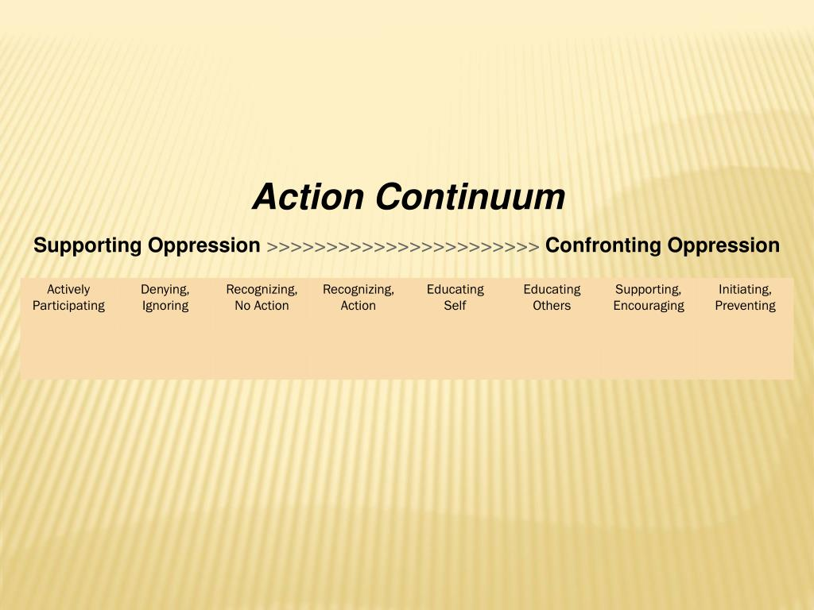
Feedback from September SDEP Anti-Racist network…
Summary of Group Discussion
Notes:
RGK
11.15-11.30
At every network session we have a group reflective discussion activity where we have reflected on themes such as white silence and what this means for active AR EP practice, for example in challenging systemic racism in schools. Last session we highlighted that we have been engaging in antiracist discussion for some time now and that this year we are keen for the network to move discussion towards more AR action.

Slide 22
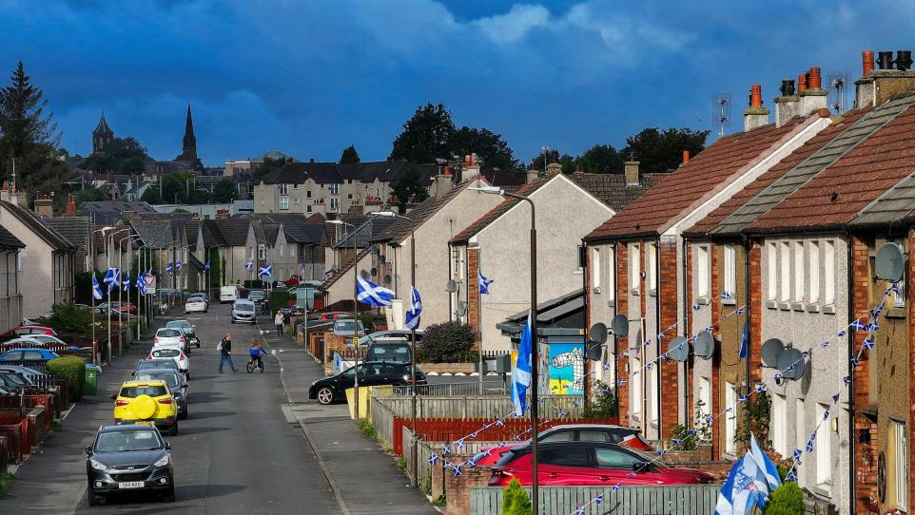
Last session we asked you to consider current tensions & racial harm…
We asked what Anti-Racist actions have the network provoked you to do?
We also asked what changes have you noticed within your service that are Anti-Racist?
Notes:
11.15-11.30
Rebecca
At the time we were seeing an emergence of the far right raise the flags campaign which through the appropriation of the saltire flag originally by far-right groups, pushed a very visible anti-immigrant message, yet for some perhaps stirred up confusion given the cultural pride often associated with the saltire.
For people of colour, the surge in highly visible nationalist imagery in the local streets as well as on the media,— reinforced the message that Scottish identity was being defined narrowly by race and origin. Whilst this likely wasn’t a view reflected by the majority, some of us felt that this very visual racist message was louder than the silence of the majority who probably wouldn’t align themselves with these views.
So given the network has been running for some time now, we asked what action is looking like right now for us EPs given the current climate

Slide 23
Racial Literacy
Network learning expanded racial literacy (e.g increasing personal reading, audiobooks)
Network has provided access to a language which has enabled clearer naming of racism/ more discussions
Increased awareness of bias and white silence
Racial literacy translated into school-level awareness-raising and staff education
Notes:
11.15-11.30
Rebecca

Slide 24
Growing Confidence to Interrupt Racism
Feeling more equipped to use racism interrupters in meetings, with colleagues, family & friends
Feeling more equipped to raise racism even when uncomfortable
Confidence strengthened by senior leadership support
Recognition that confidence to call out/ name racism varies by context (e.g in public/ in work/ with family/ extended family…ect)
Notes:
11.15-11.30
Rebecca

Slide 25
Relationship-Based Allyship
More intentional check-ins with colleagues of colour
More open conversations with friends, family, peers. More racism challenged in friendships, peer groups, and family systems with awareness of emotional complexity
Learning to close or exit harmful conversations when needed to interrupt racism
Identity signalling breaking silence (e.g., profile picture- “All Welcome”)
Notes:
11.15-11.30
Rebecca

Slide 26
Service-Level Anti-Racist Change
Some mentions of service culture moving from avoidance → ownership → shared responsibility
E.g Anti-Racist position statements, equalities embedded as a standing agenda item, protected time for dialogue in development days, recruitment and interview practices reviewed through an equalities lens
More staff naming and discussing racism in meetings
Notes:
11.15-11.30

Slide 27
Navigating Sociopolitical Tension
Growing tensions reported as being discussed within EP offices, recognition that white EP identity often affords protection to challenge racism in ways colleagues of colour may not safely be able to
Increased awareness of racial harm linked to riots, riots discourse, and media narratives -including impact on sense of safety for POC
Awareness that Scottish flags and media coverage can evoke mixed safety experiences
Notes:
11.15-11.30

Slide 28
Reflective discussion: supporting communities of colour within education
How have you directly supported POC through this time?
How have you supported schools through this time?
How have you supported CYP of colour through this time?
How have you supported communities of colour through this time?
Notes:
11.30 – 12.00pm
Maura
How you have been supporting communities of colour within education?
How have you directly supported POC through this time?, How have you supported schools through this time? How have you supported CYP of colour through this time? How have you supported communities of colour through this time?

Slide 29
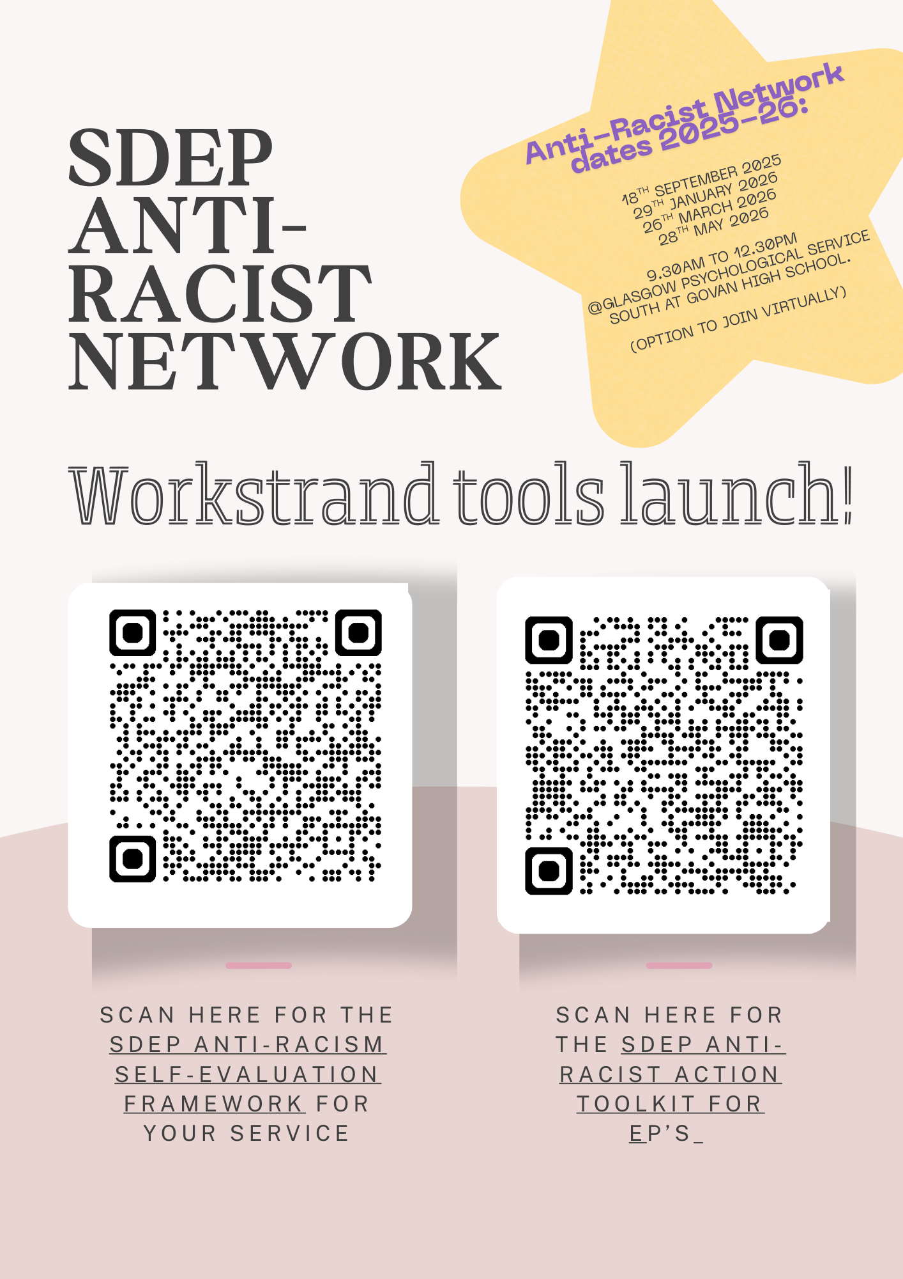
Remaining Network dates for 2025-2026
Thurs 26th March 2026
Thurs 28th May 2026
Notes:
Maura
11-11.15
Remaining network dates and QRs for workstrand tools incase people want it

