Slide 1
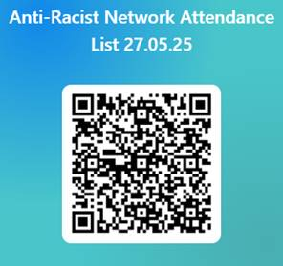
SDEP Anti-Racist Network
Session 1
18.09.25
Notes:
RGK

Slide 2

Session Outline
1. Welcome and Overview of Anti-Racist Network
2. Feedback from last network discussion:
3. Todays theme: EP Anti-Racist action in schools??
4. Workstrands feedback
5. Reflective Activity
Notes:
Presentations from EPs work in schools?

Slide 3
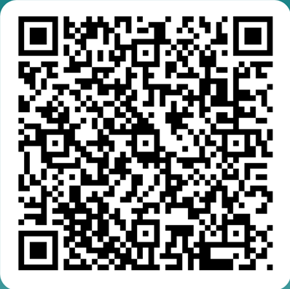
Anti-Racist Network
* Open to anyone who is an EP, TEP or EPIT in Scotland
* Aim to create a safe space for discussion and action around anti-racism within the profession
* Meet approx. 4 times in the academic year, dates set at the beginning of the academic session
* Each session focuses on both input and reflective activity
* Serves as a function for consultation for wide strategic strands
* Anyone interested in joining: Scan QR Code
Notes:
RGK

Slide 4

Content Warning & Emotional Safety
Subject and content can be emotive
Aiming to achieve a balance to allows us to sit with discomfort that serves as a springboard for change and action
Please take time to step out if this is required
We do not seek to create a hierarchy of lived experiences and this group explicitly recognises that other marginalised groups also experience discrimination
These sessions do often contain difficult challenge questions
We encourage debate and discussion but the questioning of the lived experience of BPOC is not up for discussion
Language and terminology
We ask that you pay attention to any thoughts, feeling and reactions that occur during discussions
Notes:
RGK

Slide 5
SDEP Anti-Racist Network
SDEP ARN Steering Group
Anti-Racist Network
National Training Pilot
Work Strands

Slide 6
SDEP Anti-Racist Work Strand
Steering Group members: Maura Kearney (REPS), William Corral (GEPS), Rebecca Gibson-Knowles (REPS), Samia Bashir (GEPS)
Work strand details:
Book Group
Managing Racism
Self-Evaluation
Frameworks and Functions
National Training Pilot
University Links
(on hold)

Slide 7
Summary of Group Discussion
SDEP Anti-Racist Network –May 2025
Notes:
Megan

Slide 8
1. How can EPs actively challenge systemic racism in schools beyond casework?
Promote whole-school and wider systemic work
  Support school and local authority (LA) anti-racism initiatives.
  Represent EP services on LA-wide steering groups.
  Contribute to school improvement plans (SIPs) with an anti-racist lens.
Embed anti-racism (AR) into existing practice
  Integrate an AR perspective across all training, consultations, and discussions (not just as an “add-on”).
  Share resources, tools, and literature to inform school practice.
  Use questioning to provoke reflection such as socratic questioning during school discussions.
Provide ongoing support
  Offer sustained coaching and mentoring (beyond one-off inputs).
  Facilitate conversations within networks such as JSTs, SIMS, and LISN.

Slide 9
2. What skills and strengths can EPs draw on to help school leaders and staff build confidence in talking about race and racism?
Consultation and communication skills
  Skilled in active listening, solution-focused questioning, and gathering diverse perspectives (especially BPOC voices).
  Experienced in facilitating difficult conversations while avoiding shame and blame.
Knowledge and evidence base
  Access to research, evidence, and literature for sharing and signposting.
  Existing frameworks and interventions (e.g. PATH, NVR, Restorative Approaches, Nurture).
  Knowledge of implementation science and data analysis.
Child-centered and relational practice
  Keeping children and young people (CYP) at the heart of all work.
  Understanding systemic and contextual factors affecting BPOC families and communities.

Slide 10
3. What does it mean to be a “critical friend” to a school on its anti-racism journey?
Provide challenge with care
  Apply a social justice lens to all work.
  Explicitly call out problematic views or language when needed.
  Listen for and highlight racism observed in consultations or school contexts.
Offer support and reassurance
  Create psychologically safe spaces for dialogue and reflection.
  Avoid blame and shame while modelling vulnerability and learning.
  Reassure schools that change is a journey and provide “nurturing challenge” at an appropriate pace.
Reframe and contextualise
  Help schools understand the possible needs and perspectives of BPOC families.
  Provide historical and social context to build awareness and reduce defensiveness.

Slide 11
4. What do EPs need to effectively support schools on an anti-racism journey?
Knowledge and confidence
  understanding of local community demographics and diversity to inform discussions (e.g. through data).
  Awareness of national and local contexts around anti-racism.
  Confidence in personal knowledge, plus opportunities for ongoing learning.
Professional support and collaboration
  Peer support and networks to share good practice.
  Opportunities to hear from other EP services engaging in this work.
  Safe and trusting relationships with schools and colleagues to enable constructive challenge.
Time, strategy, and reflection
  Dedicated time and prioritisation within the service’s strategic plans (e.g. in the EPS SIP).
  Use of existing frameworks to structure and guide anti-racism work.
  Space for personal reflection and owning one’s own AR journey.
  Commitment to bravery, self-development, and self-evaluation.

Slide 12
Today’s theme:
“
Notes:
RGK

Slide 13
In small groups…
Consider, discuss and record notes on the following questions:
In what ways can EPs actively challenge systemic racism in schools beyond casework?
What skills and strengths do you as an EP have to help you support school leaders and staff in building confidence in talking about race and racism?
What does it mean to be a “critical friend” to a school on its anti-racism journey?
What do you need as an EP to support school’s on an antiracism journey?
Notes:
11.35-12

Slide 14
Remaining Network dates for 2025-2026
29th January 2026
26th March 2026
28th May 2026

