Slide 1

Option Information for Parents/Carers and Students
4th February 2026
S4 into S5
S5 into S6

Slide 2



Senior School – February 2026
The Transfer process
The Subject choices booklet
Making subject choices
Types and level of courses available
The Options Form

Slide 3
Responsibilities
The Role Model
Conduct
Dress
Work ethic
Participation

Slide 4
Options Timeline
Date | Event | Detail
04/02/26 | Senior Curriculum Information and Option Form issued Senior Phase Information Evening 6-7pm | Information regarding subject choices for S5/6 available on the school website: Option Choices – Annan Academy (glowscotland.org.uk) Depute Head Teacher presentation taking parents/pupils through the process of selecting subjects to study in S5 and S6
04/02/26 | PTPS information to S5 via Tutor Teachers PTPS visit S4 Tutor classes | Principal Teacher Pupil Support provides information for Tutor Teachers to explain Subject Choice forms and answer questions. Principal Teacher Pupil Support visit S4 Tutor classes to explain Subject Choice forms and answer questions.
18/02/26 | S4 and S5 Reports issued | Information regarding performance in current subjects and recommendations for next session.
25/02/26 | S4 into S5 Options return deadline | Completed Curricular Plan Forms must be returned by your child to their Tutor Teacher at Tutor Time
26/02/26 | S5 Parents’ Evening | Opportunity to meet with subject teachers, particularly with those subject’s pupils are considering for S6.
27/02/26 | S5 into S6 Options return deadline | Completed Curricular Plan Forms must be returned by your child to their Tutor Teacher at Tutor Time

Slide 5
Important Information
Senior Phase Option Booklet is available on the school website:
https://blogs.glowscotland.org.uk/glowblogs/annanacademy/option-choices/

Slide 6

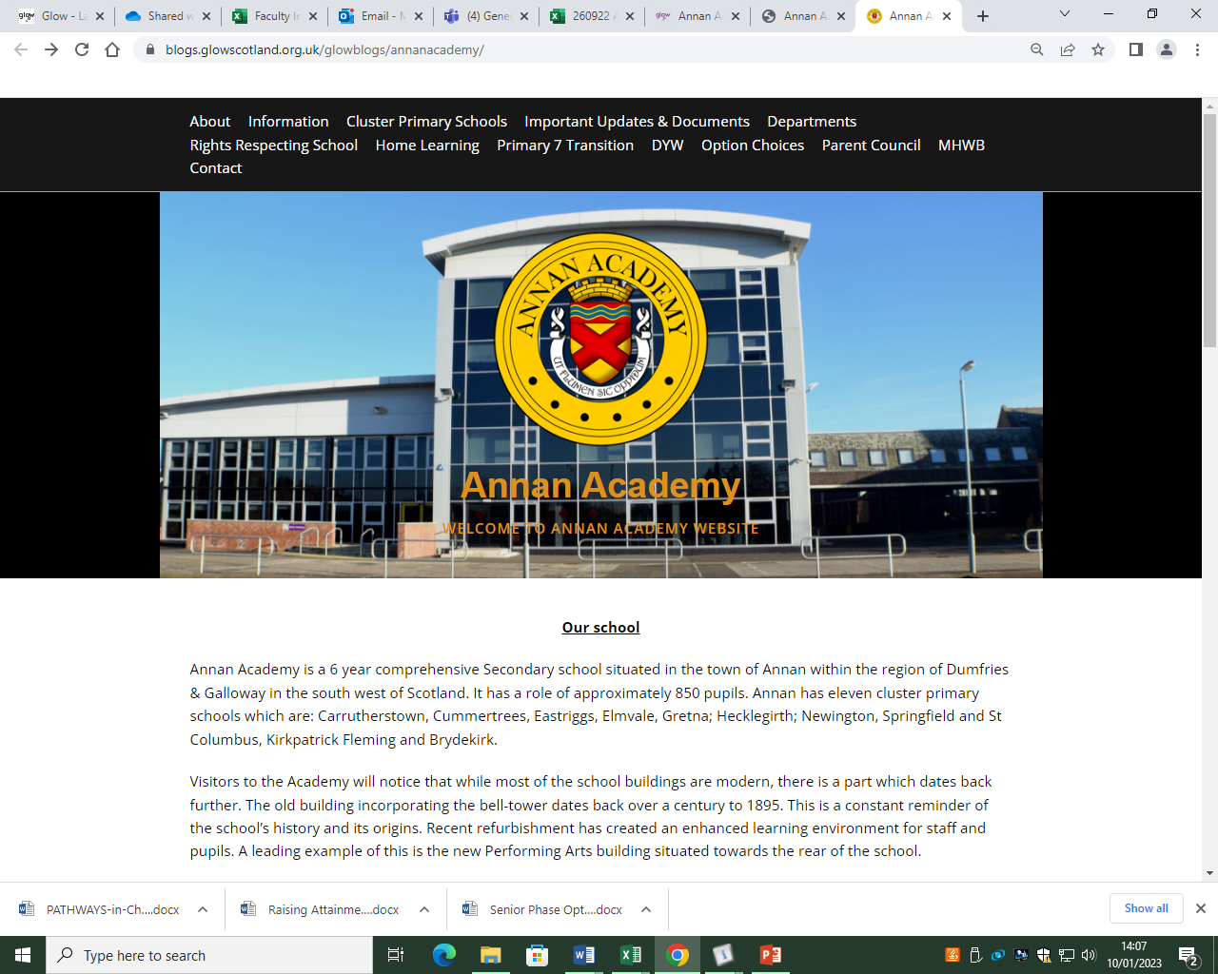
Curricular Information

Slide 7
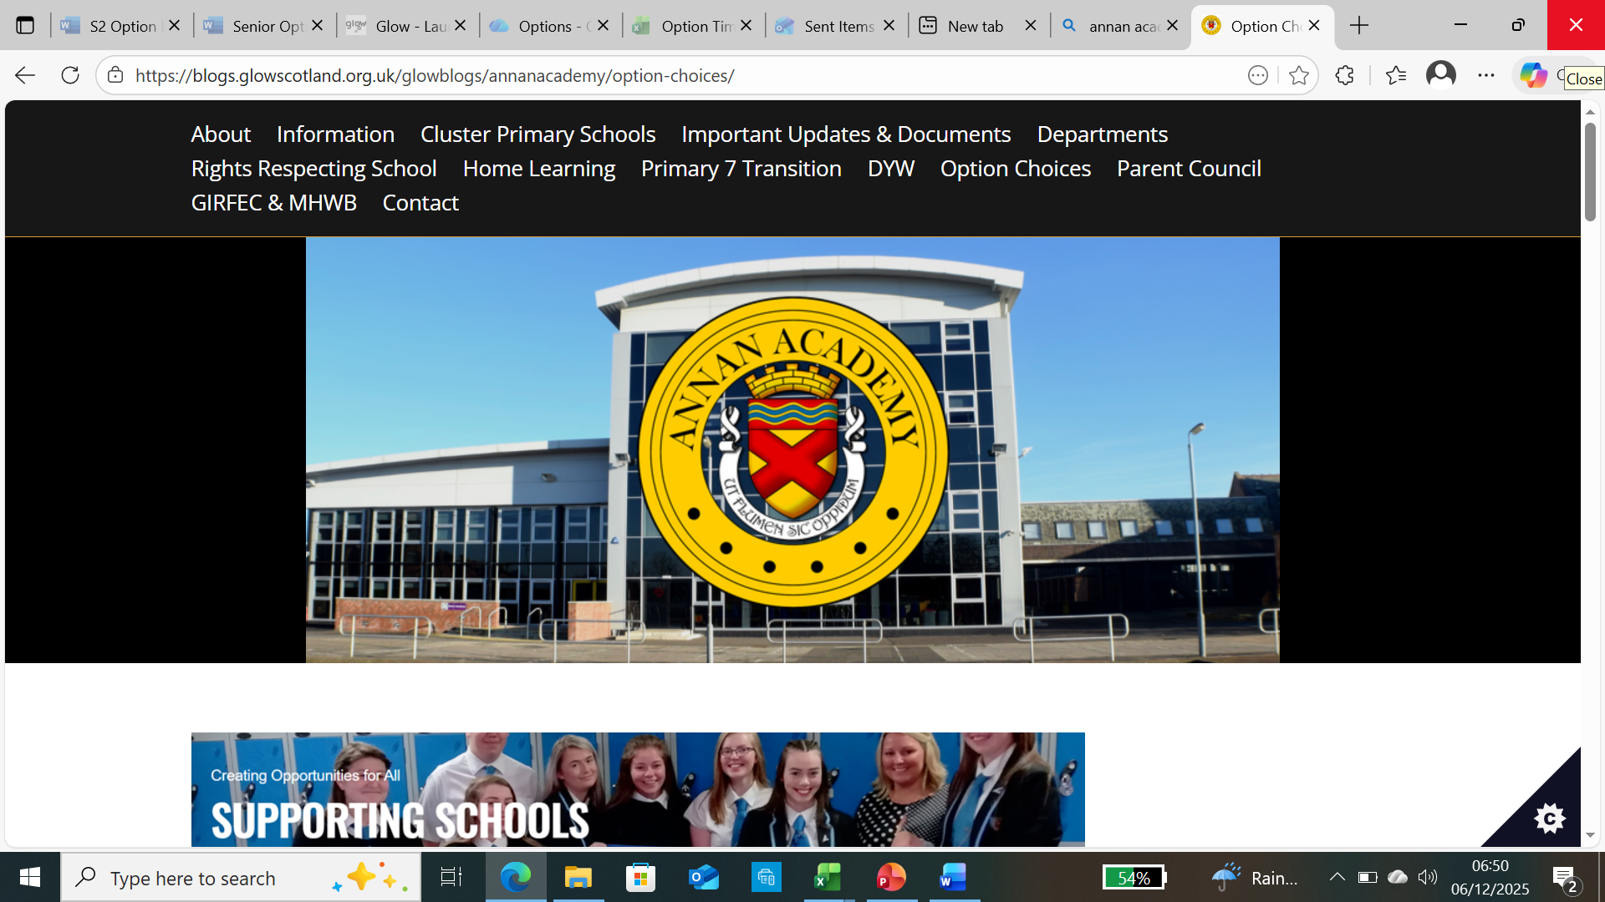
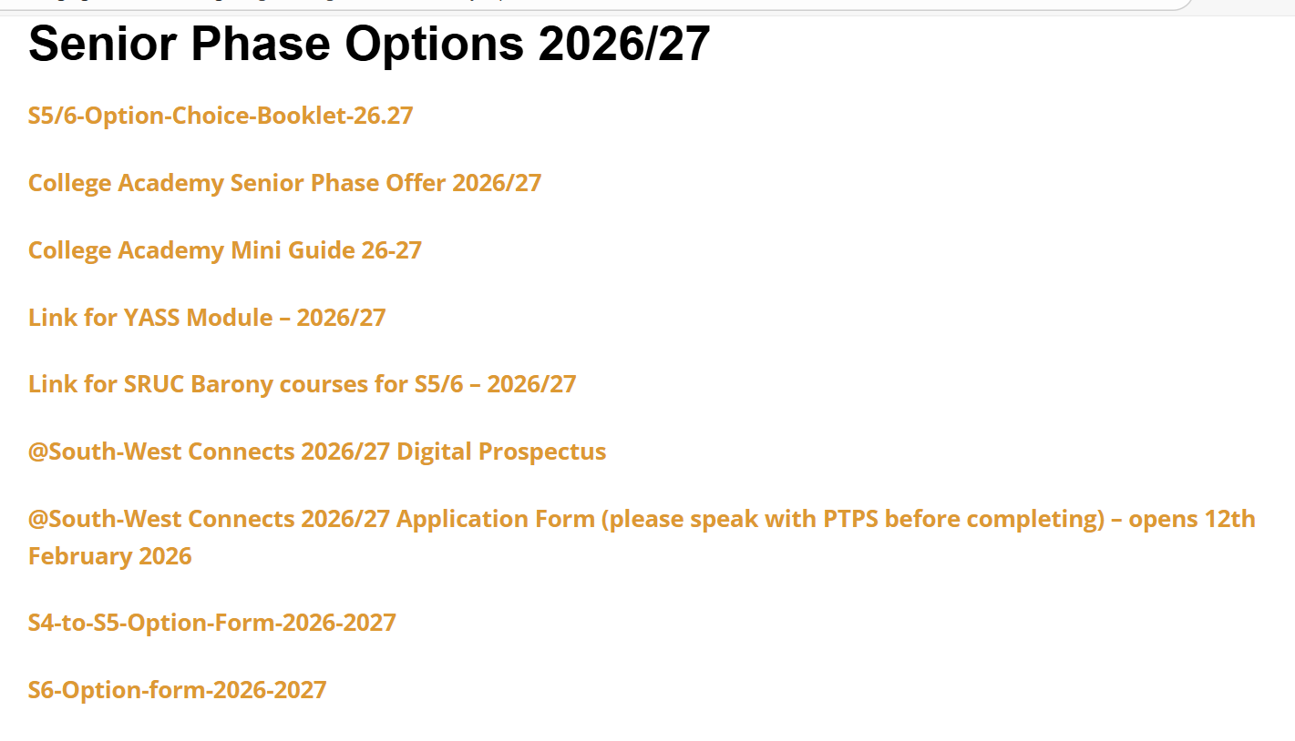
Curricular Information

Slide 8
Senior Phase S4 – S6
New Qualification | Old Qualification | SCQF Level
Advanced Higher, Awards and Scottish Baccalaureate | Advanced Higher | 7
Higher, Awards, Skills for Work Higher, National Progression Awards, and Foundation Apprenticeships | Higher | 6
National 5, Awards, Skills for Work National 5 and National Progression Awards | S Grade – Credit, Intermediate 2 | 5
National 4, Awards, Skills for Work National 4 and National Progression Awards | S Grade – General, Intermediate 1 | 4
National 3, Awards and Skills for Work | S Grade - Foundation, Access 3 | 3
National 1, 2 and Awards | Access 1, 2 | 1, 2
About the SCQF - YouTube

Slide 9
National Qualifications (NQs)
These are qualifications ranging from SCQF levels 1-7 (with 7 being advanced higher). These are equivalent to the qualifications that many parents and carers would have experienced at school.
National 1 to 4 courses are all internal assessed and are awarded a pass or fail on completion.

Slide 10
National Qualifications (NQs)
National 5, Higher and Advanced Higher courses are externally assessed and graded. The assessments typically consist of a written exam or question paper and another coursework related component.
The final assessments are set, administered and most commonly marked by the Qualification Scotland (formerly SQA). NQs are graded from A-D. Notionally as follows (this may differ each year):
  A = 70%+
  B = 60%
  C = 50%
  D = 40%

Slide 11
National Progression Awards (NPAs)
NPA qualifications range from SCQF levels 1-6. NPAs are aimed at developing students’ knowledge and understanding and, where appropriate, practical experience of a given area of vocational education.
NPAs are made up of a combination of units each involving their own assessments. To achieve the award, students must successfully complete all of the units.
The main difference between an NPA and NQ is the lack of final assessment or exam.
An NPA pass is equivalent to a pass at a National Qualification. For example,
Level 5 NPA = Pass at N5

Slide 12
Skills for Work (SfW)
Skills for Work courses are designed with employability at the centre. They are also highly practical and experiential and a good option for pupils looking to move straight into employment after school or wanting a more work based qualification.
They are typically available at SCQF levels 4 and 5 (the equivalent of a National 4 or 5 qualification).
Skills for Work have no final assessment or exam.

Slide 13
Foundation Apprenticeship (FA)
Foundation Apprenticeships (FAs) courses combine theory with work-based learning:
Courses can be completed over one or two years and are open to S5 and S6 students. Young people spend time out of school at college or with a local employer, and complete the Foundation Apprenticeship alongside their other subjects.
A pass in a Level 6 FA course is the same as a Higher pass
FAs are recognised as entry qualifications by Scottish colleges and universities.
Bing Videos

Slide 14
YASS Courses
Young Applicants in Schools Scheme (YASS) allows S6 students the opportunity to study an online university module.
YASS courses are aimed at students who have completed Highers in S5 and are intending on going to university.
Students work independently through course work and assessments.
There are courses in a range of subject areas, from science to law, languages to accounting and much more.
Students can choose to study a 10 or 30 credit course
Young Applicants in Schools | Open University in Scotland

Slide 15
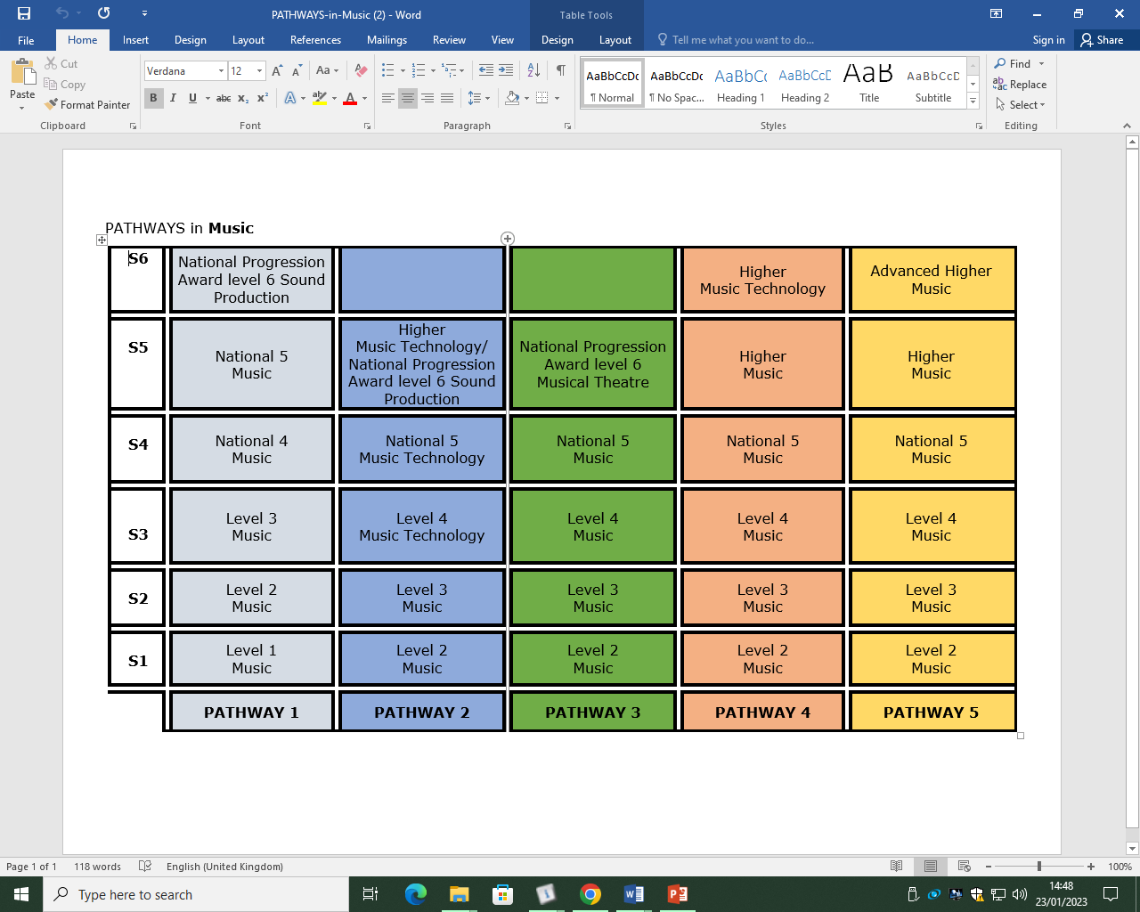
Curricular Pathways

Slide 16
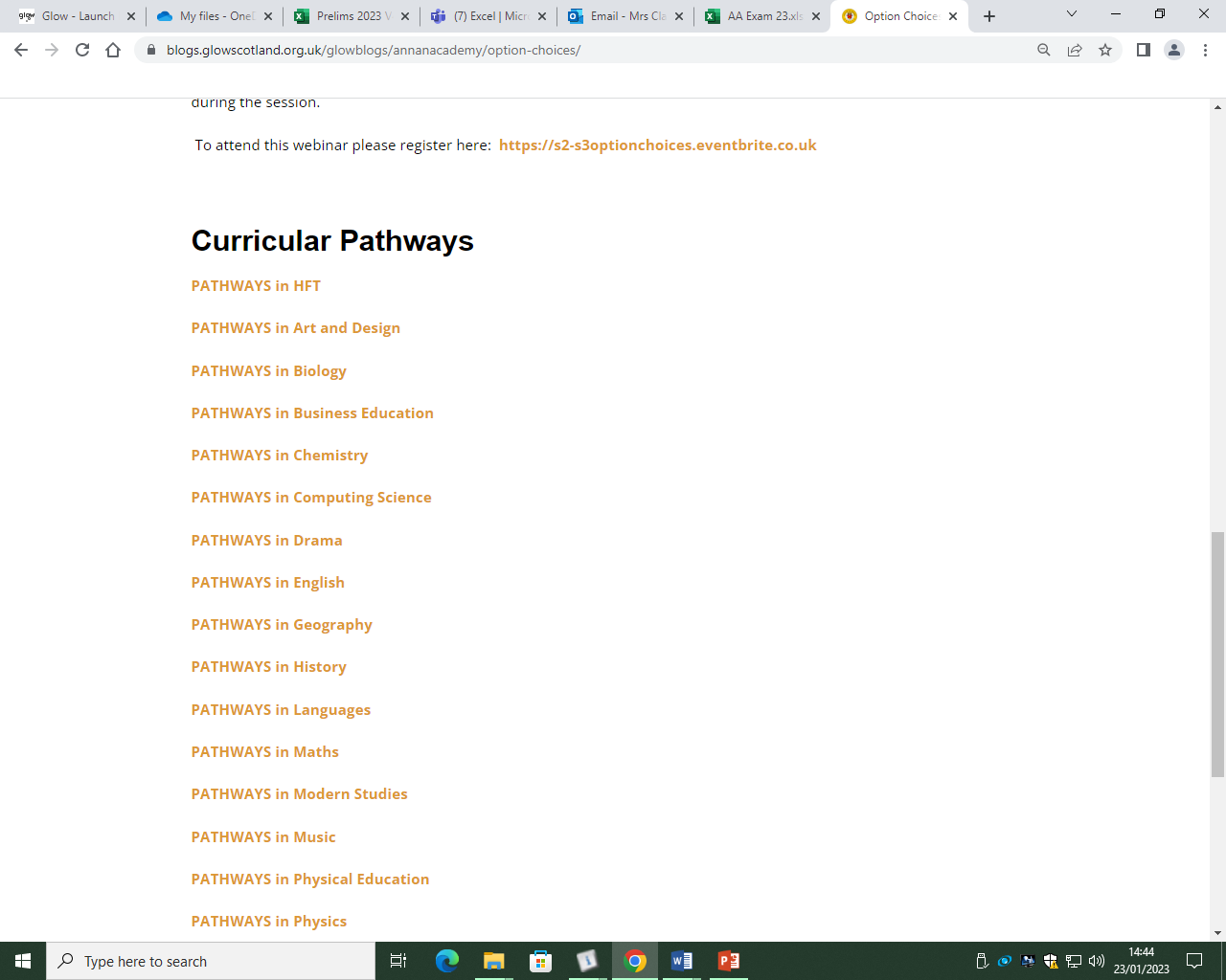

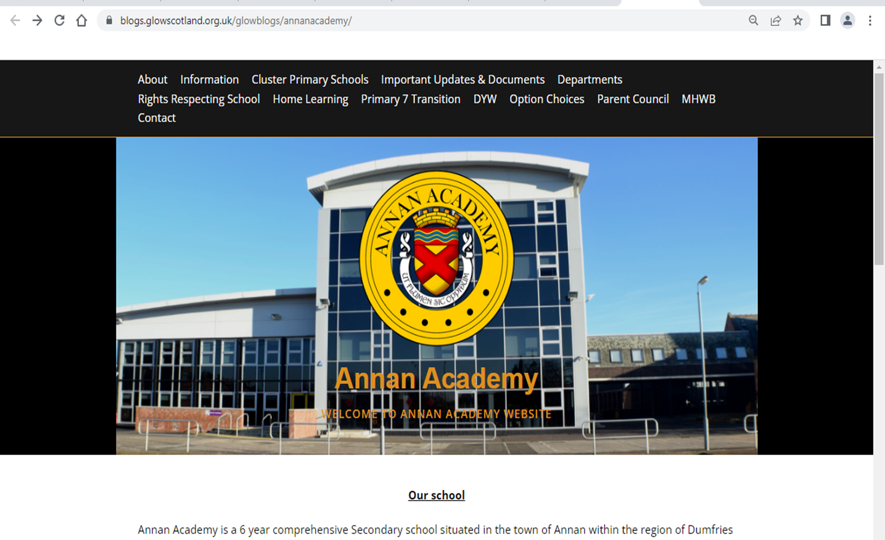
Curricular Pathways

Slide 17
MAKING SUBJECT CHOICES
Number of Subjects
  In S5 pupils study 5 subjects.
  In S6 pupils study up to 5 subjects.
Why choose a subject?
  Career interests and plans for the future
  Enjoyment
  Successful
  Recommendation
  New Interest

Slide 18
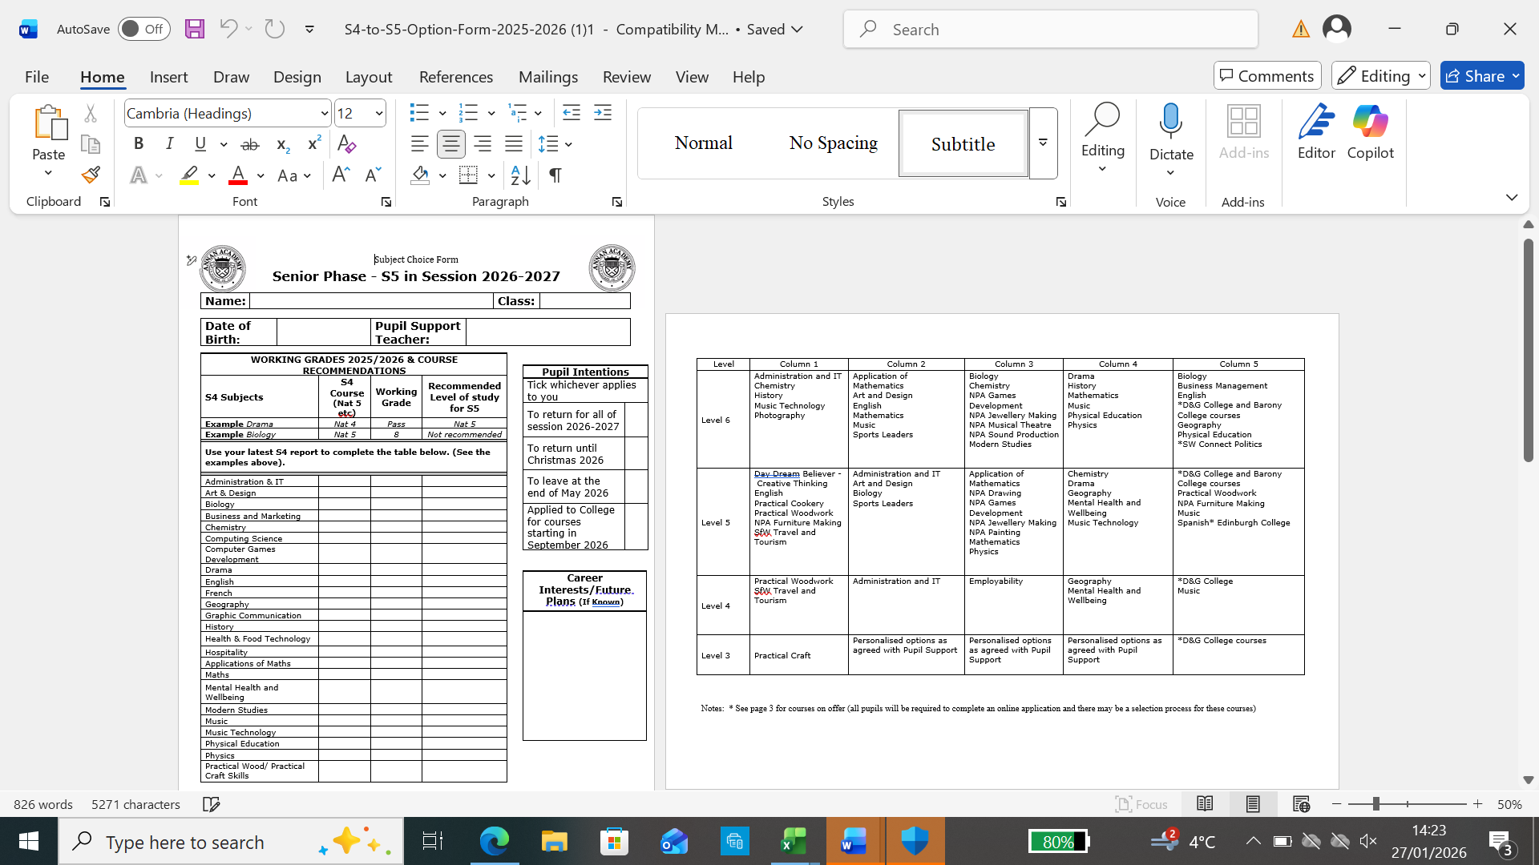
S4 into S5 Option Form

Slide 19
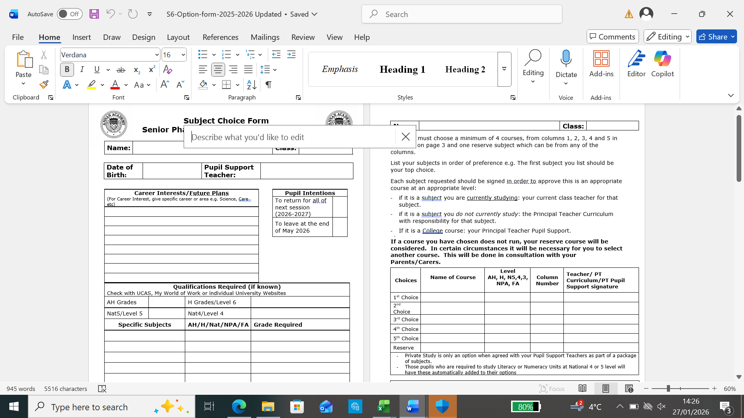
S5 into S6 Option Form

Slide 20
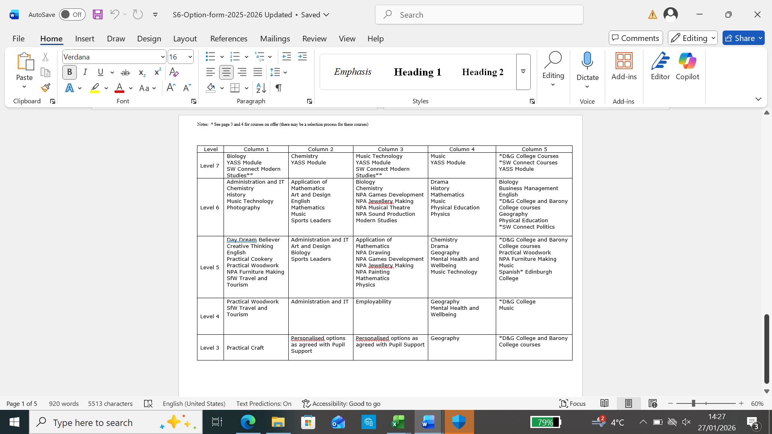

Slide 21
College Courses for 2026 -2027
Annan Academy works with a number of partners to offer a variety of different qualifications.
  Dumfries and Galloway College
  Barony College
  Dumfries Council (FA courses)
  Southwest Connect
  YASS

Slide 22
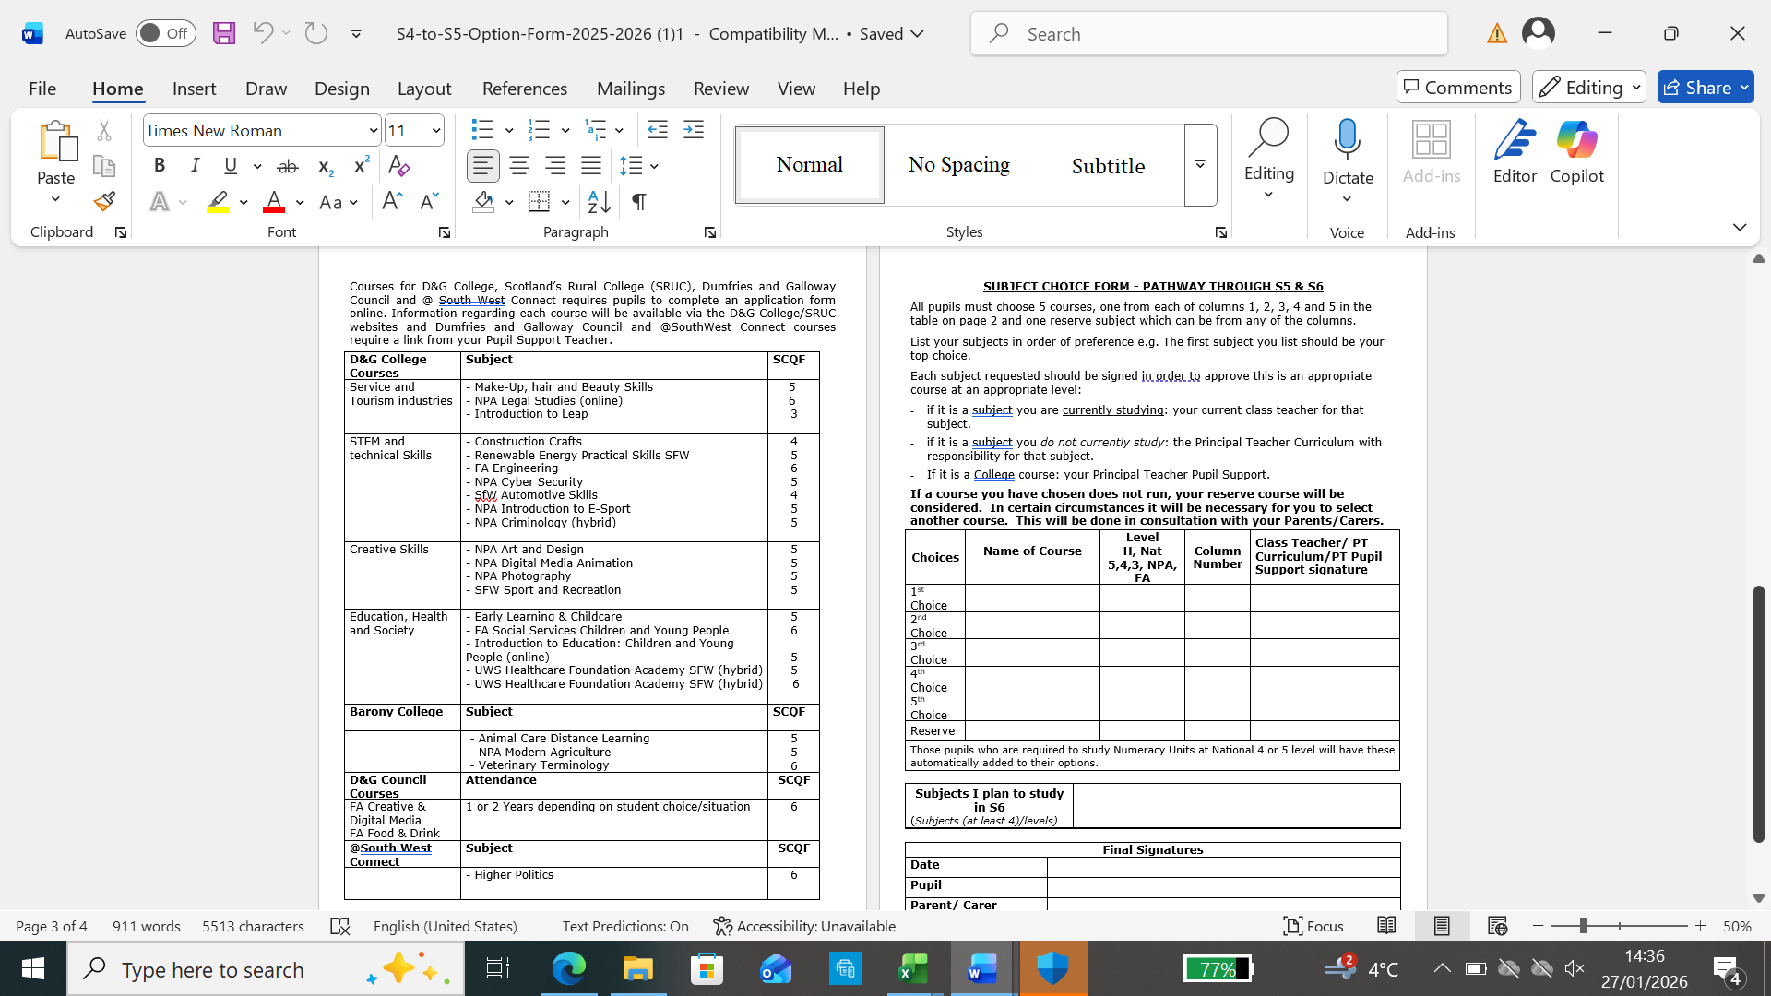

Slide 23
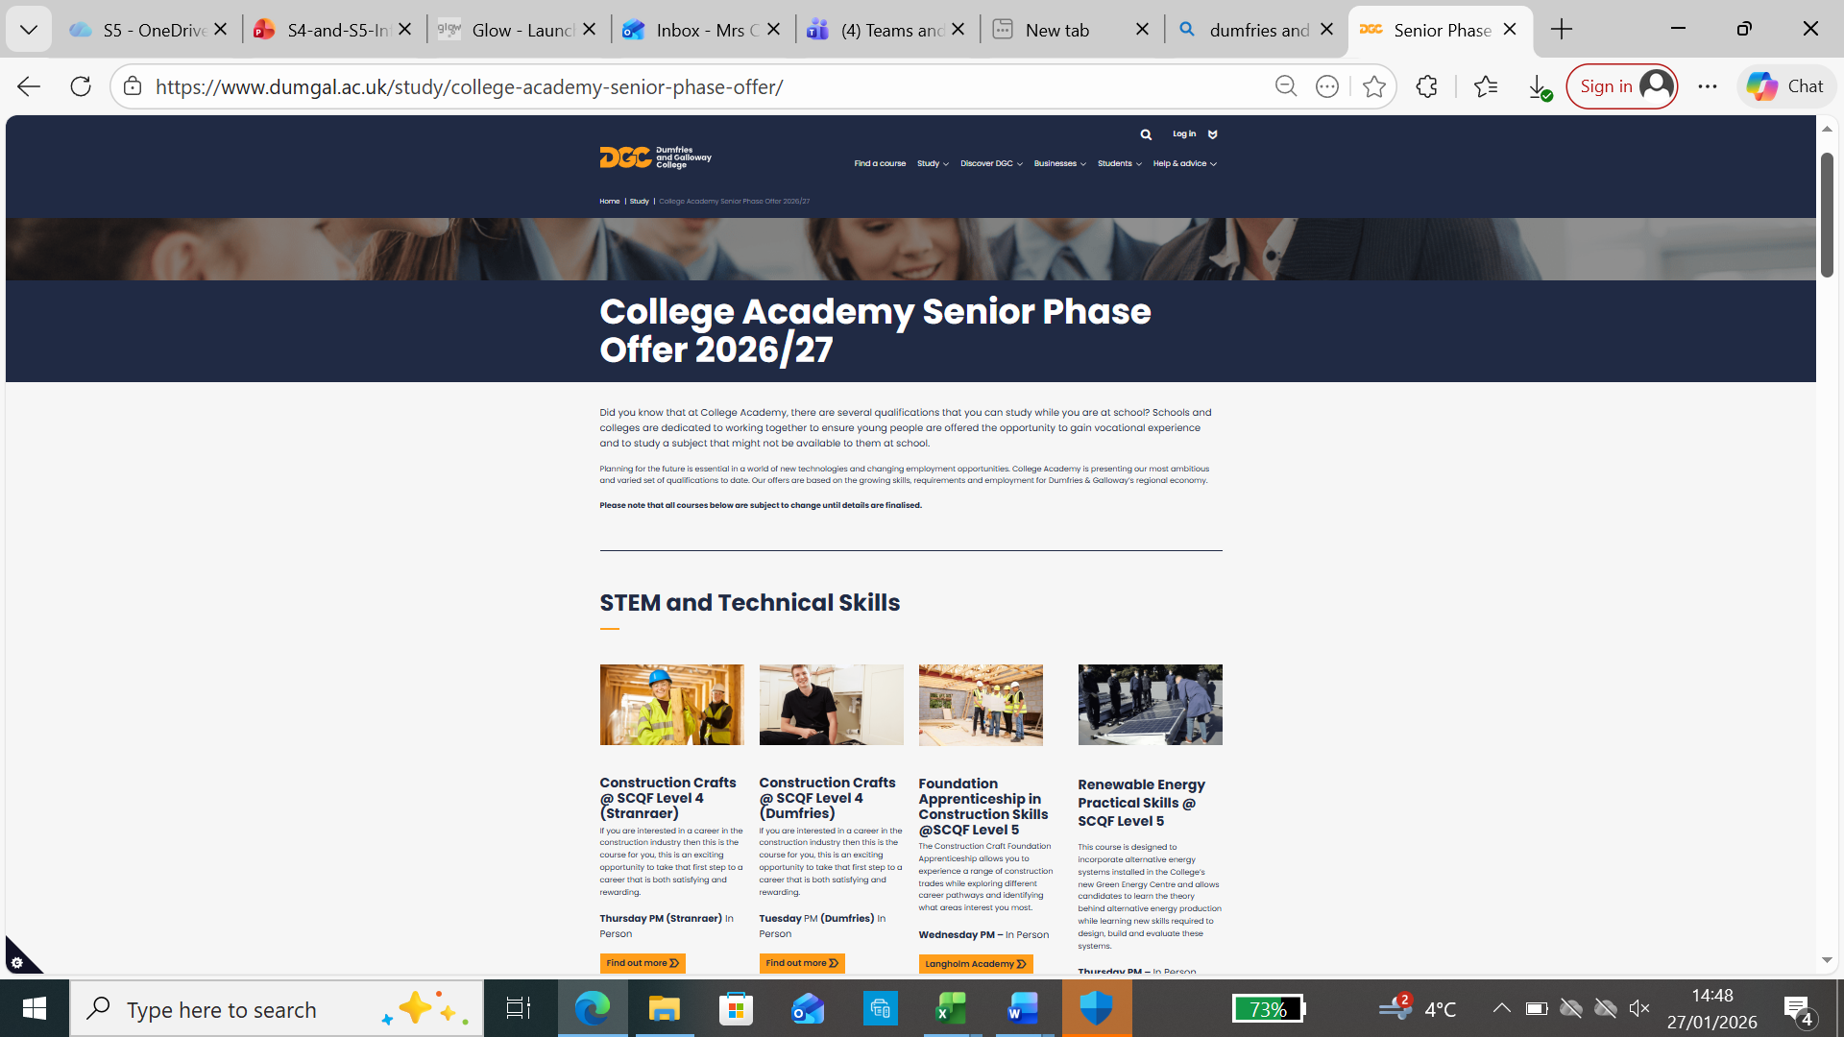
Senior Phase Offer | Dumfries and Galloway College
Applications open on 2nd March

Slide 24
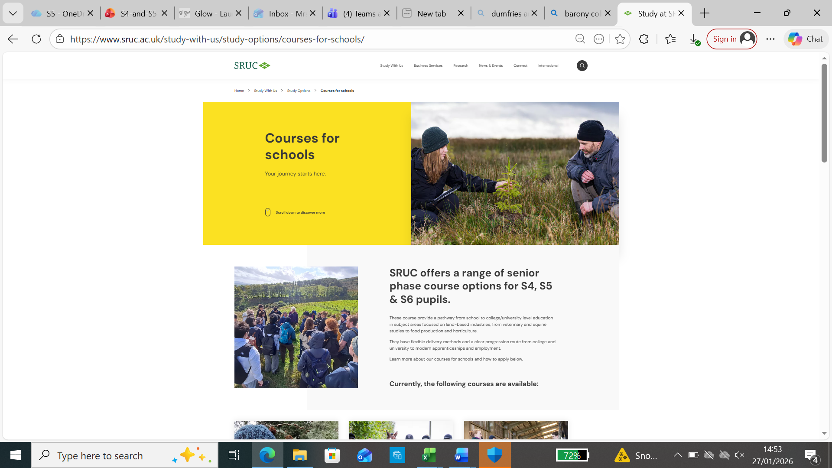
Study at SRUC | Courses for schools

Slide 25
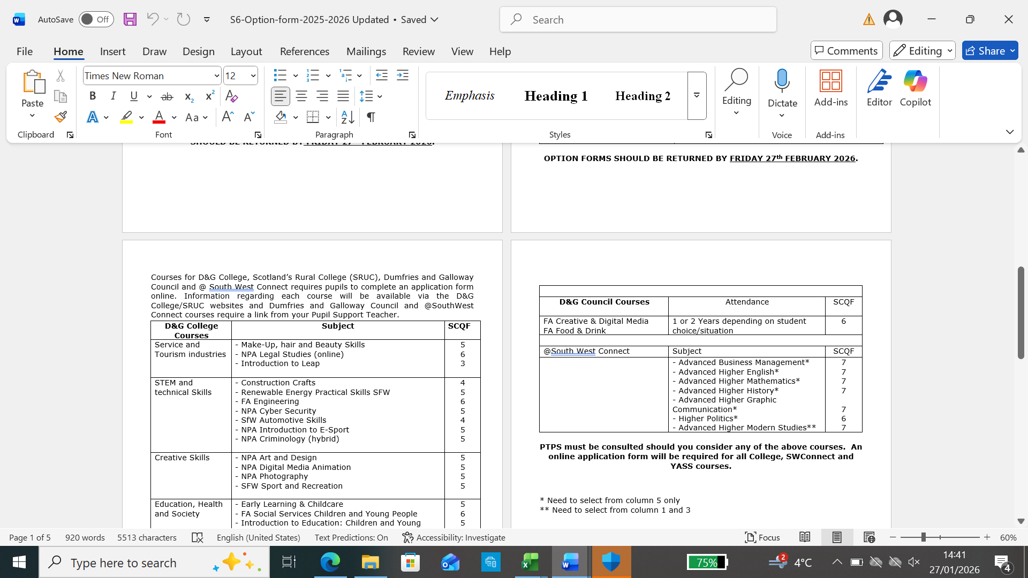
@South West Connect
Courses for pupils moving into S6.

Slide 26
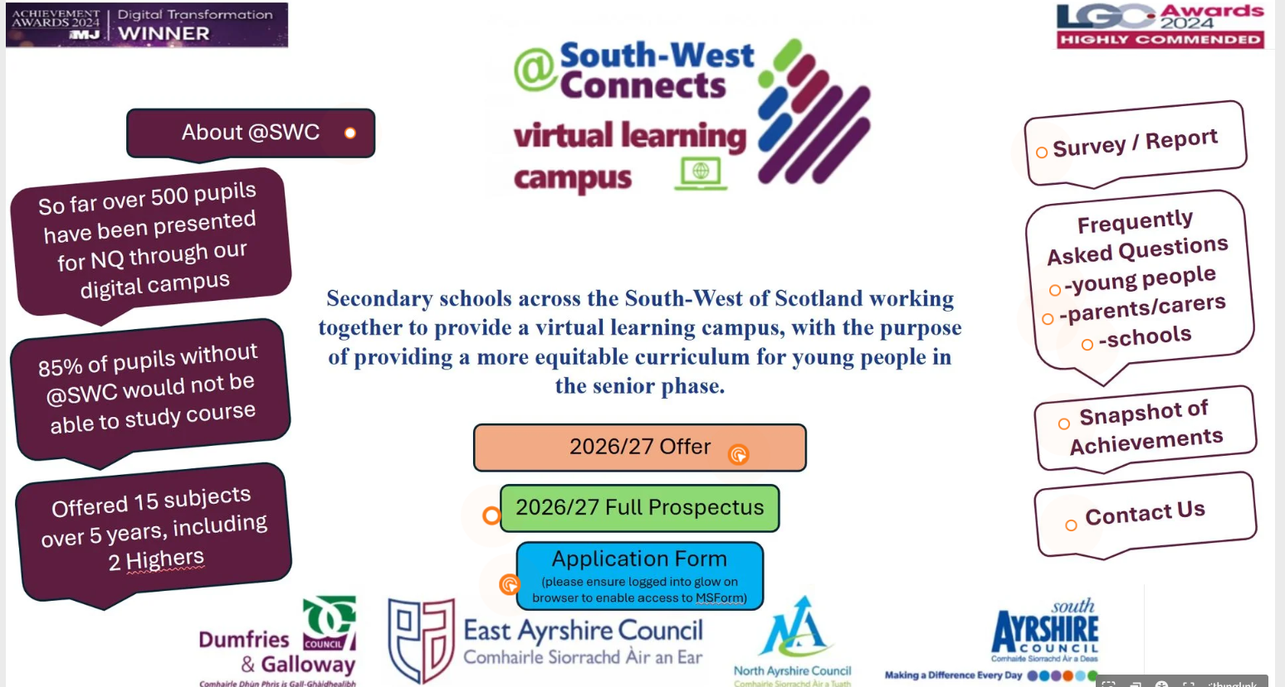
Applications will open officially on 12th February 2026
https://www.thinglink.com/scene/1932828810865017700
Adv Highers ('A' or 'B' pass in that subject at Higher level and 3 other Higher passes ('A to C' grade)
Higher (S6 = 3 Highers passes (A to C) in S5 and a N5 'A' or 'B' pass in a related subject. S5 = N5 'A' or 'B' pass in a related subject and be sitting at least 3 other Highers in S5)

Slide 27
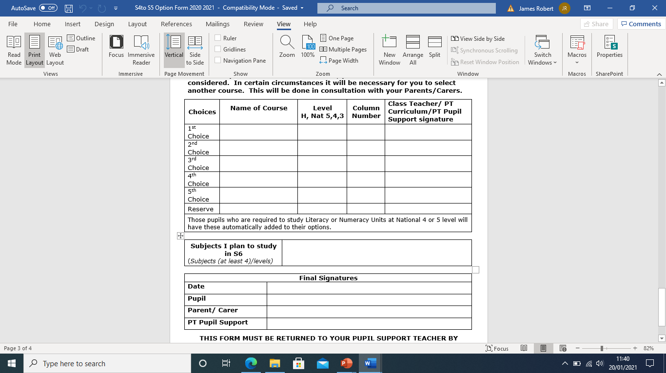
S4 into S5 Option Form

Slide 28
Deadline
S4 into S5 completed options forms are due on
WEDNESDAY 25TH FEBRUARY 2026.
S5 into S6 completed option forms are due Friday 27th FEBRUARY 2026.

Slide 29
Advice
Get as much information and advice as you can before you make final decisions.
TALK TO US!!

