Slide 1
Annan Academy S2 Options Information
9th January 2025

Slide 2
Content
Curriculum for Excellence and structure of the Curriculum
S3 Curriculum
The Senior Phase
Completing the Pupil Curriculum Plan for S3

Slide 3
Curriculum For Excellence
Broad General Education from primary 1 to S3.
Focus on Experiences and Outcomes and progression through these:
Early: Pre-school and P1, or later for some
1st: To the end of P4, but earlier or later for some
2nd: To the end of P7, but earlier or later for some
3rd and 4th: S1 to S3, but earlier or later for some
(4th level broadly equates to SCQF Level 4 – e.g General level at S Grade, National 4)
Senior Phase from S4 to S6.
Working towards National Qualifications and other awards

Slide 4
Broad General Education Primary 1 to S3
Primary 1 to end of S2
Pupils study all subject areas
S3
Personalisation and choice is available
Pupils study a blend of Subject Courses and Core Subjects

Slide 5
Subject Courses and Core
Subject Courses:
Give opportunities for greater depth of learning in subjects in which pupils wish to specialise
This will be based on pupils’ future needs and aspirations
Core subjects:
Automatically added to timetables. Core subjects include Physical Education, Modern Languages and Ethics

Slide 6
Curricular Areas
Language and Literacy English, Spanish
Mathematics and Numeracy Maths
Science Biology, Chemistry, Physics
Social Studies Geography, History, Modern Studies
Technologies IT and Technical
Expressive Arts Art, Drama, Music
Health and Wellbeing PE, Home Economics, PSE
Religious Studies Ethics

Slide 7
Senior Phase S4 – S6
Pupils will continue to study towards National Qualifications
Pupils will study:
7 subjects in S4
5 subjects in S5
Up to 5 subjects in S6

Slide 8
Qualification Structure
New Qualification | Old Qualification | SCQF Level
Advanced Higher, Awards and Scottish Baccalaureate | Advanced Higher | 7
Higher, Awards, Skills for Work Higher, National Progression Awards, and Foundation Apprenticeships | Higher | 6
National 5, Awards, Skills for Work National 5 and National Progression Awards | S Grade – Credit, Intermediate 2 | 5
National 4, Awards, Skills for Work National 4 and National Progression Awards | S Grade – General, Intermediate 1 | 4
National 3, Awards and Skills for Work | S Grade - Foundation, Access 3 | 3
National 1, 2 and Awards | Access 1, 2 | 1, 2
SCQF Learner Journey - Parent Information Video - YouTube

Slide 9
Pathway Planning
Pupils will plan pathways through S3 into the Senior Phase and towards their planned post-school destination
Support to do this from
School staff
Parents/carers
Skills Development Scotland (Careers Service)
Colleges etc.
Pupils will be able to review and revise pathways each year

Slide 10
Curricular Pathways

Slide 11
Curricular Pathways

Slide 12
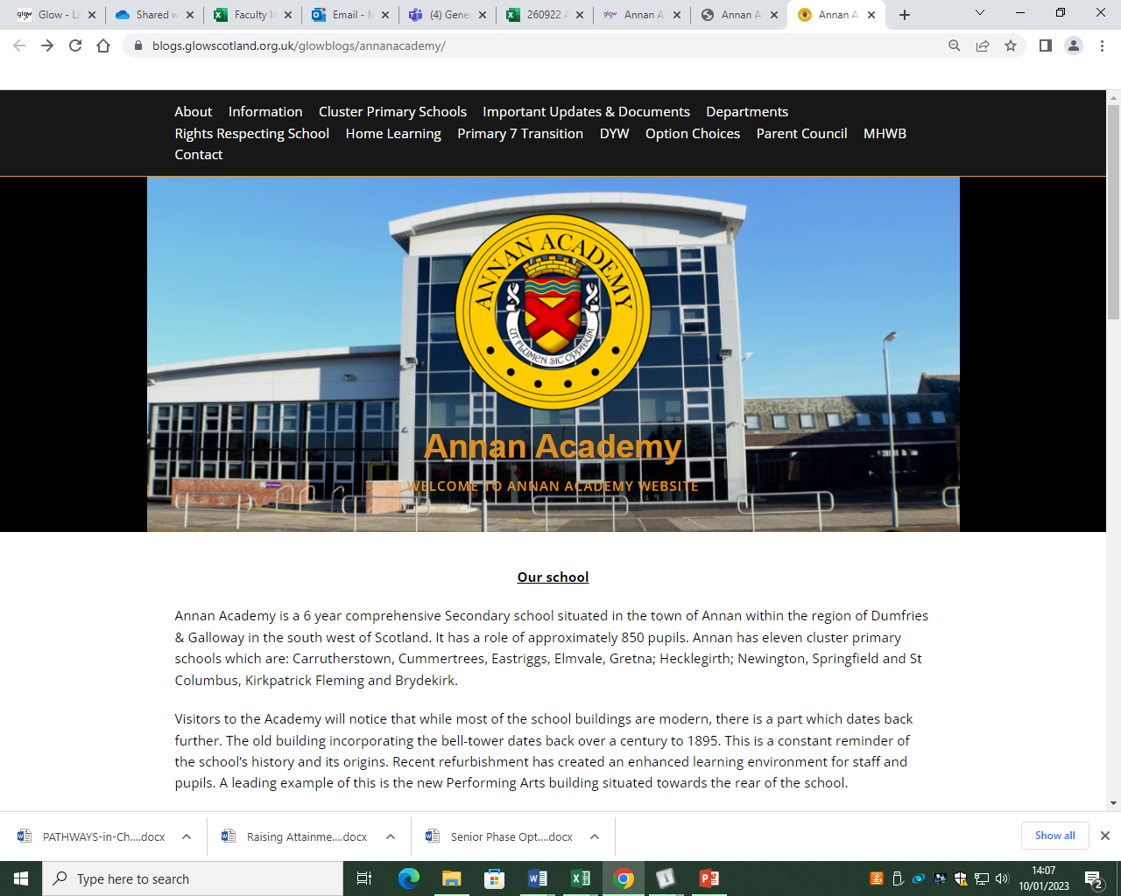
Curricular Information

Slide 13
Curricular Information

Slide 14
TIMELINE
Date | Activity
Throughout the academic year | Skills Development Scotland will work with pupils to explore careers etc.
09/09/25 | S2 Parents Information Evening Option booklet made available to pupils and parents/carers on the school website
15/01/25 | PT PS presentation to Tutor groups and option form issued
16/01/25 | S2 Reports issued
Week Commencing 20/01/25 | PT PS meet pupils individually to discuss options
21/01/25 | S2 Parents’ Evening
24/01/25 | S2 Options return deadline

Slide 15
Completing the Plan
8 Subject Courses
Pupils will also study Core Subjects – PE, Ethics, and Spanish. (These will be allocated by school and should not be included on the Pupil Curriculum Plan)

Slide 16
S3 Pupil Curricular Plan

Slide 17
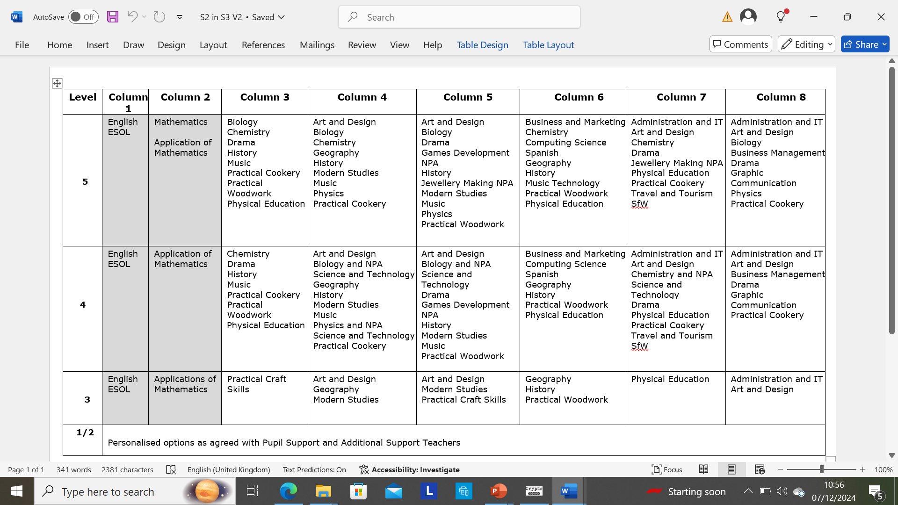

Slide 19
S3 Curriculum and completing the Pupil Curriculum Plan
Information to help you to complete the option form:
S3 Curriculum Information Booklet (available online) along with our curriculum pathways
S2 Pupil Reports, including teacher recommendations
Pupil Support information PowerPoint (available online later this month)
My World of Work website (My World of Work |)

Slide 20
S3 CURRICULUM PLAN FORM
Reminder: choose 6 subjects
Please ensure that you complete the curriculum plan and hand into your PTPS by the deadline date:
24th January 2025
If you have any questions, please contact the school office

Slide 21
Annan Academy S2 Options Information
January 2025

