Slide 1
Social Subjects
PTC: Lynne Russell
gw08russelllynne@glow.sch.uk
Geography
History
Modern Studies
Contents:
Geography N5/H
History N5/H
Modern Studies N5/H
Study Support
Supporting your learner

Slide 2
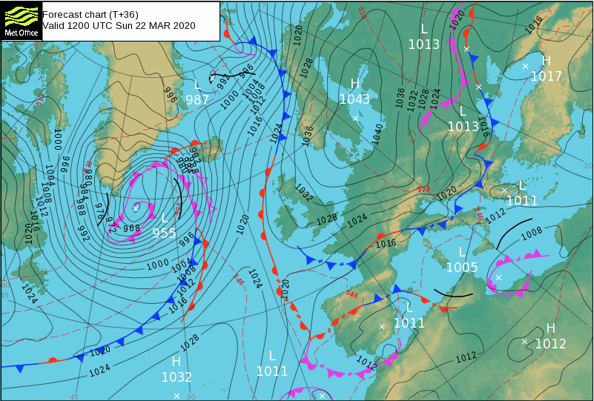
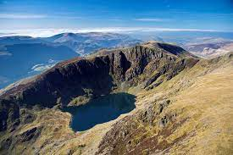
Geography
SQA Exam: Tue 29 April
National 5
Exam Components | Marks | Timing
Question Paper | 80 | 2hrs 20mins
Assignment- Report - Date? | 20 | 1 hour
Units covered​
Physical Environments – Weather, Glaciation, Coasts
Human Environments – Population, Urban, Rural
Global Issues – Climate Change, Tourism, Geographical Skills
Supported Study
Available on request
Prelim – what will be covered?
Full prelim - 2 hours 20 mins.
All topics will be covered.

Slide 3
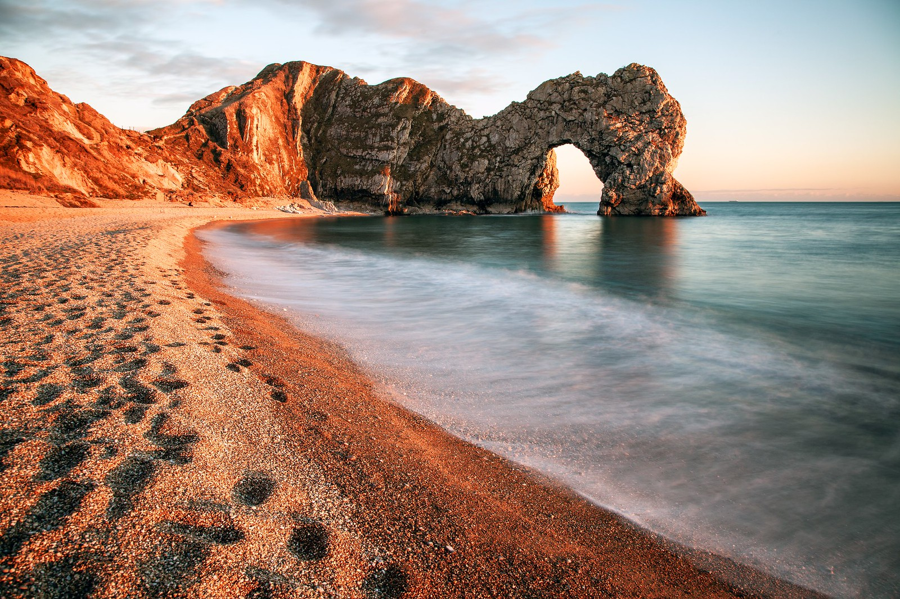
Geography
SQA Exam: Tue 29 April
Higher
Exam Components | Marks​ | Timing​
Paper 1 - Physical and Human Environments ​ | 100 | 1hr 50mins​
Paper 2 - Global Issues and Geographical Skills​ | 60 | 1hr 10mins​
Assignment - Report - Date? | 30 | 1hr 30 mins
Units covered​
Physical Environments – Atmosphere, Hydrosphere, Lithosphere, Biosphere
Human Environments – Population, Urban, Rural
Global Issues – Climate Change, River Basin Management, Geographical Skills
Supported Study
Tuesdays in F36: 3.30-4.30
or by request
Prelim – what will be covered?
Paper 1 – 1 hour 50 mins
Paper 2 – 1 hour 10 mins

Slide 4
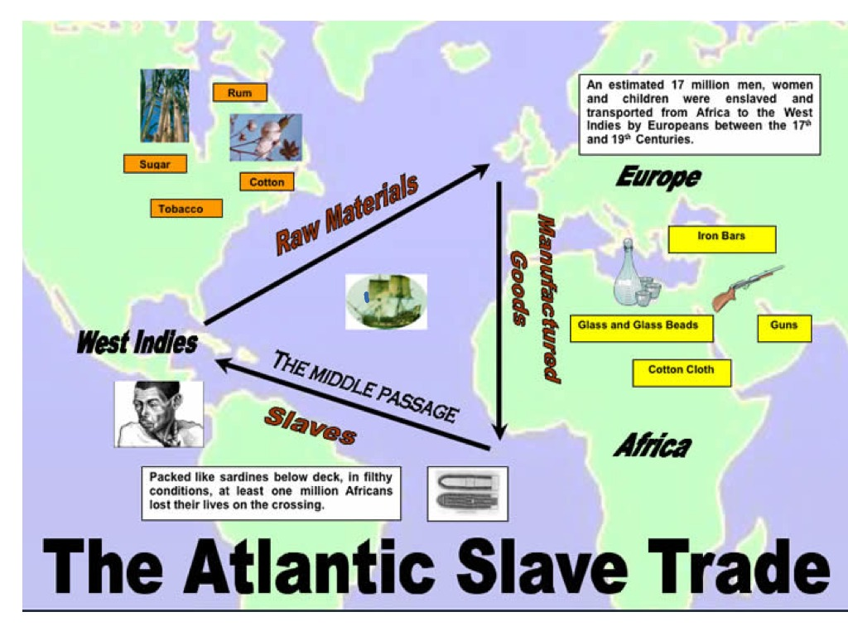
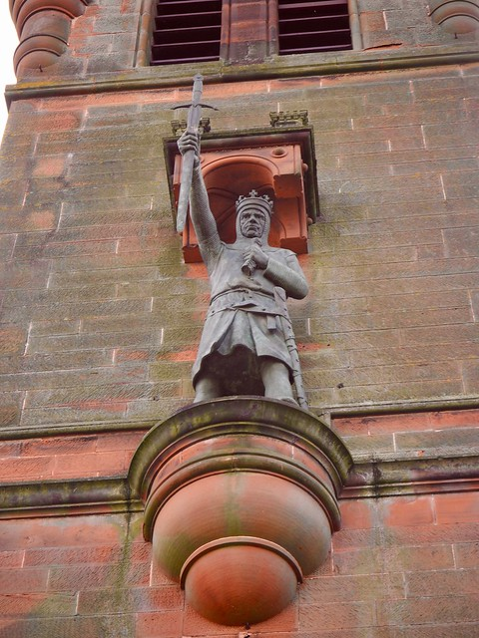
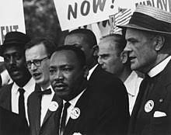
History
National 5
SQA Exam: Fri 9 May
Exam Components | Marks | Timing
Question Paper | 80 | 2hrs 20mins
Assignment – Essay - February | 20 | 1hr
Units covered​
Scottish: Wars of Independence, 1286 - 1328
British: The Atlantic Slave Trade, 1770-1807
European & World: Free at Last? Civil Rights in the USA, 1918-1968
Supported Study
Wednesdays in F40: 3.30-4.30
Thursdays in F39: 3:30 -4:30
Prelim – what will be covered?
Full prelim of 2h 20min
All Scottish and British and some E & W

Slide 5
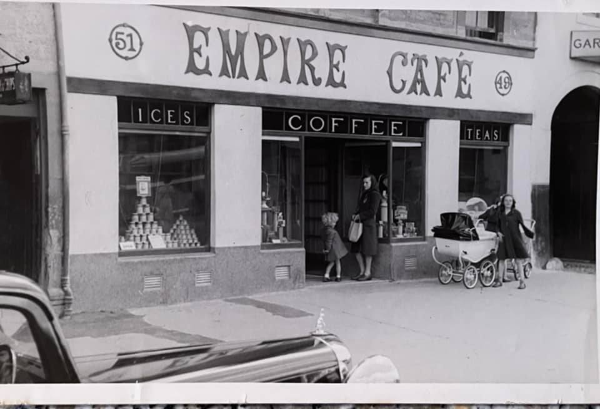
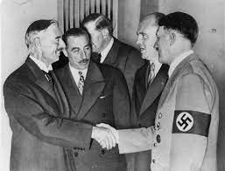
History
SQA Exam: Fri 9 May
Higher
Exam Components | Marks | Timing
Paper 1 (Essays) - British, E & W | 44 | 1hr 30mins
Paper 2 (Sources) - Scottish | 36 | 1hr 30mins
Assignment - Essay – February | 30 | 1hr 30mins
Units covered​
Scottish: Migration and Empire 1830-1939
British: Britain and Ireland 1900-1985
European & World: Appeasement to 1939
Supported Study
By arrangement with teacher.
Prelim – what will be covered?
Paper 1 – 1 hour 30 mins (British)
Paper 2 – 1 hour 30 mins (Scottish)

Slide 6
Modern Studies
SQA Exam: Tue 20 May
National 5
Exam Components | Marks | Timing
Question Paper | 80 | 2hrs 20mins
Assignment – Report - December | 20 | 1hr
Units covered​
Democracy: Democracy in Scotland
Social Issues: Crime and Law
International Issues: World Power (America)
Supported Study
Wednesdays in F39: 3:30 - 4:30
Prelim – what will be covered?
Full prelim – 2 hours 20 mins
All areas will be examined.

Slide 7
Modern Studies
SQA Exam: Tue 20 May
Higher
Exam Components | Marks | Timing
Paper 1 - Democracy in the UK, Social Inequalities, and Development in Africa | 52 | 1hr 45mins
Paper 2 – Skills | 28 | 1hr 15mins
Assignment - Report – December | 30 (27%) | 1hr 30mins
Units covered​
Democracy: Democracy in the UK
Social Issues: Social Inequality in the UK
International Issues: Development in Africa
Supported Study
Tuesdays in F39 – 3:30-4:30pm
Prelim – what will be covered?
Paper 1 and Paper 2
All areas will be examined.

Slide 8
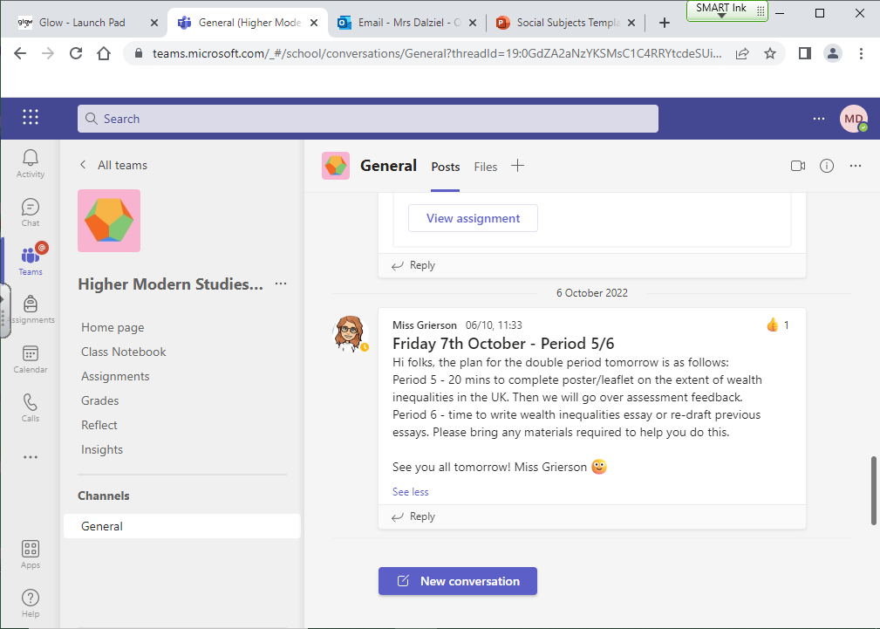
Study Support - Teams

Slide 10
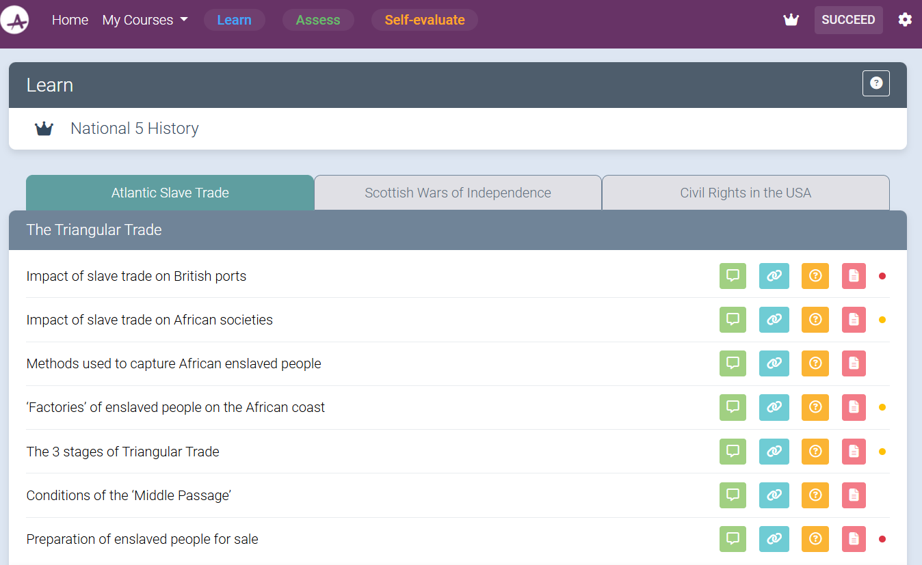
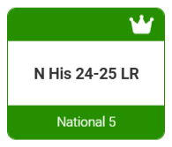
Study Support - Achieve
Achieve (hashtag-learning.co.uk)

Slide 11
Supporting your learner - GENERIC STUDY SKILLS.docx
Email for a copy
gw08russelllynne@glow.sch.uk

Slide 13
Rural Skills
National 4
Units covered ​
1. Estate Maintenance
2. Land-based industries
3. Employability skills
4. Crop Production
How is the course assessed?
To pass N4 Rural Skills pupils must complete the following:
Identify and competently use at least 10 different tools
Carry out four practical tasks under the different course units
Create a research portfolio on a range of jobs in the land-based sector
Complete evaluation sheets on a minimum of three different tasks completed through the year such as the burning and cutting of a rhododendron bush
Complete a checklist of tasks to prepare and grow different crops
Supported Study
By arrangement with teacher.
Top Tips
All resources, useful links and revision guides are available on Teams.

Slide 14
Travel and Tourism
National 4
Units covered​
Travel in Scotland, Europe and World
Employability Skills
Customer Service
Supported Study
By arrangement with teacher.
Top Tips
All resources, useful links and revision guides are available on Teams.

