Slide 1
Science Faculty
Overview of Assessment and Revision Strategies
PTC: Mrs Campbell
gw08campbellcheryl@ea.dumgal.sch.uk

Slide 2
Biology
National 5
Units covered​
Unit 1 Cell Biology
Unit 2 Multicellular Organisms
Unit 3 Life on Earth
Prelim 1 (Jan)– what will be covered?
Unit 3 Life on Earth
Unit 1 Cell Biology
Prelim 2 (Apr) – what will be covered?
Unit 2 Multicellular Organisms

Slide 3
Biology
National 5
SQA Exam
27th May 2025
Assignment
20 marks scaled to 25 to make up 20% of final mark
Experimental investigation + internet research
Final report – exam conditions 1hr 30 mins.
Marked externally by SQA
Question Paper | Marks | Timing
One paper | 100 | 2hrs 30mins
Exam

Slide 4
Biology N5 Supported Study
Day | Time | Room | Staff
Tuesday | 3.30 - 4.30 | F21 | Ms Muir
Friday | 3.30 - 4.30 | F27 | Mr Davies

Slide 5
Biology
Higher
Units covered​
Unit 1 DNA and the Genome
Unit 2 Metabolism and Survival
Unit 3 Sustainability and Interdependence
Prelim 1(Jan) – what will be covered?
Unit 1 DNA and the Genome
Unit 2 Metabolism and Survival
Prelim 2 (Apr)– what will be covered?
Unit 3 Sustainability and Interdependence

Slide 6
Biology
Higher
SQA Exam 27th May 2025
Assignment
20 marks scaled to 30 to make up 20% of final mark
Experimental investigation + internet research
Final report – exam conditions 2hr
Marked externally by SQA
Exam
Question Paper | Marks | Timing
Paper 1 | 25 | 40 mins
Paper 2 | 95 | 2hr 20 mins

Slide 7
Biology Higher Supported Study
Day | Time | Room | Staff
Tuesday | 3.30 – 4.30 | F21 | Ms Muir
Friday | 3.30 - 4.30 | F27 | Mr Davies

Slide 8
Biology
Advanced Higher
Units covered​
Unit 1 Cells and Proteins
Unit 2 Organisms and Evolution
Unit 3 Investigative Biology
Prelim (Jan) – what will be covered?
Unit 1 Cells and Proteins
Unit 2 Organisms and evolution
Unit 3 Investigative Biology

Slide 9
Biology
Advanced Higher
SQA Exam 27th May 2025
Assignment
30 marks scaled to 40 to make up 20% of final mark
Experimental investigation – practical – in school
project report – at home
Marked externally by SQA
Exam
Question Paper | Marks | Timing
One Paper | 100 scaled to 120 | 3 hours

Slide 10
Chemistry
National 5
Units covered​
Unit 1 Chemical Changes and Structure
Unit 2 Nature’s Chemistry
Unit 3 Chemistry in Society
Prelim 1 (Jan) – what will be covered?
Unit 1 Chemical Changes and Structure
Unit 3 Chemistry in Society
Nuclear Chemistry, Fertilisers,
Plastics
-
Prelim 2 (Apr) – what will be covered?
Unit 3 Chemistry in Society –
Electrochemical cells,
Metals, Chemical Analysis
Unit 2 Nature’s Chemistry

Slide 11
Chemistry
National 5
SQA Exam
1st May 2025
Assignment
20 marks scaled to 25 to make up 20% of final mark
Experimental investigation + internet research
Final report – exam conditions 1hr 30 mins.
Marked externally by SQA
Exam
Question Paper | Marks | Timing
One paper | 100 | 2hrs 30mins

Slide 12
Chemistry N5 Supported Study
Day | Time | Room | Staff
Tuesday | 3.30 – 4.30 | S10 | Mrs Campbell
Wednesday | 3.30 – 4.30 | S13 | Miss Smith
Thursday | 3.30 – 4.30 | F22 | Mr Aitken

Slide 13
Chemistry
Higher
Units covered​
Unit 1 Chemical Changes and Structure
Unit 2 Nature’s Chemistry
Unit 3 Chemistry in Society
Prelim 1 (Jan) – what will be covered?
Unit 1 Chemical Changes and Structure
Unit 3 Chemistry in Society
(All topics except Equilibrium)
-
Prelim 2 (Apr) – what will be covered?
Unit 3 Chemistry in Society –
Equilibrium topic only
Unit 2 Nature’s Chemistry

Slide 14
Chemistry
Higher
SQA Exam
1st May 2025
Assignment
20 marks scaled to 30 to make up 20% of final mark
Experimental investigation + internet research
Final report – exam conditions 2hr
Marked externally by SQA
Exam
Question Paper | Marks | Timing
Paper 1 | 25 | 40 mins
Paper 2 | 95 | 2hr 20 mins

Slide 15
Chemistry Higher Supported Study
Day | Time | Room | Staff
Tuesday | 3.30 – 4.30 | S10 | Mrs Campbell
Wednesday | 3.30 - 4.30 | S13 | Miss Smith
Thursday | 3.30 – 4.30 | F22 | Mr Aitken

Slide 16
Chemistry
Advanced Higher
Units covered​
Unit 1 Inorganic and Physical Chemistry
Unit 2 Organic Chemistry &
Instrumental Analysis
Unit 3 Researching Chemistry
Prelim 1 (Jan) – what will be covered?
Unit 1 Inorganic and Physical Chemistry
Unit 3 Researching Chemistry
(Except Organic Practical Techniques)
-
Prelim 2 (Apr) – what will be covered?
Unit 3 Researching Chemistry
(Organic Practical Techniques)
Unit 2 Organic Chemistry &
Instrumental Analysis

Slide 17
Chemistry
Advanced Higher
SQA Exam
24th May 2024
Project
25 marks scaled to 40 to make up 25% of final mark
Experimental investigation – practical – in school
project report – at home
Marked externally by SQA
Exam
Question Paper | Marks | Timing
One Paper | 110 scaled to 120 | 3 hrs

Slide 18
Chemistry AH Supported Study
Day | Time | Room | Staff
Tuesday | 3.30 – 4.30 | S10 | Mrs Campbell

Slide 19
Physics
National 5
Units covered​
Unit 1 Dynamics and Space
Unit 2 Electricity and Properties of Matter
Unit 3 Waves and Radiation
Prelim 1 (Jan) – what will be covered?
Waves, Dynamics and Electricity
Prelim 2 (Apr) - what will be covered?
Space, Properties of Matter and Radiation

Slide 20
Physics
National 5
SQA Exam
15th May 2025
Assignment
20 marks scaled to 25 to make up 20% of final mark
Experimental investigation + internet research
Final report – exam conditions 1hr 30 mins.
Marked externally by SQA
Question Paper | Marks | Timing
One paper | 135 scaled to 100 | 2hrs 30mins
Exam

Slide 21
Physics N5 Supported Study
Day | Time | Room | Staff
Wednesday | 3.30 – 4.30 | F28 | Miss Ash
Thursday | 3.30 – 4.30 | F29 | Mrs Gardette

Slide 22
Physics
Higher
Units covered​
Unit 1 Particles and Waves
Unit 2 Our Dynamic Universe
Unit 3 Electricity
Prelim 1 (Jan) – what will be covered?
Unit 2 Our Dynamic Universe
Unit 1 Particles
Prelim 2 (Apr) - what will be covered?
Unit 1 Waves
Unit 3 Electricity

Slide 23
Physics
Higher
SQA Exam
15th May 2025
Assignment
20 marks scaled to 30 to make up 20% of final mark
Experimental investigation + internet research
Final report – exam conditions 2hr
Marked externally by SQA
Exam
Question Paper | Marks | Timing
Paper 1 | 25 | 45 mins
Paper 2 | 130 scaled to 95 | 2hr 15min

Slide 24
Physics Higher Supported Study
Day | Time | Room | Staff
Wednesday | 3.30 – 4.30 | F28 | Miss Ash
Thursday | 3.30 - 4.30 | F29 | Mrs Gardette

Slide 25
Environmental Science
National 5
Units covered:
Unit 1 Living Environment
Unit 2 Earth’s Resources
Unit 3 Sustainability
Prelim 1(Jan) – what will be covered?
Unit 1 Living Environment
Unit 2 Earth’s Resources
Prelim 2 (Apr) – what will be covered?
Unit 3 Sustainability

Slide 26
Environmental Science
National 5
SQA Exam
28th May 2025
Assignment
20 marks scaled to 25 to make up 20% of final mark
Experimental investigation + internet research
Final report – exam conditions 1hr 30 min
Marked externally by SQA
Exam
Question Paper | Marks | Timing
One paper | 100 | 2hrs 30mins

Slide 27
Environmental Science N5 Supported Study
Day | Time | Room | Staff
Tuesday | 3.30 – 4.30 | F21 | Ms Muir

Slide 28
Revision Strategies for Sciences
Online Resources
TEAMS
PowerPoints used in class
Revision materials for each Key Area
Past Papers and Marking Schemes
Achieve (N5 and Higher)
Definitions
Videos
Links to past paper questions by topic
BBC Bitesize (N5 and Higher)
Course notes
Videos
Quizzes & Check tests
West OS
Video lessons for all topics/key areas

Slide 29
Revision Strategies
Online Resources
SQA Past Papers and Marking Schemes
2018 – 2024 past exam papers
Marking schemes used
SQA Understanding Standards
Exemplars of students’ exam responses and commentary on marks awarded.
Exemplars of assignments/projects.
SQA Subject Pages
Course Specification – list of required knowledge and skills
Scholar (N5, Higher and AH)
Course notes, animations and check tests
e-sgoil
National Webinars for each subject in evenings

Slide 30
How can you help?
Encourage your young person to:
1. Use the resources available
- online
- study support (free tuition!)
3. Complete all homework issued on time
– this allows them to consolidate their learning and
receive valuable feedback.
3. Ask for help when they need it
- in class
- break/lunch/after-school
- email
- during supported study

Slide 31
How can you help?
Encourage your young person to:
4. To be working at home
– even when homework has not been set. (Reading over notes,
doing past papers)
5. Use a variety of revision strategies – find what works
- practise past paper questions (essential)
- writing notes
- mind-maps
- flash-cards
- recording themselves reading through notes
6. Start now! (If not already!)
7. Take care of themselves
– eat, sleep and take time out

Slide 32
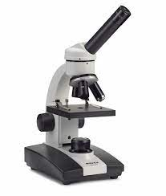
Strategies specific to Biology
Use glossaries provided to learn key terms
Parents can quiz their children using the glossaries
Highlight – Get in the habit of highlighting important parts of questions
Flash cards – make flash cards on big concepts, not just key terms.
Parents can then use these to quiz their children
Practise problem solving questions – calculations and graph work
Questions on experiments – Use a highlighter to highlight the aim, learn examples of variables, controls and reliability
Spend more time on "describe" and "explain" questions
Aim to have done all relevant past paper questions by the prelim.

Slide 33
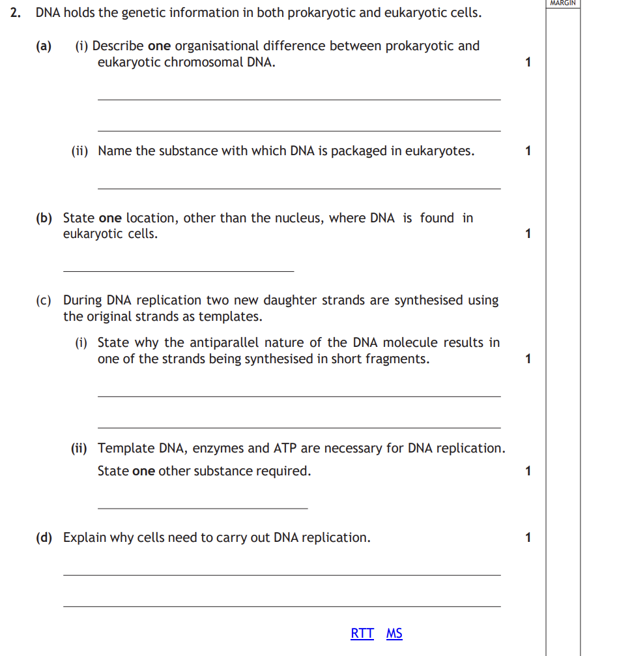
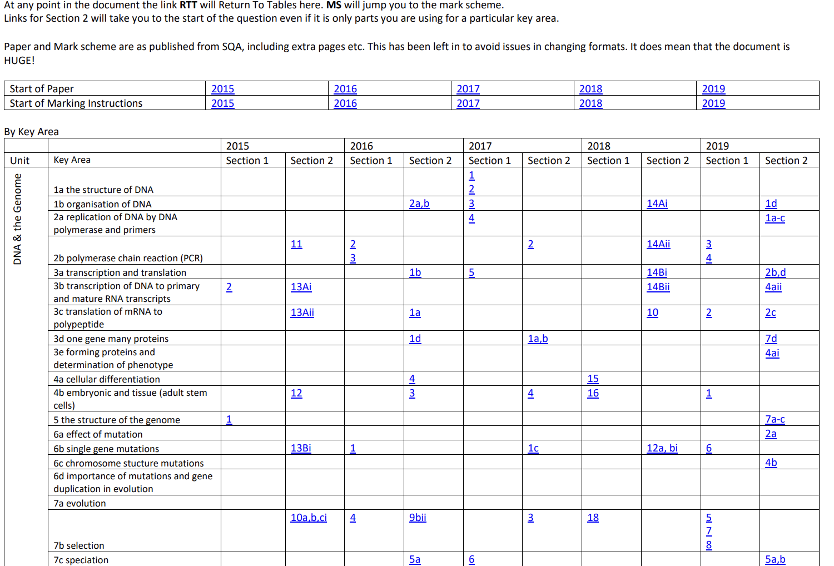
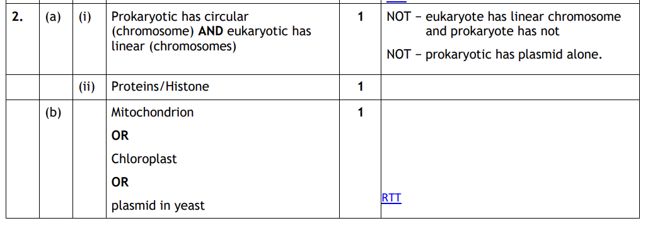
Where to find past papers
Google " national 5 / Higher Biology past papers"
The SQA website
Class Teams- Hyperlink document – should be available in all biology teams
The hyperlink document allows pupils to pick questions based on topic and if they are problem solving.

Slide 34
Strategies specific to Chemistry
Learn steps for calculations and show all working.
Ensure data booklet is used for relationships.
Correctly round final answers in calculations.
Be careful with units – only put them in when required.
Learn basic chemistry definitions, chemical tests, processes and chemical reactions.
When a 2 mark answers requires an explanation then they should demonstrate a deeper understanding of the concept.
Be familiar with ‘common chemical apparatus’, ‘general practical techniques’, ‘analytical methods’ and importantly, ‘presenting experimental work’. Be able to draw a table, graph and calculate an average.
Practise ‘open-ended’ questions.
Assignment/Project – follow structure in ‘Instructions for Candidates’

Slide 35
Where to find Resources on Teams

Slide 36
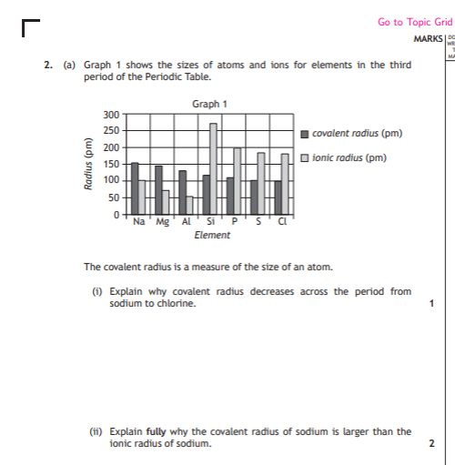
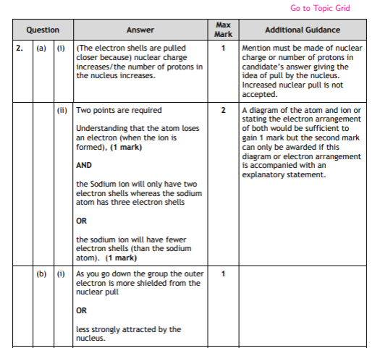
Using the Hyperlinked document

Slide 37
Strategies specific to Physics
Know how to respond to various ‘command words’ such as ‘show’ a particular answer is correct.
Follow advice given about how to answer calculation questions: highlight information, then FIFA.
Use relationship sheet and data sheet, pay attention to significant figures and units given in a question.
Practise all types of question e.g. ‘open-ended’ questions – look at understanding standards materials for exemplars.
Write answers clearly so markers can see all steps.
Be familiar with allocation of marks by looking at
SQA marking schemes.
Take care to use correct scientific language appropriate for the level.

Slide 38
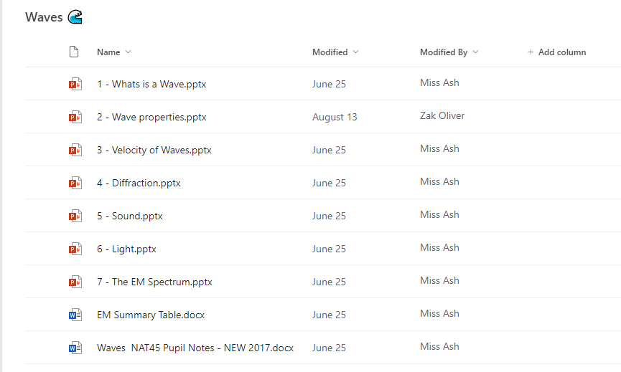
Physics Revision Resources

Slide 39
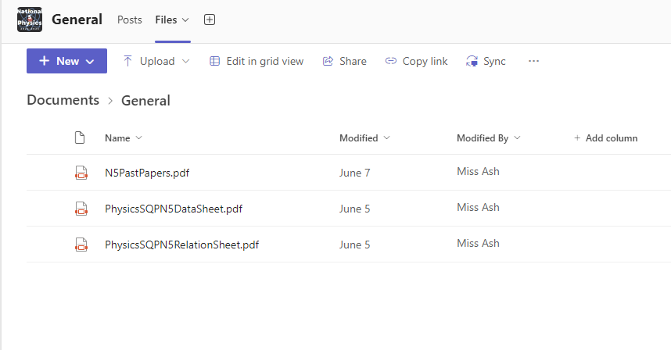
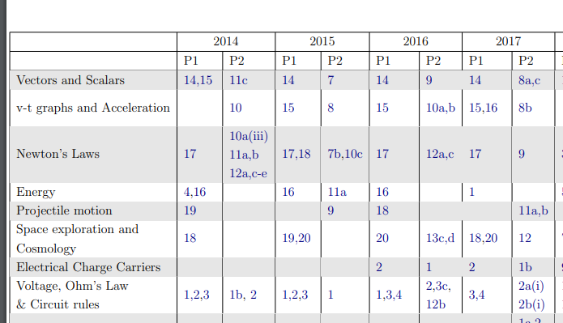
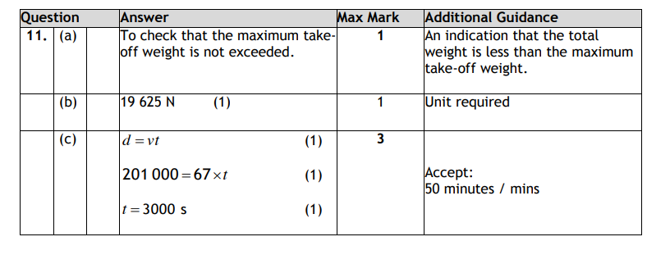
Physics Revision Resources

Slide 40
Strategies specific to N5 Env Science
Learn the definitions in the course specification and have the ability to express them accurately using scientifically appropriate terminology.
Answer ‘describe’ and ‘explain’ questions appropriately.
Be familiar with the apparatus and techniques and be aware of the purpose and methodology of each.
Practise how to structure answers for extended response questions which involve multiple marks.
Use past papers and marking schemes to gain an understanding of the expected level and depth of response.

