Slide 1
Welcome to
Annan Academy
P7 Transition 2023 - 2024
Notes:
In this powerpoint we will explain how the Pupil Support and Tutor system works. We will talk about what you will be doing in your 3 day visit. We will answer any questions on your postcards but we will also answer any other questions that you hadn’t thought about until now!

Slide 2
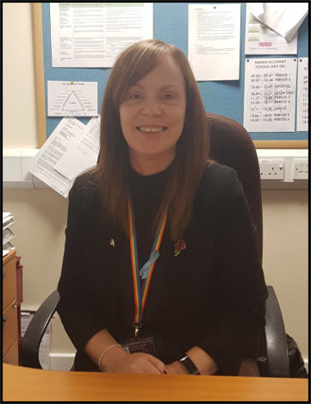
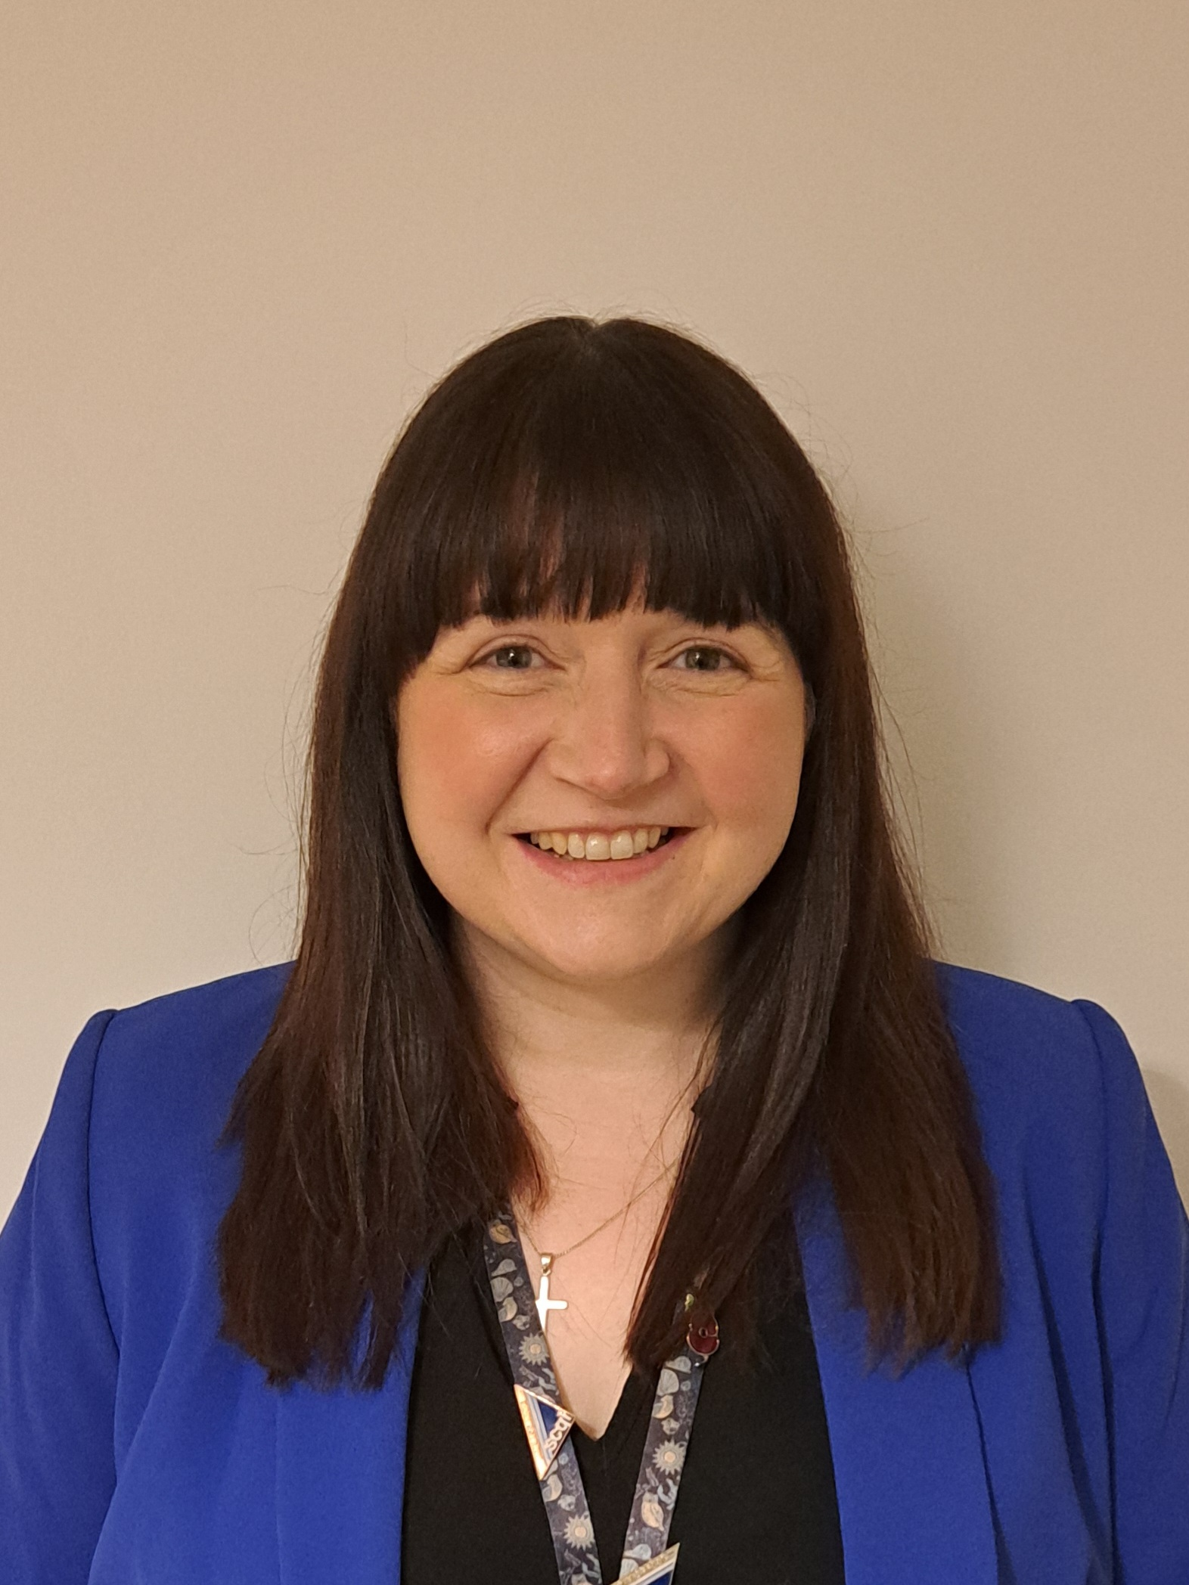
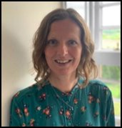
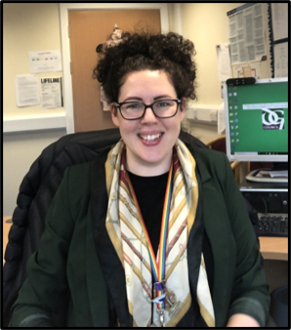
Senior Leadership Team
Mr Murray
Remit: Leadership of Change
Year link - S4
House link - Hoddom
Mrs Speight
Remit: Wellbeing, Equality and Inclusion
Year link – S1 & S5/6
House link – Solway
Mrs Clark
Remit: Raising Attainment and Achievement
Year link – S3
House link - Bruce
Ms Brown
Remit: Learning, Teaching and Assessment
Year link – S2
House Link - Douglas
Mrs Buchanan (Acting)
Remit: BGE Curriculum and alternative pathways
House link - Kinmount

Slide 3
Vision
All young people in Annan Academy will have an excellent educational experience, in a safe and inclusive environment where we will provide them with the tools to realise their ambitions and aspirations.
Values

Slide 4
Aims
We will achieve our Vision by ensuring that our values underpin everything we do in Annan Academy to allow us;
To work in partnership with pupils, parents, staff and partner agencies to ensure that Annan Academy is excellent and that every child meets their full potential.​
To have innovative and excellent learning and teaching that meets the needs of all learners.​
To ensure the school provides flexible and progressive curriculum that enables all children and young people to develop the skills they need to succeed.​
To have respectful relationships and communication at all levels in our school community, so that everyone feels included, safe and valued.​

Slide 5
Transition Process
October – December
Visits made to all primary schools
P7/S1 Welcome Evening
January – March
Transition meetings begin
Afternoon Event - Junior show
March Transition Event – Science, English, Drama, ICT
April – June
Enhanced Transition sessions
May Transition Event – Social Subjects, Technical, PE
PTPS visit Primary schools
3 day visit – Tuesday 18th June – Thursday 20th June
Notes:
You will have lots of subject teachers. Get them to name all the subjects they will have? Big change moving from one teacher all day to six subjects each day and up to 14 teachers over year on tt- but that is one of the good things- getting to move around classes and subjects..
Who do you go to if you need help though?

Slide 6
Who will support me?
Principal Teacher of Pupil Support (PTPS) - they have overall responsibility for pupil welfare. PTPS teachers usually follow family links so P7s may be able to guess who their PTPS teacher will be if they have an older sibling at school.
Tutor teacher - Pupils will see this teacher every day at tutor time.
S6 Guides – Guides help pupils find their way around when they come to the Academy in June, and then again in August.
Notes:
You will have lots of subject teachers. Get them to name all the subjects they will have? Big change moving from one teacher all day to six subjects each day and up to 14 teachers over year on tt- but that is one of the good things- getting to move around classes and subjects..
Who do you go to if you need help though?

Slide 7
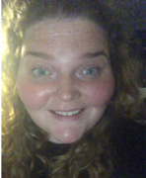
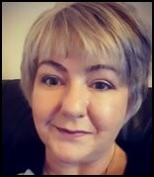
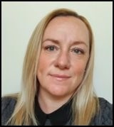
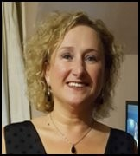
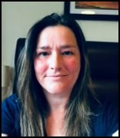
Pupil Support
Mrs Bennett Mrs Craik Mr Le Vin
(Bruce) (Bruce) (Douglas)
Mrs Whyte Mrs Jordan Miss Martin
(Hoddom) (Kinmount) (Solway)
Support

Slide 8
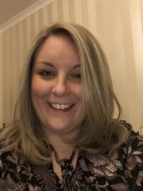
ASN
Additional Support for Learning
Mrs Wells and her team work hard to ensure every pupil has the support they need to achieve their full potential. This could take the form of support in class, during assessments or at social times.
The base and Learning Zone can be accessed through the library or via the blue doors at the car park.
ASN is open to pupils before school and offers a breakfast club, and at social times where pupils can bring along their lunch.
Mrs Wells
PTC ASN
Support

Slide 9
Tutor
Tutor groups meet after morning break-time every day.
4 tutor-times of 15 mins (Mon, Tues, Thurs, Fri)
Longer tutor-time on Wednesdays for PSE (47 mins)
Voice

Slide 10
Pupil Voice
Have your say!
Pupil Council
Each tutor group has a Rep – Reps are used for a wide range of tasks and help to drive forward positive change in the school.
Voice

Slide 11
The School Day

Slide 12
S1 Timetable
School Day

Slide 13
The School Day
Monday, Tuesday, Thursday, Friday
Period 1 | Period 2 | Interval | Tutor | Period 3 | Period 4 | Lunch | Period 5 | Period 6
9am – 9.52am | 9.52am - 10.45am | 10.45am - 11am | 11am – 11.15am | 11.15am - 12.07am | 12.07am - 1pm | 1pm – 1.45pm | 1.45pm - 2.37pm | 2.37pm - 3.30pm
Wednesday
Period 1 | Period 2 | Interval | Tutor | Period 3 | Period 4 | Lunch | Period 5 | Period 6
9am – 9.47am | 9.47am - 10.34am | 10.34am - 10.49am | 10.49am – 11.37am | 11.37am - 12.24am | 12.24am - 1.11pm | 1.11pm – 1.56pm | 1.56pm - 2.43pm | 2.43pm - 3.30pm
School Day

Slide 14
The Canteen
Young Scot cards are used to buy food at the canteen. These are topped up online and daily limits can be set. Any outstanding balance on ipayimpact will be transferred over during the holidays.
Pupils can also wit chip and pin or cash. A Meal Deal which includes a main meal, side and drink costs £2. Pupils can also bring their own packed lunch.
If pupils forget their card, they can still access their money by giving their name at the till.
School Day

Slide 15
The Canteen
Free school meals
Pupils receiving free school meals will have their cards automatically topped up.​
Parents/carers will need to reapply for free school meals, this is one through the council website.​
Have a look at the link below.
How to pre-order your lunches
School Day

Slide 16
School Uniform
Annan Academy tie (Primaries)
Black or white shirt
Black v-neck jumper or cardigan
Black trousers or skirt
Predominantly black shoes
Recent updates
Plain black joggers, combat trousers and leggings are now acceptable forms of school clothing
Leggings – should not have any see-through panels and should be entirely black
Black school branded hooded tops

Slide 17
School Transport
Induction Days, pupils should get on any school bus.
Pupils will receive their bus passes from Annan Academy in August.
If a bus pass is lost, replacement can be bought at school office (£1).
Pupils should carry bus pass every day to show to driver.
Transport

Slide 18
First Day Arrangements
All P7 pupils should gather at the bus bays upon arrival on Tuesday 18th June.
Each bus bay will be assigned to a Tutor Group and pupils should congregate at their assigned bay by 8:55am.
Primary schools will inform pupils of their Tutor Group before arrival. Here, pupils will be greeted by their Pupil Support teacher and their S6 guides.
Guides will escort each Tutor Group to their morning session which will be led by their Pupil Support teachers. Pupils will receive their new timetables and further information about the three-day visit.
Pupils will then attend their timetabled classes from Tutor on Tuesday 18th June until period 6 on Thursday 20th June. This will give P7s the opportunity to meet their new teachers, peers and give them a taste of their new classes.

Slide 19
S1 Curriculum Areas
English and Languages
Expressive Arts
School Day

Slide 20
S1 Curriculum Areas
Health and Wellbeing
ICT
School Day

Slide 21
S1 Curriculum Areas
Maths
Science
School Day

Slide 22
S1 Curriculum Areas
Social Subjects
Technologies
School Day

Slide 23
Virtual Tour
https://youtu.be/3gfG5QkonQE
https://youtu.be/LiAoLYzDDPg
Click on the link above to watch our virtual tours of the Main School Building and Performing Arts Building.
School Building

Slide 24
Beyond the Classroom

Slide 25
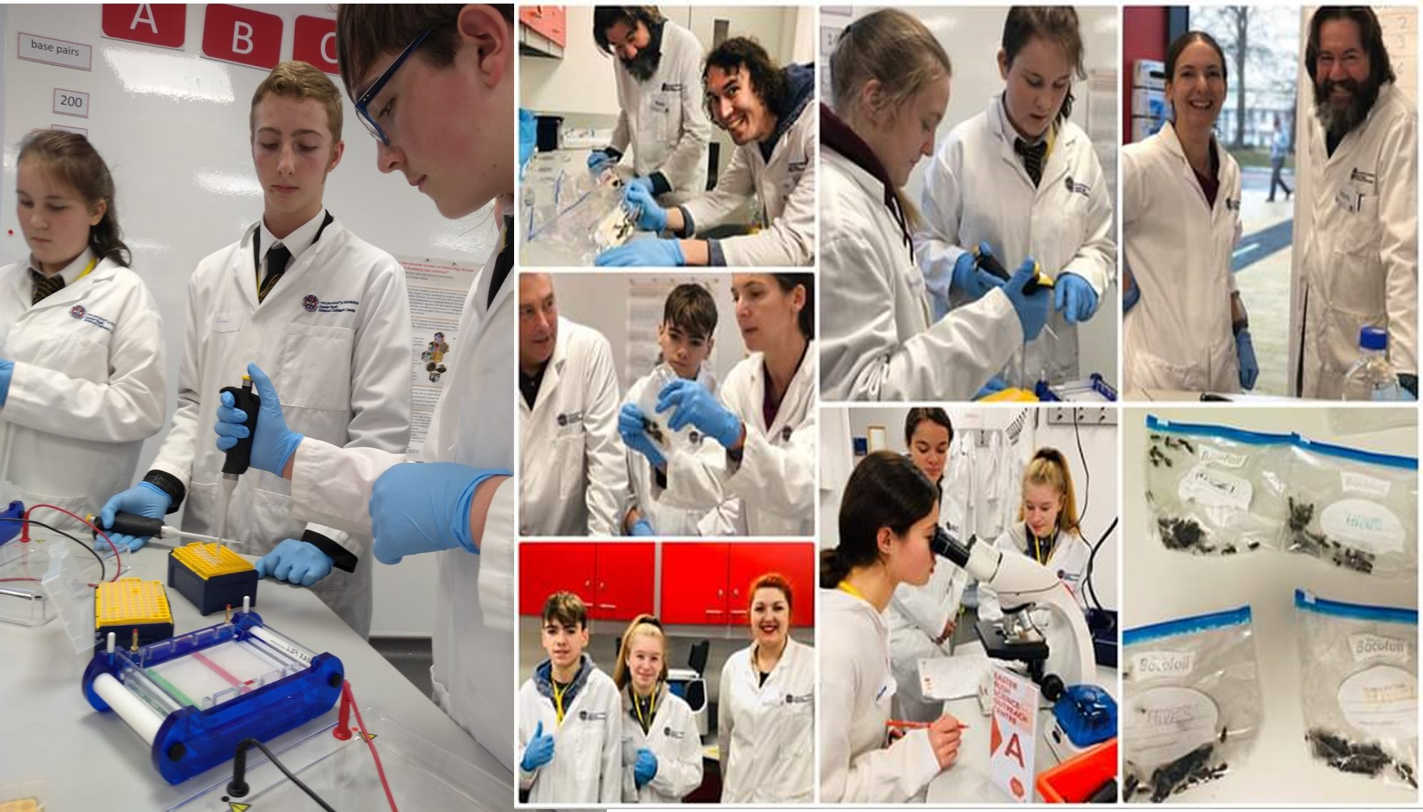
Science Club

Slide 26
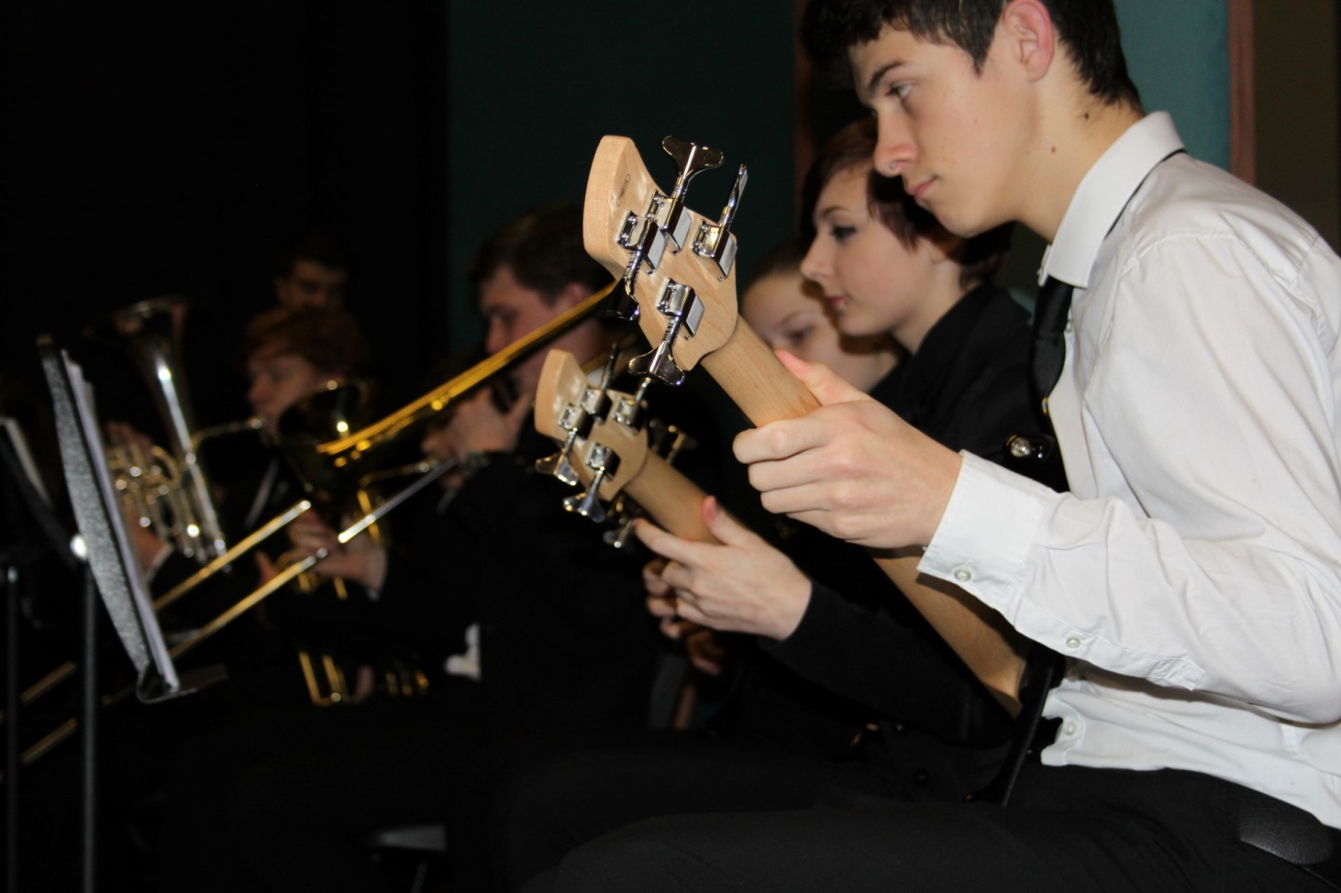
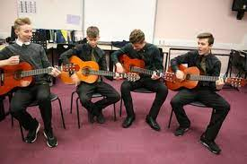
School Band and music groups

Slide 27
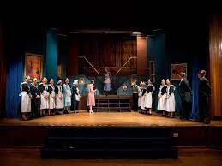
School Shows

Slide 28
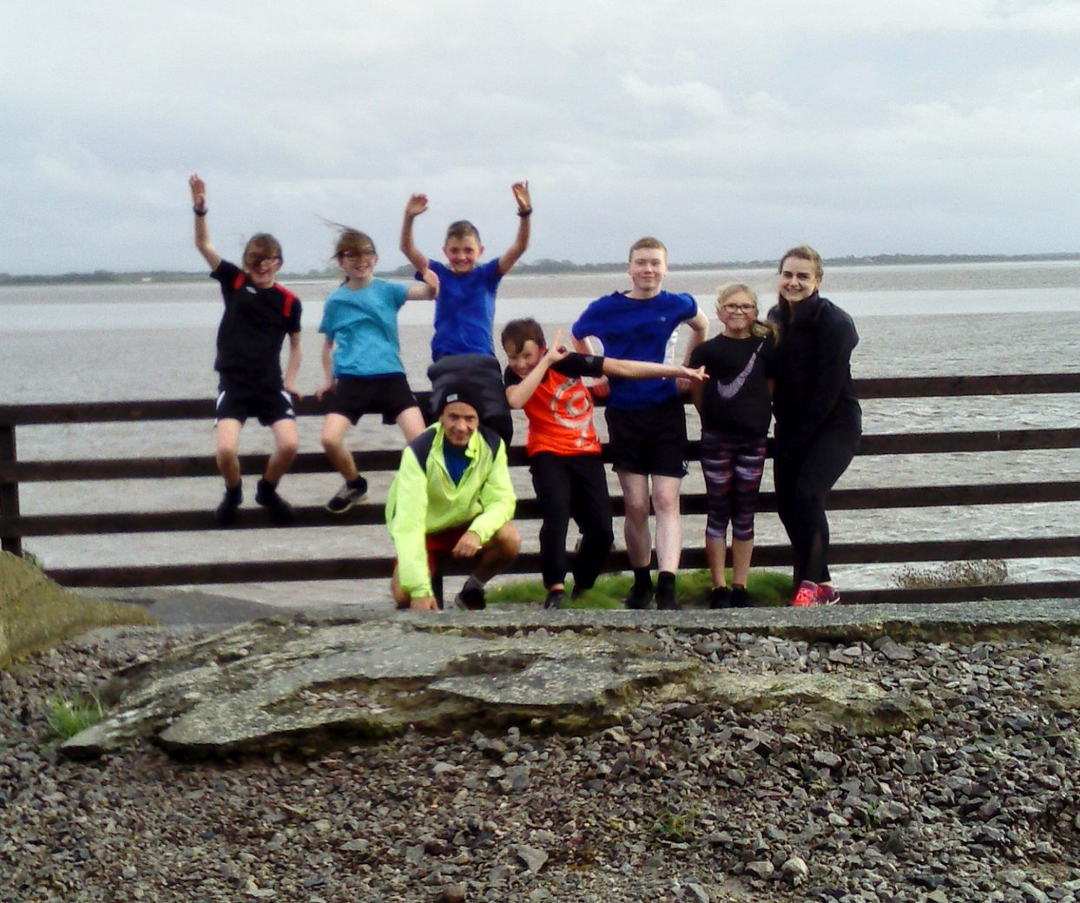
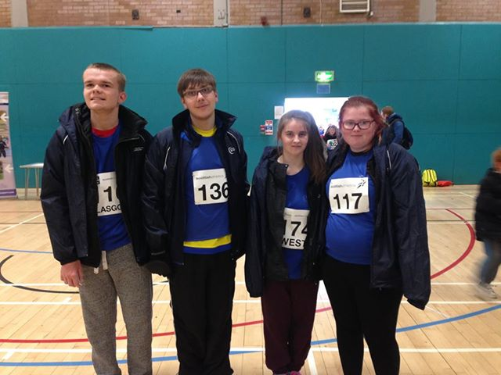
Sports Clubs

Slide 29
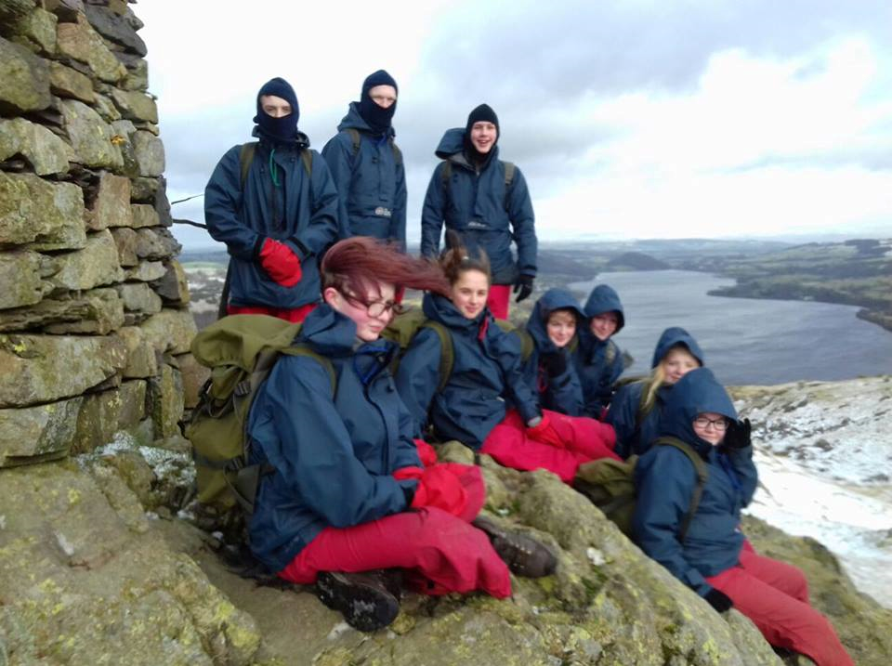
Trips

Slide 30
Keeping in touch
The school website has links to information. There is also a ‘P7 Transition’ tab with relevant information on our school website.
https://blogs.glowscotland.org.uk/glowblogs/annanacademy/
https://www.facebook.com/pg/annanacademynews/events/
FAQs
Notes:
Depends on how long question time takes whether you want to skip to the link and show them the website.

Slide 31
Q&A
Notes:
Depends on how long question time takes whether you want to skip to the link and show them the website.

