Slide 1
Option Information for Parents/Carers and Students
20th February 2024
S4 into S5
S5 into S6

Slide 2
Senior School – February 2024
The Transfer process
The Subject choices booklet
Making subject choices
Types and level of courses available
The Options Form

Slide 3
Responsibilities
The Role Model
Conduct
Dress
Work ethic
Participation

Slide 4
Options Time Line
Date | Event | Detail
19/02/24 | Senior Curriculum Information and Option Form issued | Information regarding subject choices for S5/6 available on the school website: Option Choices – Annan Academy (glowscotland.org.uk)
20/02/24 | Senior Phase Information Evening 6-7pm | Depute Head Teacher presentation taking parents/pupils through the process of selecting subjects to study in S5 and S6.
22/02/24 | S4 and S5 Reports issued | Information regarding performance in current subjects and recommendations for next session.
28/02/24 | S4 Parents’ Evening | Opportunity to meet with subject teachers, particularly with those subject’s pupils are considering for S5.
01/03/23 | PTPS information to S5 Tutor Groups PTPS visit S4 Tutor classes | Principal Teacher Pupil Support provides information for Tutor Teachers to explain Subject Choice forms and answer questions. Principal Teacher Pupil Support visit S4 Tutor classes to explain Subject Choice forms and answer questions.
29/02/24 | PTPS meetings with S4 | One to one pupil appointment to discuss/finalise subject choices, if required.
04/03/24 | S4 into S5 Options return deadline | Completed Curricular Plan Forms must be returned by your child to their Tutor Teacher at Tutor Time
08/03/24 | S5 into S6 Options return deadline | Completed Curricular Plan Forms must be returned by your child to their Tutor Teacher at Tutor Time

Slide 5
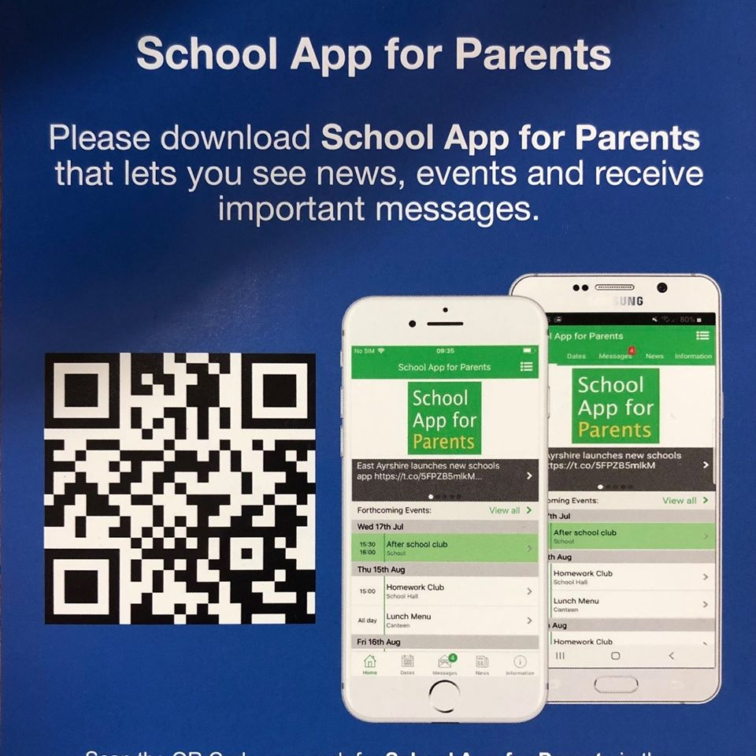
Important Information
Senior Phase Option Booklet is available on the school website:
https://blogs.glowscotland.org.uk/glowblogs/annanacademy/option-choices/
School App for Parents

Slide 6
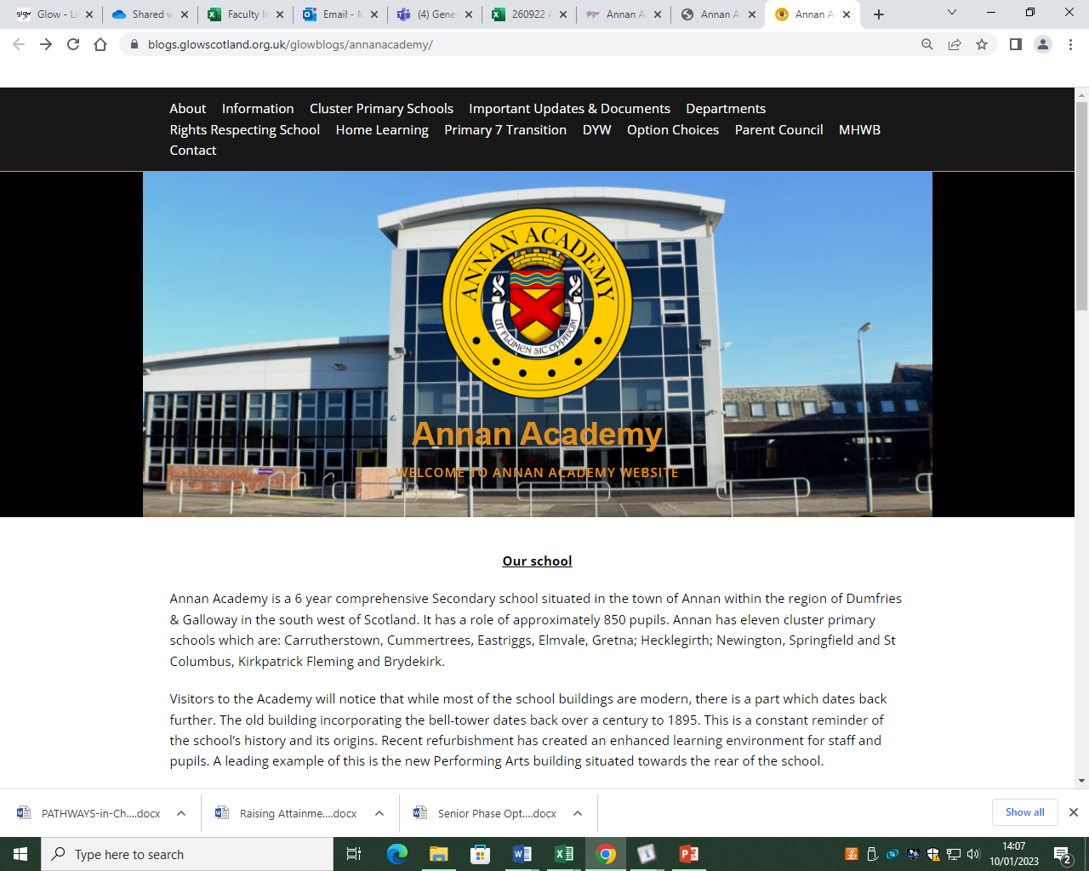
Curricular Information

Slide 7
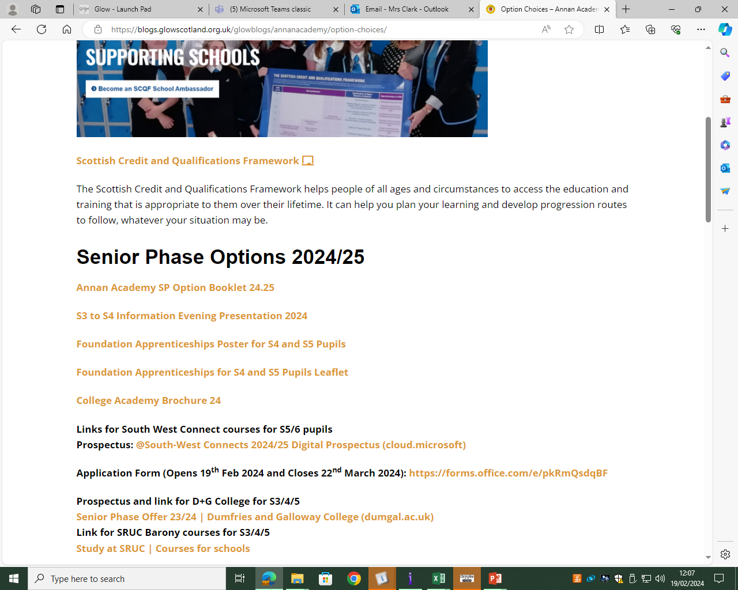
Curricular Information

Slide 8
Senior Phase S4 – S6
New Qualification | Old Qualification | SCQF Level
Advanced Higher, Awards and Scottish Baccalaureate | Advanced Higher | 7
Higher, Awards, Skills for Work Higher, National Progression Awards, and Foundation Apprenticeships | Higher | 6
National 5, Awards, Skills for Work National 5 and National Progression Awards | S Grade – Credit, Intermediate 2 | 5
National 4, Awards, Skills for Work National 4 and National Progression Awards | S Grade – General, Intermediate 1 | 4
National 3, Awards and Skills for Work | S Grade - Foundation, Access 3 | 3
National 1, 2 and Awards | Access 1, 2 | 1, 2
https://youtube.com/shorts/zykgcRJohNE?si=p4Xv6wKWYcI2XX-6

Slide 9
National Qualifications (NQs)
These are qualifications ranging from SCQF levels 1-7 (with 7 being advanced higher). These are equivalent to the qualifications that many parents and carers would have experienced at school.
National 1 to 4 courses are all internal assessed and are awarded a pass or fail on completion.

Slide 10
National Qualifications (NQs)
National 5, Higher and Advanced Higher courses are externally assessed and graded. The assessments typically consist of a written exam or question paper and another coursework related component.
The final assessments are set, administered and most commonly marked by the SQA. NQs are graded from A-D. Notionally as follows (this may differ each year):
A = 70%+
B = 60%
C = 50%
D = 40%

Slide 11
National Progression Awards (NPAs)
NPA qualifications range from SCQF levels 1-6. NPAs are aimed at developing students’ knowledge and understanding and, where appropriate, practical experience of a given area of vocational education.
NPAs are made up of a combination of units each involving their own assessments. To achieve the award, students must successfully complete all of the units.
The main difference between an NPA and NQ is the lack of final assessment or exam.
An NPA pass is equivalent to a pass at a National Qualification. For example,
Level 5 NPA = Pass at N5
httpAnnan Academy Jewellery (youtube.com)
https://www.youtube.com/watch?v=RDSisrnz1gk

Slide 12
Skills for Work (SfW)
Skills for Work courses are designed with employability at the centre. They are also highly practical and experiential and a good option for pupils looking to move straight into employment after school or wanting a more work based qualification.
They are typically available at SCQF levels 4 and 5 (the equivalent of a National 4 or 5 qualification).
Skills for Work have no final assessment or exam.

Slide 13
Foundation Apprenticeship (FA)
Foundation Apprenticeships (FAs) courses combine theory with work-based learning.
Courses can be completed over one or two years and are open to S5 and S6 students. Young people spend time out of school at college or with a local employer, and complete the Foundation Apprenticeship alongside their other subjects.
A pass in a FA course is the same as a Higher pass
FAs are recognised as entry qualifications by all Scottish colleges and universities.

Slide 14
YASS Courses
Young Applicants in Schools Scheme (YASS) allows S6 students the opportunity to study an online university module.
YASS courses are aimed at students who have completed Highers in S5 and are intending on going to university.
Students have to work independently through course work and assessments.
Young Applicants in Schools | Open University in Scotland

Slide 15
Curricular Pathways

Slide 16
Curricular Pathways

Slide 17
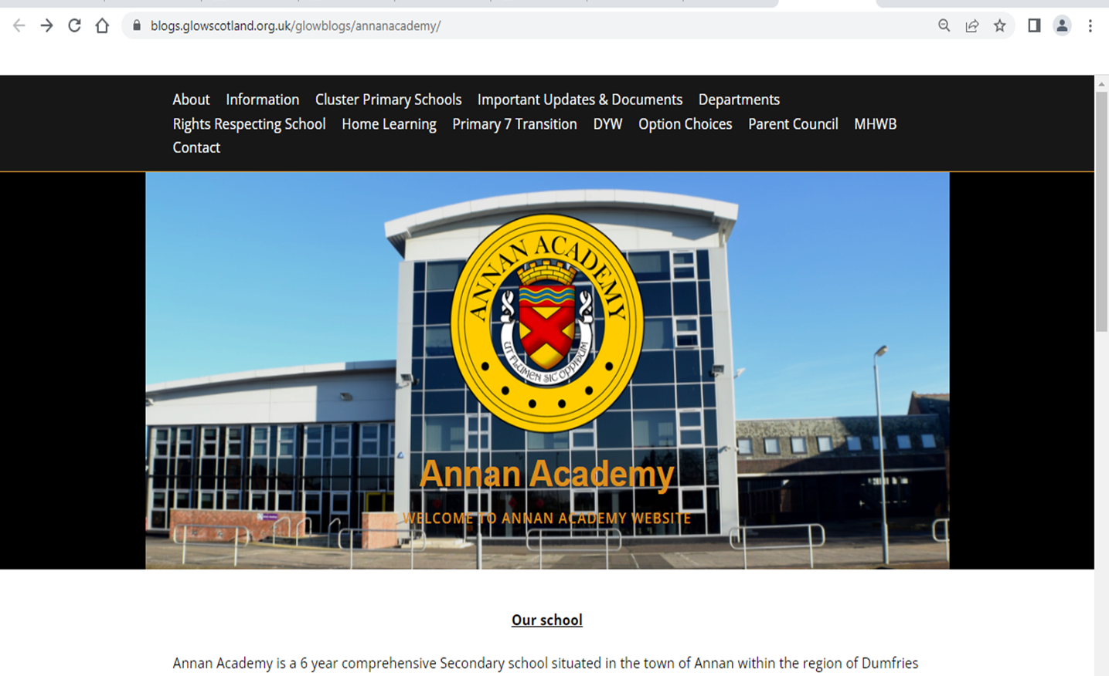
Curricular Pathways

Slide 18
MAKING SUBJECT CHOICES
Number of Subjects
In S5 pupils study 5 subjects.
In S6 pupils study up to 5 subjects.
Why choose a subject?
Career interests and plans for the future
Enjoyment
Successful
Recommendation
New Interest

Slide 19
S4 into S5 Option Form

Slide 20
S5 into S6 Option Form

Slide 22
College Courses for 2024 -2025
Annan Academy works with a number of partners to offer a variety of different qualifications.
Dumfries and Galloway College
Barony College
Dumfries Council
Southwest Connect
Scottish Borders College
YASS

Slide 23
Senior Phase Offer 23/24 | Dumfries and Galloway College (dumgal.ac.uk)

Slide 24
Study at SRUC | Courses for schools

Slide 27
Courses for pupils moving into S6
@South West Connect
Prospectus: @South-West Connects 2024/25 Digital Prospectus (cloud.microsoft)
Application Form (Opens 19th Feb 2024 and Closes 22nd March 2024): https://forms.office.com/e/pkRmQsdqBF

Slide 28
S4 into S5 Option Form

Slide 29
Deadline
S4 into S5 completed options forms are due on Monday 4th March 2024.
S5 into S6 completed option forms are due Friday 8th March 2024.

Slide 30
Advice
Get as much information and advice as you can before you make final decisions.
TALK TO US!!

