Slide 1
Presentation for Parents and S3 Students
Thursday 1st February 2024
Transfer into the Senior Phase

Slide 2
Senior Phase
Part of senior school
Pathway after S4?
Home study
Work/Social Balance
Seek advice and support

Slide 3
Senior School – February 2024
The Transfer process
The Subject choices booklet
Making subject choices
Types and level of courses available
Assessment
The Options Form

Slide 4
Options Time Line
Date | Event | Detail
During the academic session | Personal and Social Education Program – Options SDS Input | Making Decisions Stereotypes Career Fact or Fiction Delivery by Skills Development Scotland (My World of Work), this includes one to one appointment with an advisor
31/01/24 | S3 Reports Issued Senior Curriculum Information Issued PTPS information to Tutor Groups | Information regarding performance in current S3 subjects and choices for S4. Information regarding subject choices for S4 available on the school website: Option Choices – Annan Academy (glowscotland.org.uk) Principal Teacher Pupil Support visit Tutor classes to explain Subject Choice forms and answer questions
01/02/24 | Senior Phase Information Evening 6-7pm | Depute Head Teacher presentation taking parents/pupils through the process of selecting subjects to study in S4.
07/02/24 | S3 Parents’ Evening | Opportunity to meet with subject teachers, particularly with those subject’s pupils are considering for S4
08/02/24 to 19/02/24 | Meetings with Pupil Support Teacher and/or PT Additional Support | One to one pupil appointment to discuss/finalise subject choices
20/02/24 | S3 into S4 Options return deadline | Completed Curricular Plan Forms must be returned by your child to their Tutor Teacher at Tutor Time

Slide 5
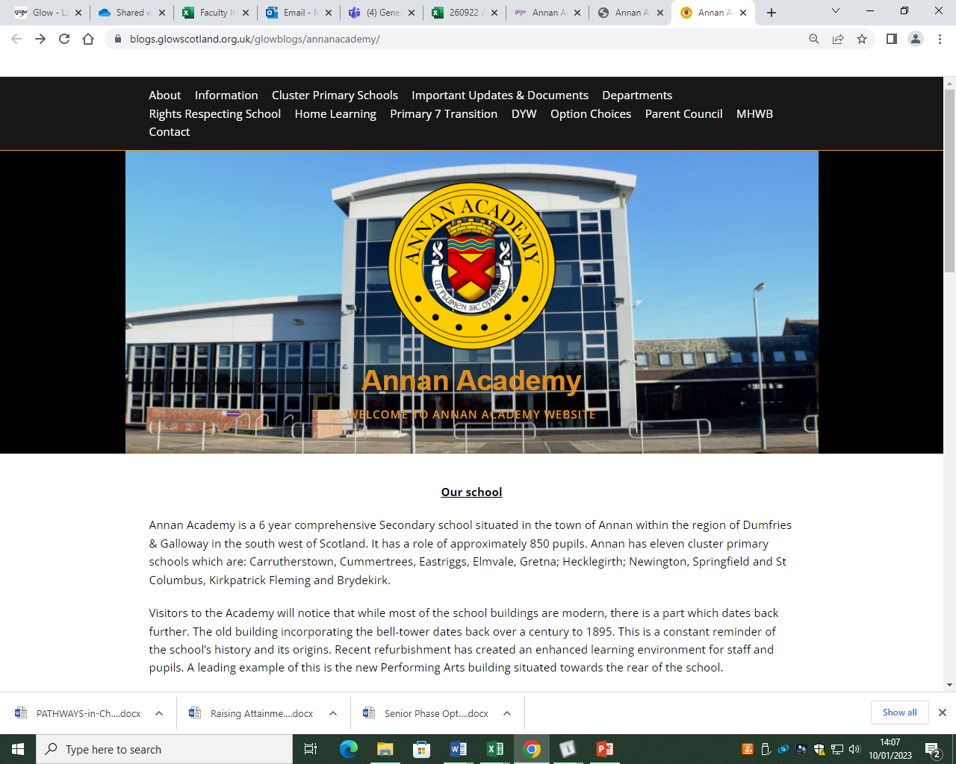
Curricular Information

Slide 6
Curricular Information

Slide 7
Senior Phase S4 – S6
New Qualification | Old Qualification | SCQF Level
Advanced Higher, Awards and Scottish Baccalaureate | Advanced Higher | 7
Higher, Awards, Skills for Work Higher, National Progression Awards, and Foundation Apprenticeships | Higher | 6
National 5, Awards, Skills for Work National 5 and National Progression Awards | S Grade – Credit, Intermediate 2 | 5
National 4, Awards, Skills for Work National 4 and National Progression Awards | S Grade – General, Intermediate 1 | 4
National 3, Awards and Skills for Work | S Grade - Foundation, Access 3 | 3
National 1, 2 and Awards | Access 1, 2 | 1, 2
https://youtube.com/shorts/zykgcRJohNE?si=p4Xv6wKWYcI2XX-6

Slide 8
National Qualifications (NQs)
These are qualifications ranging from SCQF levels 1-7 (with 7 being advanced higher). These are equivalent to the qualifications that many parents and carers would have experienced at school.
National 1 to 4 courses are all internal assessed and are awarded a pass or fail on completion.

Slide 9
National Qualifications (NQs)
National 5, Higher and Advanced Higher courses are externally assessed and graded. The assessments typically consist of a written exam or question paper and another coursework related component.
The final assessments are set, administered and most commonly marked by the SQA. NQs are graded from A-D. Notionally as follows (this may differ each year):
A = 70%+
B = 60%
C = 50%
D = 40%

Slide 10
National Progression Awards (NPAs)
NPA qualifications range from SCQF levels 1-6. NPAs are aimed at developing students’ knowledge and understanding and, where appropriate, practical experience of a given area of vocational education.
NPAs are made up of a combination of units each involving their own assessments. To achieve the award, students must successfully complete all of the units.
The main difference between an NPA and NQ is the lack of final assessment or exam.
An NPA pass is equivalent to a pass at a National Qualification. For example,
Level 5 NPA = Pass at N5
https://www.youtube.com/watch?v=RDSisrnz1gk

Slide 11
Skills for Work (SfW)
Skills for Work courses are designed with employability at the centre. They are also highly practical and experiential and a good option for pupils looking to move straight into employment after school or wanting a more work based qualification.
They are typically available at SCQF levels 4 and 5 (the equivalent of a National 4 or 5 qualification).
Skills for Work have no final assessment or exam.

Slide 12
PROGRESSION : BGE to Senior Phase
CfE Level achieved at the End of BGE (End of S3) | Level of Study on entry to S4
Level 4 or beyond | Level 5 Qualifications - National 5, Awards, Skills for Work National 5 and National Progression Awards
Level 3 | Level 4 Qualifications - National 4, Awards, Skills for Work National 4 and National Progression Awards
Level 2 | Level 3 Qualifications - National 3, Awards and Skills for Work
Level 1 | Level 2 Qualifications - National 2 and Awards

Slide 13
Curricular Pathways

Slide 14
Curricular Pathways

Slide 15
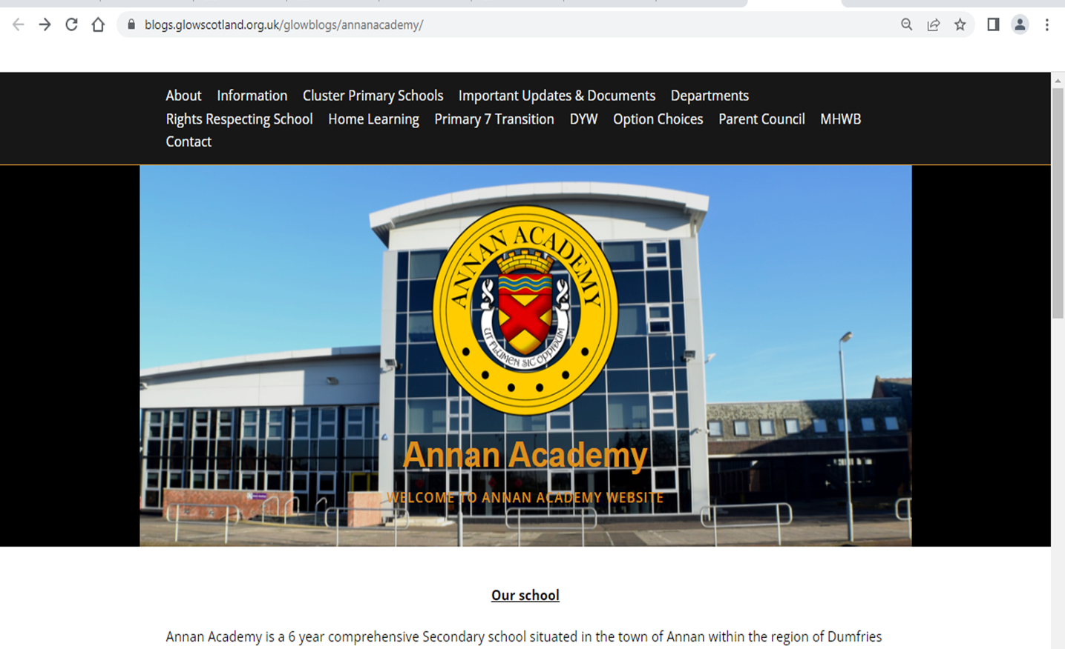
Curricular Pathways

Slide 16
MAKING SUBJECT CHOICES
Number of Subjects
In S4 pupils study 6 subjects.
In S5 pupils study 5 subjects.
In S6 pupils study up to 5 subjects.
Why choose a subject?
Career interests and plans for the future
Enjoyment
Successful
Recommendation
New Interest

Slide 17
S4 Option Form
Reminder option forms need to be completed, with the necessary sign-off signatures of teachers.
Important: our deadline is Tuesday 20th February

Slide 19
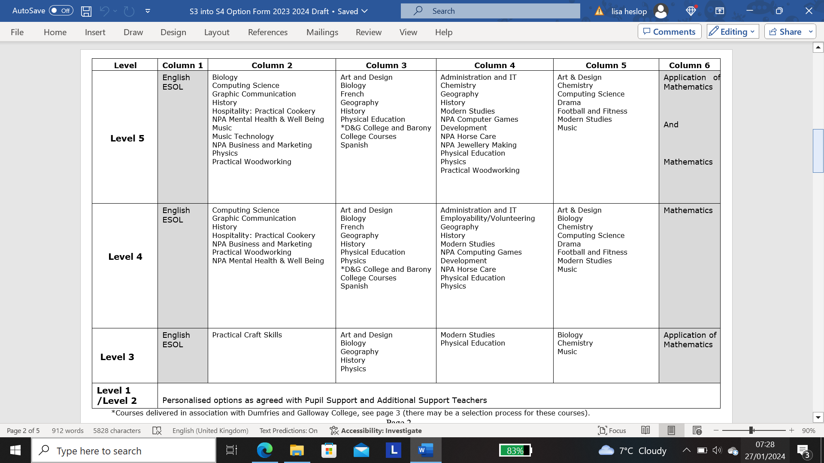

Slide 21
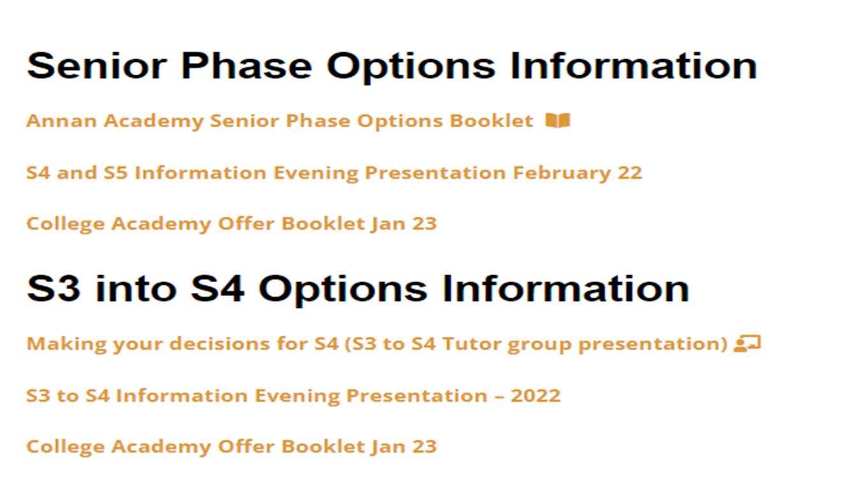

Slide 24
Advice
Get as much information and advice as you can before you make final decisions.
TALK TO US!!
Deadline – 20th February 2024

