Slide 1
AnnanAcademy.co.uk
P7/S1 Information
Evening
June 2023
Notes:
In this powerpoint we will explain how the Pupil Support and Tutor system works. We will talk about what you will be doing in your 3 day visit. We will answer any questions on your postcards but we will also answer any other questions that you hadn’t thought about until now!

Slide 2
Vision, Values & Aims
The vision at Annan Academy is that we will work together to meet the needs of every child so that they are safe, cared for and can achieve their best.
Notes:
You will have lots of subject teachers. Get them to name all the subjects they will have? Big change moving from one teacher all day to six subjects each day and up to 14 teachers over year on tt- but that is one of the good things- getting to move around classes and subjects..
Who do you go to if you need help though?

Slide 3
School Values
Notes:
You will have lots of subject teachers. Get them to name all the subjects they will have? Big change moving from one teacher all day to six subjects each day and up to 14 teachers over year on tt- but that is one of the good things- getting to move around classes and subjects..
Who do you go to if you need help though?

Slide 4
School Values
Respect We value diversity and inclusion: treating others with courtesy and working cooperatively at all times. Integrity We do the right thing at all times, and in all circumstances. We have the courage to do what is right, no matter who is watching or what the consequences may be.
Notes:
You will have lots of subject teachers. Get them to name all the subjects they will have? Big change moving from one teacher all day to six subjects each day and up to 14 teachers over year on tt- but that is one of the good things- getting to move around classes and subjects..
Who do you go to if you need help though?

Slide 5
School Values
Care We ensure we create an environment that will promote the health, welfare and safety of all young people.
Compassion We consistently treat others with empathy and understanding, supporting everyone to overcome barriers in learning and life.
Notes:
You will have lots of subject teachers. Get them to name all the subjects they will have? Big change moving from one teacher all day to six subjects each day and up to 14 teachers over year on tt- but that is one of the good things- getting to move around classes and subjects..
Who do you go to if you need help though?

Slide 6
Vision, Values & Aims
To build a nurturing school where mutual respect underpins all relationships
To provide the highest quality learning to deliver outstanding attainment
To provide a wide range of ways to celebrate the achievements of all
Notes:
You will have lots of subject teachers. Get them to name all the subjects they will have? Big change moving from one teacher all day to six subjects each day and up to 14 teachers over year on tt- but that is one of the good things- getting to move around classes and subjects..
Who do you go to if you need help though?

Slide 7
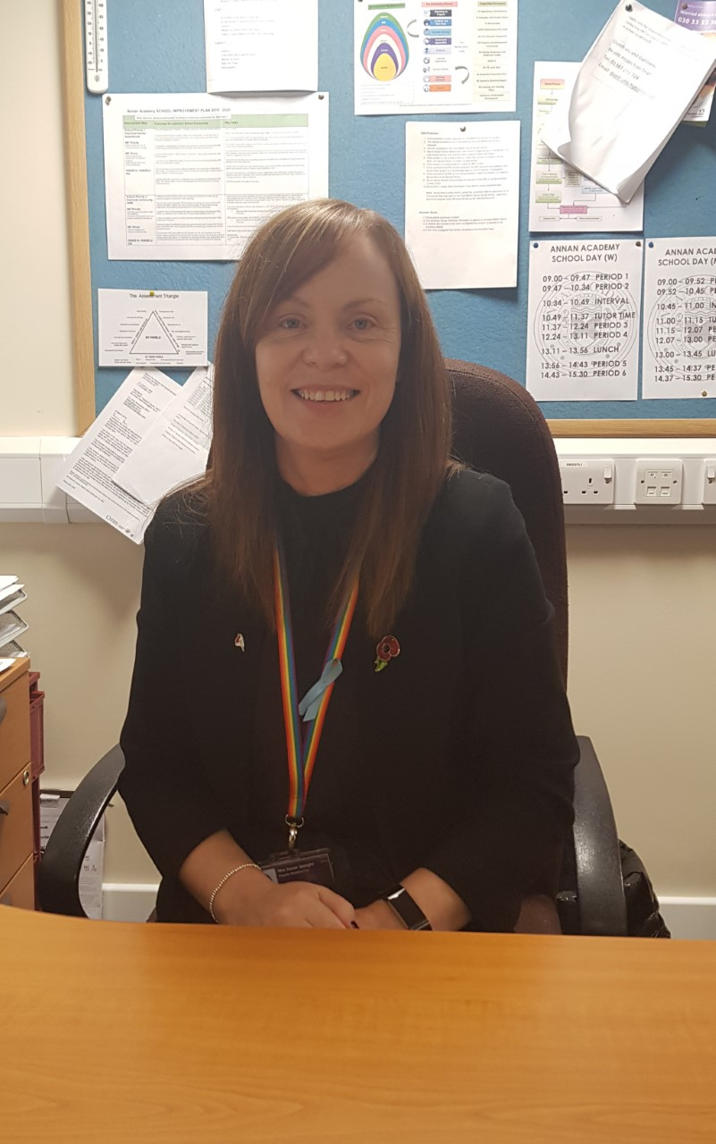
Senior Management Team
The Senior Leadership Team work hard to provide an excellent learning environment for pupils.
Mrs Speight is S1 Year Link.
Mr Murray
Mrs Speight
Mrs Clark
Ms Brown

Slide 8
Transition Process
October – December
PT transition and DHT visit all primary schools
P7 Welcome Evening
January – March
Transition meetings begin
Afternoon Event - Junior show
Transition Event – Science, English, Drama, ICT
Transition Event – Maths, Technical, PE
April – June
Extended transition sessions
PTPS visits
3 day visit
Pupil Support
Notes:
You will have lots of subject teachers. Get them to name all the subjects they will have? Big change moving from one teacher all day to six subjects each day and up to 14 teachers over year on tt- but that is one of the good things- getting to move around classes and subjects..
Who do you go to if you need help though?

Slide 9
Who will support my child?
Principal Teacher of Pupil Support (PTPS) - they have overall responsibility for your child's welfare. As they move through the secondary, they will keep the same PTPS.
Tutor teacher - Your child will see their Tutor teacher every day.
S6 Guides – Guides supported pupils during their Induction Days and will continue to do so for the first week in August.
Pupil Support
Notes:
You will have lots of subject teachers. Get them to name all the subjects they will have? Big change moving from one teacher all day to six subjects each day and up to 14 teachers over year on tt- but that is one of the good things- getting to move around classes and subjects..
Who do you go to if you need help though?

Slide 10
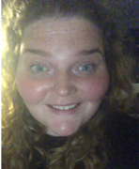
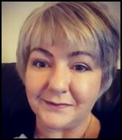
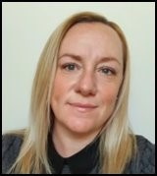
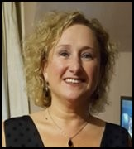
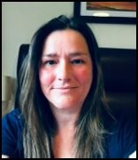
Pupil Support
Mrs Bennett Mrs Craik Mr Le Vin
(Bruce) (Bruce) (Douglas)
Mrs Whyte Mrs Jordan Miss Martin
(Hoddom) (Kinmount) (Solway)

Slide 11
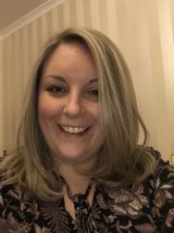
ASN
Additional Support for Learning
Mrs Wells and her team work hard to ensure every pupil has the support they need to achieve their full potential.
The base can be accessed through the library.
It is open to pupils before school and offers a breakfast club, and at social times where pupils can bring along their lunch.
Mrs Wells
Pupil Support

Slide 12
House System
Notes:
Tutor groups are allocated to the House System – if you are in 1Ba you are in Bruce House. We also have Houses called Douglas and Solway.
Explain what PSE means- in some primaries they call it PSD. Mention the changes that mean tutor time is also a lesson and not just registration.

Slide 13
Tutor
In Tutor Time pupils will have: Registration, PSE, Assemblies and other activities.
Tutor groups will be in the same classroom with the same teacher.
Tutor groups meet after morning break-time every day
4 tutor-times of 15 mins (Mon, Tues, Thurs, Fri)
Longer tutor-time on Wednesdays for PSE (47 mins)
Pupil Support

Slide 14
Pupil Voice
Have your say!
Pupil Council
Each tutor group has a Rep – Reps are used for a wide range of tasks and help to drive forward positive change in the school.
Pupil Voice

Slide 15
The School Day

Slide 16
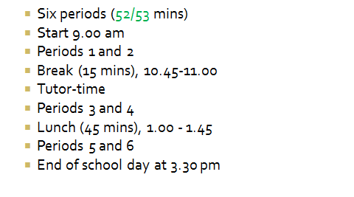
The School Day Mon/Tue/Thu/Fri
School Day

Slide 17
The School Day Wednesday
School Day

Slide 18
S1 Timetable
School Day

Slide 19
The Canteen
Young Scot cards are used to buy food at the canteen. These are topped up online and daily limits can be set. Any outstanding balance on your ipayimpact will be transferred over during the holidays.
Pupils can also pay cash, a Meal Deal which includes a main meal, side and drink costs £2. Pupils can also bring their own packed lunch.
Pupils can use their card from 8.30am until 1.45pm.
If pupils forget their card, they can still access their money by giving their name at the till.
School Day

Slide 20
The Canteen
Free school meals
Pupils receiving free school meals will have their cards automatically topped up.​
Parents/carers will need to reapply for free school meals.​
Hazel and Kerry are available in the canteen this evening to discuss ipayimpact, food allergens and school lunches.
School Day

Slide 21
School Uniform
Annan Academy tie
Black or white shirt
Black v-neck jumper or cardigan
Black trousers or skirt
Predominantly black shoes
Recent updates
Plain black joggers, combat trousers and leggings are now acceptable forms of school clothing
Leggings – should not have any see-through panels and should be entirely black
Black school branded hooded tops

Slide 22
School Transport
Pupils should get on the same bus as they did for Induction Days.
Pupils will receive their bus pass on day 1 of new term (issued at school).
If a bus pass is lost, replacement can be bought at school office (£1).
Pupils should carry bus pass every day to show to driver.

Slide 23
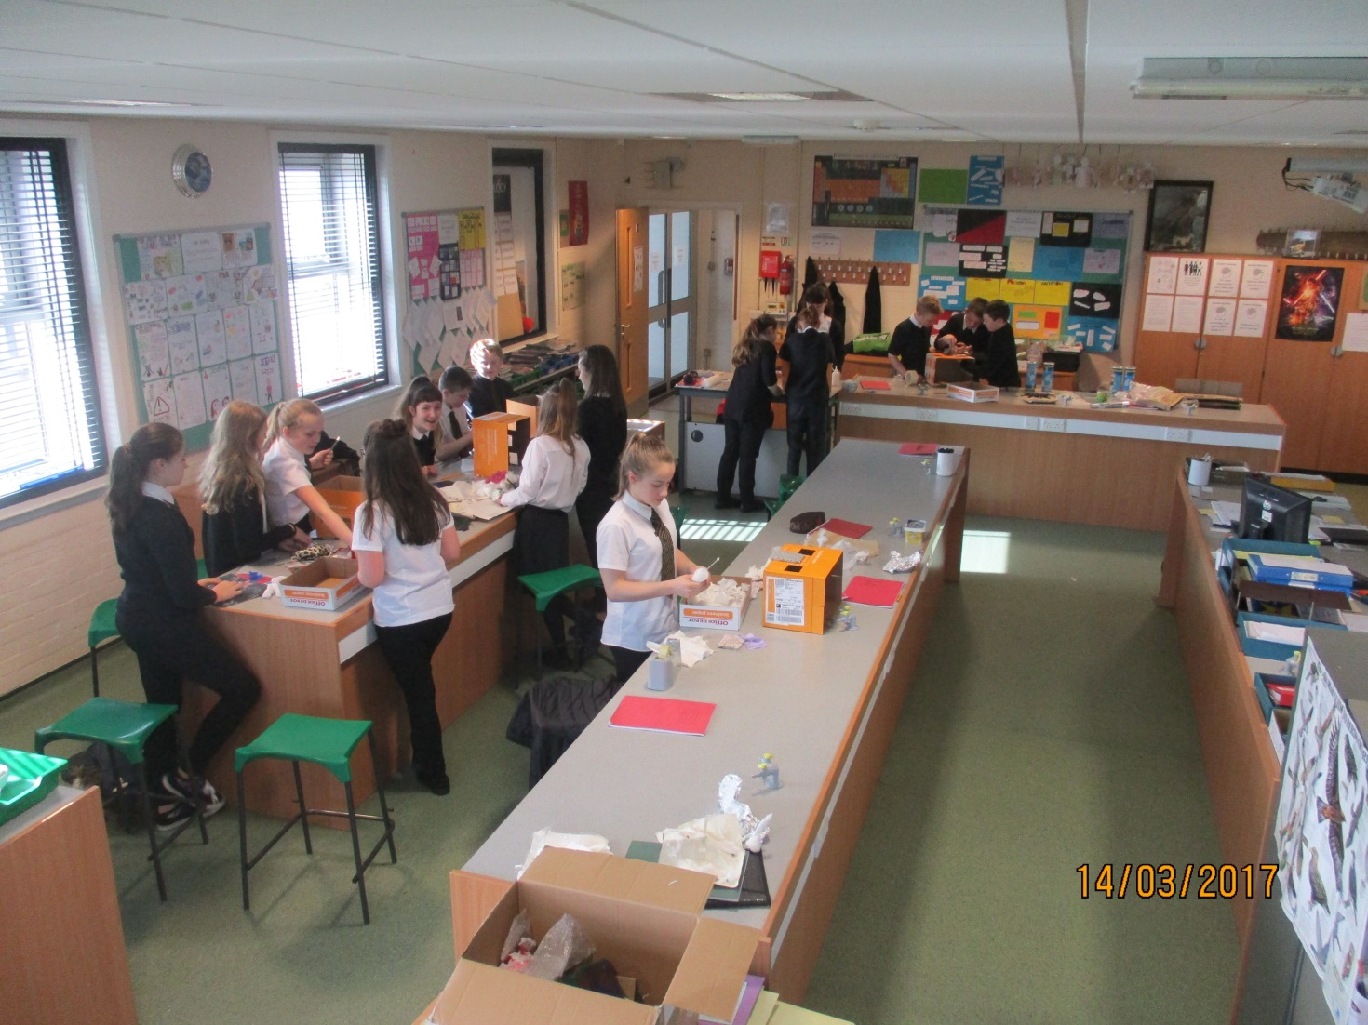
Broad General Education S1 and S2 – pupils study all subjects
Curriculum

Slide 24
S1 Curriculum Areas
Craft and Design
English and Languages

Slide 25
S1 Curriculum Areas
Expressive Arts
Health and Wellbeing

Slide 26
S1 Curriculum Areas
Maths
Science

Slide 27
S1 Curriculum Areas
Social Subjects
Technologies

Slide 28
Beyond the Classroom

Slide 29
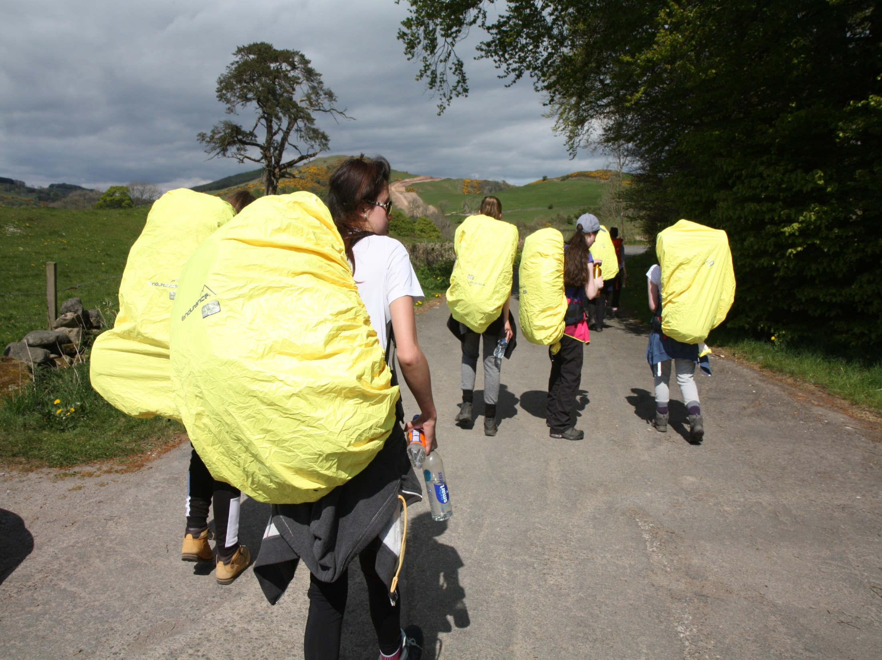
Duke of Edinburgh Award

Slide 30
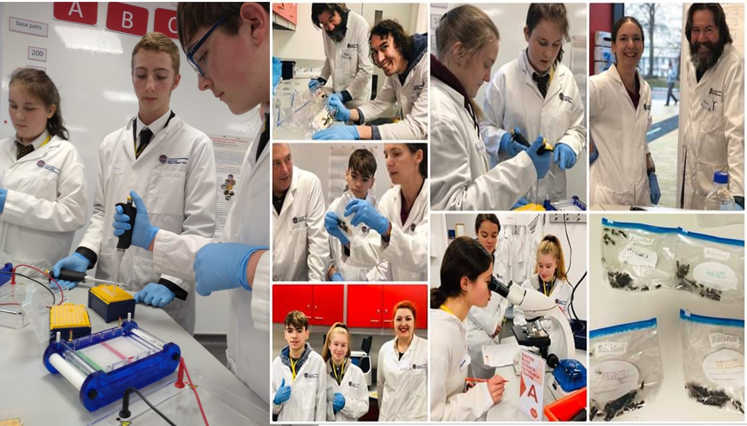
Science Club

Slide 31
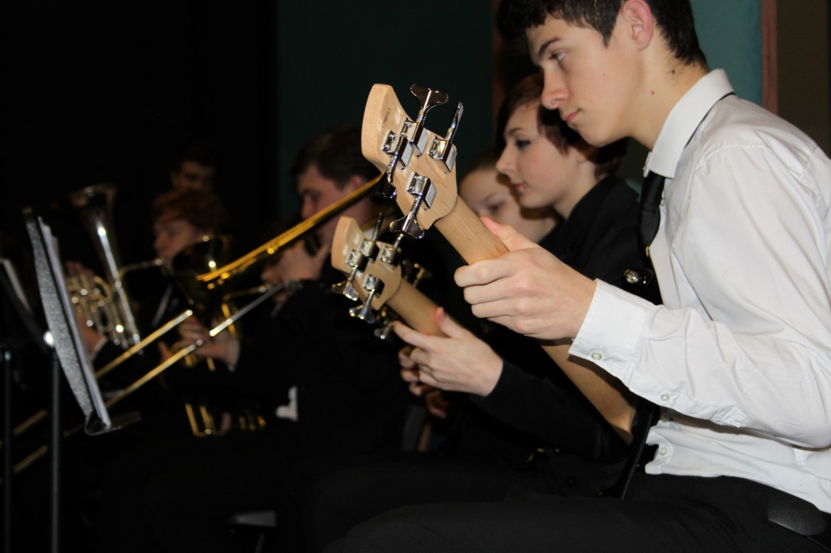
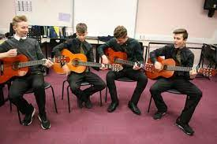
School Band and music groups

Slide 32
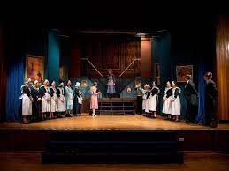
School Shows

Slide 33
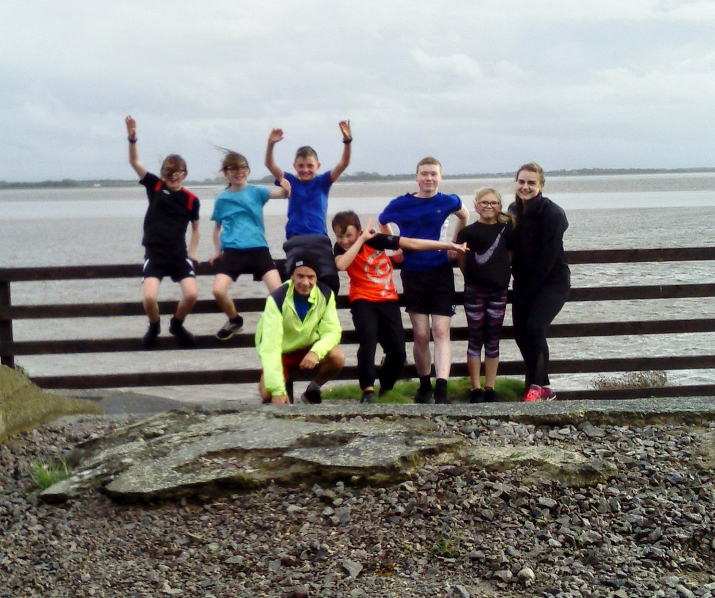
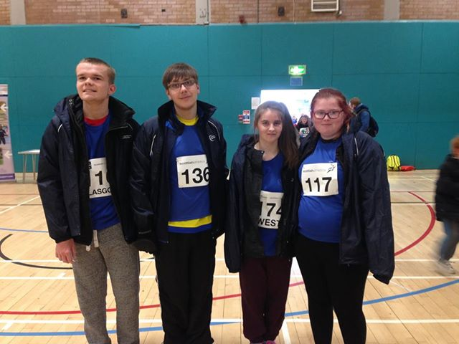
Sports Clubs

Slide 34
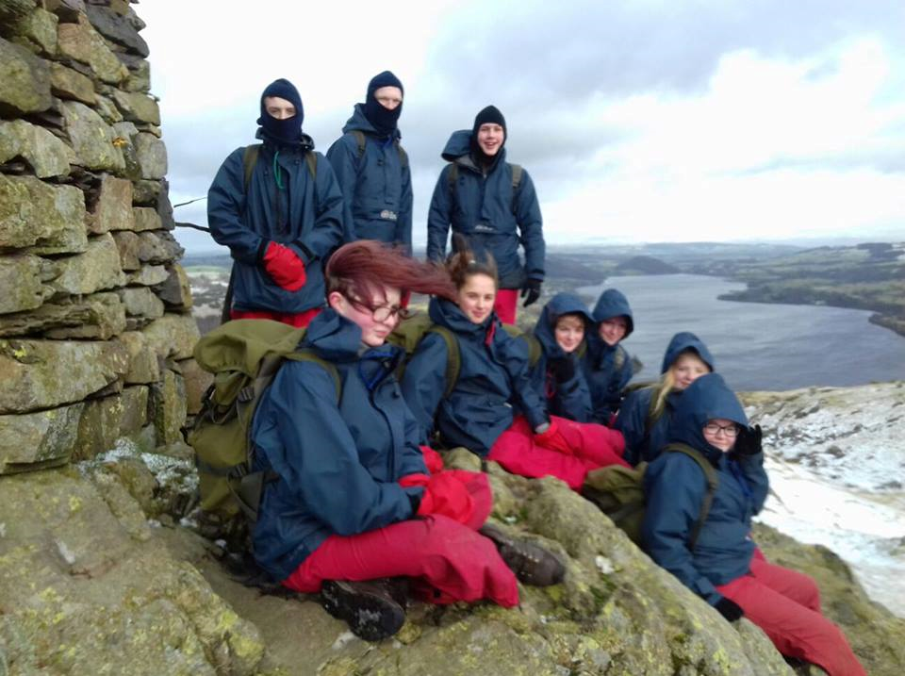
Trips

Slide 35
https://blogs.glowscotland.org.uk/glowblogs/annanacademy/
Notes:
Question time.. Blue postcards or questions from the floor.

