Slide 1
Annan Academy Languages Department
P7 Induction week 2020

Slide 2
Welcome to the Languages Department
Teachers:
Ms Brown
Mrs Chistyakova
Mr Macanulty
Mr O'Halloran
Location in school:
Classrooms are based on the THIRD FLOOR of the main building
Periods of Languages per week in S1:
2 periods French
1 period German

Slide 3
What Languages will I learn at Annan Academy?
First Year:
French
German
Second Year:
French
German
Third Year:
I period of Languages per week is compulsory
You can also choose French or German for 3 periods a week
Short courses are also on offer (called Electives) in Gaelic, Italian and Spanish

Slide 4
How will I learn Languages at Annan Academy?
You will develop understanding of languages through reading, talking, listening and writing in French and German
You will use a range of resources like textbooks, ICT and interactive approaches like games, language websites and media
You will also have opportunities to practice using French for use in real life situations

Slide 5
Why do we learn languages?
Languages are highly valued by employers and colleges and universities
Learning a language such as French helps you understand the English language even more!
French is used in many international organisations, such as NATO, the UN, EU institutions, and the World Trade Organisation. It is considered the international language of law and diplomacy
The German language is the first language of over 100 million people who primarily live in Germany, Austria and Switzerland. These countries are highly developed and economically strong, which makes them attractive locations for work and living.
Possible careers include travel and tourism, hospitality, translator/interpreter, law, medicine, finance, engineering, business and enterprise, international organisations, media and broadcasting, marketing and sales, retail, politics, diplomacy, social media, teaching and so on…

Slide 6
Induction week Tasks
On the next slides there will be tasks to do linked to 4 languages
French
German
Gaelic
Spanish
Choose 1 of the Languages and complete the tasks (you can do all 4 if you wish!)
Share your work with your household/friends and discuss what you have found
There are optional challenges (a treasure hunt) for you to complete for each language also

Slide 7
French

Slide 8
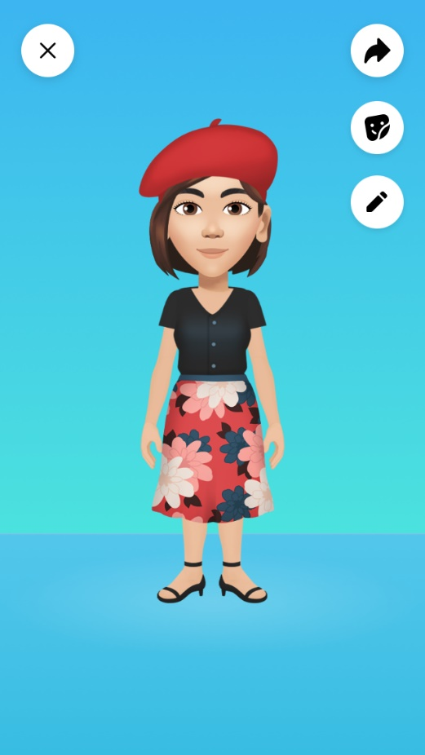
Bonjour et Bienvenue à Annan Academy! Nous attendons Votre arrivée avec impatience ☺
Voici quelques infos sur S1 Français, un petit projet et même un défi (pour toute la famille?) A bientôt!
Hello & welcome to Annan Academy! We can’t wait for you to arrive☺
Here is some information about S1 French, a little research project & even a challenge (for the whole family?) See you soon!
Modern Languages Department

Slide 9
In S1 French you practise your French listening, reading, speaking and writing with each other so that you feel more confident to communicate in French. Speaking another language is an important life skill ; your aim is to give speaking French a go, not worry about making mistakes & it’s our job to help you do this!
You will learn to use/understand language about:
your school life (school subjects; your likes & dislikes; things you need for school & your school routine)
new technology (what technology you have, what you & your family use it for; the (dis)advantages of new technology)
family life & free time ( family members, what you do as a family, you hobbies, what there us to do where you live)
Your S1 transition project for French is to: do some cultural research so that you know more about France & the French.
Task: research & note some facts on the following people or things:
Louis Braille & Joan of Arc (What are they famous for? Where are they from? etc.)
The city of Marseille (Where is it? Famous sights are there? Famous people from here? etc.)
Versailles (Where is it? What is it? who lived there? etc.)
The dish ‘cassoulet’ & the dessert ‘ tarte tatin’ (What the ingredients are? What it looks like? etc.)
Your challenge, if you wish to do it, is on the next slide!

Slide 10
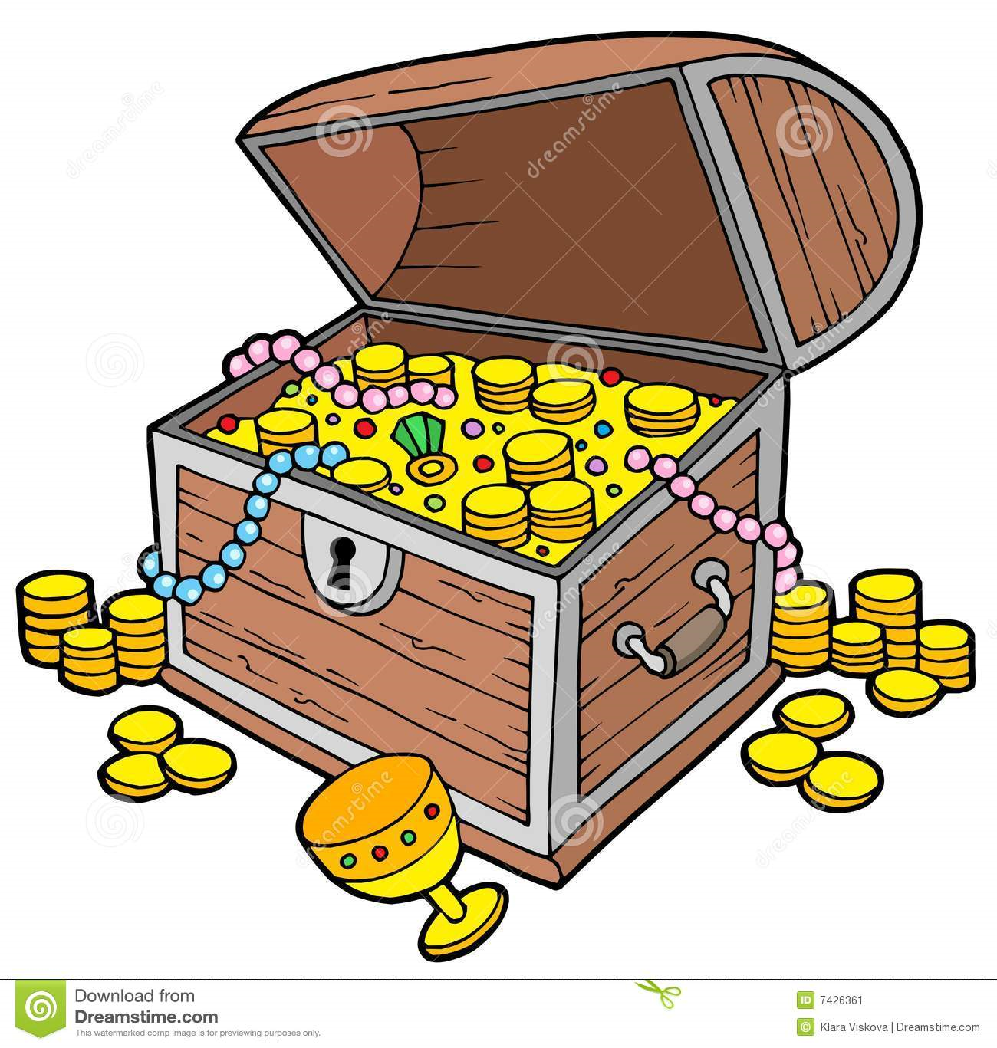
#défi (= challenge)
La Chasse au trésor
(Treasure hunt)
You can complete this challenge on your daily exercise with your family:
Read the list of French words.
You have to work out what these words mean in English
Prove it by taking a photo of each one in order on a phone. (your teacher can check this when you come to school ☺)
1.un arbre 7. une poubelle
2.une voiture rouge 8. une glace au chocolat
3.un drapeau écossais 9. des bonbons
4.un arrêt d’autobus 10. une église
5.une vache 11. une pierre /un caillou peint(e) à la main
6. un vélo noir 12. des lunettes de soleil

Slide 11
German

Slide 12
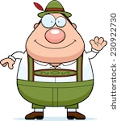
Hallo und willkommen an der Annan Academy! Wir freuen uns wirklich darauf, euch zu sehen. Hier findet ihr einige Angaben über Deutsch in S1, ein kleines Projekt zu recherchieren und sogar eine Aufgabe, die vielleicht eine Herausforderung für die ganze Familie sein könnte. Bis bald!
Hello & welcome to Annan Academy! We are really looking forward to seeing you.
Here is some information about S1 German a little research project & even a challenge (for the whole family?) See you soon!
Modern Languages Department

Slide 13
In your S1 German class, you will be presented with new language and we will then practise it using the skills of listening, speaking, reading and writing. As with the other languages, it’s important to try to communicate without worrying so much about mistakes, which you can gradually correct. You improve with practice and so does your confidence!
You will learn to understand and use language about: Introductions: greetings, name, numbers, age, where you live, colours, dates, birthday,
School: school equipment, school subjects and favourites, school timetable, 24-hour clock, giving opinions about subjects, saying what year you are in, types of school, describing the school building, describing clothing and school uniform.
Your S1 transition project for German is to do some cultural, research so that you know more about German-speaking countries.
Task: Research and note some facts about the following people or things:
1 Alexander von Humboldt and Angela Merkel (What did they achieve? Where did they live? etc)
2 The city of Vienna (Where is it? What sights are there?, Famous people from here, etc)
3 Neuschwanstein (What is it? Where is it? Who lived there?)
4 The dish “Schweinsbraten mit Knödeln” and the dessert “Schwarzwälder Kirschtorte” (What are the ingerdients? What does it look like?, etc)
Your challenge, if you wish to do it, is on the next slide!

Slide 14
Herausforderung:
Schatzsuche
(Challenge:Treasure hunt)
You can complete this challenge on your daily exercise with your family:
Read the list of German words.
You have to work out what these words mean in English
Prove it by taking a photo of each one in order on a phone. (your teacher can check this when you come to school ☺)
1 ein Zaun 7 ein Schmetterling
2 ein Fenster 8 eine gelbe Blume
3 eine Schule 9 ein LKW
4 ein Parkplatz 10 ein Pferd
5 ein Briefkasten 11 ein Bach oder Fluss
6 eine Biene 12 ein Strommast

Slide 15
Gaelic

Slide 16
Halò is fàilte gu Annan Academy! Tha sinn a’ dèanmah fiughair ri bhith gad fhaicinn. ☺ Seo fiosrachadh mun Ghàidhlig, pròiseact beag is fiù’s dhùbhain (dhan teaghlach air fad?) ¡Tìorraidh!
Hello & welcome to Annan Academy! We can’t wait to see you ☺ Here is some information about Gaelic, a little research project & even a challenge (for the whole family?) See you soon!
Modern Languages Department

Slide 17
In Gaelic you practise your Gaelic listening, reading, speaking and writing with each other so that you feel more confident to communicate in Gaelic. Speaking another language is an important life skill ; your aim is to give speaking Gaelic a go, not worry about making mistakes & it’s our job to help you do this!
You will learn to use/understand language about:
your school life (school subjects; your likes & dislikes; things you need for school & your school routine)
new technology (what technology you have, what you & your family use it for; the (dis)advantages of new technology)
family life & free time ( family members, what you do as a family, you hobbies, what there us to do where you live)
Your S1 transition project for Gaelic is to: do some cultural research so that you know more about Gaelic and Gaelic-speaking people.
Task: research & note some facts on the following people or things:
Màiri Mhòr nan Òran and Calum Cille (What are they famous for? Where are they from? etc.)
The island of Barra (Where is it? Famous sights are there? Famous people from here? etc.)
Castle Urquhart (Where is it? What is it? who lived there? etc.)
The dish ‘ceann cropaig’ & the drink ‘uisge-beatha’ (What the ingredients are? What it looks like? etc.)
Your challenge, if you wish to do it, is on the next slide!

Slide 18
#dùbhlain (= challenge)
Lorg-Ulaidh
(Treasure hunt)
You can complete this challenge on your daily exercise with your family:
Read the list of Gaelic words.
You have to work out what these words mean in English
Prove it by taking a photo of each one in order on a phone. (your teacher can check this when you come to school ☺)
1.taigh 7.beinn
2.bùth 8.uinneag
3.càr 9. bàta
4.eilean 10.nighean
5.eaglais 11.duilleag
6.doras 12.dealbh

Slide 19
Spanish

Slide 20
¡Hola y bienvenidos a Annan Academy! Tenemos unas ganas de verte. ☺ Aquí tienes información acerca del español, un pequeño proyecto y hasta un desafío (¿para toda la familia?) ¡Hasta pronto!
Hello & welcome to Annan Academy! We can’t wait to see you ☺ Here is some information about Spanish, a little research project & even a challenge (for the whole family?) See you soon!
Modern Languages Department

Slide 21
In Spanish you practise your Spanish listening, reading, speaking and writing with each other so that you feel more confident to communicate in Spanish. Speaking another language is an important life skill ; your aim is to give speaking Spanish a go, not worry about making mistakes & it’s our job to help you do this!
You will learn to use/understand language about:
your school life (school subjects; your likes & dislikes; things you need for school & your school routine)
new technology (what technology you have, what you & your family use it for; the (dis)advantages of new technology)
family life & free time ( family members, what you do as a family, you hobbies, what there us to do where you live)
Your S1 transition project for Spanish is to: do some cultural research so that you know more about Spanish and the Spanish-speaking world.
Task: research & note some facts on the following people or things:
Shakira and El Cid (What are they famous for? Where are they from? etc.)
The city of Buenos Aires (Where is it? Famous sights are there? Famous people from here? etc.)
The Alhambra (Where is it? What is it? who lived there? etc.)
The dish ‘paella’ & the dessert ‘ crema catalana’ (What the ingredients are? What it looks like? etc.)
Your challenge, if you wish to do it, is on the next slide!

Slide 22
#desafío (= challenge)
La Búsqueda del Tesoro
(Treasure hunt)
You can complete this challenge on your daily exercise with your family:
Read the list of Spanish words.
You have to work out what these words mean in English
Prove it by taking a photo of each one in order on a phone. (your teacher can check this when you come to school ☺)
1.un perro 7. una lata de Irn Bru
2.una mesa 8. una radio
3.un televisor 9. un gato
4.un cine 10. una escuela
5.una mujer inteligente 11. un dibujo de un arco iris
6. un coche rojo 12. una puerta

Slide 23
We hope you have enjoyed your introduction to languages at Annan Academy and we are very much looking forward to seeing you next term!
Au revoir Auf Wiedersehen
Beannachd leat Hasta la vista!

