Slide 1


Welcome to English

Slide 2


Your English teachers...
Ms Brown
Mrs Craik
Mrs Farnhill
Mrs Johnston
Miss MacArthur
Mrs Whyte

Slide 3
What is English?
In English we develop our skills of reading, writing, speaking and listening.
We learn to think more deeply and to ask questions about things.
We often do this through the study of books, plays, poems, news articles, film and other media texts.

Slide 4
S1 English Course Overview
S1 | August to Oct Holiday | October to Christmas | Jan to Feb Holiday | Feb to Easter | Easter to new TT | June – now S2
Unit | Me | Prose/Drama/Media | Poetry | Prose/Drama/Media | Persuasive Writing | Free Choice
Purpose | Getting to know new students. Introduction revision of personal/reflective writing techniques Presentation skills. | Enjoyment of reading/viewing prose/drama/media Introduction to and revision of analytical skills. | Introduction to poetic form and content. | Enjoyment of reading/viewing prose/drama/media Development of analytical skills. | Persuasive language techniques Research and note taking | This is an opportunity for the class, in consultation with the teacher, to choose what they would like to do next.
Key Skills to be covered in this unit. Teacher can add to this, depending on the needs of the class. | Writing Reflective techniques Creation of “voice” Writing about feelings Purpose/audience Talking Volume/pace Body Language Purpose/audience | Reading Understanding writer/ film-maker’s craft: plot, character, setting theme… Analysis of writer’s/filmmaker’s technique. Writing Selection and use of quotations/evidence. Listening & Talking Group discussion | Reading Poetic forms eg: acrostic, haiku, ballad Rhythm Rhyme scheme Imagery Sound techniques Writing Review and editing process Purpose/audience | Reading Understanding writer/ film-maker’s craft: plot, character, setting and theme… Analysis of writer’s/filmmaker’s technique. Writing Selection and use of quotations/evidence. Listening & Talking Group discussion | Listening/Reading Selecting ideas, note taking Writing Structure Content Tone/language Purpose/audience Talking Debating skills | It might be used to: Go over a topic that needs more work Revisit an area that the class enjoy arrange external visits cover any remaining Es & Os

Slide 5




Here are some texts you might study in English...

Slide 6
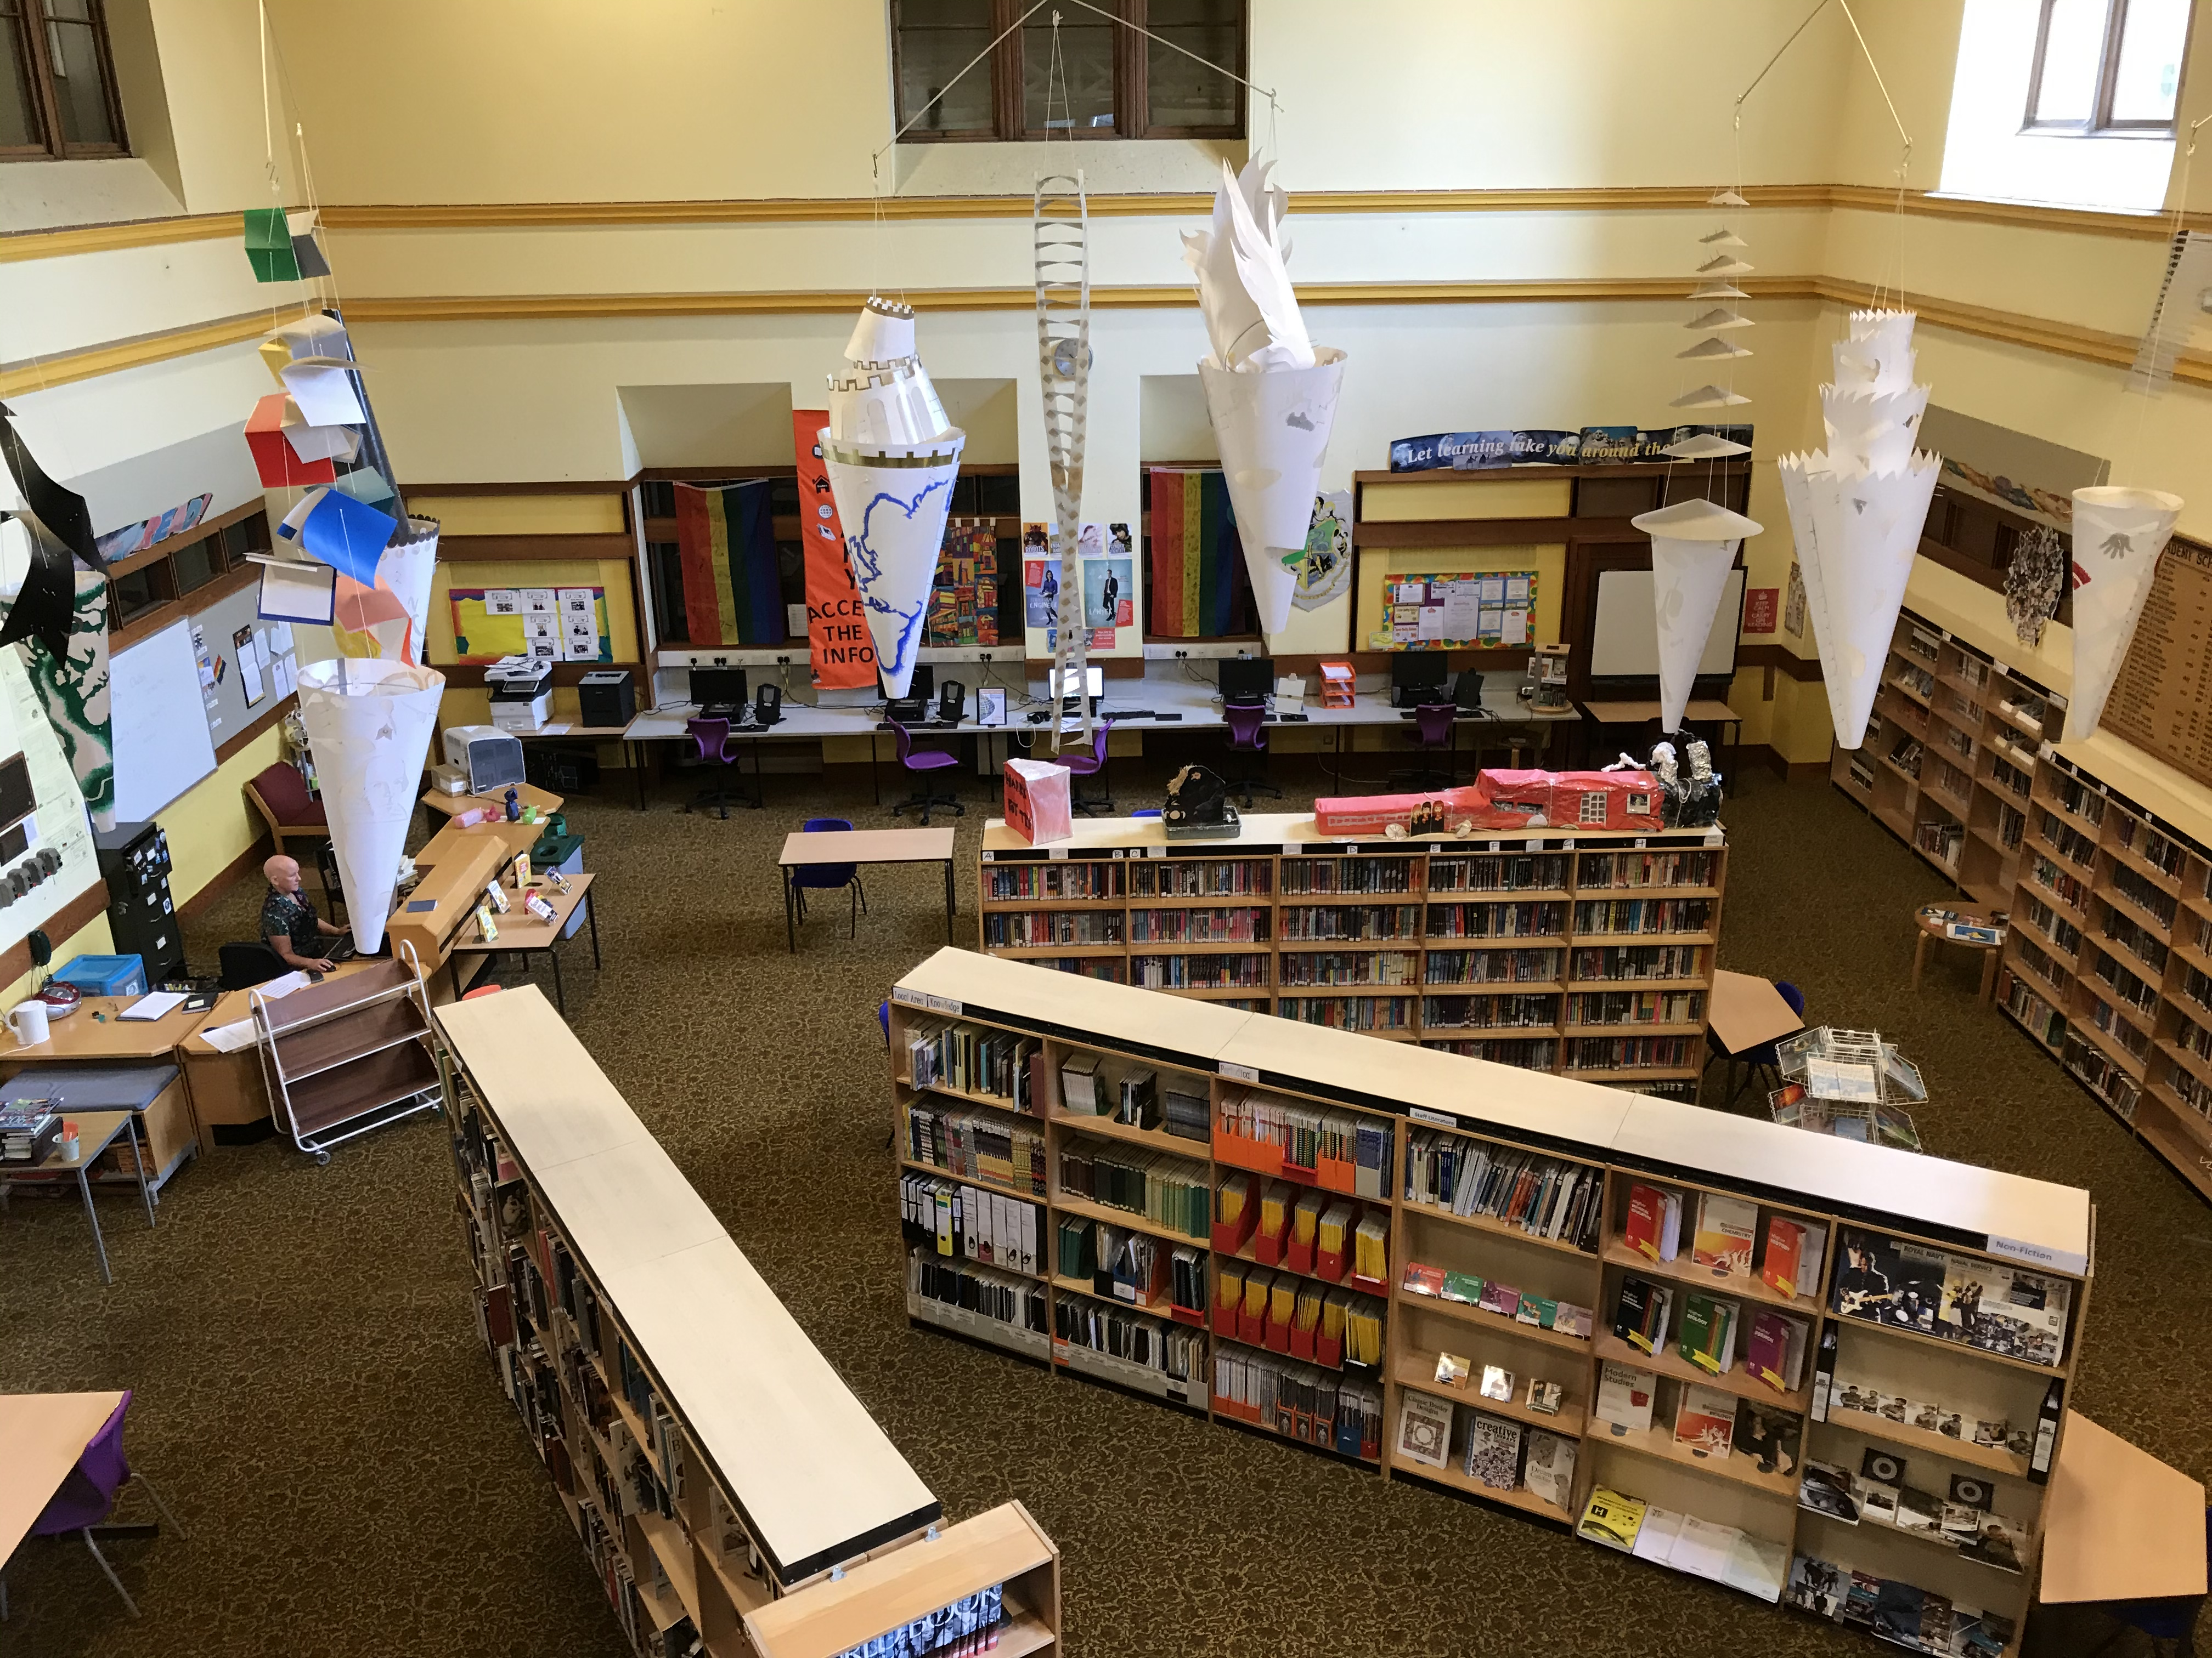
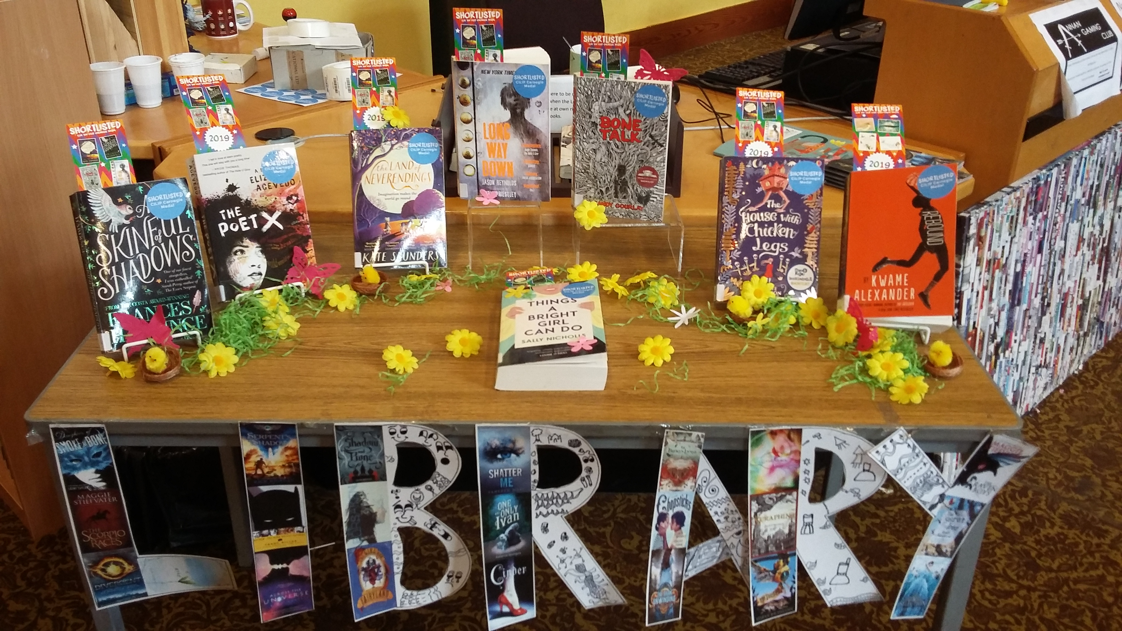
School library
In English we work closely with the school library and with Mrs Nixon our school librarian. You will have one library period every fortnight.
As well as reading we will learn new skills to help us use the library effectively.
We will encourage you to read widely and to read for pleasure. You can record what you read in your reading record – and earn certificates at bronze, silver, gold and platinum level.
photo/s here

Slide 7
English department blog
You can find out lots more about English at Annan Academy HERE

Slide 8

Task 1:
Reading Challenge

Slide 9
Task 1: Reading Challenge
You can read: books, audio books, eBooks, a reading app if you have one...
Here are some useful links to help you find things to read online:
https://stories.audible.com/discovery
https://www.oxfordowl.co.uk/for-home/find-a-book/library-page/
https://www.getepic.com/
https://www.gutenberg.org

Slide 10
Task 2:
Writing Challenge

Slide 11
10-minute creative writing task
On the next slide there is a creative writing task.
The rules are simple:
  You have TEN minutes.
  Your writing must be CREATIVE, IMAGINATIVE and INTERESTING.
Follow the instructions on the slides.
If you can persuade other members of your household to join in, when the 10 minutes are up, share what you have written and award a prize for the most creative, imaginative and interesting piece of writing.
You can then choose to follow the extension suggestions and let your imagination go further.

Slide 12
10-minute creative writing task
You find a treasure map! Wow!
Either write about how the treasure came to be buried or write about when and how it was discovered.
You can write in any way you wish: a short story, a diary entry, a series of WhatsApp messages, an email, a letter in a bottle etc.
The only limit is your imagination.
Once the 10 minutes are up you might want to continue your story with what happens next. Of course, you could create your own treasure map and stain it with tea or coffee to make it look old.

Slide 13
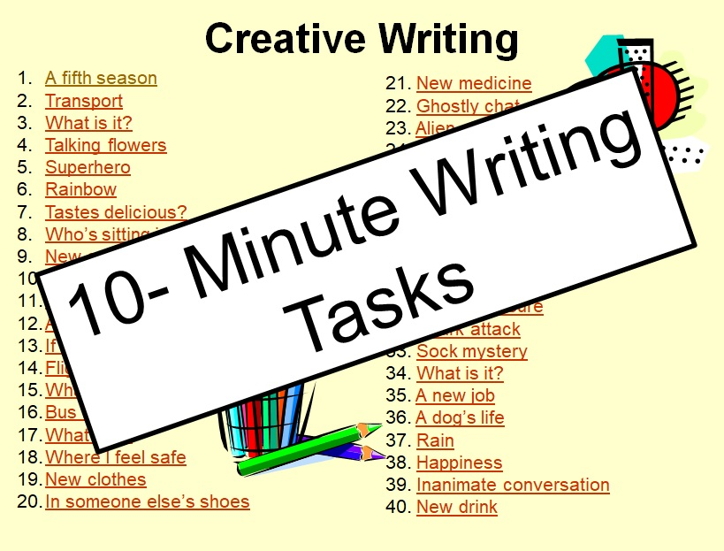
10-minute creative writing tasks
You can find more 10-Minute Creative Writing Tasks on the Annan Academy English Department blog.
Have fun being CREATIVE, IMAGINATIVE and INTERESTING.
https://annanacademyenglishdepartment.wordpress.com/online-learning/bge-s1-s3/

Slide 14
Task 3: Talking Challenge

Slide 15

Task 3: Talking Challenge
Can you talk for one minute about what you will study at Annan Academy?
Rules:
NO HESITATION
NO REPETITION
Get yourself a timer and someone to listen to you.
If you hesitate or repeat then you have to start your minute again!

Slide 16
Summer Reading Challenge

Slide 17
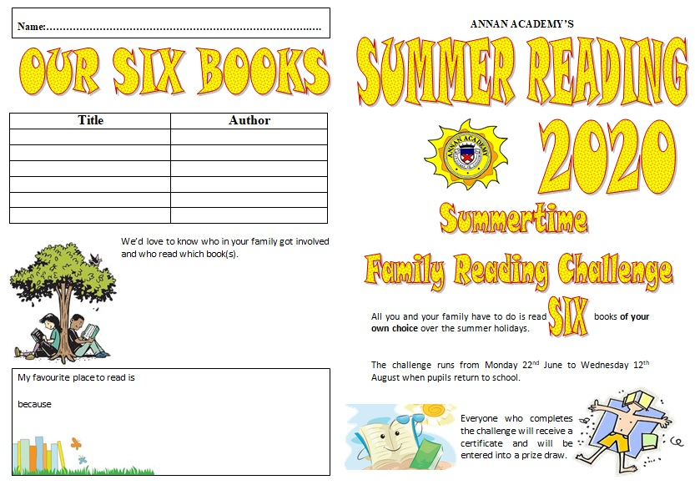
Annan Academy 2020
Summer Reading Challenge
You can either take on the Summer Reading Challenge by yourself or get the whole family involved. All you have to do is read 6 books before the schools open to pupils on August 12th.
Click on the link below for your Reading Challenge booklet.
https://annanacademyenglishdepartment.wordpress.com/online-learning/

Slide 18
See you all soon!
We hope you have enjoyed a little taster of Annan Academy English Department and we are really looking forward to meeting you all again in august.
Stay safe and keep reading!

