Slide 1

Welcome all new S1 pupils!
We are all really looking forward to meeting you.

Slide 2

Meet our staff
In Social Subjects there are 9 staff members.
Mrs Buchanan (PTC)
Mr Bremner
Miss Carruthers
Mrs Clark (DHT)
Mrs Dalziel (Acting DHT)
Mrs Galbraith
Miss Johnston
Miss Russell (Acting PTC Languages)
Mr Shepherd

Slide 3

What do we study in Social Subjects?
Uncover the images on the next four slides.
Can you guess what subjects we study?

Slide 4


Slide 5
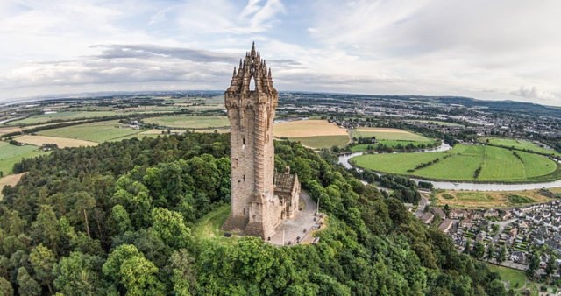

Slide 6
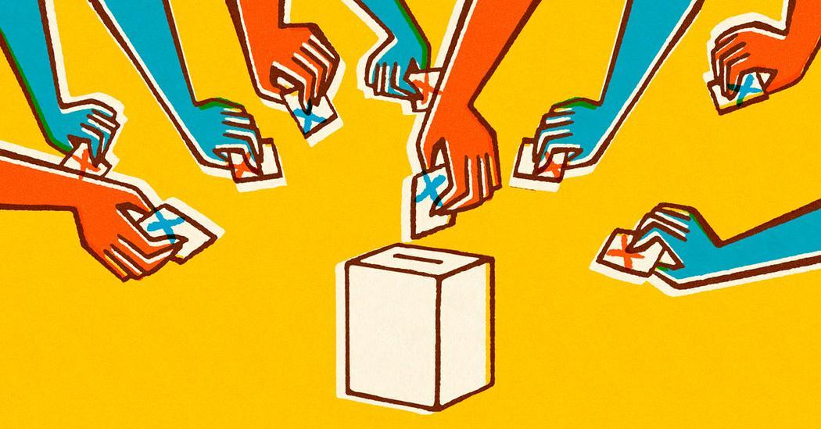

Slide 7


Slide 8

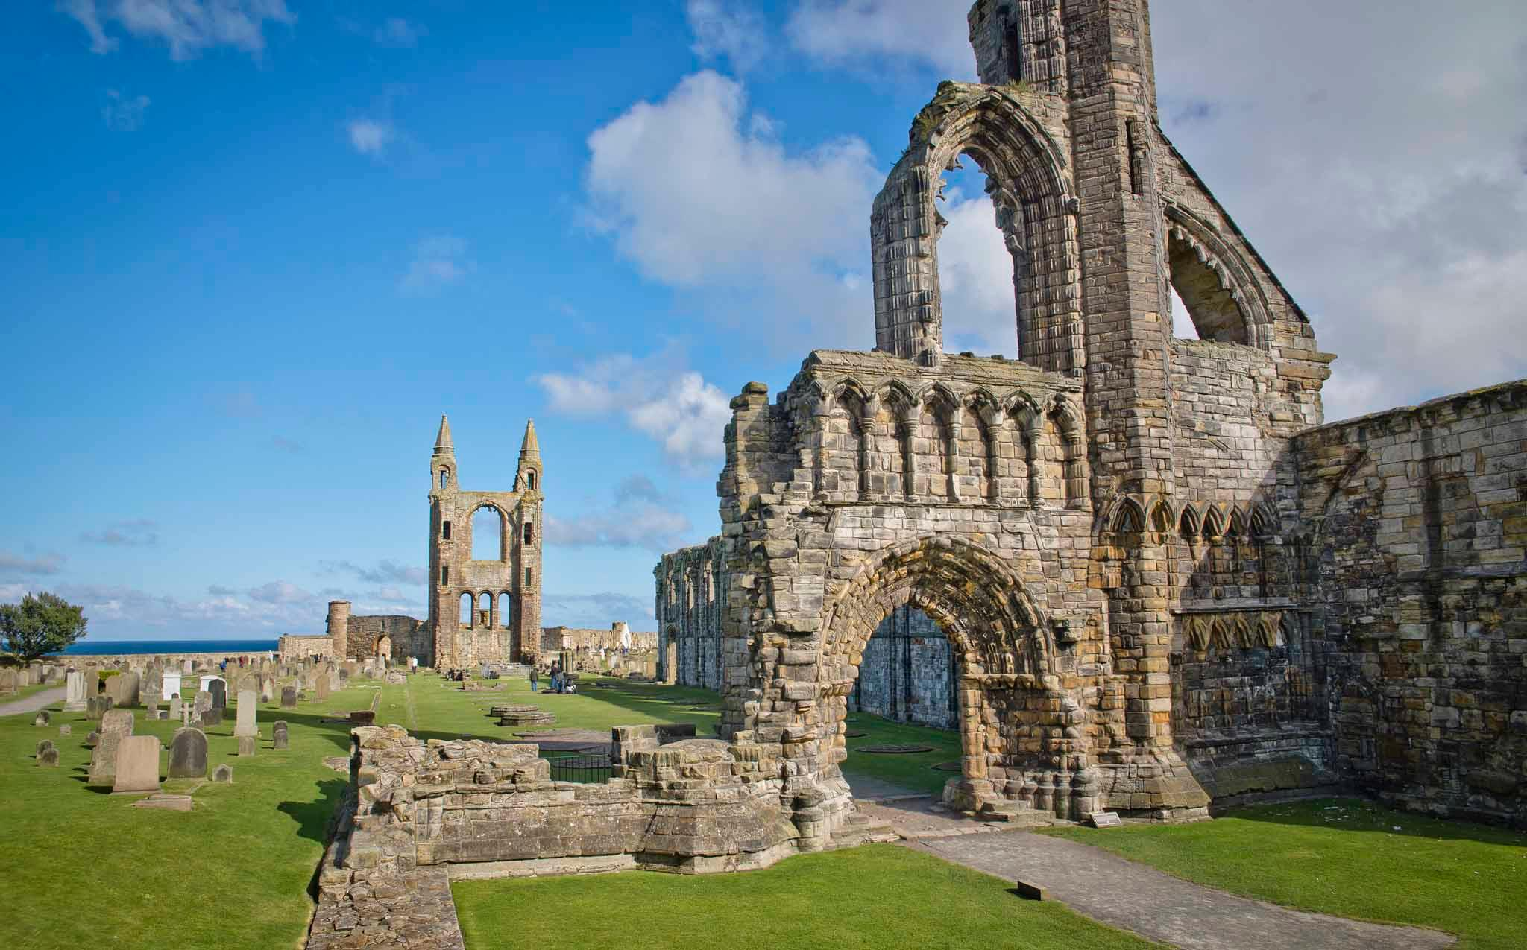
What do we study in Social Subjects?
Geography
History
Modern Studies
RMPS
Notes:
Landscape
Natural disasters
Development proposals – shopping centre
Farming
Transport – journeys
Local area

Slide 9
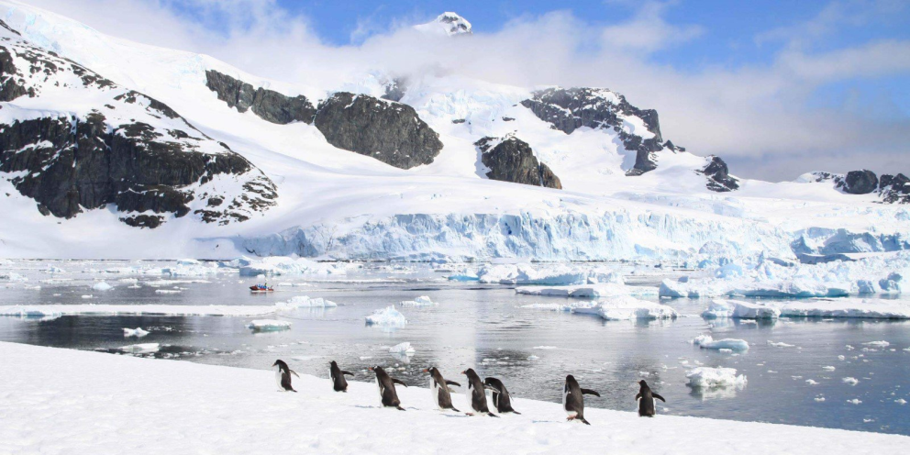

Geography – Topics covered in S1
Map Skills
Weather
Hurricanes
Scotland
Antarctica

Slide 10
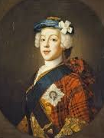

History – Topics covered in S1
Scottish Wars of Independence
Union of the Crowns
Jacobites
Notes:
Chronology - Timelines
Tudors
Victorians
Egyptians
Romans
MQS
Wars of Independence – Wallace & Bruce

Slide 11
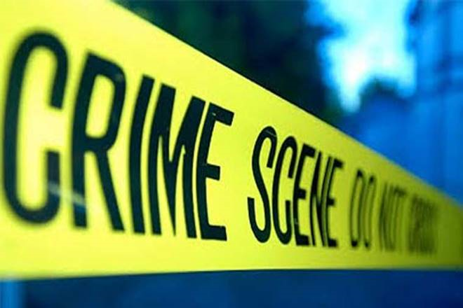
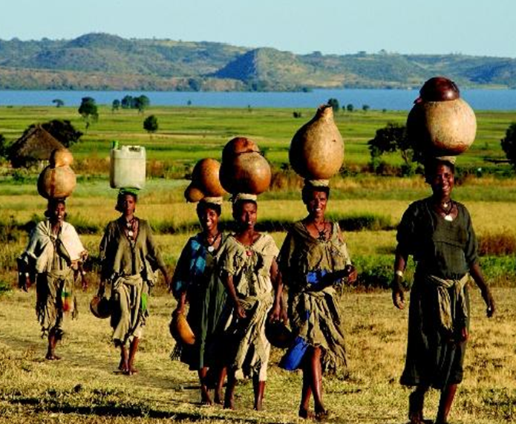
Modern Studies – Topics covered in S1
Crime and Law
Development in Africa

Slide 12
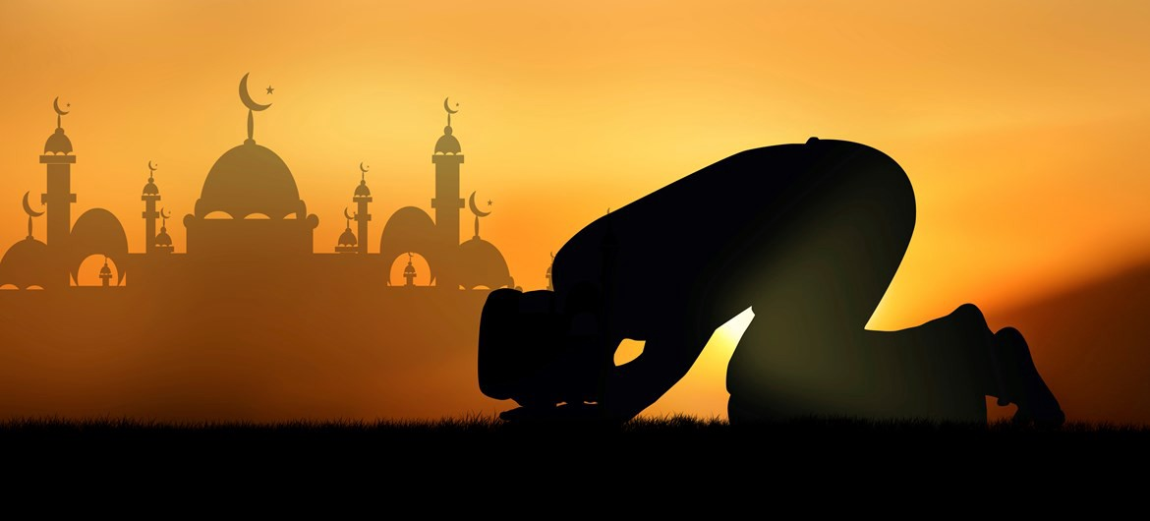
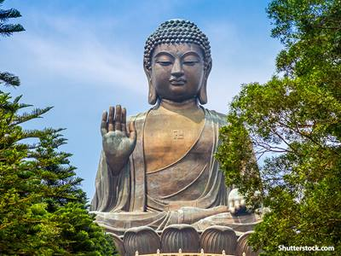
RMPS – Topics covered in S1
Christianity
Islam
Buddhism

Slide 13

Task: Identify the four different news stories displayed on the following slides and link them to one or more Social Subjects.

Slide 14
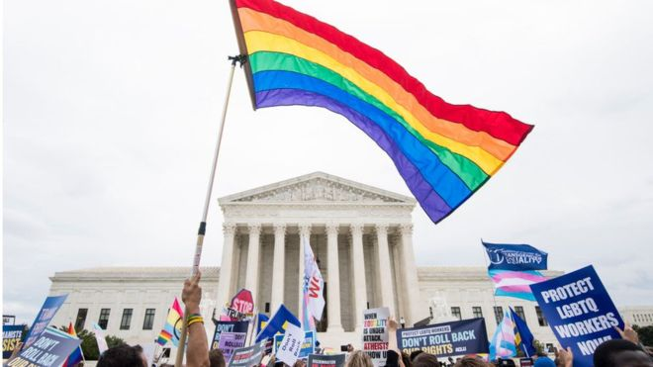
What is the story about?
What subject(s) would this link to?
Story 1

Slide 15
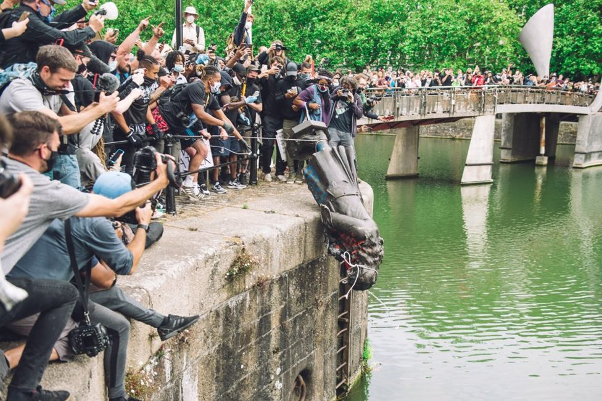
What is the story about?
What subject(s) would this link to?
Story 2

Slide 16
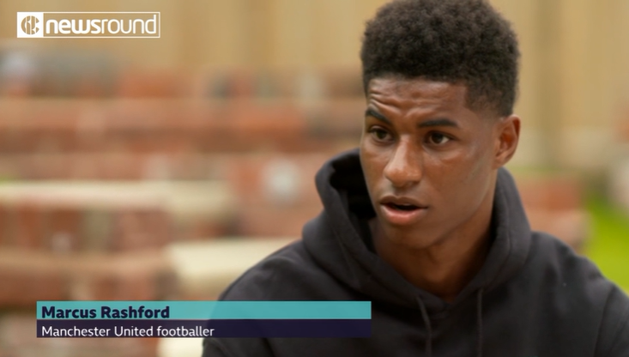
What is the story about?
What subject(s) would this link to?
Story 3

Slide 17
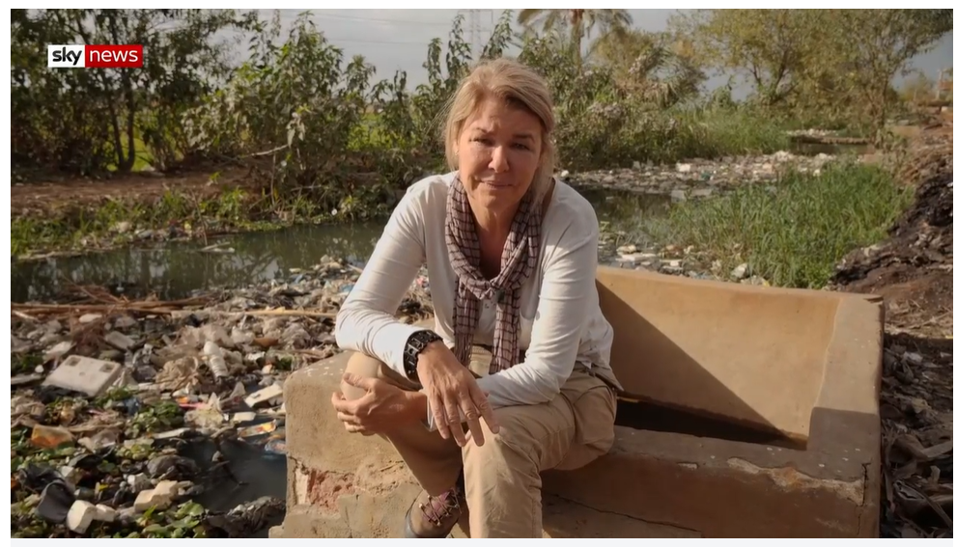
What is the story about?
What subject(s) would this link to?
Story 4

Slide 18
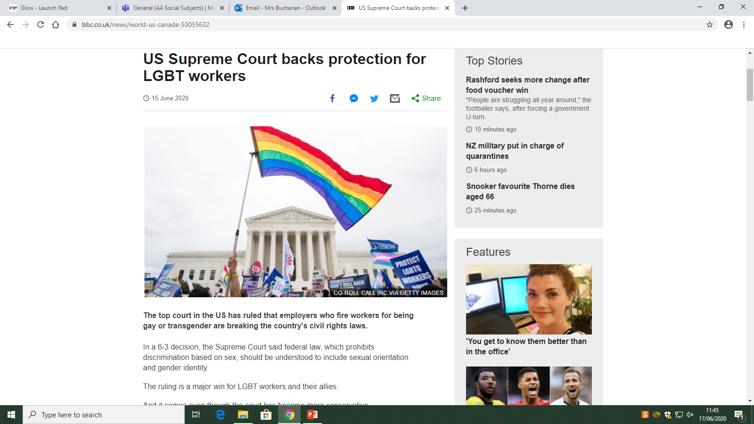
Story 1
https://www.bbc.co.uk/news/world-us-canada-53055632
RMPS – This subject looks at religion, morality and philosophy. This story looks at morality, what is right and wrong, this shows a step towards acceptance and equality for all.
Modern Studies – This subject looks at how countries are governed and the laws that are in place to protect the people. This new law protects LGBTQ+ workers.

Slide 19
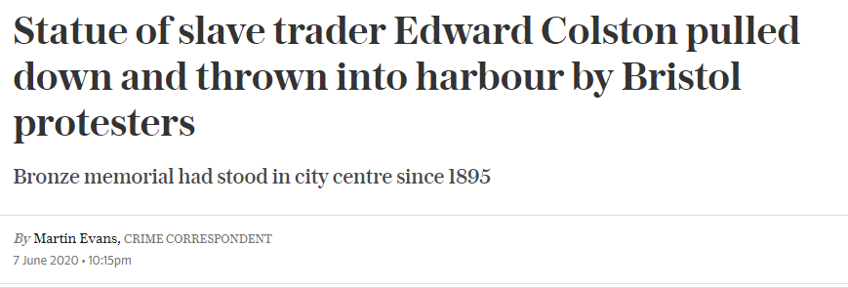
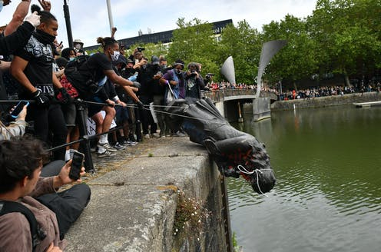
Story 2
History – This subject looks at events in the past and how they have shaped the world today. This historical statue is controversial as it symbolises the slave trade, a time when Africans were stolen from their homes and sold in to slavery. Britain benefited greatly from the profits of this trade.
Modern Studies – This subject looks at the rights people have. Here, people are using their right to protest to voice their views to the government.
https://www.telegraph.co.uk/news/2020/06/07/edward-colston-statue-pulled-bristol-black-lives-matter-protesters/

Slide 20
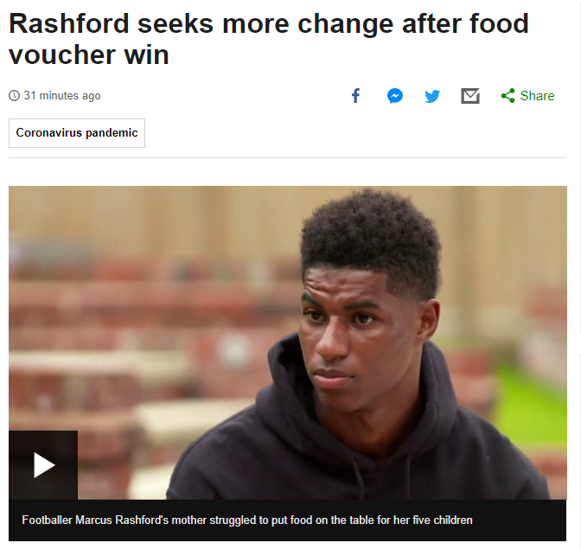
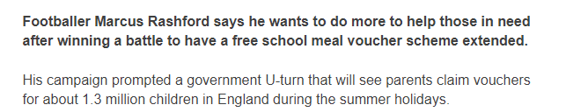
Story 3
Modern Studies – This subject looks at government policies. In this case the government changed their policies to ensure the poorest families in England received free schools meals during the holidays.
RMPS – This subject looks at humanity and protecting the most vulnerable.
https://www.bbc.co.uk/newsround/53068466

Slide 21
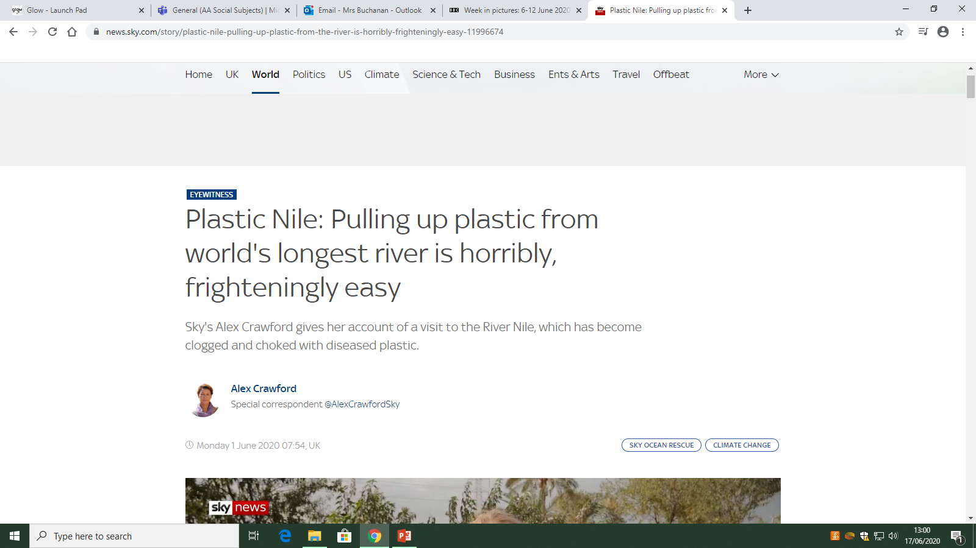
Story 4
Geography – This subject looks at climate change and sustainability. This story shows the consequences plastic has had on the environment and how this effects natural resources and wildlife.
https://news.sky.com/story/plastic-nile-pulling-up-plastic-from-the-river-is-horribly-frighteningly-easy-11996674

