Slide 1
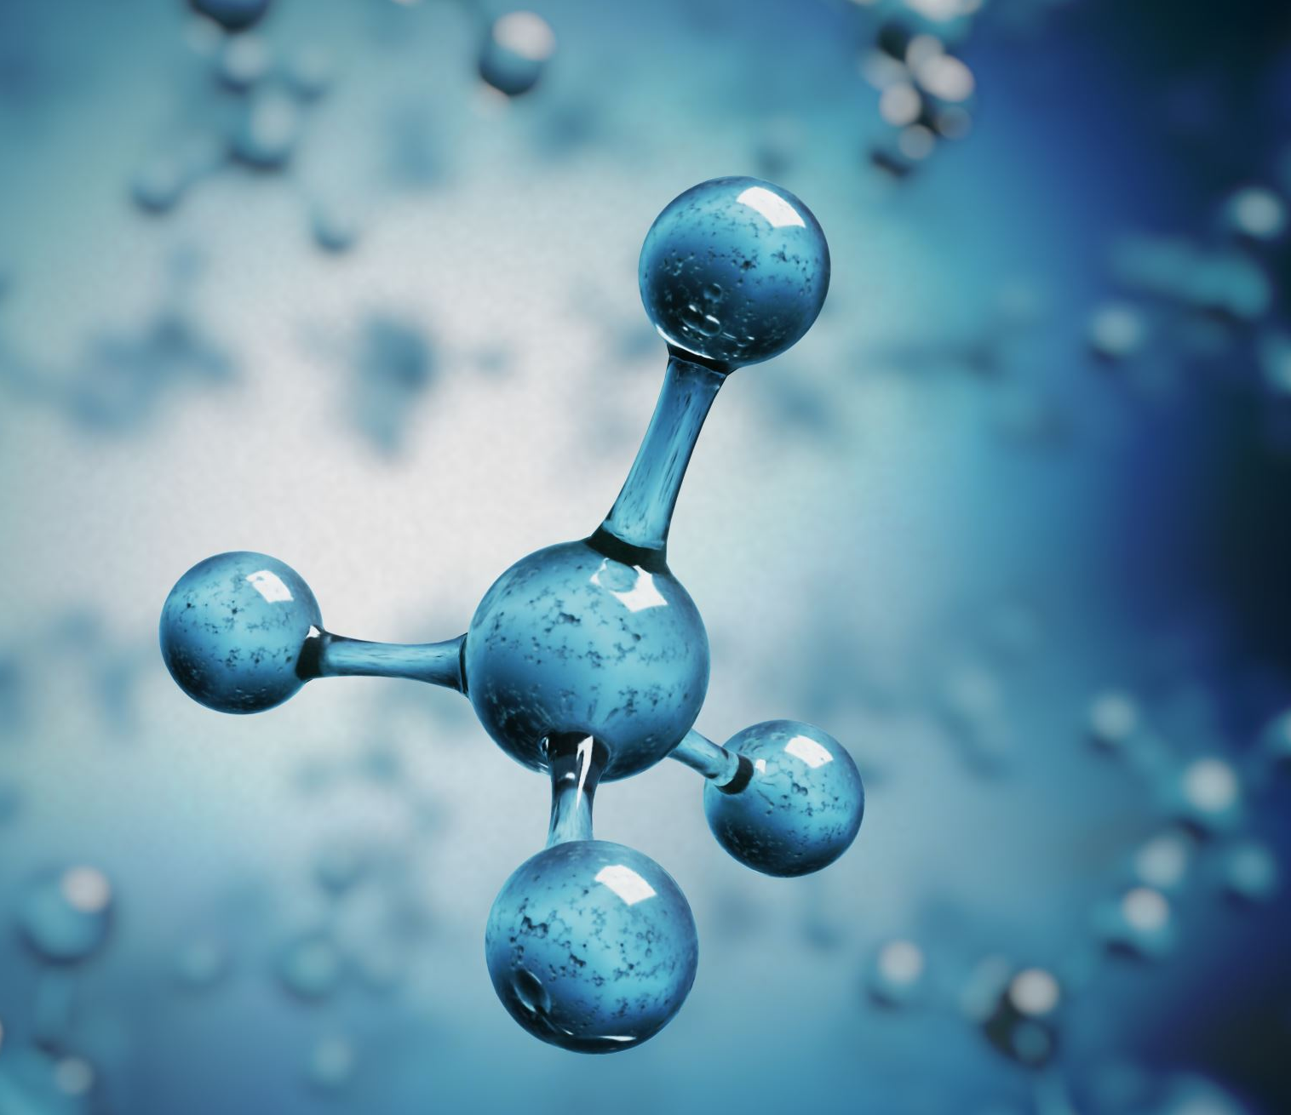

Science in S1

Slide 2
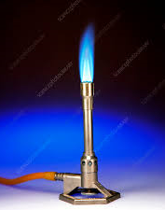
Welcome P7 Pupils!
We are really looking forward to meeting you all in August!

Slide 3
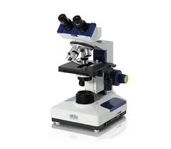
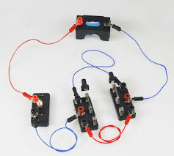
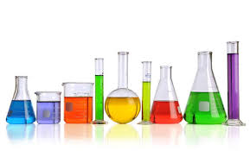
Topics covered in S1
During S1 we cover a mixture of Biology, Chemistry and Physics topics and build scientific investigative skills.

Slide 4
Topics covered in S1 – Level 3
Introduction – laboratory safety, science equipment, investigative skills
Electricity – electrical circuits
States of Matter – properties of solids, liquids and gases and particle theory
Biological Systems- cells, organs, organ systems, monitoring health
Energy – heat transfer, home insulation, alternative energy, friction
Elements and Compounds – atoms, molecules, Periodic table
Reproduction and DNA – human reproduction, DNA and genetics

Slide 5

Science Staff
Mrs C Campbell (PTC)
Mr J Aitken
Miss S Ash
Mr T Davies
Mrs N Few
Mrs K Jordan (PTPS)
Mr D Kidd
Mr D Le Vin (PTPS)
Miss J Martin (PTPS)
Ms J Muir
Mrs L Tipping
Mrs L Woodman (Science Technician)

Slide 6
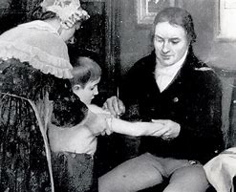
Induction week task – Famous Scientists
Scientific inventions are fundamental to life. Without them we wouldn’t have all the things we have today.
One very topical invention was the use of vaccines to treat disease. A famous scientist called Edward Jenner developed the first vaccine to treat smallpox in 1776.
Watch this video clip - https://www.bbc.co.uk/teach/class-clips-video/history-ks1-ks2-edward-jenner/zm8fcqt

Slide 7

Task
Choose a famous Scottish Scientist to investigate and create a fact- file.
Your fact-file should include the
following success criteria:
Name of Scientist
What they invented
Where and when they were born
Where and when did they die
How their invention has changed our lives
Present your information in the form of a poster. This can be completed electronically or on paper.

Slide 8

See you in August!

