Slide 1
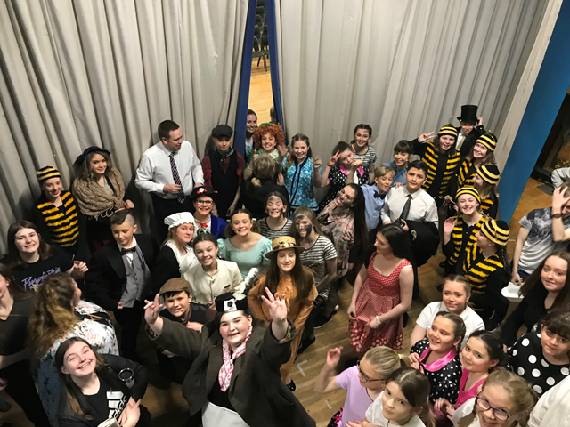
Welcome to the music department!

Slide 2
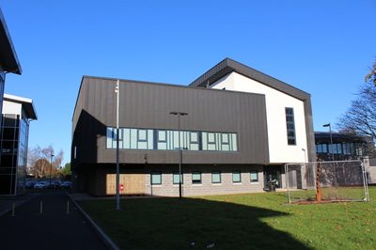
There are four members of music staff:
Mr Brand
Mr Boardman
Miss Chapman
Miss Pryde-Firmin

Slide 3
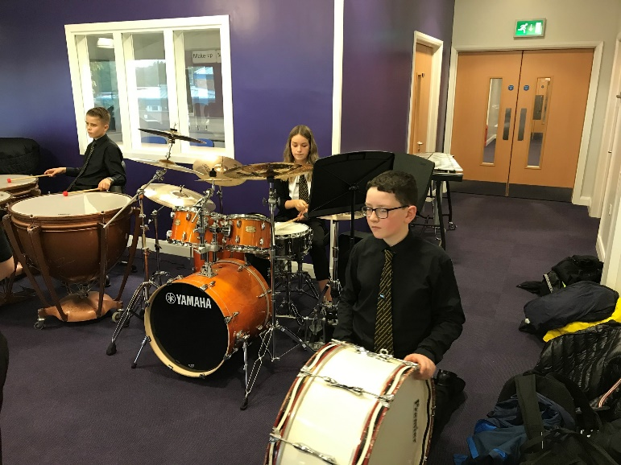
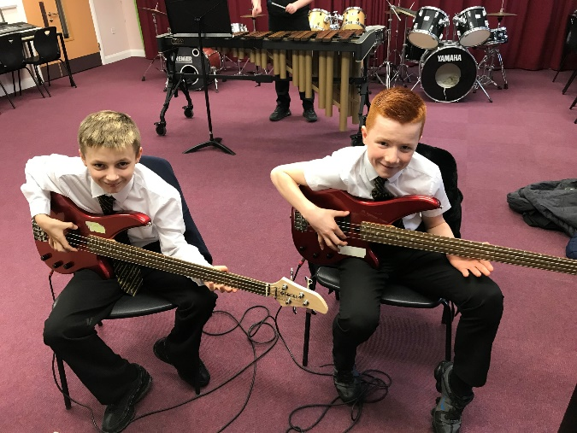
What will I learn in music?
You will learn to develop skills on instruments such as the keyboard, drumkit, xylophone and Bass Guitar
You will also learn basic note names and music theory

Slide 4
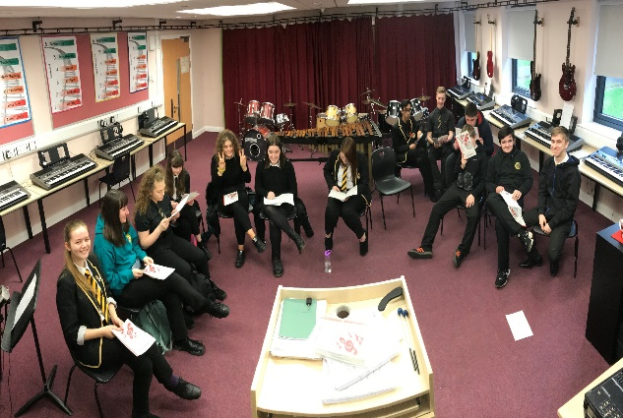
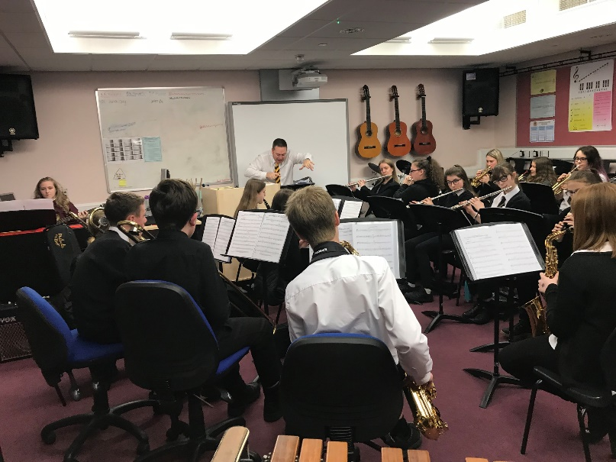
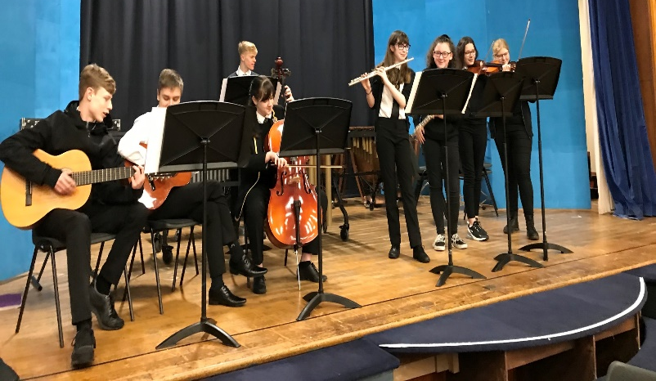
What goes on in the music department?
There is lots going on in our department…. such as……
Music groups
Choir
School band and Ceilidh band

Slide 5
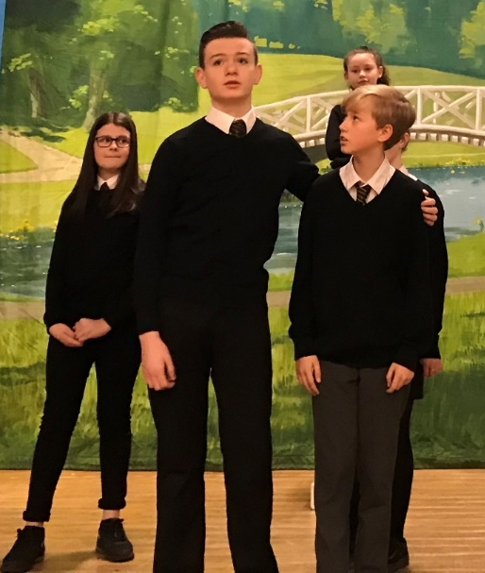
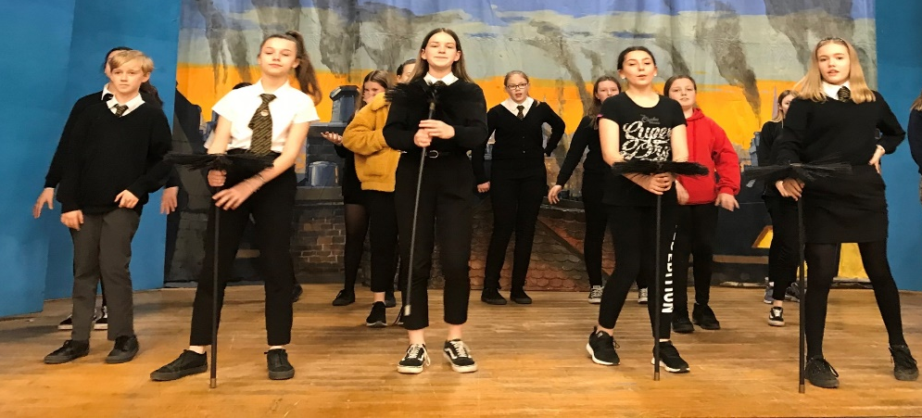
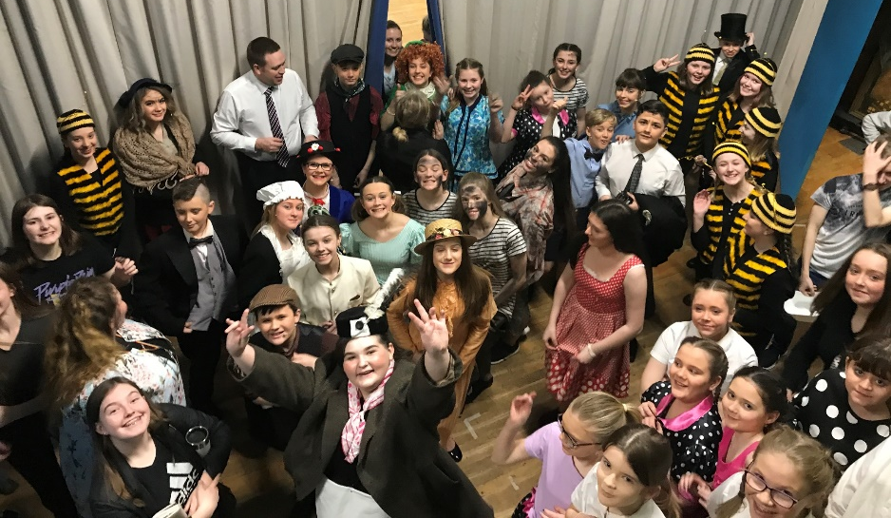
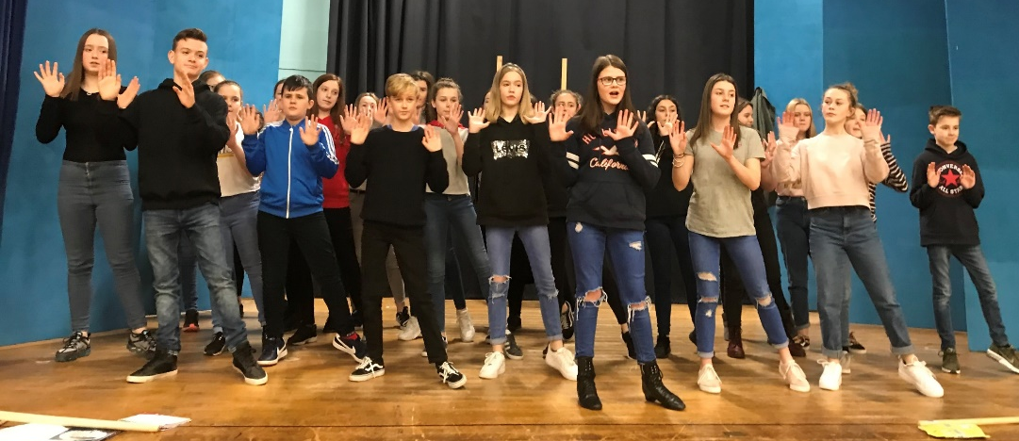
Junior show
Every year, the Music and Drama Depts. Put on an S1/2 Junior Show. This year it was Mary Poppins!

Slide 6
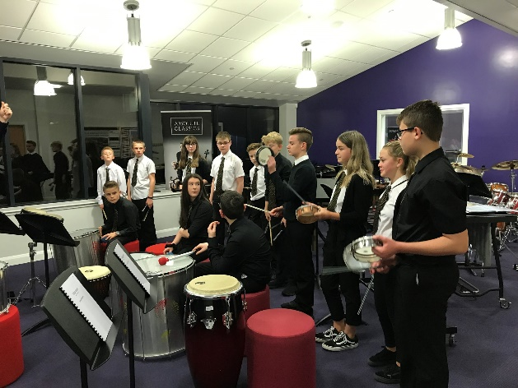
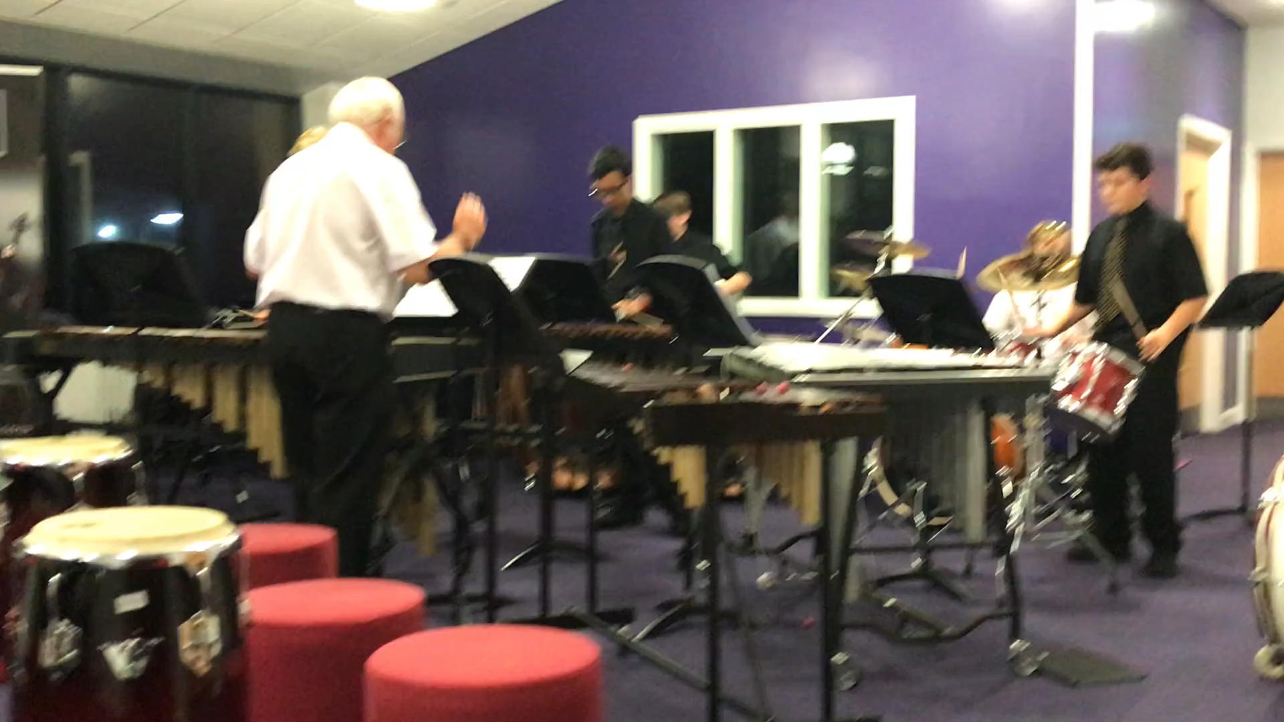

We also have a variety of musical workshops every year. Here are some photos and a video from a Percussion workshop we had in November

Slide 7
Your task: Here is the link to a wee quiz based on musical instruments
https://forms.office.com/Pages/ResponsePage.aspx?id=oyzTzM4Wj0KVQTctawUZKVuu2CnNPX5MiMS5OFDD02ZUNUpXVEtEOTBMSDRMRVhTVzY0NVNJRlNJWC4u

