Slide 1
Welcome to ICT
In S1 you will learn about how to use the following applications more effectively:
• GLOW
• World Wide Web - Browsers and Services
• Word Processing
• Databases
• Presentations
• BBC Micro:Bits and Scratch programming

Slide 2

We are looking forward to seeing you all in August ☺
Your tasks for the Summer are to:
1. Create a Poster to promote the SMART rules around the school
Play Interland and record your High score with a photo/screenshot
Class Prizes for the winning poster and highest Interland score will await you in August ☺
Have a great Summer and
stay safe
Find out more about ICT in S1 to S3
on the following slides

Slide 3
S1 to S3
Information & Communications Technology (ICT)
Digital Literacy, Business & Computing Science
S4 to S6
ADMINISTRATION & IT
BUSINESS MANAGEMENT
COMPUTER GAMES DEVELOPMENT
COMPUTING SCIENCE

Slide 4

Digital Literacy
Microsoft (MS) Word – Letters and Reports
MS Access - Databases
MS Excel - Spreadsheets
MS Edge – Internet Services & Security
MS Publisher – Posters and Newsletters
MS PowerPoint - Presentations
MS Outlook - e-mail and electronic diary

Slide 5

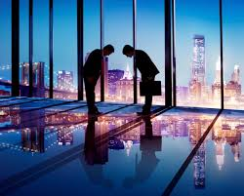
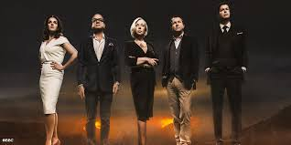
Business
Learn about
Goods and Services
Needs and Wants
Entrepreneurs
Customers
Voluntary Organisations
Profit or Loss?
Investigate a small local business and produce a promotional leaflet
Organise a Business Trip to Japan
Create a product & try to obtain Finance

Slide 6
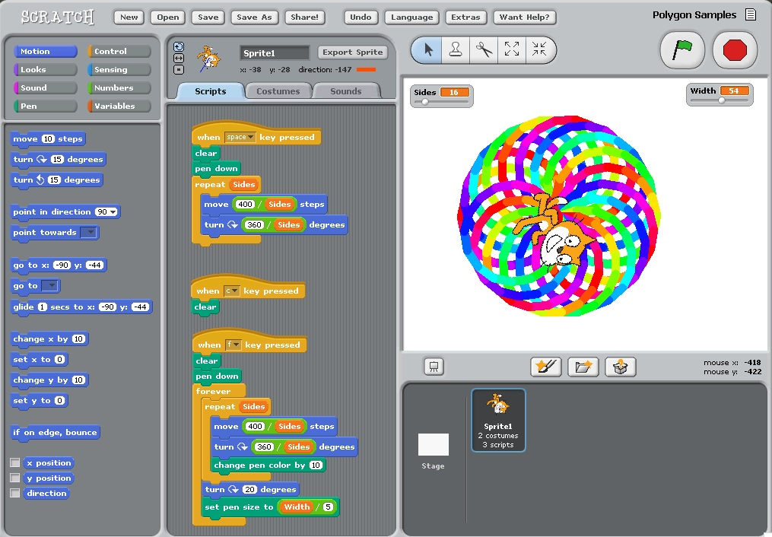
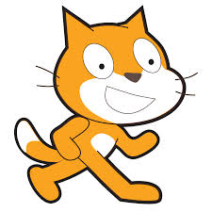
Computing Science
Learn to code
With Scratch

Slide 7
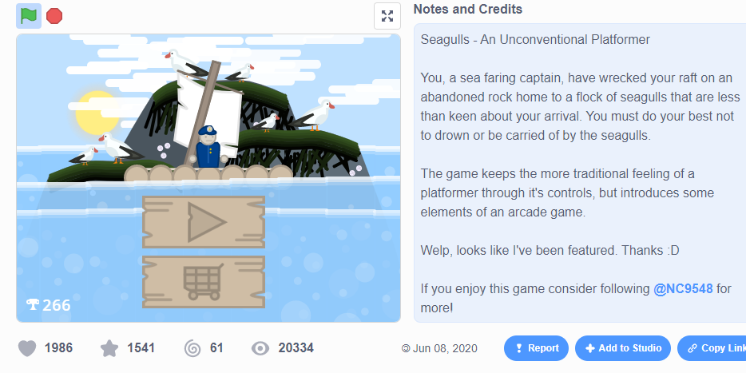

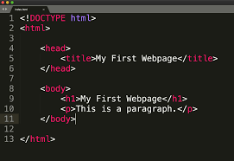
Computing
Design, Create and Publish your first website using HTML
Design, Create and Publish your first Game
Watch This – ICT Changes Everything

