Slide 1






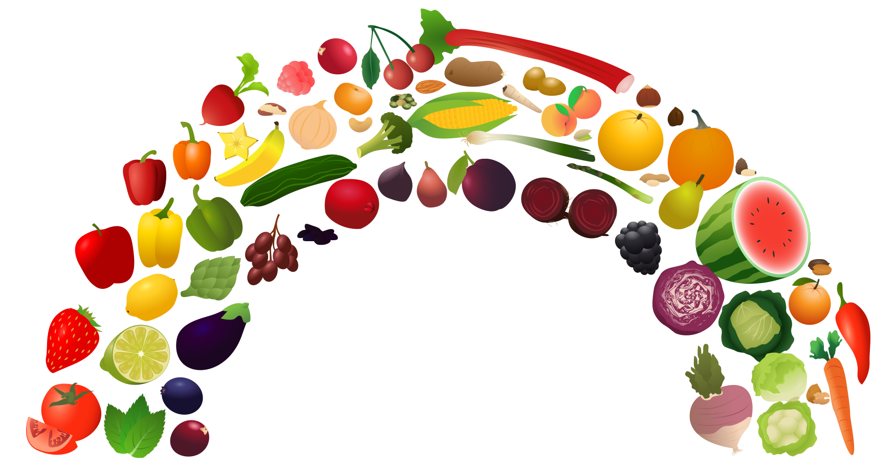



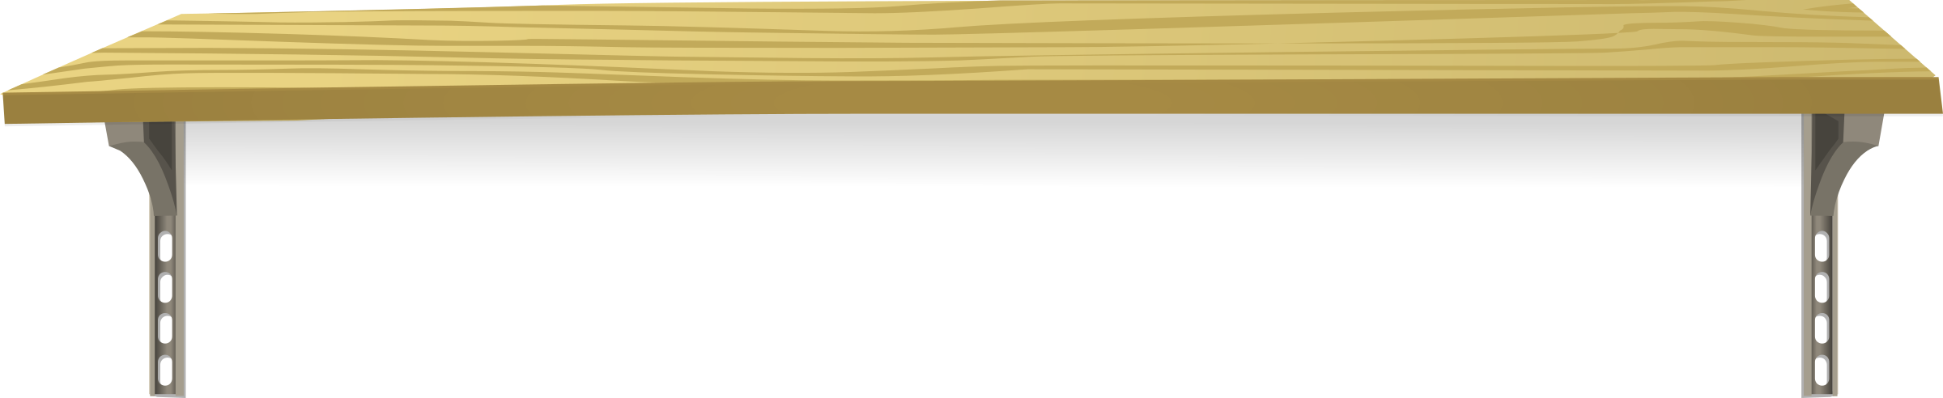


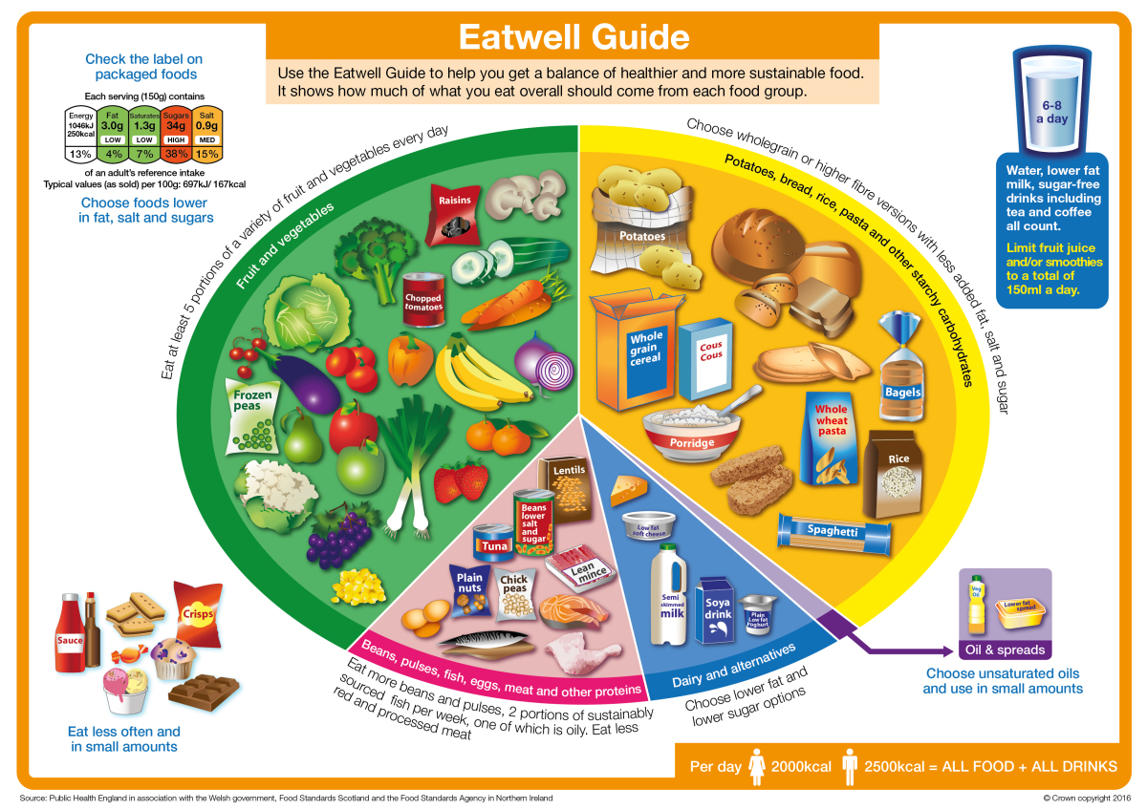





Health and Wellbeing Faculty
Home Economics
The Eat Well Guide
Scottish Dietary Goals
Cognitive skills
Problem solving
Practical Cookery Skills
Knife skills
Nutritional Knowledge
Eat well plate
Personal Qualities
Motivation
Focus and concentration
Creativity
Decision making
Confidence
Determination and resilience
Responsibility and leadership
Respect and tolerance
Communication
Hob management
Presentation
Garnishing
Recipe modification
Weighing and measuring
Scottish dietary goals
The nutrients
Stages of the lifecycle
Digestion
Task 1:
Find out the name of all sections of the Eat Well Plate
Task 2:
Find out how many Scottish Dietary Goals you achieved today

