Slide 1
Disasters: Tsunami
Amy, Arnult, Clare & Lauren

Slide 2
Introduction
Level (pitched to)
Tsunami facts
Japan (case studies)
Malaysia (case studies)
CFE outcomes
Teaching task

Slide 3
Tsunami facts
A tsunami is a huge wave, usually caused by volcanic or earthquake activity under the ocean.
Tsunamis are typically caused by large, undersea earthquakes at tectonic plate boundaries.
Tsunamis may also be caused by underwater landslides or volcanic eruptions.

Slide 4
How it is formed

Slide 5
Facts Continued…
The name ‘tsunami’ is Japanese. It means ‘great harbour wave’.
Waves sometimes reach heights of over 100 feet (30.5 meters).
About four out of five tsunamis happen within the Ring Of Fire, a zone in the Pacific Ocean where earthquakes and volcanic eruptions frequently take place.
When tsunamis hit shallow water (often near the coast) they slow down but increase in height.

Slide 6
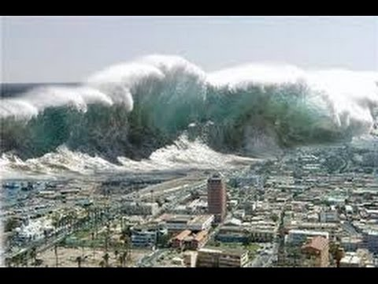
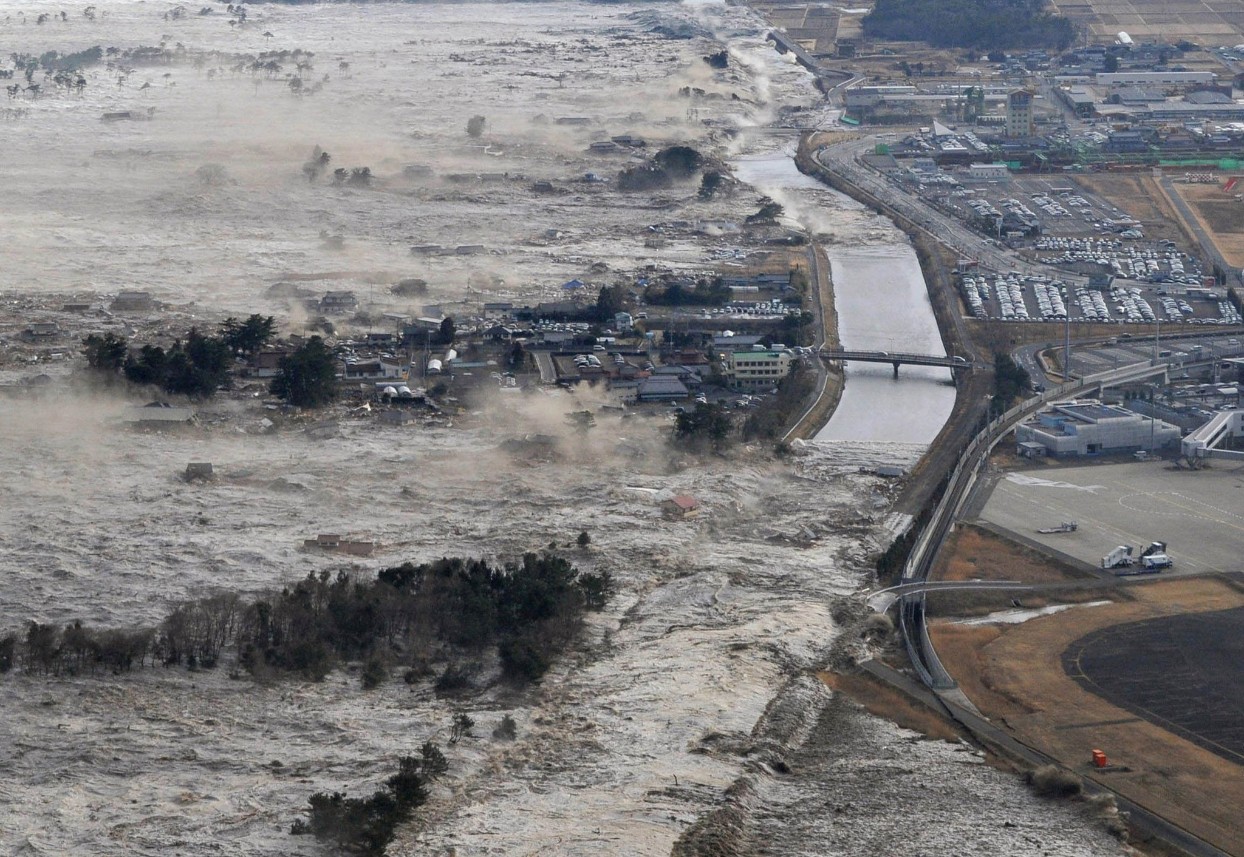
Japan, 2011
11th March 2011
Earthquake under the sea was a magnitude of 9.0
Waves of 40.5m
Honshu was moved 2.4m east
15,894 death, 6,152 injured and 2,562 missing

Slide 7
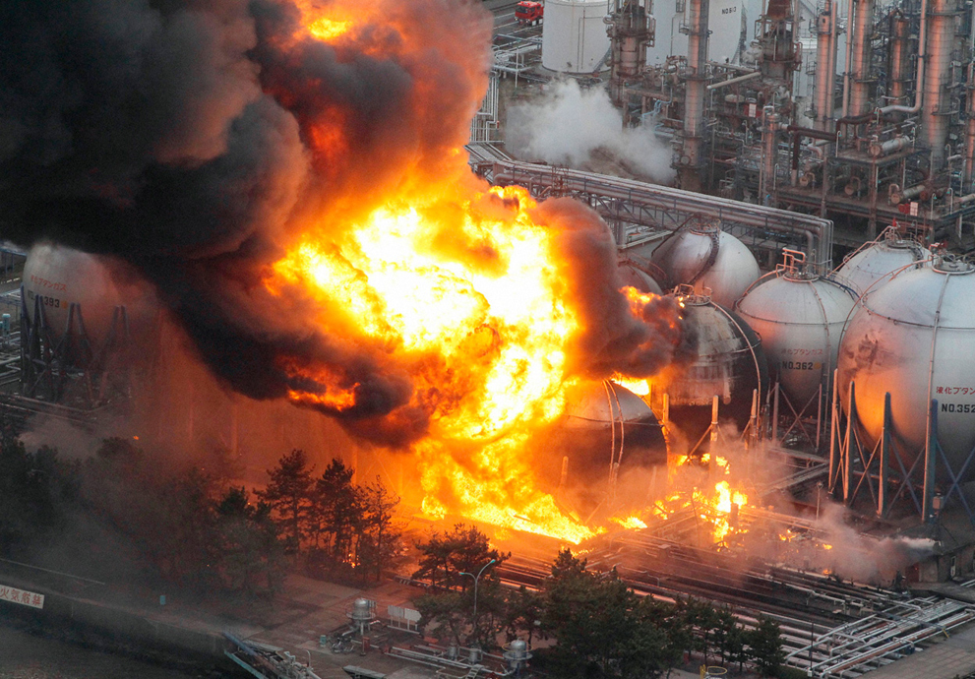
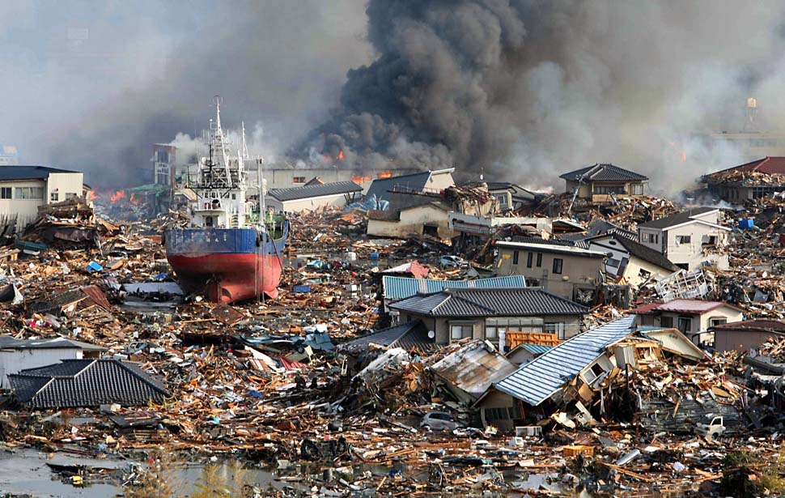
Aftermath and Aid
Tsunami caused nuclear explosions
Japanese government sent self-defence forces
Japanese Red Cross reportedly sent $1 billion in donations
Rebuilding costs around $122 billion
UK government sent 70 rescuers, 2 search dogs, medical support team and 11 tons of specilised rescue equipment

Slide 8
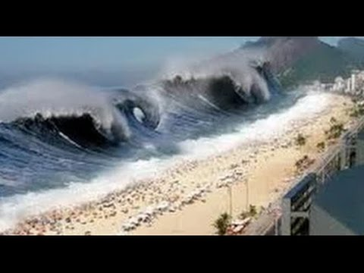
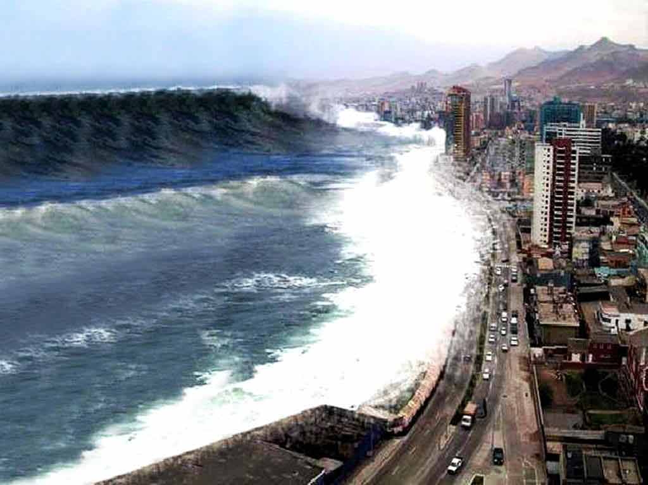
Tsunami 2004, Malaysia
26th December 2004
Hit- Indonesia, Sri Lanka, India, Thailand, Maldives and Somalia.
Over 500,000 people were injured, 150,000 were at risk of infectious diseases in the aftermath.
Death toll- Unknown, but over 230,000 people are believed to have been killed.
How does it happen?

Slide 9
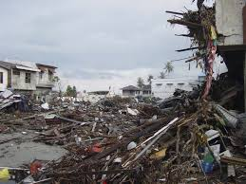
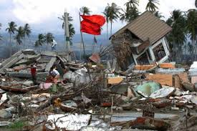
Aid/ Aftermath
Billions of pounds raised after the disaster.
Disaster emergency committee launched its appeal on 29th December.
Aid and Charities- British Red cross
Media coverage- Widespread, well publicised.

Slide 10
CFE Outcomes
Representing my class, school and/or wider community encourages my self-worth and confidence and allows me to contribute to and participate in society. HWB 0-12a / HWB 1-12a / HWB 2-12a / HWB 3-12a / HWB 4-12a
Through contributing my views, time and talents, I play a part in bringing about positive change in my school and wider community. HWB 0-13a / HWB 1-13a / HWB 2-13a / HWB 3-13a / HWB 4-13a
I can talk about science stories to develop my understanding of science and the world around me.
Topical Science- I have contributed to discussions of current scientific news items to help develop my awareness of science. SCN 1-20a
I can report and comment on current scientific news items to develop my knowledge and understanding of topical science. SCN 2-20b

Slide 11
Teaching task
^{Using the 1st} experiences and outcomes above- as a school we can organise fundraising events to help out and help those who suffered as a result of the Tsunamis and that can be done throughout all levels.
^{For the 2nd} once we can create a correspondence with individuals of similar age group who survived the Tsunamis or even with a school in Japan and just write about the impact the Tsunamis has had on them personally or their society and form a pen pal conversation between our pupils and the children from overseas. ( Cross- Curricular ; Literacy and HWB) .
^{The 3rd}, 4th and 5th experiences and outcomes are a sequence and that could be followed through as we can see that children can talk about the Tsunamis and the scientific cause behind it and relate it in scientific terms (Tornadoes, Earthquakes etc...) depending on the level the children are at and this theme can be developed in that way.

Slide 12
Conclusion

Slide 13
References
http://www.redcross.org.uk/What-we-do/Emergency-response/Past-emergency-appeals/Boxing-Day-tsunami-2004/How-we-helped-survivors
http://environment.nationalgeographic.com/environment/natural-disasters/tsunami-profile/
http://www.ngkids.co.uk/science-and-nature/tsunamis
https://www.theguardian.com/world/2009/dec/23/2004-tsunami-five-years-on

