Slide 1
Michaela and Amie’s I AM Poem

Slide 2
I am green and mysterious

Slide 3
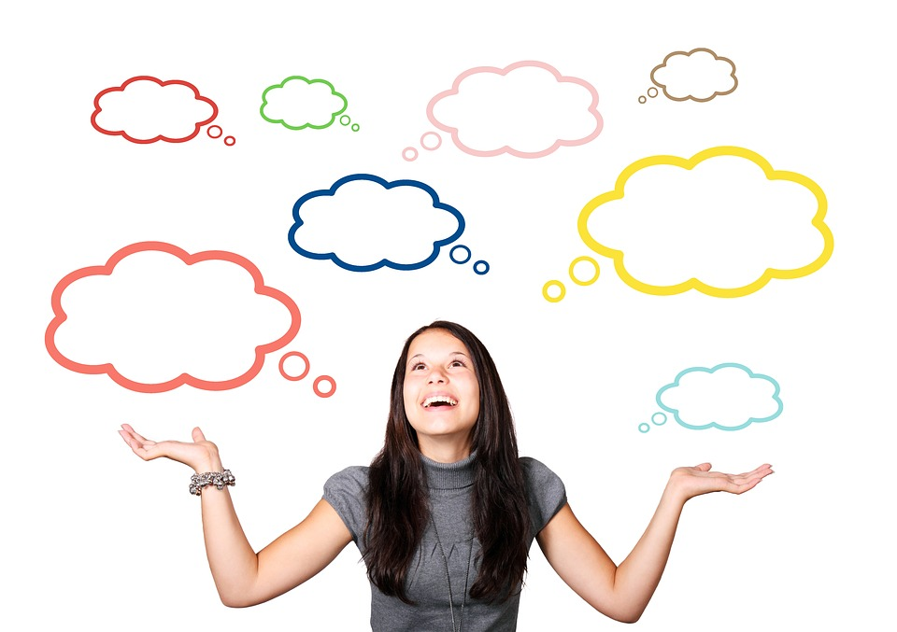
I wonder if people know I exist

Slide 4
I hear stars shooting by me

Slide 5
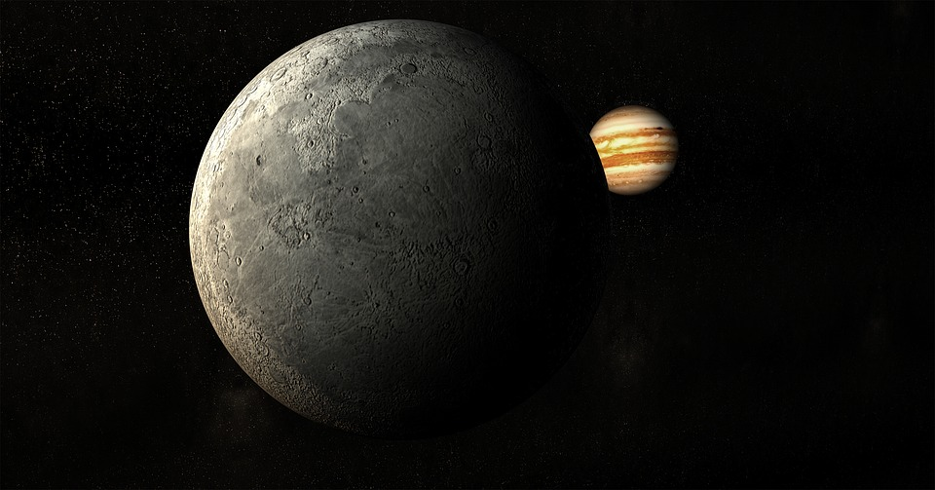
I see planets around me

Slide 6
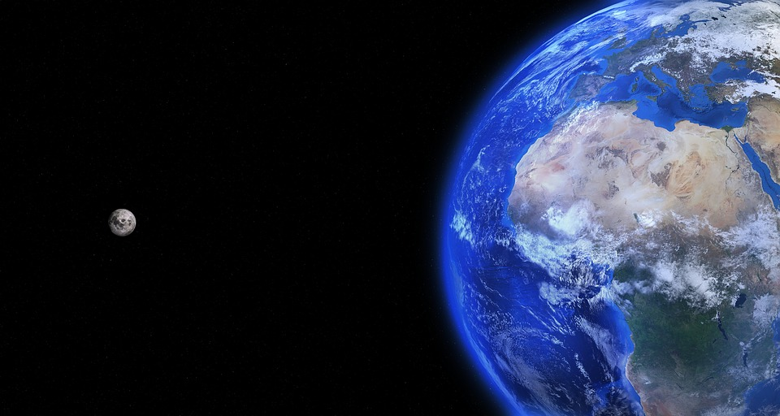
I want to visit planet earth

Slide 7
I am green and mysterious

Slide 8
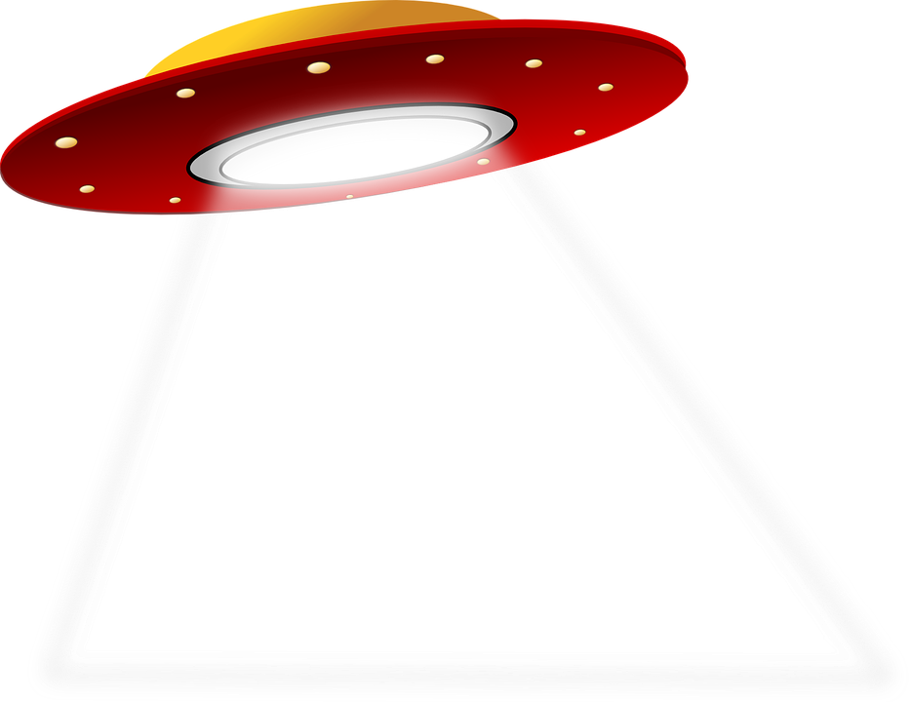
I pretend to fly in my own spaceship

Slide 9
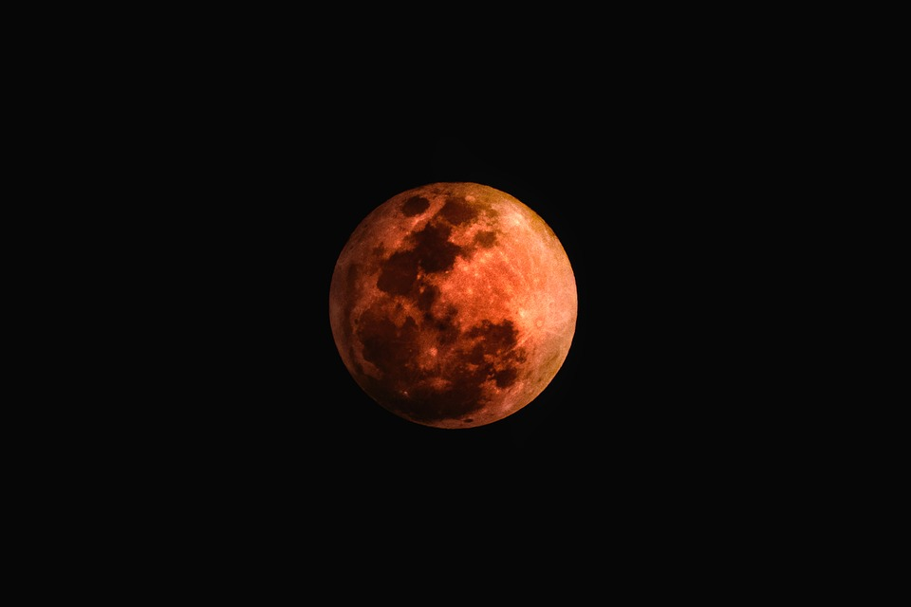
I feel lonely on my little planet

Slide 10
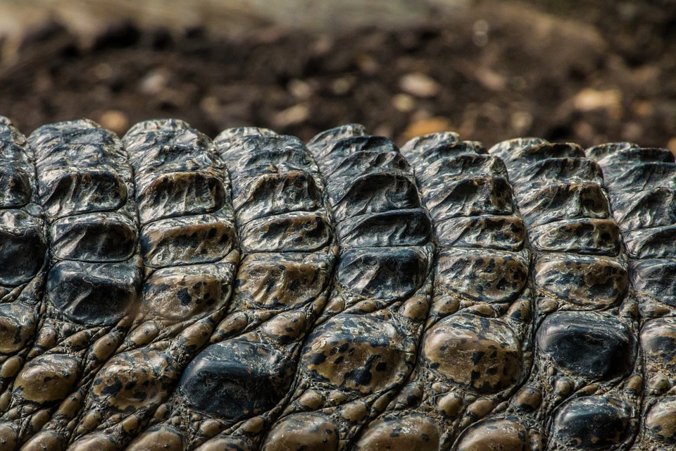
I touch my scaly skin

Slide 11
I worry about going extinct

Slide 12
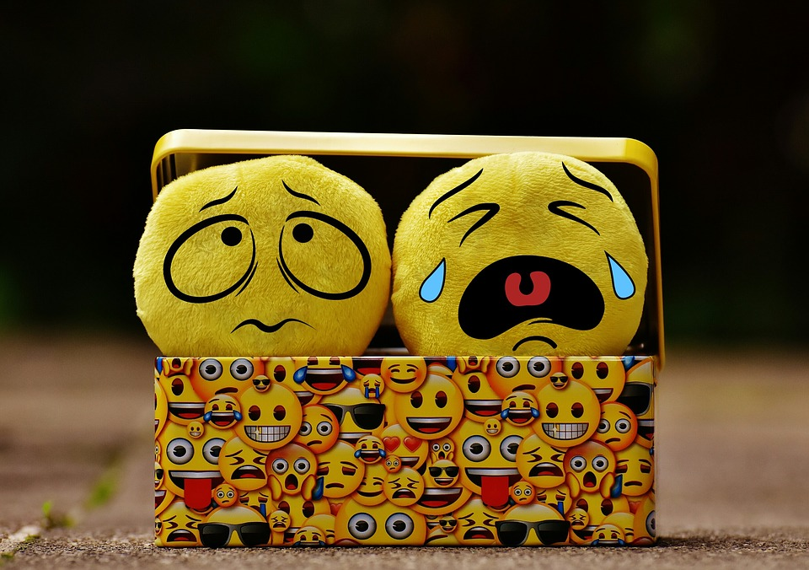
I cry because no one visits me

Slide 13
I am green and mysterious

Slide 14
I understand I look scary

Slide 15
I say words in my own language

Slide 16
I dream about visiting every planet

Slide 17
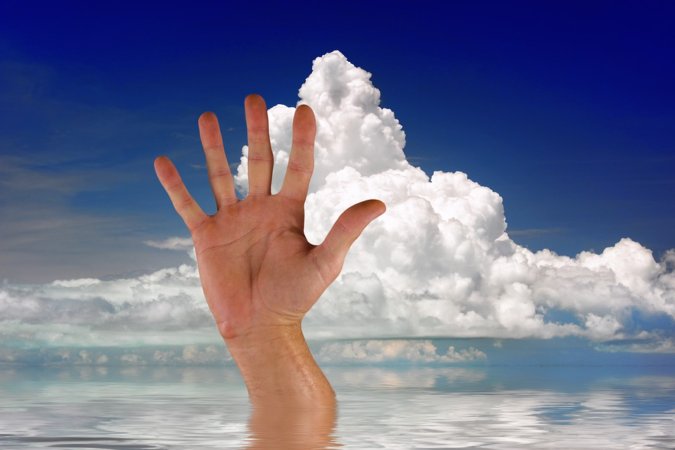
I try waving to humans

Slide 18
I hope to make friends

Slide 19
I am green and mysterious

