Slide 1




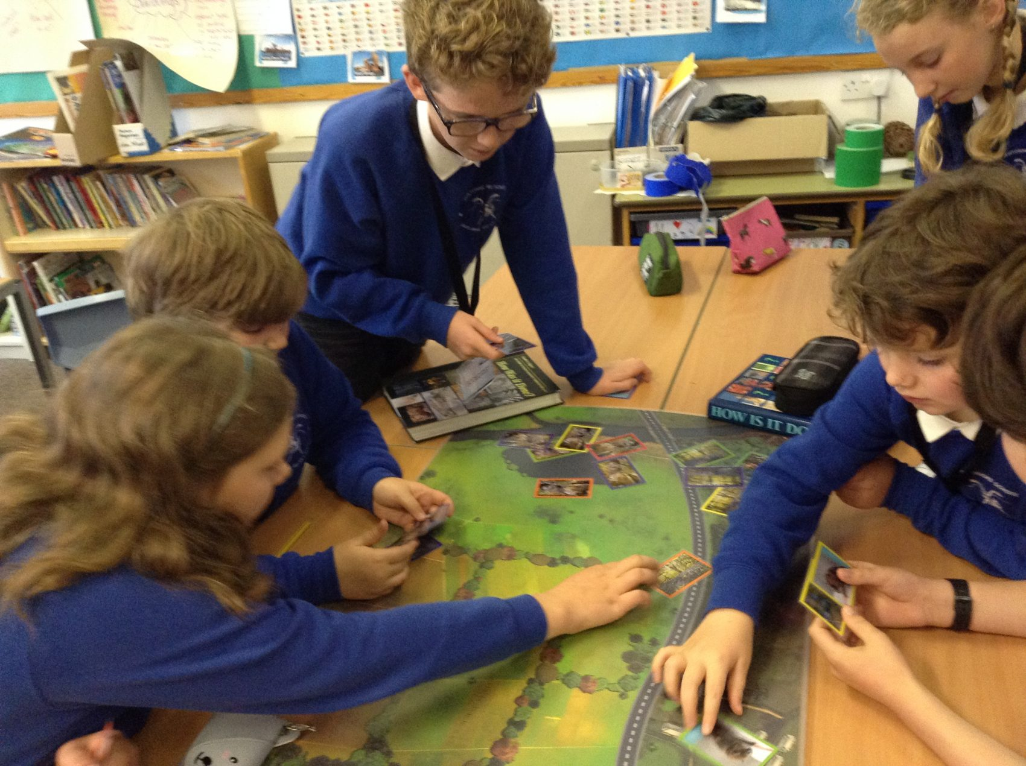
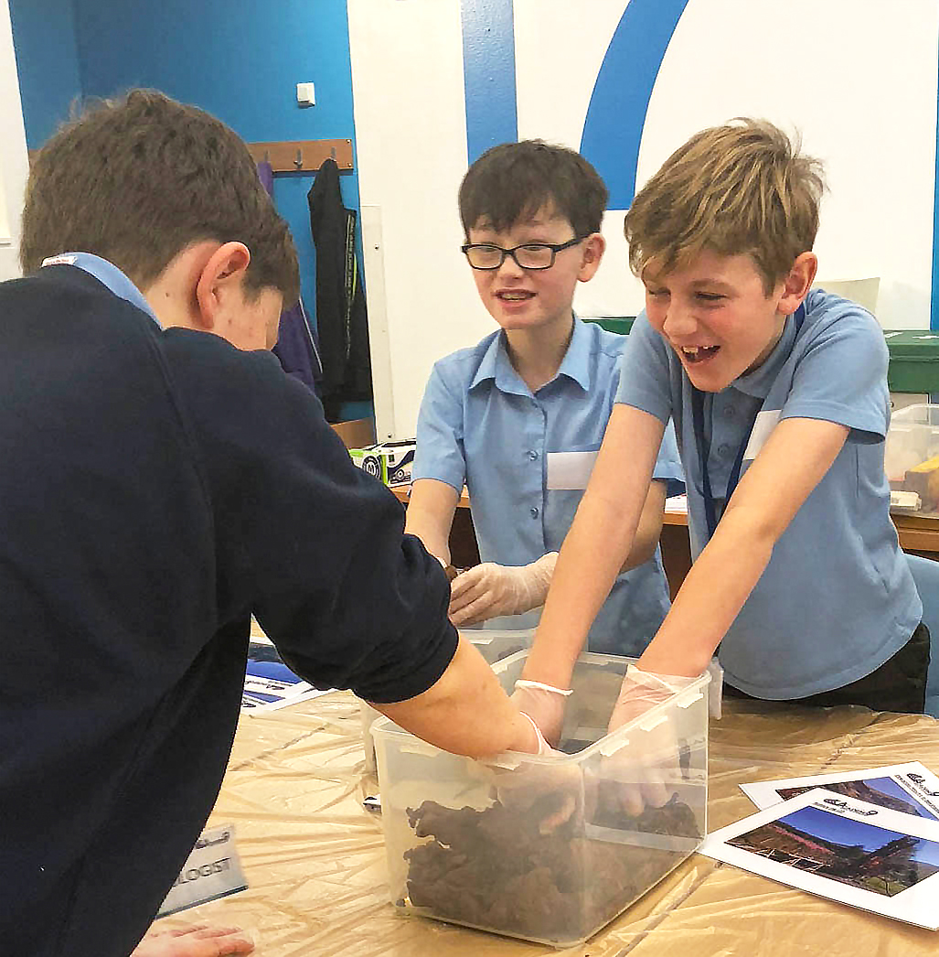
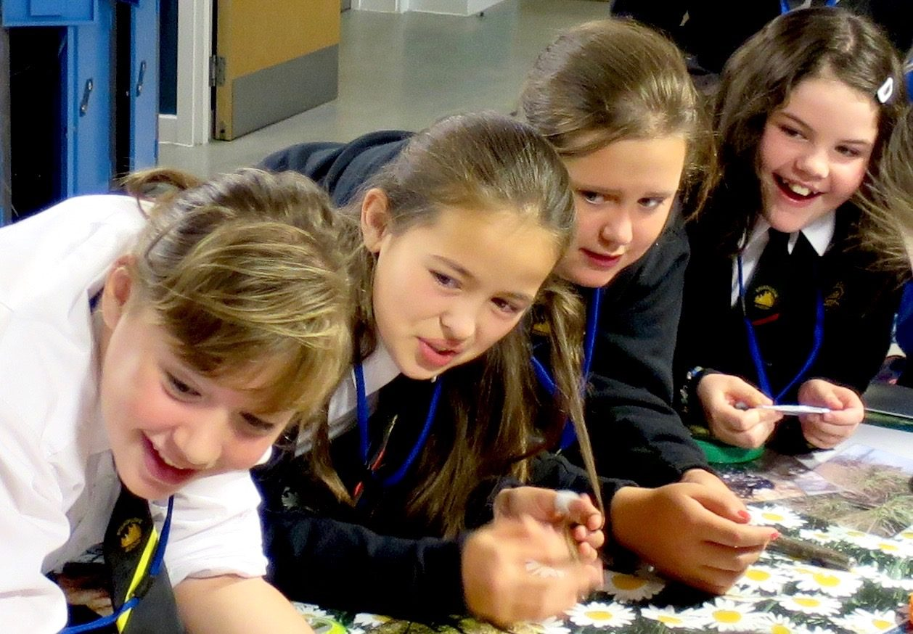
Academy9
Roadshow II
9Facts

Slide 2

Academy9
Learning Intentions
I am learning new facts about the A9 Dualling programme.
I am learning new ways to remember facts so that I can recall them.
bit.ly/academy9

Slide 3
Academy9
Success Criteria
I can listen carefully to the facts as they are told.
I can write keywords or draw pictures that will help me remember the facts.
I can speak clearly and confidently when retelling facts.
bit.ly/academy9

Slide 4

Academy9
What is the A9 Dualling Programme?
Click to watch the video below to find out more.
bit.ly/academy9

Slide 5
Academy9
9 Facts Bingo
007 | 2 | 3 | 4 | 5 | 9
14 | 18 | 20 | 22 | 30 | 40
50 | 51 | 60 | 70 | 77 | 80
100 | 142 | 462 | 1856 | 1923 | 32000
40000 | 65000 | 12 million | 3 billion | 19 billion
bit.ly/academy9

Slide 6

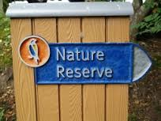
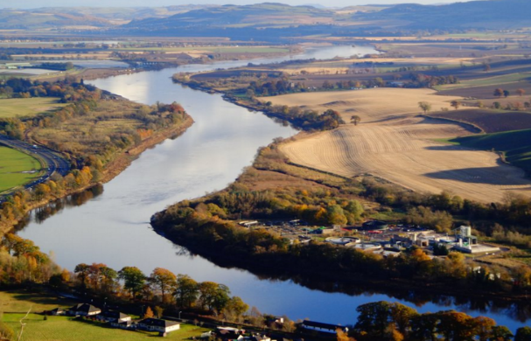

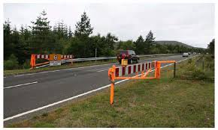
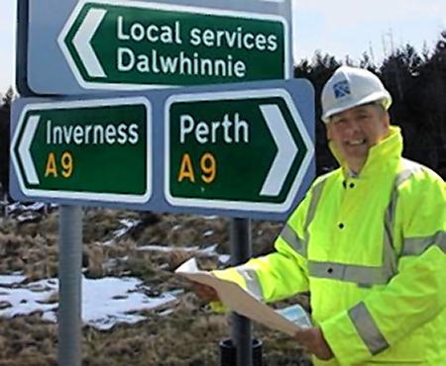

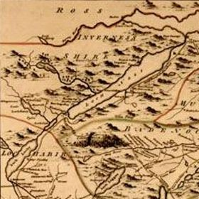

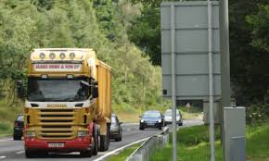
Academy9
Which film is the A9 mentioned in?
How many National Nature Reserves
will the project need to take into account?
How many major river systems will the project need to take into account?
What are the 4 main benefits of dualling the A9?
How many snow gates are there on the A9 between Perth and Inverness?
What is the name of the road to be dualled?
How many scheduled monuments will the project need to take into account?
What century was the military roads programme developed?
How many minutes are forecast to be saved on journey times between Perth and Inverness when dualling is complete?
What percent of the vehicles using the A9 are HGV’s?
bit.ly/academy9

Slide 7
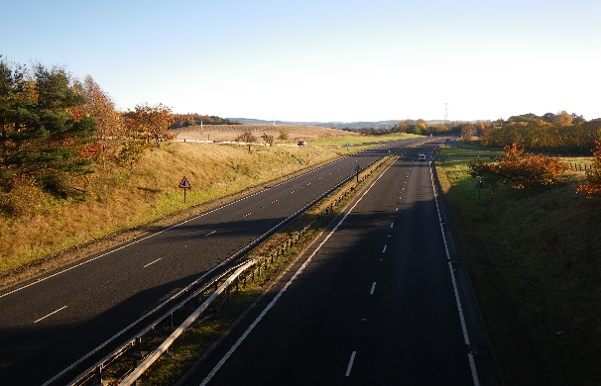

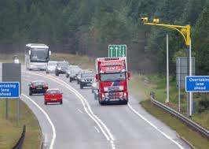
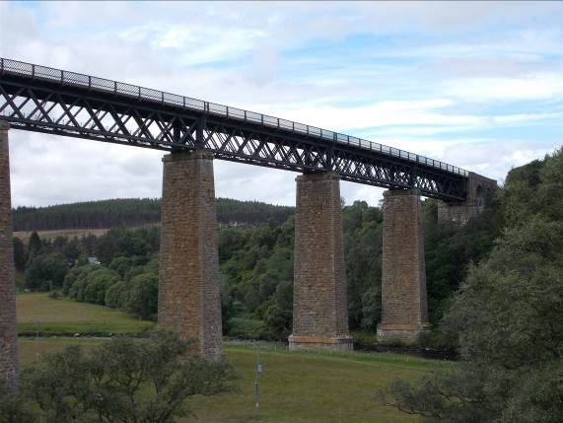
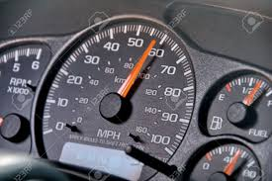
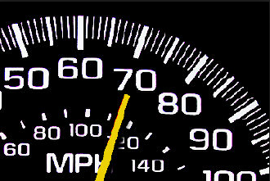
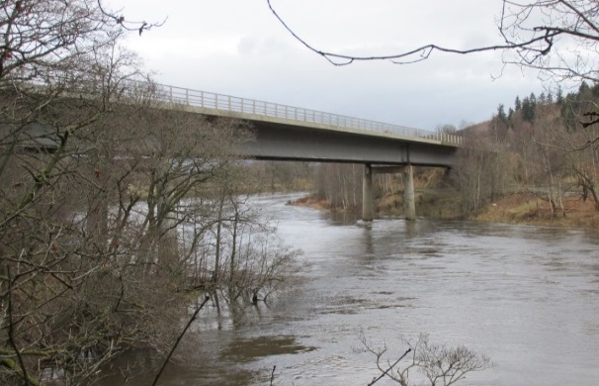
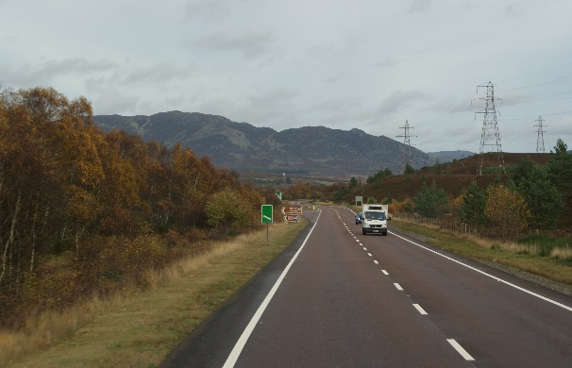
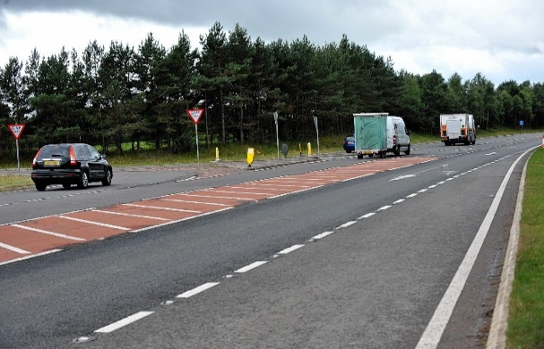
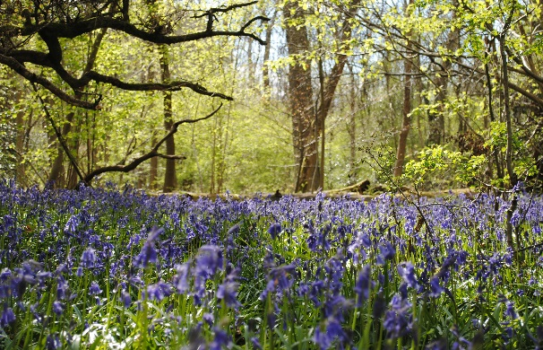
How many miles of the existing A9 are dual carriageway sections between Perth and Inverness?
What is the maximum speed limit for traffic travelling through roadworks on the A9?
What is the maximum speed limit for lorries on A9?
How many listed buildings will the project need to take into account?
What is the maximum speed limit on single carriageway for cars and motorcycles?
What is the maximum speed limit on dual carriageway for cars and motorcycles?
How many bridges will the project need to take into account?
How many miles of single carriageway will be upgraded between Perth and Inverness?
How many Ancient Woodland sites will the project need to carefully consider?
How many junctions will the project need to take into account?

Slide 8
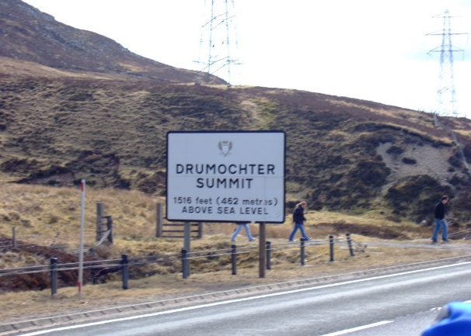
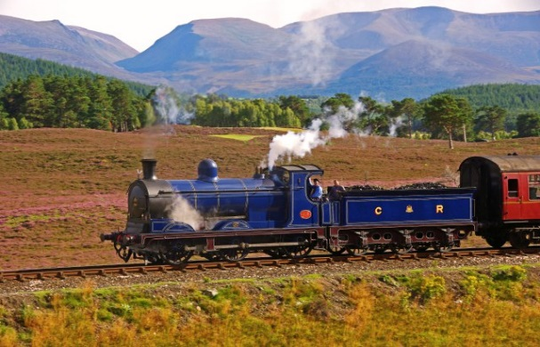

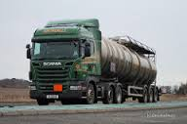
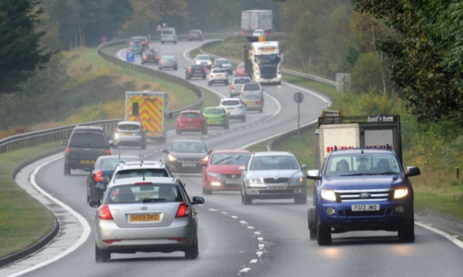

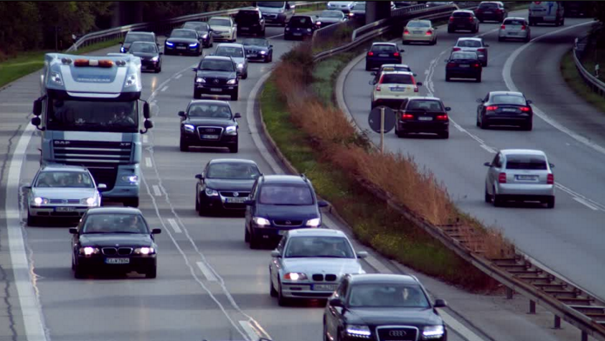
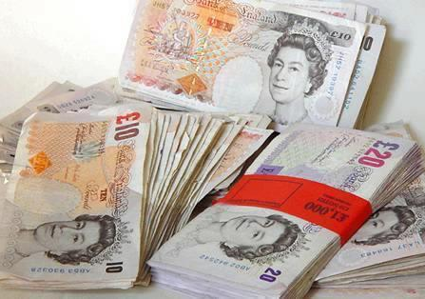
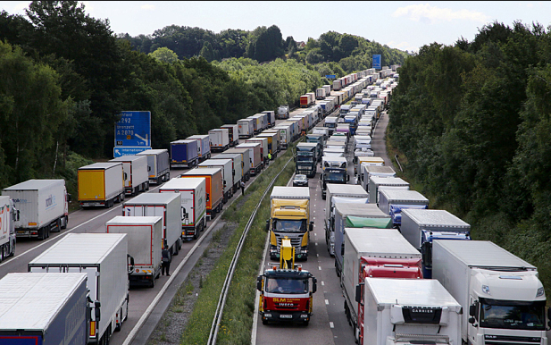
What is the Highest point of dual carriageway in Scotland?
When was the Highland Mainline Railway built?
What year was the road numbered?
How many tonnes of freight are transported along the A9 between Perth and Inverness every day?
How many vehicles use the A9 between Perth and Inverness every day?
How many people take trips on the A9 between Perth and Inverness every day?
How many vehicles use the A9 between Perth and Inverness every year?
What is the estimated cost of the dualling programme?
What is the estimated cost of goods carried along the A9 between Perth and Inverness every year?

