Slide 1




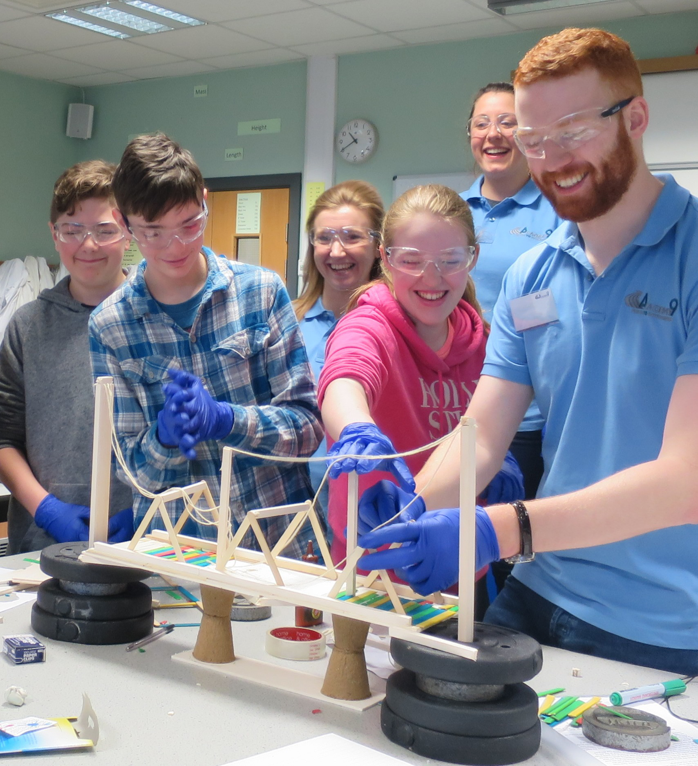
Civil and Infrastructure Engineering Projects (SCQF level 4)
Outcome 3

Slide 2

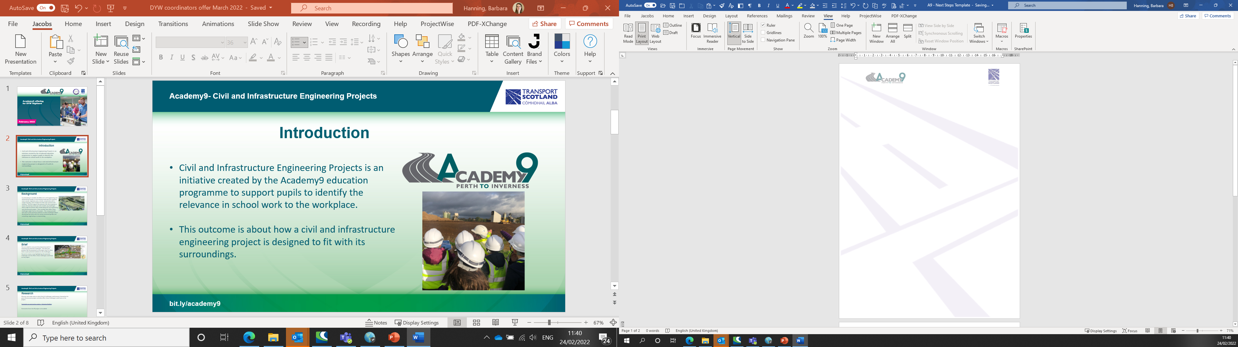
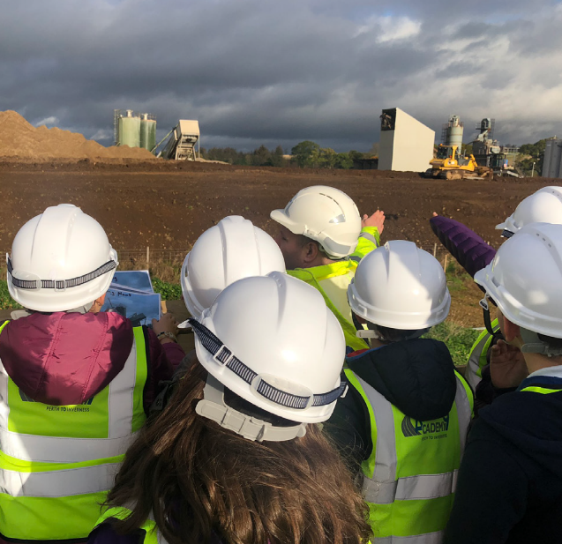
Academy9- Civil and Infrastructure Engineering Projects
Civil and Infrastructure Engineering Projects is an initiative created by the Academy9 education programme to support pupils to identify the relevance in school work to the workplace.
This outcome is about how a civil and infrastructure engineering project is designed to fit with its surroundings.
Introduction
bit.ly/academy9

Slide 3
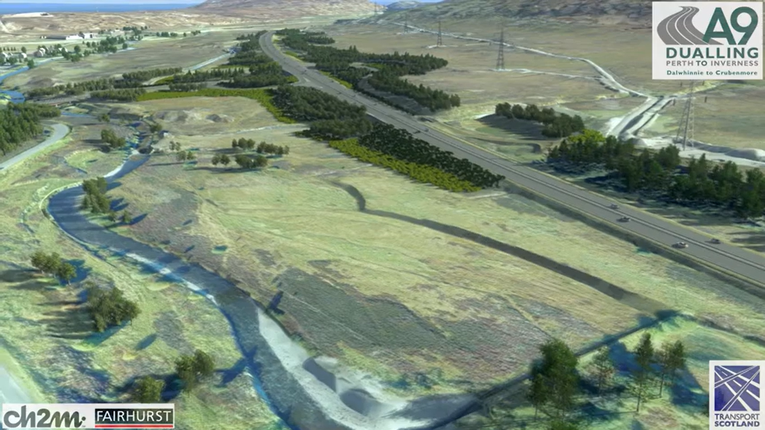
Academy9- Civil and Infrastructure Engineering Projects
Background
In attempting to consider the effects of a civil engineering and infrastructure project on the existing landscape the company must consult, negotiate and, at times, compromise, with a range of groups, each of which has their own concerns and interests. The first stage of this process is for the company to assess the existing landscape and consider any challenges which might be present when undertaking the civil engineering and infrastructure project. Then consider what effect these challenges might have on the project. The company would then plan to find potential solutions to these challenges before discussing their plans with the various interested groups and consulting, negotiating or compromising.
bit.ly/academy9

Slide 4
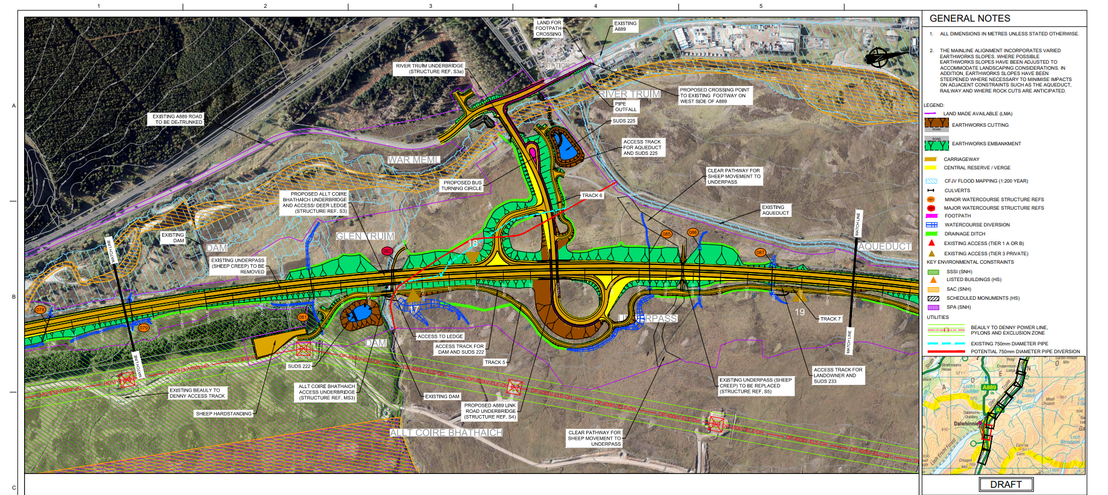
Academy9- Civil and Infrastructure Engineering Projects
Brief
You are tasked to carry out the preparatory work in assessing the potential challenges. The work you produce will be presented to the project team to allow them to plan potential solutions to the challenges.
You are to create a map highlighting the potential challenges and the effects these challenges could have on the project.
bit.ly/academy9

Slide 5
Academy9- Civil and Infrastructure Engineering Projects
Research
Discover and make notes on what kind of challenges could present themselves for your infrastructure project and what effect these challenges could have on the project.
Constraints on construction projects - Designing Buildings
Constraints from the A9 project.
bit.ly/academy9

Slide 6
Academy9- Civil and Infrastructure Engineering Projects
Task
Analyse the map provided, read the map key and identify the features on the map.
Make a note of at least 3 challenges you can identify to the infrastructure project.
Consider and then add detail to the map of the effects these challenges could have on the project for the company.
(NB task could be done as part of a site visit.)
bit.ly/academy9

Slide 7
Academy9- Civil and Infrastructure Engineering Projects
Useful links
Academy9 pupil resource page for this qualification.
Guide to A9 challenges Possible-challenges-associated-with-the-A9-dualling.pdf (glowscotland.org.uk)
Links to maps
https://blogs.glowscotland.org.uk/glowblogs/public/academy9/uploads/sites/3601/2022/03/09130835/B2140005_Academy9_Figure_3_A3.pdf
https://blogs.glowscotland.org.uk/glowblogs/public/academy9/uploads/sites/3601/2022/03/09130832/B2140004_Academy9_Figure_2_A3.pdf
https://blogs.glowscotland.org.uk/glowblogs/public/academy9/uploads/sites/3601/2022/04/22113625/B2140003_Academy9_Figure_1_A3.pdf
bit.ly/academy9

Slide 8
Academy9- Civil and Infrastructure Engineering Projects
Es and Os, Career Education Standard goals.
CfE:
I am investigating different careers/occupations, ways of working, and learning and training paths. I am gaining experience that helps me recognise the relevance of my learning, skills and interests to my future life. HWB 2-20a / HWB 3-20a / HWB 4-20a
I can solve problems through the application of engineering principles and can discuss the impact engineering has on the world around me. TCH 4-12a
I can extend my use of manual and digital graphic techniques to realise ideas, concepts and products and recognise the importance of real world standards. TCH 4-11a
I can assess the impact of developments in transport infrastructure in a selected area and can contribute to a discussion on the development of sustainable systems. SOC 4-09b
I can explain the development of the main features of an urban area in Scotland or elsewhere and can evaluate the implications for the society concerned. SOC 4-10b
I can use a range of maps and geographical information systems to gather, interpret and present conclusions and can locate a range of features within Scotland, UK, Europe and the wider world. SOC 3-14a
I can make notes and organise them to develop my thinking, help retain and recall information, explore issues and create new texts, using my own words as appropriate. LIT 3-15a / LIT 4-15a
I can justify my choice and use of layout and presentation in terms of the intended impact on my reader. LIT 4-24a
Career Education Entitlements:
Experience a curriculum through which they learn about the world of work and job possibilities and which makes clear the strengths and skills needed to take advantage of these opportunities
Develop skills for learning, life and work as an integral part of their education and be clear about how all their achievements relate to these.
Develop understanding of the responsibilities and duties placed on employers and employees.
Develop CMS as an integral part of their curriculum, (strengths, horizons, networks).
bit.ly/academy9

