Slide 1




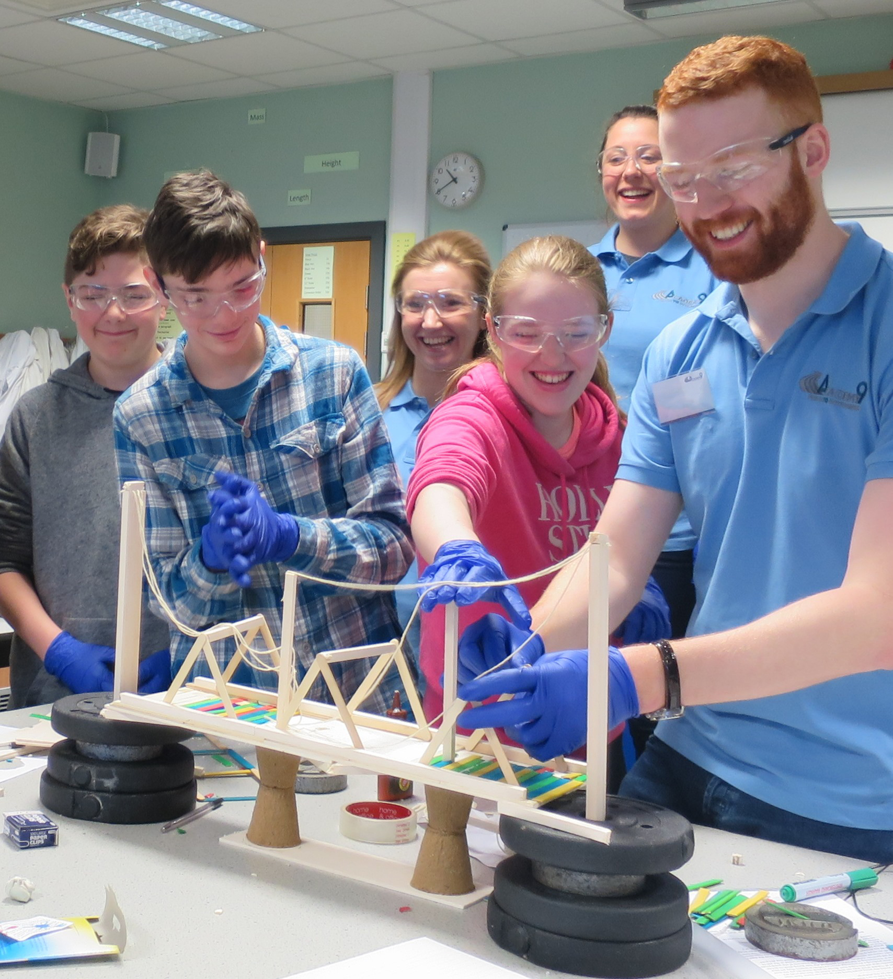
Civil and Infrastructure Engineering Projects (SCQF level 4)
Outcome 1

Slide 2

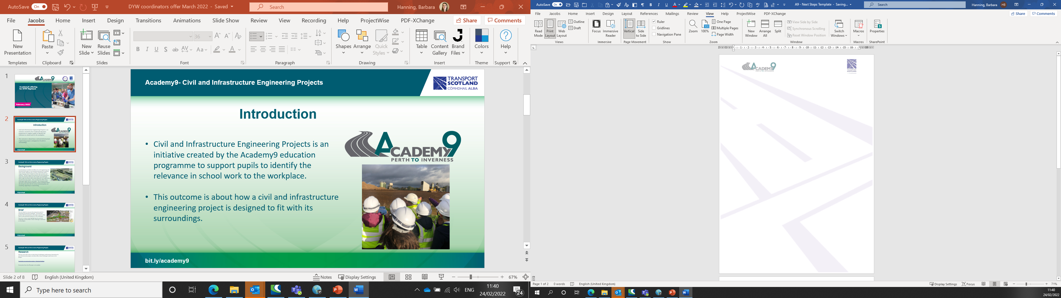
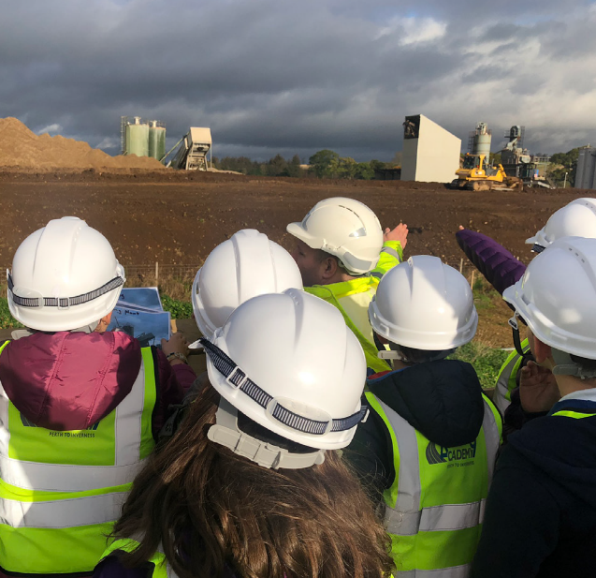
Academy9- Civil and Infrastructure Engineering Projects
Civil and Infrastructure Engineering Projects is an initiative created by the Academy9 education programme to support pupils to identify the relevance in school work to the workplace.
This outcome is about understanding what a civil and infrastructure engineering project is.
Introduction
bit.ly/academy9

Slide 3

Academy9- Civil and Infrastructure Engineering Projects
Background
A major Civil Engineering and Infrastructure project is to be undertaken nearby a village. The company who will work on the project are keen to engage with those who live in the village to ensure they know what the project is, why it is happening and what benefits it will bring to the community. The company will hold several open sessions for village residents to attend to find out about the project and ask questions about the project. As part of the sessions the company will produce a visual display to share information about the project.
bit.ly/academy9

Slide 4
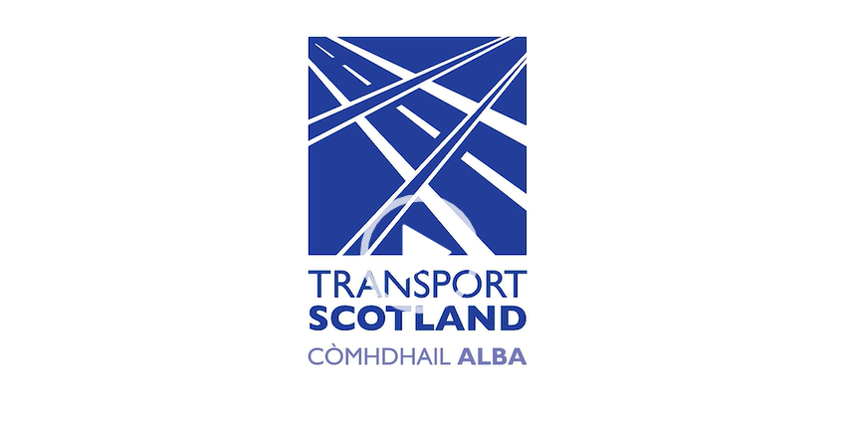
Academy9- Civil and Infrastructure Engineering Projects
The A9 Dualling
We are going to use the Dualling of the A9 road as our Civil and Infrastructure Engineering Project.
Play this video as an introduction to the project. Academy9 (glowscotland.org.uk)
bit.ly/academy9

Slide 5
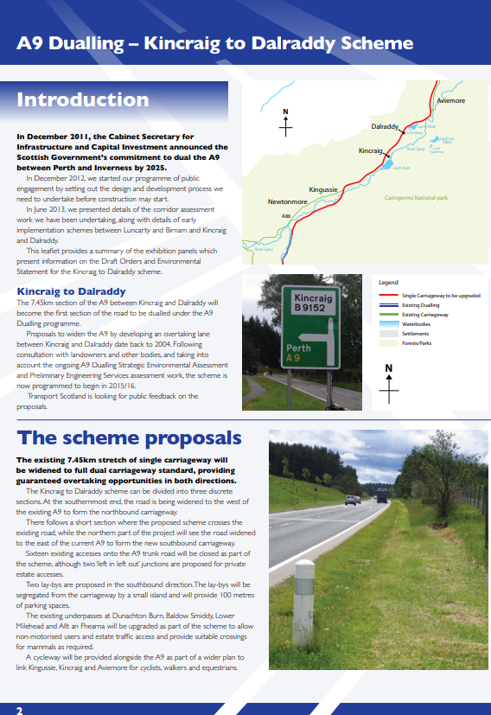
Academy9- Civil and Infrastructure Engineering Projects
Brief
Create a poster to enable a company to inform a local community about a nearby Civil Engineering and Infrastructure project.
Include:
3 facts about what a Civil Engineering and Infrastructure project is.
2 objectives of this Civil Engineering and Infrastructure project.
2 benefits to the community of this project.
bit.ly/academy9

Slide 6
Academy9- Civil and Infrastructure Engineering Projects
Research
What is a Civil Engineering and Infrastructure project?
What are the objectives of this project?
What will be the benefits to the community from this project?
bit.ly/academy9

Slide 7
Academy9- Civil and Infrastructure Engineering Projects
Useful links
Academy9 pupil resource page for this qualification.
What is civil engineering: Civil engineer | My World of Work
What is civil engineering? | Institution of Civil Engineers (ice.org.uk)
What is infrastructure: INFRASTRUCTURE | meaning in the Cambridge English Dictionary
Funding infrastructure | The Institute for Government
A9 objectives : A9 Dualling Perth to Inverness (transport.gov.scot)
Benefits to communities: A9 Dualling: Luncarty to Pass of Birnam benchmark community benefits legacy | Transport Scotland
bit.ly/academy9

Slide 8
Academy9- Civil and Infrastructure Engineering Projects
Es and Os, Career Education Standard goals.
CfE:
I am investigating different careers/occupations, ways of working, and learning and training paths. I am gaining experience that helps me recognise the relevance of my learning, skills and interests to my future life. HWB 2-20a / HWB 3-20a / HWB 4-20a
I can solve problems through the application of engineering principles and can discuss the impact engineering has on the world around me. TCH 4-12a
I can extend my use of manual and digital graphic techniques to realise ideas, concepts and products and recognise the importance of real world standards. TCH 4-11a
I can assess the impact of developments in transport infrastructure in a selected area and can contribute to a discussion on the development of sustainable systems. SOC 4-09b
I can explain the development of the main features of an urban area in Scotland or elsewhere and can evaluate the implications for the society concerned. SOC 4-10b
I can make notes and organise them to develop my thinking, help retain and recall information, explore issues and create new texts, using my own words as appropriate. LIT 3-15a / LIT 4-15a
I can justify my choice and use of layout and presentation in terms of the intended impact on my reader. LIT 4-24a
Career Education Entitlements:
Experience a curriculum through which they learn about the world of work and job possibilities and which makes clear the strengths and skills needed to take advantage of these opportunities
Develop skills for learning, life and work as an integral part of their education and be clear about how all their achievements relate to these.
Develop understanding of the responsibilities and duties placed on employers and employees.
Know where to find information and access support making effective use of online sources such as My World of Work.
Develop CMS as an integral part of their curriculum, (horizons).
bit.ly/academy9

