Slide 1
Engaging parents

Slide 2
Parental Engagement
Higher academic achievement
Greater cognitive competence
Greater problem solving skills
Greater school enjoyment
Better school attendance
Fewer behavioural problems at school
Greater social and emotional development
“Why Families Matter to Literacy,” National Literacy Trust

Slide 3
“When parents and schools work together children do better.”
Guidance on the Scottish Schools (Parental Involvement) Act 2006

Slide 5
What you already do:
In Writing? Letter formation sheets Weekly phonics homework Fun fact finding activities Send home ideas on our Curriculum Flyers Prompts for discussion on upcoming writing | In Reading? Sounds sent home Key / sight word cards Encourage sharing books Real books sent home Books sent daily Space for parental comments Blooms Buttons questions / ideas for questioning Reading markers for each book Games they can play Highland Literacy booklet Creating books Teddies in beddies 5 a day challenge – sharing stories, rhymes, songs etc Bookbug Book Trust Author events World Book day Websites / apps shared | In Listening / Talking? Show and tell preparation Oral history My favourite stories on CD Isle of Stories Nursery rhyme books sent home to encourage learning of nursery rhymes Philosophy for children questions Storysacks Encourage storytelling between parents and child e.g. homework task Questions to ask children are sent home Story, song, sentence, word of day / week Ideas for games Sharing what we’re discussing in class Targetted support where needed (SLT, selective mutism etc)
Initial workshop / open afternoon (4)
More than 1 workshop (2)
Reports / parents’ evenings / PLPs / Learning Journeys

Slide 6
Parental engagement evening
PowerPoint
Supporting the foundations of literacy in the home
Talking with your child: Ideas and Guidance
Scotland Reads: Parents as paired reading partners
Sharing Books handout
Evaluation

Slide 7
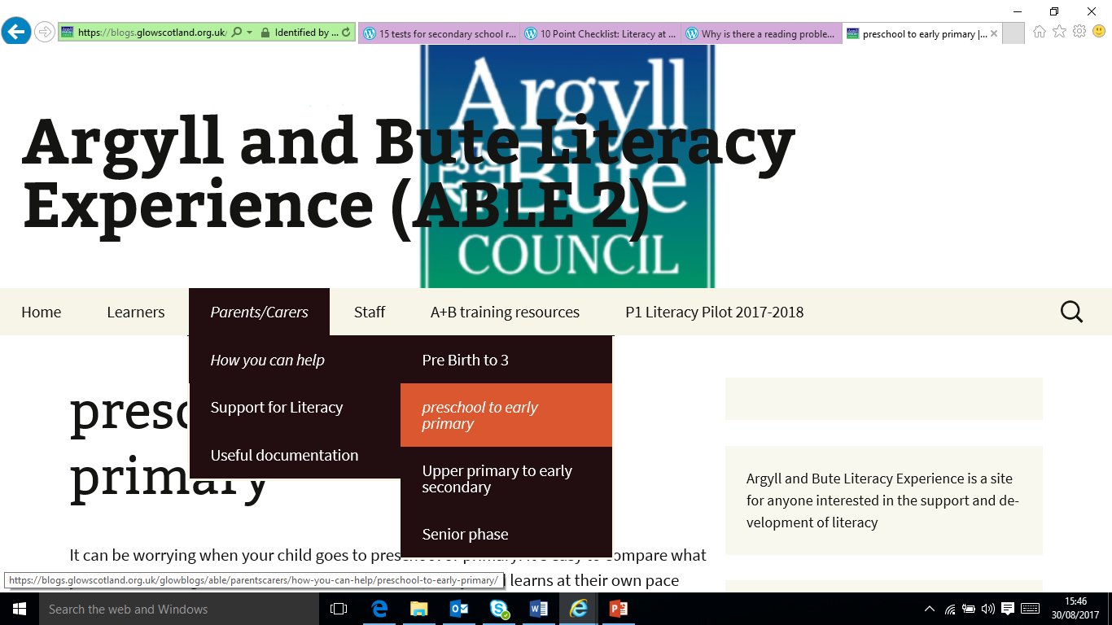
https://blogs.glowscotland.org.uk/glowblogs/able/
/
https://blogs.glowscotland.org.uk/glowblogs/able/

Slide 8
How do we continue to engage our parents?

Slide 9
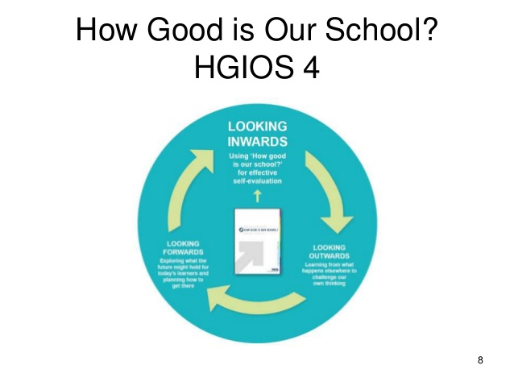
How well are families supported in developing strategies which lead to positive relationships, better learning and better behaviour?
How is family learning improving their capacity to learn?
How can we demonstrate that families are feeling included?
How are we ensuring that provision is responsive to the needs of families?

Slide 10
“Importantly, parents can help show children that education is more than just the delivery of a curriculum.”
Cullingford & Morrison 1999

