Slide 1

Effective use of assessment in identifying and addressing literacy difficulties
Literacy Twilight 2 March 2017

Slide 2
Literacy difficulties and dyslexia
‘In most practice in Scotland a medical model, where there is a diagnosis and a prognosis that assumes young people with dyslexia need different strategies from other learners in relation to literacy and language acquisition, has been replaced by a wider perspective.
Dyslexia is now seen widely as part of a continuum of needs that relate to approaches to developing language and literacy skills.’
Education for Learners with Dyslexia, HMIE (2008)
Literacy assessment is most usefully done by direct methods (assessing reading /spelling) rather than indirect methods (cognitive profile, sequencing,
short term memory…)

Slide 3
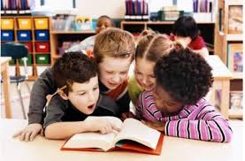
Assessment in schools
What information do we have, tools do we use to assess children’s progress with literacy?

Slide 4

Using data
We need to use data as a treasure hunt for what’s working, not a witch hunt for what’s not.
(John Hattie, 2016)

Slide 5
How do we identify literacy difficulties?
Developmental milestones / Baseline assessment
Assess reading skills
Directly assess spelling
Gather examples of written work
Consider how the child performs when the mechanics of reading and writing are removed (eg scribe a creative writing task for them)
Consider affect – motivation, confidence
Reflect on the impact of other factors such as language delay, concentration, anxiety
Consider progress over time, measured against evaluation of interventions

Slide 6
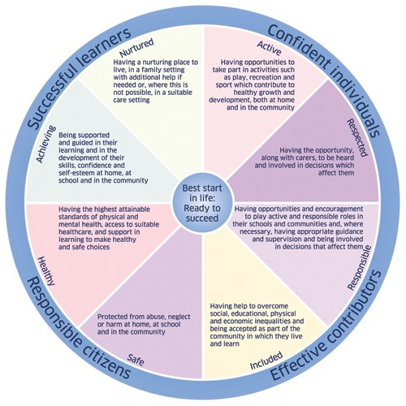
Wider assessment

Slide 7
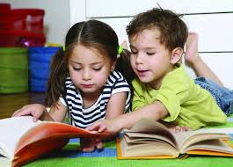
Where do we need to focus?
Building strong phonological awareness
Using high quality assessment to understand how children are progressing
Identifying those children who are failing as early as possible, and putting appropriate interventions in place

Slide 8
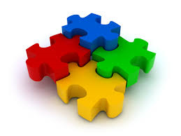
Interventions and impact
Once assessment information has been gathered and analysed – what next?
What interventions will be put in place?
What do we hope to achieve? What are the short term objectives?
How are these interventions delivered?
How do we measure success?

Slide 9
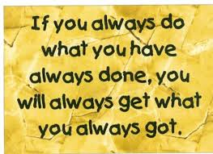
Evaluate you current strategies
Which school strategies are currently helping most to raise the attainment of disadvantaged youngsters?
You may be using Improvement Science and undertaking small tests of change. If these are proving effective extend them across larger groups or across the school.
Use your data – collect, analyse and use your data to monitor and track what is currently going on
However … be aware…

