Slide 1
Working together to improve literacy: achievement for all
Argyll and Bute Literacy Forum

Slide 2
The Literacy Forum on the Road…
Currently touring across all clusters in Argyll and Bute
The literacy forum is made up of a variety of practitioners from a range of backgrounds and specialisms who come together and share knowledge based on research at both a local and national level
The process is to encourage discussion and dialogue and encourage effective literacy practices by sharing what works and what does not work
The aim today is to offer that feeling of support and knowing that you are not alone and that we are not alone
Notes:
Stuart Craig – Educational Psychologist. Chair of the literacy forum. Claire Bidwell PT Lochdonhead Primary School Islay, Oban, Dunoon, Helensburgh. Early years workers, childcare workers, child nurses, homestart, social work, librarians, teachers across all ages, adult and community literacy workers working together

Slide 3
Support
It is fundamental to support our learners but just as fundamental to support ourselves as we are at the forefront of children’s learning
Huge responsibility on all of our shoulders to develop literacy in schools and to all children at all levels
Current research is heavily supporting the importance of literacy development and acquisition in the early years; pre-birth, babies, toddlers and pre-school
Children are arriving at school equipped to be literacy learners suggesting that literacy is not learned in isolation or taught in isolation so the importance of co-operative learning is an important part of literacy achievement
All practitioners have effective knowledge, insight and practice to share

Slide 4
Sharing Good Practice
Sometimes its about stripping it back to what matters most to that child at that time and what the child needs most from the environment and others around them
Its easy to feel isolated, as practitioners, in Argyll and Bute so its important to work together and engage in discussion and dialogue
By bringing people together to work collegiately we can share good practice and build resilience
We need to share where we see good results and ask for support when we need it

Slide 5
Our Children, Their Future – Argyll and Bute’s Vision and Strategy
Our aspiration is to ensure that Argyll and Bute is the best place in Scotland for our children to grow up. Our vision is that together we will realise ambition, excellence and equality for all.

Slide 6
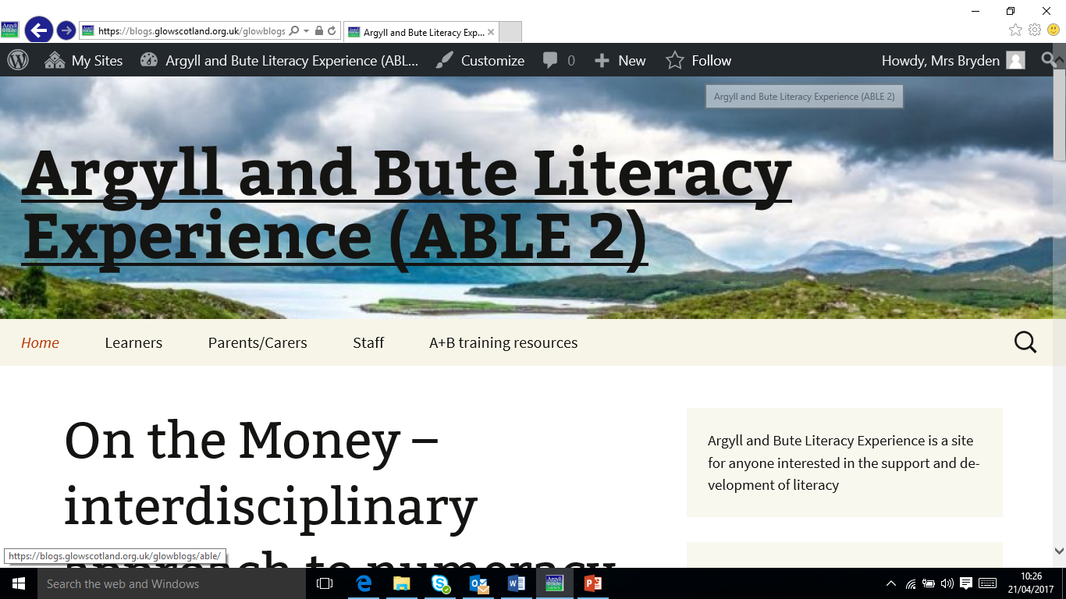
https://blogs.glowscotland.org.uk/glowblogs/able/

Slide 7
Literacy Forum Twilight
What is being offered today is the opportunity to see examples of evidence based practices and examples of what can work.
It is an opportunity to think about your environment, your practice and the children whose literacy development you are responsible for
We need to discover what works in our area and what doesn’t to raise achievement and attainment for all

Slide 8
Timings
Session 1: 1705 - 1750
Session 2: 1750 – 1830 (including evaluation)

Slide 9
Workshops
Session 1 1705-1750
ELC Literacy tracker
Effective use of assessments in identifying and supporting literacy difficulties
Practical Reading interventions and support in the primary classroom
Session 2 (& evaluation) 1750 -1830
ELC Literacy tracker
Effective use of assessments in identifying and supporting literacy difficulties
Practical Reading interventions and support in the primary classroom

Slide 10
Mull Literacy Support Group
Aim: To encourage discussion and dialogue and encourage effective literacy practices
Invite practitioners across all teaching and learning areas to share knowledge of effective practice
Workshops: Adult Community learning, Reciprocal Reading, Supporting literacy difficulties in the classroom
Meet three or four times a year
Would you be interested?
Further Ideas and suggestions

