Slide 1
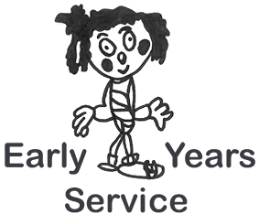
Argyll and Bute Learning and Development Framework Literacy Progression and Tracking

Slide 2
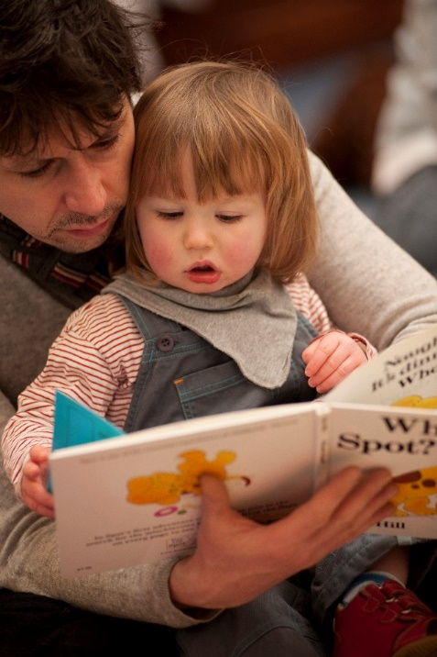
What is Literacy?
Literacy can be defined as “the set of skills which allows an individual to engage fully in society and in learning through the different forms of language, and the range of texts which society values and finds useful”, Curriculum for Excellence.
The key literacy skills are listening, talking, reading and writing.
It’s all about communication!

Slide 3
Why is being Literate important?
The acquisition of literacy skills allows children to be part of their world; it allows them to:
express their needs, feelings and ideas
understand others and to be understood
access the rich world of books and lifelong learning
access opportunities in adult life and the world of work.

Slide 4
Early Language development
Gap at 18 months

Slide 5
Social Impact of language development
Child living in social disadvantage hears 600 words per hour, ratio 2:1 negative e.g.‘stop that’ vs. 2000 words per hour, ratio 6:1 positive
16 – 18 month vocabulary gap on starting school
Vocabulary at age 5 strong predictor of socio-economic outcomes
Home communication environment significant protective factor e.g. books, nursery rhymes play etc.

Slide 6
The National Improvement Framework
The NIF is supported by four national priorities:
• Improvement in attainment, particularly in literacy and numeracy
• Closing the attainment gap between the most and least disadvantaged children
• Improvement in children and young people’s health and wellbeing
• Improvement in employability skills and sustained, positive school
leaver destinations for all young people

Slide 7
Why is tracking a child’s progress so Important? Argyll and Bute’s Ambition
Raise educational attainment and achievement for all
Use performance information to secure improvement for children and young people
Ensure children have the best start in life and are ready to succeed
Equip young people to sustain positive destinations and achieve success in life
Strengthen partnership working and community engagement
Strengthen leadership at all levels

Slide 8
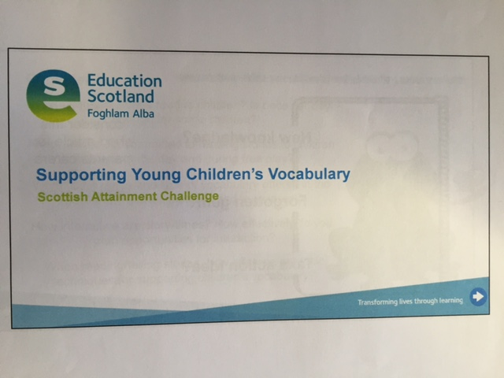
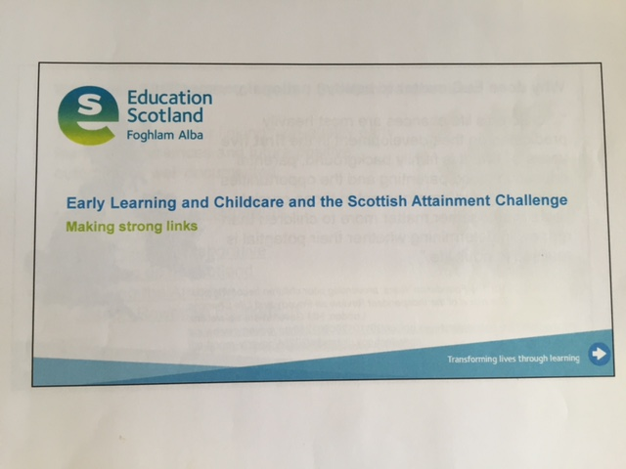

Slide 9
Action points for ELC Practitioners
Involving Parents
Environment
Experiences
Interactions
Reflective question:
How do you develop vocabulary and encourage a strong reading culture within your ELC setting?

Slide 10
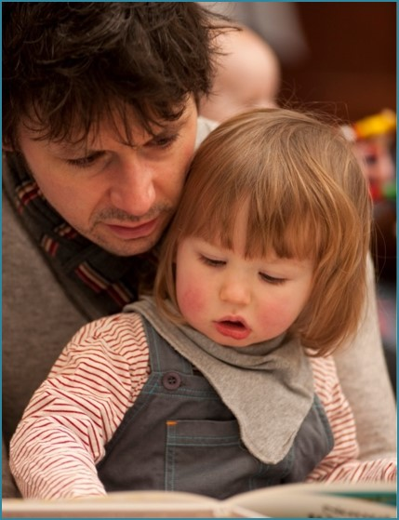
Involving Parents
Every day’s a learning day
Play Talk Read
Play@home
DMT Parent’s guide
Bookbug
Bookbug Explorer Pack
Lending library
Song/Rhyme of the week
Information on adult literacy support

Slide 11
A literacy rich environment
What does that look like, sound like, feel like?
An irresistible reading corner
Puppets and props to engage children
Visuals/objects for retelling/sequencing stories
Wonderful word wall
Real and sensory resources provide more opportunity for descriptive language

Slide 12
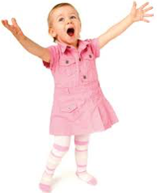
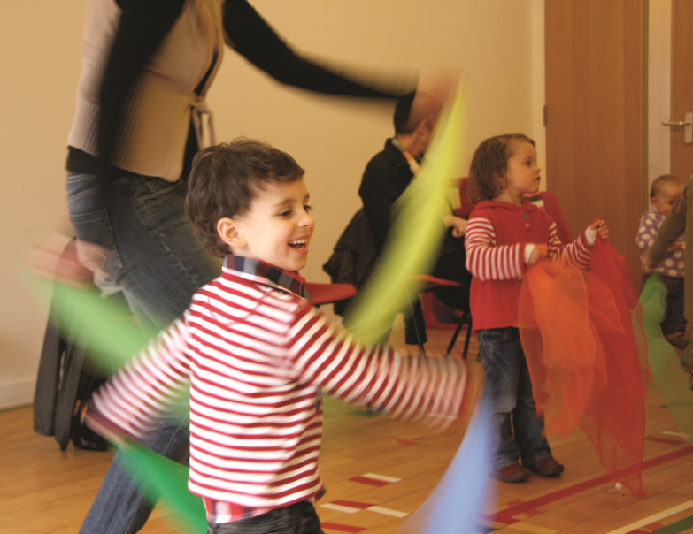
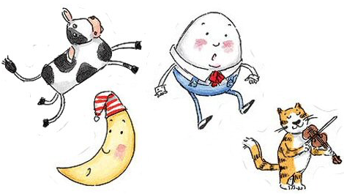
Experiences
Songs
Rhymes
Stories
Sparkle Words

Slide 13
Interactions – Role of the Adult
Actions and facial expressions reinforcing the language
Talking through what you are doing, problem solving out loud – sustained shared thinking
4 comments to a question
Comment, model, expand
Feed in language at every opportunity
Repetition, repetition, repetition

Slide 14
Literacy Progression Tracker
How to use the tracker
There are 3 data collection points:
Year 1, May/June (column 1)
Year 2, Dec/Jan (column 2)
Year 2, May/June (column 3)
At each point, the corresponding column should be dated and progress briefly recorded.
However, children’s individual progress should be discussed weekly

Slide 15
Outlining progress
See page 2 of
information booklet
All staff should ensure
that they have read this

Slide 16
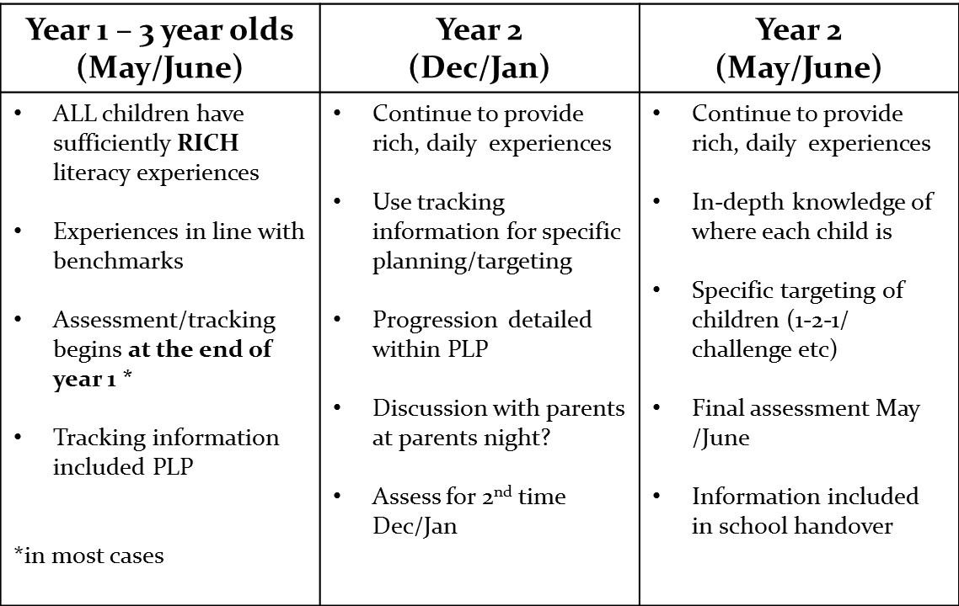

Slide 17
Literacy Progression Tracker Insert for PLP’s

Slide 18
Equality and Equity

Slide 19
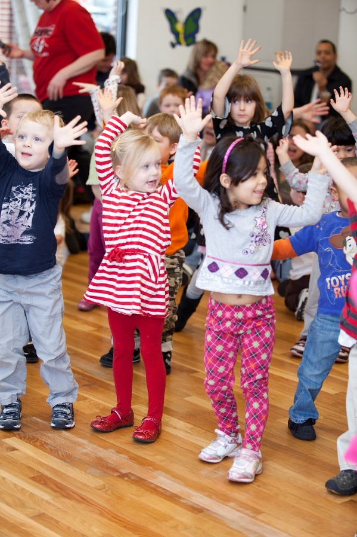
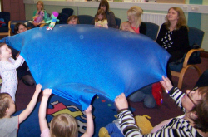
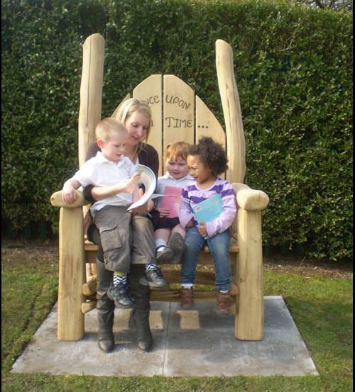
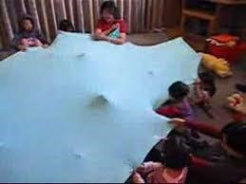
Songs, stories and rhymes
Every day as we play!

