Slide 1
Argyll and Bute Council
Adult Learning and Literacies
Notes:
Introduction

Slide 2
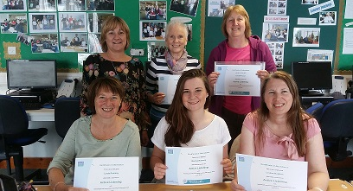
Adult Learning and Literacies
Is run by Argyll and Bute Council
Open to all aged 16 and over
We provide courses, classes, one-to-ones and drop-ins from community based venues, schools and workplaces throughout Dunoon and Cowal
Notes:
Introduction
Delivery mainly in Dunoon Community Centre.
Workplace ESOL in Scottish Salmon Cairndow and Dunoon Community Centre.
Partnership working NHS Mental Health, Job Centre HELP Project and Dunon Grammar School.

Slide 3
Adult Learning and Literacies
Adult Literacies and Numeracy
Community Based Adult Learning
Themes
Employability
Health and Wellbeing
Learner Journey
Notes:
Explain one team but different parts of Adult Learning. Always working towards 3 themes. Employability. As before, we do not focus on hard outcomes so sometimes courses run to increase confidence and social interaction. Progression always at a learners own pace and choice.

Slide 4
We use skills like these every day
Text messages
timetables
shopping
sending cards
writing or reading official letters
job applications
road signs
website information
Email
CVs & online applications
solving problems
listening
banking
school/college work
Notes:
Most of us take these skills for granted. We do these things as part of our daily lives without thinking about it. However… (next slide)

Slide 5
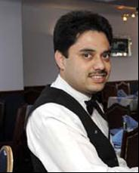
Did you know that in Scotland…
more than 1 in 4 people of working age sometimes face literacies challenges, even though they generally cope with their daily lives?
Notes:
The above group may miss out on a promotion opportunity at their workplace

Slide 6
What is Adult Literacies?
Reading, writing and numbers
Listening
Speaking
Handling information
Financial capability
Problem solving
Expressing ideas and opinions
Digital Literacy or IT Skills
Notes:
Not just helping people with their reading. Encompasses a whole range of skills.

Slide 7
What is Community-based Adult Learning?
Accredited and non-accredited learning
Generally offered universally but also targeted at vulnerable and excluded adults
Plays a part in family and community lives
Helps access to work and training
Helps boost self esteem and confidence
Support in a non formal environment relevant to our learners needs
Notes:
Informal learning in local settings, small groups or 1:1, flexible learning, react to local need

Slide 8
Referrals ?
Notes:
Open to the whole community but with particular target groups, eg unemployed, low income etc.
Agency Referrals – eg, Job Centre Plus, Housing, Addictions Team, SDS, Schools, NHS
Internet Access – people wanting to improve IT skills for a range of reasons, sometimes family.
Universal Job Match requirements. ESOL.
Self or work, ie literacies issues with homework, or forms or employers referring for IT work.

Slide 9
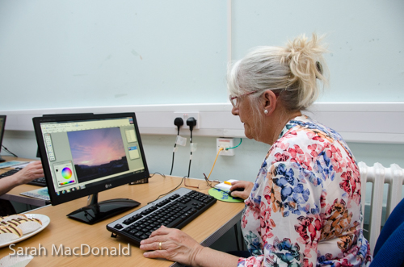
Learners Issues/Barriers
Unemployment
Mental Health
Addiction
Literacy/Dyslexia
Criminal Convictions
Health Issues
Welfare System
Bad experience of learning
Embarrassment and lack of confidence
Notes:
People may have bad experiences of learning and fear can now play a part. Everything is needs based and we work together with other agencies to form partnerships. We can then work together and assess need. Approach -very informal.

Slide 10
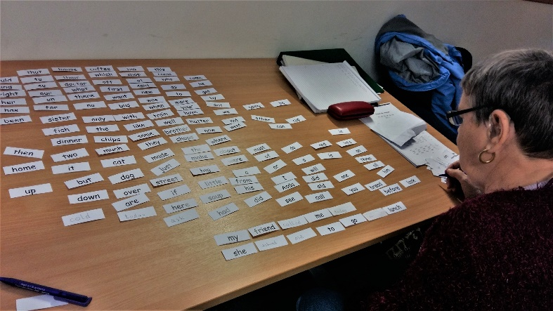
How do we do what we do ?
Informal and confidential
Needs Based/Targeted
Learner Centred
Small Groups
One to One with dedicated volunteer tutors
Notes:
Everything very focussed on the learner and take account of the learners strengths. Important to acknowledge small steps of progress. Always working towards 3 themes. Work in person centred way. Progression always at a learners own pace and choice.

Slide 11
Learner Development ?
Building Relationship
Family
Background
Health
Confidence
Goals
Learning Style
Interests
Motivation
Notes:
Assessment and Learner Development is dialogue with an individual. Encompasses all these issues and looks at a person holistically.

Slide 12
What we can offer
Literacy/Numeracy
Basic Computing
Next Steps in Computing
SQA Certificates
Job Club
ESOL
Creative/Craft
SQA Accredited Units
Driving theory
Confidence
Wellbeing
CSCS
Notes:
bespoke training to suit needs of groups or individuals – eg recovery café volunteers Assertiveness and listening skills

Slide 13
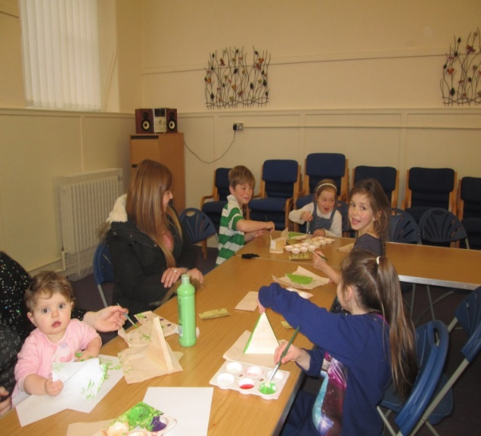
How can school staff refer?
Knowing a parent’s interests?
Any issues?
Awareness Raising Events
Notes:
We can hold awareness raising events, even specialised ones, including dyslexia or employability.
If you know a parent has an interest, eg, craft classes. Things that there is a good chance parent will turn up. Also use parent/child learning.
If there are any issues identified through child, we can arrange a private, confidential chat with parent. Appointments will be arranged.

Slide 14
FACTS AND FIGURES
Since January 2016:
Over 396 adults accessed CBAL last year
150 adults achieved accredited learning outcomes
72 in activities that improve literacy and numeracy
294 in activities which improve employment
172 reported increased confidence
Notes:
Figures are from Dunoon since Jan 16.

Slide 15
What our learners say…..
Connecting with others is valuable especially as one gets older. Important to re-evaluate your life at times.
We are now able to shop online in areas where we are no longer able to access physically. We have been introduced to eBooks and kindle. The best thing is the way we learnt through communicating with each other, having a laugh and talking about serious subjects with humour.
The course was good fun, relaxed but learning at the same time.
I have learned to express myself more constructively and positively when being interviewed either on the phone or in person. It clarified what the employer and interviewee aims are
I think I have improved on my numbers and I am a lot more confident in working out numbers and helping my kids with their homework.
The best thing about this course? There was a broad spectrum of people taking part. The course was carried out in a relaxed environment which made the detail of it easier to take in and remember.
Notes:
Sample of Helensburgh learner evaluations

Slide 16
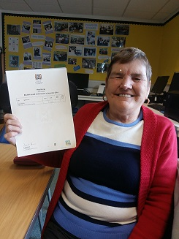
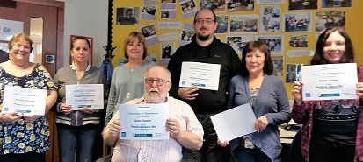
We don’t give up on people !
Take time with learner
Returning learners
Notes:
Reiterate we work with people however long it takes. Some learners stop then come back after some time. We are not concerned with outcomes but more the distance travelled for that individual.

