Slide 1
Literacy across learning
Dunoon Grammar School
Thursday 16th February 2017

Slide 2
Issues we’ve faced:
Tacking on Es and Os to courses already in existence
Lack of knowledge about where we were going
Sheer overwhelmed exhaustion

Slide 3
“It doesn’t mean that every practitioner will teach everything a secondary English teacher does . . .the greatest impact for learners will come from all practitioners, in all learning environments, including rich literacy experiences as part of their day to day learning and teaching programmes.”
Literacy and English principles & Practice paper

Slide 4
Priorities of NIF
• Improvement in attainment, particularly in literacy and numeracy
• Closing the attainment gap between the most and least disadvantaged children
• Improvement in children and young people’s health and wellbeing
• Improvement in employability skills and sustained, positive school leaver destinations for all young people.

Slide 5
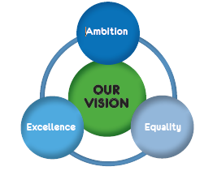
Our Children, Their Future – Argyll and Bute’s Vision and Strategy
Our aspiration is to ensure that Argyll and Bute is the best place in Scotland for our children to grow up. Our vision is that together we will realise ambition, excellence and equality for all.

Slide 6
What will create this impact on leaners?
Appropriate levels of challenge
Learning made visible
Skills embedded across all areas

Slide 7
By the end of this session:
You will understand the importance of literacy to all subject areas
You will have reflected on the levels of challenge in literacy within tasks you offer
You will have thought about ways to embed literacy within your department planning
Ongoing:
Pupils will be challenged at an appropriate level in all areas of the school
Pupils will be aware of the literacy skills they are using across all subject areas
Pupils will know that literacy is not just for English

Slide 8
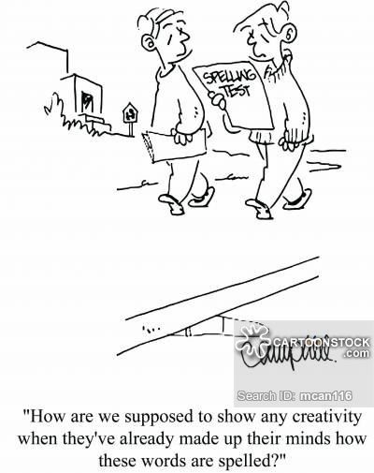

Slide 9
“Many literacy messages fail to resonate with mathematics educators because they neglect, deemphasize, or misrepresent the nature and content of the discipline of mathematics”.
- Siebert and Draper (2008, p. 231).

Slide 10
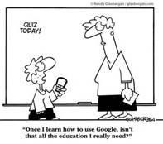

Slide 11
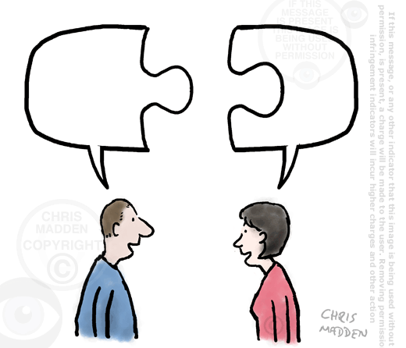

Slide 12
The limits of my language mean the limits of my world.
Wittgenstein

Slide 13
“Literacy is the key to lifting children out of poverty.”
Sir Harry Burns – chief medical officer for Scotland 2005 - 2014

Slide 14
In all subjects
Assessments written in English will always be, to some extent, assessments of English (Abedi, 2004; Martiniello, 2007
Lower language proficiency tends to be associated with poorer mathematics performance (Cocking & Mestre, 1988; Wiest, 2003).
Research indicates that students perform 10% to 30% worse on arithmetic word problems than on comparable problems presented in a numeric format (Abedi & Lord, 2001; Carpenter, Corbitt, Kepner Jr, Lindquist, & Reys, 1980,Neville-Barton & Barton, 2005).

Slide 15
3-18 Literacy and English review
“All staff have a responsibility to develop, reinforce and extend learning in literacy.”
“There is a need for staff across all subject areas to highlight literacy skills more clearly to young people. When appropriate, staff should highlight for young people the literacy skills being developed and provide feedback. Currently, this is still not being done in a consistent way across secondary school curricular areas.”

Slide 16
BENEFITS
BTC1 – “Competence and confidence in literacy, including competence in grammar, spelling and the spoken word, are essential for progress in all areas of the curriculum.”
It has a positive impact on ethos
It supports young people to transfer and develop their skills and reflect on their progress.
Teachers across subject areas benefit from the shared standards and expectations
Opens up a space for interesting aspects of a subject
Notes:
SPICE – strategies to support closing the attainment gap – strengthening reading ability & enjoymeny can mitigate 30% of the attainment gap and have a positive effect on other subject areas (Sosu & Ellis 2004)
It can promote social awareness
Metacognition – young people learn through talking and explaining processes. In even the least literacy friendly subjects, giving pupils structured opportunities to talk through their thinking has a positive effect on understanding.

Slide 17
What is Literacy (officially?)
“the set of skills which allow an individual to engage fully in society and in learning, through the different forms of language and the range of texts, which society values and finds useful.”
Literacy and English principles and practice paper

Slide 18
Contexts for literacy
Reading / Listening
Writing
Talking

Slide 19
TASK
In pairs, think of specific instances where these elements of literacy occur within your course:
Reading
Writing
Listening
Talking
You should consider whether these tasks are at S1, S2 or S3

Slide 21
Need to challenge pupils – what they can produce is higher than you think
“Teachers across the curriculum would benefit from a shared understanding of standards in literacy. Staff are not always sure if they have high enough expectations of young people’s standards of literacy, particularly in writing.”
3-18 Literacy and English Review, 2015

Slide 22
What does progress look like?
Reading: Growing fluency and understanding. A move from dealing with straightforward information to analysing, evaluating and being aware of the trust they should place on evidence.
Writing: growth in degree of independence, organisation and quality of ideas, skills in spelling, punctuation and grammar, matching of writing to audience, effectiveness of use of language.
Talking – increasing ability to sustain interactions, take turns, complexity of texts they listen to, clarity of ideas

Slide 23
Key areas
Group Discussion
Solo Talk
Informative writing
Persuasive writing
Reading for information

Slide 24
Support for planning
Copy of the Es and Os bundled for each area

Slide 25
Support for creating appropriate levels of challenge
Summary of what the Es and Os mean & progression
Outline of Benchmarks
Ideas for what this means in practical terms at levels 2, 3 & 4
Ideas for activities in subjects other than English

Slide 26
Think of ways these can be incorporated
When students have to write an explanation or explain their problem to someone else, they develop a deeper understanding of the concept. Or, if there are any misconceptions, they are discovered and can be easily corrected.
TEACH THOUGHT: 10 WAYS LITERACY CAN PROMOT A DEEPER UNDERSTANDING OF MATHS

Slide 27
“If in the classroom we limit written language to getting information from a book and writing it down to show the teacher that the work is done, we ignore and reject its function as an instrument for reshaping experience, that is as a means of learning”.
From “From Communication to Curriculum” by D.Barnes.

Slide 28
Support for making learning visible
Terms to use with students
Glossary of what terms mean

Slide 29
Support for developing deep understanding of texts
What types of questions could you ask about a text?
What tasks, other than question and answer style activities, might demonstrate these skills?
Reading for Understanding: a concern for all
Before, during and after reading strategies

Slide 30
Support for basic writing skills
Progressions
An idea for good practice

Slide 31
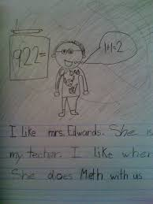

Slide 32
“Literacy is a bridge from misery to hope. It is a tool for daily life in modern society. It is a bulwark against poverty and a building block of development . . .for everyone, everywhere, literacy is, along with education in general, a basic human right . . Literacy is, finally, the road to human progress and the means through which every man, woman and child, can realise his or her full potential.”
Kofi Annan

Slide 33
